Slide 1
The Beauty Paradox
Cairo Chapters 3 and 4

Slide 2
“Journalism is not just about covering the news, but also about providing context for the news.” -- Cairo

Slide 3
The Visualization Wheel (of death!)
I find the wheel really hard to read. I’d rather have a series of lines – an array of axes.
Abstraction – figuration
Functionality – decoration
Density – lightness
Multidimensionality – unidimensionality
Originality – familiarity
Novelty – redundancy

Slide 4
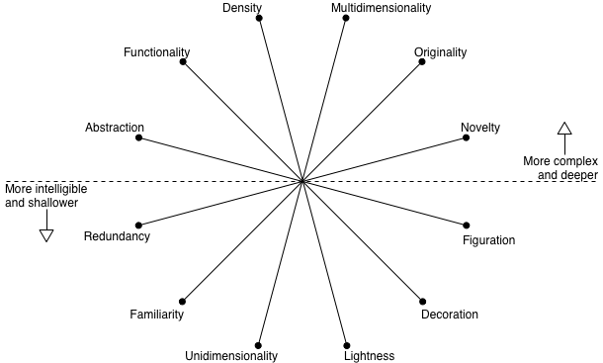
The wheel

Slide 5
The wheel
It’s not so easy as to say to the left or the right is best.
Complexity should be adapted to the audience.
Dumbing down the data – do we back away from complexity or do we strive to clarify it? Augment it? Make it work?

Slide 6
How do we square Tufte’s Data-Ink ratio to the wheel? Is spare always best?

Slide 7
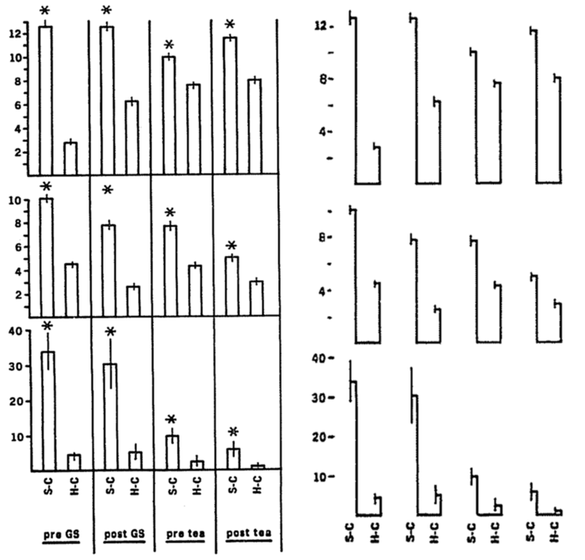

Slide 8
Balancing Tufte vs. Beauty
A good graphic presents information and allows users to explore.
Cairo advises first seek depth – take advantage of the space you have to seek depth within reasonable limits.
Only after, worry about how to make it prettier.
Clarify messages, not simplify. Highlight trends, uncover patterns, reveal.

Slide 9
Do you seek depth? Do you think readers seek it?

Slide 10
Cairo’s solution to the wheel
Organize your graphics in layers.
First: your lead – A headline, a summary, a main overview graphic of the key data.
Second: Inner layers of data. Make editorial choices. Do not overwhelm.
Third: Structure in logical order.
Structure first, eye candy second.
Does this story meet Cairo’s solution?

Slide 11
What about this?

Slide 12
For Thursday
Read Cairo Chapter 3, 4 and 6 and Tufte 5 and 6.
Prepare for the Mother Of All Reading Quizzes. It’ll be 20 questions over Cairo 2, 3, 4 and 6 and Tufte 1, 2, 4, 5 and 6.

