Slide 1
Data Visualization
Matt Waite
T | TH 3:30-4:45
ANDN 114

Slide 2
Introductions

Slide 3
The syllabus

Slide 4
How this class will be different
You’re going to be expected to learn outside of class, on your own, with nothing but spit and guile and Google.
I expect you to fail. A lot. And that’s totally okay because that’s how you learn. It won’t hurt you, mentally or academically.
You’re going to do everything via GitHub, which means you’re going to learn version control.

Slide 5
How this class will be different
This class will be highly experimental and what we do will depend on you and the work you put in.
Some of this class will be conducted via Google Hangouts online (for several reasons).
Effort, ambition and creativity will get you an A in this class. Mailing it in will not go well for you.

Slide 6
How this class will be different
You’re going to learn how to tell a new kind of story, combining visuals with data and narrative to promote understanding.
And, you’re not alone. Stuck? Struggling? Come to Maker Hours. Most Fridays, room 27 in Andersen Hall, 1 to 5.
http://www.makerhours.org/

Slide 7
What we’re here to learn.
More like this.
Not this.

Slide 8
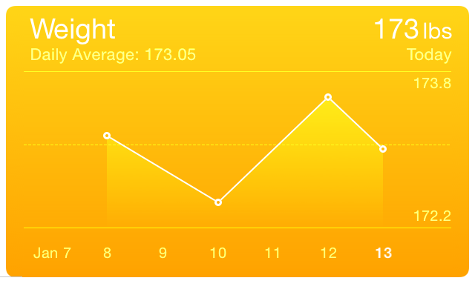

Slide 9
First assignment.
Buy the books.
Go to GitHub.com and sign up for an account.
Download the Git installer for your machine (see the syllabus).
Clone the repository to your local machine.
Clueless? Confused. Get thee to Google.
Revel in all that you have done. Look upon it for it is good.

Slide 10
Questions?
matt.waite@unl.edu
@mattwaite

