Slide 1
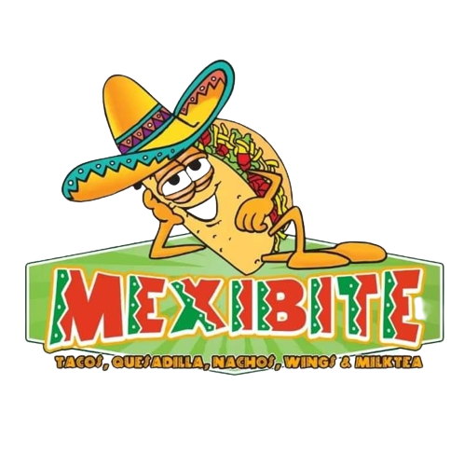
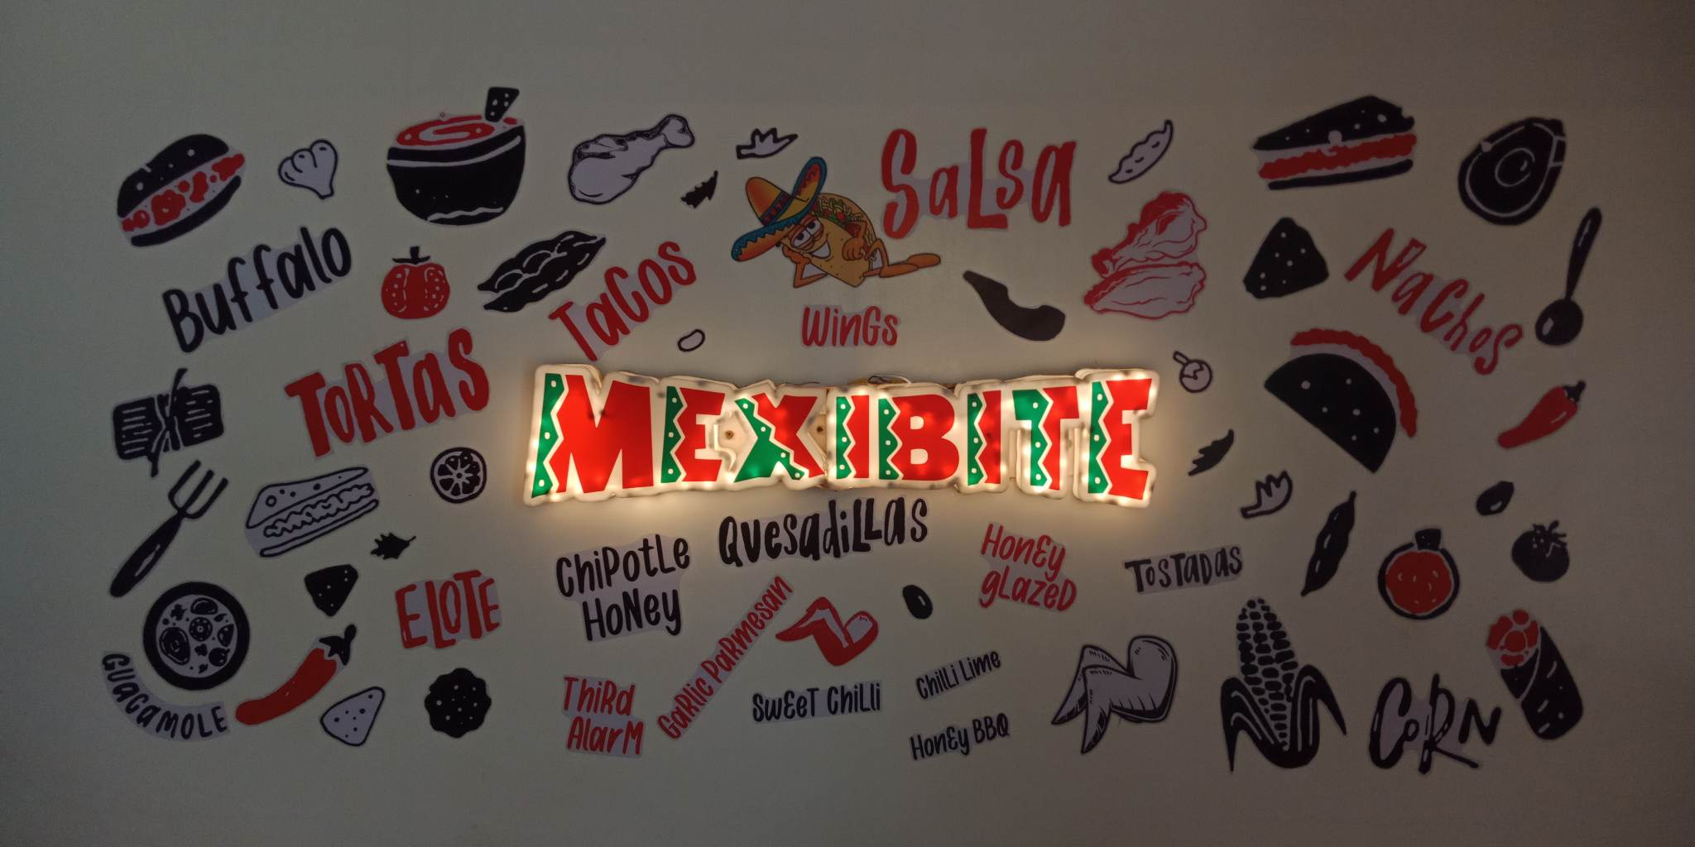
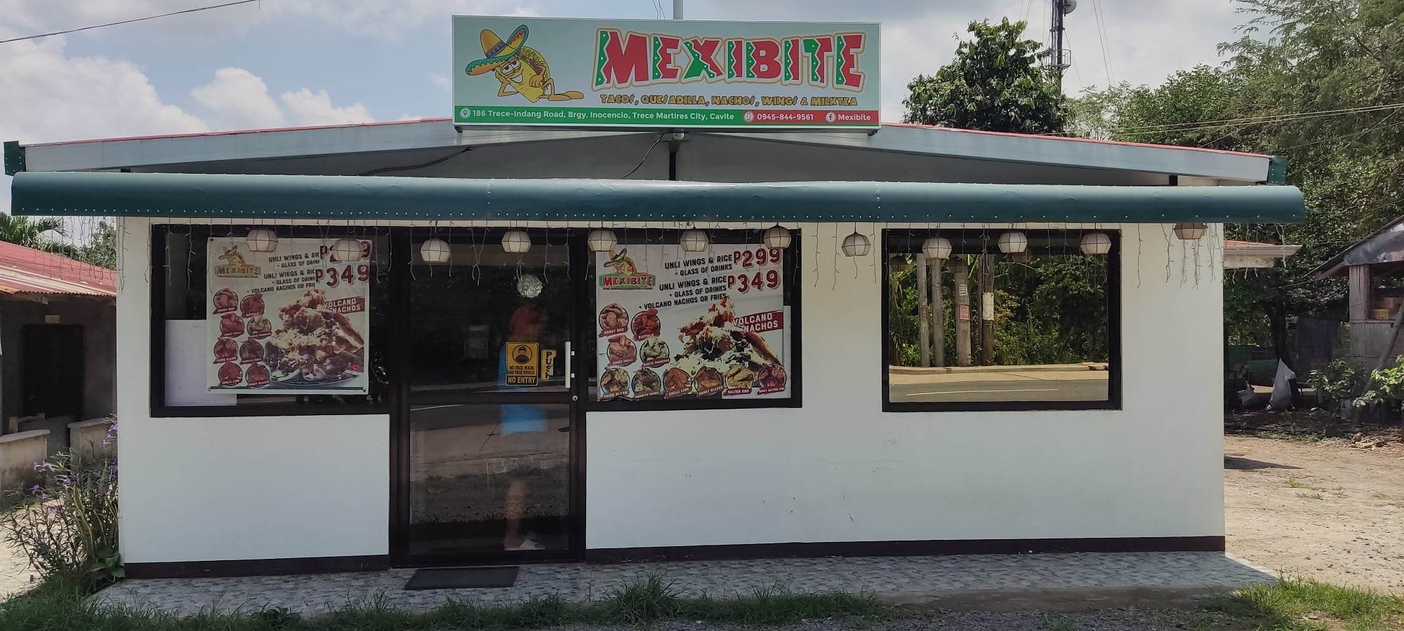
Home
Menu
Deliveries
About Us
Contacts
ABOUT US
Mexibite is one of the popular restaurants in the barangay of Inocencio, Trece Martires City. It is known for its delectable, crispy, and various flavors of chicken wings, as well as the fact that it offers unlimited wings and rice. It started first at Trece Martires City Market in 2019, where it only offers nachos and tacos. Then they came up with the idea of making unli wings, which became popular and the best-selling food in their cuisines later on. However, as the pandamic became a hindrance to their restaurant, they were forced to go bankrupt due to strict implementations of health protocols. As the new normal approaches the country, they found a place here in Brgy. Inocencio, Trece Martires City.
Mexibite is one of the popular restaurants in the barangay of Inocencio, Trece Martires City. It is known for its delectable, crispy, and various flavors of chicken wings, as well as the fact that it offers unlimited wings and rice. It started first at Trece Martires City Market in 2019, where it only offers nachos and tacos. Then they came up with the idea of making unli wings, which became popular and the best-selling food in their cuisines later on. However, as the pandamic became a hindrance to their restaurant, they were forced to go bankrupt due to strict implementations of health protocols. As the new normal approaches the country, they found a place here in Brgy. Inocencio, Trece Martires City.

