Slide 1
FELSIM · 2026.04—2026.08
FELSim
Work Summary
Tensor
Adapter
From PyTorch core migration to a unified simulation architecture—and research on optimizers, noise, and Hessian structure
Presented by: Yi Lu
Repository: github.com/Louis-26/FELsim · Branch: pytorch_transform
Notes:
Presenter notes
- Frame the presentation around two questions: what changed in the code, and how those changes entered the new architecture.
[Sources]
- Local Git: branch pytorch_transform, HEAD fecacfd4904bd501aee1ed2e1aca59ec69c2ecfa
- Repository: https://github.com/Louis-26/FELsim

Slide 2
FELSIM · WORK SUMMARY
Executive Summary: Core × Architecture × Research
Beyond replacing NumPy, the work established reusable evaluation capabilities across the experiment and results layers.
Tensor Migration
Dual Adapters
Step 1—4
Core Propagation & Statistics
Unified Simulation Architecture
Optimization Research Loop
beamline / ebeam / utilities
Shared Results Layer for FELsim and COSY
landscape · noise · random scan · Hessian
Key Deliverables
Migrated particle propagation, Twiss/covariance calculations, sampling, and physics utilities to torch.float64 while preserving the public APIs.
Integrated the PyTorch implementation through SimulatorBase and FELsimAdapter, connecting it to BeamEvolution, EvolutionPlotter, and the COSY backend.
Decoupled pointwise evaluation through evaluate(), enabling five optimizers, noise studies, close/far scans, Jacobian/Hessian calculations, and local-curvature analysis.
02
Notes:
Presenter notes
- Begin with the integrated outcome—numerical migration, architecture integration, and a reusable research pipeline.
[Sources]
- Local: backend/beamline.py, backend/ebeam.py, backend/beamOptimizer.py
- Local: backend/felsimAdapter.py, backend/beamEvolution.py, backend/evolutionPlotter.py
- Local: experiment/step_1 through experiment/step_4

Slide 3
FELSIM · WORK SUMMARY
Scope and Evidence Base
Git history shows what changed; directory differences and outputs show current capabilities.
backend ↔ backend_orig
experiment / step 1—4
work_progress / 1—9
results / outputs
Identify current semantic differences
and Tensor integration points
Reproduction, noise studies, random scans,
and second-order curvature analysis
Trace tasks, decisions, and open items
by week and month
Validate obtained data through PKLs,
figures, and notebooks
Baseline Caveat
backend_orig is not a fully frozen snapshot of the original code: the new architecture was synchronized into both backend and backend_orig on May 18. The final directory diff therefore captures only current direct differences; the full scope and attribution must be reconstructed from Git history.
03
Notes:
Presenter notes
- Explain both baselines so upstream synchronization is not misrepresented as wholly independent development.
[Sources]
- Git commit 73d1785: first introduction of backend_orig
- Git commit 2c71c2a: architecture modules added to both backend and backend_orig
- Local: backend, backend_orig, experiment, work_progress, results

Slide 4
FELSIM · WORK SUMMARY
End-to-End Timeline
The backend stabilized by late June; July and August focused on research experiments and results analysis.
APR
MAY
JUN
JUL
AUG
Migrate
Unify
Extend
Broaden
Deepen
PyTorch
Numerical Core
Unified Simulator
and Dual Adapters
evaluate / logMSE
noise / R26→R9
3 Variables × 3 Objectives
Close/Far Random Scans
Hessian / HGN
Eigenvalues & Rank
Key turning point: no backend source code changed after June 26, 2026, indicating that the architecture interfaces could support subsequent experiment-layer extensions.
04
Notes:
Presenter notes
- Use the monthly sequence to show the progression from numerical migration to second-order analysis.
[Sources]
- Local: work_progress/work_progress_1.md through work_progress/work_progress_9.md
- Git log: 2026-04-01 through 2026-08-10 on branch pytorch_transform
- Git commit d3d7cbd: last backend source-code change on 2026-06-26

Slide 5
FELSIM · APRIL
Phase I: Migrate the Numerical Core to Tensors
First establish a runnable, verifiable PyTorch implementation; then provide stable low-level interfaces for architecture integration.
04.01
04.03
04.22
Repository Mapping
and Environment Setup
Core-Module Conversion
and File-by-File Debugging
float64 / Relativistic
Boundary Cleanup
05
Notes:
Presenter notes
- This phase prioritized numerical equivalence and stable interfaces before performance and architecture work.
[Sources]
- Git commits 5f76cb0, 3695a99, 73d1785, e38e7bc, 96ae968
- Local: work_progress/work_progress_1.md

Slide 6
APRIL · CODE CHANGES
April: Detailed Code-Migration Timeline
Each commit corresponds to a verifiable engineering task.
Date / Commit | Task | Outcome
04.01 · 5f76cb0 | Understand the baseline | Mapped backend responsibilities and recorded the first tasks and dependencies.
04.03 · 3695a99 | First Tensor conversion | beamline / ebeam / beamUtility / radiation / schematic; about +474 / -315.
04.03 · 73d1785 | Complete transport details | Tensorized position accumulation, interpolation, fringe fields, and relativistic parameters; added backend_orig.
04.03 · e38e7bc | Debug and equivalence tests | Fixed dtype issues, Tensor-to-NumPy plotting, test paths, and platform differences.
04.22 · 96ae968 | Boundary cleanup | Switched the beta calculation to torch.sqrt and removed debug code.
06
Notes:
Presenter notes
- Present the phase as verifiable engineering tasks tied directly to commits and outcomes.
[Sources]
- Git show 5f76cb0, 3695a99, 73d1785, e38e7bc, 96ae968
- Local: work_progress/work_progress_1.md

Slide 7
APRIL · NUMERICAL CORE
Modules Covered by the PyTorch Migration
The numerical core now uses Tensors consistently, while NumPy, Pandas, and Matplotlib remain at compatibility boundaries.
Module | Original pattern | Improved implementation | Architectural role
beamline.py | Per-particle loops + np.matmul | Batched torch.matmul; cumsum positions; Tensor fringe fields | Core transport
ebeam.py | NumPy statistics and sampling | Vectorized mean / covariance / Twiss / Gaussian sampling | Statistics and objectives
beamUtility.py | Nested grids and profile calculations | 4D broadcasting; Tensor charge / deposition | Physics utilities
radiation.py | NumPy angular distributions and histograms | Tensor energy grids, trigonometry, and histograms | Radiation layer
schematic.py | Column-wise transforms and min/max | Vectorized drift transforms and boundary statistics | Visualization preprocessing
beamOptimizer.py | Optimization and evaluation coupled | float64, evaluate, jac/options, logMSE, noise | Reusable experiment entry
07
Notes:
Presenter notes
- Emphasize that the migration spans propagation, statistics, physics utilities, and optimization interfaces.
[Sources]
- Local diff: backend_orig versus backend for Python source files
- Local: backend/beamline.py, backend/ebeam.py, backend/beamUtility.py
- Local: backend/radiation.py, backend/schematic.py, backend/beamOptimizer.py

Slide 8
APRIL · BEAMLINE
Core Improvement 1: Batched Beamline Propagation
Replaced particle loops with batched matrix operations while preserving the public useMatrice() entry point.
Before · NumPy
After · PyTorch
for particle in particles:
out = np.matmul(M, particle)
• Python-level loop
• Each particle computed separately
• Checkpoints difficult to standardize
particles = torch.matmul(M, particles.T).T
• One batched matrix multiplication
• Element matrices standardized as float64 Tensors
• torch.cumsum tracks longitudinal positions
• Tensorized fringe-field interpolation and reconstruction
Architectural value: beamPropagator and FELsimAdapter retain the same public interface, so migration changes do not propagate upward.
08
Notes:
Presenter notes
- Use this example to show that the numerical implementation changed while upper-layer calling conventions remained stable.
[Sources]
- Local: backend/beamline.py:173 useMatrice()
- Local: backend/beamline.py:204 batch torch.matmul
- Local: backend/beamline.py:757 element-position accumulation
- Local: backend/beamline.py:875 fringe-field reconstruction

Slide 9
APRIL · EBEAM / UTILITIES
Core Improvement 2: Beam Metrics & Physics
Standardized repeatedly evaluated optimization statistics as Tensor operations.
Twiss / covariance
Particle generation
Ellipse / envelope
Mean, covariance, and dispersion correction
Vectorized α / β / ε
Twiss-Based 6D Gaussian Sampling
Device and float64 Support
Tensorized X / Y / Z Ellipse Tests
and Envelope Calculations
Power / deposition
Radiation
Plot boundary
4D Power-Grid Broadcasting
Charge and Deposition Profiles
ICS Angular Distributions and Spectrum Grids
Histograms and Normalization
Convert to NumPy Only at
DataFrame / Matplotlib Boundaries
Unified precision: from June 8, 2026, torch.float64 became the default across the research workflow.
09
Notes:
Presenter notes
- The statistics layer matters because each optimization forward pass repeatedly evaluates these quantities.
[Sources]
- Local: backend/ebeam.py:94 cal_twiss()
- Local: backend/ebeam.py:752 gen_6d_from_twiss()
- Local: backend/beamUtility.py, backend/radiation.py, backend/schematic.py
- Git commit 7d2bb28: float64 integration

Slide 10
APRIL · VERIFICATION
Equivalence Verification after Migration
Key functions were first checked against the original implementation, followed by optimization results as system-level evidence.
ebeam · ellipse
ebeam · cal_twiss
beamline
X / Y / Z
allclose = True
mean / cov / Twiss
allclose = True
interpolation / reconfigure
True / True
schematic
beamUtility
System-Level Optimization
drift / min-max
True / True
Bethe close
profile True / True
Saved PyTorch Results as PDF
for Residual and Iteration Comparisons
Validation remains primarily notebook- and script-based; an automated pytest regression suite is the next engineering step.
10
Notes:
Presenter notes
- Distinguish completed equivalence checks from the automated regression infrastructure still to be built.
[Sources]
- Local: modify_test_cases/test_ebeam.ipynb
- Local: modify_test_cases/test_beamline.ipynb
- Local: modify_test_cases/test_schematic.ipynb
- Local: modify_test_cases/test_beamUtility.ipynb
- Local: backend/beamline_optimization_pytorch_res.pdf

Slide 11
FELSIM · MAY
Phase II: Integrate the Tensor Core into the Unified Architecture
In May, the focus shifted from runnable functions to coexistence, shared outputs, and reusable experiments.
05.18
05.19
05.29
Integrate SimulatorBase
with the FELsim/COSY Architecture
Add NumPy Baselines
and Correct Units
Scenario A
Five-Optimizer Comparison
11
Notes:
Presenter notes
- Position May as the bridge between low-level implementation and the reusable research workflow.
[Sources]
- Git commits 2c71c2a, 3812df0, f829316
- Local: work_progress/work_progress_2.md through work_progress/work_progress_4.md

Slide 12
MAY · ARCHITECTURE INTEGRATION
May: Largest Architecture-Integration Commit
Commit 2c71c2a synchronized the upstream architecture and completed PyTorch bridging, unit correction, and results-layer adaptation.
35 files
13 modules
2 backends
Files Changed under backend/
New Architecture Components
Unified Output Protocol
~+10,980 / −367 (including upstream synchronization)
Simulator / Adapter / COSY / Evolution
Parallel FELsim and COSY Backends
Accurate Attribution
The upstream nginx branch provided the unified simulator/COSY foundation. My contribution was to synchronize it into this branch; connect the PyTorch core through FELsimAdapter, beamPropagator, BeamEvolution, plotting, and optimization; and extend validation, outputs, and subsequent experiments.
12
Notes:
Presenter notes
- State attribution explicitly: upstream supplied the foundation; this work synchronized, adapted, validated, and extended it.
[Sources]
- Git commit 2c71c2a: 2026-05-18 architecture integration
- Upstream history recorded in local Git: komochristian/FELsim nginx branch
- Local: backend/simulatorBase.py, backend/felsimAdapter.py, backend/cosyAdapter.py

Slide 13
MAY · SYSTEM ARCHITECTURE
Two Backends, One Unified Results Layer
Adapters isolate backends; BeamEvolution unifies particle, Twiss, and element metadata
FELsimAdapter
Input
Builder
Simulator
Base
beamPropagator
+ Tensor core
Excel / JSON
lattice
latticeLoader
BeamlineBuilder
Unified simulate /
optimize contract
Unified result
Simulation
Result
BeamEvolution
EvolutionPlotter
COSYAdapter
COSYSimulator
+ ResultsReader
Key design: preserve FELSim's public API and integrate through adapters instead of rewriting the full call stack.
13
Notes:
Presenter notes
- Walk through the data flow from left to right, then emphasize the value of the Adapter layer and unified result container.
[Sources]
- Local: backend/latticeLoader.py, backend/beamlineBuilder.py, backend/simulatorBase.py
- Local: backend/felsimAdapter.py, backend/cosyAdapter.py
- Local: backend/beamEvolution.py, backend/evolutionPlotter.py

Slide 14
MAY · DATA FLOW
How Improved Code Enters the New Architecture
Keep the numerical core in tensors; convert only at result and visualization boundaries
Particles
Tensor
useMatrice
Checkpoint
cal_twiss
BeamEvolution
Outputs
float64 / device
Batched torch.matmul
clone() preserves
boundary state
Vectorized statistics /
objectives
Particles + Twiss
+ metadata
NumPy / Pandas / plots / API
Boundary Rule
Use tensors internally for batching and differentiation; convert only at DataFrame, Matplotlib, SciPy, and API boundaries.
14
Notes:
Presenter notes
- This slide directly explains how the improved numerical code integrates into the new architecture.
[Sources]
- Local: backend/beamPropagator.py
- Local: backend/beamline.py:173 useMatrice()
- Local: backend/ebeam.py:94 cal_twiss()
- Local: backend/felsimAdapter.py:253 collect_evolution()

Slide 15
MAY · JUNE · OPTIMIZER
Optimizer Evolution: Black Box → Evaluation API
June interface changes created one entry point for experiment Steps 1–4
calc()
_prepare()
evaluate()
jac / options
noise / log
Original optimizer entry
Unified variables / objectives
Independent pointwise evaluation
Supports first- / second-order methods
Study perturbations and scaling
Reusable outputs
Landscape grids · optimization trajectories · Gaussian noise · close/far random scans · Jacobian · Hessian · Gauss–Newton approximation
15
Notes:
Presenter notes
- The evaluate() method is the key architectural contribution enabling subsequent research by decoupling optimization from pointwise evaluation.
[Sources]
- Local: backend/beamOptimizer.py:477 _prepare()
- Local: backend/beamOptimizer.py:527 evaluate()
- Git commits 7d2bb28, 7c53968, d3d7cbd

Slide 16
MAY · ADAPTER DETAILS
COSY Integration: Bridge and Unified Results
Keep index and variable differences inside helpers and adapters, not the experiment layer
cosyOptHelper
FELsimAdapter
BeamEvolution
• Parse FELsim Excel element indices
• Map stages to COSY FIT blocks
• Map symmetric variables
• Read back optimized currents
Resolves naming and indexing differences for the same physical variable across backends.
• Wrap the existing beamline / optimizer
• Tensor particles → checkpoints
• collect_evolution()
• Convert dispersion units
Implements the SimulatorBase contract without a full backend rewrite.
• Store evolution by longitudinal position
• Particles / Twiss / element metadata
• Unified across FELsim / COSY
• Consumed by EvolutionPlotter
Separates propagation, result storage, and plotting.
The experiment layer uses only the unified interface: switching simulators does not require duplicating downstream analysis.
16
Notes:
Presenter notes
- Emphasize architectural isolation: backend-specific differences are confined to the bridging layer.
[Sources]
- Local: backend/cosyOptHelper.py:18, :93, :162, :196
- Local: backend/felsimAdapter.py
- Local: backend/beamEvolution.py, backend/evolutionPlotter.py

Slide 17
MAY · PERFORMANCE
Performance: End-to-End Gains Are Uneven
Report total scenario time, key stages, and caveats
1.46×
Scenario B
~31% lower total runtime
4.25×
Quadrupole Triplet
480.85s vs 2045.76s
Caveats
Short stages can be slower. Scenario C is excluded due to likely NumPy non-convergence.
17
Notes:
Presenter notes
- Avoid the blanket claim that every scenario is faster.
[Sources]
- Local: optimizer_compare/runtime_comparison_beamline_optimization.md
- Scenario B: PyTorch 142m35s; NumPy 207m38s
- Triplet: 480.85s versus 2045.76s; UND match: 786.13s versus 1149.20s

Slide 18
EXPERIMENT · OVERVIEW
Architecture to Research: Experiment Steps 1–4
A shared evaluate() interface supports optimizers, noise, sensitivity, and curvature
Step 1 · Reproduction and Comparison
Step 2 · Stability and Cost
Step 3 · Problem Generalization
Step 4 · Second-Order Structure
5 optimizers
landscape / trajectories
logMSE / noise
R26→R9 / derivative cost
3 variables × 3 objectives
close / far sampling
Hessian / HGN
rank / eigenvectors
Research sequence: establish reproducibility → identify algorithmic differences → add noise and scaling pressure → interpret local geometry.
18
Notes:
Presenter notes
- Use this slide as the experiment roadmap and the bridge from engineering work to research questions.
[Sources]
- Local: experiment/step_1, experiment/step_2, experiment/step_3, experiment/step_4
- Local: work_progress/work_progress_3.md through work_progress/work_progress_9.md

Slide 19
STEP 1 · REPRODUCTION
Step 1: A Reproducible Scenario A Benchmark
Fix the physics, variables, and targets before comparing algorithms
40 MeV
2 → 2
0.01—1.5 A
Electron-Beam Energy
Variables and Objectives
Variable Bounds
1000 particles per forward pass
I1, I3 → αx, αy
26-current reference configuration
Common Benchmark
Nelder–Mead
L-BFGS-B
SLSQP
COBYLA
trust-constr
Current PKL: 100×5 = 500 runs; archived v4 PDF: 1,000×5 = 5,000 runs (~23.8 h); plus 50 trajectories and a 500×500 landscape.
19
Notes:
Presenter notes
- Establish the experimental variables, objectives, and control conditions before discussing the results.
[Sources]
- Local: experiment/configs.py
- Local: experiment/step_1/scenario_A_reproduce_v4.ipynb
- Historical archive: experiment/step_1/scenario_A_reproduce_v4.pdf documents 1000 runs per method; the corresponding v4 PKL is no longer present
- Local: results/scenario_A_results.pkl, results/scenario_A_trajectories.pkl, results/scenario_A_landscape.pkl

Slide 20
STEP 1 · OPTIMIZER COMPARISON
Step 1 Results: Speed–Accuracy–Basin Trade-offs
Zero noise; 100 random starts per method
Method | Convergence | Mean time | Geometric mean MSE | Observation
COBYLA | 100% | 35.26 s | 1.24e-4 | Robust, lower accuracy
L-BFGS-B | 100% | 10.41 s | 9.71e-13 | High accuracy and fast
Nelder–Mead | 99% | 15.31 s | 1.30e-8 | Derivative-free baseline
SLSQP | 100% | 7.13 s | 3.63e-8 | Fastest on average
trust-constr | 100% | 34.02 s | 3.12e-13 | Lowest error scale
How to Read
SLSQP: shortest mean runtime
L-BFGS-B / trust-constr: lowest errors
Nelder–Mead: more robust under high noise
Convergence need not recover the reference currents; multiple basins can attain equivalent objectives.
20
Notes:
Presenter notes
- The MSE values in the table are geometric means from the final_summary object in the results file.
[Sources]
- Local: results/scenario_A_results.pkl (df_A and final_summary)
- Noise-free campaign: 500 total optimization runs

Slide 21
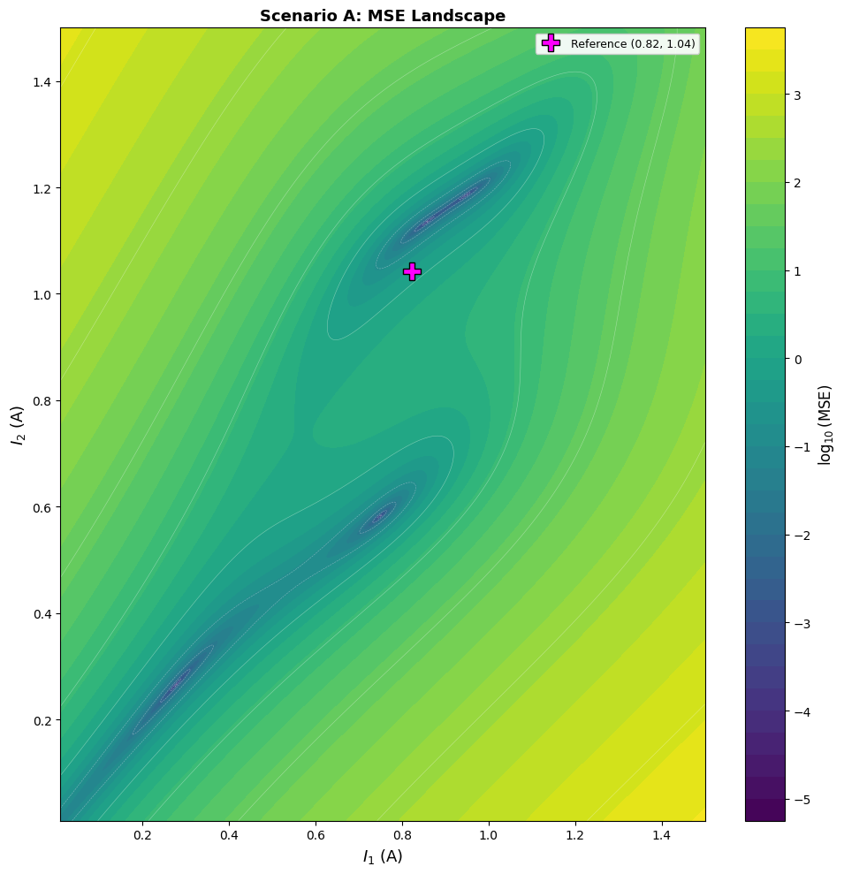
STEP 1 · LANDSCAPE
250,000-Point Landscape Reveals Multiple Basins
The target αx=0, αy=0 has multiple acceptable regions in current space
500 × 500
Regular-Grid Evaluation
40,280 s · 11.19 h
MSE Range
9.79e-6 → 3.41e3
Conclusion
Only 66/250,000 points (0.0264%) have MSE < 1e−3. Narrow, multi-basin valleys require joint inspection of error, currents, and trajectories.
21
Notes:
Presenter notes
- The landscape is not decorative; it provides evidence explaining why algorithms terminate at different solutions.
[Sources]
- Local: results/scenario_A_landscape.pkl (500x500 grid, 250000 evaluations)
- Local: experiment/step_1/scenario_A_reproduce_v4.ipynb, output cell 10

Slide 22
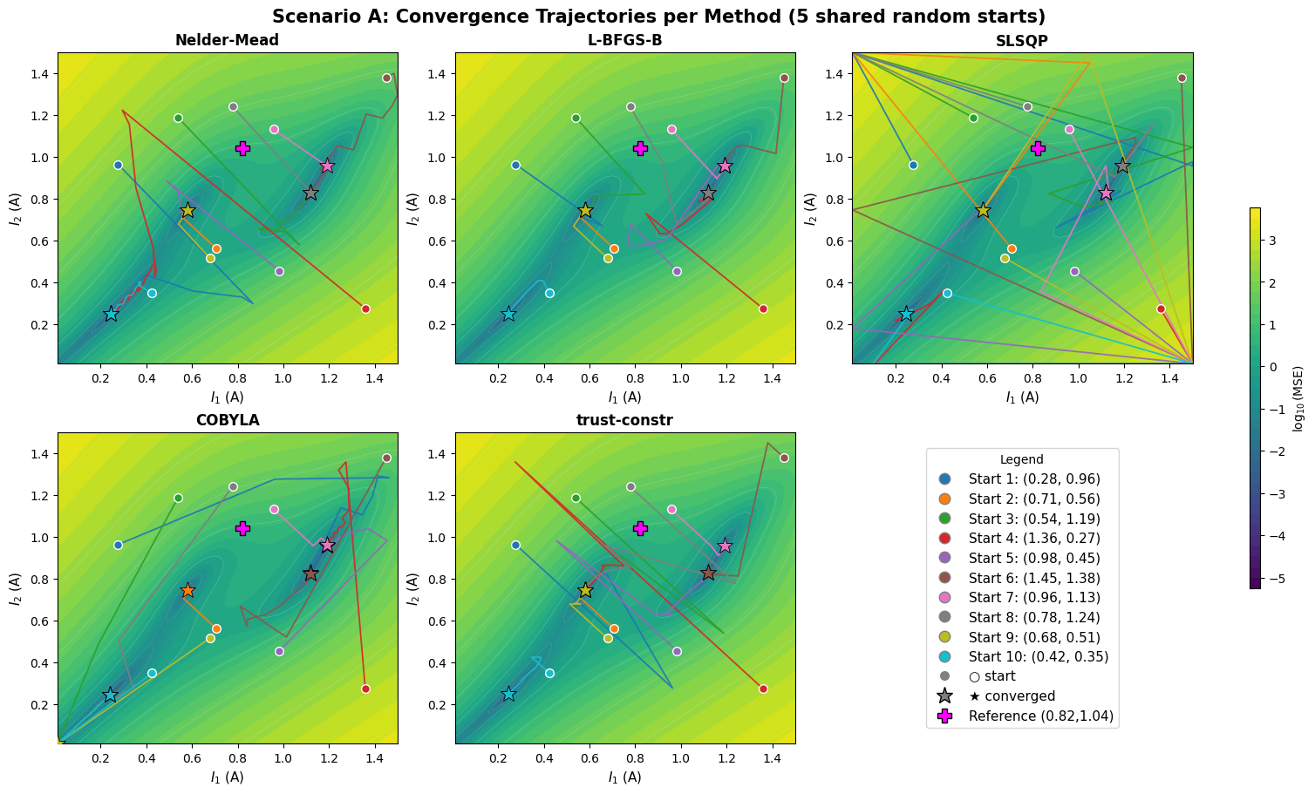
STEP 1 · TRAJECTORIES
Shared Starts, Different Optimization Trajectories
Gradient, simplex, and constrained methods follow different paths and reach different endpoints
Trajectory Findings
Repeated convergence from different starts to the same basin indicates stable local attraction regions.
SLSQP makes more cross-basin jumps; its speed advantage comes with greater step-size sensitivity.
Nelder–Mead and COBYLA are gradient-free, providing robust baselines for the noise study.
Final MSE omits both path cost and the physical location of the solution.
22
Notes:
Presenter notes
- All methods use the same random starting points, enabling a fair comparison of optimization paths.
[Sources]
- Local: results/scenario_A_trajectories.pkl
- Local: experiment/step_1/scenario_A_reproduce_v4.ipynb, output cell 11

Slide 23
FELSIM · JUNE
Stage 3: Building a Research-Ready Evaluation System
This stage added logMSE, Gaussian current noise, R26→R9 data mapping, and second-order sensitivity interfaces.
06.08
06.21—26
06.24
float64 + evaluate
jac / options / callback
logMSE and Gaussian
current noise
1,000-Sample Mapping
and Multicore Parallelism
23
Notes:
Presenter notes
- June marks the transition from benchmarking to a reusable research toolchain.
[Sources]
- Git commits 7d2bb28, 7c53968, 1f41e94, d3d7cbd
- Local: work_progress/work_progress_5.md through work_progress/work_progress_7.md

Slide 24
STEP 2 · LOGMSE
logMSE Pilot: Retained as an Option, Not the Default
Small pilot (n=3 per method): better scaling, but excessive runtime and stability costs
Conclusion
Mean runtime increased for every method
L-BFGS-B: ~9.6×
trust-constr: ~13.3×
Low-MSE scaling benefits did not offset runtime and truncation/instability issues
Keep use_log as an option; MSE remains the default.
24
Notes:
Presenter notes
- This slide captures the full cycle of experimentation, decision-making, and retention of an optional interface.
[Sources]
- Local: experiment/step_2/scenario_A_reproduce.ipynb
- Local: work_progress/work_progress_6.md
- Git commit 7c53968: use_log and log_epsilon

Slide 25
STEP 2 · DATA PIPELINE
Step 2: R²⁶ → R⁹ Mapping with Multicore Execution
Map 26 currents to α, β, and ε in x/y/z for surrogate and sensitivity studies
R²⁶ currents
FELSim
R⁹ output
Notebook output
26 quadrupole settings
1,000 random samples
Tensor propagation
+ cal_twiss()
[α, β, ε] ×
[x, y, z]
1,000 text records
machine-readable dataset pending export
102 → 17 min
1000
3 × 3
6-core parallelism
notebook mapping records
Twiss output tensor
≈6× wall-clock speedup
Current results do not retain the 1,000×35 dataset
Some random settings yield nonphysical solutions
25
Notes:
Presenter notes
- Present both the achievement and the data-quality issue: random current settings do not always produce physically plausible beams.
[Sources]
- Local: experiment/step_2/current_twiss_map.py
- Local: work_progress/work_progress_6.md
- Recorded runtime: 102 minutes serial-equivalent to 17 minutes with 6 cores

Slide 26
STEP 2 · NOISE ROBUSTNESS
Noise Robustness under a Strict MSE Threshold
All results use MSE < 1e-3; five σ levels and 100 runs per method
Key Findings
At σ=1e-8, the strict pass rate for gradient-based methods already falls to 8–13%.
Nelder–Mead retains a 93% pass rate at σ=1e-4, but only 7% at σ=1.
COBYLA: 88% → 81% → 36% → 7% → 0%
The repo uses is_converged with MSE<1 and no solver-success requirement; this slide uses a stricter definition.
26
Notes:
Presenter notes
- The figure recomputes the strict MSE<1e-3 pass rate from each df_A rather than using the more permissive is_converged flag.
[Sources]
- Local: results/scenario_A_results_sigma_1e-08.pkl through scenario_A_results_sigma_1.0.pkl
- Each sigma file: five methods x 100 runs = 500 optimizations
- Strict pass rates derived from df_A final_mse; repository is_converged uses EPSILON=1
- Local: experiment/step_2/scenario_A_reproduce.ipynb

Slide 27
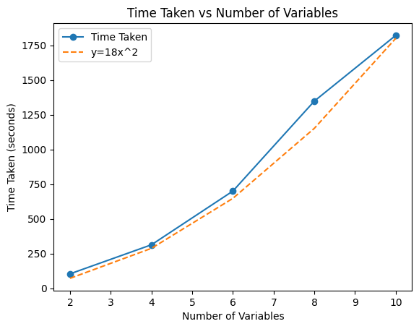
STEP 2 · DERIVATIVE SCAN
Hessian Dominates Second-Order Scan Cost
Measured cost grows roughly quadratically with variable count
Typical Per-Sample Cost in the Current 4-Point PKL
Component | Time | Share / role
MSE | ≈ 7.6 s | Base forward pass
Jacobian | ≈ 23–24 s | Local first-order sensitivity
Hessian | ≈ 108–110 s | About 68–69%; main bottleneck
H_GN | ≈ 19 s | Gauss–Newton approximation
Eigen | ≈ 0.001 s | Eigendecomposition is nearly free
Variables 2→4→6→8→10: ≈104→314→700→1,348→1,821 s; the current scan_parameters.pkl retains only four points.
27
Notes:
Presenter notes
- This performance bottleneck motivates the subsequent design choices: introducing H_GN and parallel execution.
[Sources]
- Local: experiment/step_2/SOBOL_scan.ipynb, output cell 18; file name is historical and sampling is not a Sobol low-discrepancy sequence
- Local: results/scan_parameters.pkl
- Measured variable scaling: 104.389s, 313.645s, 700.434s, 1348.088s, 1821.205s for 2,4,6,8,10 variables
- Current scan_parameters.pkl contains 4 points; the notebook-recorded 1000-point run is no longer present in the current PKL

Slide 28
FELSIM · JUNE—AUGUST
Phase 4: Multi-CPU Parallelization
Scale independent FELSim evaluations across CPU processes for mapping, optimizer restarts, and close/far derivative scans.
28
Notes:
Introduce Phase 4 as coarse-grained multiprocessing across independent simulation tasks. The next slides separate measured results from 24-core projections.
[Sources]
- C:/Users/yilu2/my_files/research/FELsim/experiment/step_2/current_twiss_simulation_parallel.py
- C:/Users/yilu2/my_files/research/FELsim/experiment/experiments_utils.py
- C:/Users/yilu2/my_files/research/FELsim/experiment/SOBOL_scan.py
- C:/Users/yilu2/my_files/research/FELsim/work_progress/work_progress_6.md
[/Sources]

Slide 29
PHASE 4 · EXECUTION ARCHITECTURE
One Process Pool Serves Three Experiment Workloads
Parallelism is coarse-grained across independent samples and optimizer runs—not within one beam propagation.
Task generation
Process pool
FELSim workers
Fan-in + export
Samples or method × restart jobs
created in the parent process
ProcessPoolExecutor
worker count from CLI / SLURM
One task per process
BLAS / PyTorch threads fixed at 1
Collect → regroup / sort
→ pickle or notebook output
1,000
method × restart
close + far
Twiss-mapping trials
Optimizer benchmark tasks
Derivative-scan batches
26 currents → clean + noisy Twiss output
Each worker runs one independent optimization
MSE · J · H · H_GN · eigensystem
29
Notes:
Walk left to right: the parent creates independent tasks, ProcessPoolExecutor fans them out, each worker runs single-threaded numerical kernels, and the parent gathers deterministic outputs. Explain that the same architecture is reused by Twiss mapping, optimizer restarts, and derivative scans.
[Sources]
- C:/Users/yilu2/my_files/research/FELsim/experiment/step_2/current_twiss_simulation_parallel.py:59-125
- C:/Users/yilu2/my_files/research/FELsim/experiment/experiments_utils.py:728-815
- C:/Users/yilu2/my_files/research/FELsim/experiment/SOBOL_scan.py:391-540
- C:/Users/yilu2/my_files/research/FELsim/experiment/step_3/baseline_eval_multiprocess.py:94-164
[/Sources]

Slide 30
PHASE 4 · 24-CORE IMPACT
24-Core Timing: Measured Anchor, Projected Savings
Measured 6-core scaling anchors two transparent 24-core compute-only projections.
24-core view
Twiss map: 102 → 17 min is measured on 6 cores; 4.25 min on 24 cores is projected.
Projected saving: 97.75 min per 1,000-sample mapping job.
5,000 optimizer restarts: ≈22 h 53 min projected saving (23 h 53 min → 59.7 min).
Assumes near-linear scaling; excludes startup, serialization, memory contention, and queue time.
No completed 24-core Koa timing is stored; a 24-core request was estimated to queue for ≈3 days.
30
Notes:
Lead with the integrity statement: there is no recorded completed 24-core Koa run. The Twiss benchmark is measured at 102 minutes serial and 17 minutes on six cores. The 24-core values divide measured serial workloads by 24 and therefore describe compute-only projections. The optimizer-batch projection uses the archived 23 h 53 min serial workload.
[Sources]
- C:/Users/yilu2/my_files/research/FELsim/work_progress/work_progress_5.md:8-19
- C:/Users/yilu2/my_files/research/FELsim/work_progress/work_progress_6.md:10-30
- C:/Users/yilu2/my_files/research/FELsim/work_progress/work_progress_7.md:14
- C:/Users/yilu2/my_files/research/FELsim/experiment/step_2/current_twiss_simulation_parallel.py:19-125
[/Sources]

Slide 31
PHASE 4 · PARALLEL SCOPE
Parallelize Outer Tasks; Keep Each Evaluation Serial
This boundary explains both the strong batch-level scaling and the remaining Hessian bottleneck.
1,000 trials
method × restart
close + far
Current → Twiss mapping
Optimizer benchmarking
Local geometry scans
Measured: 102 → 17 min on 6 cores
One independent optimization per worker
One sample payload per worker
Workload | Parallel unit | Worker payload | Observed / configured evidence
Twiss map | 1 current vector | Clean + noisy propagation; Twiss output | 1,000 tasks; 6-core measured
Optimizer batch | 1 method × restart | Independent beamline optimization | ProcessPool; CLI-configured cores
Global / close-far scan | 1 sample point | MSE · J · H · H_GN · eigenpairs | 11-core 1,000-point run; no matched serial A/B
Boundary: J, H, and H_GN finite differences are still serial inside each worker; close and far batches and the three objective cases are launched sequentially.
31
Notes:
Use this slide to answer where multiprocessing is applied. The outer workload is parallel: a current vector, optimizer restart, or scan point is one process task. Inside a task, beam propagation and finite-difference Jacobian/Hessian calculations remain serial. Also note that the historical 'SOBOL' filenames use pseudorandom uniform/Gaussian sampling rather than a Sobol low-discrepancy sequence.
[Sources]
- C:/Users/yilu2/my_files/research/FELsim/experiment/step_2/current_twiss_simulation_parallel.py:59-125
- C:/Users/yilu2/my_files/research/FELsim/experiment/experiments_utils.py:728-815
- C:/Users/yilu2/my_files/research/FELsim/experiment/SOBOL_scan.py:228-267,391-478
- C:/Users/yilu2/my_files/research/FELsim/experiment/step_2/SOBOL_scan_multiprocess.ipynb
- C:/Users/yilu2/my_files/research/FELsim/results/scan_parameters.pkl
[/Sources]

Slide 32
FELSIM · JULY—AUGUST
Phase 5: Geometry Near Optima
Stable core interfaces enabled 3×3 close/far scans and Hessian eigenspectrum analysis.
07.15
07.23
08.10
Arbitrary Variables / Objectives
Problem Generalization
close / far scan
Jacobian + Hessian
H_GN / L1 distance
rank / eigenvectors
32
Notes:
Resume the scientific narrative after the dedicated parallelization section. This phase uses the multiprocessing-enabled experiment pipeline to study close/far loss and local curvature.
[Sources]
- C:/Users/yilu2/my_files/research/FELsim/experiment/step_3
- C:/Users/yilu2/my_files/research/FELsim/experiment/step_4
- C:/Users/yilu2/my_files/research/FELsim/results/benchmark_scan_multi
[/Sources]

Slide 33
STEP 3 · GENERALIZATION
Step 3: Generalization to 3 Variables × 3 Objectives
The optimization layer is now generic; second-order diagnostics still need full support for multiple objectives at a single location.
Case 1
Case 2
Case 3
I1 / I3 / I10
Objective Set A
Archived Coordinates*
(0.01, 1.455, 0.981)
I1 / I3 / I10
Objective Set B
Archived Coordinates*
(0.935, 1.084, 0.816)
I1 / I3 / I10
Objective Set C
Archived Coordinates*
(1.156, 1.479, 0.786)
Local minimum
Close scan
Far scan
Derivatives
Optimize each case first
10 nearby random samples
10 distant random samples
J / H / eigenpairs / H_GN
* Coordinates follow stored column order; set construction may swap axes across sessions. “SOBOL” is historical—the implementation uses uniform/Gaussian random sampling.
33
Notes:
Presenter notes
- All three objective configurations use the same analysis pipeline.
[Sources]
- Local: experiment/step_3
- Local: results/benchmark_scan, results/benchmark_scan_multi (60 close/far samples per folder)
- Local: work_progress/work_progress_8.md
- Implementation note: variable order originates from list(set(...)); saved coordinates may swap axes across sessions
- Sampling note: no Sobol low-discrepancy sequence is called despite historical SOBOL naming

Slide 34
STEP 3 · CLOSE / FAR SCAN
Step 3 Archive: Far Loss Up; Curvature Under Review
Far/close median-loss ratios across three multiprocessing cases
133×
3.87e3×
5.45e4×
Case 1 · far / close
Case 2 · far / close
Case 3 · far / close
5.94e-7 → 7.92e-5
0.1255 → 485.21
1.09e-4 → 5.95
Region | Negative eigenvalues | Near-zero / flat | Positive eigenvalues | Interpretation
Close | 40 / 90 | 30 / 90 | 20 / 90 | Not strictly positive definite; saddle and flat directions remain
Far | 28 / 90 | 44 / 90 | 18 / 90 | More flat directions; 26/30 samples contain negative curvature
Limitation: Case 2 J/H uses one residual per location, not the full five-objective Hessian; second-order statistics remain prototypes.
34
Notes:
Presenter notes
- The rise in far-region loss is a reliable archived result; multi-objective second-order interpretation requires recomputation after correcting the residual construction.
[Sources]
- Local: results/benchmark_scan_multi
- Multi-process far/close median ratios: Case1 133x, Case2 3.87e3x, Case3 5.45e4x
- Stored eigenvalue counts: close negative/flat/positive = 40/30/20; far = 28/44/18
- Implementation limit: compute_weighted_MSE builds residuals by objective location and only reads the first target at a multi-target location

Slide 35
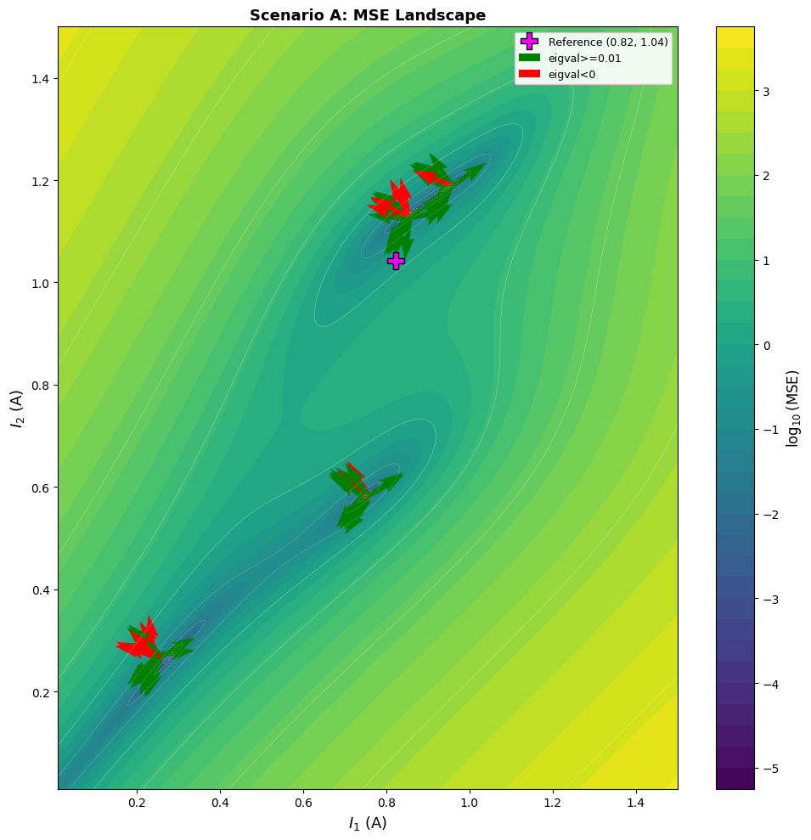
STEP 4 · CURVATURE PROTOTYPE
Step 4: Visualizing Second-Order Directions
Overlay workflow complete; directions and MSE–eigenvalue relations require correction.
Exploratory Prototype · Review Required
Complete workflow for overlaying local second-order information on the global landscape.
Cell 7 iterates over rows, but NumPy stores eigenvectors by column; arrow directions require review.
Cell 3 uses a residual-vector element, not scalar φ/MSE; no quantitative correlation is justified.
Robust result: multiple basins and narrow valleys. After correction, recompute principal-curvature directions, H_GN, and rank.
35
Notes:
Presenter notes
- Frame this figure as an implemented research prototype, not a final quantitative second-order result.
[Sources]
- Local: experiment/step_4/plot_summary.ipynb, output cell 7
- Local: results/scan_parameters.pkl
- Local: work_progress/work_progress_9.md
- Implementation limit: eigenvectors are iterated by rows in cell 7; NumPy eigenvectors are stored by columns
- Implementation limit: cell 3 logs a residual-vector element rather than scalar phi/MSE

Slide 36
TIMELINE · EXPERIMENT LAYER
June–August: Experiment-Layer Commit Timeline
With stable core interfaces, commits shifted to reusable experiments, results, and second-order diagnostics.
JUNE · CAPABILITY EXPANSION
JULY—AUGUST · GENERALIZATION & INTERPRETATION
06.05 · Step 1 v3: 5×100 runs, 2 h 03 m 34 s
07.04 · 8b25364: unified configuration, second-order scans, and the main current PKL
06.08 · 7d2bb28: float64, evaluate, jac/options
07.10 · f86d162: generalized current variables and objective functions
06.17 · c560bdc: archived historical v4, 5×1,000 runs
07.15 · df43c47: close/far scans; serial and multiprocessing scripts
07.17 · 5e35deb: updated Step 3 benchmark results
06.20 · 7c53968: reorganized step_1 / step_2 and added logMSE
07.23 · ec82112: created the Step 4 visualization summary
06.23 · 1f41e94 / c88962f: R²⁶→R⁹ and multiprocessing
07.26—27 · updated visualization and standalone CLI scanning scripts
06.26 · d3d7cbd: generalized Gaussian current noise
08.10 · 032121e: final update to the serial/multiprocessing CLI
36
Notes:
Presenter notes
- This slide completes the June–August commit-level timeline, complementing the detailed April timeline shown earlier.
[Sources]
- Local Git log on branch pytorch_transform from 2026-06-05 through 2026-08-10
- Git commits 7d2bb28, c560bdc, 7c53968, 1f41e94, c88962f, d3d7cbd
- Git commits 8b25364, f86d162, df43c47, 5e35deb, ec82112, 032121e
- Local: work_progress/work_progress_5.md through work_progress/work_progress_9.md

Slide 37
DELIVERABLES
Deliverables: A Traceable Loop from Code to Results
Every layer is traceable to a specific file or commit
Layer | Major deliverables | Verification evidence
Backend | Tensor core; Adapters; BeamEvolution; optimizer evaluate/log/noise; COSY helper | Notebook equivalence checks; optimization outputs; runtime comparison
Experiment Step 1 | Scenario A; five methods; 500×500 landscape; shared-start trajectories | scenario_A_results / trajectories / landscape.pkl
Experiment Step 2 | logMSE; five noise levels; R26→R9; second-order scan cost | Five noise PKLs; Twiss notebook records; scan_parameters.pkl (4 current points)
Experiment Step 3 | Three variables / three targets; close/far random scans; J/H/eigen | benchmark_scan and benchmark_scan_multi
Experiment Step 4 | Hessian–MSE prototype; eigenvalue classes; eigenvector overlay; H_GN | plot_summary notebook / PDF; exploratory curvature figure
Work progress | Stages 1–9: issues, decisions, runtime, compute resources, and next steps | Complete April–August timeline
37
Notes:
Presenter notes
- This slide enables the advisor to quickly locate the evidence supporting each deliverable.
[Sources]
- Local: backend, experiment, results, work_progress
- Git diff 5e5cb7c..HEAD -- backend experiment results work_progress: 103 files, about 33652 insertions and 777 deletions; notebooks inflate counts

Slide 38
STATUS · NEXT
Known Gaps and the Next-Phase Roadmap
Advancing the research prototype into a more stable, reusable, and maintainable engineering implementation
P0 · Interface Boundaries
P1 · Dependencies & Quality
P2 · Validation and Performance
• .copy() in FELsimAdapter.simulate() conflicts with Tensor returns
• felAPI does not support the tuple from gen_6d_from_twiss()
• schematic obtains torch indirectly through a wildcard import
Goal: standardize Tensor / NumPy / API input-output contracts.
• torch is not declared explicitly in requirements
• beamUtility.getPowerDF() is defined twice
• model_Bethe is missing from the production module
• optimizer hard-codes the default sigma length to 26
Goal: consolidate dependencies, remove duplication, and make parameters configurable.
• Move notebook checks to pytest regressions
• Accelerate Hessians with caching, parallelism, and H_GN/low-rank approximations
• Correct multi-objective residual/J/H and eigenvector column orientation
• Align “SOBOL” naming, actual sampling, and strict convergence criteria
Goal: turn research evidence into a reproducible workflow.
Priority: first align interfaces, then automate regression tests, and finally expand GPU, surrogate, and second-order approximation research.
38
Notes:
Presenter notes
- Present the technical debt as evidence of an accurate understanding of the current system, not as a qualification of the completed work.
[Sources]
- Local: requirements.txt
- Local: backend/beamUtility.py, backend/felsimAdapter.py, backend/felAPI.py
- Local: backend/schematic.py, backend/beamOptimizer.py
- Local: finished_test/overview.md and notebook-based validation files

Slide 39
FELSIM · SUMMARY
Two Workstreams,
One End-to-End Loop.
01 · Code and Functionality Delivered
02 · Integration into the New Architecture
Tensorized propagation, statistics, and physics utilities; standardized float64; added evaluate, jac/options, logMSE, and noise support; completed the Step 1–4 research pipeline and outputs.
Preserved existing interfaces through SimulatorBase and adapters; unified data flow with beamPropagator and BeamEvolution; exposed a shared evaluate() capability to the experiment, results, and visualization layers.
Current state: optimizer, noise, and curvature studies are supported; next: harden interfaces, automate tests, and reduce cost.
39
Notes:
Presenter notes
- Return to the advisor’s two central questions, then close with the immediate next steps.
[Sources]
- Local repository evidence summarized throughout this deck
- Repository: https://github.com/Louis-26/FELsim/tree/pytorch_transform

