Slide 1
Test bilipschitz embedder effect for Equivariant-MLP
Data Science Capstone project-Yi Lu
github link: https://github.com/Louis-26/bilipschitz_scalars_EML

Slide 2
Project Architecture
Stage 1: reproduce the results from Yao et al. (2021): scalar-based HNN and Neural ODE on the springy double pendulum
Stage 2: Apply bilipschitz embedder, i.e. replace the Gram matrix XXᵀ of the scalar features by its square root (XXᵀ)^(1/2), then tune hyperparameters
Stage 3: Add white noise/adversarial attack: Gaussian noise on the training data and on test initial conditions (adversarial attack: next step)
Notes:
Three stages. Stage 1 reproduces Table 1 of Yao et al. 2021 with the upstream code. Stage 2 swaps the inner-product (Gram) block of the 30 scalar features for its matrix square root, which is bilipschitz, and tunes the models. Stage 3 adds Gaussian noise; the adversarial attack is the next step.

Slide 3
Problem setting: learning the springy double pendulum
State z = (q₁, q₂, p₁, p₂) ∈ (ℝ³)⁴, gravity g = (0, 0, −1); all masses, stiffnesses and lengths = 1
5000 simulated trajectories; train / val / test = 500 / 500 / 500 chunks of 5 steps (Δt = 0.2)
HNN: MLP → H(z), dynamics J∇H. N-ODE: MLP → 24 invariant coefficients of an equivariant field
Metric: geometric mean of the state relative error over 150-step rollouts (paper Table 1)
30 invariant scalars | #
norms ‖uᵢ‖ | 4
Gram uᵢᵀuⱼ → bilipschitz block | 16
gravity gᵀuᵢ | 4
spring 2: |q₁−q₂|², |q₁−q₂| | 2
(q₁−q₂)ᵀuᵢ | 4
u = (q₁, q₂, p₁, p₂). Only the orange block changes between the two models.
Notes:
The task and data are exactly those of Yao et al. 2021. The scalar method feeds 30 O(3)-invariant scalars to an MLP. The 16 Gram entries are the only features that the bilipschitz embedder replaces, so the comparison isolates the embedding.

Slide 4
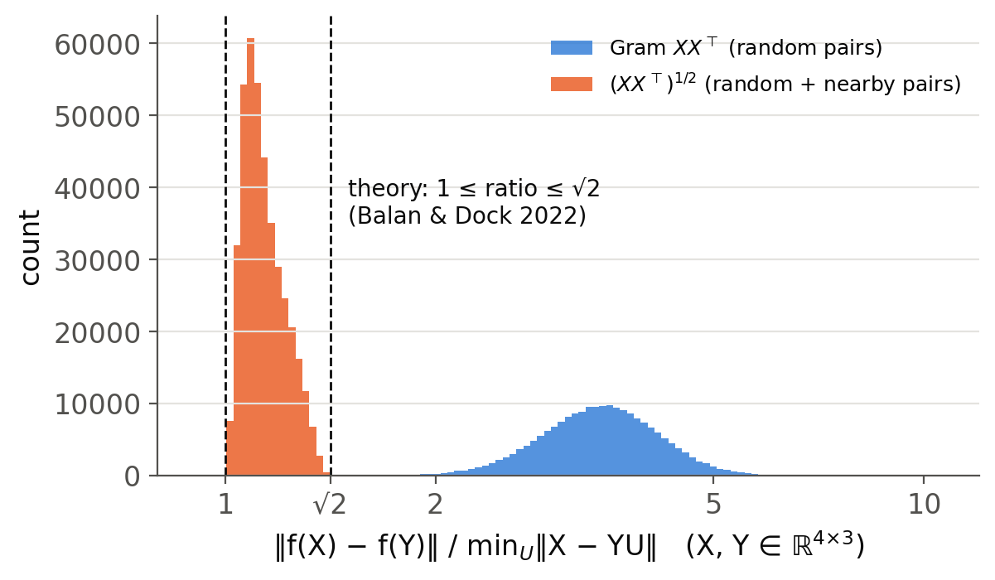
Bilipschitz embedder: θ(X) = (XXᵀ)^(1/2)
Balan & Dock (2022): D(X,Y) ≤ ‖θ(X) − θ(Y)‖ ≤ √2 · D(X,Y), D = minᵤ ‖X − YU‖ (Procrustes distance)
Gram XXᵀ has no such bound: ratio from 1.2 to 8 on random pairs (right)
Implementation: thin SVD X = UΣVᵀ ⇒ θ(X) = UΣUᵀ. Pure JAX, exact, twice differentiable (HNN training needs 2nd derivatives)
Fixed: the earlier torch version crashed inside jax.grad, so no bilipschitz model had actually been trained
200 000 random + 200 000 nearby pairs X, Y ∈ ℝ⁴ˣ³: all ratios in [1.0004, 1.409]
Notes:
The square root of the Gram matrix is bilipschitz with respect to the Procrustes distance, with constants 1 and sqrt 2. The histogram checks this numerically. The 4x4 Gram matrix has rank 3, so we never take the square root of its eigenvalues directly: the thin SVD of X gives the same matrix and has finite derivatives.

Slide 5
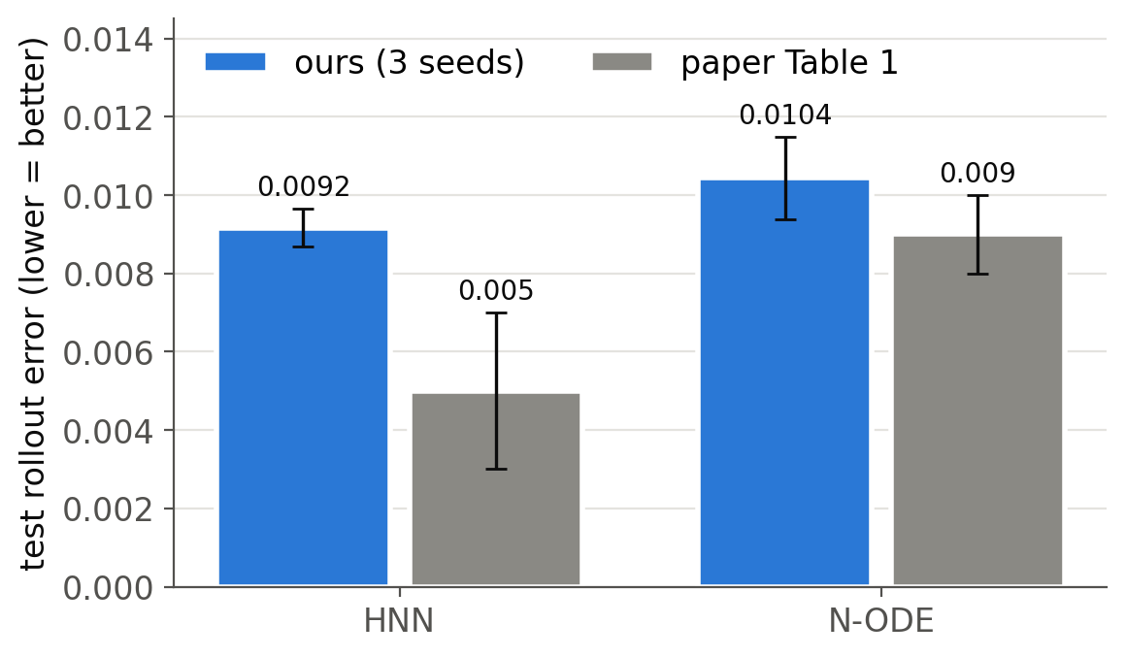
Stage 1: reproducing Yao et al. (2021), Table 1
0.0104
N-ODE, ours (paper 0.009 ± 0.001): within 1 std
0.0092
HNN, ours (paper 0.005 ± 0.002): within 2×
Upstream setting (3 × 100, lr 5e-3, 2000 epochs), 3 seeds. Needed: restoring the upstream Hamiltonian (k₂ instead of ½k₂) and regenerating the data.
Notes:
With the upstream Hamiltonian and hyperparameters, the N-ODE matches the paper within one standard deviation and the HNN is within a factor 2. The branch had a modified Hamiltonian, so all older caches were regenerated.

Slide 6
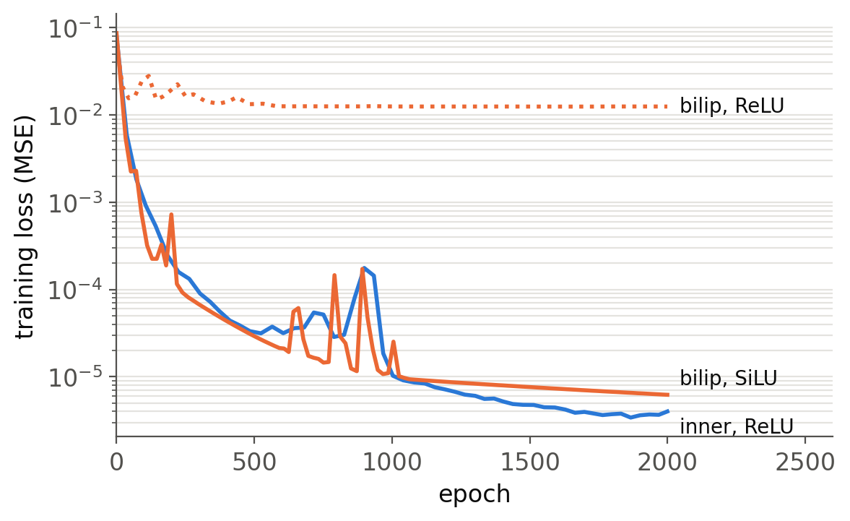
Stage 2: the HNN needs a smooth activation
ReLU: H is piecewise linear in the scalars, so the vector field J∇H is piecewise constant
Inner product: the true H is exactly linear in the scalars (½|p|² is a Gram entry), ReLU is harmless
Square root: |p|² becomes quadratic → loss plateau, rollout error 0.32 for every size / lr
SiLU / softplus: 0.32 → 0.0074 (43× better)
Notes:
With ReLU the bilipschitz HNN never learns (dotted curve), for all 27 grid points. Gradients were checked against float64 finite differences, so this is representational: a ReLU Hamiltonian has a piecewise-constant gradient. Smooth activations fix it.

Slide 7
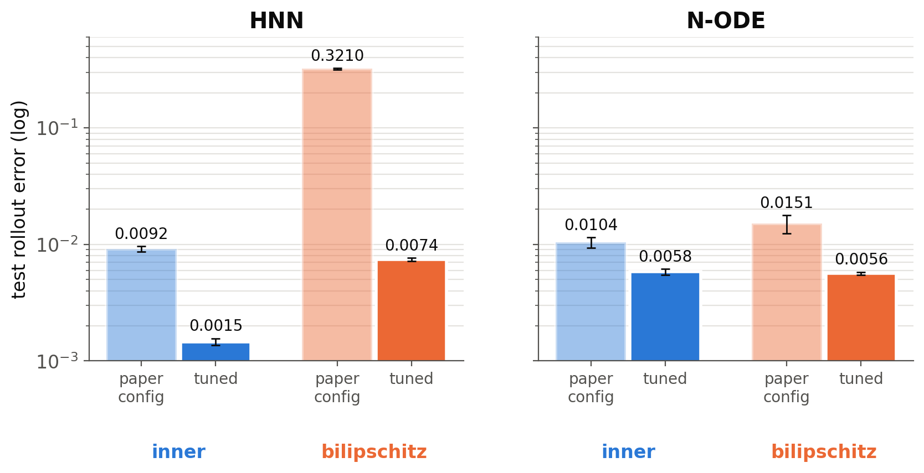
Stage 2: hyperparameter search (212 runs)
Selection on the validation rollout; test numbers only reported. Search: depth {3, 5, 7} × width {100–300} × lr {3e-3 – 5e-2} × activation {ReLU, SiLU, softplus, tanh} × RBF width. Selected: HNN inner 3-100-0.03 ReLU · HNN bilip 3-200-0.02 SiLU · N-ODE inner 7-200-0.02 · N-ODE bilip 7-200-0.005
Notes:
Light bars: paper setting; dark bars: selected configuration, 3 seeds. Tuning also improves the baseline: the HNN reaches 0.0015, three times better than the paper. N-ODE: the bilipschitz embedder is on par with the tuned baseline (0.0056 vs 0.0058). HNN: bilipschitz stays about 5 times worse on clean data.

Slide 8
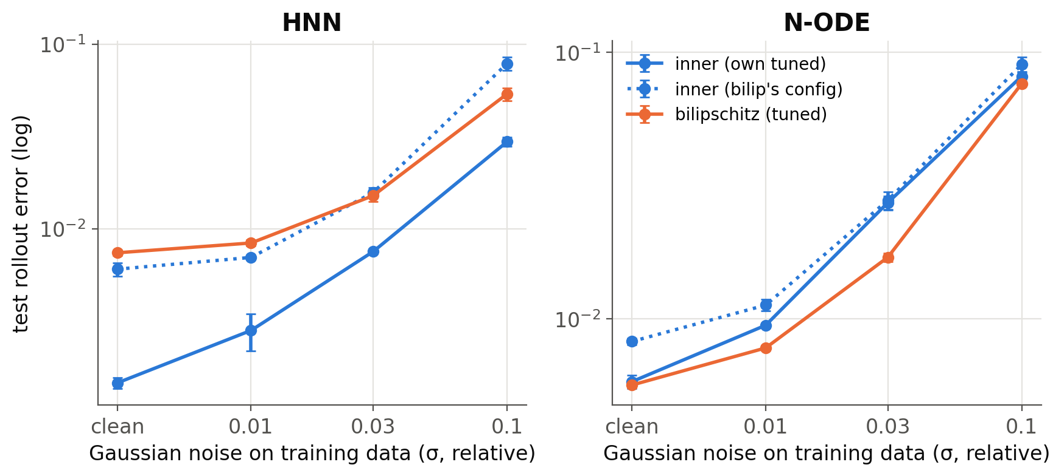
Stage 3: Gaussian noise on the training data
N-ODE: bilipschitz is best at every noise level. HNN: the tuned ReLU inner product stays best, but the bilipschitz model degrades more slowly than the inner product with the same configuration (dotted).
Notes:
Noise with standard deviation sigma times the per-coordinate scale is added to every training state; test data stay clean. Dotted lines are the control: the inner-product model trained with the hyperparameters selected for the bilipschitz model.

Slide 9
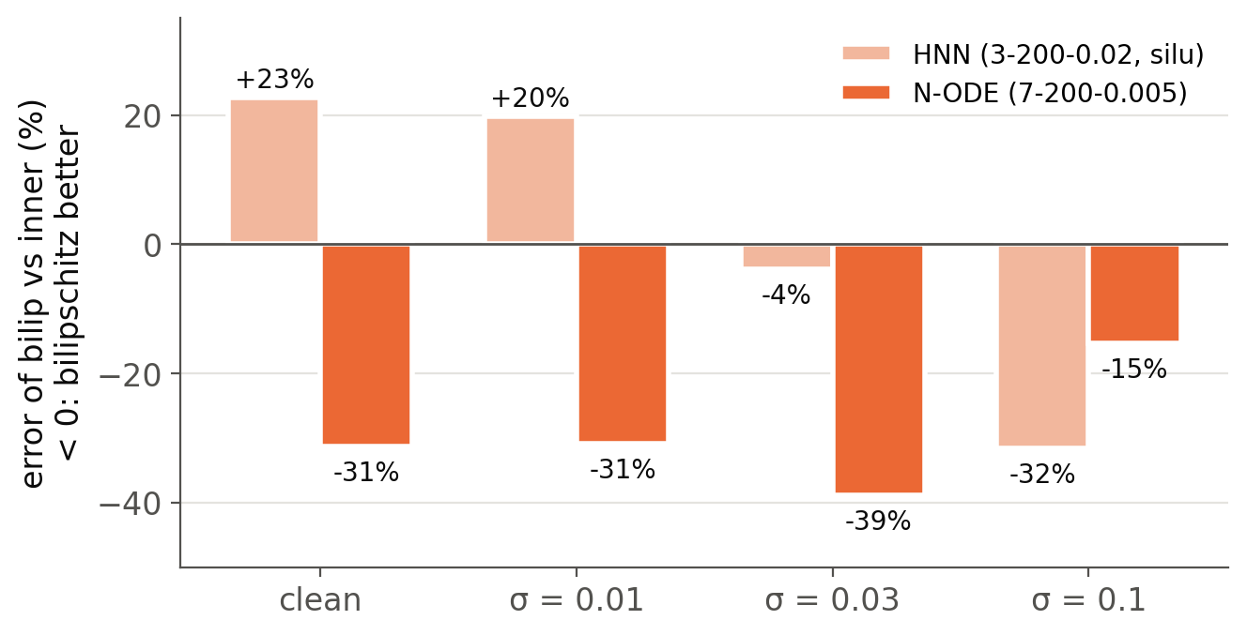
Same hyperparameters: embedding effect alone
−39 %
N-ODE error at σ = 0.03 (−15 to −39 % at every level)
−32 %
HNN error at σ = 0.1 (but +23 % on clean data)
Perturbing test initial conditions instead shows no difference: that error is dominated by the chaotic dynamics.
Notes:
Bars: relative change of the rollout error, bilipschitz versus inner product with identical hyperparameters, 3 seeds each. Apart from the -4 percent point, all differences exceed two standard deviations.

Slide 10
Conclusions and next steps
Findings
Paper reproduced: N-ODE within 1 std, HNN within 2×
N-ODE: bilipschitz scalars match the tuned baseline on clean data and cut the error by 15–39 % under training noise
HNN: needs a smooth activation; 5× worse on clean data (the true H is linear in inner products) but more robust at high noise
Initial-condition perturbations: no effect of the embedding
Next steps
Adversarial attack on initial conditions / training data
Embeddings that keep the linear structure (add squared norms back, θ on a sub-block)
More data seeds and physical systems
Notes:
Summary: the bilipschitz embedder helps the Neural ODE, especially with noisy data, and needs care for the HNN. Code, results and the overview folder are in the repository.

Slide 11
Reference
Paper:
Scalars are universal: Equivariant machine learning, structured like classical physics
https://arxiv.org/pdf/2106.06610
A simple equivariant machine learning method for dynamics based on scalars
https://arxiv.org/pdf/2110.03761
Lipschitz Analysis Of Generalized Phase Retrievable Matrix Frames
https://arxiv.org/pdf/2109.14522

Slide 12
Reference
Github:
Scalar-based multi-layer perceptron models - https://github.com/weichiyao/ScalarEMLP
A Practical Method for Constructing Equivariant Multilayer Perceptrons for Arbitrary Matrix Groups
https://github.com/mfinzi/equivariant-MLP

