Slide 1
Astronomy image restoration
Lu Yi 121090386
Li Junxi 120090124

Slide 2
presentation structure
Motivation
Project pipeline
Restoration results and comparison
Conclusion

Slide 3
Motivation
When we take the astronomy images, we often suffer from different kinds of noise, especially Moire pattern and sine periodic noise because of the special environment of the outer space and the transportation devices. Since we do need clear images for scientific research, it is very critical for us to have powerful denoising algorithms. However, classical algorithms are not necessarily able to deal with all kinds of noise very efficiently. As a result, we want to make some improvement by giving innovative restoration algorithms.

Slide 4
Project pipeline
1 input the images from kaggle/nasa
2 add different noise to the original images, including Moire pattern noise, sine periodic noise, gaussian noise
3 use classical algorithm to remove the noise, such as average filter, inverse filter,Wiener filter
and use PSNR, SSIM to evaluate the quality of denoising
4 use the innovative algorithm defined by ourselves to restore the noisy image, use PSNR, SSIM to evaluate the quality of denoising as well
5 use some way to enhance the derived image slightly(e.g, improve the contrast)
6 do the comparison of the results between classical and innovative algorithms, and give our conclusion

Slide 5
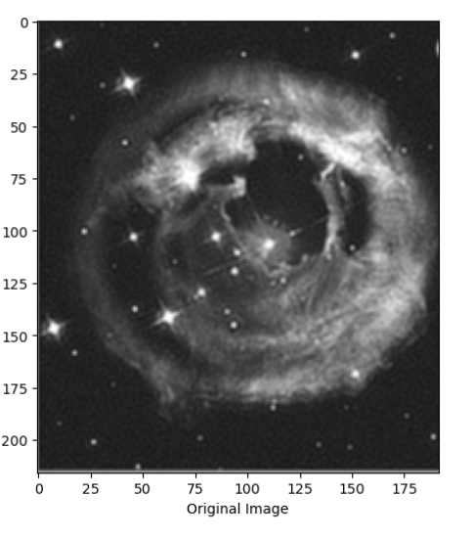
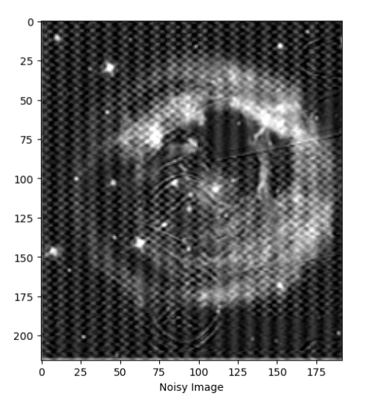
Original image and noisy image
Noise category:
moire pattern,
sine periodic noise,
additive gaussian noise
PSNR: 20.18
SSIM: 0.3469

Slide 6
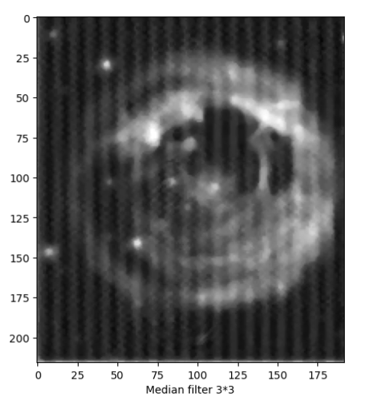
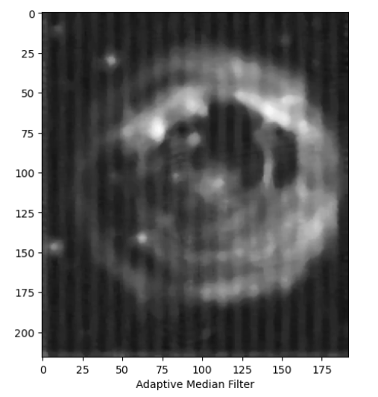

Restored results of classical algorithms in spatial domain
PSNR: 24.73
SSIM: 0.5151
PSNR: 24.13
SSIM: 0.5996
PSNR: 23.14
SSIM: 0.6451

Slide 7
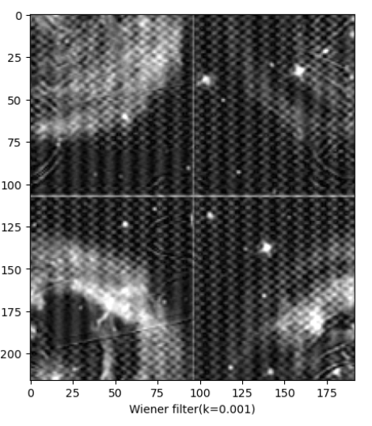
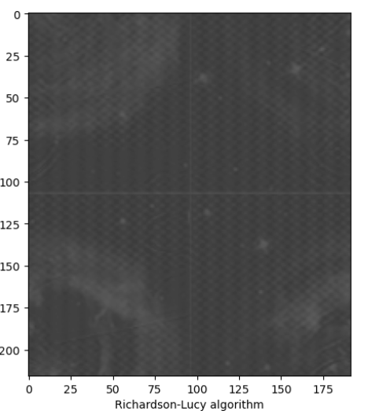
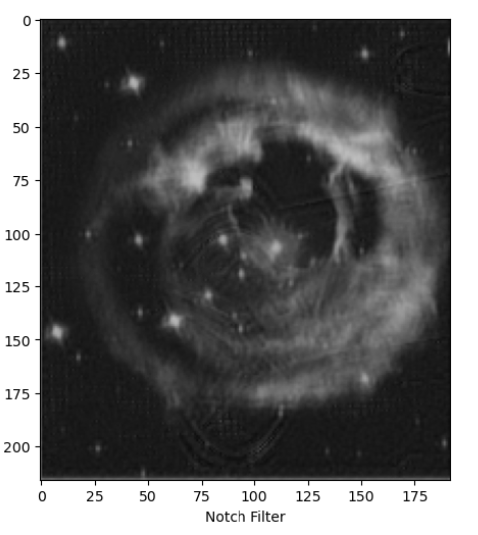
Restored results of classical algorithms in frequency domain
PSNR: 10.75
SSIM: 0.0442
PSNR: 9.98
SSIM: 0.0028
PSNR: 21.40
SSIM: 0.8176

Slide 8
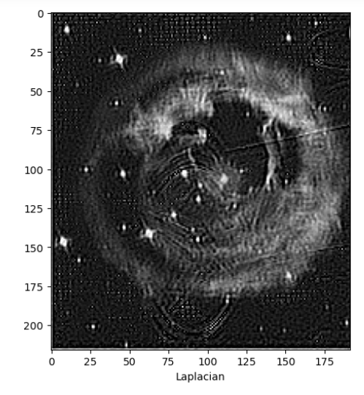
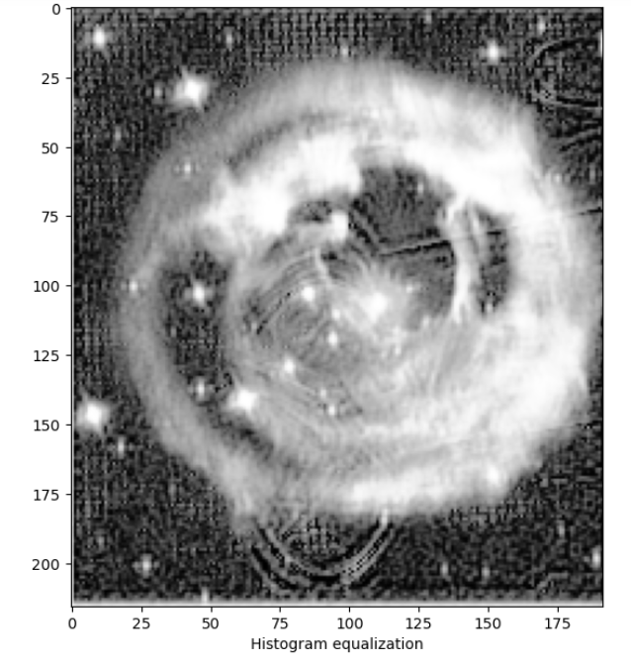
Innovitive algorithm based on the notch filter
PSNR: 21.40
SSIM: 0.8176
PSNR: 16.95
SSIM: 0.4377
PSNR: 10.03
SSIM: 0.0092

Slide 9
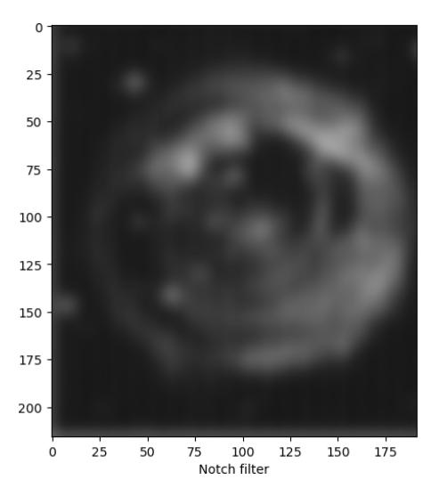
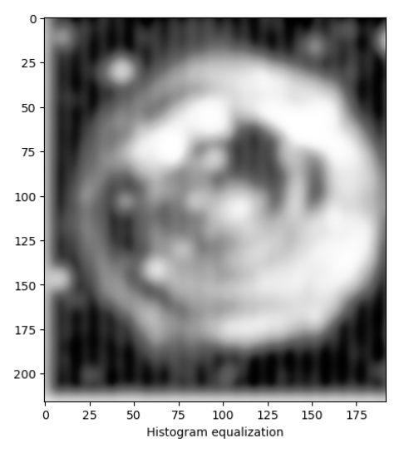
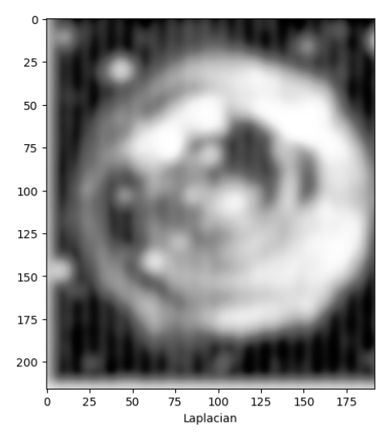
Innovitive algorithm based on spatial domain filters
PSNR: 21.40
SSIM: 0.8176
PSNR: 19.41
SSIM: 0.6034
PSNR: 19.82
SSIM: 0.6257
PSNR: 10.03
SSIM: 0.0087

Slide 10
Conclusion
One of the innovative algorithms gets good result and the other performs worse than the classical ones.
The combination of different algorithms with appropriate order is very critical to restore the image with the better result.
There are still some limitations for our algorithms, and different parameters should be tuned to derive better results for different raw images. Meanwhile, we should also apply different algorithms in face of different kinds of noises.

Slide 11
Thanks for your listening!
Q&A

