Slide 1
数字系统设计
Digital System Design
-----验证与测试
王维东
Weidong Wang
浙江大学信息与电子工程学院
College of Information Science & Electronic Engineering
信息与通信工程研究所
Zhejiang University
Spring 2026 – Lec. #10
Notes:
EE141

Slide 2
任课教师
王维东
浙江大学信息与电子工程学院, 信电楼306
邮箱：wdwang@zju.edu.cn
College of Information Science & Electronic Engineering
Zhejiang University, Hangzhou, 310027
Tel: 86-571-87953170 (O)
Mobile: 13605812196
TA:
    钟睿, 13687791509; 22331166@zju.edu.cn;
    Office Hours：玉泉信电楼 308室（可以钉钉、微信或邮件联系）.
Spring 2026 – Lec. #10
Notes:
EE141

Slide 3
Prerequisites预修课程
电子电路基础
电子线路
C语言
How to learn this Course?
  Not only listening, thinking and waiting ….
  But Exercise, Simulation, Practice!

Slide 4
课程简介
课程代码：671C0050
参考书
  阎石, 《数字电子技术基础》, 第6版, 高等教育出版社, 2016.
  王金明著，《数字系统设计与Verilog HDL》，电子工业出版社，第8版
  《数字系统设计-补充讲义》，浙江大学自编讲义
  Stanford 大学 108A课程notes.
  R.H.Katz, G.Borriello, Contemporary Logic Design, second edition,电子工业出版社, 2005.
  M.M.Mano, 数字设计(第四版), 电子工业出版社, 2010.
    http://www.prenhall.com/mano
Spring 2026 – Lec. #10
Notes:
EE141

Slide 5
Other Course Info
Website:
  http://mypage.zju.edu.cn/wdwd/教学工作/
  学在浙大: 数字系统设计
  Check frequently
答疑
  玉泉信电楼308室/周一周四下午2:30-5:30
  上课课间、课后均可
  Email，钉钉/微信群/数字系统设计，短信均可

Slide 6
Grading (考核)
Final grades will be computed approximately as follows:
平时（含课程作业、期中考试、小测验、Project、出勤等）40%
  期中考试 10%
  Homework Sets 15% (12~20)%
  Project 5% (5~7)%
  Class Room Check+小测验等 10% (7~10)%
  作业每周一上交，截止期为课后一周内有效。
Project
  Project-1必做 (1 members)
  Project-2可选（成绩加分1%~5%，但不超过平时成绩范围）
Finial Exam期末闭卷考试 - 60%
Notes:
上课说明此门课程的成绩合成：平时成绩包括平时小测验、期中考试、作业、出勤、课堂讨论、论文

Slide 7
授课时间和地点：
2025年春夏学期，
  周一上午，第1~2节(8:00-9:35)
  星期四上午，第6~7节(13:25-13:00)
地点：紫金港西2-415(多)
http://mypage.zju.edu.cn/wdwd/教学工作/
学在浙大/数字系统设计
钉钉/微信/数字系统设计-答疑

Slide 8
课程结构
数字理论知识(必备)
  数字系统和编码、逻辑代数、门电路
数字电路分析与设计
  组合逻辑电路
  触发器、半导体存贮器、可编程器件
  时序逻辑电路
脉冲电路与接口
控制器与数字系统
  状态机
  控制器
  微码控制器
  测试和验证
微处理器简介
  指令集
  4位CPU介绍
Spring 2026 – Lec. #10
Notes:
EE141

Slide 9
讲义第九章 验证与测试

Slide 10
9.1 引言
系统可测性设计（design for testability，DFT）
  DFT是整个设计过程一个非常重要的组成部分
  在设计流程中需要尽早考虑
  如果你不测试它，系统很可能不工作
DFT策略
  提供必要的电路
    以使测试过程快速且全面
  提供测试激励矢量
    测试过程需要的
    降低成本
      希望测试序列尽可能短
      但仍能覆盖大部分可能存在的缺陷。

Slide 11
9.2 生产测试过程
诊断测试
  芯片和板级调试期间
  识别和指出失效的部位
    对于给定的失效部件
功能测试
  确定一个制造出的元件是否能工作。
  每一个制造出来的芯片都要经过这一测试
    直接的影响芯片成本
    测试尽可能简单快速
参数测试
  在各种工作条件（如温度和电源电压）下
    检查许多非离散参数，如噪声容限、传播延时和最大时钟频率
  参数测试一般分为静态和动态测试。

Slide 12
9.2.生产测试过程
Introduction
  The fabrication process is one of the most precise manufacturing methods we know of, but it is still not perfect.
  Each time a chip is made, there is a finite chance that at least one of the millions of transistors or wires will have an error in it.
Production test
  Since users of the chips assume that the chip is function, we need to have some method to sort out the function chips from the bad ones.
  a critical part of manufacturin
Design for test.
  Given the complexity of today’s chips, designers need to add features to the chip to make production testing possible.

Slide 13
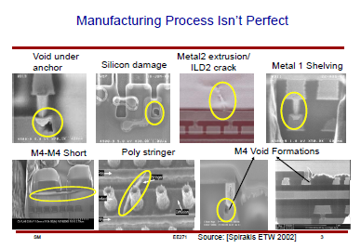

Slide 14
Design Methodology in Detail
Design Specification
Postsynthesis
Design Validation
Design Partition
Postsynthesis
Timing Verification
Design Entry
Behavioral Modeling
Test Generation and
Fault Simulation
Simulation/Functional
Verification
Cell Placement/Scan
Insertation/Routing
Design Integration
And Verification
Verify Physical and
Electrical Rules
Pre-Synthesis
Sign-Off
Synthesize and Map
Gate-level Net List
Synthesize and Map
Gate-level Net List
Design Sign-Off

Slide 15
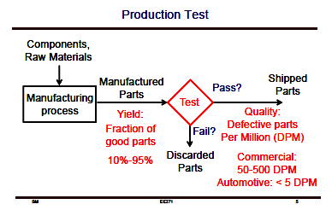
一个典型的生产测试

Slide 16
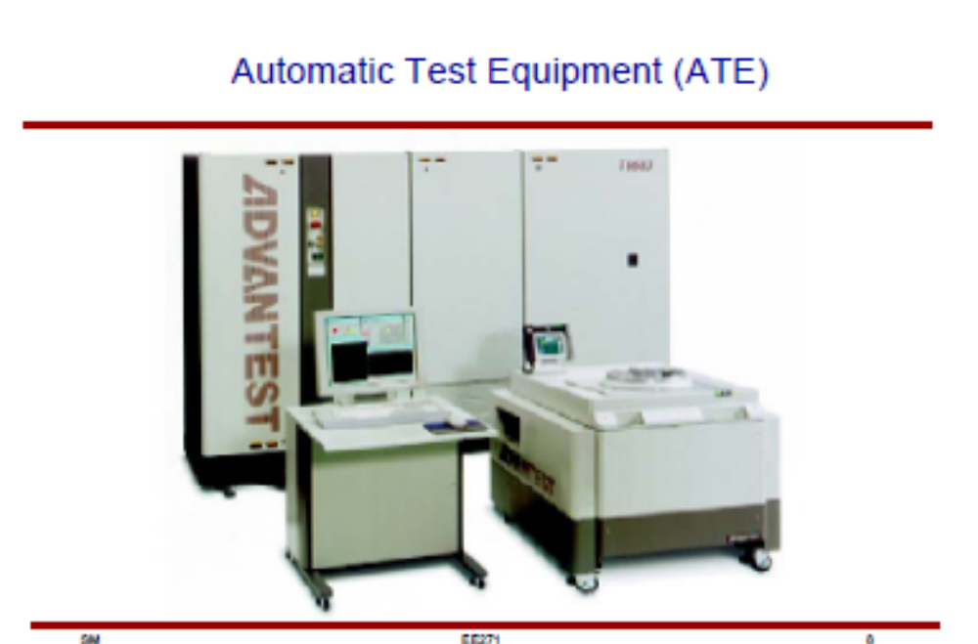
自动测试仪

Slide 17
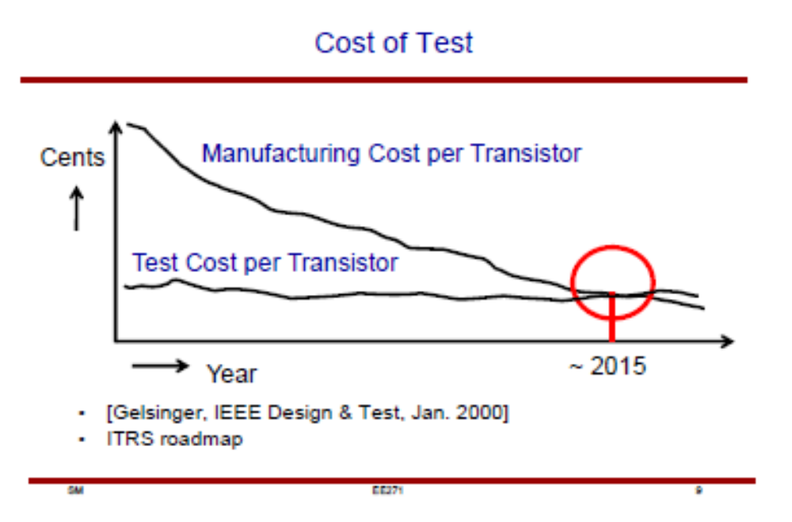

Slide 18
9.3.可测性设计
Testing of Logic Circuits
  Fault Models故障模型
  Test Generation and Coverage
  Fault Detection
  Design for Test
在设计过程的早期考虑测试
  可能简化整个验证过程
  所有可能的输入矢量并观察相应的响应实现
    验证该电路的正确性
Notes:
EE141

Slide 19
Fault Model故障模型
Stuck-At固定故障Model
  Assume selected wires (gate input or output) are “stuck at”固定logic value 0 or 1故障
  Models curtain kinds of fabrication flaws that short circuit wires to ground or power, or broken wires that are floating
    Wire w stuck-at-0: w/0
    Wire w stuck-at-1: w/1
  Often assume there is only one fault at a time—even though in real circuits multiple simultaneous faults are possible and can mask each other
  Obviously a very simplistic model!

Slide 20


Fault Model
Simple example:
Generate a testcase to determine if a is stuck at 1
  Try 000
  If a stuck at 1, expect to see f = 0, but see 1 instead
0
0
0
w₁
w₂
w₃
a/1
b
c
f
see 1
but should be 0
d
0

Slide 21
Fault Model
Simple example
w₁
w₂
w₃
f
a
b
c
d
Test
w1 w2 w3
000
001
010
011
100
101
110
111
Fault Detected
a/0
X
X
X
a/1
X
X
X
b/0
X
b/1
X
c/0
X
c/1
X
d/0
X
d/1
X
X
X
f/0
X
X
X
X
X
f/1
X
X
X
Test
Set

Slide 22
Problems with Fault Model故障模型
In general, n-input circuits require much less than 2^{n} test inputs to cover all possible stuck-at-faults in the circuit
However, this number is usually still too large in real circuits for practical purposes
Finding minimum test cover is an NP-hard problem too（NP难题，non-deterministic polynomial缩写）

Slide 23
Path Sensitization
Wire-at-time testing too laborious
Better to focus on wiring paths, enabling multi-wire testing at the same time
“Activate” a path so that changes in signal propagating along the path affects the output

Slide 24
Path Sensitization
Simple Example:
w₁
w₂
a
b
1
c
w₃
0
f
To activate the path, set inputs so that w₁ can influence f
E.g., w₂ = 1, w₃ = 0, w₄ = 1
AND gates: one input at 1 passes the other input
NOR gates: one input at 0 inverts the other input
To test: w₁ set to 1 should generate f = 0 if path ok
faults a/0, b/0, c/1 cause f = 1
w₁ set to 0 should generate f = 1 if path ok
faults a/1, b/1, c/0 cause f = 0
One test can capture several faults at once!
w₄
1

Slide 25
Path Sensitization
Good news: one test checks for several faults
  Number of paths much smaller than number of wires
  Still an impractically large number of paths for large-scale circuits
Path idea can be used to “propagate” a fault to the output to observe the fault
  Set inputs and intermediate values so as to pass an internal wire to the output while setting inputs to drive that internal wire to a known value
  If propagated value isn’t as expected, then we have found a fault on the isolated wire

Slide 26
Fault Propagation
w₁
w₂
b
b/0
h
g
f
w₃
w₄
c
k
w₁
w₂
0
0
D
D
D
1
f
w₃
w₄
1
1
0
1

Slide 27
Fault Propagation
w₁
w₂
b
h
g
g/1
f
w₃
w₄
c
k
w₁
w₂
0
0
1
D
D
D
f
w₃
w₄
0
0
1
D

Slide 28
Tree Structured Circuits
To test inputs stuck-at-0 at given AND gate
  Set inputs at other gates to generate AND output of zero
  Force inputs at selected gate to generate a one
  If f is 1 then circuit ok, else fault
To test inputs stuck-at-1 at given AND gate
  Drive input to test to 0, rest of inputs driven to 1
  Other gates driven with inputs that force gates to 0
  If f is 0 then OK, else fault
w₁
w₃
w₄
w₂
w₃
w₄
f
w₁
w₂
w₃

Slide 29
Tree Structured Circuits
Product Term
Test
Stuck-at-0
w₁
1
0
0
0
1
1
1
0
w₃
1
1
0
1
0
1
0
0
w₄
1
0
0
1
1
0
0
0
w₂
0
1
1
1
1
0
1
0
w₃
1
1
0
1
0
1
0
0
w₄
0
1
1
0
0
1
1
1
w₁
0
1
1
1
0
0
0
1
w₂
0
1
1
1
1
0
1
0
w₃
0
0
1
0
1
0
1
1
w₁
1
0
0
0
1
1
1
0
w₂
0
1
1
1
1
0
1
0
w₃
0
0
1
0
1
0
1
1
w₄
0
1
1
0
0
1
1
1
1
1
1
0
1
0
0
0
0
w₁
w₃
w₄
1
2
3
4
5
6
7
8
Stuck-at-0
w₂
w₃
w₄
0
0
0
f
0
w₁
w₂
w₃
Stuck-at-1
Notes:
EE141

Slide 30
Tree Structured Circuits
Product Term
Test
Stuck-at-0
w₁
1
0
0
0
1
1
1
0
w₃
1
1
0
1
0
1
0
0
w₄
1
0
0
1
1
0
0
0
w₂
0
1
1
1
1
0
1
0
w₃
1
1
0
1
0
1
0
0
w₄
0
1
1
0
0
1
1
1
w₁
0
1
1
1
0
0
0
1
w₂
0
1
1
1
1
0
1
0
w₃
0
0
1
0
1
0
1
1
w₁
1
0
0
0
1
1
1
0
w₂
0
1
1
1
1
0
1
0
w₃
0
0
1
0
1
0
1
1
w₄
0
1
1
0
0
1
1
1
0
1
0
1
1
1
1
1
0
w₁
w₃
w₄
1
2
3
4
5
6
7
8
Stuck-at-0
w₂
w₃
w₄
0
0
0
f
0
w₁
w₂
w₃
Stuck-at-1
Notes:
EE141

Slide 31
Tree Structured Circuits
Product Term
Test
Stuck-at-0
w₁
1
0
0
0
1
1
1
0
w₃
1
1
0
1
0
1
0
0
w₄
1
0
0
1
1
0
0
0
w₂
0
1
1
1
1
0
1
0
w₃
1
1
0
1
0
1
0
0
w₄
0
1
1
0
0
1
1
1
w₁
0
1
1
1
0
0
0
1
w₂
0
1
1
1
1
0
1
0
w₃
0
0
1
0
1
0
1
1
w₁
1
0
0
0
1
1
1
0
w₂
0
1
1
1
1
0
1
0
w₃
0
0
1
0
1
0
1
1
w₄
0
1
1
0
0
1
1
1
0
0
0
1
0
1
1
1
1
w₁
w₃
w₄
1
2
3
4
5
6
7
8
Stuck-at-0
w₂
w₃
w₄
0
0
0
f
0
w₁
w₂
w₃
Stuck-at-1
Notes:
EE141

Slide 32
Tree Structured Circuits
Product Term
Test
Stuck-at-1
w₁
1
0
0
0
1
1
1
0
w₃
1
1
0
1
0
1
0
0
w₄
1
0
0
1
1
0
0
0
w₂
0
1
1
1
1
0
1
0
w₃
1
1
0
1
0
1
0
0
w₄
0
1
1
0
0
1
1
1
w₁
0
1
1
1
0
0
0
1
w₂
0
1
1
1
1
0
1
0
w₃
0
0
1
0
1
0
1
1
w₁
1
0
0
0
1
1
1
0
w₂
0
1
1
1
1
0
1
0
w₃
0
0
1
0
1
0
1
1
w₄
0
1
1
0
0
1
1
1
0
1
1
1
1
0
1
1
0
w₁
w₃
w₄
1
2
3
4
5
6
7
8
Stuck-at-0
w₂
w₃
w₄
1
0
0
f
1
w₁
w₂
w₃
Stuck-at-1
Notes:
EE141

Slide 33
Tree Structured Circuits
Product Term
Test
Stuck-at-1
w₁
1
0
0
0
1
1
1
0
w₃
1
1
0
1
0
1
0
0
w₄
1
0
0
1
1
0
0
0
w₂
0
1
1
1
1
0
1
0
w₃
1
1
0
1
0
1
0
0
w₄
0
1
1
0
0
1
1
1
w₁
0
1
1
1
0
0
0
1
w₂
0
1
1
1
1
0
1
0
w₃
0
0
1
0
1
0
1
1
w₁
1
0
0
0
1
1
1
0
w₂
0
1
1
1
1
0
1
0
w₃
0
0
1
0
1
0
1
1
w₄
0
1
1
0
0
1
1
1
0
1
1
1
1
0
1
1
0
w₁
w₃
w₄
1
2
3
4
5
6
7
8
Stuck-at-0
w₂
w₃
w₄
0
1
0
f
1
w₁
w₂
w₃
Stuck-at-1
Notes:
EE141

Slide 34
Tree Structured Circuits
Product Term
Test
Stuck-at-1
w₁
1
0
0
0
1
1
1
0
w₃
1
1
0
1
0
1
0
0
w₄
1
0
0
1
1
0
0
0
w₂
0
1
1
1
1
0
1
0
w₃
1
1
0
1
0
1
0
0
w₄
0
1
1
0
0
1
1
1
w₁
0
1
1
1
0
0
0
1
w₂
0
1
1
1
1
0
1
0
w₃
0
0
1
0
1
0
1
1
w₁
1
0
0
0
1
1
1
0
w₂
0
1
1
1
1
0
1
0
w₃
0
0
1
0
1
0
1
1
w₄
0
1
1
0
0
1
1
1
0
1
1
1
1
0
1
1
0
w₁
w₃
w₄
1
2
3
4
5
6
7
8
Stuck-at-0
w₂
w₃
w₄
0
0
1
f
1
w₁
w₂
w₃
Stuck-at-1
Notes:
EE141

Slide 35
Tree Structured Circuits
Product Term
Test
Stuck-at-1
w₁
1
0
0
0
1
1
1
0
w₃
1
1
0
1
0
1
0
0
w₄
1
0
0
1
1
0
0
0
w₂
0
1
1
1
1
0
1
0
w₃
1
1
0
1
0
1
0
0
w₄
0
1
1
0
0
1
1
1
w₁
0
1
1
1
0
0
0
1
w₂
0
1
1
1
1
0
1
0
w₃
0
0
1
0
1
0
1
1
w₁
1
0
0
0
1
1
1
0
w₂
0
1
1
1
1
0
1
0
w₃
0
0
1
0
1
0
1
1
w₄
0
1
1
0
0
1
1
1
1
0
1
1
0
0
0
1
1
w₁
w₃
w₄
1
2
3
4
5
6
7
8
Stuck-at-0
w₂
w₃
w₄
1
0
0
f
1
w₁
w₂
w₃
Stuck-at-1
Notes:
EE141

Slide 36
Tree Structured Circuits
Product Term
Test
Stuck-at-1
w₁
1
0
0
0
1
1
1
0
w₃
1
1
0
1
0
1
0
0
w₄
1
0
0
1
1
0
0
0
w₂
0
1
1
1
1
0
1
0
w₃
1
1
0
1
0
1
0
0
w₄
0
1
1
0
0
1
1
1
w₁
0
1
1
1
0
0
0
1
w₂
0
1
1
1
1
0
1
0
w₃
0
0
1
0
1
0
1
1
w₁
1
0
0
0
1
1
1
0
w₂
0
1
1
1
1
0
1
0
w₃
0
0
1
0
1
0
1
1
w₄
0
1
1
0
0
1
1
1
1
0
1
1
0
0
0
1
1
w₁
w₃
w₄
1
2
3
4
5
6
7
8
Stuck-at-0
w₂
w₃
w₄
0
0
1
f
1
w₁
w₂
w₃
Stuck-at-1
Notes:
EE141

Slide 37
Tree Structured Circuits
Product Term
Test
Stuck-at-1
w₁
1
0
0
0
1
1
1
0
w₃
1
1
0
1
0
1
0
0
w₄
1
0
0
1
1
0
0
0
w₂
0
1
1
1
1
0
1
0
w₃
1
1
0
1
0
1
0
0
w₄
0
1
1
0
0
1
1
1
w₁
0
1
1
1
0
0
0
1
w₂
0
1
1
1
1
0
1
0
w₃
0
0
1
0
1
0
1
1
w₁
1
0
0
0
1
1
1
0
w₂
0
1
1
1
1
0
1
0
w₃
0
0
1
0
1
0
1
1
w₄
0
1
1
0
0
1
1
1
1
1
0
0
1
1
0
0
0
w₁
w₃
w₄
1
2
3
4
5
6
7
8
Stuck-at-0
w₂
w₃
w₄
0
1
0
f
1
w₁
w₂
w₃
Stuck-at-1
Any other stuck-at-1 cases covered?
Notes:
EE141

Slide 38
Tree Structured Circuits
Product Term
Test
Stuck-at-1
w₁
1
0
0
0
1
1
1
0
w₃
1
1
0
1
0
1
0
0
w₄
1
0
0
1
1
0
0
0
w₂
0
1
1
1
1
0
1
0
w₃
1
1
0
1
0
1
0
0
w₄
0
1
1
0
0
1
1
1
w₁
0
1
1
1
0
0
0
1
w₂
0
1
1
1
1
0
1
0
w₃
0
0
1
0
1
0
1
1
w₁
1
0
0
0
1
1
1
0
w₂
0
1
1
1
1
0
1
0
w₃
0
0
1
0
1
0
1
1
w₄
0
1
1
0
0
1
1
1
1
0
0
1
0
1
0
1
1
w₁
w₃
w₄
1
2
3
4
5
6
7
8
Stuck-at-0
w₂
w₃
w₄
0
1
0
f
1
w₁
w₂
w₃
Stuck-at-1
Any other stuck-at-1 cases covered?
Was that case already covered?
Notes:
EE141

Slide 39
Tree Structured Circuits
Product Term
Test
Stuck-at-1
w₁
1
0
0
0
1
1
1
0
w₃
1
1
0
1
0
1
0
0
w₄
1
0
0
1
1
0
0
0
w₂
0
1
1
1
1
0
1
0
w₃
1
1
0
1
0
1
0
0
w₄
0
1
1
0
0
1
1
1
w₁
0
1
1
1
0
0
0
1
w₂
0
1
1
1
1
0
1
0
w₃
0
0
1
0
1
0
1
1
w₁
1
0
0
0
1
1
1
0
w₂
0
1
1
1
1
0
1
0
w₃
0
0
1
0
1
0
1
1
w₄
0
1
1
0
0
1
1
1
0
0
0
0
0
1
1
0
1
w₁
w₃
w₄
1
2
3
4
5
6
7
8
Stuck-at-0
w₂
w₃
w₄
0
0
1
f
1
w₁
w₂
w₃
Stuck-at-1
All inputs stuck-at-1’s covered now
Notes:
EE141

Slide 40
Random Testing
So far: deterministic testing(确定性)
  电路中的同一个缺陷为许多输入图形所覆盖，检测出这样一个缺陷只需要这些矢量中的一个，而其他矢量是冗余的。
Alternative: random testing
  Generate random input patterns to distinguish between the correct function and the faulty function
  放宽必须检测出所有缺陷这一要求可以大大减少矢量的数目。为此一般的测试过程只要求95-99%的故障覆盖率。
Probability
Fault
Detected
Small number of tests
has reasonable
probability of finding
the fault
Number of
Tests

Slide 41
Sequential Testing
Due to embedded state inside flip-flops, it is difficult to employ the same methods as with combinational logic
  为了测试一个状态机中一定的故障仅仅应用正确的输入激励是不够的。
  因为首先必须使这个被测部件处于所希望的状态。这需要应用一系列的输入。同时把电路响应传送到其中的输出上。
  测试一个FSM中的单个缺陷需要一系列的测试向量。
Alternative approach: design for test
  Scan Path technique:
    FF inputs pass through multiplexer stages to allow them to be used in normal mode as well as a special test shift register mode
    在测试过程中把反馈回路断开，从而把时序电路变成组合电路。
  自测试（self-test）

Slide 42
设计可测试性的重要特性
设计可测试性的重要特性
  高的可控性。
    只利用输入引线就可以使一个电路节点进入某一指定状态
    如果只用一个输入向量就可以把一个节点带到任何状态，那么容易控制
    一个具有低可控性的节点或电路需要一个很长的向量序列才能到预期的状态。
  高可观察性
    在输出引线上观察一个节点的值
    对于一个具有高可观察性的节点，可以在输出引线上直接监测到它的值
    一个低可观察性的节点则需要多个周期才能使的状态出现在输出口上。
    当电路的复杂性和引线数目一定时，一个可测电路应当具有较高的可观察性。
专门测试（ad hoc test）
  同应用类型相关
  集合了一些可用来提高设计的可观察性和可控性的技术
额外的I/O引线
  为了减少可能需要的额外压焊块的数目，可以采用在同一个压焊块上分路选择测试信号和功能信号的方法。
  I/O总线在正常工作期间作为数据总线，而在测试期间则用来提供测试图形和收集响应。

Slide 43
Design for Testability
Basic idea
  Convert a sequential circuit into a combinational circuit
    Control every flip-flop content
    Observe every flip-flop output
How?
  Connect flip-flops into one or more shift registers
SCAN Design for Testability (Scan DFT)
Other benefits
  Diagnosis & debug
  Low cost test equipment

Slide 44
Scan Path Technique扫描测试
串联扫描方式
Combinational
Logic
Configure FFs into shift register mode (red path)
Scan in test pattern of 0s and 1s
Non-state inputs can also be on the scan path (think synchronous Mealy Machine)
  激励向量通过引线ScanIn输入逻辑模块
Run system for one clock cycle in “normal” mode (black path)—next state captured in scan path
  结果锁存到寄存器中
Return to shift register mode and shift out the captured state and outputs
  寄存器中的结果通过引线ScanOut送出电路并与期望的数据进行比较。
激励向量

Slide 45
Scan Path Example
w,y1,y2 test vector 001
  Scan 01 into y1, y2 FFs
w
Y₁
Y₂
Scan-out
z
y₁
y₂
0
1
Q
D
Q
Q
D
0
1
Q
0
Scan-in
G/S

Slide 46
Scan Path Example
w,y1,y2 test vector 001
  Scan 01 into y1, y2 FFs
w
Y₁
Y₂
Scan-out
z
y₁
y₂
0
1
Q
D
0
Q
Q
D
0
1
0
Q
1
Scan-in
G/S

Slide 47
Scan Path Example
w,y1,y2 test vector 001
  Scan 01 into y1, y2 FFs
w
Y₁
Y₂
Scan-out
z
y₁
y₂
0
1
Q
D
0
0
Q
Q
D
0
1
1
Q
1
Scan-in
G/S

Slide 48
Scan Path Example
w,y1,y2 test vector 001
  Scan 01 into y1, y2 FFs
  Normal w=0
0
Y₁
Y₂
w
Scan-out
z
y₁
y₂
0
1
Q
D
0
0
Q
Q
D
0
1
1
Q
1
Scan-in
G/S

Slide 49
Scan Path Example
w,y1,y2 test vector 001
  Scan 01 into y1, y2 FFs
  Normal w=0
  Output z=0, Y1=0, Y2=0
0
0
Y₁
Y₂
w
0
0
Scan-out
z
y₁
y₂
0
1
Q
D
0
Q
Q
D
0
1
1
Q
Scan-in
G/S

Slide 50
Scan Path Example
w,y1,y2 test vector 001
  Scan 01 into y1, y2 FFs
  Normal w=0
  Output z=0, Y1=0, Y2=0
  Observe z directly
0
0
Y₁
Y₂
w
0
0
Scan-out
z
y₁
y₂
0
1
Q
D
0
Q
Q
D
0
1
0
Q
Scan-in
G/S

Slide 51
Scan Path Example
w,y1,y2 test vector 001
  Scan 01 into y1, y2 FFs
  Normal w=0
  Output z=0, Y1=0, Y2=0
  Observe z directly
  Scan out Y1, Y2
w
Y₁
Y₂
0
Scan-out
z
y₁
y₂
0
1
Q
D
0
0
Q
Q
D
0
1
0
Q
Scan-in
G/S

Slide 52
Scan Path Example
w,y1,y2 test vector 001
  Scan 01 into y1, y2 FFs
  Normal w=0
  Output z=0, Y1=0, Y2=0
  Observe z directly
  Scan out Y1, Y2
w
Y₁
Y₂
0
Scan-out
z
y₁
y₂
0
1
Q
D
0
Q
Q
D
0
1
0
Q
Scan-in
G/S

Slide 53
Scan Operations
Scan-in: test pattern shifted in
  Apply Test Mode = 1
  Number of clock cycles applied in this mode = number of flip-flops in scan chain (shift register)
• Apply primary inputs
• Capture: combinational logic response to the test pattern captured
in flip-flops
  Apply Test Mode = 0, and 1 or more clock cycles
• Observe primary outputs
• Scan-out: captured response shifted out
  Apply Test Mode = 1
  Number of clock cycles applied in this mode = number of flip-flops In· scan chain (shift register)

Slide 54
部分扫描
并不是设计中所有的寄存器都需要扫描
  流水线寄存器只是为了提高性能，并不增加电路的新状态
  只需使输入和输出寄存器可扫描就可以了

Slide 55
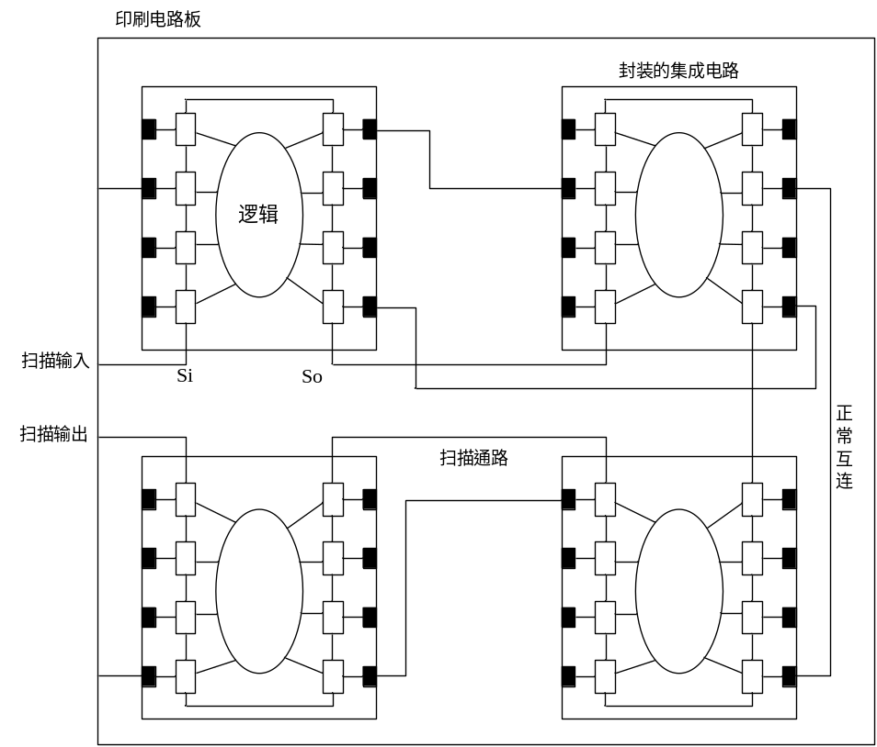
边界扫描设计（boundary scan）
边界扫描
  把一个板上部件的输入-输出引线连接成一条串联的扫描链
  在正常工作时，边界扫描压焊块pads作为正常的输入-输出器件
  在测试模式，向量可以从这些压焊块处扫入扫出，从而在部件的边界上提供可控性和可观察性。
    可以利用各种控制模块来测试各个部件以及板上的互连线。
    这方法的开销是要求稍微复杂一些的输入-输出压焊块以及一个附加的片上测试控制器。
    目前大多数产品部件都提供边界扫描。
板级测试的边界扫描方法

Slide 56
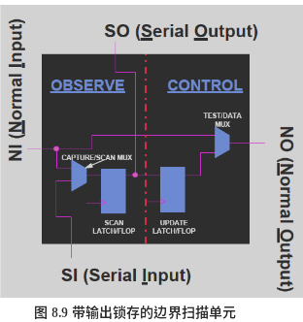
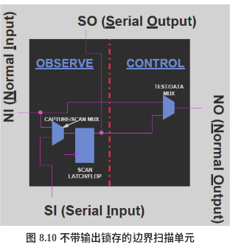
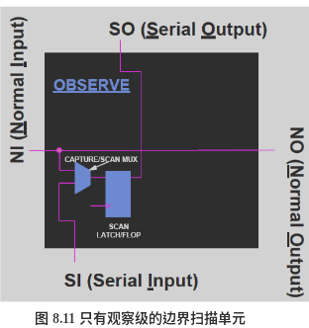
边界扫描链
边界扫描链
  由边界扫描单元串行组成
边界扫描单元
  能够完成对电路节点的控制和观察功能
边界扫描单元的结构

Slide 57
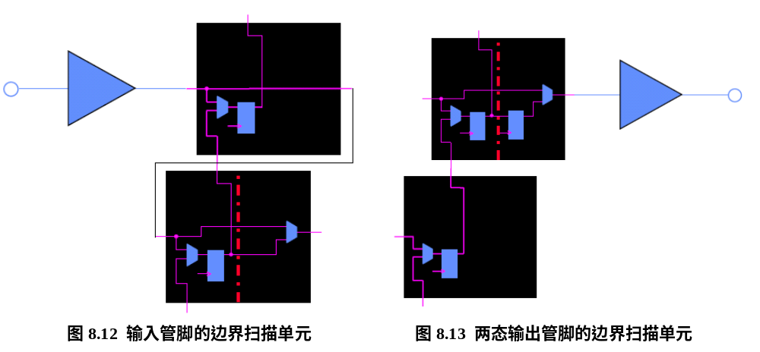
为了实现PCB测试，芯片的边界扫描链要求必须在所有的管脚添加边界扫描单元。
  对于输入管脚、两态输出管脚、三态输出管脚和双向管脚，边界扫描单元添加方式有所不同
    当不实现INTEST指令时，输入管脚的边界扫描单元只用一个观察级的扫描单元即可，
    当需要实现INTEST指令时，还必须添加一个带控制级的扫描单元。

Slide 58
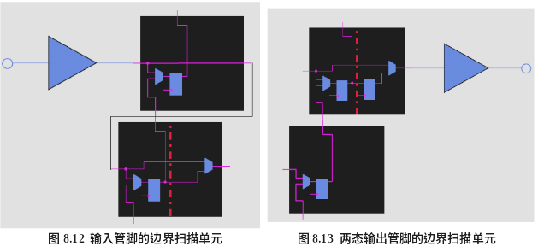
两态的输出管脚必须添加带输出锁存的边界扫描单元

Slide 59
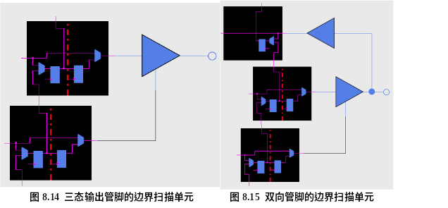
三态输出管脚除了添加带输出锁存的边界扫描单元外，还必须在三态控制信号上也添加一个带输出锁存的边界扫描单元
双向边界扫描单元由一个三态输出扫描单元和一个只带观察级的输入扫描单元组成

Slide 60
边界扫描
除了在管脚上添加边界扫描单元外，为了实现芯片内部的电路级可测试性，还必须在内部的电路节点添加扫描单元。
扫描单元一般添加在寄存器的位置，用带扫描功能的寄存器替换设计中的所有寄存器，即可实现全扫描设计。
全扫描资源消耗很大，同时扫描链过长也使得串行数据扫描的速度急剧下降，使得测试速度变慢。
需要根据电路逻辑结构采用部分扫描设计。

Slide 61
Built-in Self-Test (BIST)内建测试
x₀
.
.
.
x_{n-1}
P₀
.
.
.
P_{m-1}
Test
Vector
Generator
Circuit
Under
Test
Test
Response
Compressor
Signature
内建自测试
  让电路自己生成测试图形
  电路自己能够决定它所得到的测试结果是否正确
Test Vector Generator
  Pseudorandom tests with a feedback shift register
    穷尽测试，所有可以得到的输入信号空间，所有可测的故障都会被检测到。
    对于N值较大的电路，通过整个输入空间的操作所需要的时间是无法接受的。
  Seed generates a sequence of test patterns
  Outputs combined using the same technique
  Generates a unique signature签名 that can be checked to determine if the circuit is correct
原则是应当能得到合理的故障覆盖率

Slide 62

Linear Feedback Shift Register
由多个一位的寄存器串联构成
把这个寄存器初始化为一定的种子值就会产生不同的伪随机序列。
D
Q
D
Q
D
Q
D
Q
有些输出被异或（XOR）并反馈回移位寄存器的输入
Q
Q
Q
Q
Random Test Pattern
P
D
Q
D
Q
D
Q
D
Q
Input from
circuit under test
Q
Q
Q
Q
Signature

Slide 63
Linear Feedback Shift Register
f
D
Q
D
Q
D
Q
D
Q
Q
Q
Q
Q
Initial Configuration
x₃
x₂
x₁
x₀
x₃
x₂
x₁
x₀
f
1
0
0
0
1
1
1
0
0
1
1
1
1
0
1
1
1
1
1
0
0
1
1
1
1
1
0
1
1
0
0
1
0
1
1
1
0
1
0
1
1
1
0
1
0
0
1
1
0
0
0
0
1
1
1
1
0
0
1
0
0
1
0
0
0
0
0
1
0
0
0
0
0
1
1
1
0
0
0
1
…
…
Starting with the pattern 1000种子, generates 15 different patterns in sequence and then repeats
Pattern 0000 is a no-no

Slide 64
Linear Feedback Shift Register
改进的线性反馈移位寄存器
用同一硬件来完成图形生成和信号分析
响应分析器
  将所生成的响应与存放在片上存储器中的预期响应进行比较
  更经济的技术是在对它们进行比较之前把这些响应进行压缩
Multi-input Compressor
  每一个进来的数据字被一个接一个地与LFSR的内容相比较(XOR)。
  在测试序列结束时，LFSR中含有了这个数据序列的签名或特征字，可以用来与正确电路的特征字进行比较。
Signature
D
Q
D
Q
D
Q
D
Q
Q
Q
Q
Q
Circuit Under Test Outputs
P₃
P₂
P₁
P₀

Slide 65
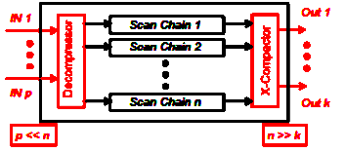
Test Compression
• BIST benefits retained, BIST issues avoided
• MAJOR proliferation in the industry
• Example configurations:
  n = 200, p = k = 15;
  n = 500, p= k = 20;
  n = 1,000, p = k = 50

Slide 66

一位信号流的压缩签名分析器
  响应分析器有一个动态压缩被测电路输出的电路以及一个比较器构成。
  被压缩的输出也常常称为该电路的签名，而整个方法称为签名分析。
  这一电路只是计数输入流中0->1和1->0的翻转数目。这一压缩并不能保证接收到的序列是正确的，也就是说许多不同的序列可以有相同数目的翻转。
  但是翻转数目不对，电路肯定有错。

Slide 67
Test Compression Advantages
• Exponential reduction (50 – 80X, sometimes even more)
  Test data volume, time, pins, tester channels
• High test quality
• X tolerance
  New X-Compactor technique – an example of combining VLSI
with information theory
• Commercial ATPG tool compatibility
• Diagnosis support
• Fault model & test set independence
• Very little area overhead, no extra delay
• Easy automation

Slide 68
Complete Self-Test System
Normal
Inputs
MIC
M
U
X
Combinational
Circuit
Multi-input
Compressor
PRBSG
Scan out
SIC
Random
Test
Sequences
FFs and
Muxes
Single-input
Compressor
Scan in
PRBSG
Random
Test
Sequences

Slide 69

Built-in Logic Block Observer (Bilbo)
内建逻辑块监测器
Test generation and compression in a single circuit!
  M₁, M₂ = 11: Regular mode
  M₁, M₂ = 00: Shift register mode扫描移位寄存器
  M₁, M₂ = 10: Signature generation mode签名分析/模式产生
  M₁, M₂ = 01: Reset mode
1
M₁
P₃
P₂
P₁
P₀
0
M₂
S_{in}
D
Q
D
Q
D
Q
D
Q
1
0
Q
Q
Q
Q
G/S
Q₃
Q₂
Q₁
Q₀
Normal/Scan
S_{out}
Notes:
EE141

Slide 70
Bilbo Architecture
Scan-out
Combinational
Network
CN1
Combinational
Network
CN2
BILBO1
BILBO2
Scan-in
Scan initial pattern in Bilbo1, reset FFs in Bilbo2
Use Bilbo1 as PRBS探测信号 generator for given number of clock cycles and use Bilbo2 to produce signature
Scan out Bilbo2 and compare signature; Scan in initial test pattern for CN2; Reset the FFs in Bilbo1
Use Bilbo2 as PRBS generator for a given number of clock cycles and use Bilbo1 to produce signature
Scan out Bilbo1 and compare signature;
Notes:
EE141

Slide 71
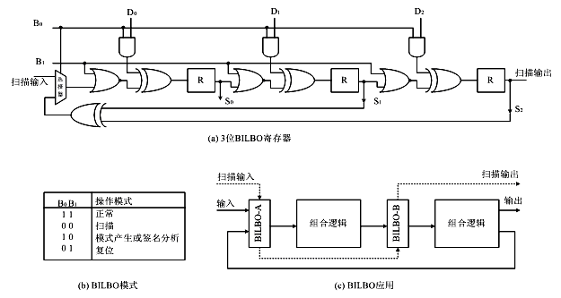
内建逻辑块监测（BILBO）

Slide 72
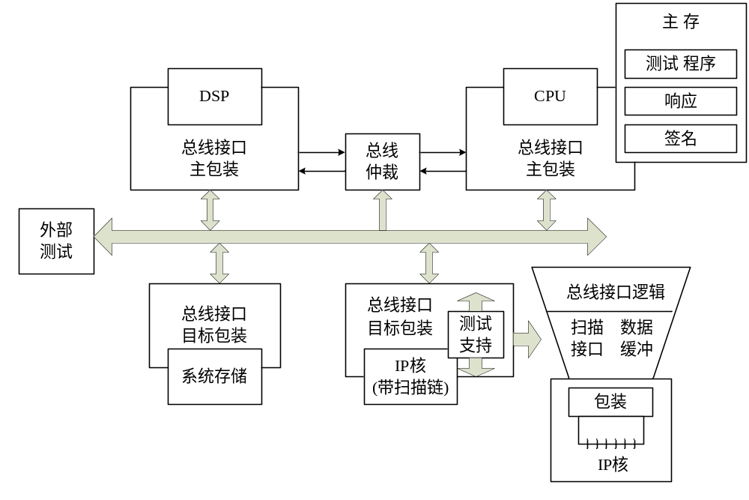
系统芯片测试方法
片上系统时代的到来并未使测试工作变得更简单一些。
内建自测试应当是解决这一问题的惟一方法。
BIST自测试方法允许测试以实际的时钟速度运行，减少了测试时间

Slide 73
Summary
Fault models故障模型
  Approach for determining how to develop a test pattern sequence
  Weakness is the single fault assumption
Scan Path扫描路径
  Technique for applying test inputs deep within the system, usually for asserting state
  Technique for getting internal state to edges of circuit for observation
Built-in Test内建测试
  Founded on the approach of random testing
  Generate pseudo random sequences; compute signature; determine if signature generated is same as signature of a correctly working circuity

Slide 74
课后作业
1）查阅：
  国际电路公司的
    8051，PIC，AVR单片机, ARM，MIPS，DSP等微控制器芯片的型号、类型、速度……
  图书馆资源：电子器件天地, 软件
2）作业：
  见学在浙大题目
3）阅读：
  复习《数字系统设计与Verilog HDL》
  书CH.11
Notes:
EE141

Slide 75
课后作业
4）Project
  Project1（必做）：将讲义P31页图8.33的框图用具体型号的数字集成电路设计实现为具体电路图。（交报告和电路图）
  Project2（选做平时成绩加分）：用具体逻辑电路描述设计并FPGA实现一个4bit简单CPU实物。（期末停课一周前完成）
Spring 2026 – Lec. #10
Notes:
EE141

Slide 76
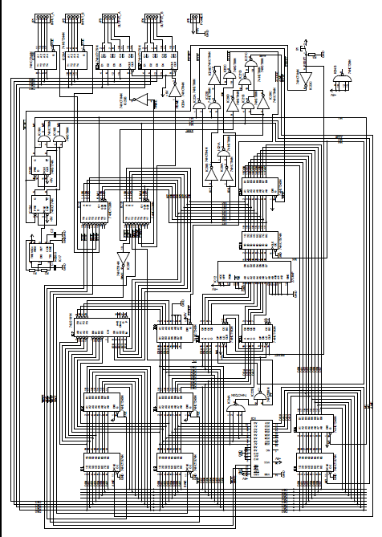
4bit Simple CPU
ALU
时钟
PC计数器
寄存器
程序存储器
寄存器组
总线
Spring 2026 – Lec. #10

Slide 77
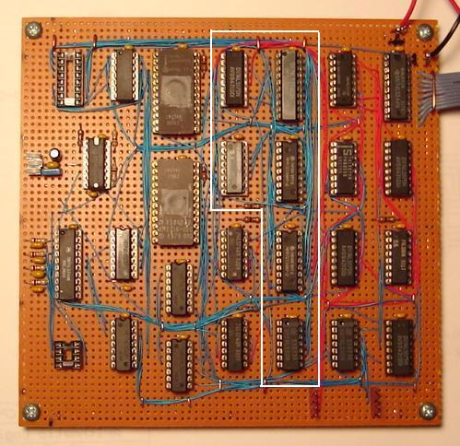
4bit Simple CPU
Spring 2026 – Lec. #10

Slide 78
参考资料
www.ttlcpu.com
Spring 2026 – Lec. #10

