Slide 1
Function Programming Utility (Basic)
Reporter: John

Slide 2
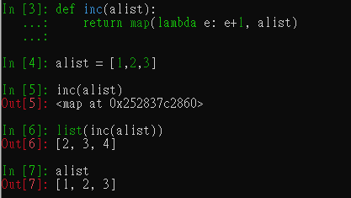
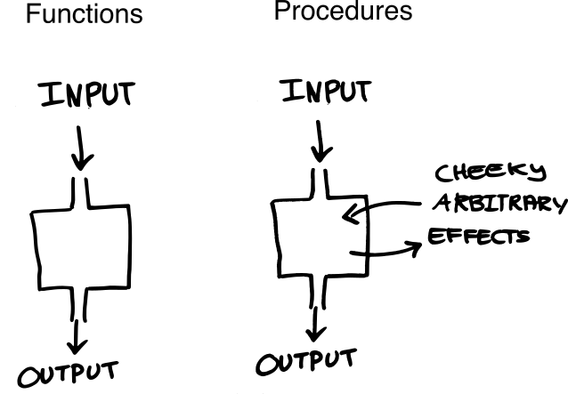
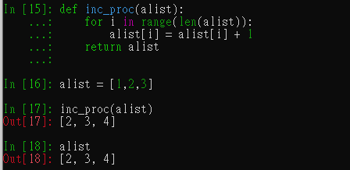
FP Introduction
Functional programming has a long history. In a nutshell, its a style of programming where you focus on transforming data through the use of small expressions that ideally don’t contain side effects. In other words, when you call my_fun(1, 2), it will always return the same result. This is achieved by immutable data typical of a functional language.
Stateful
1/output2/output3/…
(picture source)

Slide 3
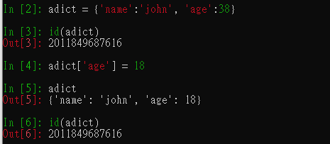
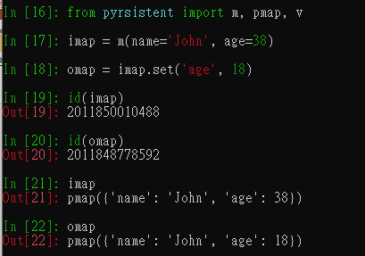
Features of FP
Pure functions without side effects: Discipline and raise a habit
Immutable data structures: Leverage exist python package such as pyrsistent.
Preserve state in functions (Closure, Cury): Solution to get rid of global state.
Recursion instead of loops/iteration: Think of a solution gracefully.
More not to do…

Slide 4
Pro & Con from FP
Advantages of FP
Absence of side effects can make your programs more robust
Programs tend to be more modular come and typically in smaller building blocks
Better testable - call with same parameters always returns same result
Focus on algorithms
Conceptional fit with parallel / concurrent programming
Function composition let you show the code on “what to do” rather than “how to do”
Disadvantages of FP
Solutions to the same problem can look very different than procedural/OO ones
Finding good developers can be hard
Not equally useful for all types of problems
Input/Output are side effects and need special treatment
Recursion is "an order of magnitude more complex" than loops/iterations
Immutable data structures may increase run times

Slide 5

Pro & Con from FP
(Why functional programming matters): What does maintainable code exactly mean, that a software developer candidate needs to have expertise in? How can be a codebase’s resistance to change kept low, so that more and more features can be added without interruptions, and more and more developers can be hired to add new features even faster, and less and less full rewrites are needed, every couple of years?
The key to containing change and thus reducing a codebase’s resistance to it, is to write code that is the theory of a problem domain, instead of being a solution to a specific problem. A theory of a problem domain is basically the most generic domain language, that is sound, and still only allows correct combinations of the building blocks. This way, as a business grows and evolves, new problems and new solutions can be described and expressed by the same language, and thus easily incorporated into the codebase.

Slide 6
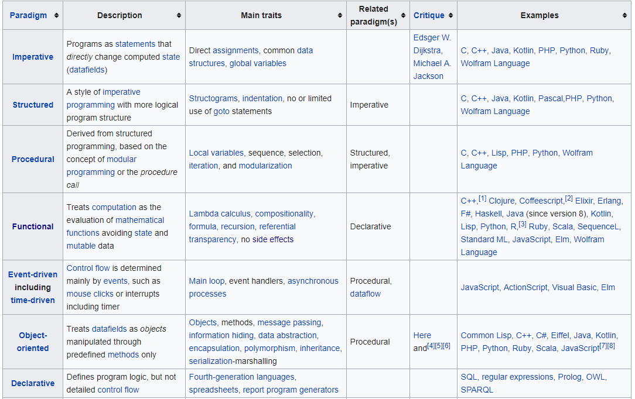

FP Terminology (Imperative vs Declarative)
Declarative vs Imperative (Programming paradigms):
How to do
What to do

Slide 7
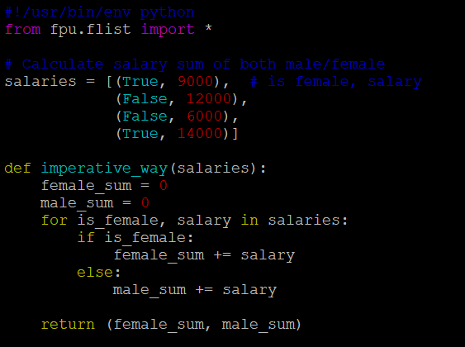
FP Terminology (Imperative vs Declarative)
Declarative vs Imperative (Programming paradigms):
Imperative programming is like building assembly lines, which take some initial global state as raw material, apply various specific transformations, mutations to it as this material is pushed through the line, and at the end comes off the end product, the final global state, that represents the result of the computation. Each step needs to change, rotate, massage the workpiece precisely one specific way, so that it is prepared for subsequent steps downstream. Every step downstream depend on every previous step, and their order is therefore fixed and rigid. Because of these dependencies, an individual computational step has not much use and meaning in itself, but only in the context of all the others, and to understand it, one must understand how the whole line works.

Slide 8
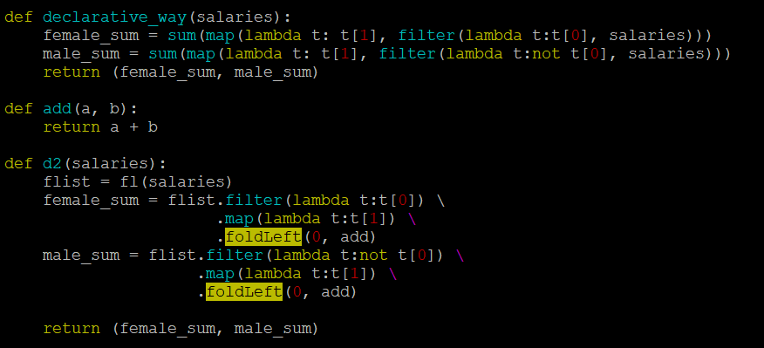
FP Terminology (Imperative vs Declarative)
Declarative vs Imperative (Programming paradigms):

Slide 9
FP Terminology (Imperative vs Declarative)
Declarative vs Imperative (Programming paradigms):

Slide 10
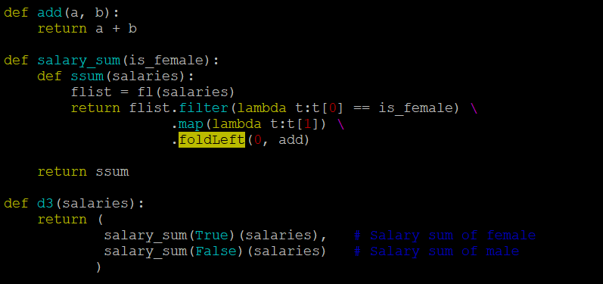
FP Terminology (Imperative vs Declarative)
Declarative vs Imperative (Programming paradigms):

Slide 11
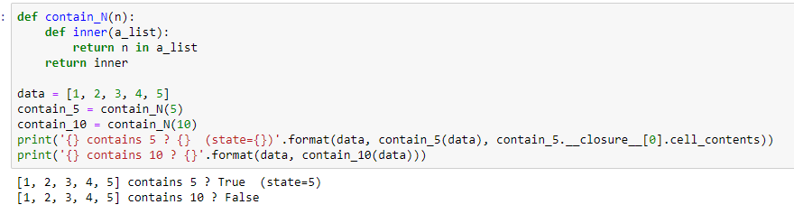
FP Terminology (Closures/Curring)
A Closure is a function which simply creates a scope that allows the function to access and manipulate the variables in enclosing scopes. Normally, you will follow below steps to create a Closure in Python:
We have to create a nested function (a function inside another function).
This nested function has to refer to a variable defined inside the enclosing function.
The enclosing function has to return the nested function

Slide 12
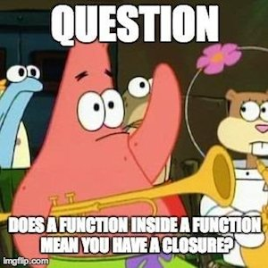
FP Terminology (Closures/Curring)
Even if closures seem pretty interesting (a function returning another function which knows its creation context!) there is another question: where can we utilize closures to make the best of them? Here are a few uses for closures:
Eliminating global variables
Replacing hard-coded constants
Providing consistent function signatures
No, a function inside of a function doesn’t have to reference variables outside of its scope. A closure only exists when a function accesses a variable(s) outside of its immediate scope.

Slide 13
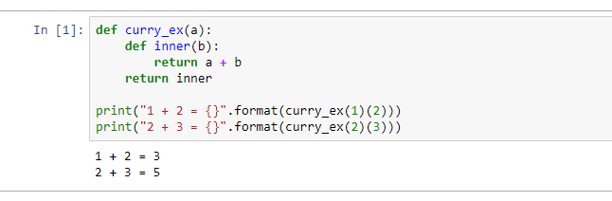
FP Terminology (Closures/Curring)
Currying is like a kind of incremental binding of function arguments. It is the technique of breaking down the evaluation of a function that takes multiple arguments into evaluating a sequence of single-argument functions.
Concept by Haskell Curry
Translating a function that takes multiple arguments into a sequence of functions which all take 1 argument. e.g.: add(a, b) AND add(a)(b)
Improves reusability and composition
In some languages (Haskell, F#) functions are curried by default

Slide 14
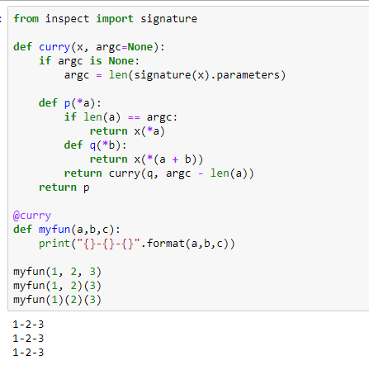
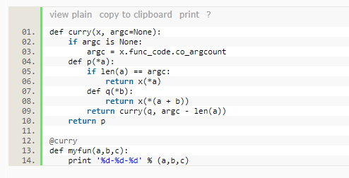
FP Terminology (Closures/Curring)
However, Python doesn't support Curring well. So you have to use decorator technique to get around it. One example:
(Python2)
(Python3)
(stackoverflow)

Slide 15
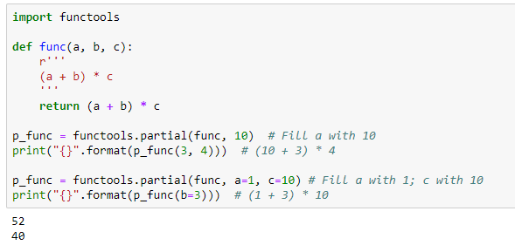
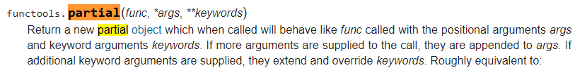
FP Terminology (Partial application)
Partial application allow one to derive a function with x parameters to a function with fewer parameters and fixed values set for the more limited function. Module functools offers some tools for the functional approach.

Slide 16
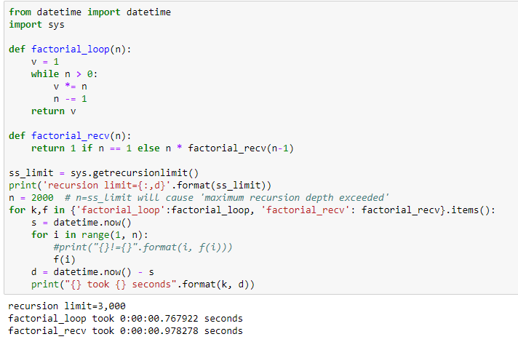
FP Terminology (Recursion)
FP favors recursion over for/while loop. The best example to adopt recursion is to calculate factorial (e.g.: 5!=5*4*3*2*1):

Slide 17
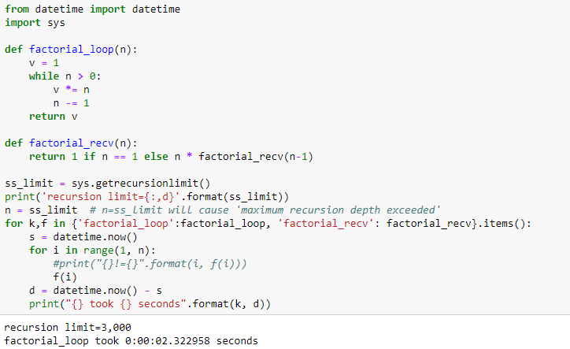
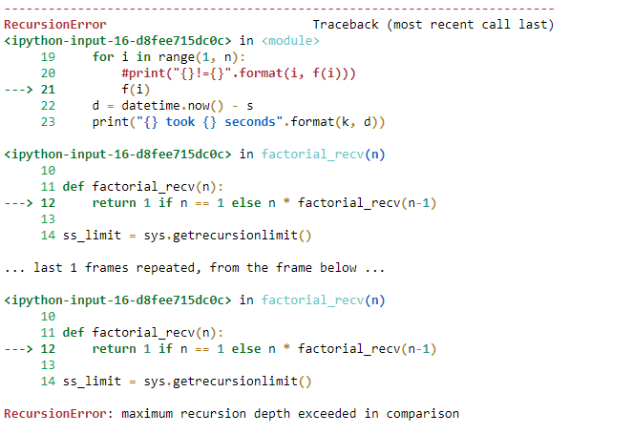
FP Terminology (Recursion)
FP favors recursion over for/while loop. The best example to adopt recursion is to calculate factorial (e.g.: 5!=5*4*3*2*1):

Slide 18
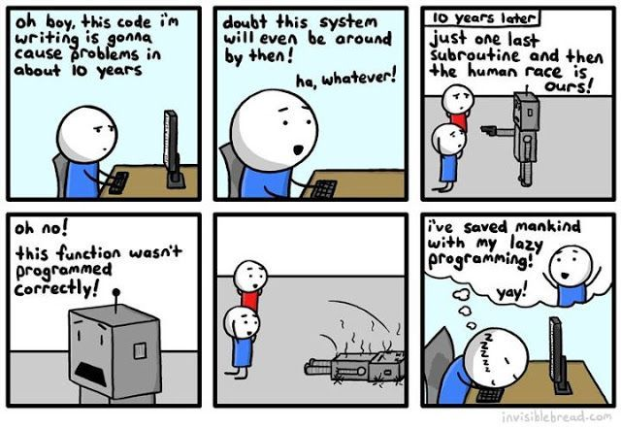
FP Terminology (Lazy Evaluation)
When applied to method arguments, strictness means that arguments are evaluated as soon as they’re received by the method. Laziness means that arguments are evaluated only when they’re needed (Lazy Evaluation). Of course, strictness and laziness apply not only to method arguments, but to everything:
Iterators and generators
Saves memory and possibly CPU time
Working with infinite data structures
(Laziness driven programming)

Slide 19
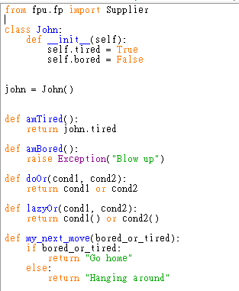
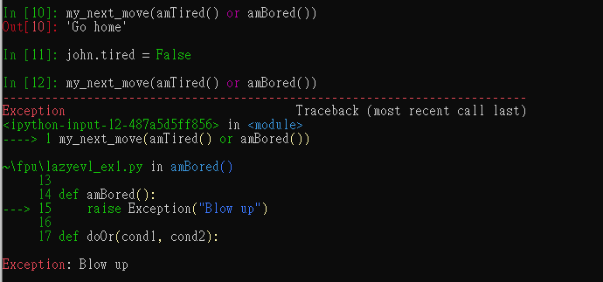
FP Terminology (Lazy Evaluation)
Let’s take a look at first usage of “Lazy Evaluation”:
short-circuit

Slide 20
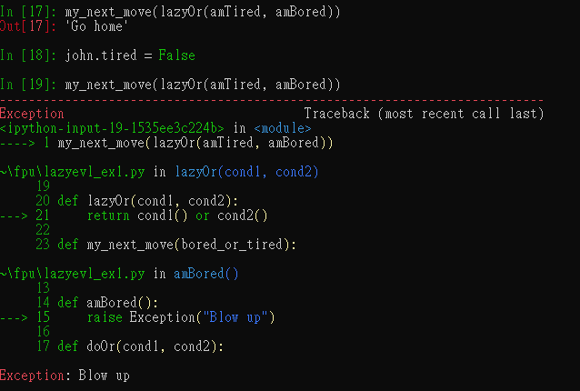
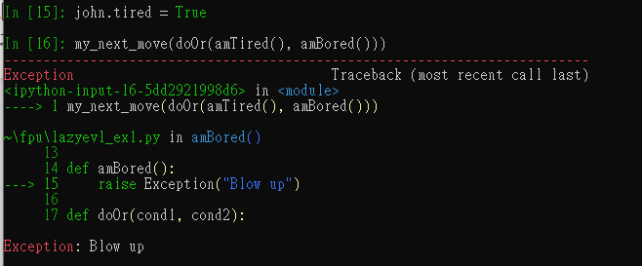


FP Terminology (Lazy Evaluation)
Let’s take a look at first usage of “Lazy Evaluation”:

Slide 21
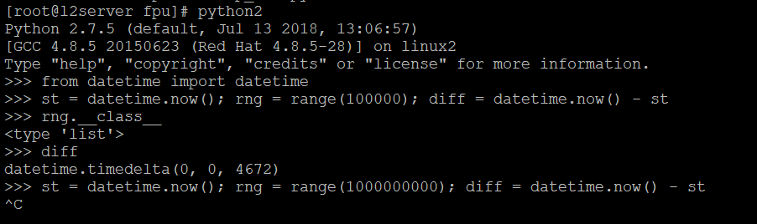
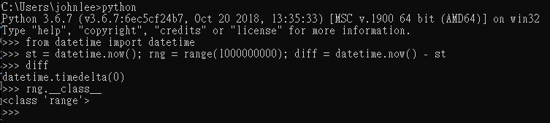
FP Terminology (Lazy Evaluation)
Another usage of “Lazy Evaluation” is for infinite data structures (generator):
(Iterator & Generator)

Slide 22
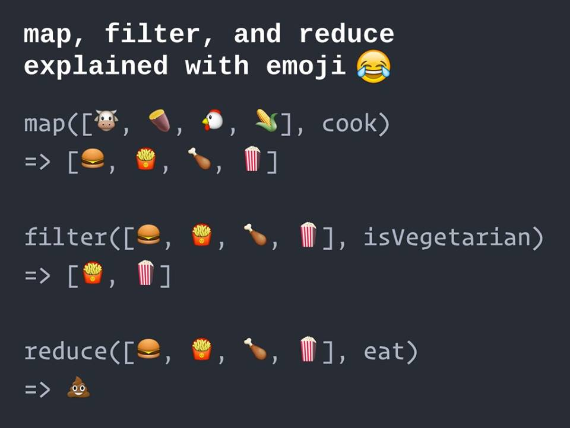
Built-in FP in Python (filter, reduce and map)
Here we will going to introduce some built-in FP functions in Python.
(Picture source)

Slide 23
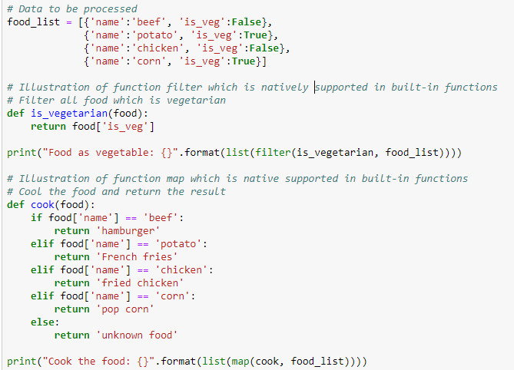
Built-in FP in Python (filter, reduce and map)
All is well explained except “reduce”. Let’s check the easy ones:

Slide 24
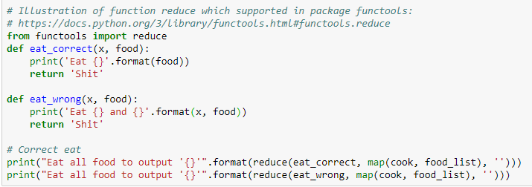
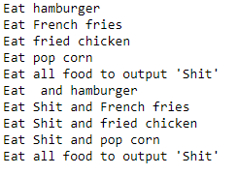
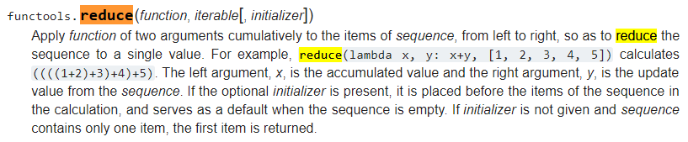
Built-in FP in Python (filter, reduce and map)
Then is the subtle one:

Slide 25
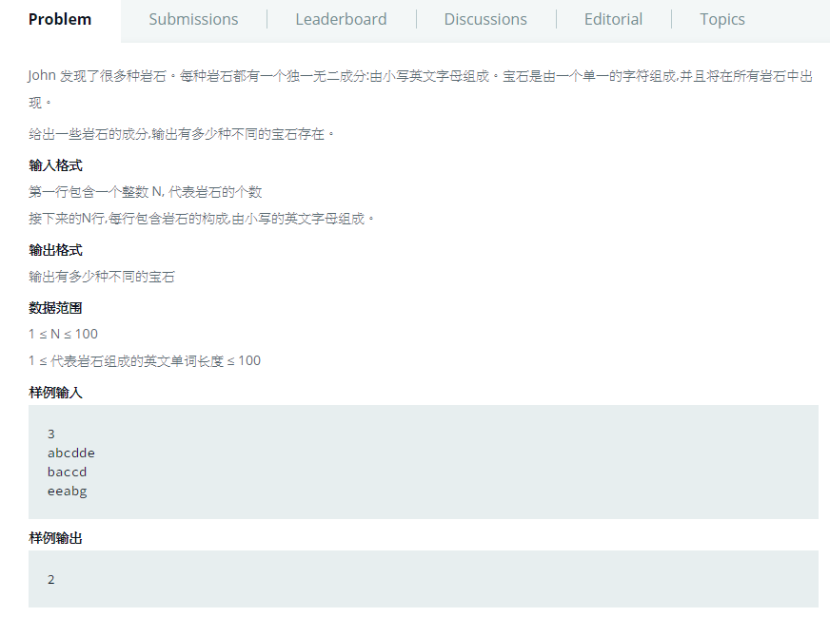

HackerRank Sample (gem-stones)
Source link:

Slide 26
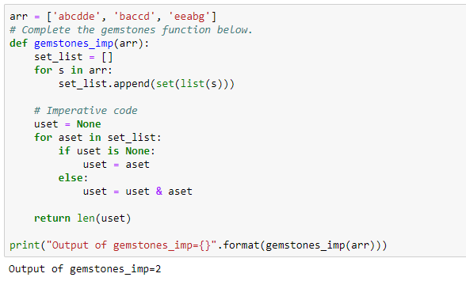
HackerRank Sample (gem-stones)
Source link: Imperative approach
1) Collect unique element of each rock
2) Keep calculating overlap of two set to find
element exist in all rock.

Slide 27
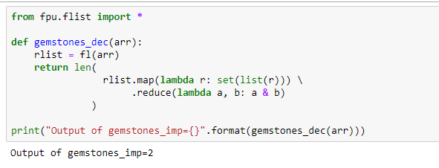
HackerRank Sample (gem-stones)
Source link: Declarative approach

Slide 28
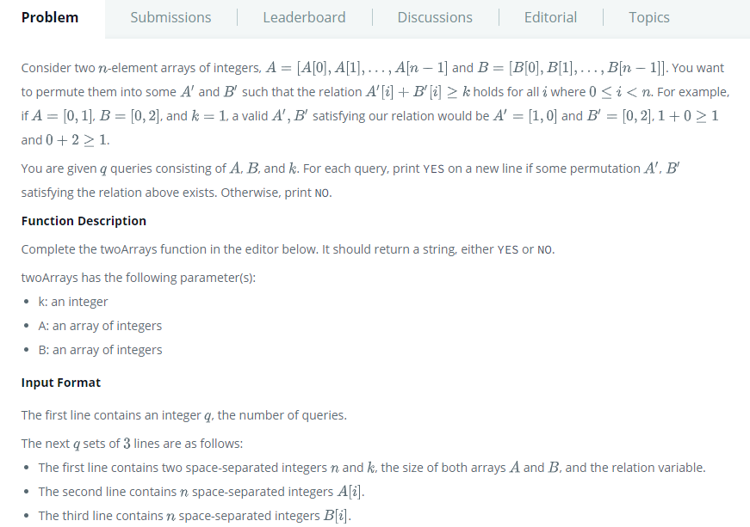
HackerRank Sample (Permuting Two Arrays)
Source link:

Slide 29
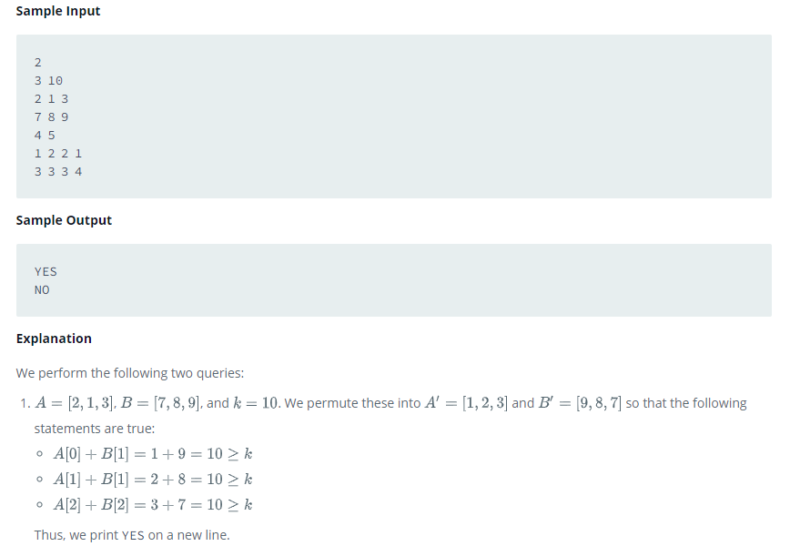
HackerRank Sample (Permuting Two Arrays)
Source link:

Slide 30
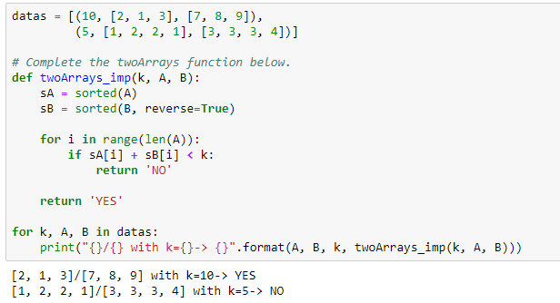
HackerRank Sample (Permuting Two Arrays)
Source link: Imperative approach

Slide 31
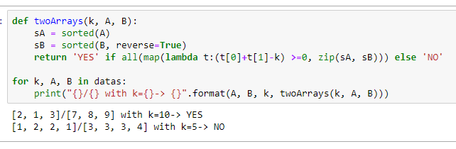
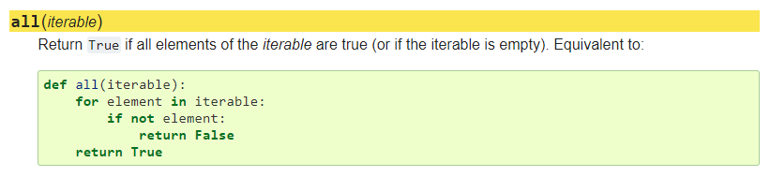
HackerRank Sample (Permuting Two Arrays)
Source link: Declarative approach

Slide 32
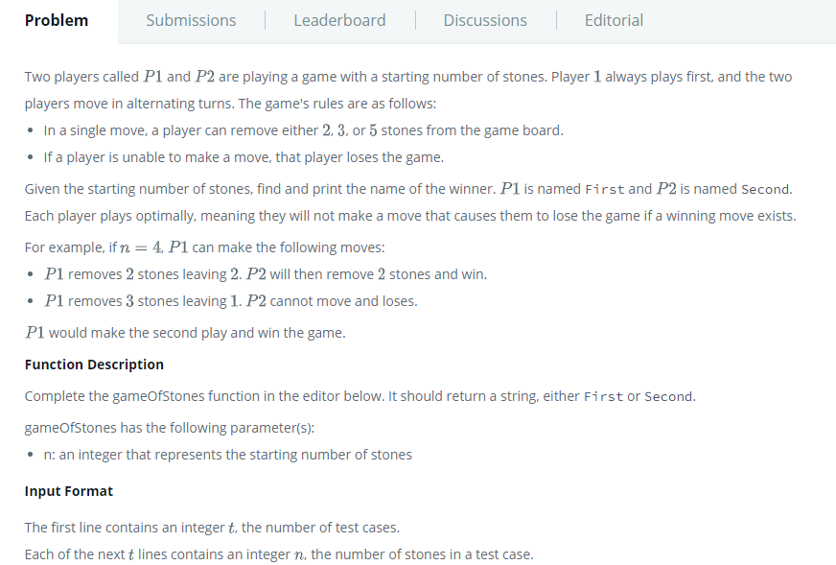
HackerRank Sample (Game of Stones)
Source link:

Slide 33
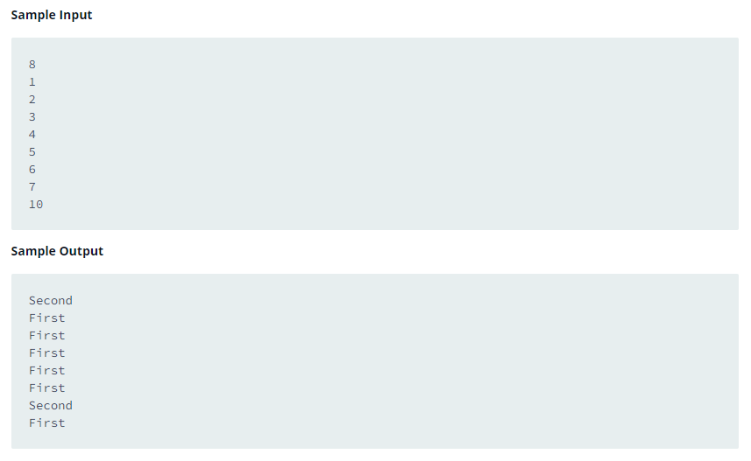
HackerRank Sample (Game of Stones)
Source link:
Second win cause 1 not in [2, 3, 5]
First win by removing 2 stones and left 0 stone.
First win by removing 2 stones and left 1 stone.
First win by removing 3 stones and left 1 stone.
First win by removing 5 stones and left 0 stone.
First win by removing 5 stones and left 1 stone.
Second win:
0 | 1 | 2 | 3 | 4 | 5 | 6 | 7
S | S | F | F | F | F | F | S
2
3
5
None of available move can reach “S”!

Slide 34
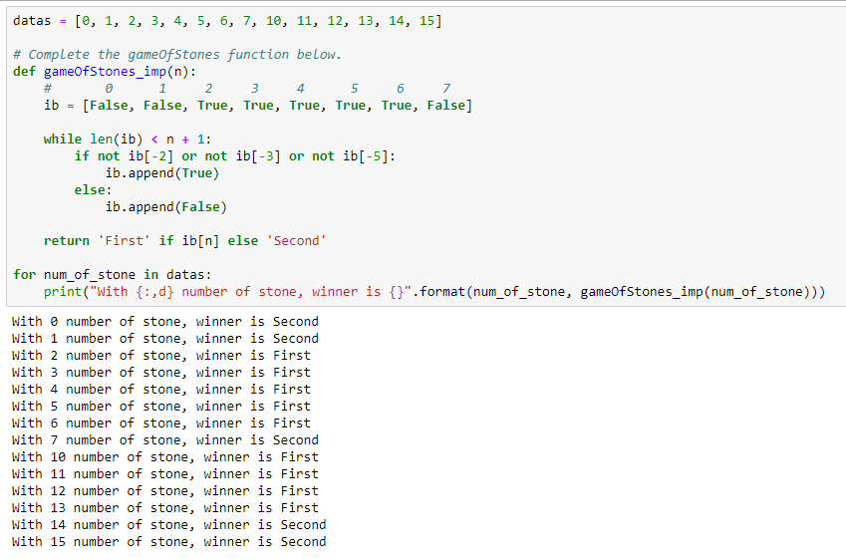
HackerRank Sample (Game of Stones)
Source link: Imperative approach

Slide 35
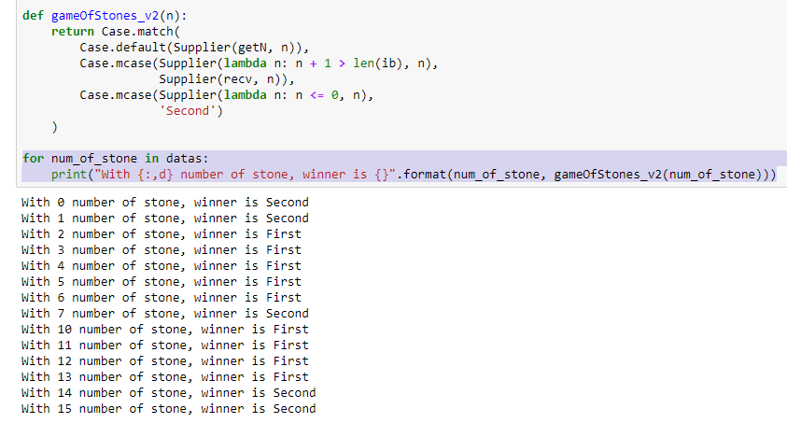
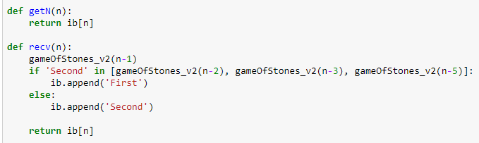
HackerRank Sample (Game of Stones)
Source link: Declarative approach

Slide 36
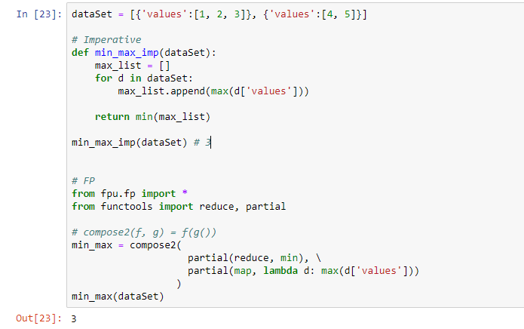
Summary
FP is one kind of programming paradigm with long history. There are both advantages/disadvantages in it and we can leverage the best part of it under suitable occasion to write graceful code.
Less variables and more reusable code:
Code that can not be reused out side function:min_max_imp

Slide 37
Appendix
Slidshare - Functional Programming Principles & Patterns
Functional Programming with Python
What pure functional programming is all about: Part 1.
Why functional programming matters
Why Functional Programming Language?
Others

Slide 38

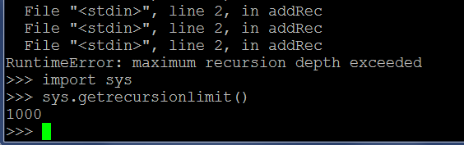

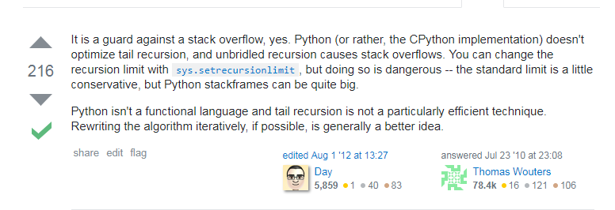
RuntimeError: maximum recursion depth exceeded
What is the maximum recursion depth in Python, and how to increase it?

Slide 39
TailCall - Abstracting recursion
Corecursion is composing computing steps by using the output of one step as the input of the next one, starting with the first step. Recursion is the same operation, but starting with the last step. In recursion, you have to delay evaluation until you encounter a base condition (corresponding to the first step of corecursion).
What you have to do is create a function or a method returning a non-evaluated step. To represent a step in the calculation, you’ll use an abstract class called TailCall (because you want to represent a call to a method that appears in the tail position).
This TailCall abstract class has two subclasses. One represents an intermediate call, when the processing of one step is suspended to call the method again for evaluating the next step. This is represented by a subclass named Suspend. It’s instantiated with Supplier<TailCall>>, which represents the next recursive call.
The second subclass represents the last call, which is supposed to return the result, so you’ll call it Return. It won’t hold a link to the next TailCall, because there’s nothing next, but it’ll hold the result.

Slide 40
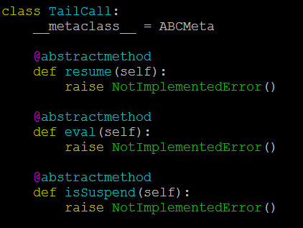
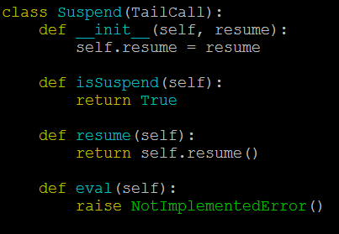
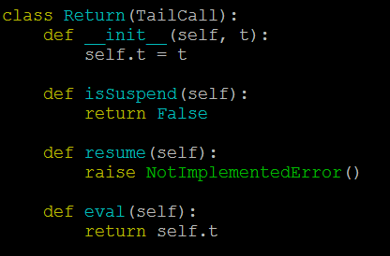
TailCall – Suspend/Return

Slide 41

TailCall – Rewrite add()
Corecursion is composing computing steps by using the output of one step as the input of the next one, starting with the first step. Recursion is the same operation, but starting with the last step. In recursion, you have to delay evaluation until you encounter a base condition (corresponding to the first step of corecursion).

Slide 42
TailCall – Rewrite add()
Corecursion is composing computing steps by using the output of one step as the input of the next one, starting with the first step. Recursion is the same operation, but starting with the last step. In recursion, you have to delay evaluation until you encounter a base condition (corresponding to the first step of corecursion).

Slide 43



TailCall – Enhancement

Slide 44

TailCall – Practice
Fibonacci numbers (Recursive version)

