Slide 1
Comp7940 Presentation
Prepared by Group 19
Name: YU YUK CHUN ID: 22458379

Slide 2

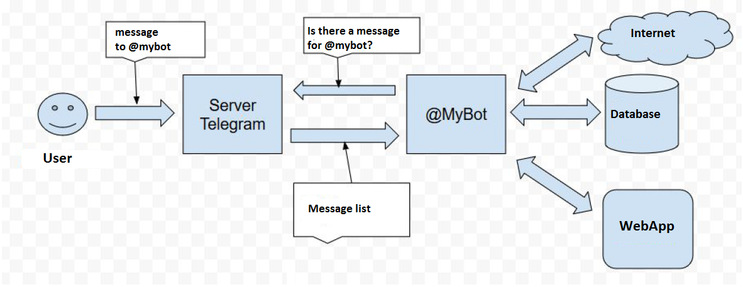
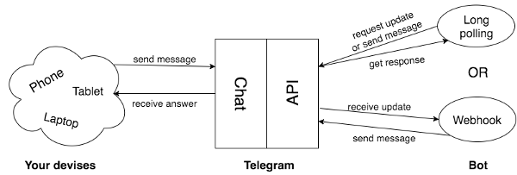
About our Telegram ChatBot

Slide 3
The ChatGPT API can interact with the Telegram platform and MongoDB.
This is done by sending HTTP requests to the API endpoint and receiving responses in JSON format.
A script can be written in a programming language such as Python or JavaScript to send messages from a Telegram bot to the ChatGPT API.
The script can also store the response from the ChatGPT API in a MongoDB database.
Data from the MongoDB database can be used to generate more personalized responses from the ChatGPT API.

Slide 4
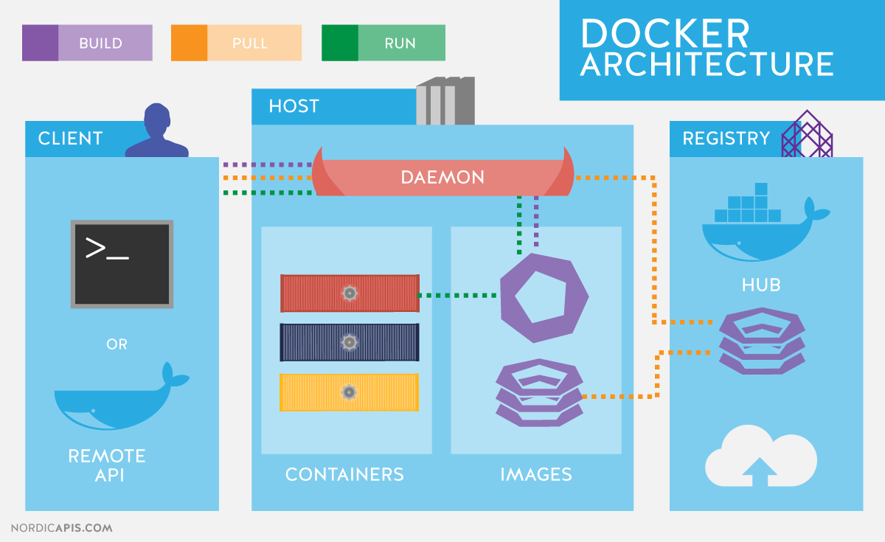

The flow of using Docker and ACI together typically involves the following steps:
The application was packaged into a Docker container using a Dockerfile.
The Docker image was then pushed to an Azure Container
The container image is then deployed to an Azure Container Instance using the Azure
ACI takes care of provisioning the resources needed to run the container and starts it up

Slide 5
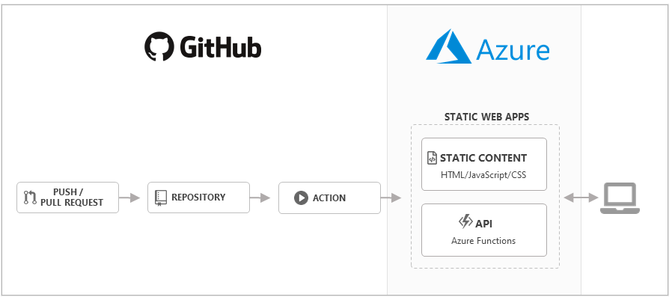
GitHub that allowed us to automate our software development workflows.
With the Azure Web Deploy action, we could automate our workflow to deploy custom containers to App Service using GitHub Actions.
A workflow was defined by a YAML file in the /.github/workflows/ path in our repository. The file had three sections: Authentication, Build, and Deploy. It retrieved credentials, built the container image, and deployed it.

Slide 6
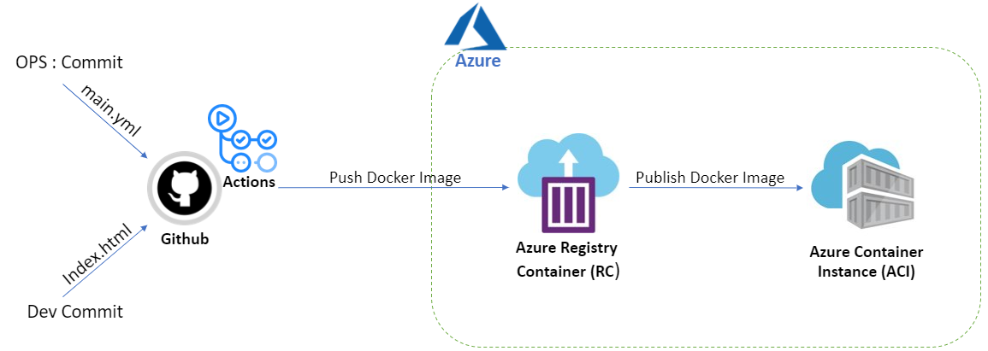
Upon pushing code changes to a GitHub repository, a GitHub Actions workflow is initiated. This workflow constructs a Docker image from the source code and subsequently transfers it to an Azure Container Registry. The image can then be deployed to an Azure Web App for Containers.

Slide 7
Discuss how Docker contexts can be used to deploy an app to the cloud by creating an Azure Container Instances (ACI) context. You could explain how to check what contexts you have by looking at the CONTEXTS section of the Docker view in Visual Studio Code and how to create an ACI context by selecting View > Command Palette and entering Docker Contexts: Create Azure Container Instance Context.

Slide 8
References
“karfly/chatgpt_telegram_bot: A simple Telegram bot that uses OpenAI’s GPT-3 to generate human-like responses to messages. (https://github.com/karfly/chatgpt_telegram_bot)”

