Slide 1
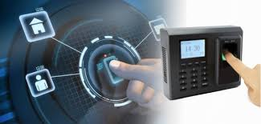
Information Systems Auditing

Slide 2

Introduction
DevElite
Growing IT Solution Startup
located at a commercial building in Central
Open office
Services
Consultancy
Software development
Hardware deployment & maintenance

Slide 3
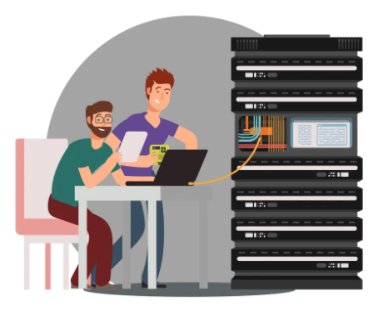
Physical Control
Server
Weakness
Server located at open area
Risk
Potential lost or damage on server
Current control
Security guards and fire alarm system
Proposed control:
HVAC system and UPS system
server rental services

Slide 4

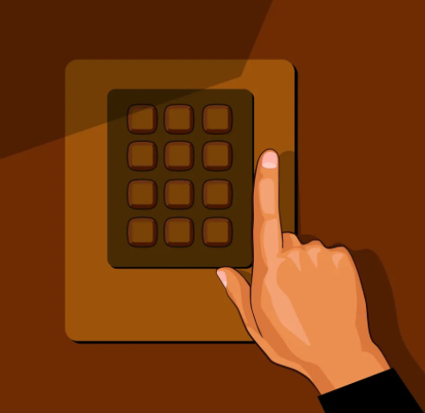
Physical Control
Hardware
Weakness: Hardware disposal by reselling
Risk: Company data will be retrieved/recovered from hard disk
Current control: Erasing hard disk
Proposal control:
Degaussing
avoid reselling hard disk
Weakness : Keypad lock system
Risk : Unauthorized access or theft due to compromised passcode
Current control : Annual passcode change
Proposed control : Smart card system

Slide 5
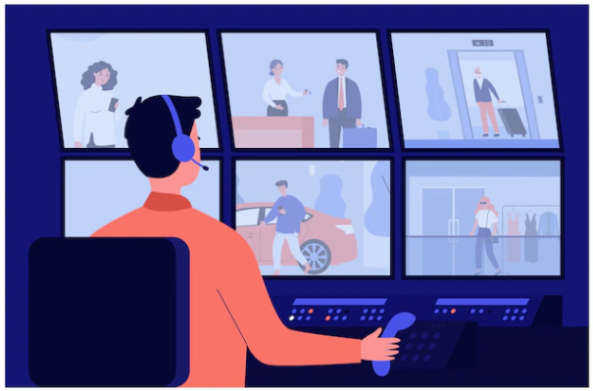
Physical Control
CCTV
Weakness
CCTV tapes is stored locally in office
Risk
Tapes will be damage lost in case of disaster or theft
Current Control
N/A
Proposal control
Cloud storage and local copy in parallel

Slide 6
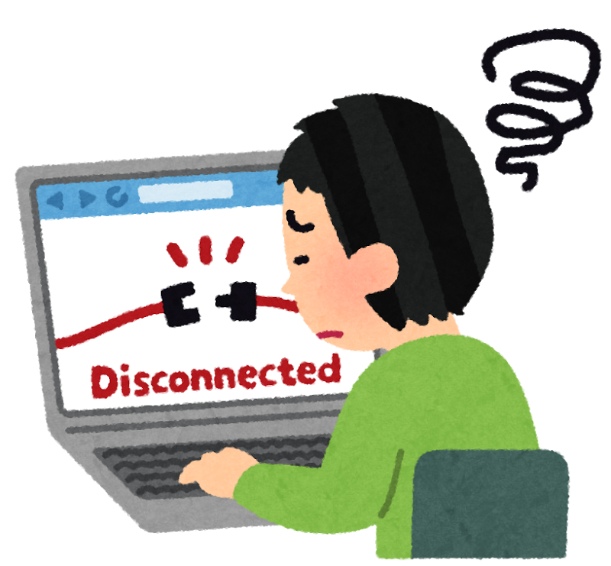
Infrastructure Resilience
Internet Connection
Weakness: Single internet connection
Risk: Loss of Internet connection
Internal staff cannot access the Internet
External customers cannot access the company website
Current corrective control: personal mobile and data plan to process emails
Proposed control: install a backup Internet link
Notes:
Picture source: https://cdn-ak.f.st-hatena.com/images/fotolife/w/wanichan/20170725/20170725163643.png

Slide 7
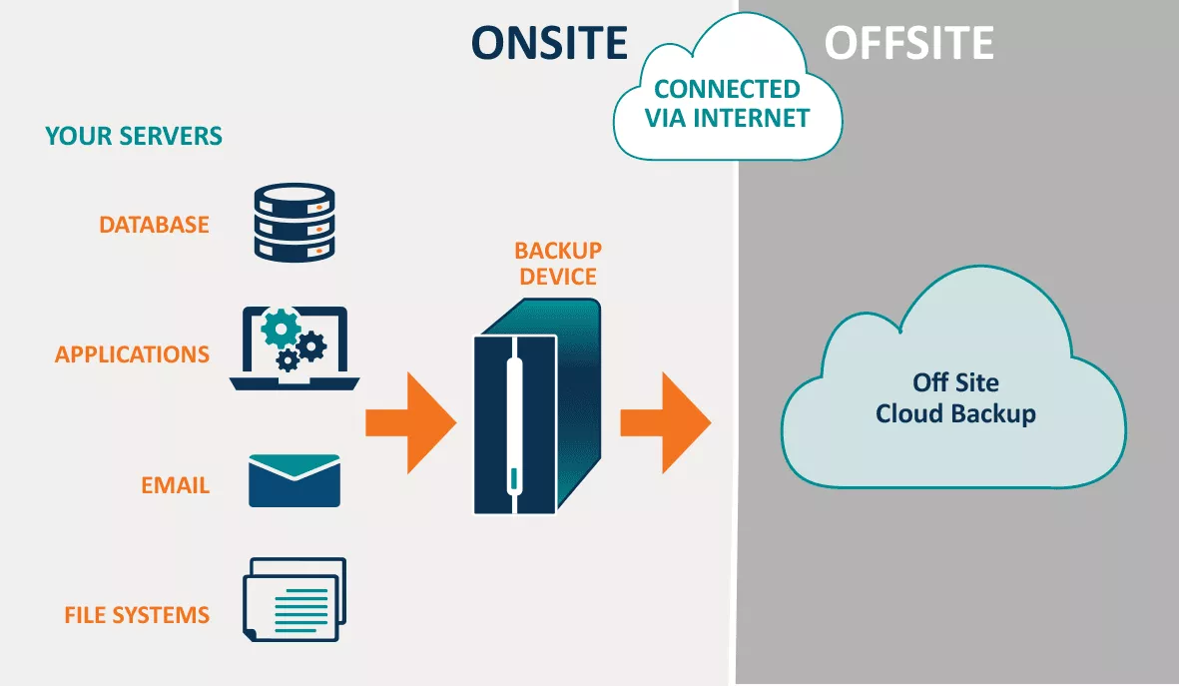
Infrastructure Resilience
Local data backup
Weakness: no offsite backup
Risk: Loss of data due to site disaster like fire accidents or flooding, no regular data restoration exercise to verify backup data integrity
Current preventive control: store backup data in a local server
Proposed control:
use dedicated backup software and hardware or cloud backup solution
store the backup data offsite
perform regular data verification exercises
Notes:
Picture source: https://cdn-bolfm.nitrocdn.com/mWgYjbaMRWDNjecvpTWonpPocStwNRqT/assets/static/optimized/rev-f48e0a3/wp-content/uploads/cloud-backup-diagram.png

Slide 8
Recovery Procedure
Begin recovery restoring files from backup
Change all password
Communicate with clients affected by letting them know what happened and how you are fixing it
Acquire the services of an IT expert or a forensic expert who can find, analyze and preserve electronic equipments to analyze precisely what happened.

Slide 9

Software development Development circle
Weakness
No dedicated testing team to evaluate the products
Risk
Have bugs, performance & security loopholes at products due to poor QC
Current Practice
Developers shared testing & support workloads
Develop and test at their own device
Proposal Control
Separate testing and support role from development
Setup isolated testing environment

Slide 10
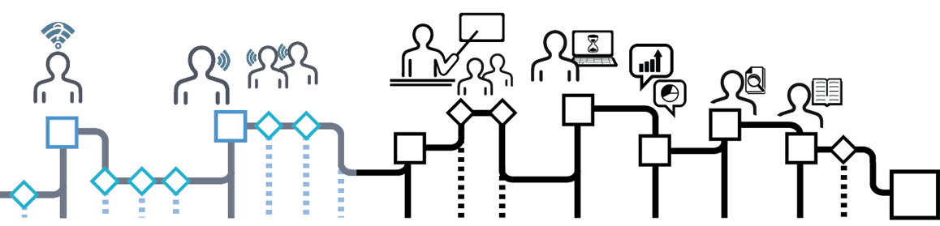
Software Development
Project Management
Weakness
Scattered project documents and issue logs at share folders
Low visibility to project status
Risk
Project delay due to issues NOT logged or resolved properly
Current Practice
Use Google sheets to communicate with customers and log issues
Update task status at shared excel spreadsheets
Proposal Control
Migrate to a cloud project management software

Slide 11
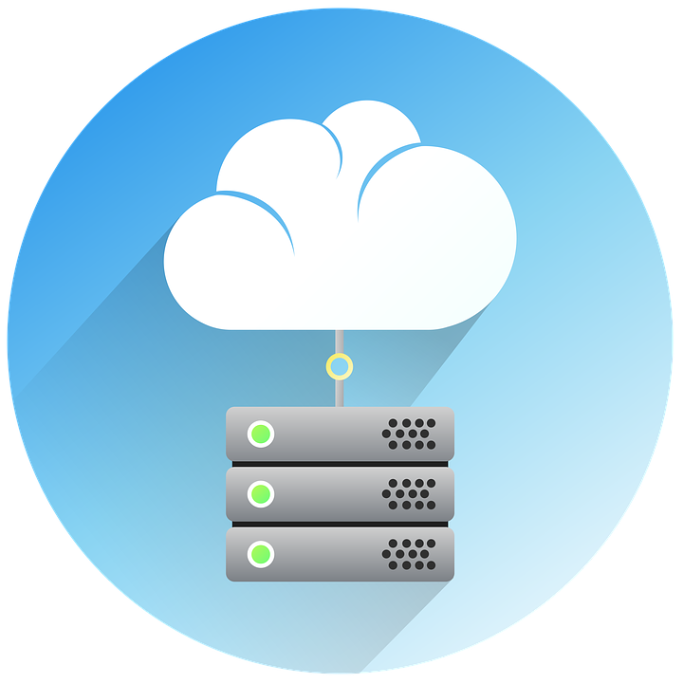
Software Development
Source Code Management
Weakness
No security and version control for source code
Risk
Can’t resume development work if have virus or hardware failure occurs
Current Practice
Upload the changes to the company server
Deploy to client UAT server for testing
Proposal Control
Commit source code to central repository
Deploy stable version to client UAT server

Slide 12
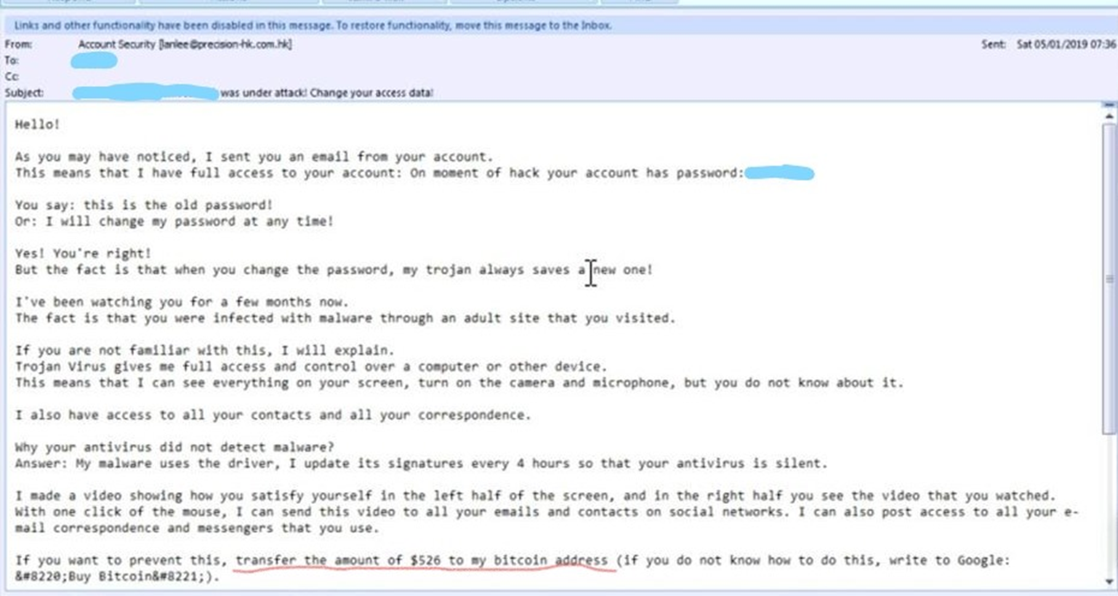
Cyber Securities
•Weakness
Exposed to risk of cyber attack in daily operations once computers are connected to the internet
According to Hong Kong Computer Emergency Response Team Coordination Centre (HKCERT), botnets and phishing are the major cyber incidents reported in February 2022
•Risk
Loss of efficiency on daily operation
Loss of business opportunities
Direct loss of money

Slide 13


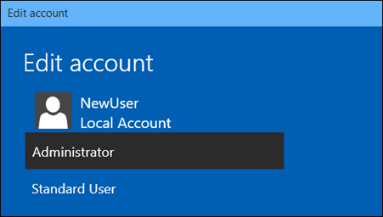

Cyber Securities
Current Control
Antivirus software
License will be expired shortly
Out-of-date virus database
Proposed Control
Firewall
Antivirus software – license renewal and keep virus database up-to-date
Type of Users in PCs
Cyber security training

Slide 14
Conclusion
Physical Control, Infrastructure Resilience, Database, Software Development and Cyber Securities issues are discussed in this project
Weaknesses and risks are identified
Hope the proposed control can help the company business
Thank You!

