Slide 1
Deep Learning Software PyTorch
Department of Computer Science, NYCU
TA 葉宥麟 賴佑家
Some slides are from Stanford CS231n
Notes:
Let’s introduce the deep learning framework pytorch

Slide 2








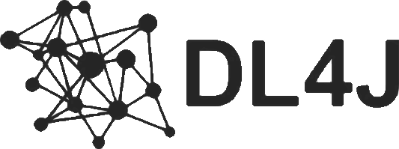


Frameworks
And others……
Notes:
Nowadays, There are many deep learning frameworks that can be used.

Slide 3

Frameworks
Most people use these
And others……
Notes:
The most popular are tensorflow and pytorch

Slide 4
Frameworks
We will focus on this
And others……
Notes:
In this class we use pytorch as our framework

Slide 5
The advantages of deep learning frameworks
Developing and testing new ideas are quickly
Computing gradients automatically
Running model structures on GPU is efficiently
Please use PyTorch to complete all your assignments !!
Notes:
Next, let’s talk about the advantages of pytorch, First, there are many packages that can be used. You don’t need to write it by yourself. Second, the gradient will be automatically calculated in pytorch. Last, The whole model can be accelerated on GPU to make the process more efficient. And Please use pytorch to complete your homeworks

Slide 6
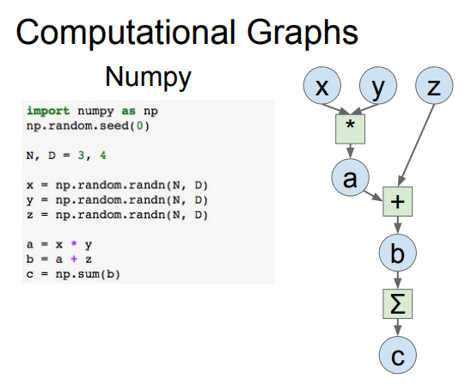

$$x×y+z$$
Neural network can be denoted as a directed acyclic graph
Notes:
And next let’s talk about why we need to use the deep learning framework pytorch. What happen if we just use the numpy. Let’s start from the numpy. This is a simple example. The equation is x times y plus z, and they are all 3 by 4 arrays. At the beginning, I assign initial values randomly , a is equals X multiplied by Y, and b equals a plus Z, and finally C is the sum of element of b

Slide 7
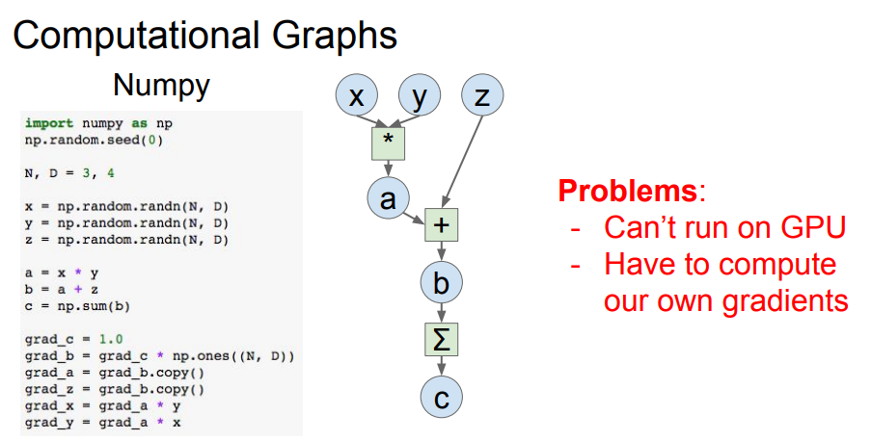
compute gradients
Notes:
However, there are some problems with using numpy, that is, it cannot be executed on the GPU, and the gradient must be calculated by hand-craft. In the example, each update requires six commands. If the model is very large, the code will be very complicated.

Slide 8
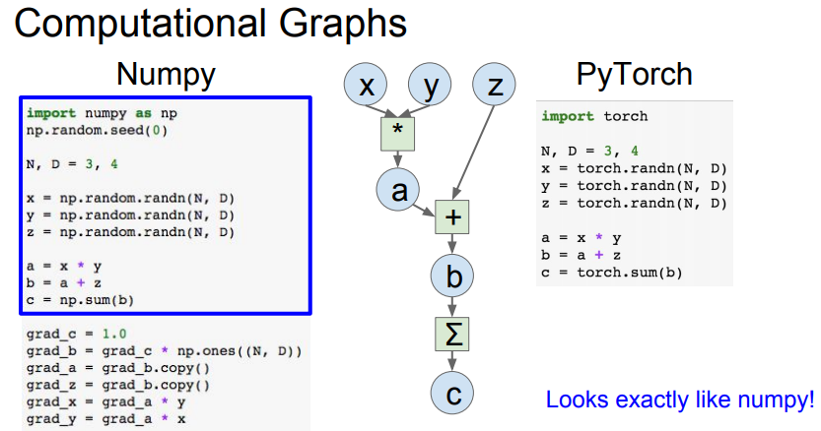
Notes:
And if we use pytorch, on the right, you can see that the form of tensor used in pytoch is quite similar with the numpy .

Slide 9
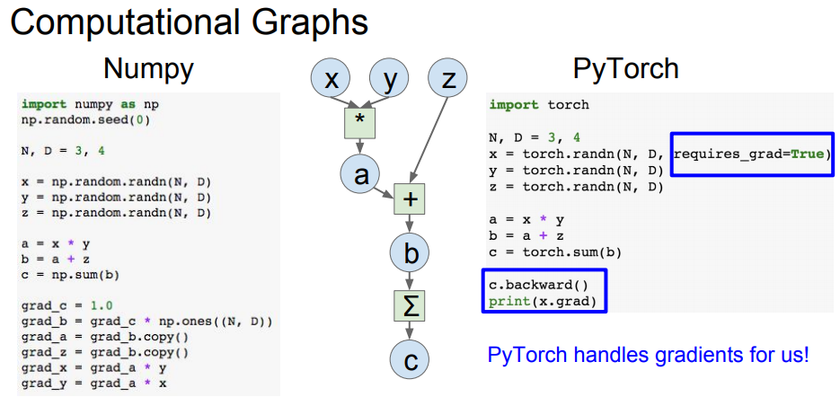
.backward() compute gradient
Notes:
Next, let’s talk about how to calculate the gradient. When creating the data, just set the require gradient to true, then call the backward function of C, and all the previous gradients will be automatically calculated. It’s more easy and efficient than the mumpy.

Slide 10
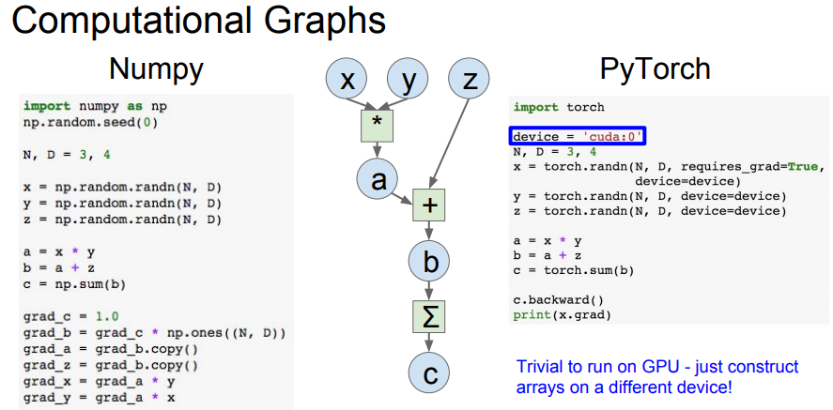
Notes:
You can choose the device you want. For example, if you have two GPUs, you can specify here whether you want to use cuda0 or cuda1. When creating the data, you can put the data into chosen device.

Slide 11
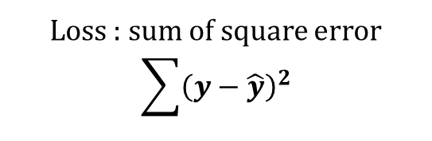

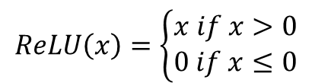



Example
2-layer network
Input: 1000 , batch size = 64
$$x:64×1000$$
Hidden Layer: 100
$$w1:1000×100$$
$$ReLU\left(x\right)=\left\{\begin{aligned}x if x>0 \\ 0 if x≤0\end{aligned}\right.$$
ReLU
Out Layer: 10
$$w2:100×10$$
Loss : sum of square error
$$\sum{{\left(y−\hat{y}\right)}^{2}}$$
$$y :64×10$$
Notes:
Next, let's talk about another example. This is a two-layer network, a hidden layer, and an output layer. The input dimension is 1000 and the batch size is 64, and relu as activated function in the middle,

Slide 12
Flow Chart
Prepare data
Create model
Forward pass
Repeat n times or until convergence
Training
Backward pass
Update weights
Notes:
Start with the flow chart first. At the beginning, you must prepare your data. You may need to do some preprocessing. Next, you need to select the model to be used. And pass the data to the model. We can this as forward pass, you can get the output value. And calculate the loss with the ground truth and output . and then the do the back propagation to obtain the gradient, which can be used to update the parameters, and continue to perform these three green blocks until the loss is converged.

Slide 13
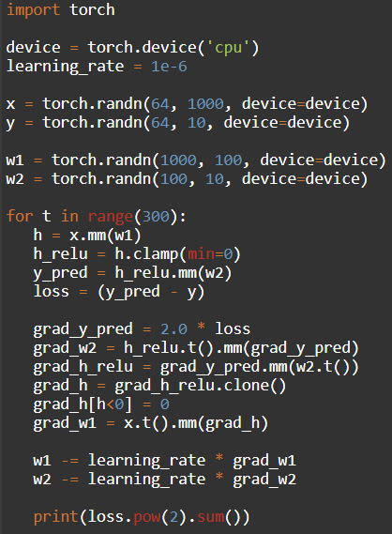
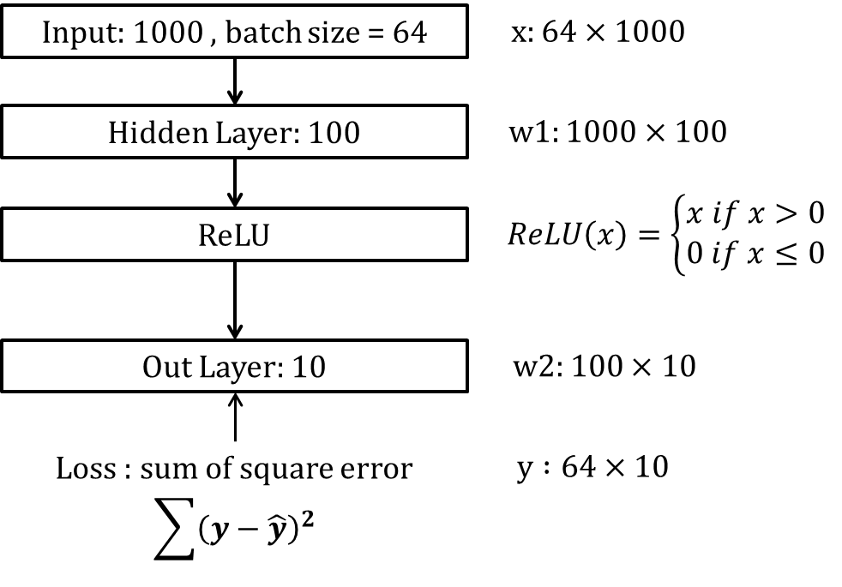
Step1. Prepare Data
PyTorch Tensors
Create random tensors as input and ground truth
To run on GPU, just use a different device, like a following:
Notes:
The first step is prepare data. Going back to the previous example, , the input x has 1000 points and batch size is 64, so the dimension is 64x1000, and ground truth y is 10 points bcause there are 10 class of the output. And you can also assign the GPU to tensor

Slide 14
Step2. Create Model
PyTorch Tensors
Create random tensors as layer weights
Notes:
The second step is that build the model. The two layers is given, the input is 1000, the output of this layer is 100, so its weight is 1000 X 100, and then the next operation is relu, it will not change the dimension, so the weight of output layer is 100 X 10,

Slide 15
Step3. Forward pass
PyTorch Tensors
Compute predictions and loss
Notes:
The third step is to perform forwarding. At the beginning, the input data and the first layer are calculated, then apply the activation function ReLU, and the second layer is calculated, and then the loss can be done with the ground truth.

Slide 16
Step4. Backward pass
PyTorch Tensors
Manually compute gradients
Notes:
The fourth step is backward. Because it is simple here, the calculation of the gradient can be done on your own. Buf if the model is large, the code will become very complicated. Using partial derivative from the end. push it backward. Here is the back propagation. The detailed process will be discussed in the class.

Slide 17
Step5. Update Weights
PyTorch Tensors
Gradient descent step on weights
Notes:
Finally, you can get the gradient, you can update the parameters with the learning rate and gradient. And repeat the step3 to step5 until the loss converge

Slide 18
Easily implement your own deep learning model by using PyTorch
Notes:
And this example we can use the deep learning framework pytorch to implement it easily. The next part we give the other TA to explain it.

Slide 19
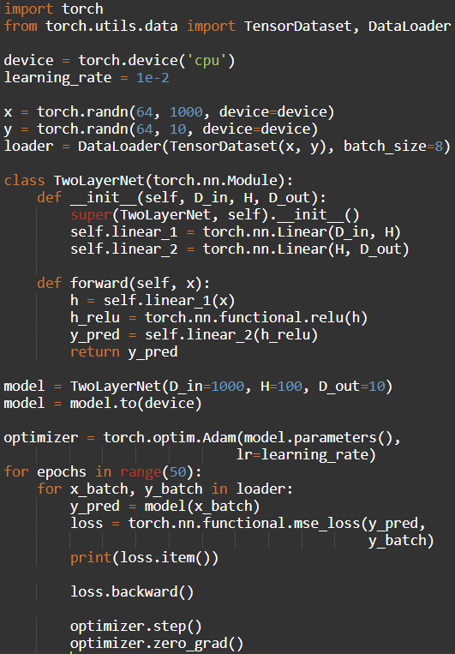
Step1. Prepare Data
PyTorch.utils.data
DataLoader wraps a Dataset and provides minibatches, shuffling, multithreading, for you
When you need to load custom data, just write your own Dataset class
Iterate over loader to form mini-batchs
https://github.com/utkuozbulak/pytorch-custom-dataset-examples
Notes:
Here we use random data as input, x is the input, and y is the ground truth. Then dataloader is needed. You need to set a batch size, because most of the time, there are a lot of training data, which is impossible to throw it all into the GPU at a same time, and it needs to be divided into many batch. The following part is to calculate the loss of the output by the model after input the data to the model.

Slide 20
Step2. Create Model
PyTorch.nn
Higher-level wrapper for working with neural nets
Use this ! It will make your life easier
A PyTorch Module is a neural net layer, it can contain weights or other modules
Define your whole model as a single module
Notes:
The next step is to build a model
In General, it will be written as a class, which is divided into two parts.

Slide 21
Step2. Create Model
PyTorch.nn
Initializer sets up two children (Module can contain Modules)
Notes:
Initial part is to declare what content is in the model, such as convolution pooling or padding..

Slide 22
Step2. Create Model
PyTorch.nn
Define forward pass using child modules
No need to define backward – autograd will handle it
Notes:
The forward part is flow chat, which steps need to be performed. Finally, call this class and specify the device

Slide 23
Step3. Forward pass
PyTorch.nn
Define forward pass using child modules
Feed data to model, and compute loss
nn.functional has useful helpers like loss functions
Notes:
Pytorch provides many loss functions that can be used. MSE is used here, and you must choose the one you need such as cross entropy.

Slide 24
Step4. Backward pass PyTorch.autograd
Forward pass looks exactly the same as before, but we don’t need to track intermediate values
PyTorch keeps track of them for us in the computational graph
Compute gradient of loss with respect to all model weights (they have requires_grad=True)
Notes:
just said that torch can help us calculate the gradient. After forwarding, just use loss.backward. to do the back propagation.

Slide 25
Step5. Update Weights PyTorch.optim
Use an optimizer for different update rules
After computing gradients, use optimizer to update each model parameters and reset gradients
Notes:
After that, we can update the parameters. Pytorch provides an optimizer to do this. There are also many opitmizers that can be used. Adam is used here. Remember to set your learning rate when using it.

Slide 26
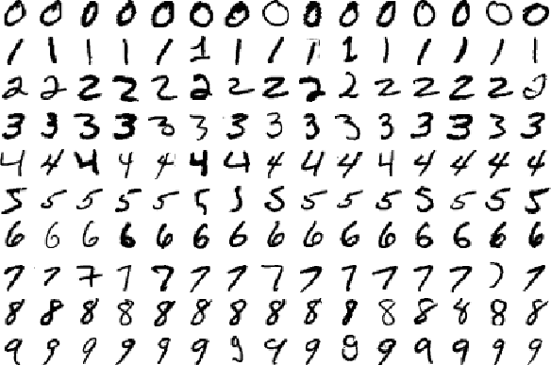
Real Application
MNIST example for PyTorch
https://github.com/pytorch/examples/tree/master/mnist
Notes:
This is a practical example. CNN is used to do the classification of numbers. The code below is given at the below addres. You can implement it yourself.

Slide 27
Build and train a CNN classifier
Data Loader
Define Network
Define Optimizer/Loss function
Learning rate scheduling
Training
Testing
Run and Save model
Notes:
This is a complete process. Use a dataloader, design your own network, define the optimizer and loss function, set up a learning rate. After that, you can start to train your model and test it . Do not forget to save your model.

Slide 28
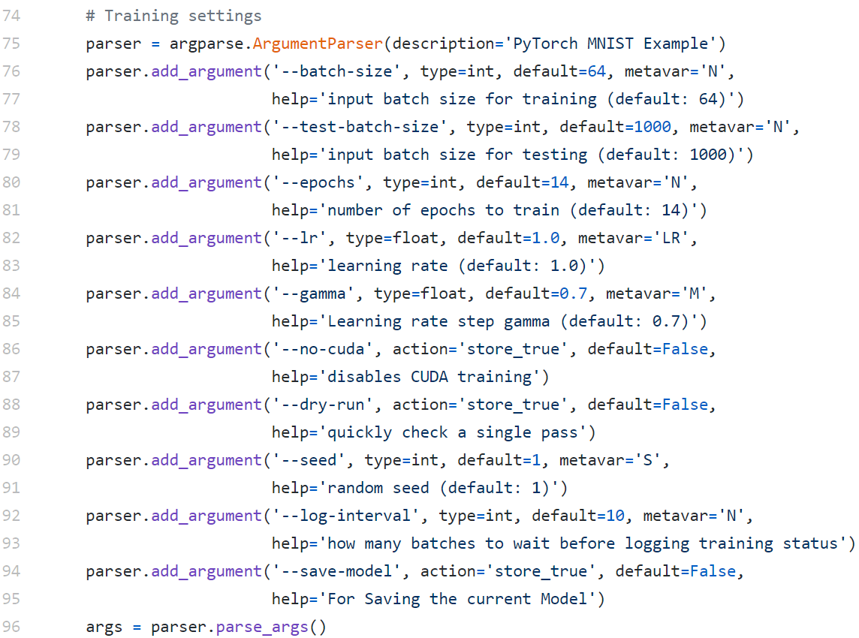
Set hyperparameters
Notes:
Next, there will be some hyper-parameters that need to be set by yourself.

Slide 29
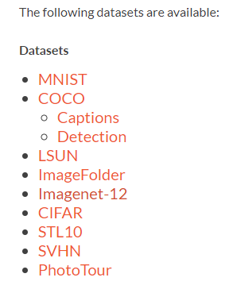
Data Loader
Pytorch offers data loaders for popular dataset
Notes:
Pytorch provides some datasets, you can download if you are interested

Slide 30
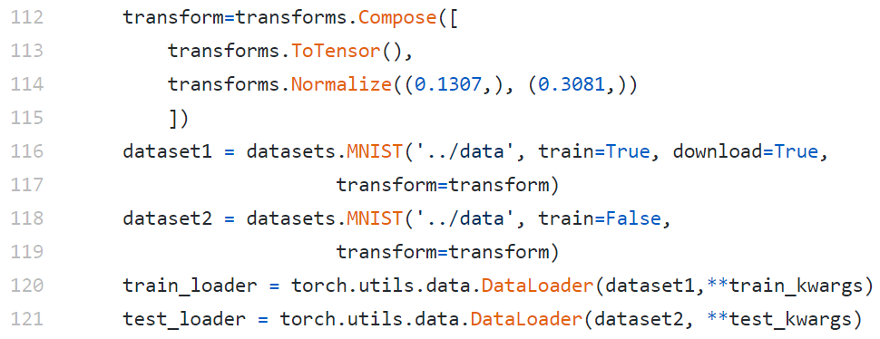
Data Loader
Notes:
Next, let’s talk about data loader. At first, we need to use transform to transform the data into tensor form, and you can do some normalize or argumentation, such as rotation, etc.

Slide 31
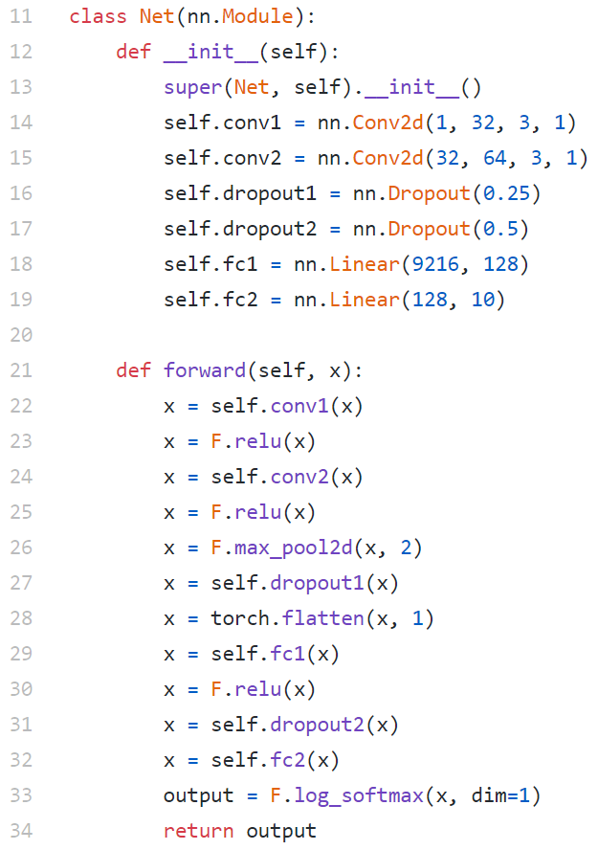
Define Network
Notes:
Initial is to declare what content is in the model , such as convolution pooling padding.. The forward part is flow chat, determined what steps need to be performed.

Slide 32
Define Optimizer/Loss function
Negative log likelihood loss
Adadelta
Notes:
Next is optimizer and loss
Just use this function to determine the loss using output and target.
Optimizer can also choose by yourself, remember to set the learning rate

Slide 33
Learning rate scheduling
Notes:
Pytorch provides Learning rate scheduling to dynamically adjust the size of lr. Usually, the lr will get smaller in the later epoch of training. You can set the conditions you want.

Slide 34
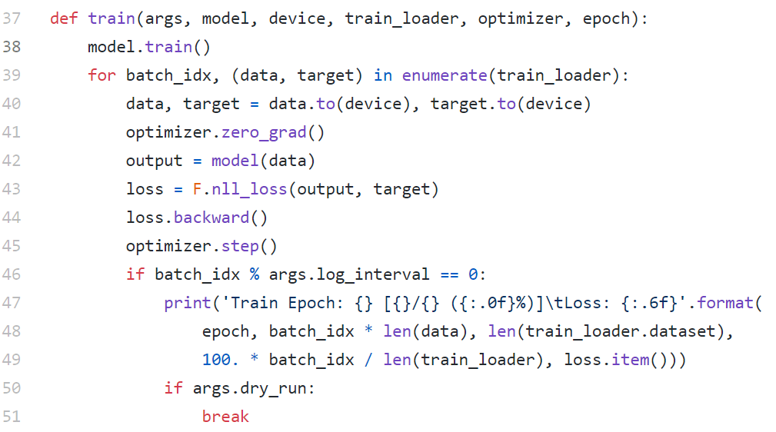
Training
Notes:
At the beginning, model.train will be used to represent that the model is about to start training. First, clean the gradient. Input the data into the model, use the output and ground truth to calculate the loss, and then calculate the gradient to update the parameters

Slide 35
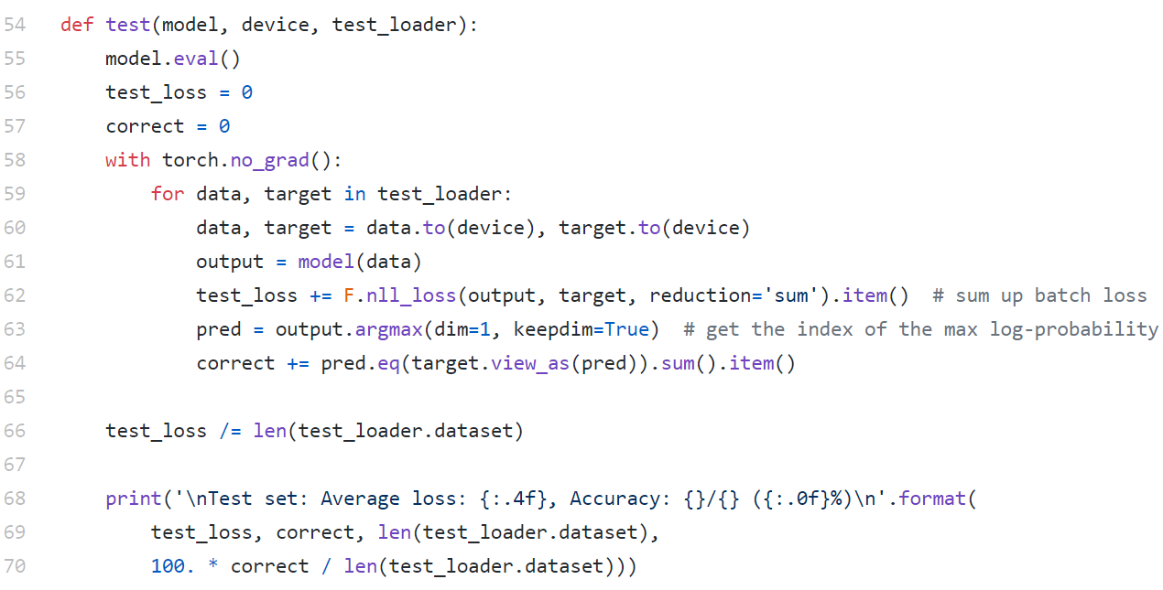
Testing
Notes:
model.eval will be used to represent that the model is about to start testing, and with torch.no_gradient will be used to avoid continuous update of the model, and the output and ground truth will be used to calculate accuracy.

Slide 36
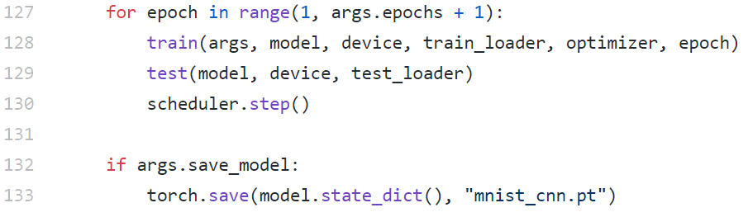
Run and Save model

