Slide 1
LAB 6
Deep Reinforcement Learning TA 李政毅

Slide 2
Deadline: 2022/8/30(Tue) 23:59 No Demo

Slide 3
Must use sample code, otherwise no credit.
In this lab,

Slide 4
Outline
1. Solve LunarLander-v2 using DQN
2. Solve LunarLanderContinuous-v2 using DDPG
3. Modify and Run Sample Code
4. Scoring Criteria
5. Reminders

Slide 5
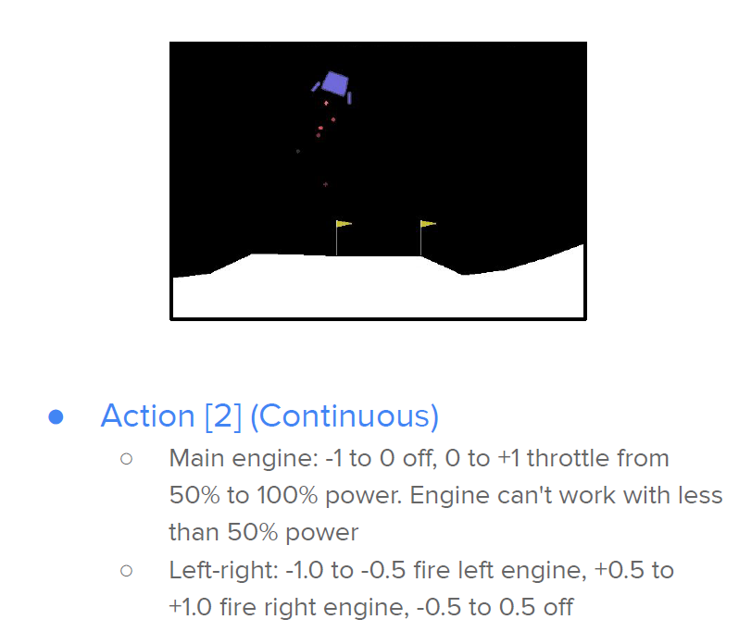
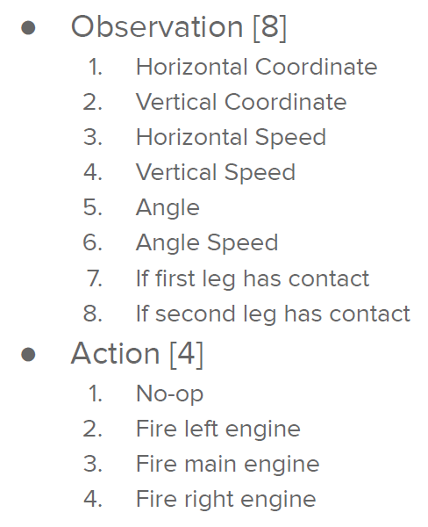
LunarLander-v2

Slide 6
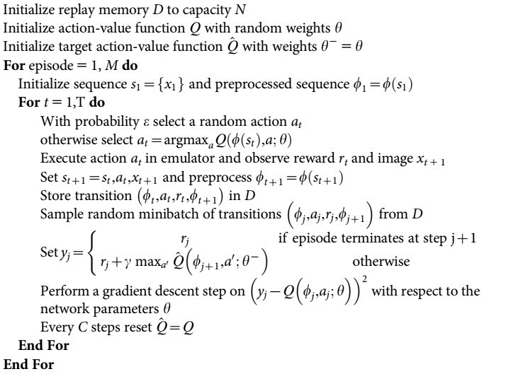
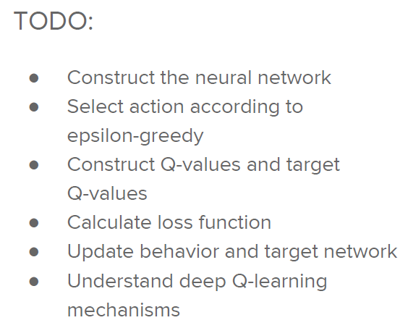
Deep Q-Network (DQN)
Algorithm 1 – Deep Q-learning with experience replay:

Slide 7
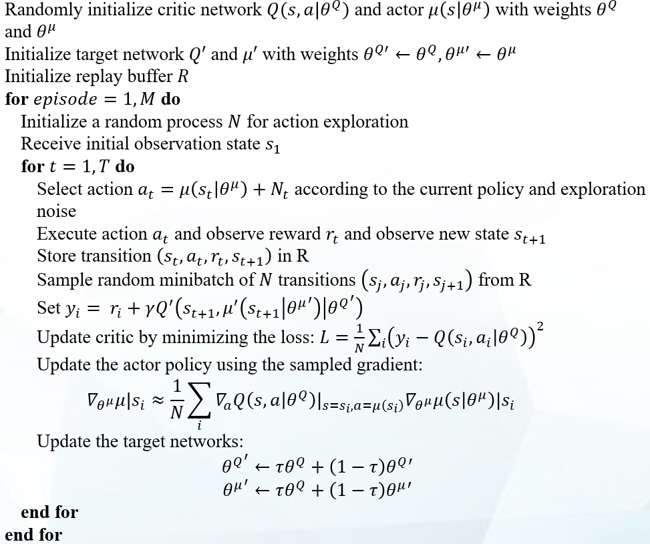
Deep Deterministic Policy Gradient (DDPG)
Algorithm 2 – Deep Deterministic Policy Gradient Algorithm:

Slide 8
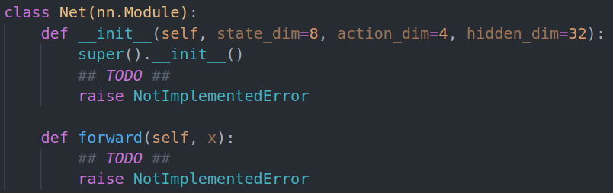
3. Modify Sample Code
1. Find a #TODO comment with hints
2. remove the raise NotImplementedError

Slide 9
3. Run Sample Code
Simply train and test: python dqn.py
Only test and render: python dqn.py --test_only --render

Slide 10
4. Scoring Criteria
Show your work, otherwise no credit will be granted.
Report (80%)
(DO explain; do not only copy and paste your codes.)
Report Bonus (15%)
Implement and Experiment on Double-DQN (5%)
Implement and Experiment on TD3 (Twin-Delayed DDPG) (10%)
Performance (20%)
[LunarLander-v2] Average reward of 10 testing episodes: Average ÷ 30
[LunarLanderContinuous-v2] Average reward of 10 testing episodes: Average ÷ 30

Slide 11
5. Reminders
Your network architecture and hyper-parameters can differ from the defaults.
Ensure the shape of tensors all the time especially when calculating the loss.
Be aware of the indentation of hints.
When testing DDPG, action selection need NOT include the noise.

Slide 12
References
Mnih, Volodymyr et al. “Playing Atari with Deep Reinforcement Learning.” ArXiv abs/1312.5602 (2013).
Mnih, Volodymyr et al. “Human-level control through deep reinforcement learning.” Nature 518 (2015):529-533.
Van Hasselt, Hado, Arthur Guez, and David Silver. “Deep Reinforcement Learning with DoubleQ-Learning.” AAAI. 2016.
Lillicrap, Timothy P. et al. “Continuous control with deep reinforcement learning.” CoRRabs/1509.02971 (2015).
Silver, David et al. “Deterministic Policy Gradient Algorithms.” ICML (2014).
Fujimoto, S., Hoof, H.V., & Meger, D. (2018). Addressing Function Approximation Error in Actor-Critic Methods. ArXiv, abs/1802.09477.
OpenAI. “OpenAI Gym Documentation.” Retrieved from Getting Started with Gym: https://gym.openai.com/docs/ .
OpenAI. “OpenAI Wiki for Pendulum v0.” Retrieved from Github: https://github.com/openai/gym/wiki/Pendulum-v0 .
PyTorch. “Reinforcement Learning (DQN) Tutorial.” Retrieved from PyTorch Tutorials: https://pytorch.org/tutorials/intermediate/reinforcement_q_learning.html .

