Slide 1
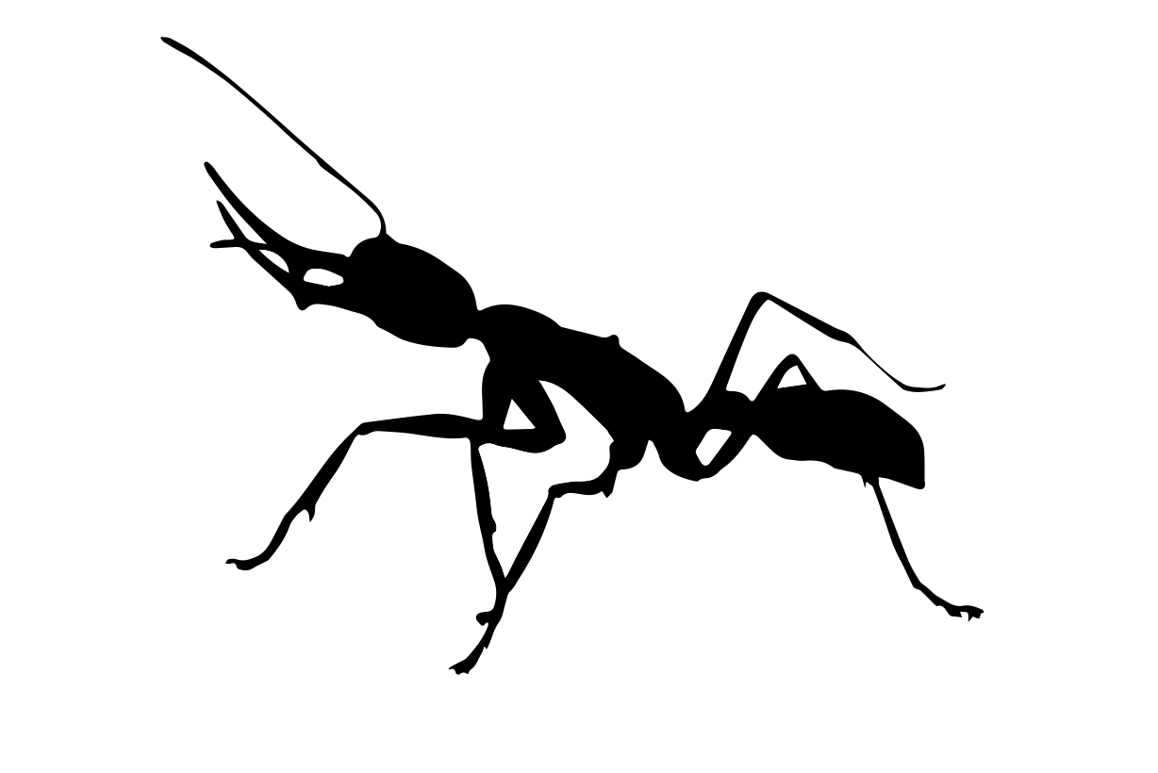
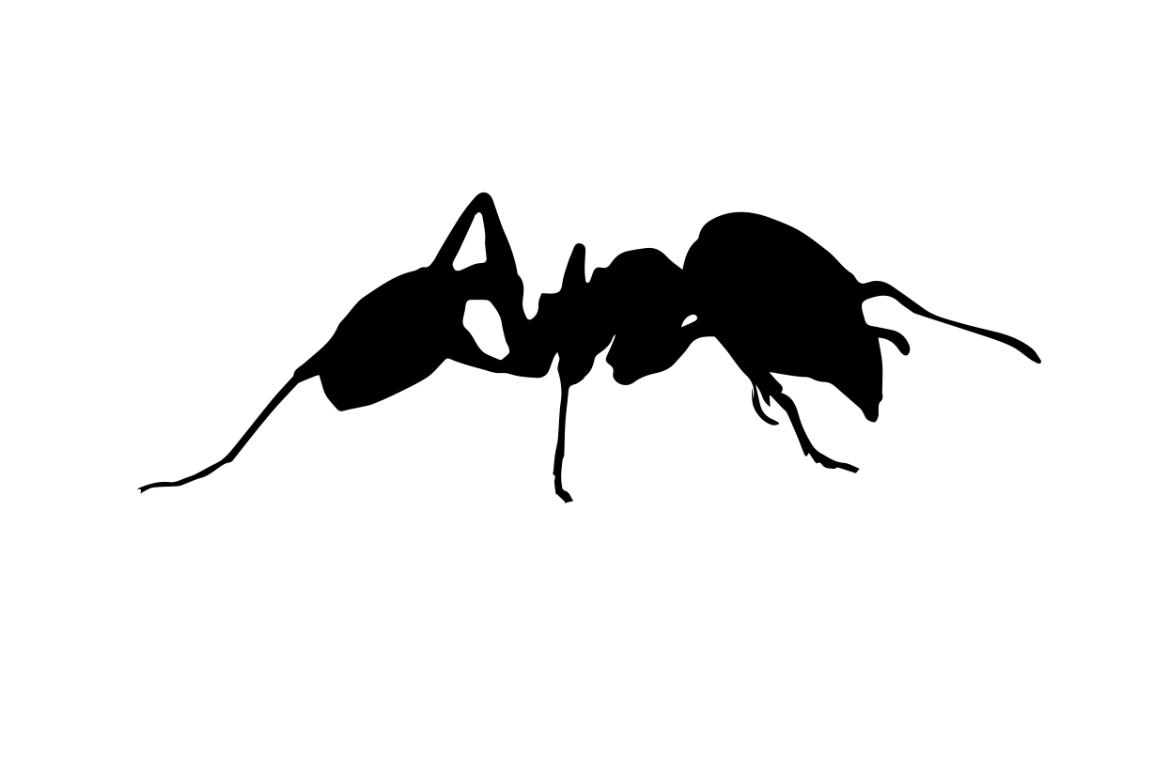
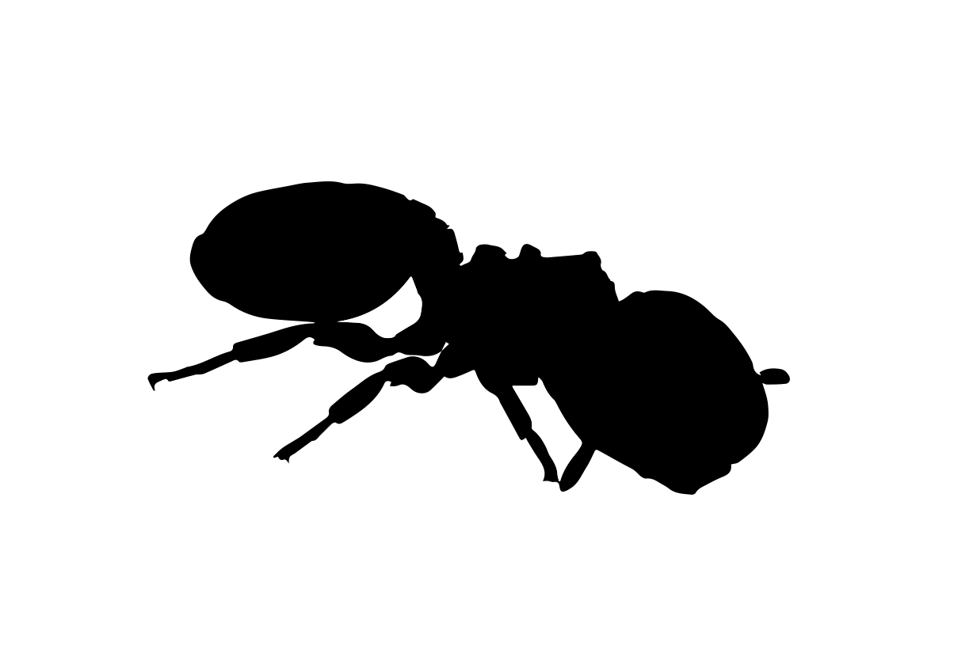
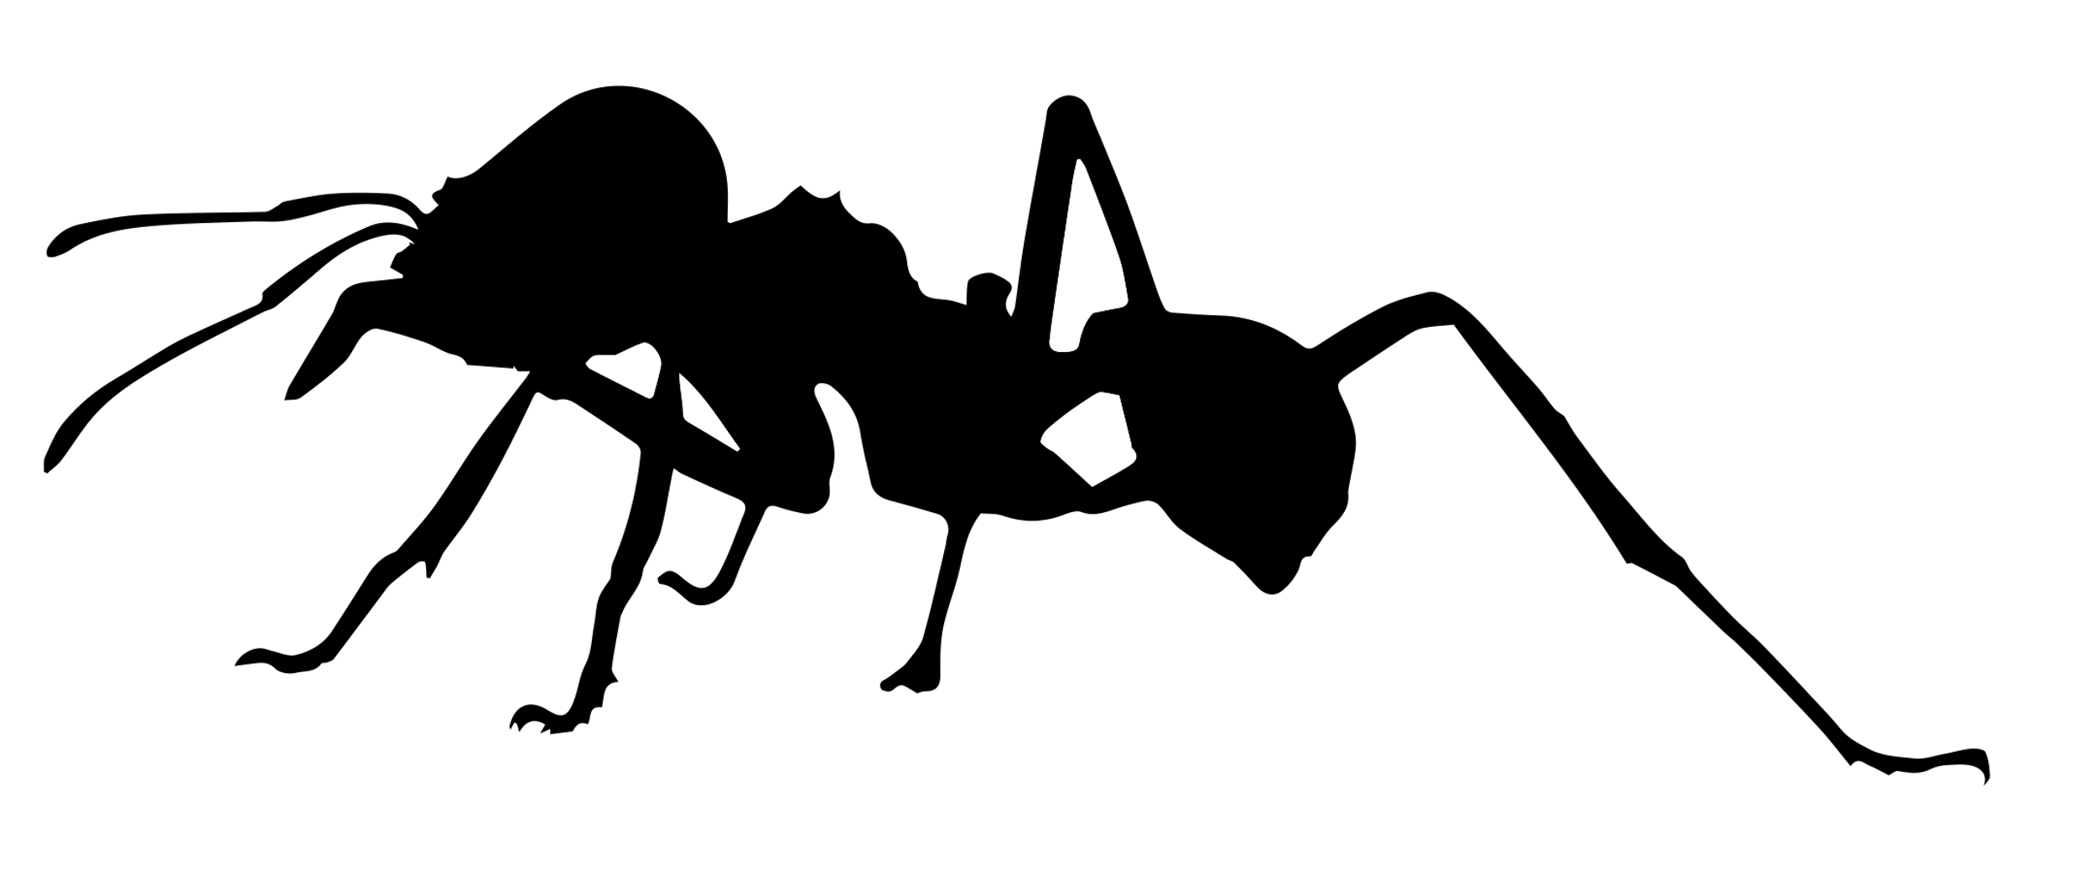
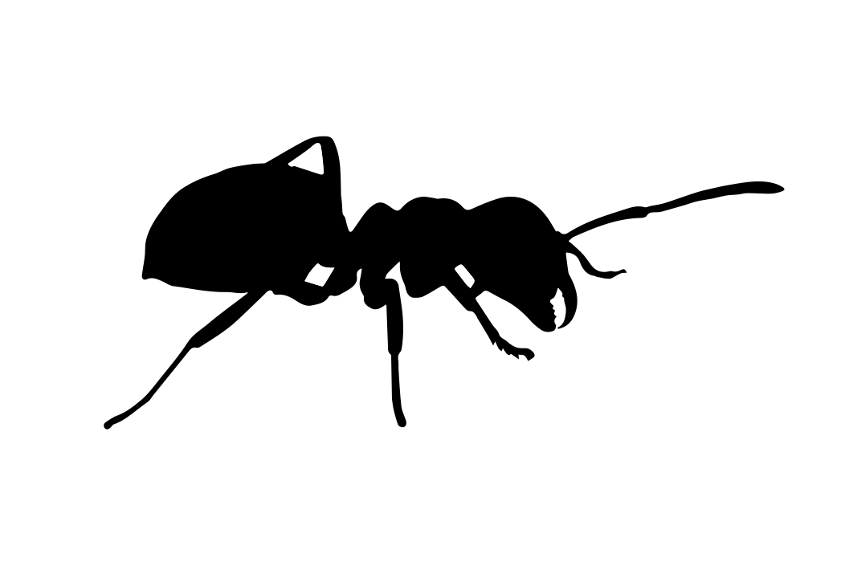
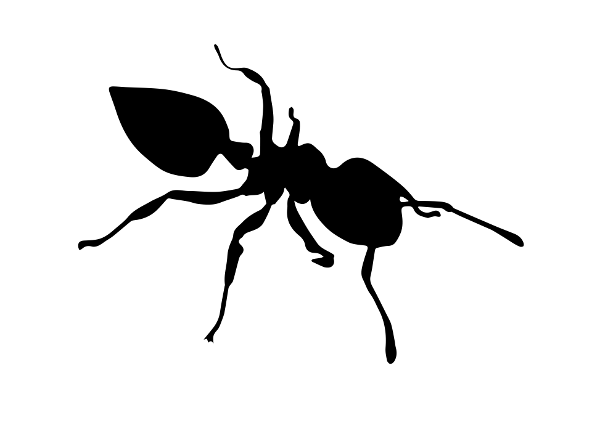
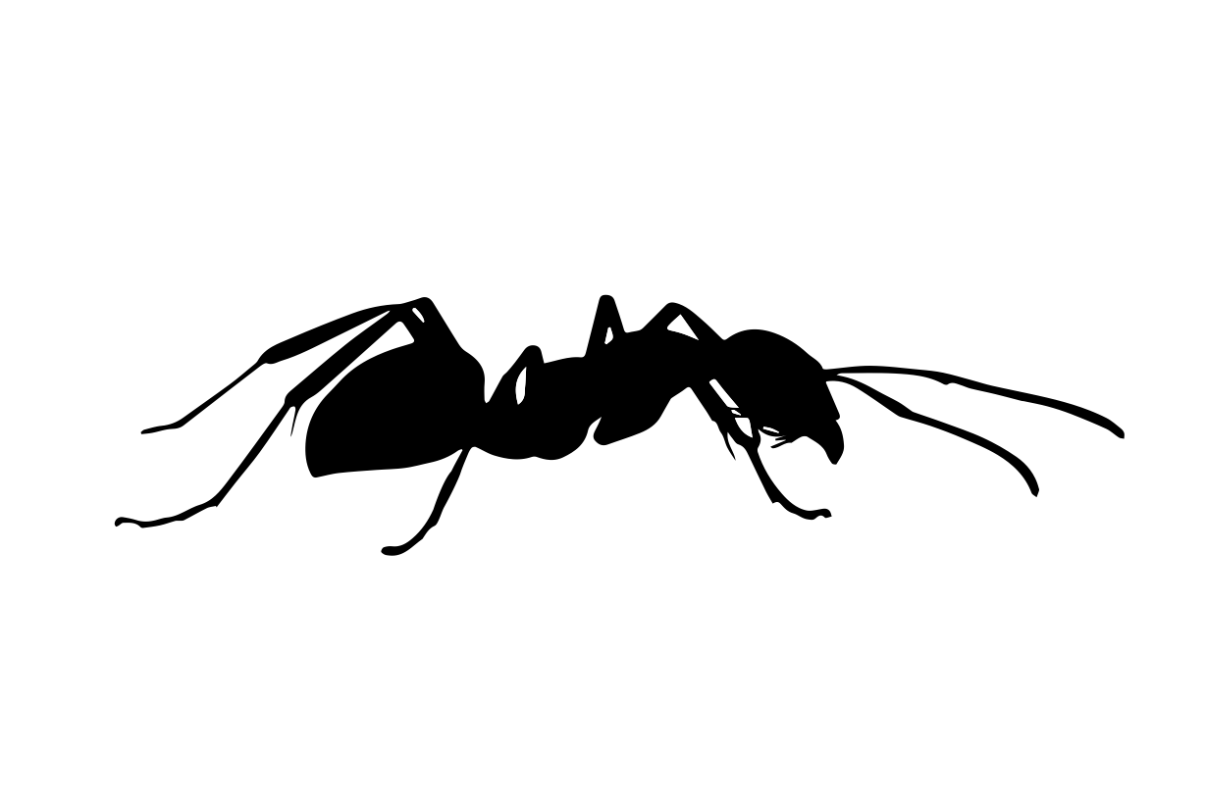
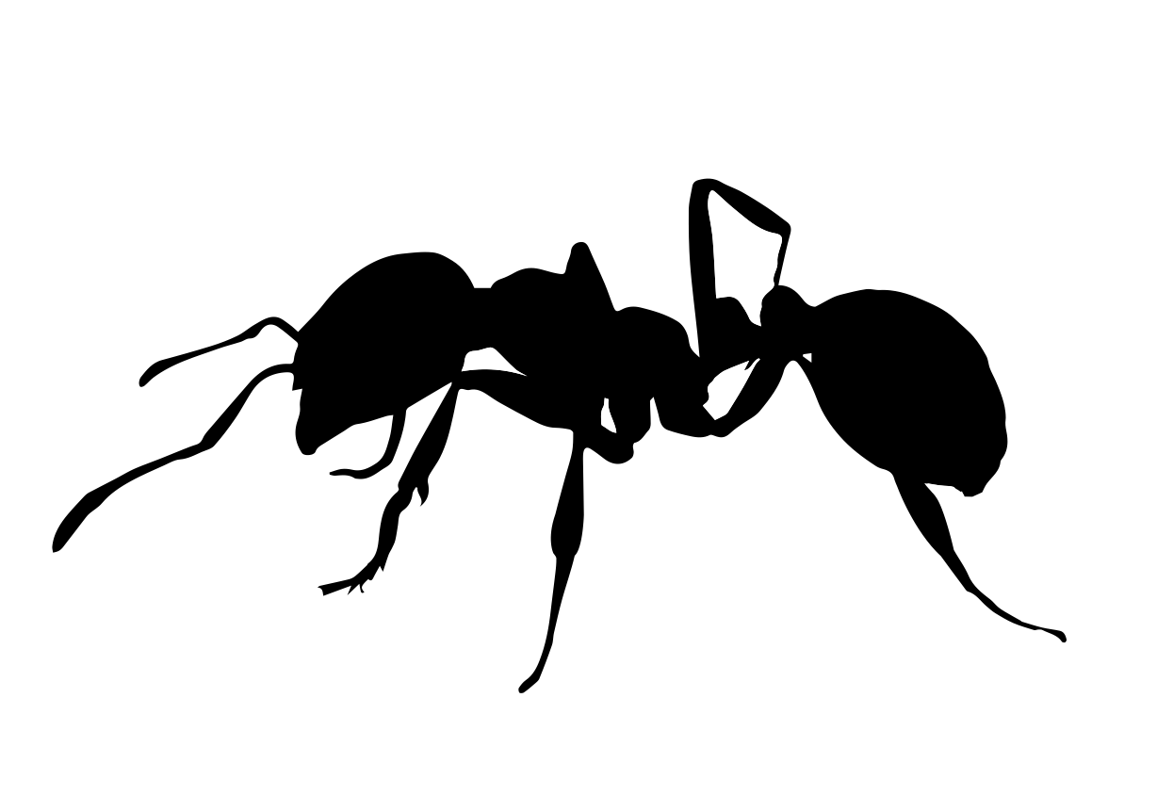
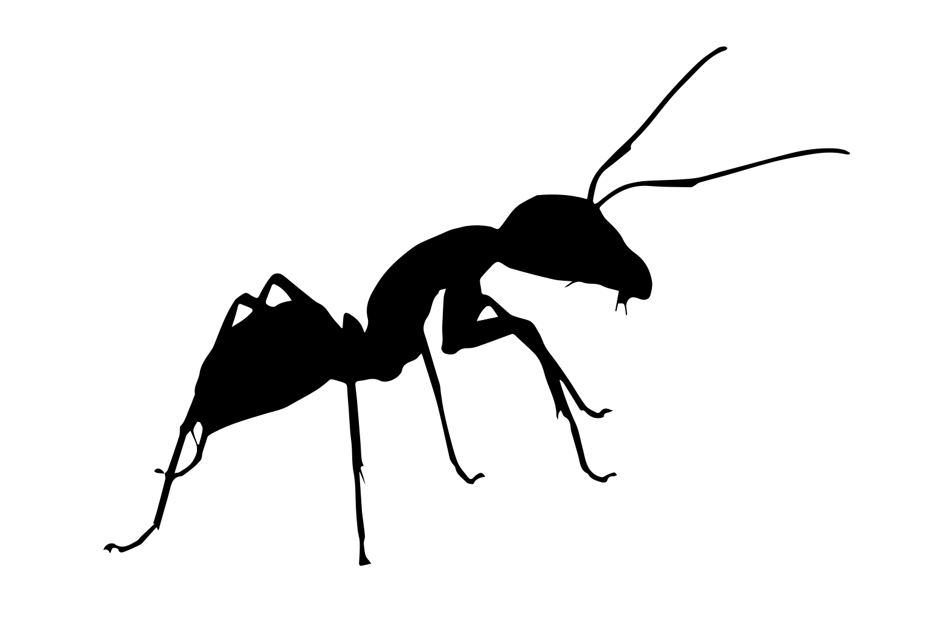
Amblyoponini
Ponerinae
Pheidole
(big-headed ants)
Cephalotes
(turtle ants)
Dorylinae (army ants)
Strumigenys
Fungus-growing
ants (including Atta &
Acromyrmex)
Dolichoderinae
Daceton &
Orectognathus
Pseudomyrmecini
Temnothorax
Myrmeciini
Brachymyrmex
Tetramorium
Lasius &
Myrmecocystus
Crematogaster
Cataglyphis
(desert ants)
Acanthomyrmex
Formica (wood ants)
Carebara
Camponotus &
Calomyrmex
(including
carpenter ants)
Solenopsidini
(including fire ants
Polyrhachis
Stenammini
Pogonomyrmex
Myrmicini
Ectatommini

Slide 2
Amblyoponini
Ponerinae
Pheidole
(big-headed ants)
Cephalotes
(turtle ants)
Dorylinae (army ants)
Strumigenys
Fungus-growing
ants (including Atta &
Acromyrmex)
Dolichoderinae
Daceton &
Orectognathus
Pseudomyrmecini
Temnothorax
Myrmeciini
Brachymyrmex
Tetramorium
Lasius &
Myrmecocystus
Crematogaster
Cataglyphis
(desert ants)
Acanthomyrmex
Formica (wood ants)
Carebara
Camponotus &
Calomyrmex
(including
carpenter ants)
Solenopsidini
(including fire ants
Polyrhachis
Stenammini
Pogonomyrmex
Ectatommini
Myrmicini

Slide 3
Amblyoponini
Ponerinae
Pheidole
(big-headed ants)
Cephalotes
(turtle ants)
Dorylinae (army ants)
Strumigenys
Fungus-growing
ants (including Atta &
Dolichoderinae
Acromyrmex)
Daceton &
Pseudomyrmecini
Orectognathus
Temnothorax
Myrmeciini
Brachymyrmex
Tetramorium
Lasius &
Myrmecocystus
Crematogaster
Cataglyphis
(desert ants)
Acanthomyrmex
Formica (wood ants)
Carebara
Camponotus &
Calomyrmex
Solenopsidini
(including fire ants
(including
carpenter ants)
Stenammini
Polyrhachis
Pogonomyrmex
Ectatommini
Myrmicini

