Slide 1

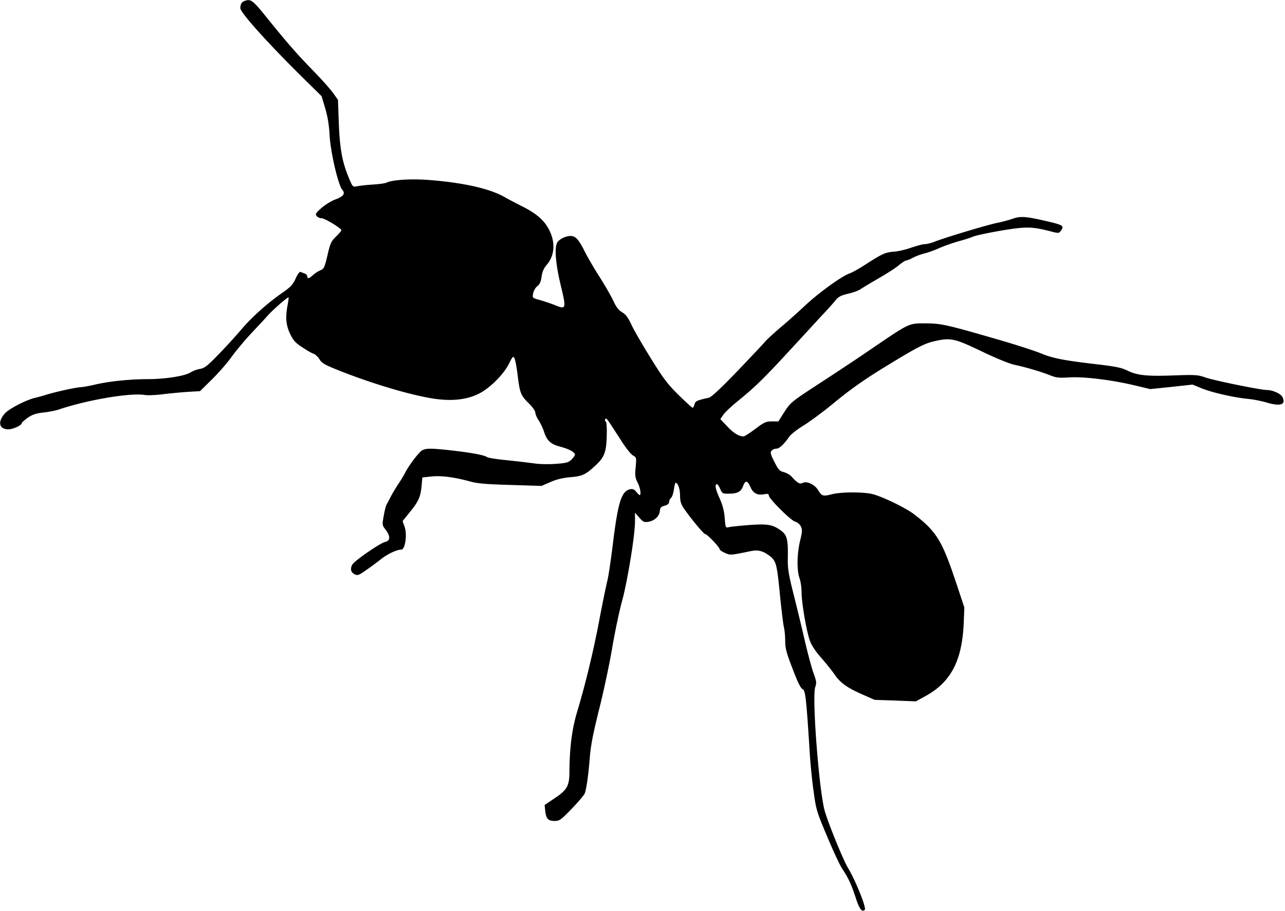
CS median_Caste 400 trees
Single caste Small colonies
Multiple castes Small colonies
0
3.18
9.28
9.29
7.37
9.28
Single caste Large colonies
Multiple castes Large colonies
9.27
9.27

Slide 2
CS median_Caste 400 trees
Single caste Small colonies
Multiple castes Small colonies
0
3.18
(0, 10.57)
9.2
(7.35, 11.58)
9.29
(7.44, 11.68)
7.37
(0, 11.12)
9.28
(7.35, 11.55)
Single caste Large colonies
9.27
(7.28, 11.51)
Multiple castes Large colonies
9.27
(7.27, 11.51)

Slide 3
CS median_Caste 400 trees
Single caste Small colonies
Multiple castes Small colonies
0
3.18
(0, 10.57)
9.2
(7.35, 11.58)
9.29
(7.44, 11.68)
7.37
(0, 11.12)
9.28
(7.35, 11.55)
Single caste Large colonies
9.27
(7.28, 11.51)
Multiple castes Large colonies
9.27
(7.27, 11.51)

Slide 4
CS median_Caste 400 trees
Single caste Small colonies
Multiple castes Small colonies
0
3.18
(0, 10.57)
9.2
(7.35, 11.58)
9.29
(7.44, 11.68)
7.37
(0, 11.12)
9.28
(7.35, 11.55)
Single caste Large colonies
9.27
(7.28, 11.51)
Multiple castes Large colonies
9.27
(7.27, 11.51)

Slide 5
CS median_Caste 400 trees
Single caste Small colonies
Multiple castes Small colonies
0
3.18
(0, 10.57)
9.2
(7.35, 11.58)
9.29
(7.44, 11.68)
7.37
(0, 11.12)
9.28
(7.35, 11.55)
Single caste Large colonies
9.27
(7.28, 11.51)
Multiple castes Large colonies
9.27
(7.27, 11.51)

