Slide 1

Louis BURET

Slide 2
Classification d’email
Comment filtrer des messages

Slide 3
Quel intérêt ?
Gain en efficacité
Minimisation des risques
Gain en productivité
Notes:
Efficacité gain de temps
Productivité meilleurs résultats

Slide 4
Choix du dataset
Source : Kaggle
2007 TREC Public Spam Corpus
+ 75,000 entrées brutes
+ 50.000 entrées utilisables
45% - 55%
Notes:
TREC Text Retrieval Conference
Communauté de chercheurs en récupération d’informations et NLP

Slide 5
Visualisation du dataset
Hi... I have to use R to find out the 90% confidence-interval for the sensitivity and specificity of the following diagnostic test: A particular diagnostic test for multiple sclerosis was conducted on 20 MS patients and 20 healthy subjects, 6 MS patients were classified as healthy and 8 healthy subjects were classified as suffering from the MS. Furthermore, I need to find the number of MS patients required for a sensitivity of 1%... Is there a simple R-command which can do that for me? I am completely new to R... Help please! Jochen
# New Ticket Created by Paul Cochrane # Please include the string: [perl #42355] # in the subject line of all future correspondence about this issue. # In the file src/ops/pic.ops in the pic_callr__() op there is a todo item which merely states: ""ARG_MAX"" I believe this means use the ARG_MAX macro instead of a hard-coded number in the args[] array mentioned on this line. In short: fix.
Hi , Is there any way to find out what other package dependencies needed for an un-install package in unix? Thanks Hridyesh
HoodiaLife - Start Losing Weight Now! HoodiaLife is a natural substance that literally takes your appetite away! Learn more and buy HoodiaLife!
Mega authenticV I A G R A $ DISCOUNT priceC I A L I S $DISCOUNT priceDo not miss IT, CLICK here. http://www.inkanjkjkreight.com
VIAGRAIf you have a problem getting or keeping an erection, your sex life can suffer. You should know that youâ€™re not alone. In fact, more than half of all men over 40 have difficulties getting or maintaining an erection. This issue, also called erectile dysfunction, occurs with younger men as well!You should know there is something you can do about it. Join the millions of men who have already improved their sex lives with VIAGRA!VISIT STORE ONLINE!

Slide 6
Transformation du dataset
import pandas as pd
import spacy
df = pd.read_csv('email_text.csv')
nlp = spacy.load('en_core_web_lg’)
docs = []
vectors = []
for doc in nlp.pipe(list(df['text'].astype('unicode').values)):
docs.append(doc)
vectors.append(doc.vector)
df['docs'] = docs
df['vectors'] = vectors

Slide 7
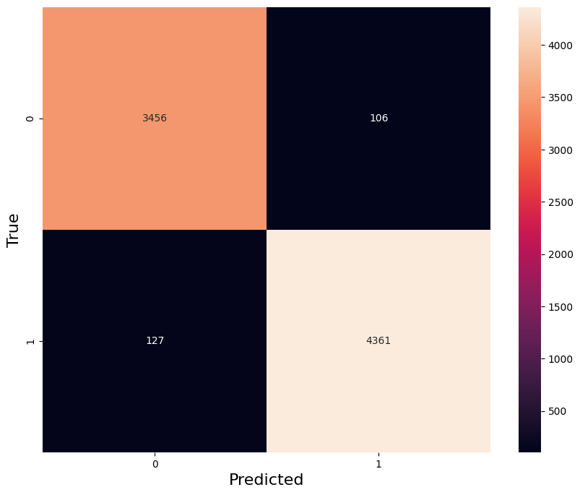

Choix du modèle
Machine Learning
Deep Learning
Notes:
ML
Fit 1 min
97 % de réponses justes en validation
DL
Fit 15 min
99 % de bonnes réponses en validation

Slide 8
Optimisation des paramètres
import keras
from keras.models import Sequential
from keras.layers import Dense, Input
model = Sequential()
model.add(Input((X_train.shape[1],)))
model.add(Dense(X_train.shape[1], activation='relu'))
model.add(Dense(X_train.shape[1] * 2, activation='relu'))
model.add(Dense(16, activation='relu'))
model.add(Dense(1, activation='sigmoid’))
model.compile(optimizer='adam', loss='binary_crossentropy', metrics=['accuracy’])
model.fit(x_train_dl, y_train_dl, batch_size=16, epochs=50, validation_split=0.1)
Notes:
Opt
Adam sgd
Metrics
Accuracy f1score recall precision
Batch_size
4 8 16 32
Epochs
100 mais 50 suffisant
Validation_split
0,1 0,15 0,2

Slide 9
Structure finale du modèle
Input
300
Dense
300
Dense
600
Dense
16
Dense & Output
1

Slide 10
Possibilités d’améliorations
Intégration
Personnalisation
Multi-classification

Slide 11



Merci pour votre écoute

Slide 12
Place à une petite demonstration !

