Slide 1

Homework 3– Supervised Learning
Due Date: To Be Determined
Human-centered Intelligent Systems Lab

Slide 2
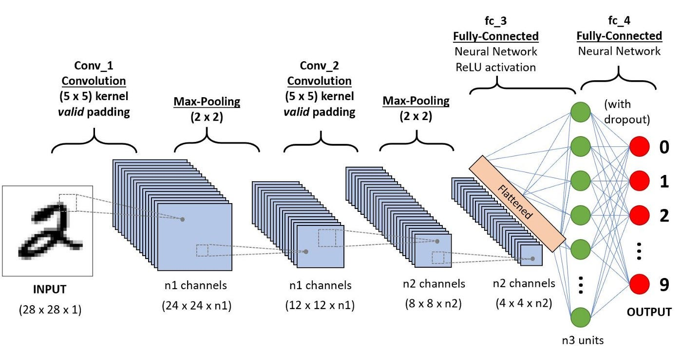
Introduction
This is a brief description about CNN.
Option1
Option2
Option3
https://medium.com/@draj0718/convolutional-neural-networks-cnn-architectures-explained-716fb197b243

Slide 3
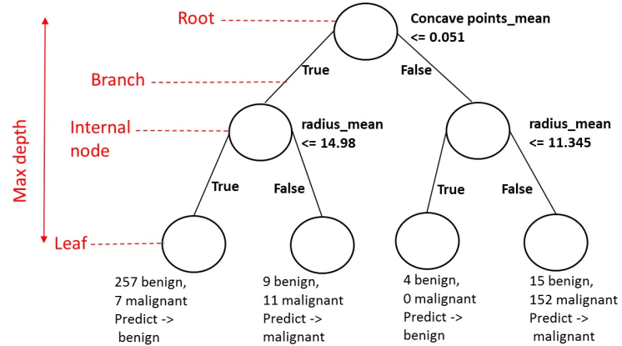
Introduction
This is a brief description about Decision Tree.
Option1
Option2
Option3
https://goldinlocks.github.io/Decision-trees-in-python/

Slide 4
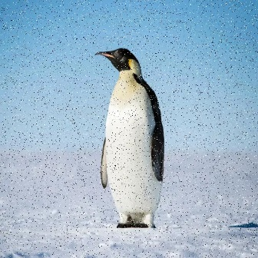
Introduction
This is a brief description about the homework design of Decision Tree.
Option1
Option2
Option3
Pretrained
CNN
Decision
Tree
attribute

Slide 5
Requirements
Please modify the codes in source code between # Begin your code and # End your code. In addition, do not import other packages.
Requirement2
Requirement3
For more detail requirements, please check the spec!

Slide 6
Implementation (70%)
Part 1-1: Data Preparation (5%)
Please design the data loading in utils.py and main.py
Part 1-2: Model Architecture (10%)
Please design your own decision tree in decision_tree.py
Part 1-3: Kaggle Evaluation Baseline (20%)
Evaluation the accuracy in Kaggle (accuracy > 75% for full score)

Slide 7
Implementation (70%)
Part 2-1: Model Architecture (10%)
Please design your own CNN in CNN.py
Part 2-2: Kaggle Evaluation Baseline (20%)
Evaluation the accuracy in Kaggle (accuracy > 80% for full score)
Part 2-3: Plot Training and Validation Loss(5%)
Please plot the CNN training and validation loss in utils.py

Slide 8
Report (30%)
You should write your report following the report template.
The report should be written in English.
Please save the report as a .pdf file. (font size: 12)
For every parts, please take some screenshots of your code and explain how you implement codes in detail.

Slide 9


Submission
Due Date: To Be Determined
Please compress your source code, results, and report (.pdf) into {STUDENTID}_hw3.zip. The file structure should look like:
{student_id}_hw3.zip
┣ main.py
┣ decision_tree.py
┗ report.pdf
Please zip the contents, instead of the _hw3 folder,
so there should NOT be a folder named
{student_id}_hw3 in the zip file.
Wrong submission format leads to -10 point.
Late Submission Policy
-20 points per late day (rounds up the day to the
next whole number).

Slide 10

QA Page
If you have any questions about this homework, please ask them on the following Notion page. We will answer them as soon as possible. Additionally, we encourage you to answer other students' questions if you have any idea

Slide 11
Reference
[1] CNN Architecture Explained (Medium)
https://medium.com/@draj0718/convolutional-neural-networks-cnn-architectures-explained-716fb197b243
[2] Decision trees (GitHub pages)
https://goldinlocks.github.io/Decision-trees-in-python/

Slide 12
Please check out the spec for more details!
Human-centered Intelligent Systems Lab

