Slide 1
The TinyTol optical system and grading cadence

Slide 2
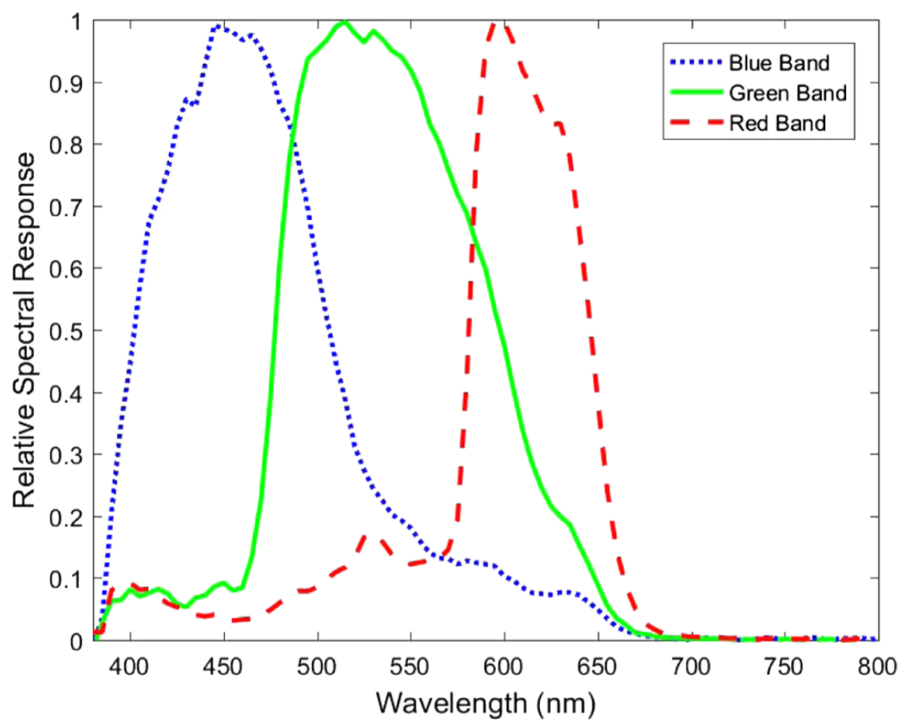
Optical system
Chip specifications:
Pixel size: 1.12μm x 1.12μm
Chip dimensions: 3280 x 2464 pixels
Optical specifications:
Folded optical system
150mm focal length lens
18mm aperture
Pupil mounted at a 5.8° angle to lens
Spectral response

Slide 3
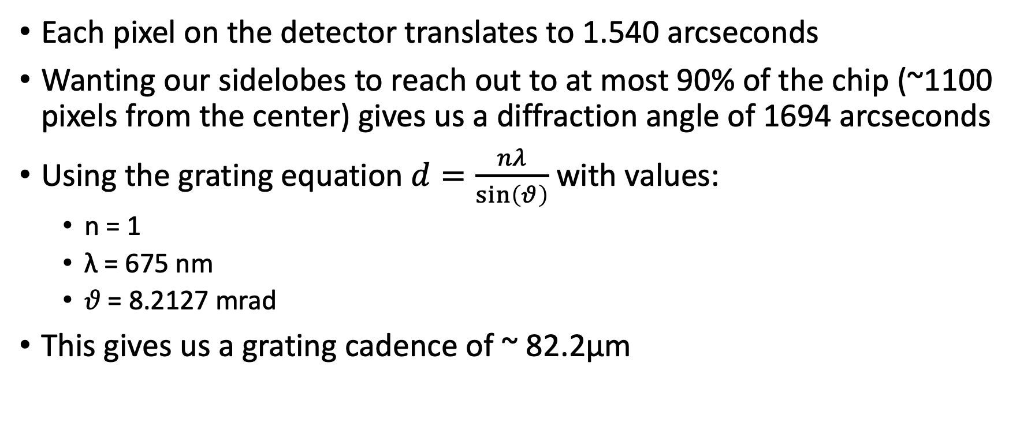
Grating cadence
Each pixel on the detector translates to 1.540 arcseconds
Wanting our sidelobes to reach out to at most 90% of the chip (~1100 pixels from the center) gives us a diffraction angle of 1694 arcseconds
Using the grating equation $d=\frac{nλ}{\sin\left(θ\right)}$ with values:
n = 1
λ = 675 nm
𝜗 = 8.2127 mrad
This gives us a grating cadence of ~ 82.2μm

