Slide 1
Optimizing the Tinytol pupil using Genetic and Hill climbing algorithms
Louis Desdoigts

Slide 2
Briefing:
The task given to me was to find optimizations that could be made to the current iteration of the Tinytol pupil (figure 1)
The value chosen to optimize was the max power delivered to any pixel across the array in the focal plane
By Finding the pupil that minimized this we hoped to spread the power across all the fringes in the array
No constraints were placed on either the amount of power contained within the 6λ/D region or the power gradient on the detector
Approach:
Starting from this base pupil (fig 1) - the code used to generate the pupil was modified such that it took in a list of Boolean values that is used to encode the different spirals
Each entry in this list corresponds to some section of the spiral that can either be ‘on’ or ’off’ (\pi or 0 phase)”
The hole in the middle of the pupil was widened in order to reduce computation time so that not too much time was spend making small changes to the spiral in the central regions of the pupil.
These lists were then permutated both through Genetic and Hill climbing algorithms in order to find optimize the pupil design

Slide 3
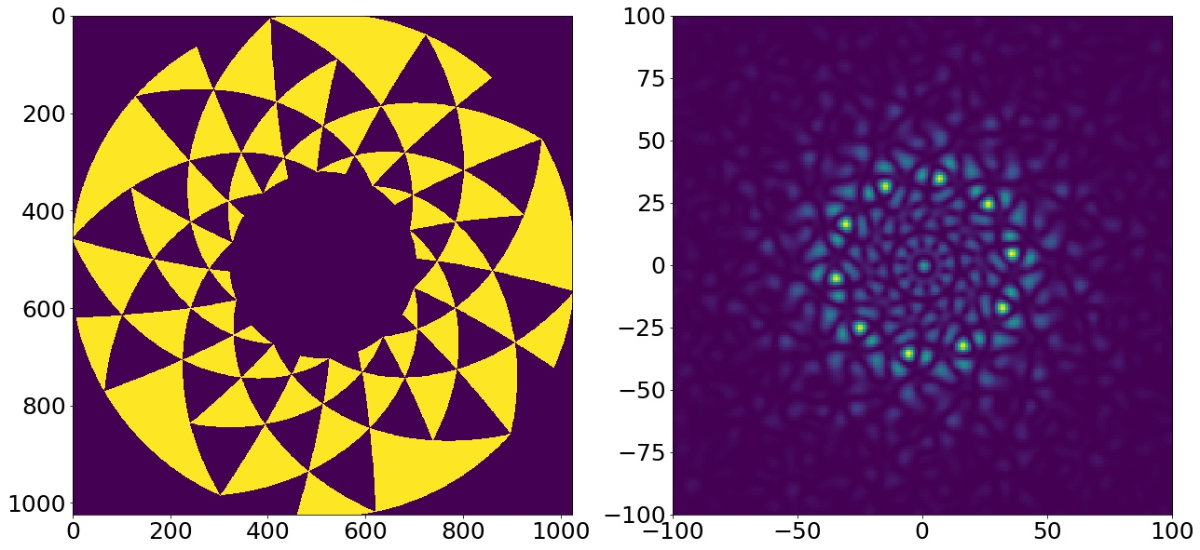
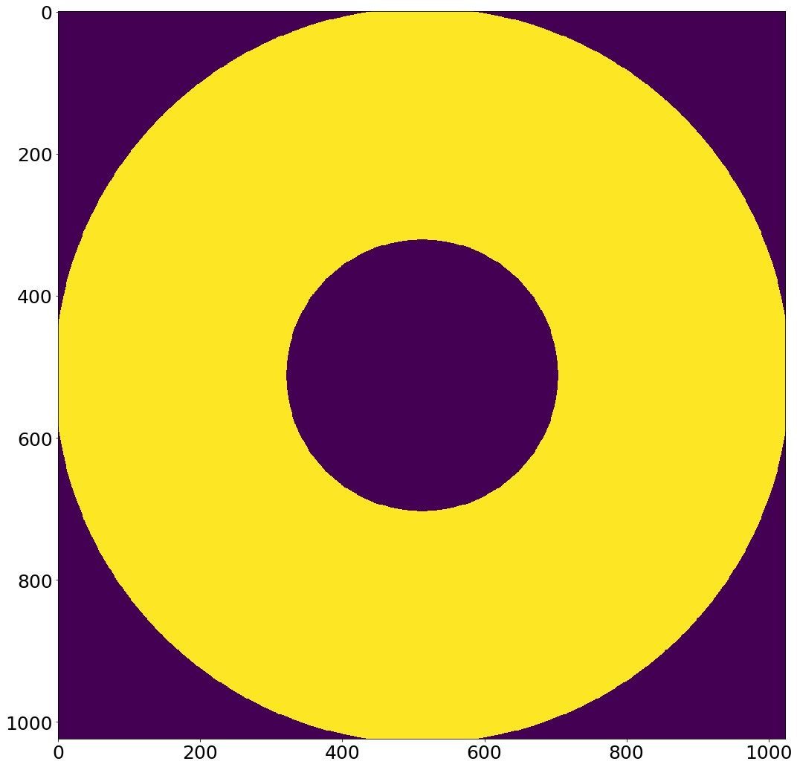
Starting point
Note: the Heuristic used has arbitrary units and is only a relative measure
Note: that 6λ/D converts to circle on the detector of with a radius of ~30 pixels. All images shown are a 120x120 pixel central region of the array
Note: These simulations were run on an aperture size of 15mm
Figure 1. Left, Initial pupil design. Right: Formed image
H = 92
Figure 2. Power delivered to the pupil

Slide 4
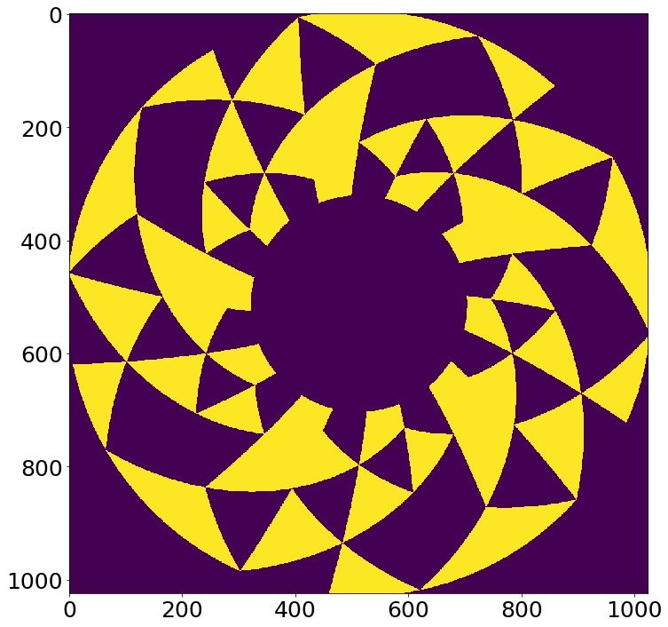
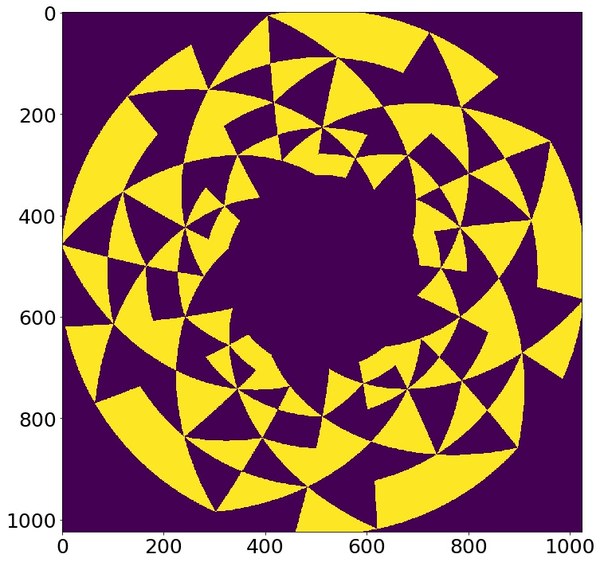
Whole Pupils and Half Pupils
Two different kinds of pupils were searched for, dubbed “half” and “whole” pupils.
Whole pupils refer to permutations of the original pupil that try flipping ‘whole triangle’ regions in the pupil
These pupils were found to have a lower-bound heuristic value of ~50
Half pupils refer to permutations of the original pupil that have had each triangle cut into two smaller triangles, each of which can be flipped independently
These pupils were found to have a lower-bound heuristic value of ~30
Figure 3. Example whole pupil
Figure 4. Example half pupil

Slide 5
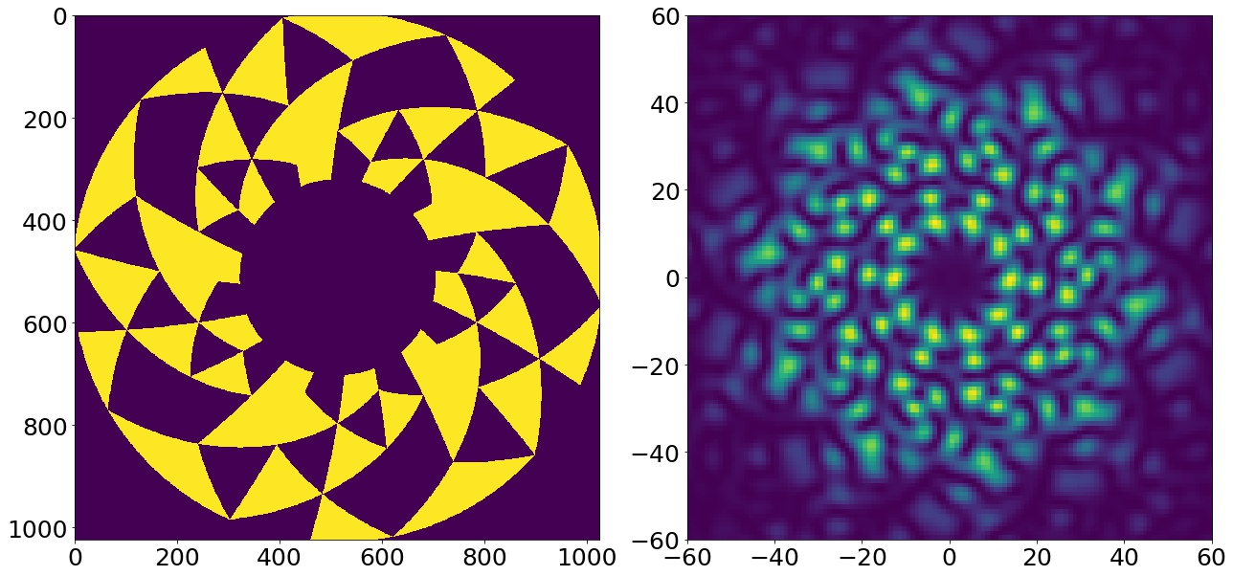

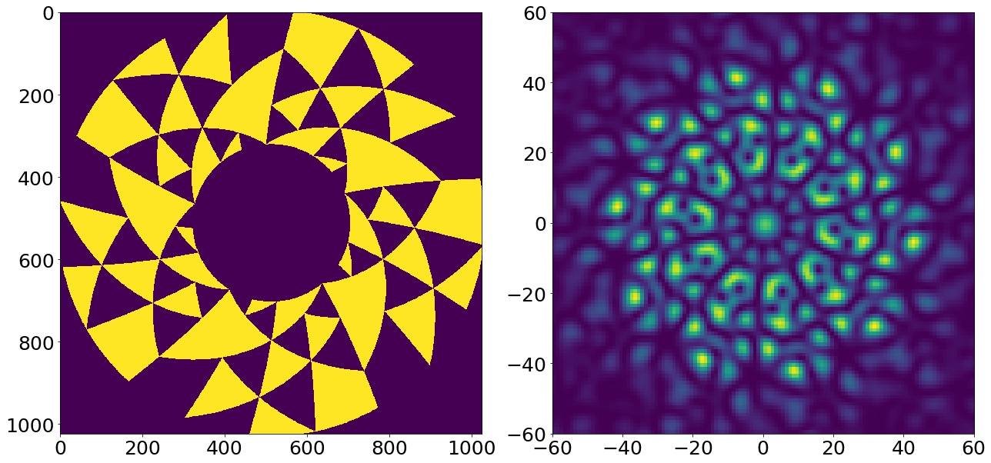
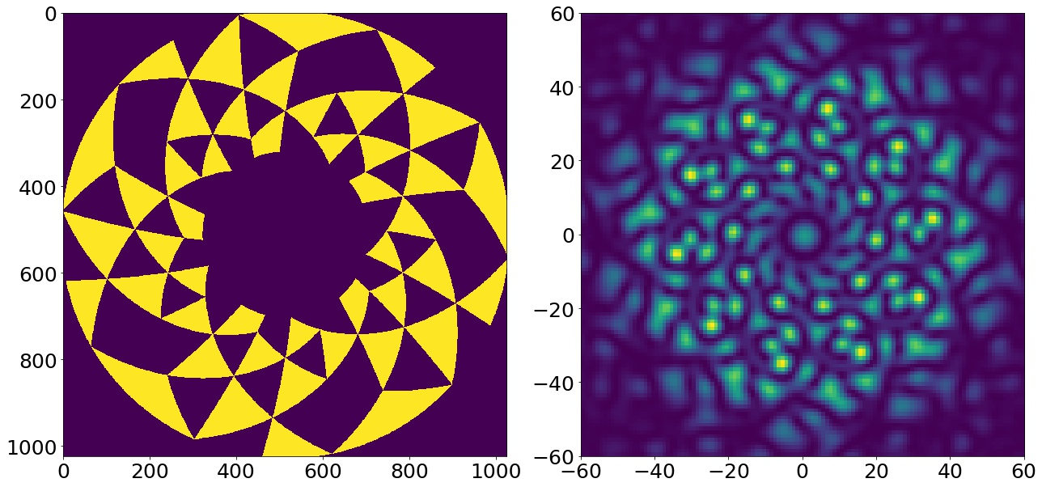
Whole Pupil designs
Figure 5. Heuristic value of 52
Figure 6. Heuristic value of 52
Figure 7. Heuristic value of 54
Figure 8. Heuristic value of 53

Slide 6
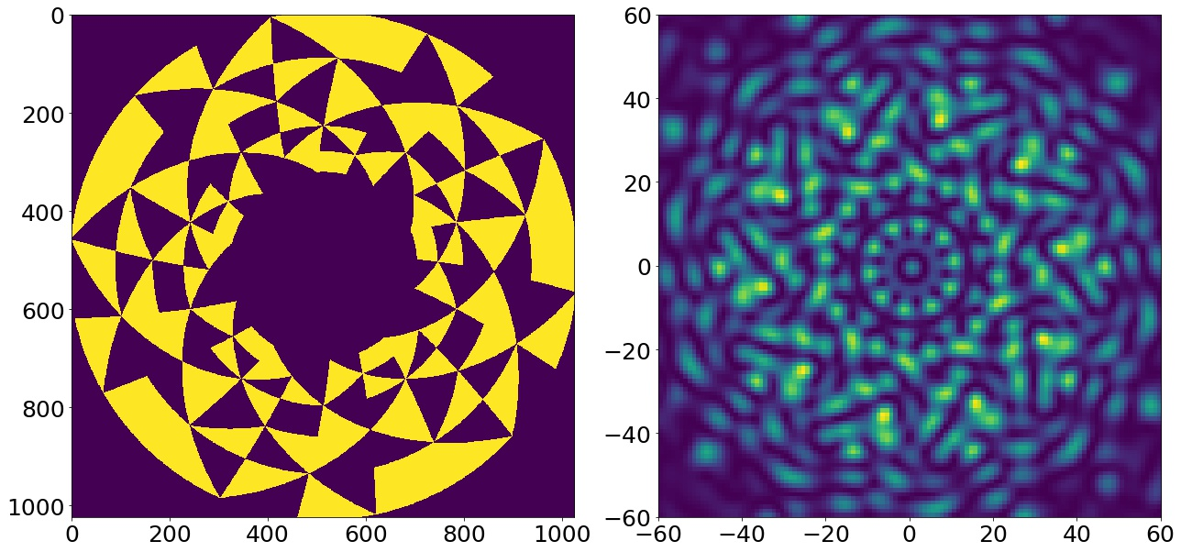
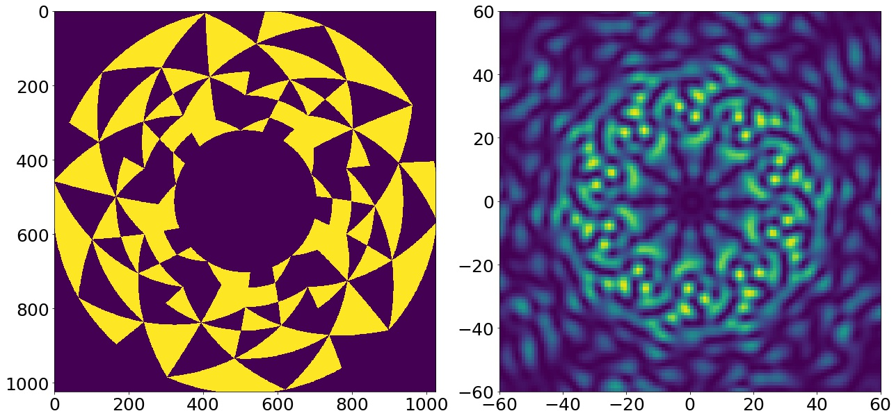
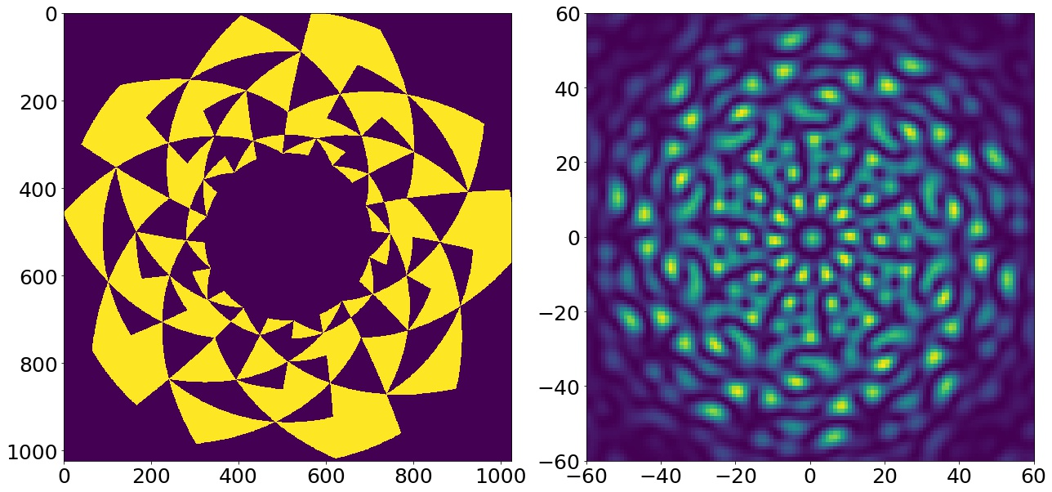
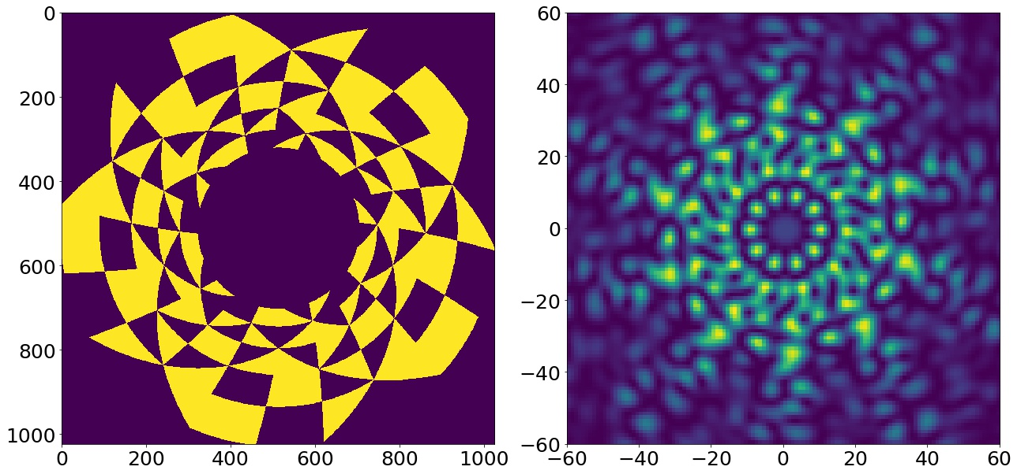
Half Pupil designs
Figure 9. Heuristic value of 34
Figure 10. Heuristic value of 36
Figure 11. Heuristic value of 37
Figure 12. Heuristic value of 37

Slide 7
Results and Discussion
Results:
The best pupils were found to have a heuristics value of 52 and 34 for the half and whole pupil respectively.
Using the given heuristic this reflects a large improvement (92 -> 34), showing that there is potentially a great deal more ideal pupils that haven’t been found.
These results could be improved upon given further computation time as these results were found just doing an initial exploration of the parameter space
Discussion:
More specialized pupils can be found using this method given a tighter set of design constraints
From these tight constraints we could construct a more rigorous heuristic that allows us to hone in on a design that is much more suited to what we want

Slide 8
Further work
It seems that the other teams working on this pupil have gone a different route in terms of their optimization methods. The method I have used in limited in the sense that it can only make modifications to a pre-designed base pupil and optimize from there
Re-defining our heuristic to better match the tight constraints could be done in order to find a new base pupil,. This could then be further optimized using the ‘table top’ algorithm described by Kieran
Hopefully these different designs can be incorporated in some manner that further idealizes the pupil
As mentioned earlier a better heuristic function is the starting point of any further optimization among all the teams

Slide 9
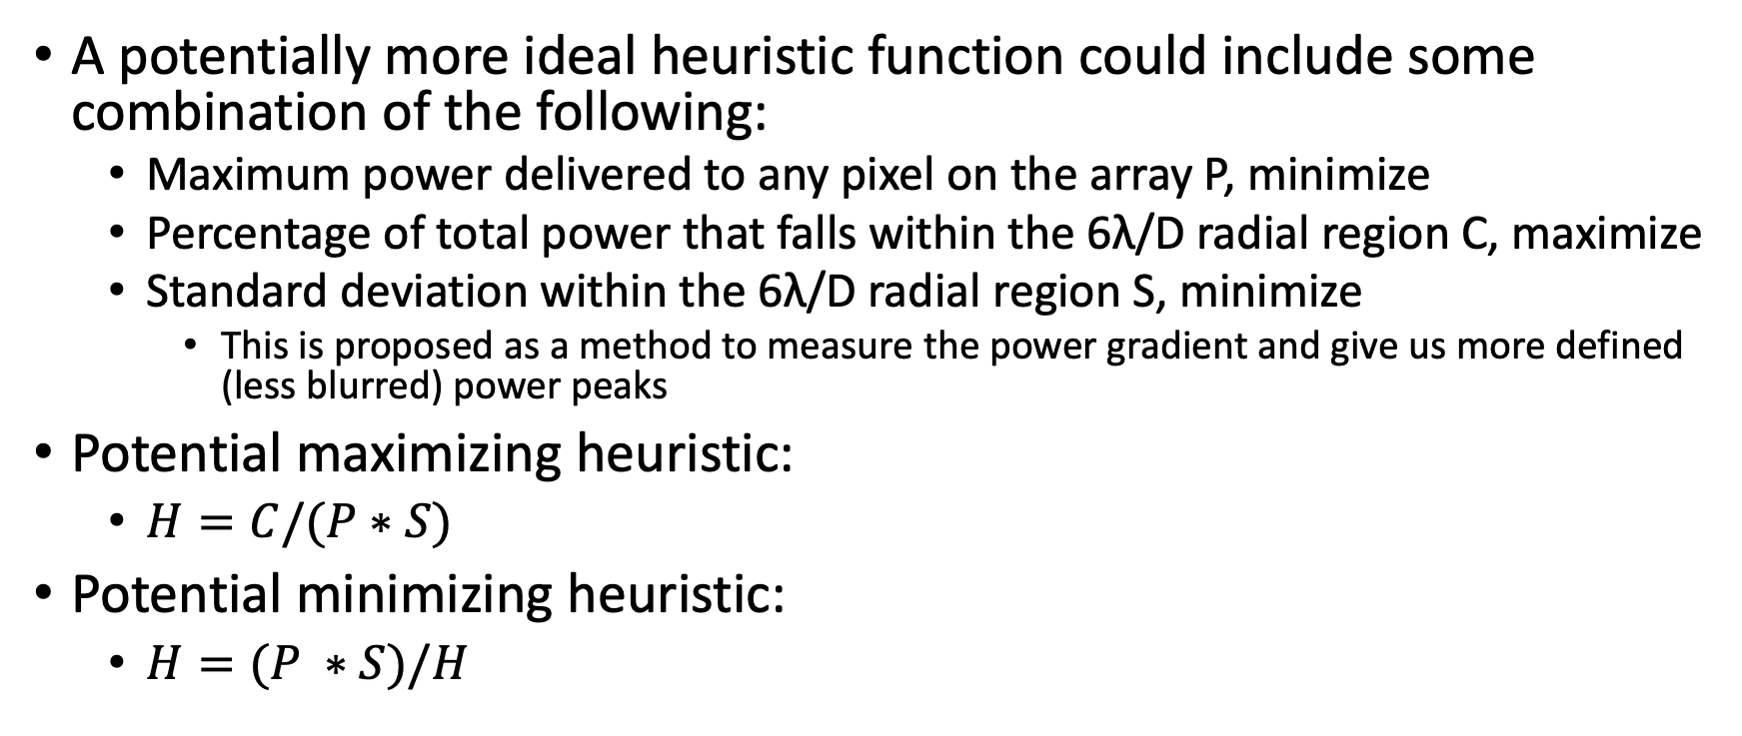
Potential Heuristic functions
A potentially more ideal heuristic function could include some combination of the following:
Maximum power delivered to any pixel on the array P, minimize
Percentage of total power that falls within the 6λ/D radial region C, maximize
Standard deviation within the 6λ/D radial region S, minimize
This is proposed as a method to measure the power gradient and give us more defined (less blurred) power peaks
Potential maximizing heuristic:
$H=C/(P∗S)$
Potential minimizing heuristic:
$H=(P ∗S)/H$

