Slide 1
TreeNet Data in Vetroz

Slide 2
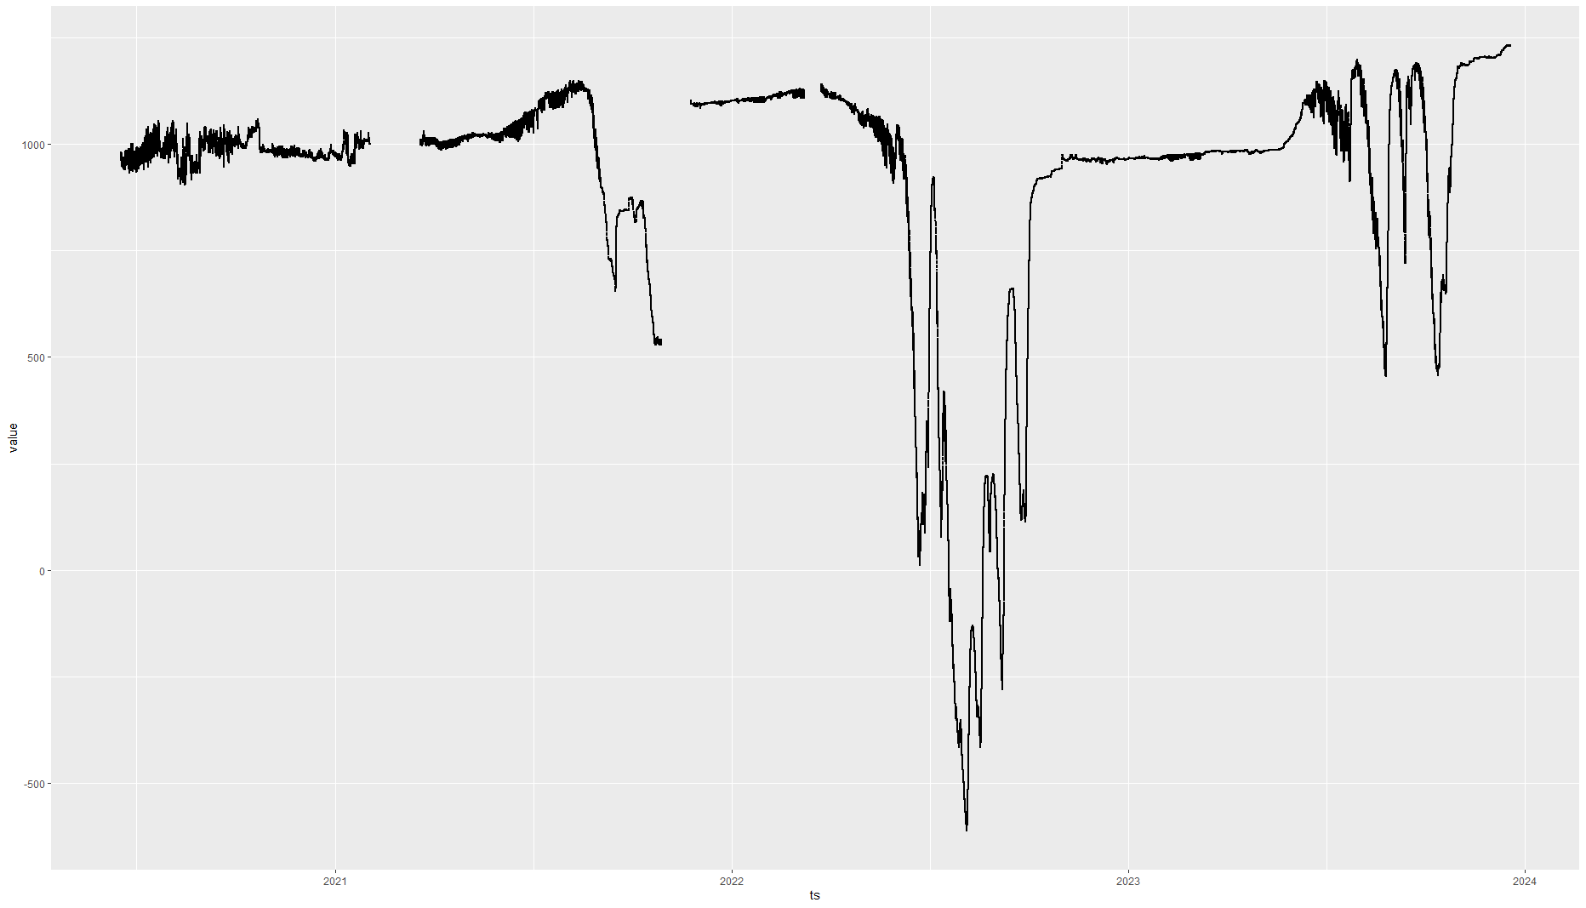
Worst offender – series 1357 Sensor 15417

Slide 3
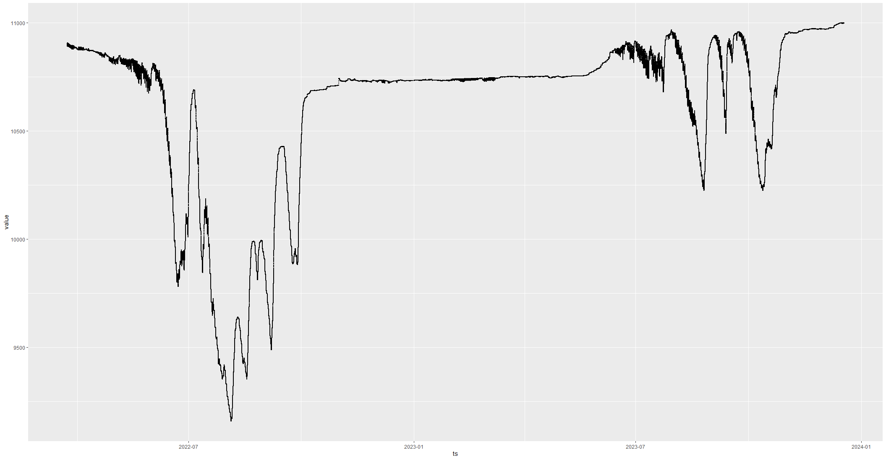
Series 1812 Sensor 15417

Slide 4
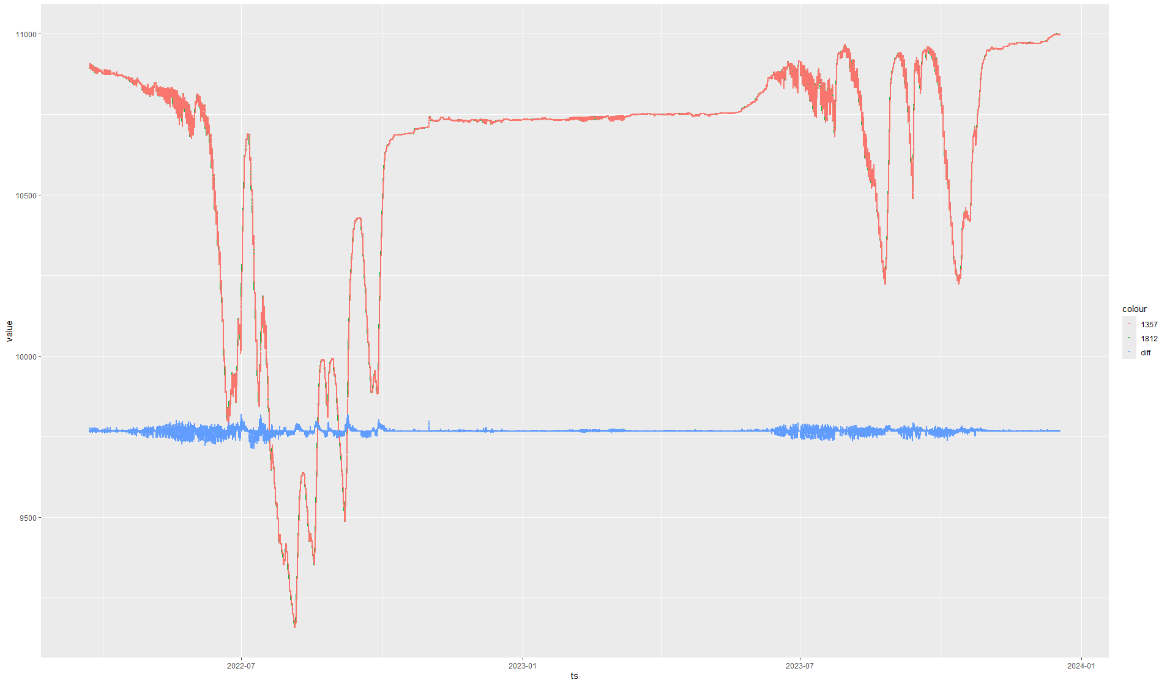

Slide 5
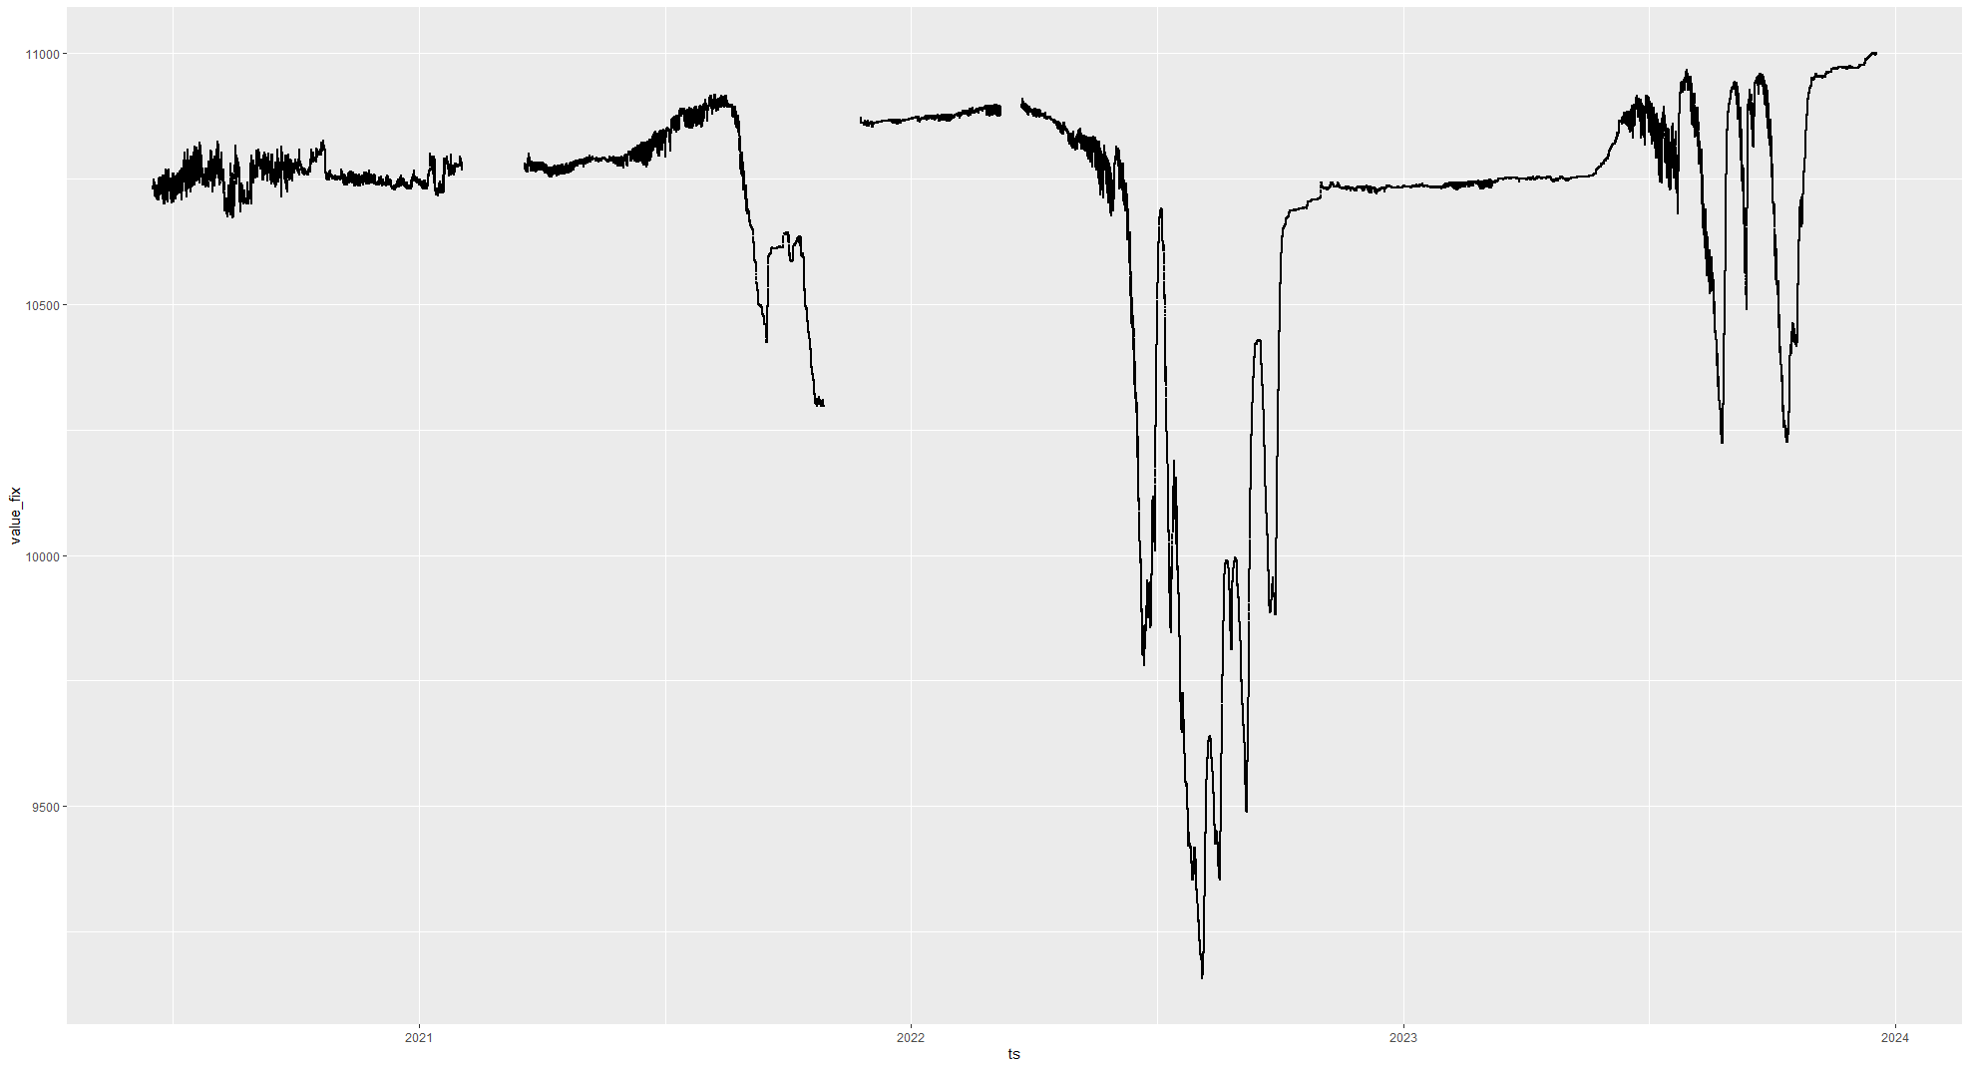
Fixed series 1357 Sensor 15417

Slide 6
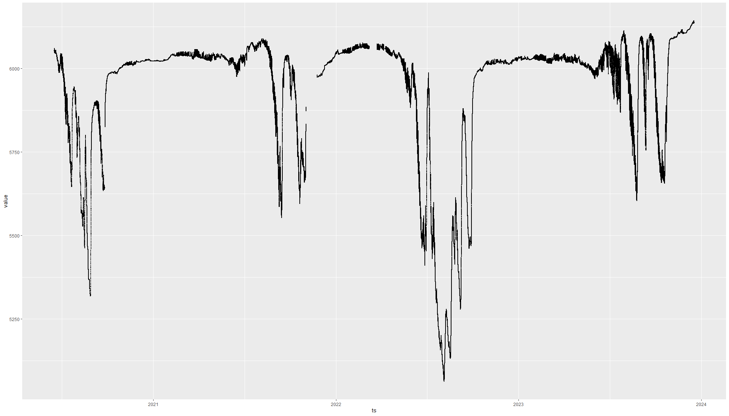
Next example – series 1362 Sensor 15418

Slide 7
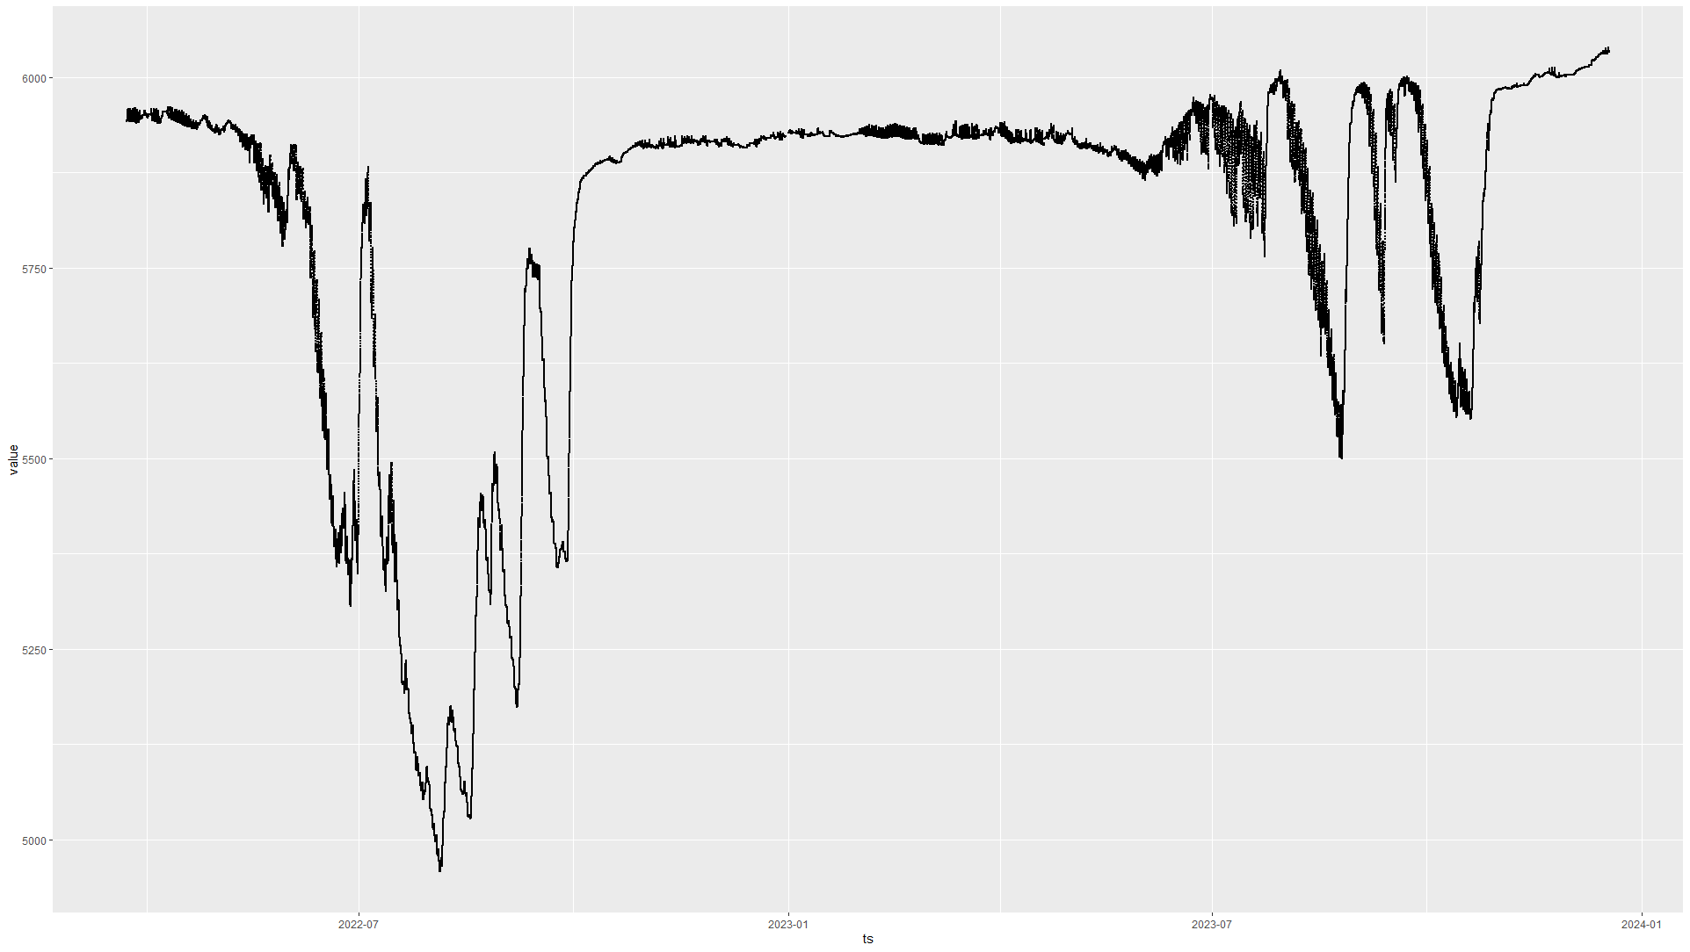
Series 1813 Sensor 15418

Slide 8
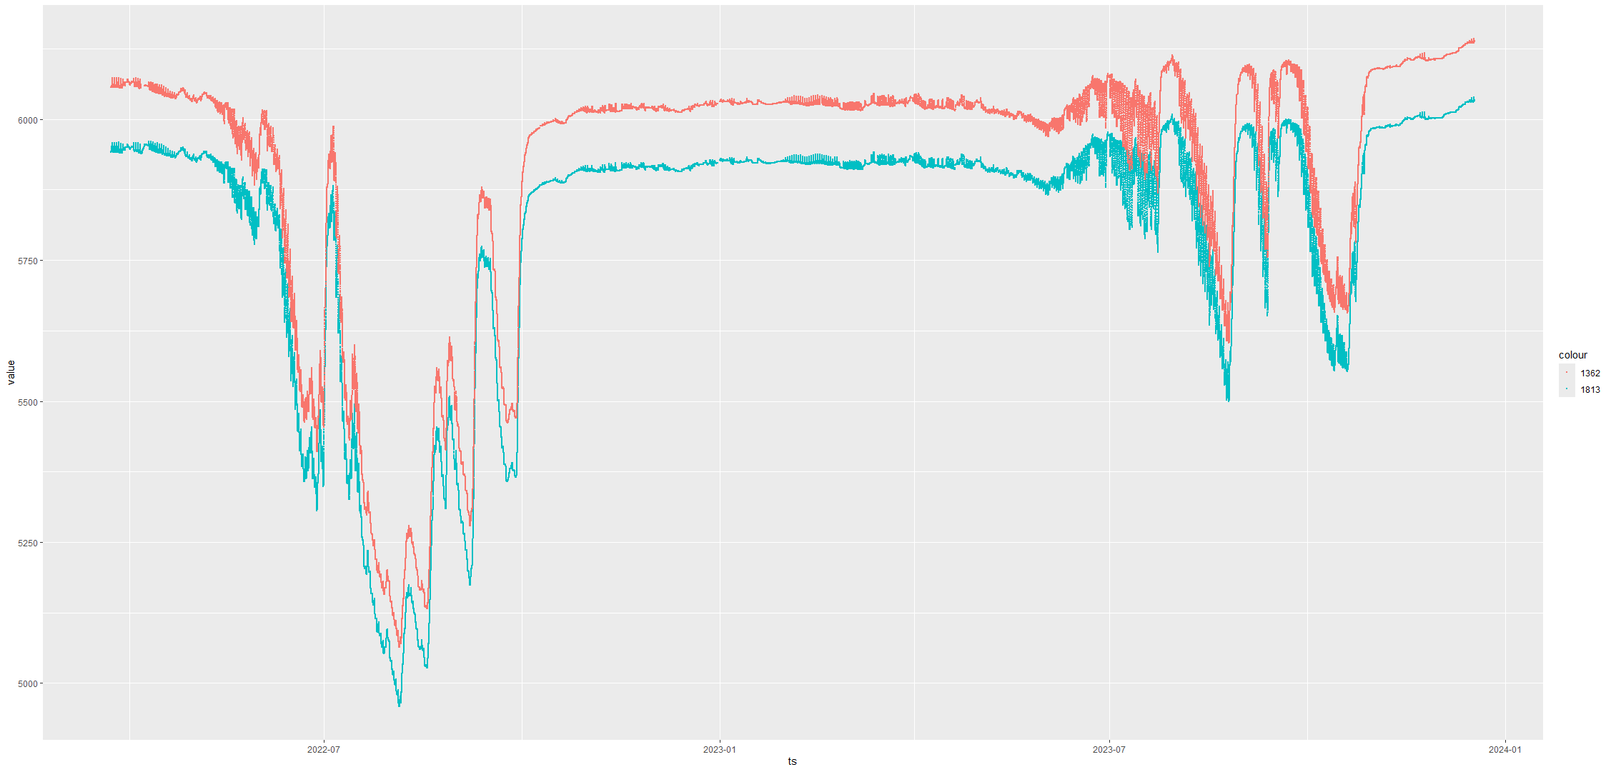
~500 missing values from longer data set for overlapping time period
Sensor 15418

Slide 9
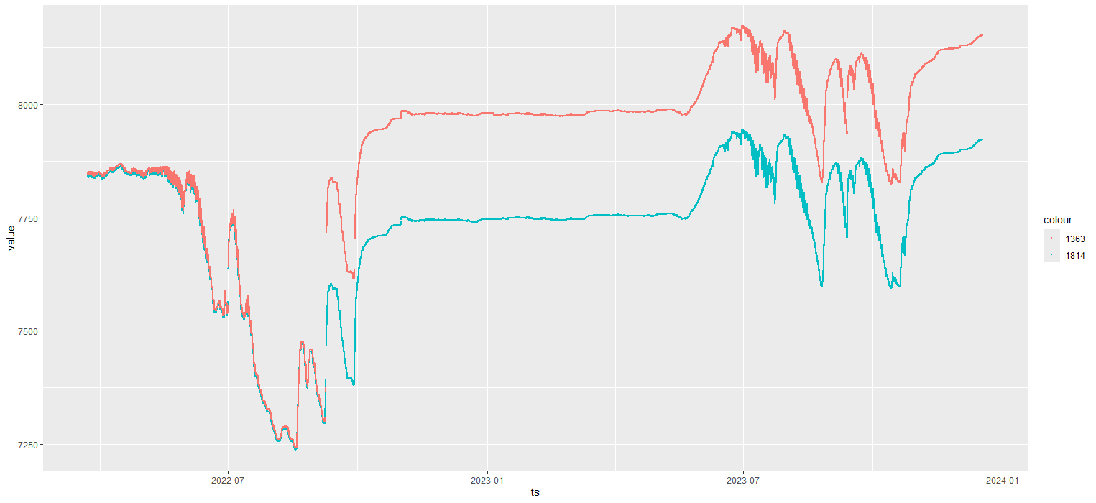
Sensor 15419

Slide 10
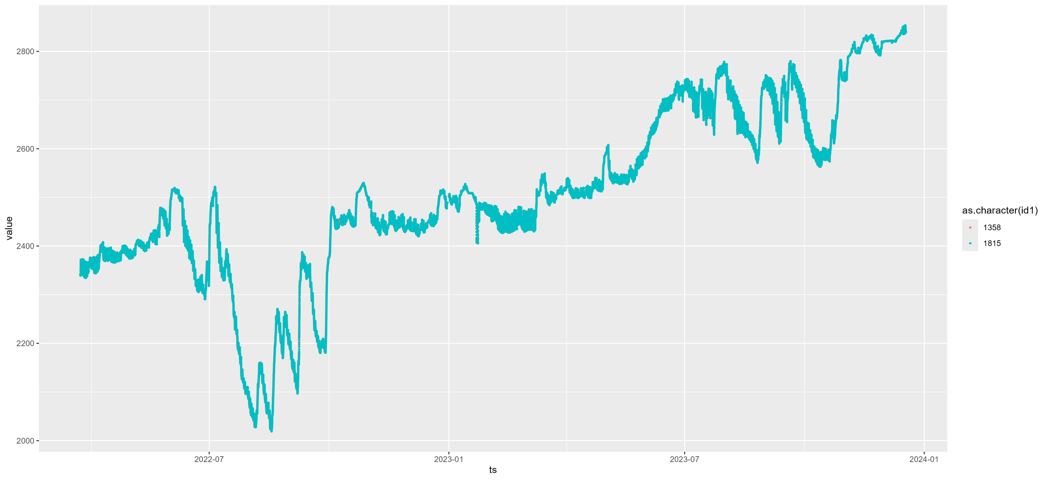
Sensor 15422

Slide 11
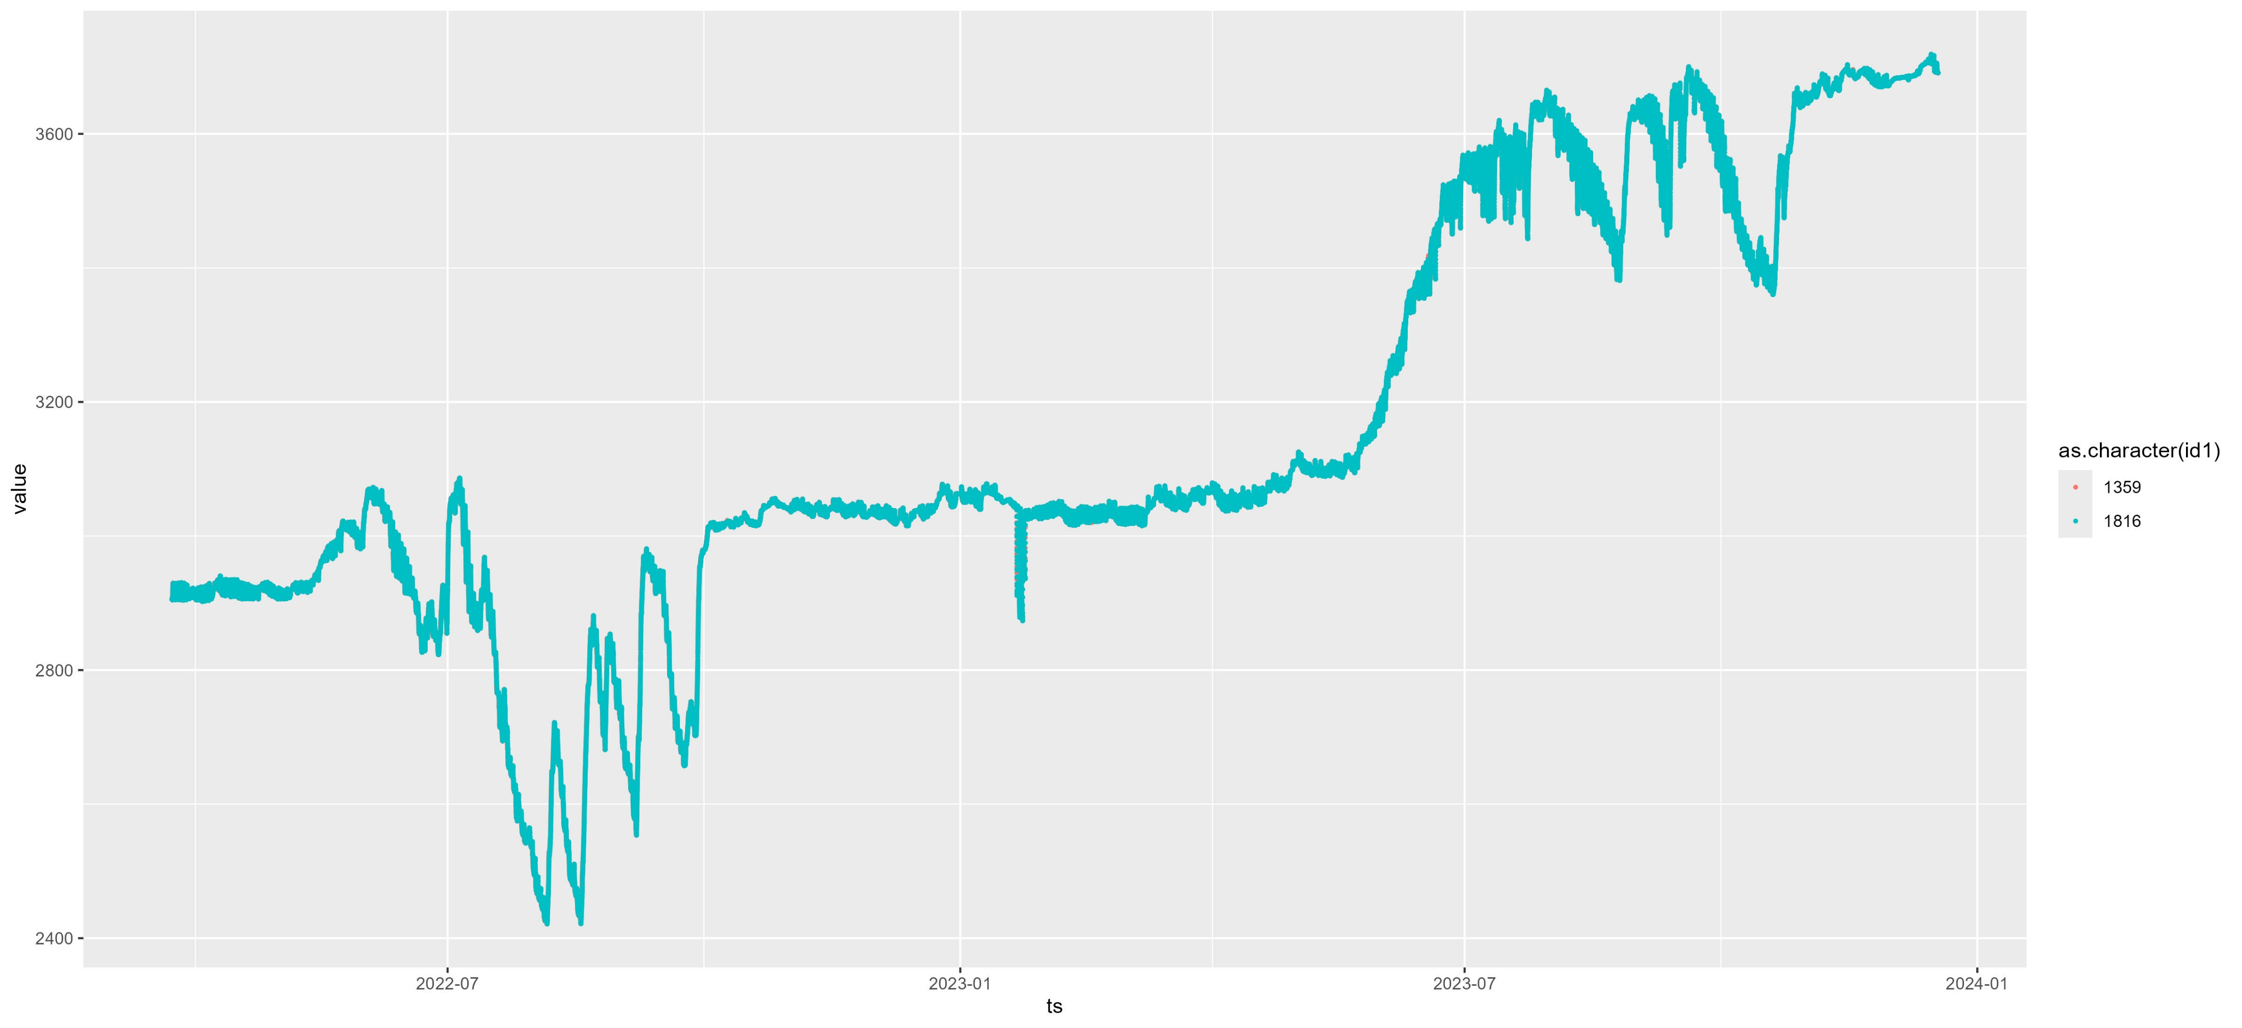
Sensor 15423

