Slide 1
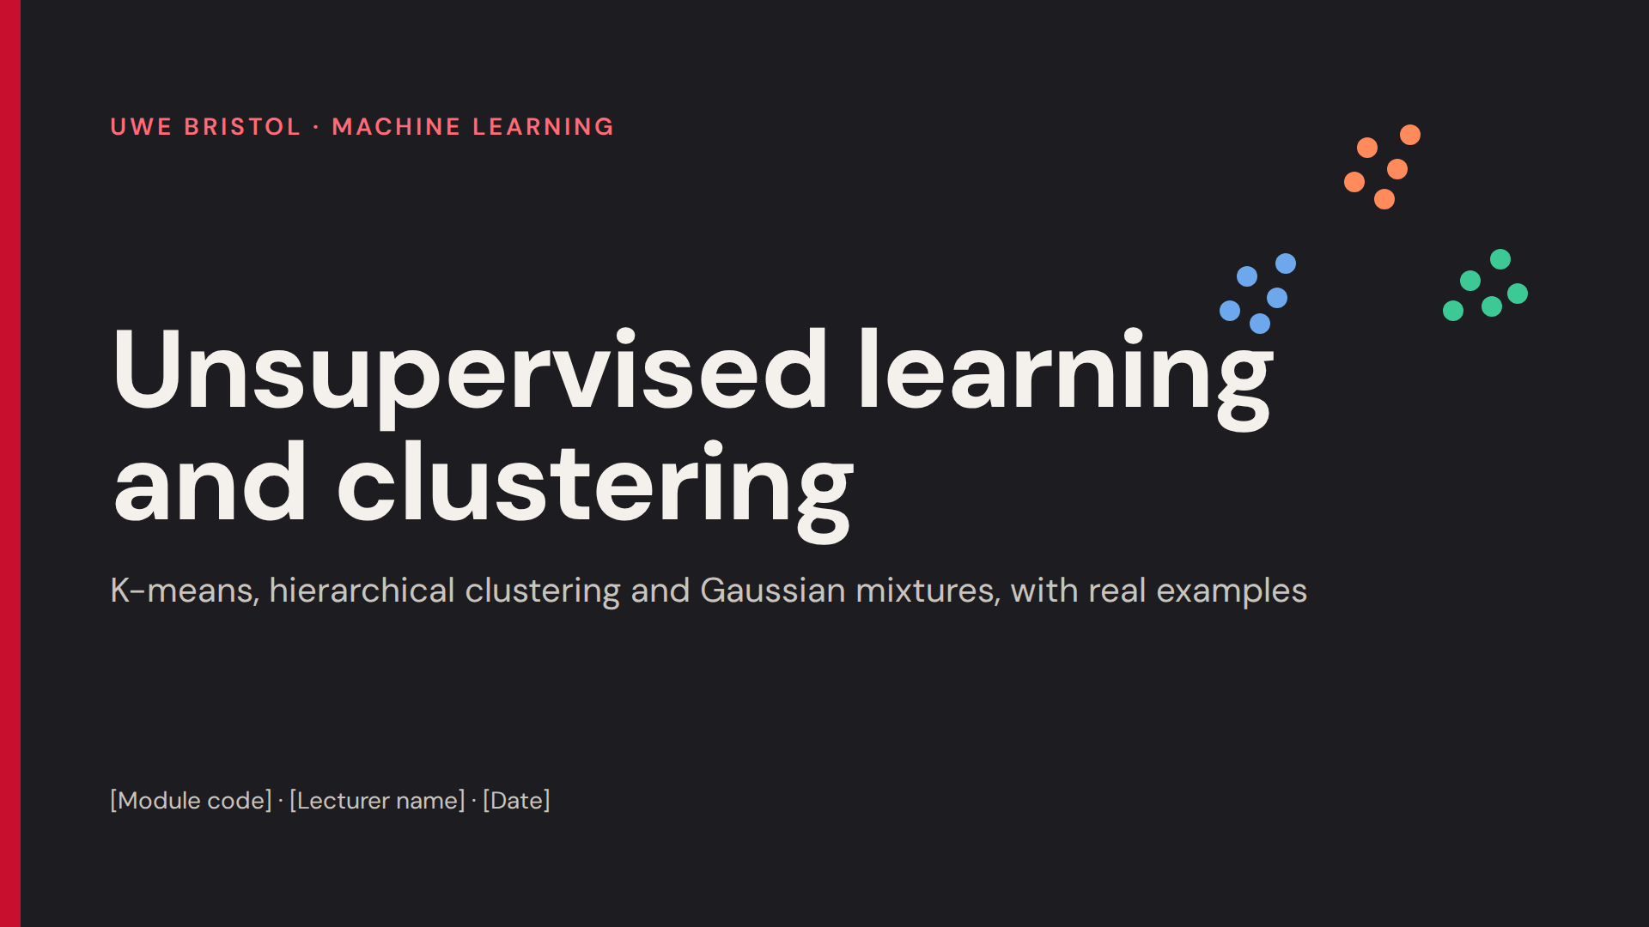
With a recap into regression errors

Slide 2
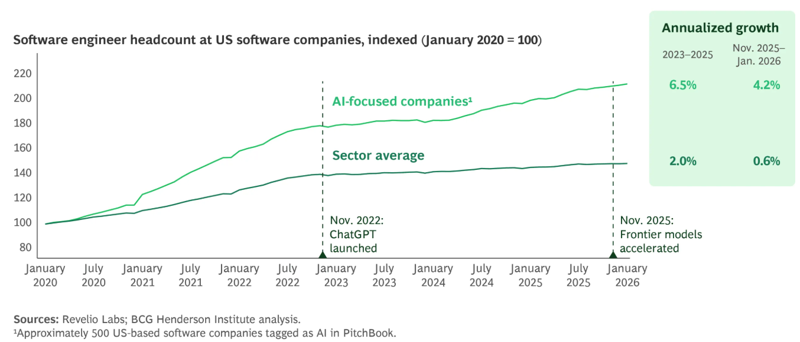

Slide 3
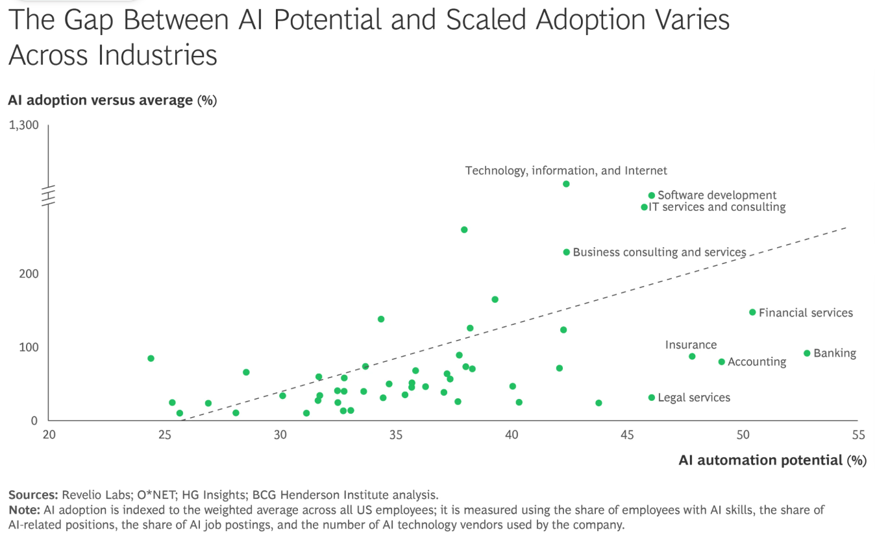
AI Will Reshape More Jobs Than It Replaces | BCG

Slide 4
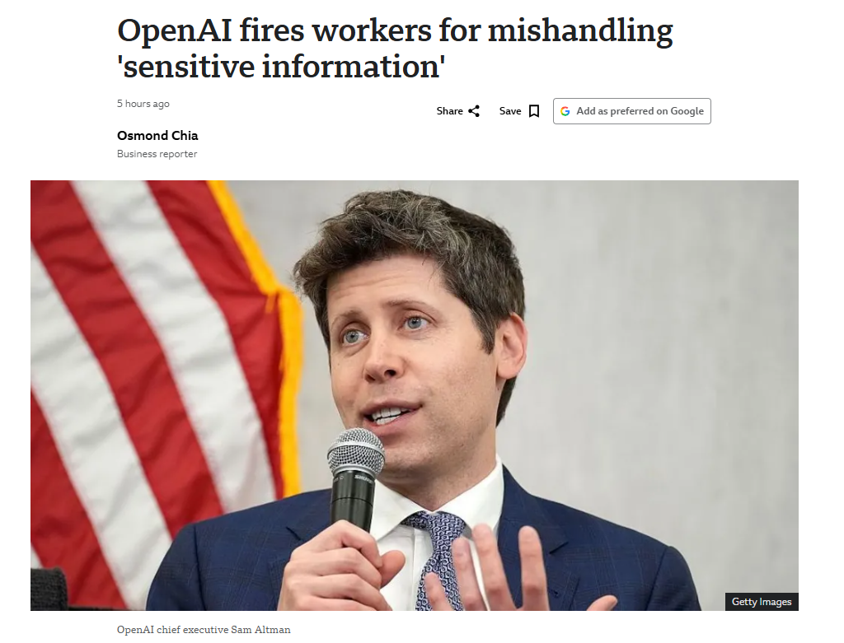
"Our investigation confirmed that these individuals mishandled sensitive information outside established company procedures, violating our policies and breaking the trust essential to our work," a spokesperson told the BBC.
The ChatGPT-maker did not name the sacked workers, but at least two of them were involved in safety research at the firm.
Be mindful of what you input into these large language models!

Slide 5
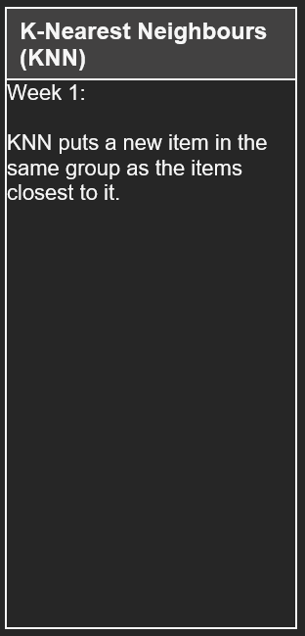
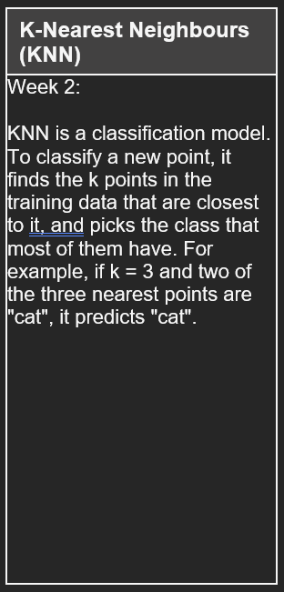
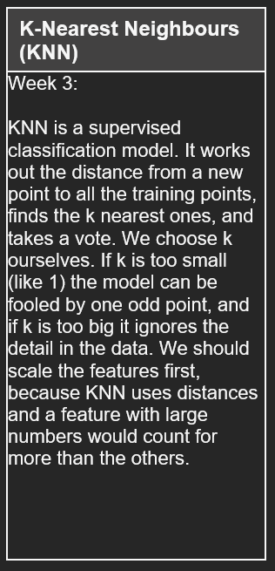
Please revise the learning models.
Go through the notebooks and write what you know about them, increasing every session or week.

Slide 6
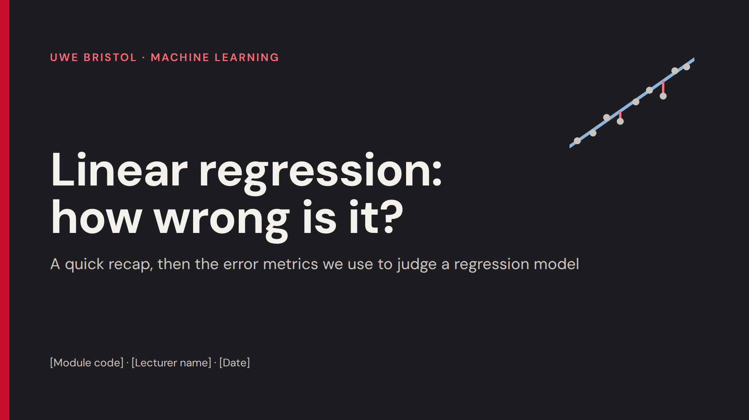

Slide 7
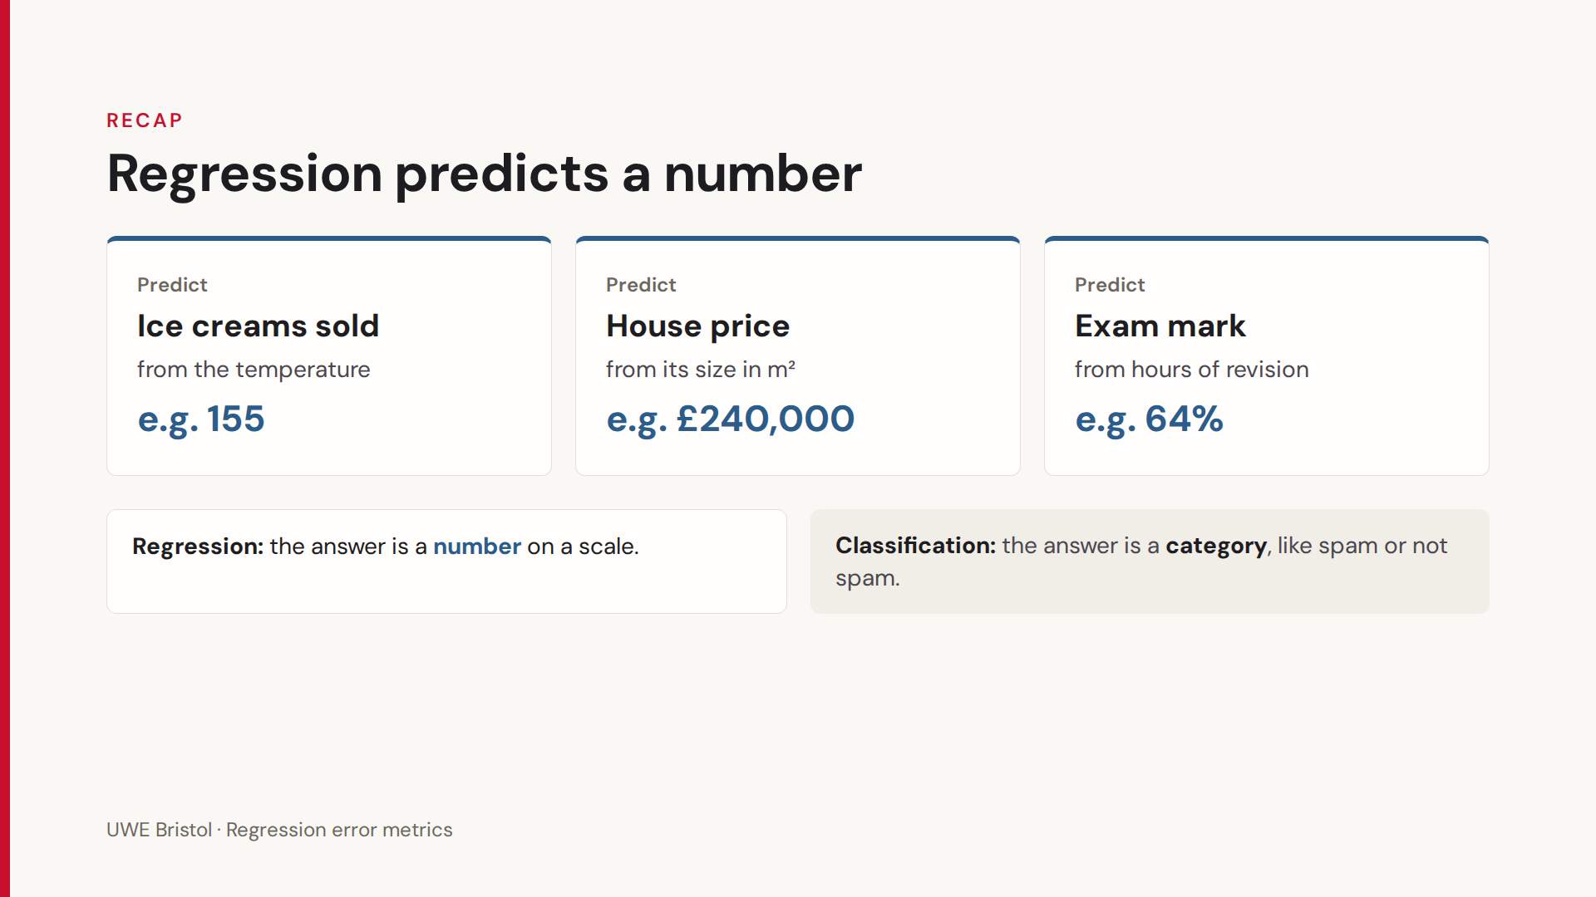

Slide 8
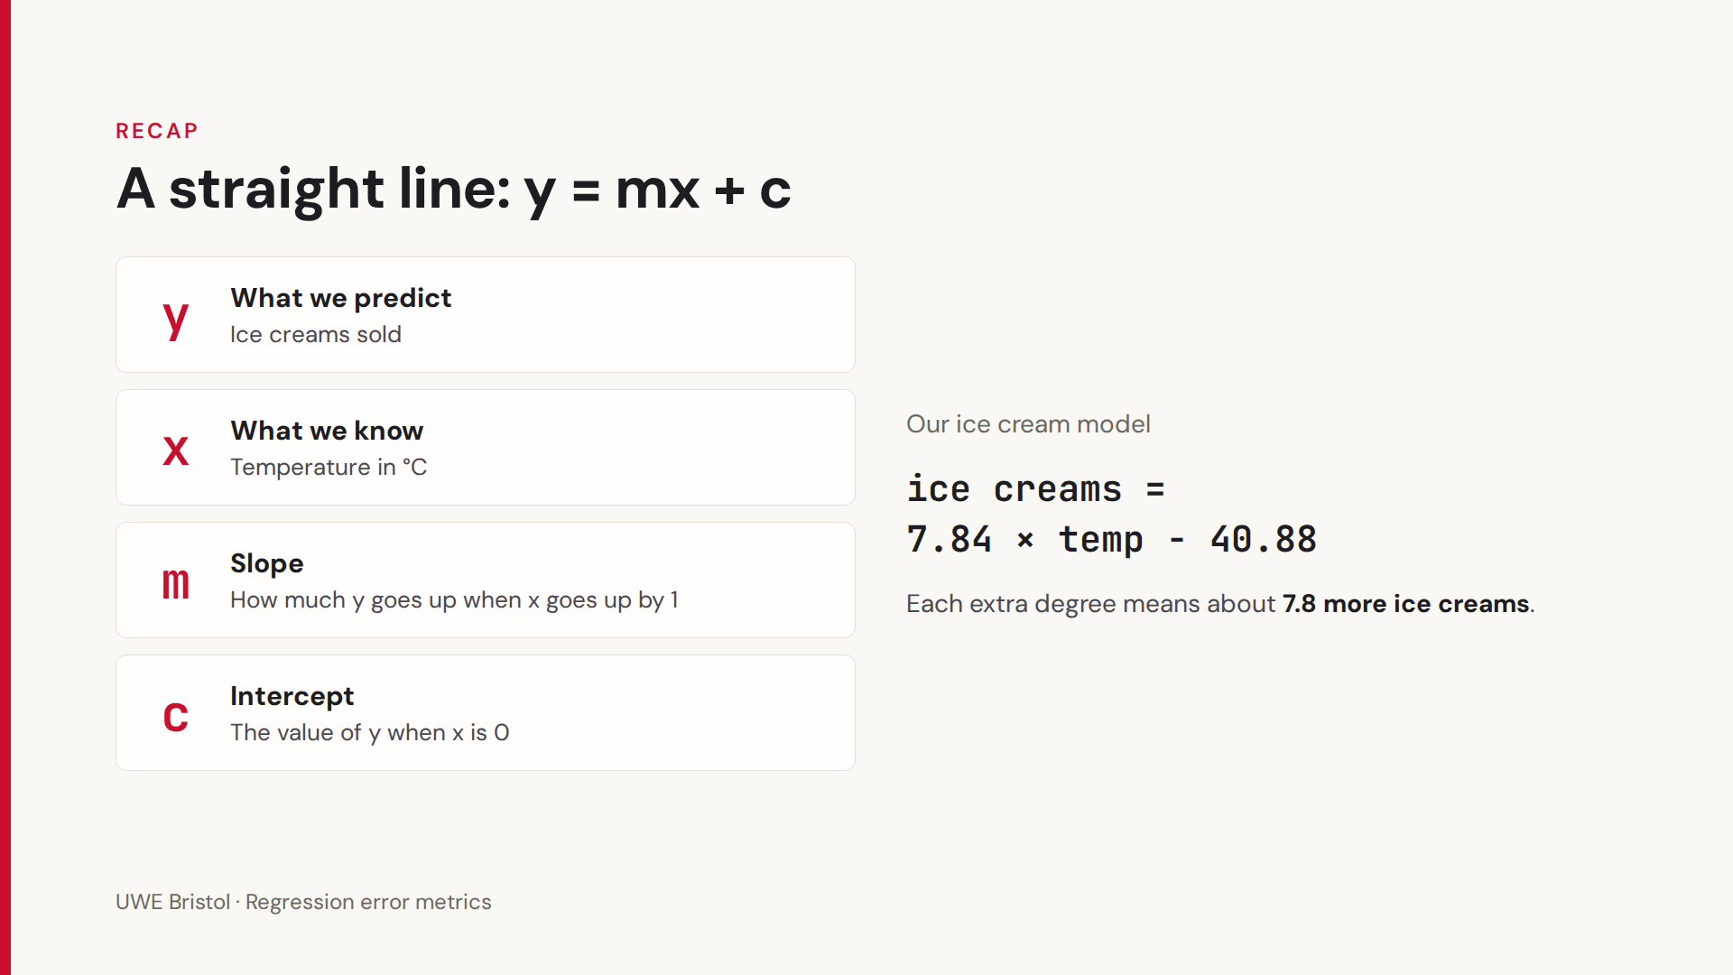
Please try to remember this

Slide 9
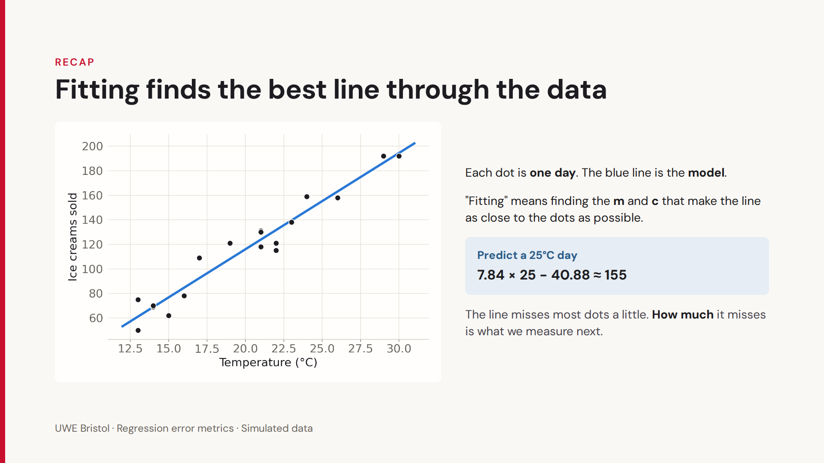

Slide 10
Let’s actually draw a linear regression model together

Slide 11
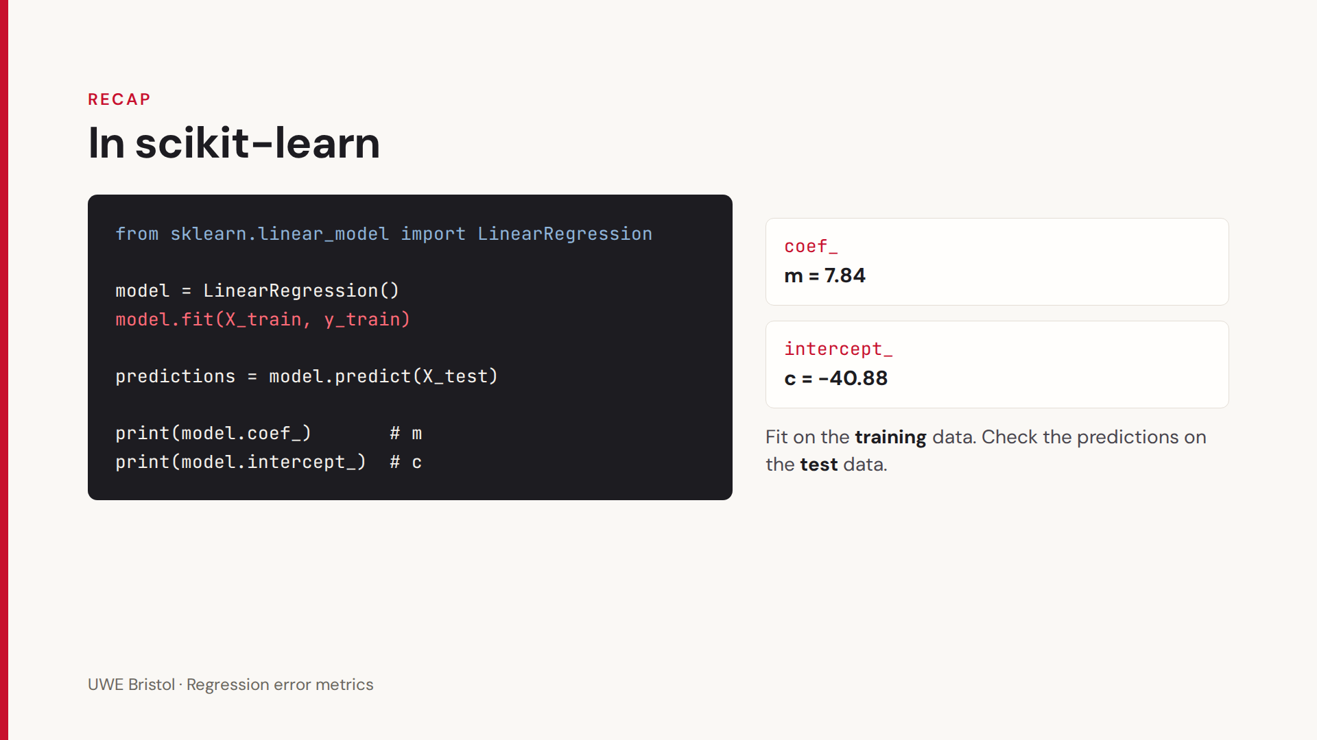
slopes_and_intercepts.ipynb

Slide 12
Area | Possible inputs (x) | Output (y)
Retail | Temperature, day of the week, school holidays | Number of ice creams sold
Housing | Floor area (m²), number of bedrooms, distance to the city centre | House price (£)
Education | Hours of revision, attendance (%), mock exam mark | Final exam mark (%)
Cars | Engine size, weight, age of the car | Fuel economy (miles per gallon)
Used cars | Age, mileage, engine size | Resale price (£)
Energy | Outside temperature, time of day, day of the week | Electricity demand (MW)
Solar power | Hours of sunshine, cloud cover, month | Energy generated by a solar panel (kWh)
Health and fitness | Height, age, weekly exercise (hours) | Body weight (kg)
Sport | Distance run in training, previous race times, age | Marathon finish time (minutes)
Football | Shots on target, possession (%), passes completed | Goals scored in a match
Agriculture | Rainfall, fertiliser used, hours of sunshine | Crop yield (tonnes per hectare)
Transport | Distance, time of day, number of stops | Journey time (minutes)
Deliveries | Distance, parcel weight, traffic level | Delivery time (minutes)
Hospitality | Price per night, star rating, distance to the beach | Hotel bookings per month
Marketing | Advertising spend on TV, radio and social media | Sales (£)
Streaming | Trailer views, number of well-known actors, budget | First-week viewing figures
Coffee shop | Time of day, temperature, footfall outside | Coffees sold per hour
Jobs | Years of experience, qualification level, region | Starting salary (£)
Environment | Traffic volume, wind speed, temperature | Air pollution level (NO₂, µg/m³)
Gaming | Hours played, number of friends on the platform | In-game spending (£)
Phones | Screen-on time, number of apps running, screen brightness | Battery life (hours)
Weather | Today's temperature, humidity, air pressure | Tomorrow's temperature (°C)

Slide 13
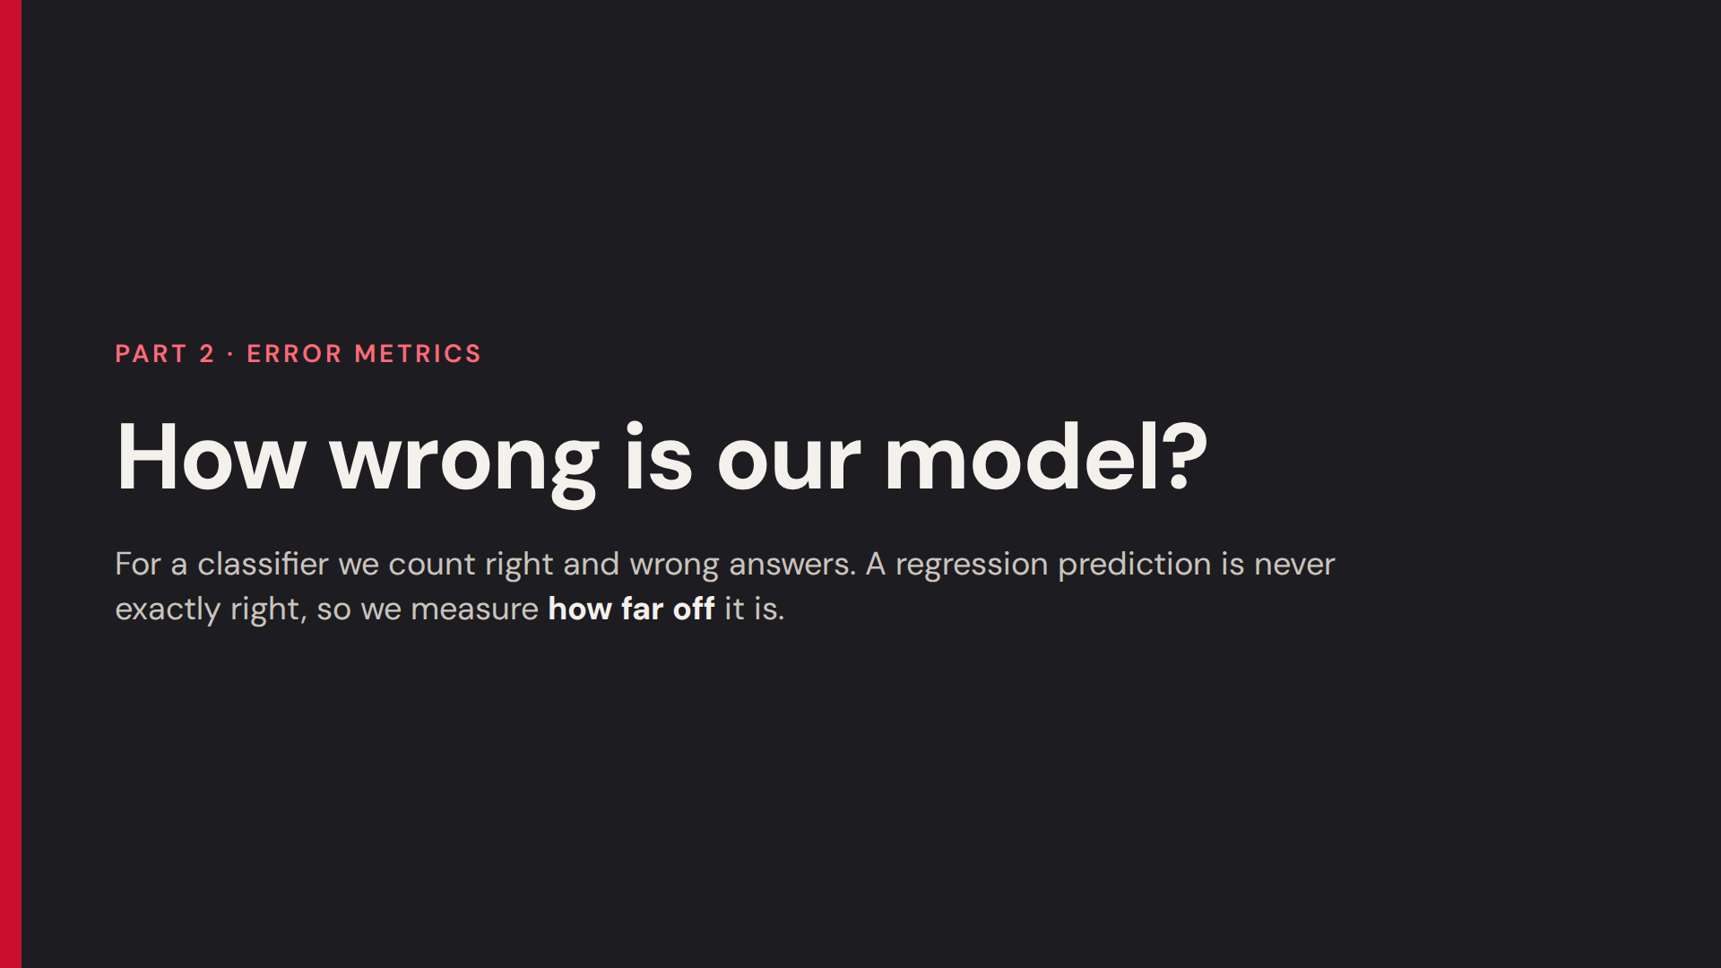

Slide 14
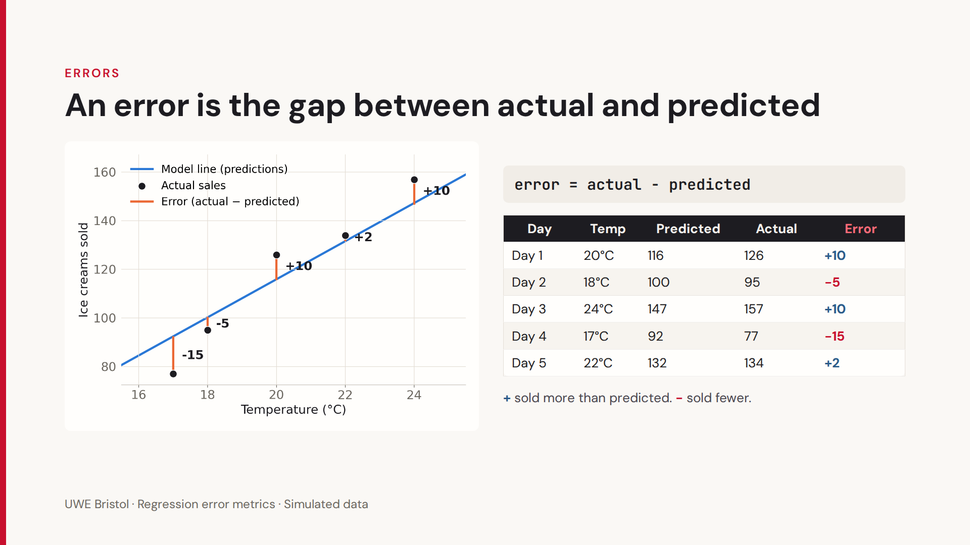

Slide 15
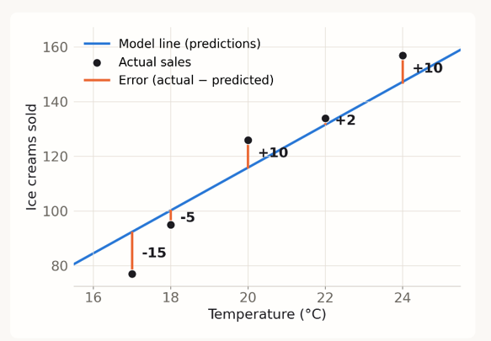
If we add another line to this model that is poor, we can see the error is higher..
(add the line Ryan)

Slide 16
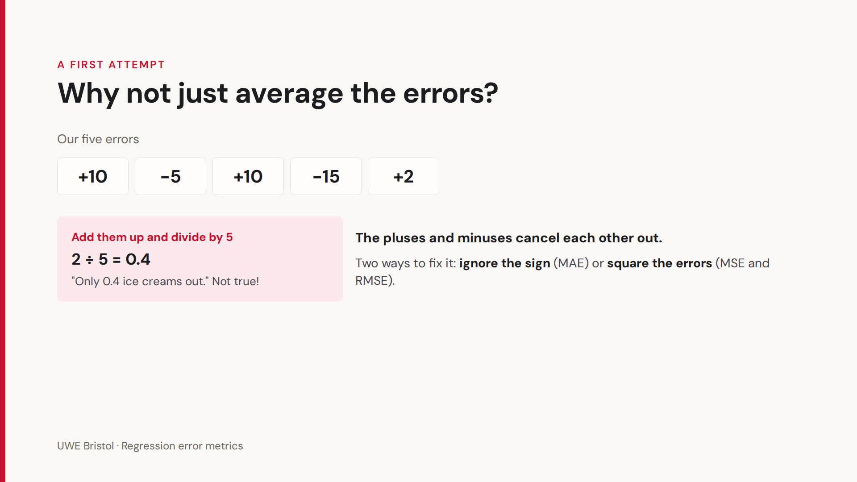
= 2

Slide 17
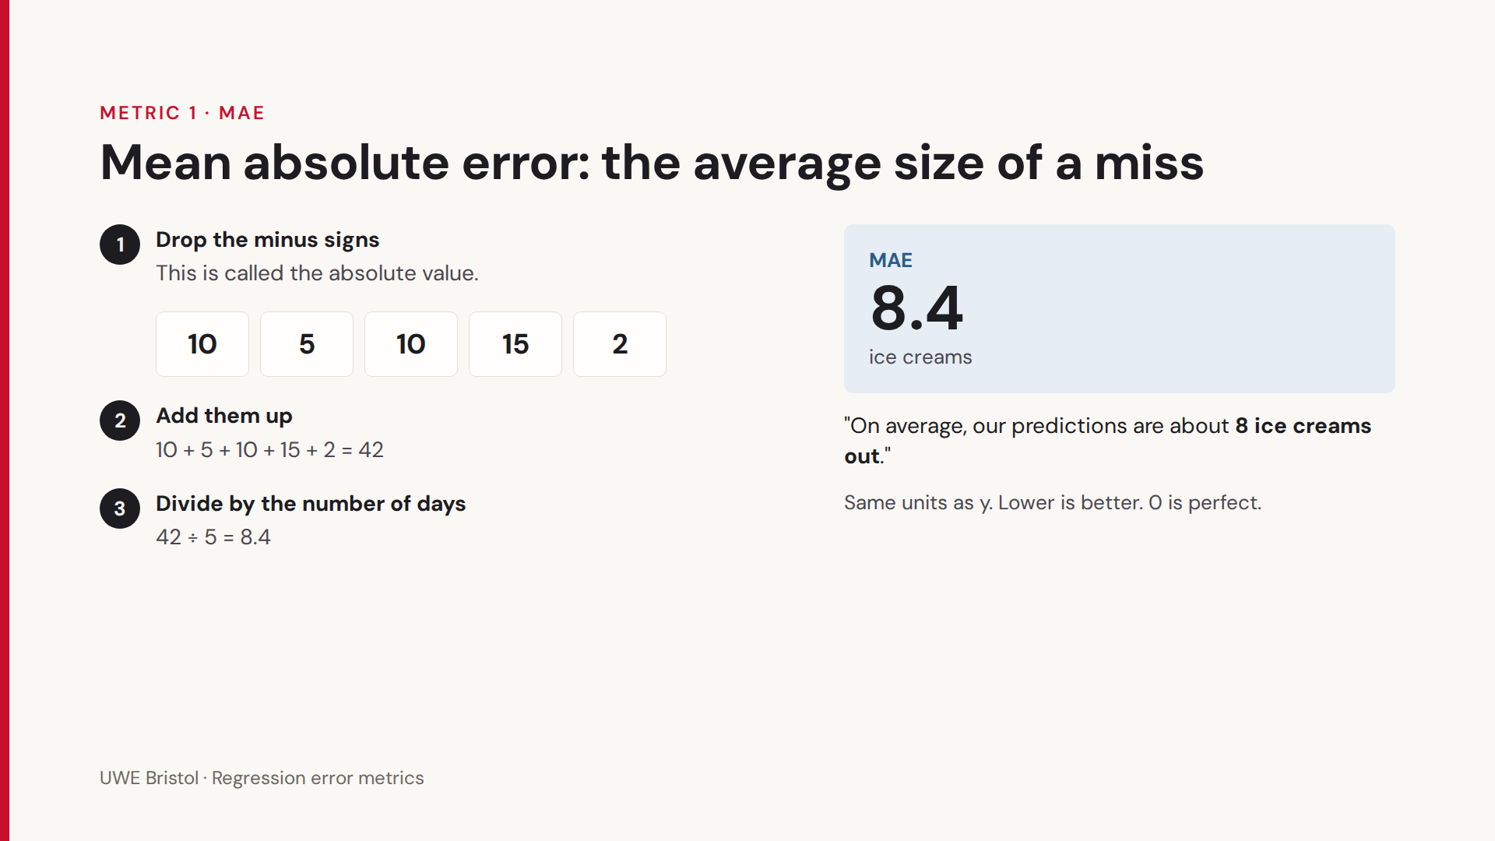

Slide 18
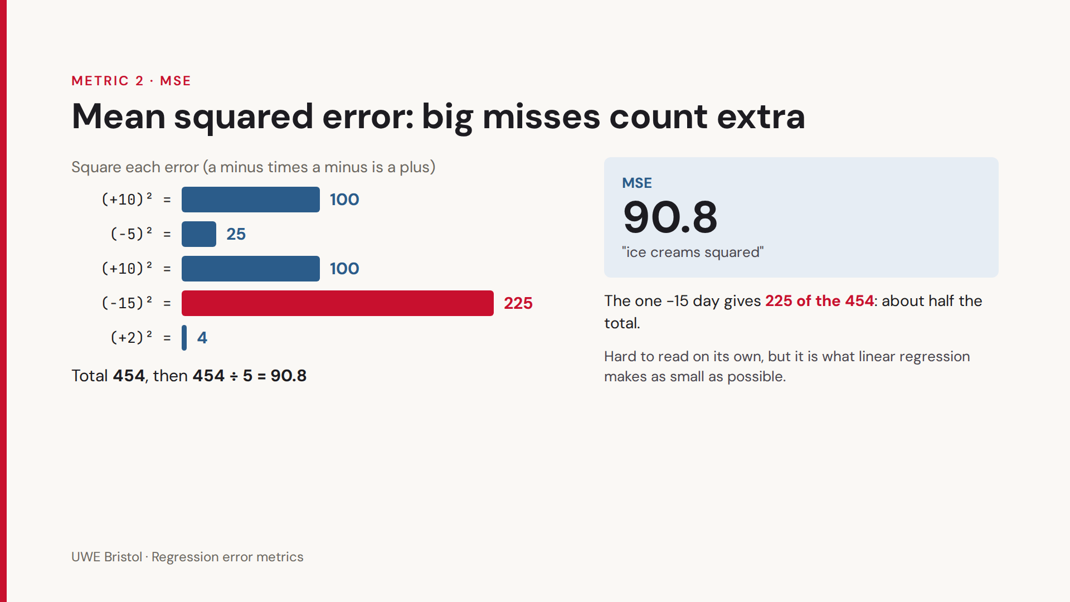

Slide 19
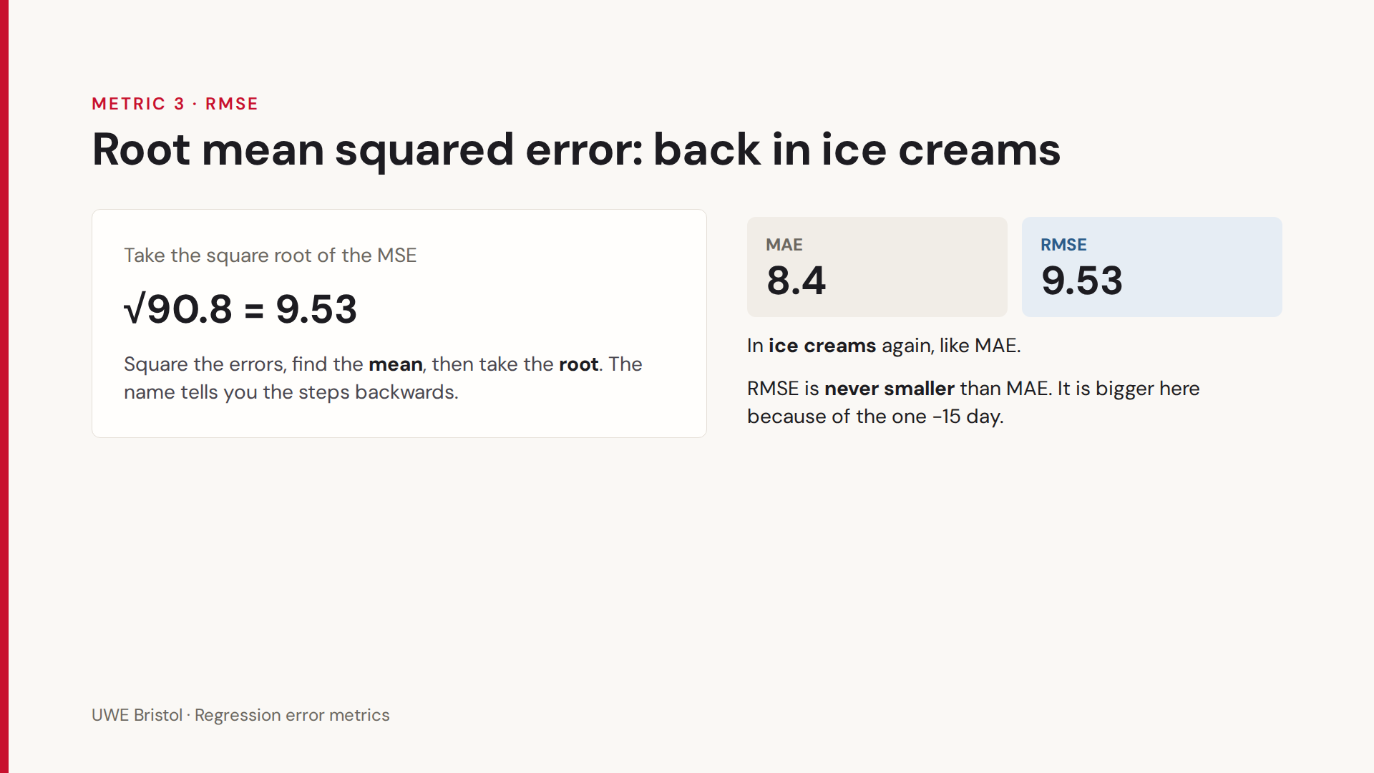

Slide 20
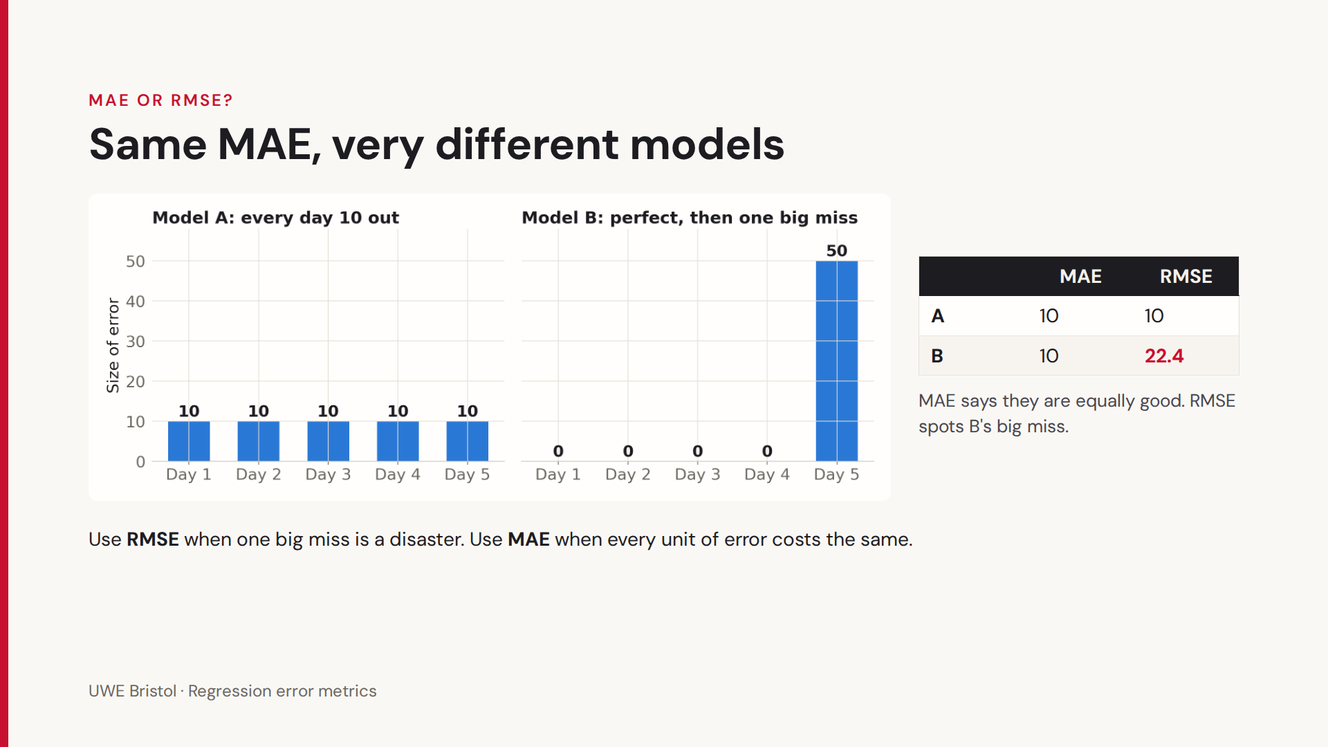

Slide 21
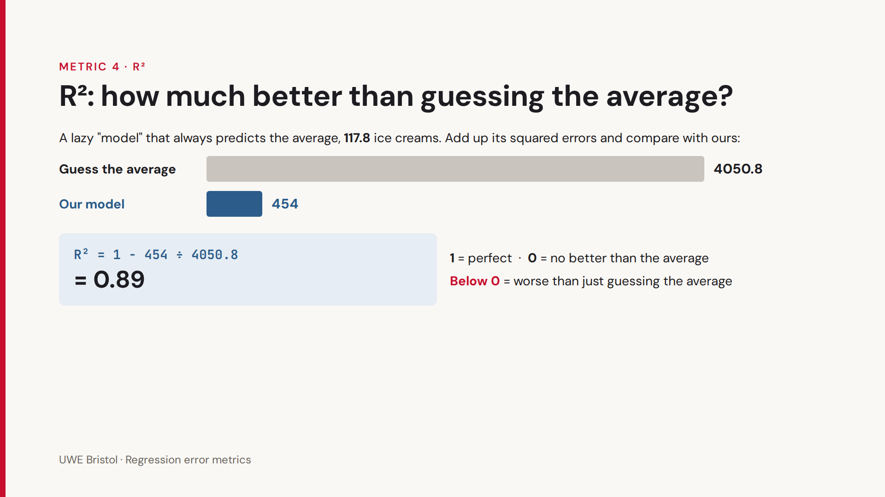

Slide 22
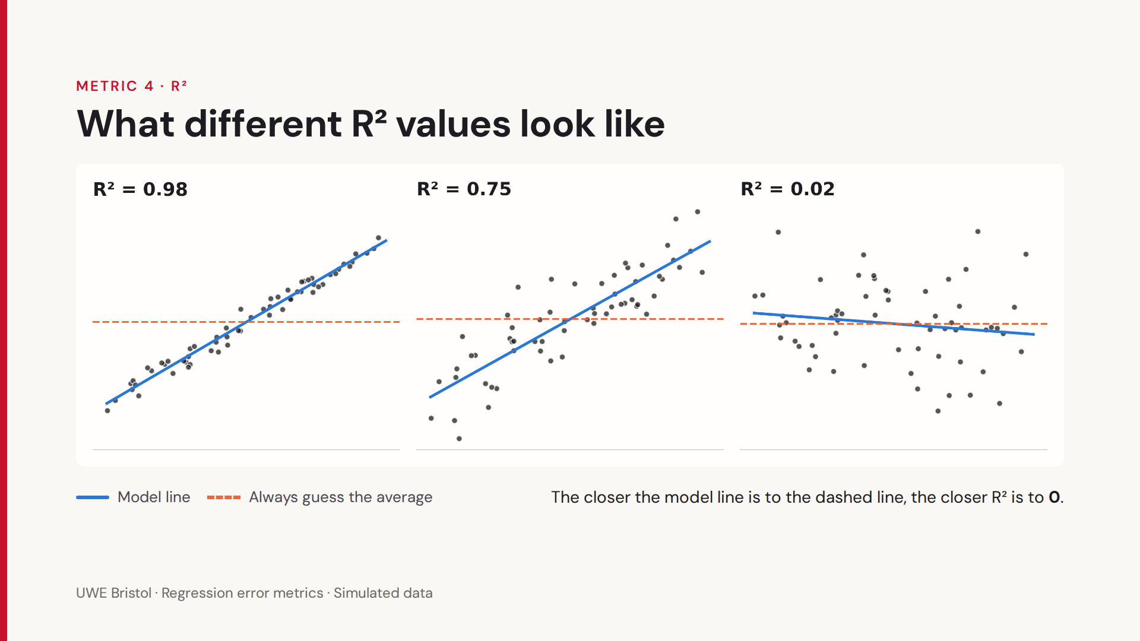
Dr Ryan Fellows

Slide 23
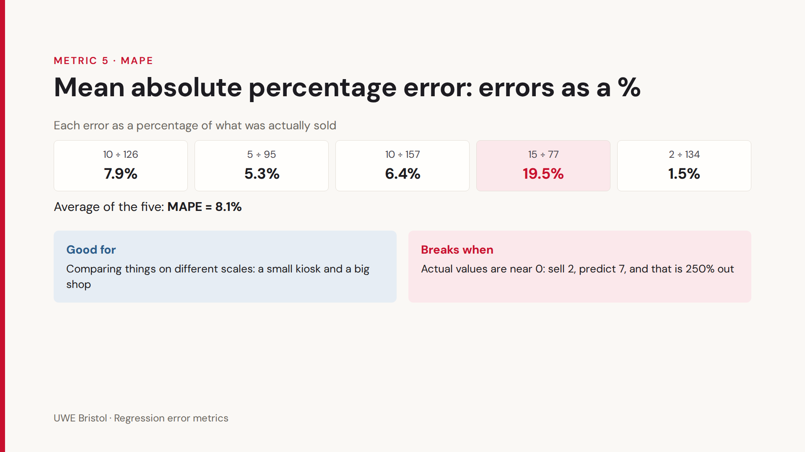
This one is less important for now but I left it in anyway.

Slide 24
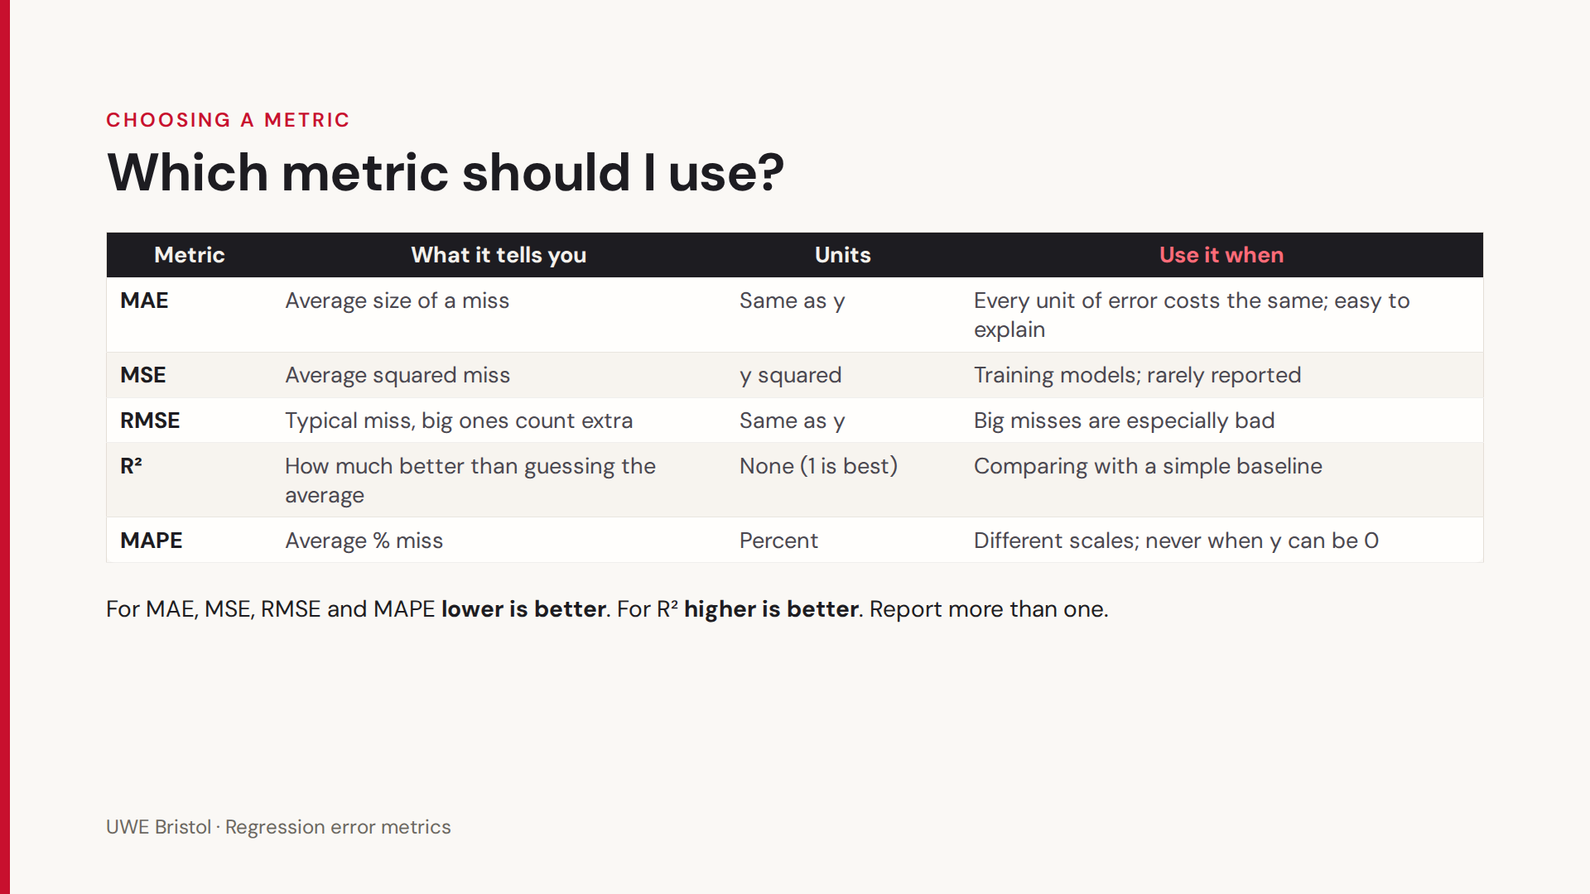

Slide 25
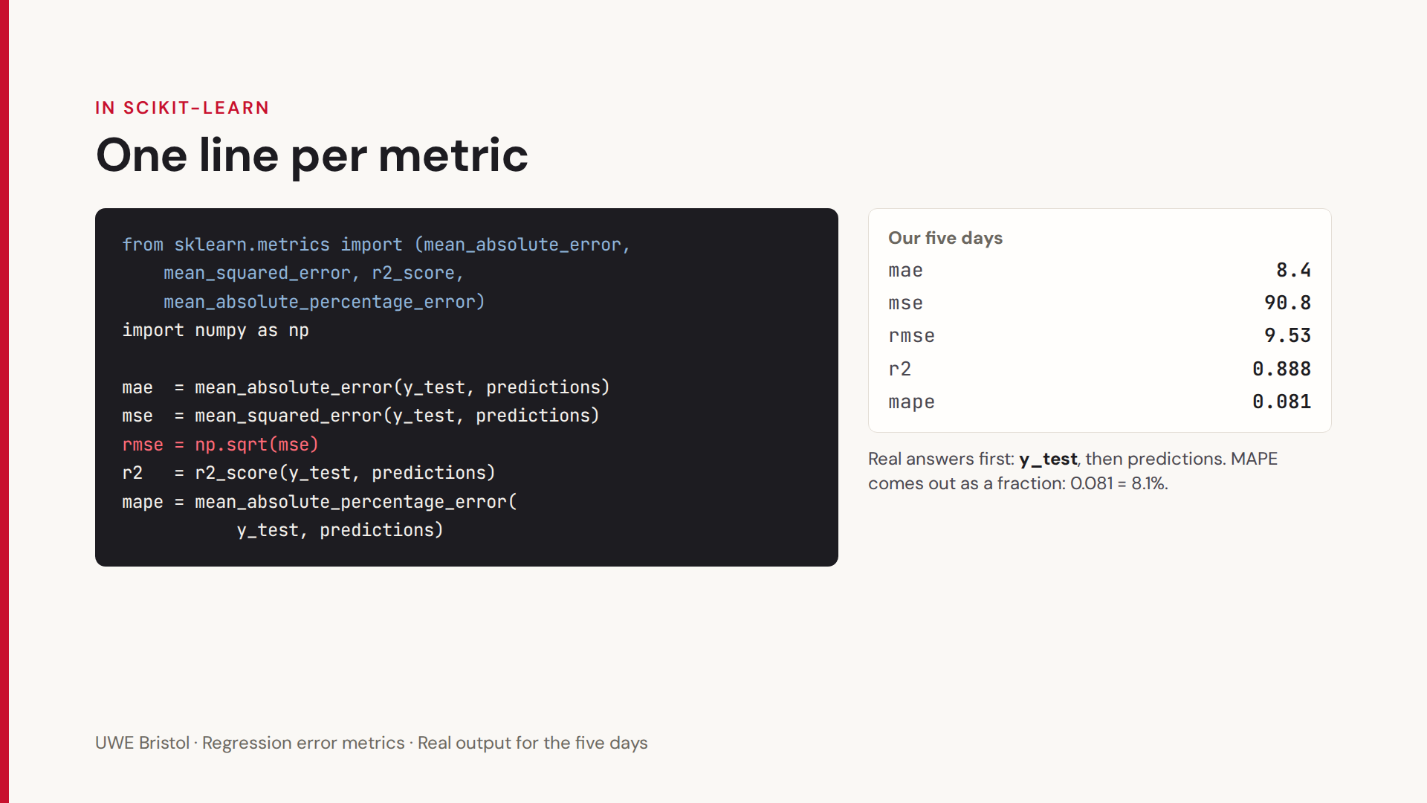

Slide 26
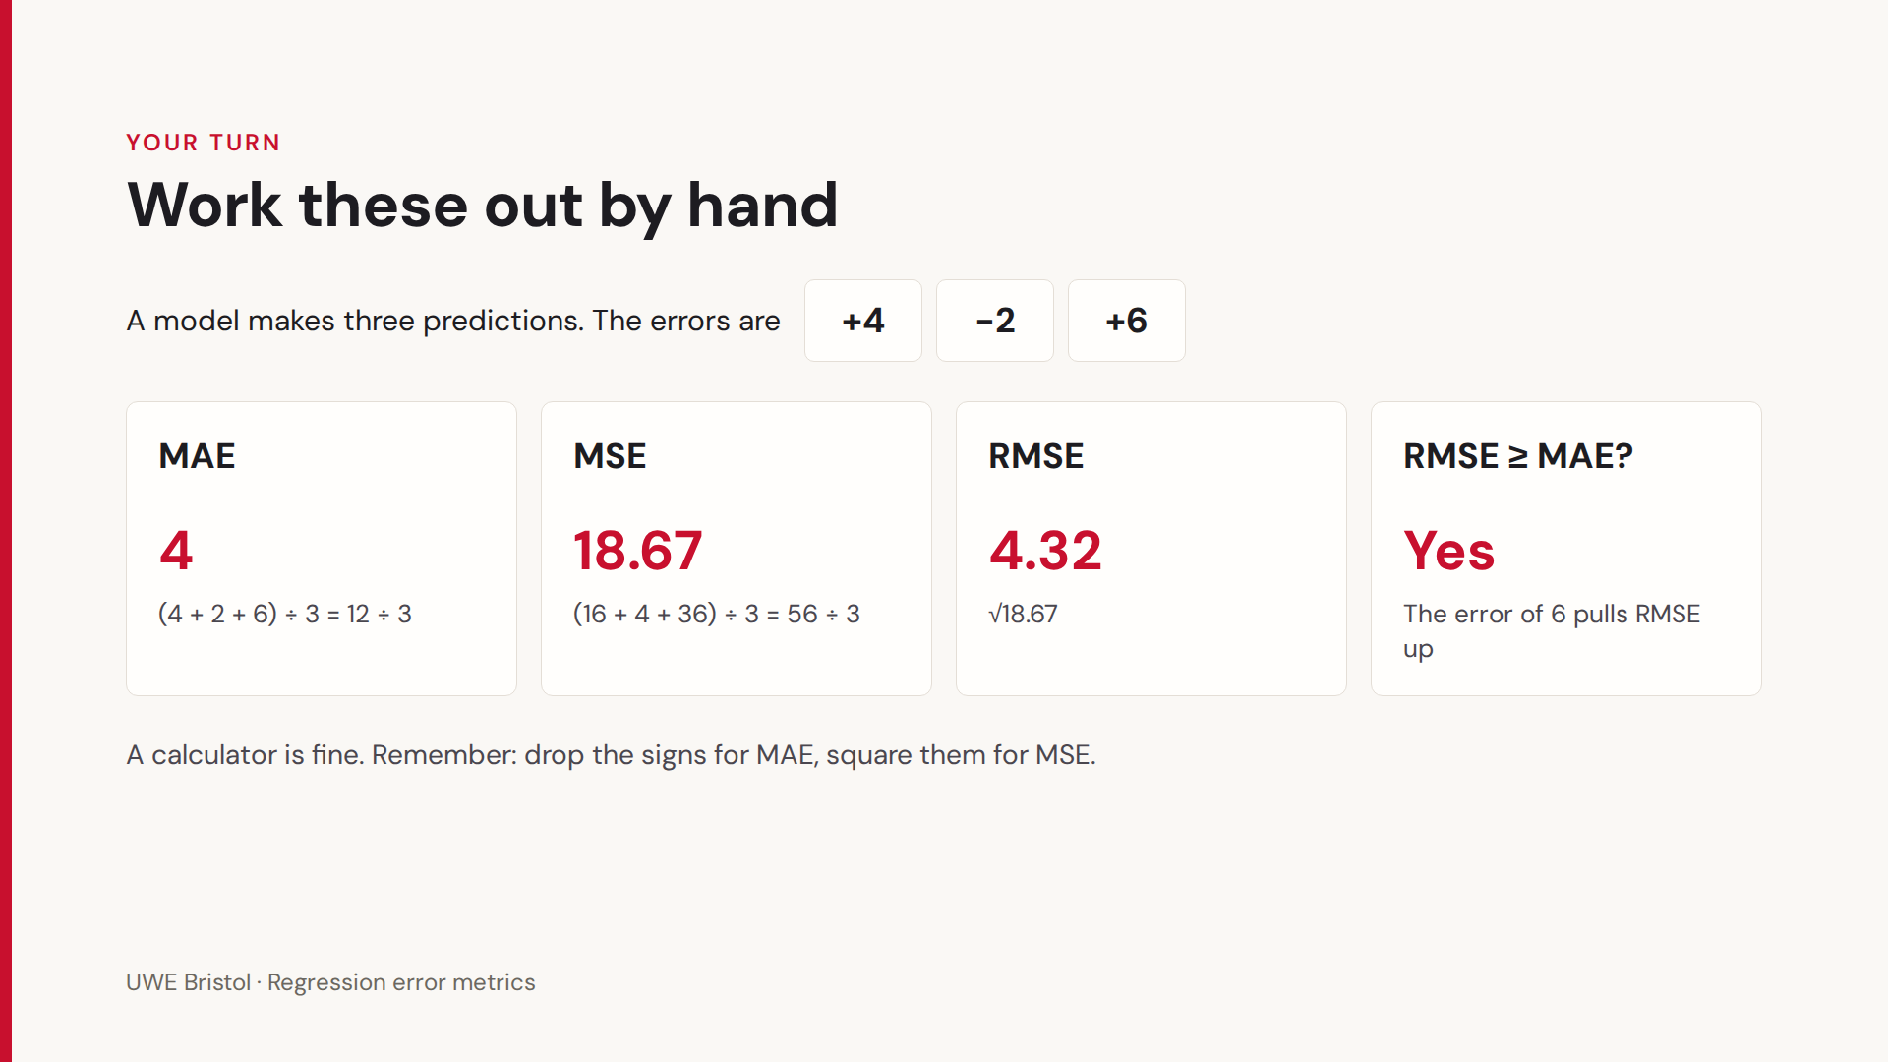

Slide 27
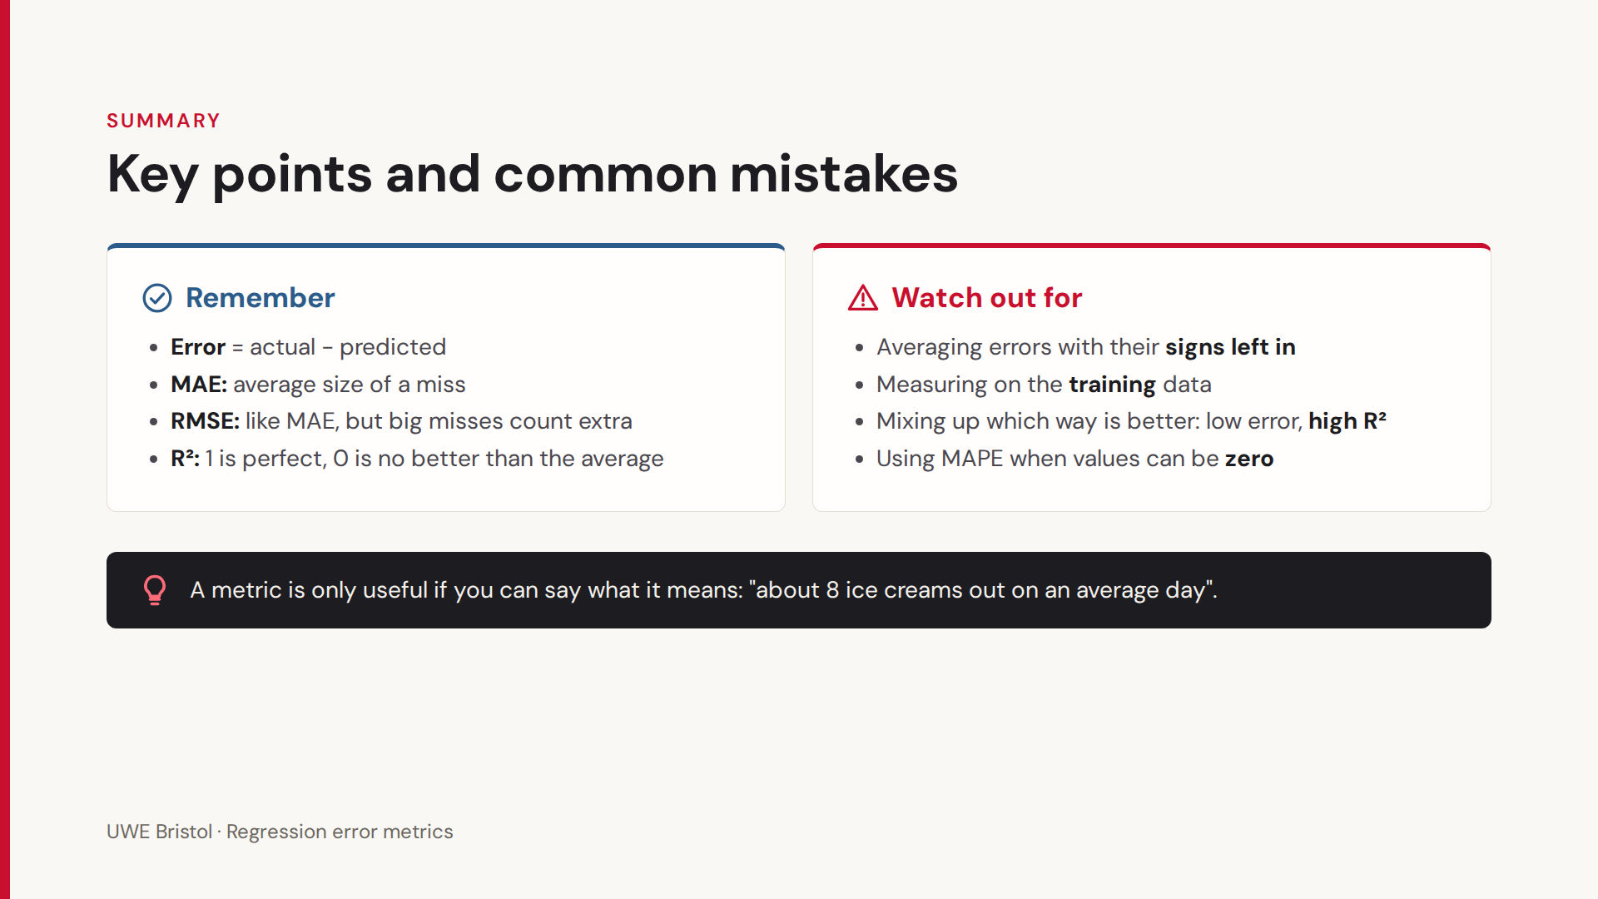

Slide 29
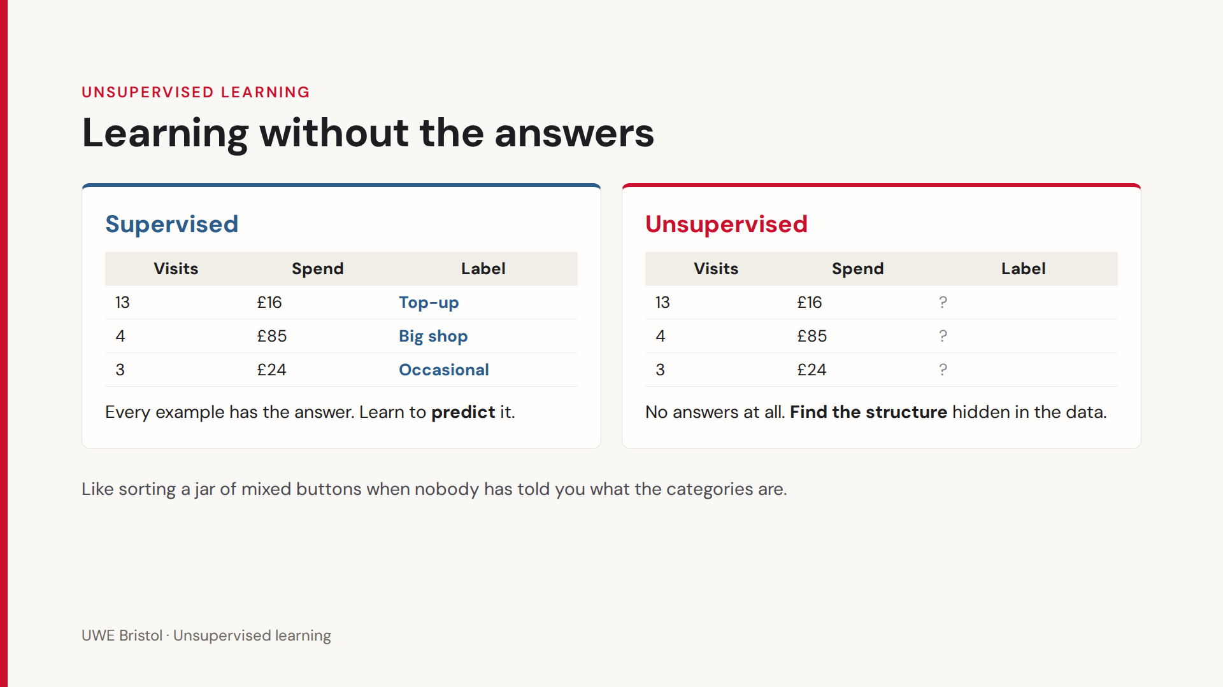

Slide 30
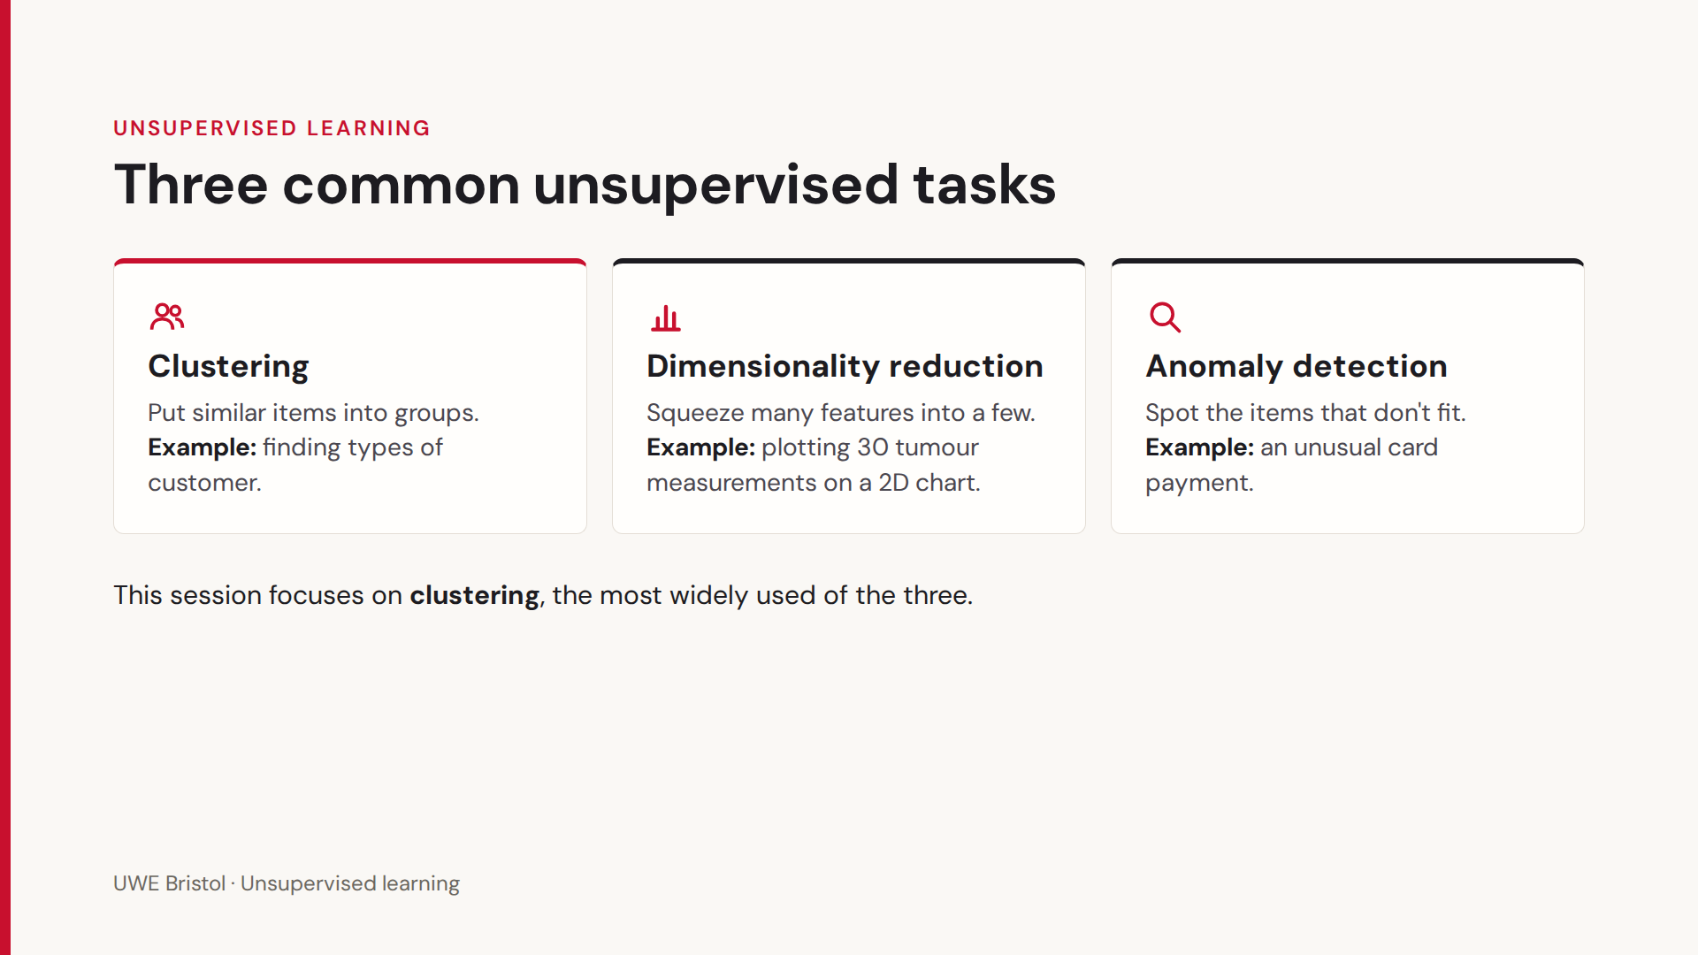

Slide 31
1.0,1.2 1.3,0.8 0.7,1.0, 1.1,1.5 1.5,1.1 0.8,1.4 1.2,0.9 0.9,0.7, 1.4,1.3 1.1,1.0 5.0,5.2, 5.3,4.8 4.7,5.0 5.1,5.5 5.5,5.1 4.8,5.4, 5.2,4.9 4.9,4.7 5.4,5.3, 5.0,4.8 9.0,1.0 9.3,1.3 8.7,0.8 9.2,1.5, 9.5,1.1 8.8,1.4 9.1,0.7, 8.9,1.2 9.4,0.9 9.0,1.4
Sometimes we get data like this. To the human eye, it almost looks random, but it does represent something.
With no labels we need unsupervised learning to see if there is anything interesting going on.

Slide 32
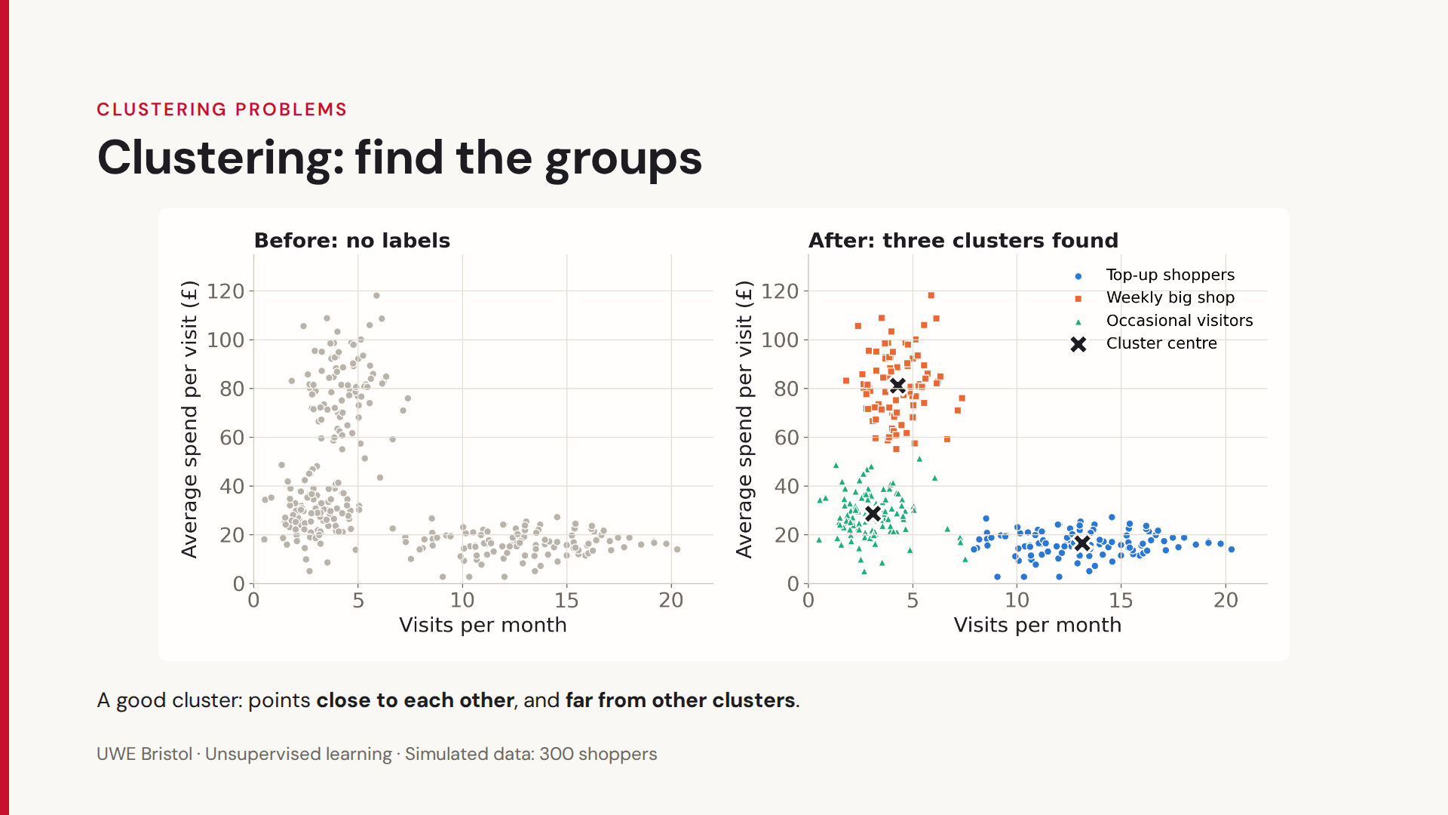

Slide 33
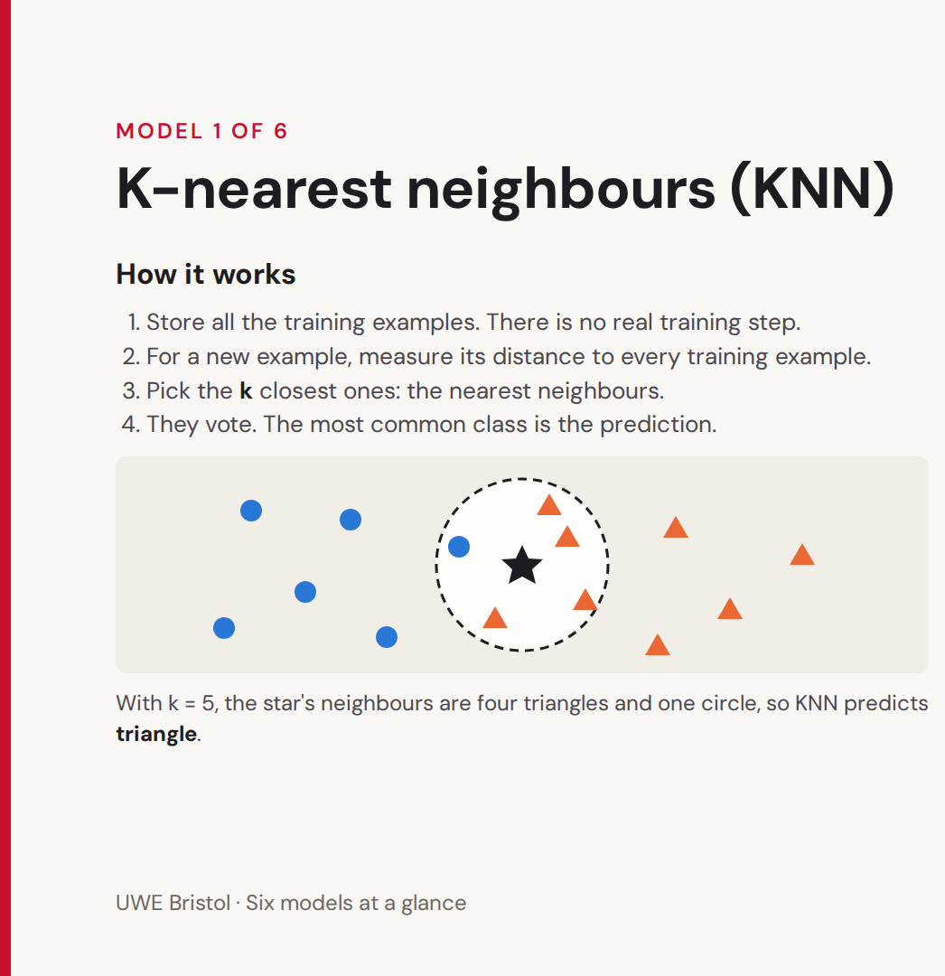
KNN has some similarities to clustering algorithms but it is a supervised algorithm. Clustering is an unsupervised algorithm.
KNN needs labels.
KNN works by classifying incoming features based on what their attributes are closest too.
K-means works by associating features together based on their attributes.

Slide 34
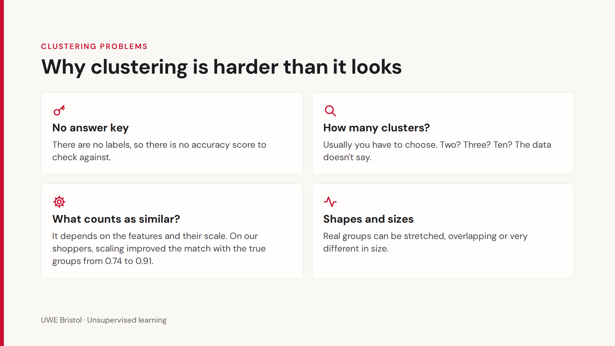

Slide 35
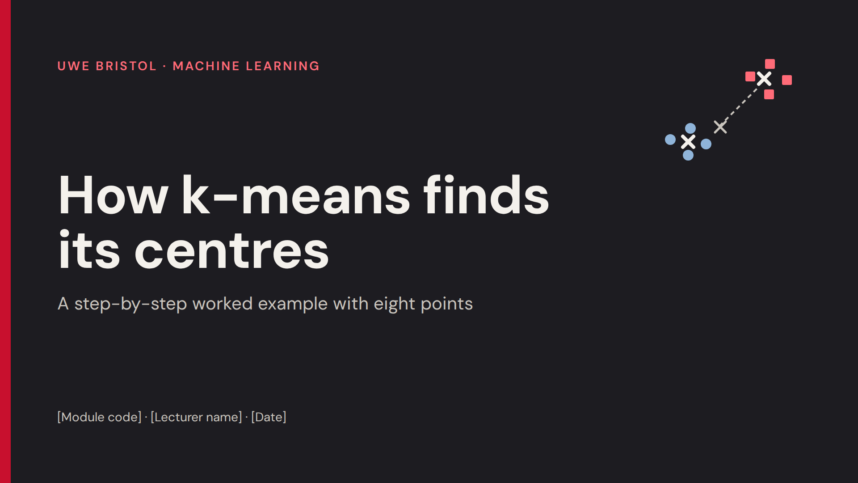

Slide 36
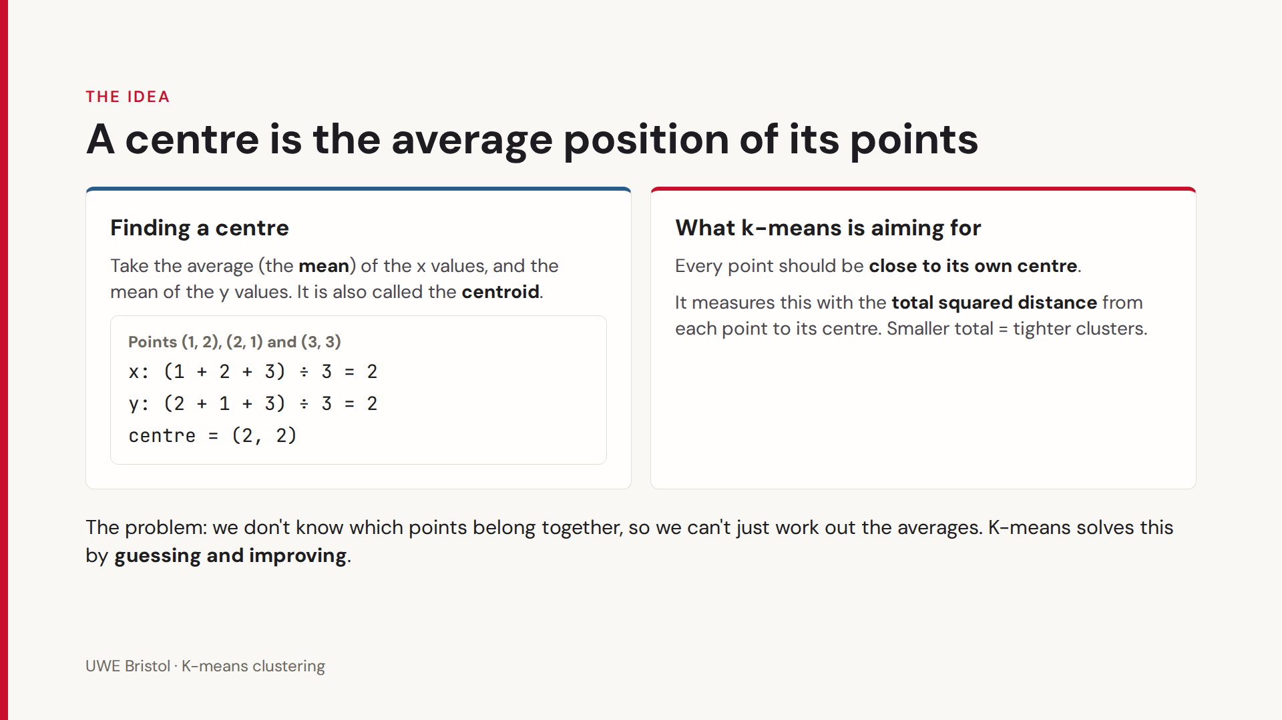

Slide 37
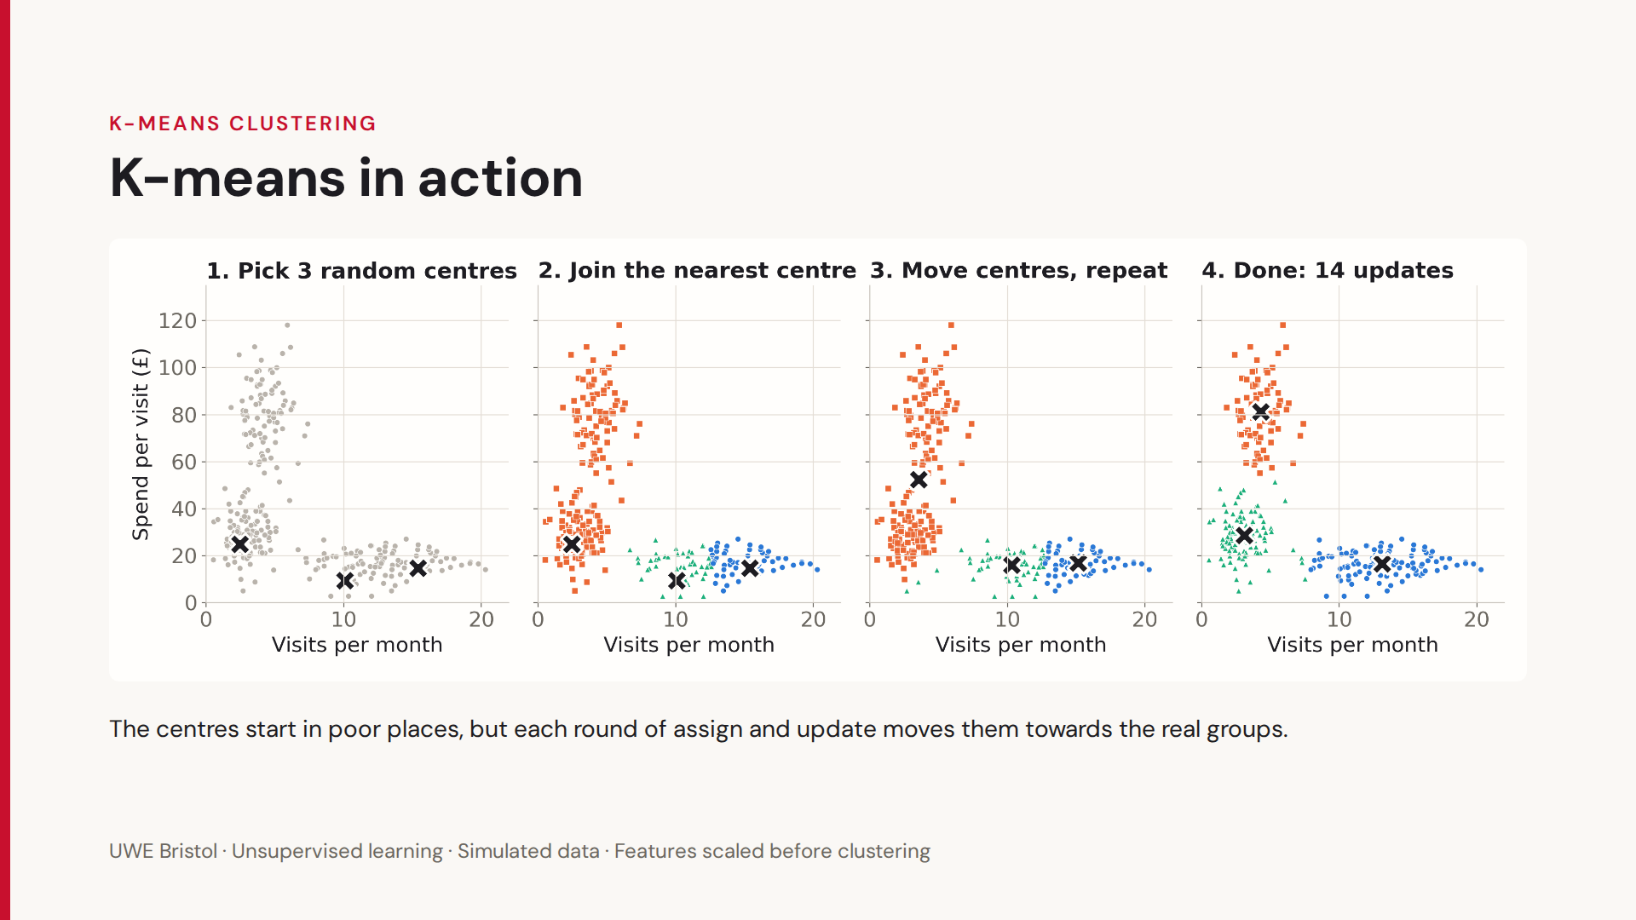

Slide 38
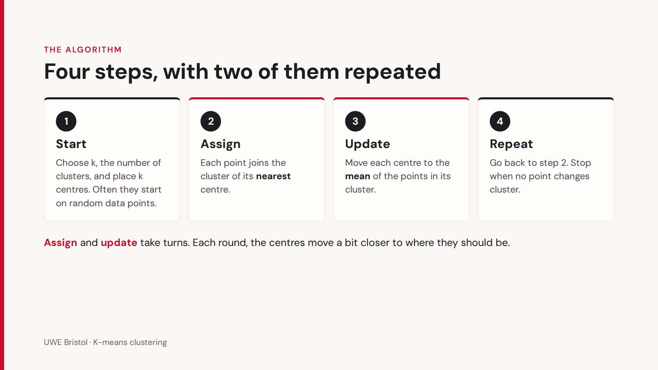

Slide 39
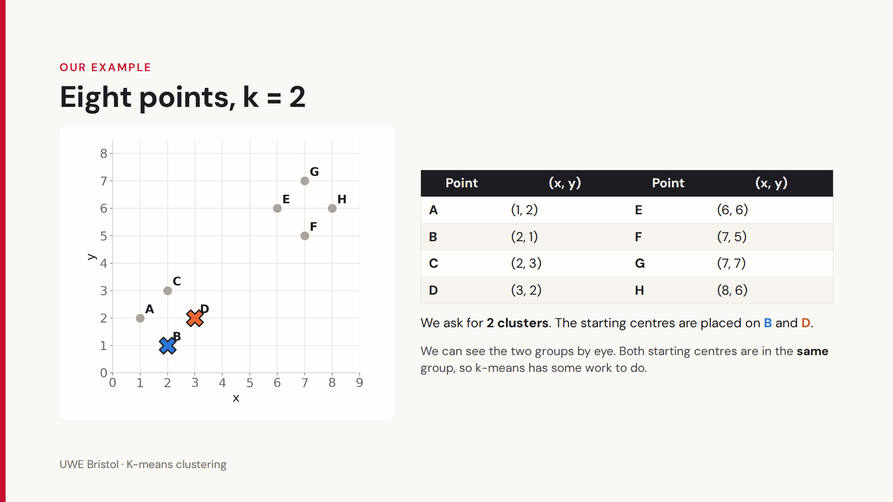

Slide 40
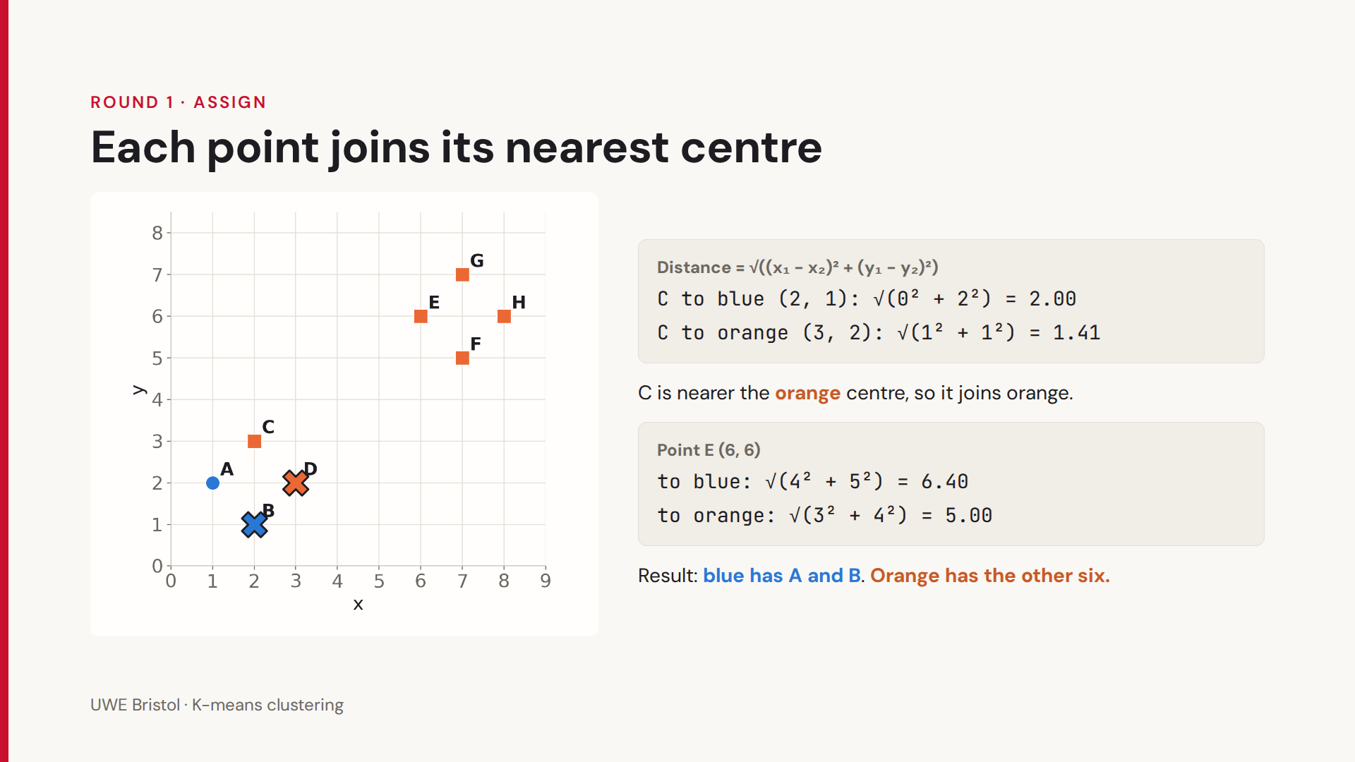

Slide 41
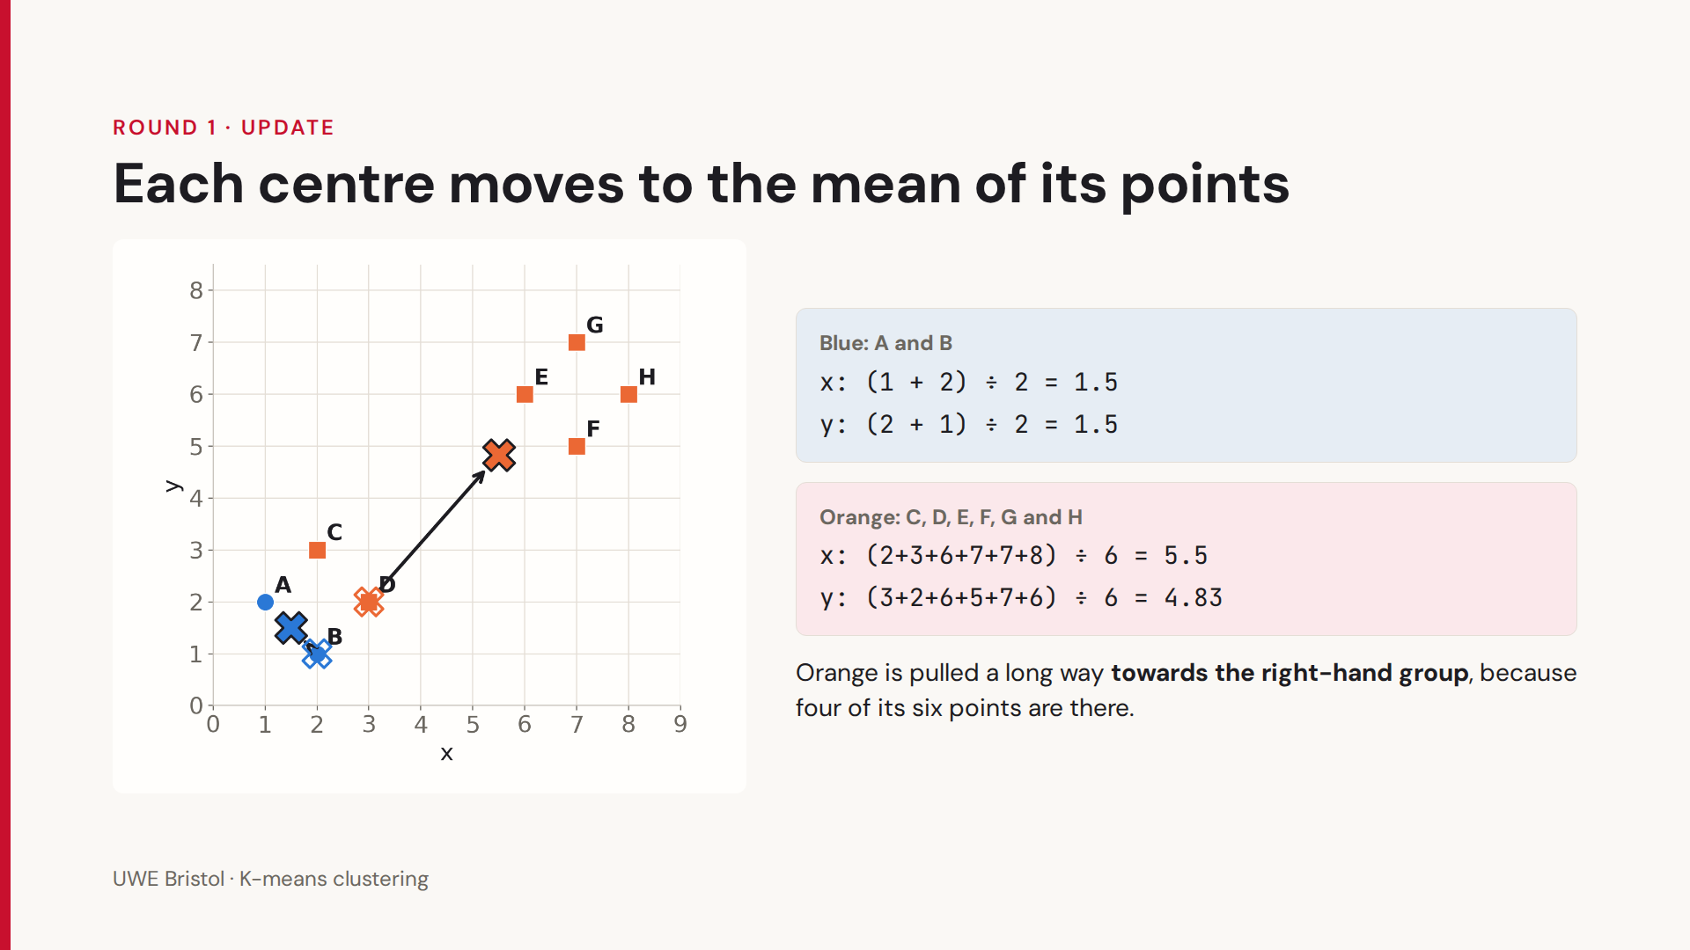

Slide 42
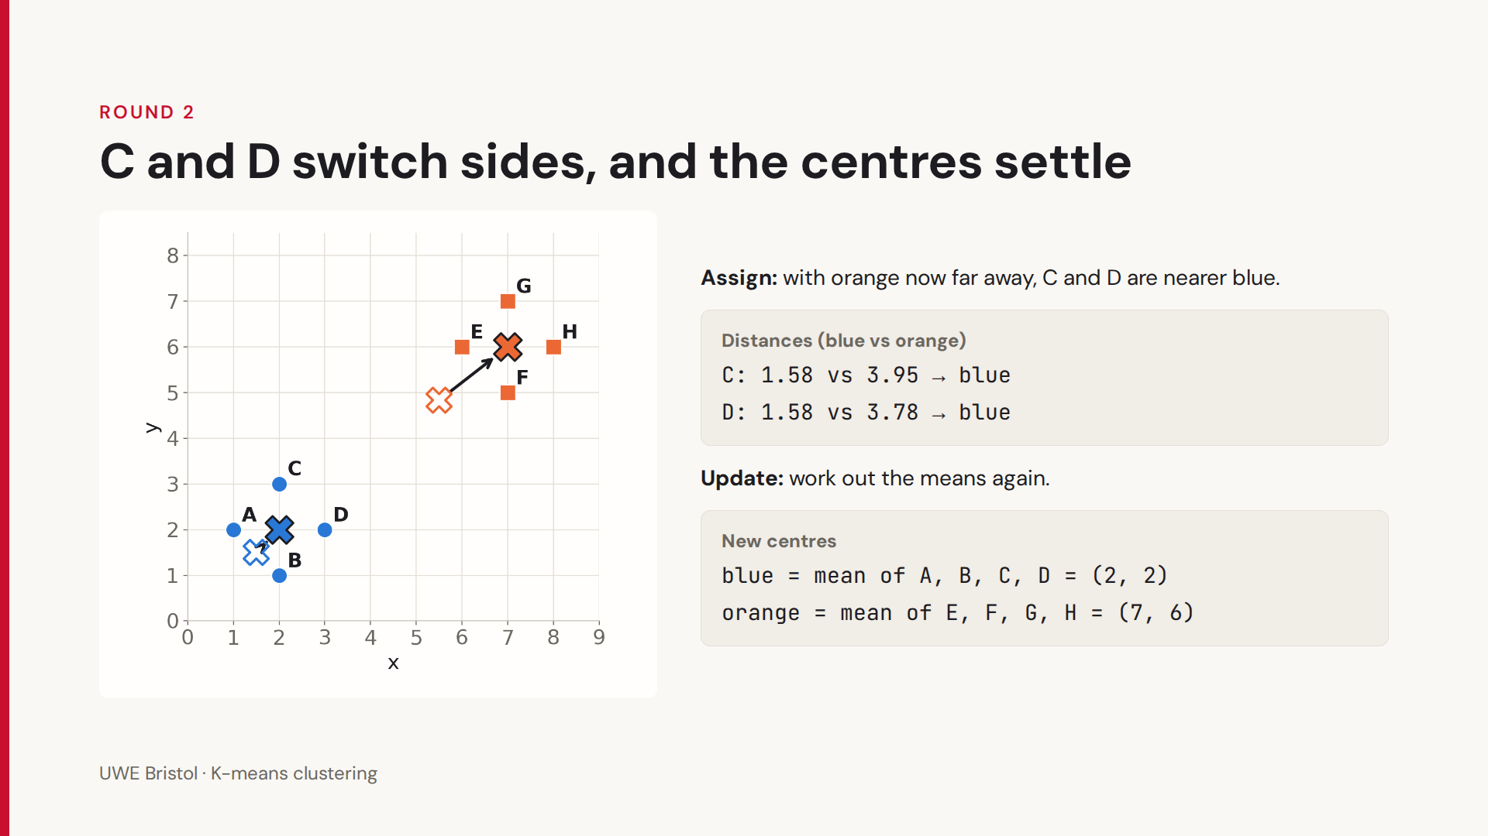

Slide 43
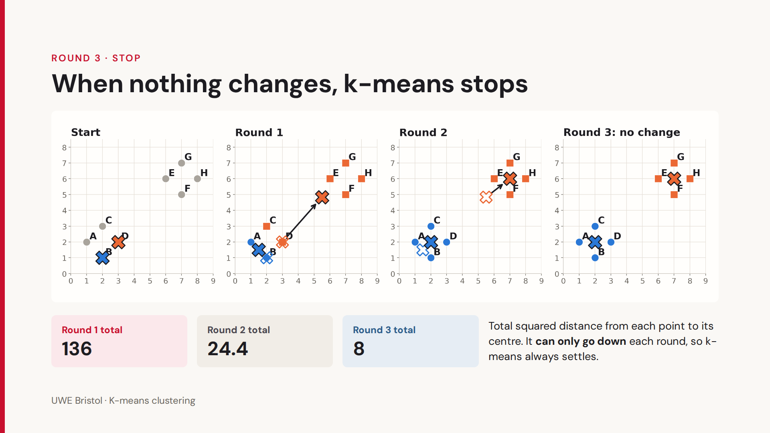

Slide 44
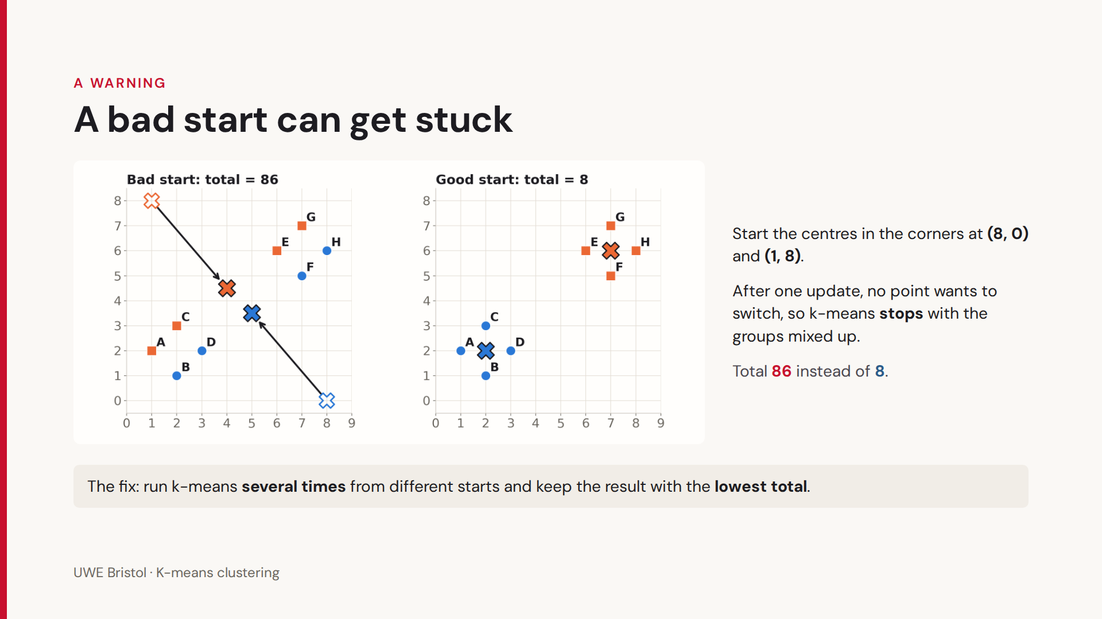

Slide 45
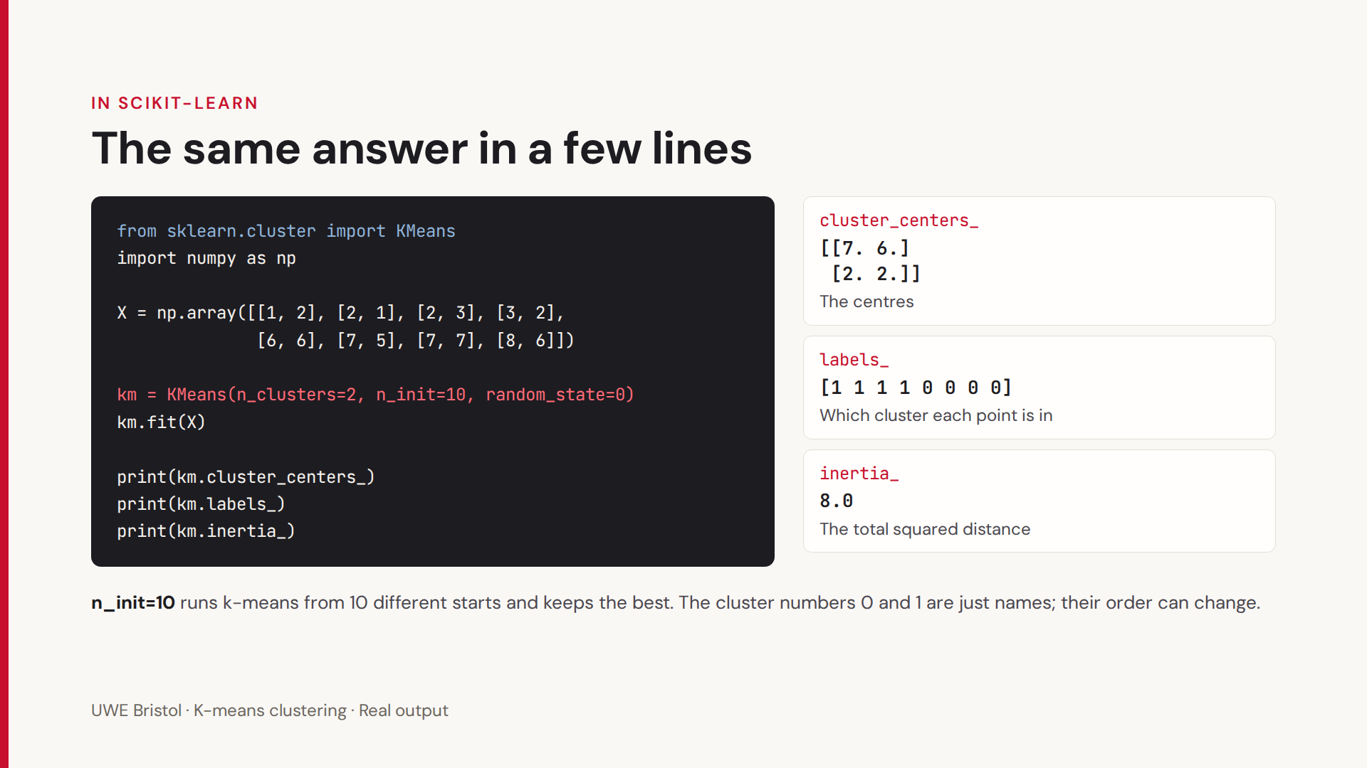

Slide 46
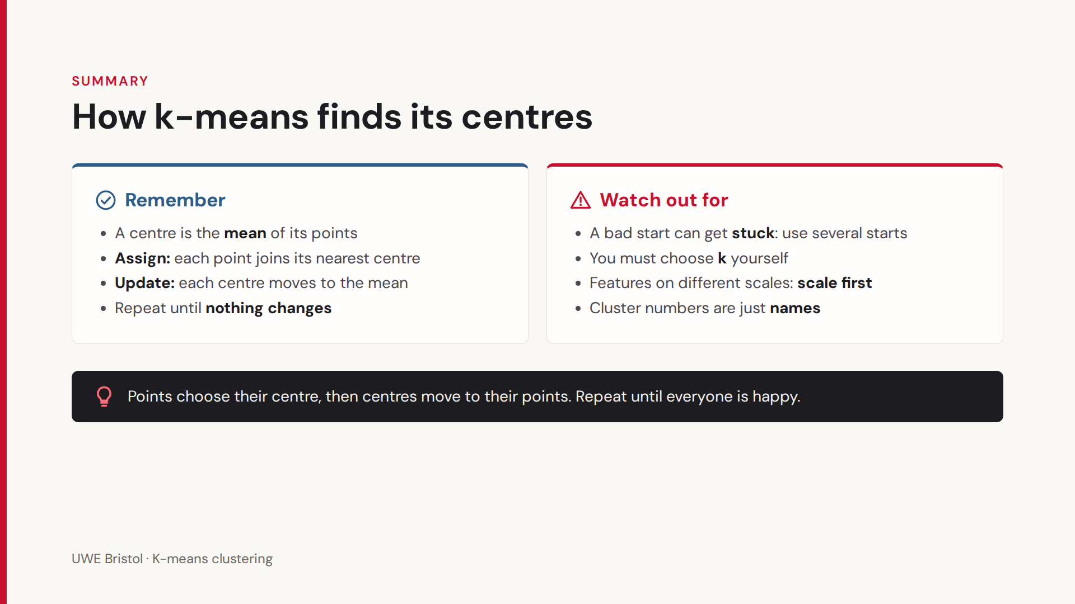

Slide 47
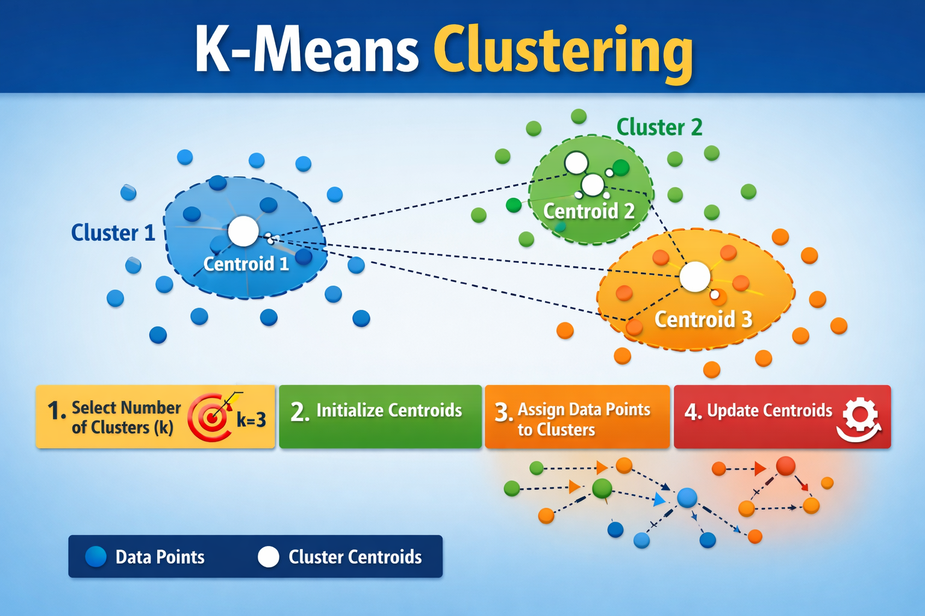

Slide 48
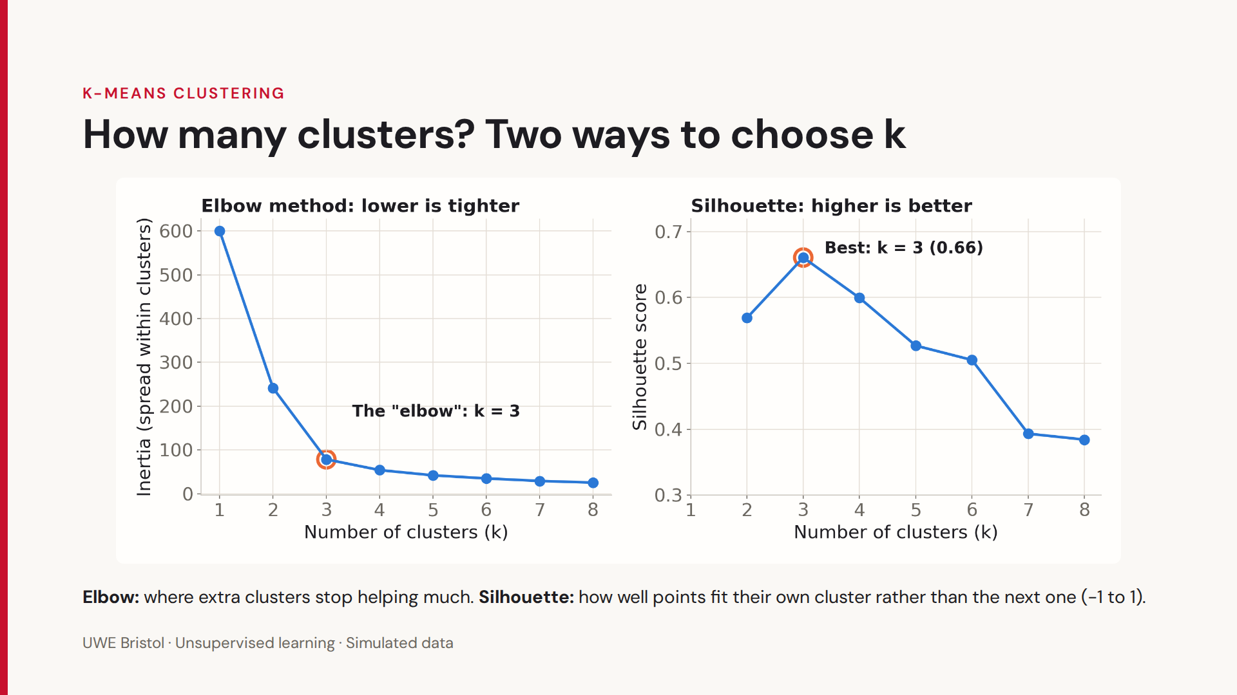

Slide 49
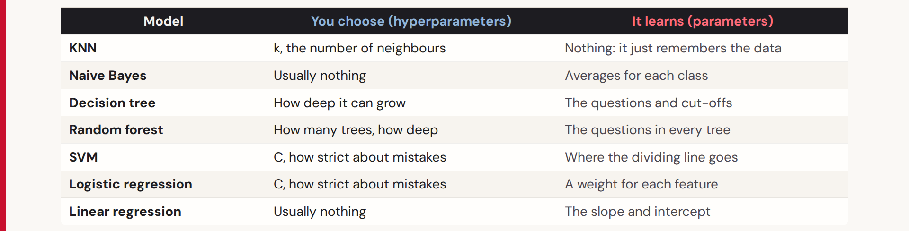
Remember the hyperparameters of the classification metrics?
“k” in K-means clustering is the same!

Slide 50
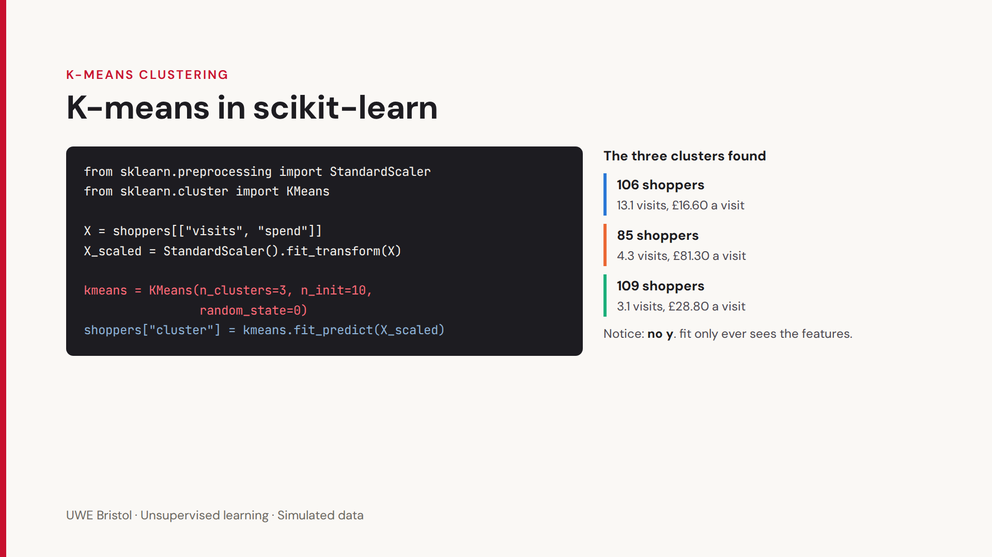

Slide 51
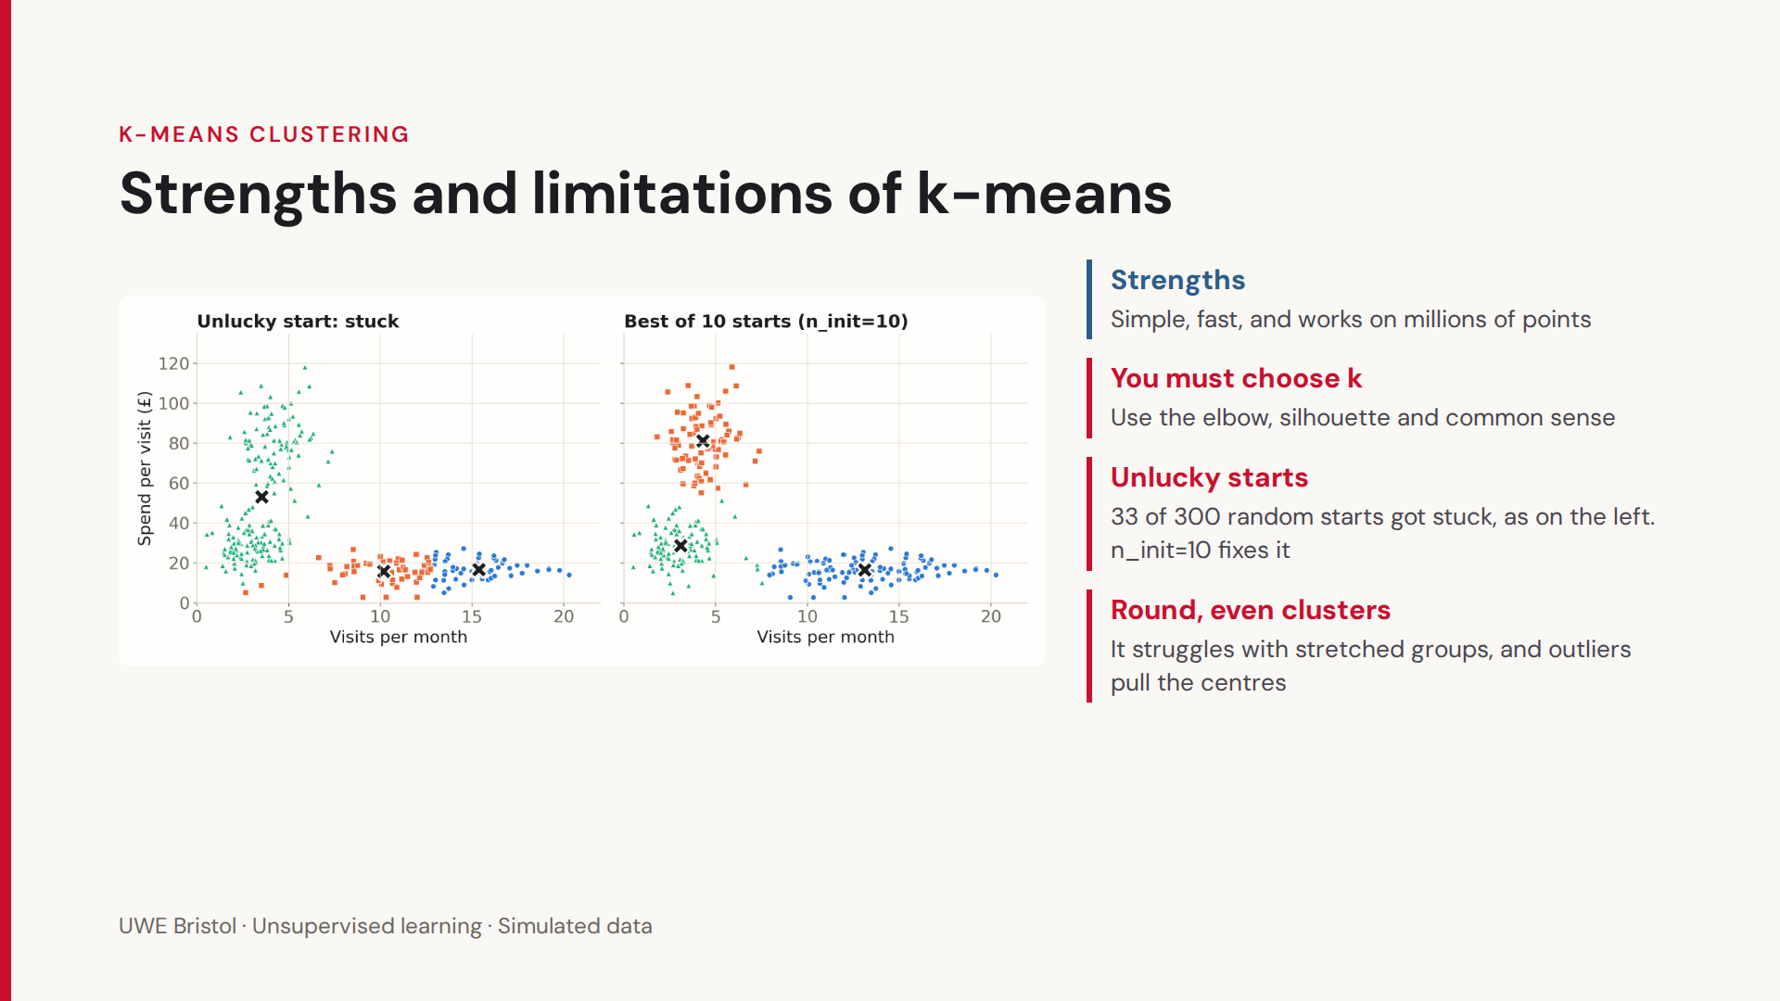

Slide 52
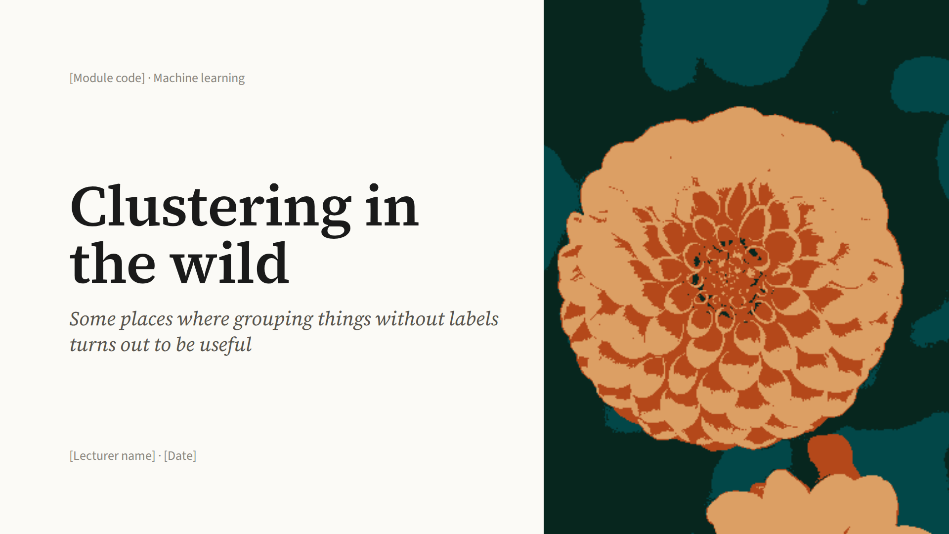

Slide 53


Slide 54


Slide 55


Slide 56


Slide 57


Slide 58


Slide 59


Slide 60


Slide 61


Slide 62


Slide 63


Slide 64


Slide 65

We will discuss this tomorrow, this is just an introduction

Slide 66

We will discuss this tomorrow, this is just an introduction

Slide 67

We will discuss this tomorrow, this is just an introduction

Slide 68

We will discuss this tomorrow, this is just an introduction

Slide 69

We will discuss this tomorrow, this is just an introduction

Slide 70

We will discuss this tomorrow, this is just an introduction

Slide 71

We will discuss this tomorrow, this is just an introduction

Slide 72


Slide 73


Slide 74


Slide 75

Clustering the
colours of a photo
UWE BRISTOL · MACHINE LEARNING
How k-means turns 96,615 colours into 8, and what that shows about clustering
[Module code] · [Lecturer name] · [Date]

Slide 76

A photo is a table of numbers
THE DATA
Every pixel is three numbers from 0 to 255: how much red, green and blue light.
 | Pixel | R | G | B
1 | Sky | 238 | 245 | 255
2 | Roof | 215 | 75 | 24
3 | Tree | 144 | 161 | 47
Rows (pixels)
Different colours
273,280
96,615
UWE Bristol · Clustering a photo

Slide 77

Every pixel becomes a point in a colour cube
THE DATA
Use red, green and blue as the three axes. Each pixel is a dot, drawn in its own colour.
Similar colours end up close together: the sky pixels sit together in one corner, the dark shadows in the opposite one.
Where a pixel is in the photo is thrown away. Only its colour matters.
4,000 randomly chosen pixels shown.
UWE Bristol · Clustering a photo

Slide 78

K-means splits the cube into 8 groups
CLUSTERING
With k = 8, k-means repeats its two steps on the pixels:
Assign: each pixel joins the centre with the most similar colour.
Update: each centre moves to the average colour of its pixels.
The crosses are the 8 final centres. Each one is an average colour.
UWE Bristol · Clustering a photo

Slide 79
Every pixel takes its centre's colour
REPAINTING
Sky
(238, 245, 255)
→
(233, 240, 249)
Almost unchanged
Roof
(215, 75, 24)
→
(203, 146, 107)
Duller, more orange
Tree
(144, 161, 47)
→
(125, 123, 98)
Green turns grey-olive
Do this for all 273,280 pixels and the photo uses only 8 colours. Pixels near a centre barely change; pixels far from every centre change a lot.
UWE Bristol · Clustering a photo

Slide 80


96,615 colours down to 8
THE RESULT
Original: 96,615 colours
8 colours:
UWE Bristol · Clustering a photo

Slide 81

Centres go where most of the pixels are
WHY THESE 8?
The sky and lake cover 43% of the photo, so they get 2 of the 8 colours.
The red pillars and green leaves cover only a few pixels. They get no colour of their own and are merged with browns and olives.
K-means makes the total distance small, so big groups matter most.
UWE Bristol · Clustering a photo · Share of all 273,280 pixels, k = 8

Slide 82

More clusters, more detail
CHOOSING K
k = 2
k = 4
k = 16
k = 64
Light against dark: just a silhouette.
The main shapes appear, but still no colour.
The reds come back. Close to the original.
Very hard to tell apart from the original.
We choose k. There is no single right answer: it is a trade-off between detail and simplicity.
UWE Bristol · Clustering a photo

Slide 83
Fewer colours means smaller images
WHY DO THIS?
Colours | Bits per pixel | Raw size
Original | 24 | 820 KB
k = 64 | 6 | 205 KB
k = 16 | 4 | 137 KB
k = 8 | 3 | 103 KB
k = 2 | 1 | 34 KB
Normally each pixel stores 24 bits: 8 each for red, green and blue.
With 8 colours, each pixel only stores which of the 8 it uses. That needs 3 bits (2 × 2 × 2 = 8), plus a tiny table of the 8 colours.
GIF images use this idea, with up to 256 colours.
UWE Bristol · Clustering a photo

Slide 84

What the photo shows about clustering
SUMMARY
Data points and features
Centres summarise clusters
Each pixel is a point; red, green and blue are its features.
Each centre is an average colour that stands in for all its pixels.
Big groups win
We choose k
K-means minimises the total, so small groups like the red pillars can be lost.
A trade-off between detail and simplicity: 8 colours or 64?
Discussion: what would change if we also gave k-means each pixel's x and y position?
UWE Bristol · Clustering a photo

Slide 85


Slide 86


Slide 87


Slide 88
Notebook

