Slide 1


CORPORATE IDENTITY GUIDELINES
Our story, our look, our voice.
Overcoming Limits.
How HumanRise looks, sounds and shows up, from a LinkedIn post to a training workbook to a partner’s website.
HumanRise ZA (Pty) Ltd · Version 1.0 · October 2026 · humanrise.co.za

Slide 2

—
CONTENTS
What’s inside
01
Introduction
05
Typography
09
Applications
Who this guide is for, the brand at a glance
Roboto, type scale, setting rules
Web, social, job ads, email, print, slides
02
Our story
06
Graphic elements
10
Partners & linking
Purpose, the idea in the logo, values, AI stance
The star, the rising path, buttons, icons
Co-branding, links, approvals, compliance
03
Logo
07
Photography
11
Checklist
Versions, clear space, backgrounds, misuse
Style, subjects, text on images, consent
Ten checks before anything goes out
04
Colour
08
Voice & tone
12
Open items
Core palette, ranges, accessibility
How we write, words we use, boilerplate
What still needs doing

Slide 3
01
INTRODUCTION
One brand, told the same way everywhere.
People meet HumanRise in many places: a vacancy on LinkedIn, a call about a disciplinary hearing, a workshop, a partner’s website. Each moment should feel like the same warm, capable team.
The brand at a glance
Brand name | HumanRise (one word, capital H and R)
Registered name | HumanRise ZA (Pty) Ltd
Tagline | Overcoming Limits
Headline line | Raising People. Raising Potential.
What we do | Recruitment · HR & Compliance · Training & Development
Where | Cape Town office, serving clients nationally
Primary colour | Star Purple #7869BC
Typeface | Roboto (Office fallback: Arial)
Web | humanrise.co.za · jobs.humanrise.co.za
Contact | info@humanrise.co.za · 021 001 8094
OUR TEAM
Consultants, recruiters, trainers and admin writing ads, emails, proposals and course material.
MAKERS
Designers, developers, printers and agencies building the website, artwork and templates.
PARTNERS
Partners, clients, venues and media who mention, link to or co-brand with us.

Slide 4


02
Our story
Why we exist, what our logo means and what we stand for.

Slide 5

02
OUR STORY
Hiring is about people, not paperwork.
Behind every CV is a person with ambitions. Behind every vacancy is a team trying to grow. Too often the process between them is rushed and impersonal, and businesses pay for it with hires that don’t last.
We do it differently. We listen first. We match on skills and on fit. We take care of the HR and compliance detail so owners and managers can get back to running their business. We use modern tools, AI included, to work faster and more carefully, and a person always makes the call.
Our name says what we do. Human, because people come first. Rise, because we help people and teams go further than they thought they could.
Our promise: Overcoming Limits.

Slide 6



02
OUR STORY
Why we exist.
PURPOSE · WHY WE EXIST
MISSION · WHAT WE DO
PROMISE · OUR TAGLINE
To help people and teams overcome their limits.
We connect great businesses with great people, and give both the HR support, training and guidance they need to grow.
Overcoming Limits.
Human, because people come first. Rise, because our work is about helping people and teams go further than they thought they could.

Slide 7

02
OUR STORY
The idea in the logo.
1
“Hum” starts soft
Lowercase and approachable, in Human Lavender: the person as they are today, on the line.
2
The star replaces the “a”
Hand-drawn because we are people, imperfect but we fit in. A star because your potential is full and great.
3
After the star, the “n” rises
It lifts off the baseline and turns vivid purple. Meet your potential and you rise.
4
RISE in capitals
Larger and stronger: the outcome we reach together, and a call to act.
5
The I breaks through
Lifted off the baseline and through the top line: the individual rising, a limit overcome.
A+I
Two changed letters spell AI
Forward-thinking: we use AI usefully and safely, in our own way. The human star comes first.

Slide 8
02
OUR STORY
The colour flows like a career.
Purple is new, fun and creative. Blue is trust, experience and stability. Read the logo top to bottom and the colour deepens the way a career grows: fresh and creative at the start, steady and experienced over time.
Human Lavender
Star Purple
Rise Blue
Deep Rise
#8E8AAE · Starting out
#7869BC · Potential, energy
#6E86AE · Growing in trust
#456285 · Experience, stability
New · fun · creative
Trust · experience · stability
“It grows and flows like we do in our careers.”

Slide 9

02
OUR STORY
Human-led. AI-assisted.
The A and the I in our logo are a promise about technology. We use AI where it makes us faster, fairer and more careful: sorting applications, drafting documents, scheduling, spotting patterns. People make the decisions that affect people.
A person makes the call
A HumanRise consultant reviews every CV, shortlist and HR recommendation. AI supports that work and never replaces it.
We’re open about it
When AI plays a part in a process that affects someone, we say so in plain language.
This keeps us in line with section 71 of POPIA, which limits decisions about a person that are based solely on automated processing.
Data stays protected
We only use tools that meet our POPIA obligations, and keep personal information out of tools that don’t.

Slide 10
02
OUR STORY
What we stand for.
People first
Fit over filling
We treat candidates and clients as people, not transactions, with honesty at every step.
The right match beats a fast one. We aim for retention, not just placement count.
Shows up as: Real conversations before shortlists, plain-language updates and a consultant on every CV.
Shows up as: Skills and culture-fit matching, psychometric testing, and checking in well beyond day one.
Compliance built in
Practical & affordable
POPIA-ready processes and ethical data handling are part of how we work from the start.
Advice that works in a real business, at a price a small team can manage.
Shows up as: Consent on every form, lawful and fair disciplinary processes, accredited training where it counts.
Shows up as: Clear quotes, SMME-friendly options and no jargon.

Slide 11

02
OUR STORY
Our personality.
We are | We are not | In practice
Warm | Over-familiar | Friendly and kind, without slang or forced jokes.
Professional | Corporate or cold | Expert and precise, in plain words.
Confident | Pushy | A clear recommendation, and respect for the decision.
Clear | Simplistic | Short sentences that still carry the detail people need.
Modern | Trend-chasing | Clean, current design and tools, AI included, used with care.
Supportive | Patronising | We guide and encourage, and treat people as capable adults.
POSITIONING
For South African businesses and job seekers who want more than a CV shuffle, HumanRise is the people-first HR and recruitment partner that matches on fit, builds compliance in and stays involved long after the placement.

Slide 12
02
OUR STORY
Who we talk to.
BUSINESSES
INDIVIDUALS
LEARNERS
Owners, directors, managers and HR
Job seekers and working professionals
Teams, managers and first-time job seekers
SMMEs, startups, corporates, retailers, manufacturers and professional services. They want to save time and money, improve efficiency and hire people who stay, while staying compliant.
All ages and career stages. They value quality, speed, trust and a personal connection, and often want guidance, mentoring or coaching.
HR practitioners, supervisors, recruiters, entry-level employees and unemployed youth who want practical, recognised skills.
TELL THEM
TELL THEM
TELL THEM
“We find people who raise the room, and we handle the HR detail.”
“A real consultant reads your CV and matches you to roles that fit.”
“Practical training, accredited where it counts.”

Slide 13
02
OUR STORY
One master brand.
HumanRise
Master brand: the logo, always present
Recruitment
HR & Compliance
Training & Development
Permanent, temporary and contract placement · psychometric testing · skills and culture-fit matching
Payroll and benefits · contracts, policies and handbooks · POPIA-compliant practice · disciplinary and CCMA support
Managing Workplace Discipline · Recruitment Made Easy · My Team Motivator · Workplace Essentials (WES) · Workplace Preparation
Channels humanrise.co.za (website) · jobs.humanrise.co.za (live vacancies and applications)
Partner brand the Career Cat (careercat.co.za): its own logo, shown in a partnership lock-up
Service lines are described in words next to the logo. Never create separate logos for them.

Slide 14
03–07
Visual identity
Logo, colour, typography, graphic elements and photography.

Slide 15
03
LOGO
One mark, used with care.
Our logo is a stacked wordmark: “Hum★n” above “RISE”. It is one piece of artwork. Always use the master files, and never rebuild, retype or rearrange it.
LOGO FILES · brand/assets/
logo/humanrise-logo-colour.png
logo/humanrise-logo-white.png
logo/humanrise-logo-deep.png
logo/humanrise-logo-black.png
logo/humanrise-logo-email.png
star/humanrise-avatar.png
Cleaned artwork: the light-blue strip under the rising I is removed, and the cream exports are retired.

Slide 16





03
LOGO
Logo versions.
Full colour (primary)
White (reversed)
Single colour, Deep Rise
Black
Star mark
The default, on white and the lightest tints (Mist, Sky, Lavender 100).
On Deep Rise, Star Purple, Purple 600–700 and calm, dark areas of photos.
One-colour print, embroidery, engraving, stamps and branded pens.
Only when print is limited to black: newspapers, faxed or copied forms.
Favicons, avatars, watermarks and small spaces. Never the first introduction.
Never use the full-colour logo on a dark or mid-tone background. Switch to the white logo instead.

Slide 17

03
LOGO
Clear space, size and placement.
X is the width of the rising I in RISE. Keep at least 2X clear on every side (about 10% of the logo’s width). Never less than 24px on screen or 6mm in print.
Item | Screen | Print
Full logo | 120px wide | 30mm wide
Full logo, website header | 72px wide | –
Star mark | 24px | 8mm
PLACEMENT
Top left: documents, web pages and slides
Centred: covers, card fronts, banners and avatars
Bottom right: sign-off on adverts and social posts

Slide 18



03
LOGO
Backgrounds.
White is our base. Full colour goes on white or our lightest tints, and the white logo goes on our deep colours. If you have to ask whether it’s readable, it isn’t.
White, the default
Mist #F7F6FB
Deep Rise, white logo
Star Purple, white logo
Purple 700, white logo
No colour logo on mid-tones
No colour logo on dark colours
No cream or off-white grounds

Slide 19






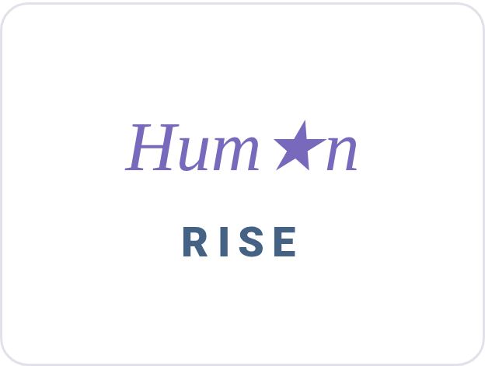

03
LOGO
Please don’t.
Stretch or squash it
Recolour it
Rotate or tilt it
Add shadows, glows or effects
Place it on a busy photo
Rearrange the parts
Retype it or swap the star
Outline it or box it in

Slide 20
04
COLOUR
Purple for the person. Blue for the rise.
PRIMARY
PRIMARY DARK
SECONDARY
SECONDARY
Star Purple
Deep Rise
Rise Blue
Human Lavender
HEX #7869BC
RGB 120 105 188
CMYK 36 44 0 26
HEX #456285
RGB 69 98 133
CMYK 48 26 0 48
HEX #6E86AE
RGB 110 134 174
CMYK 37 23 0 32
HEX #8E8AAE
RGB 142 138 174
CMYK 18 21 0 32
The star and the “n”. Buttons, links, highlights, icons.
The rising I. Headings, dark panels, footers.
“RISE”. Outlines, graphics, charts, large text only.
“Hum”. Soft tints, dividers, decoration.
White
Black
Ink
CMYK values are converted from the screen colours. Always approve a printed proof.
#FFFFFF · base background
#000000 · one-colour print
#23222B · body text
Mist
Sky
Line
#F7F6FB · sections, cards
#F4F7FA · alternate sections
#E2E1EA · borders, faint star

Slide 21
04
COLOUR
Tints, shades and how much of each.
Lavender
0
#FFFFFF
100
#E2E1EA
200
#C6C4D6
300
#AAA7C2
400
#8E8AAE
500
#6A6782
600
#474557
700
#23222B
1000
#000000
Purple
0
#FFFFFF
100
#DDD9EE
200
#BBB4DD
300
#998ECC
400
#7869BC
500
#5A4E8D
600
#3C345E
700
#1E1A2F
1000
#000000
Blue
0
#FFFFFF
100
#DAE0EA
200
#B6C2D6
300
#92A4C2
400
#6E86AE
500
#526482
600
#374357
700
#1B212B
1000
#000000
Deep
0
#FFFFFF
100
#D0D7E0
200
#A2B0C2
300
#7389A3
400
#456285
500
#334963
600
#223142
700
#111821
1000
#000000
The outlined swatch (400) is the core colour. Use tints for backgrounds and shades for text or depth.
White & neutrals 60%
Deep Rise / Ink 20%
Star Purple 12%
Keep layouts light and open. Star Purple is the spark: use it for what people should notice or press. Rise Blue (5%) and Human Lavender (3%) add depth in small amounts.

Slide 22
04
COLOUR
Accessible pairings.
Text / foreground | Background | Ratio | Body text | Large text & icons
Ink | White | 15.7:1 | Yes | Yes
Deep Rise | White | 6.3:1 | Yes | Yes
Star Purple | White | 4.6:1 | Yes | Yes
White | Star Purple (buttons) | 4.6:1 | Yes | Yes
White | Deep Rise | 6.3:1 | Yes | Yes
Purple 500 | Mist | 6.7:1 | Yes | Yes
Star Purple | Mist | 4.3:1 | No | Yes
Rise Blue | White | 3.7:1 | No | Yes
Human Lavender | White | 3.3:1 | No | Yes
White | Rise Blue | 3.7:1 | No | Yes
THE RULES
Body text needs at least 4.5:1. Large text (24px+, or 19px bold) and icons need 3:1.
Small purple text on a tinted background uses Purple 500 #5A4E8D.
Small uppercase labels use Star Purple or Deep Rise, never Rise Blue.
Never rely on colour alone. Pair it with a word or an icon.

Slide 23
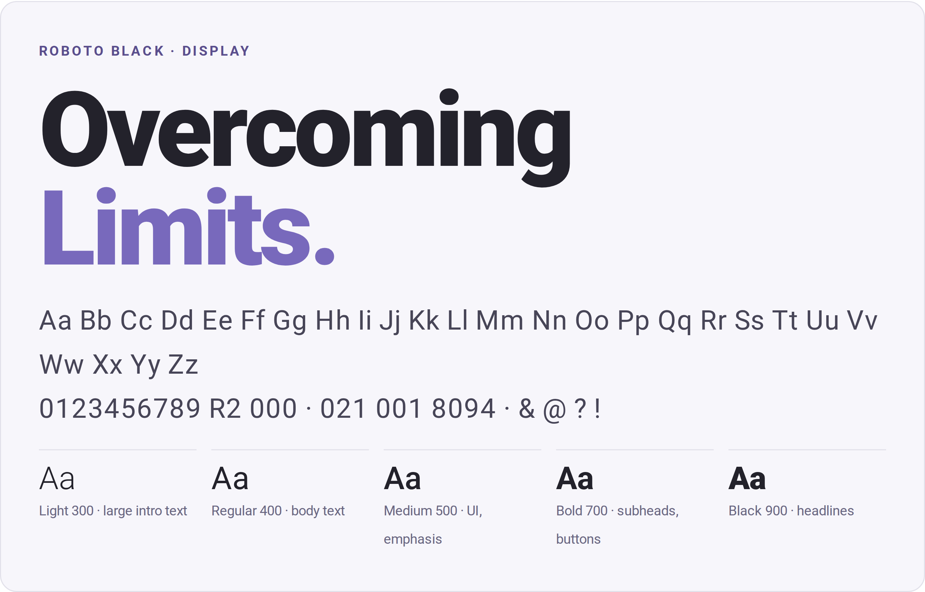
05
TYPOGRAPHY
Roboto, set clean and confident.
One typeface family does everything. Roboto is clean, modern and easy to read at any size, and it is free from Google Fonts.
WHERE TO USE WHAT
Web: Roboto from Google Fonts, then Arial, Helvetica, sans-serif.
Google Docs & Slides: Roboto is built in.
Word & PowerPoint: install Roboto. Use Arial in files others will edit (like this deck).
Email: Arial.
Print: PDFs with fonts embedded.

Slide 24
05
TYPOGRAPHY
Type scale and setting rules.
Style | Screen | Print | Settings
Display | 64–78px | 48pt | Black 900 · tight tracking · hero and covers
H1 | 48–64px | 36pt | Black 900 · line height 1.05
H2 | 32–40px | 24pt | Black 900 · line height 1.1
H3 | 24–28px | 16pt | Bold 700
Lead | 20px | 12pt | Light 300 or Regular 400
Body | 16–18px | 10–11pt | Regular 400 · line height 1.6
Small | 14px | 8.5pt | Captions and legal lines
Eyebrow | 13–14px | 8pt | Bold · UPPERCASE · +18% tracking
Button | 15px | – | Bold · sentence case · +3% tracking
SETTING RULES
Sentence case for headings and buttons.
Left-align text. Centre only short headlines.
Highlight one idea per headline in Star Purple.
Emphasise with Medium or Bold, not italics.
45–75 characters per line of body text.
Never stretch, outline or shadow type.

Slide 25


06
GRAPHIC ELEMENTS
The star.
One continuous hand-drawn line with two small loops: human and a little imperfect. Always an outline, never filled. Every colourway is drawn at 82% opacity for its soft, pencil-like feel.
Star Purple
Deep Rise
Rise Blue
Faint
White
Icons, value cards, accents
Formal documents, print
Supporting accents
Large watermarks on white
Watermarks on purple and blue
Use the star
Don’t
as one large watermark, cropped by the edge
as a small icon beside values and key points
as the avatar and favicon
redraw, trace, smooth or “fix” the line
fill it, shadow it or put it in a solid shape
scatter it as a pattern, spin it or use it for ratings

Slide 26
06
GRAPHIC ELEMENTS
The rising path, soft edges and buttons.
A dotted trail joins numbered markers. Use it only for real sequences: a process, a course outline, a timeline.
1
2
3
Tell us your need
We shortlist
You hire & grow
Share the role, the team and the must-haves. We listen first.
A curated shortlist of screened, fit-matched candidates.
We support onboarding and check in well beyond day one.
SHAPES
BUTTONS · SENTENCE CASE
Book a consultation
Browse jobs
Buttons
Inputs
8–12px radius
10px radius
Get in touch
For businesses
Cards & images
Feature bands
18px radius
26px radius
One primary (Star Purple) button per view. Hover: #6A5BB0. Start with a verb: “Submit your CV”, “Request talent”.

Slide 27









06
GRAPHIC ELEMENTS
Icons.
Google Material Symbols, Outlined (weight 400, unfilled, 24px grid). Colour them Star Purple, Rise Blue or Deep Rise inside a white rounded square with a soft shadow. One icon style only, and no emoji.
Recruitment
Talent sourcing
Psychometrics
HR & compliance
Payroll
groups
person_search
psychology
gavel
receipt_long
Training
Temp & contract
Jobs
Accredited
Partners
school
schedule
work
verified
handshake

Slide 28

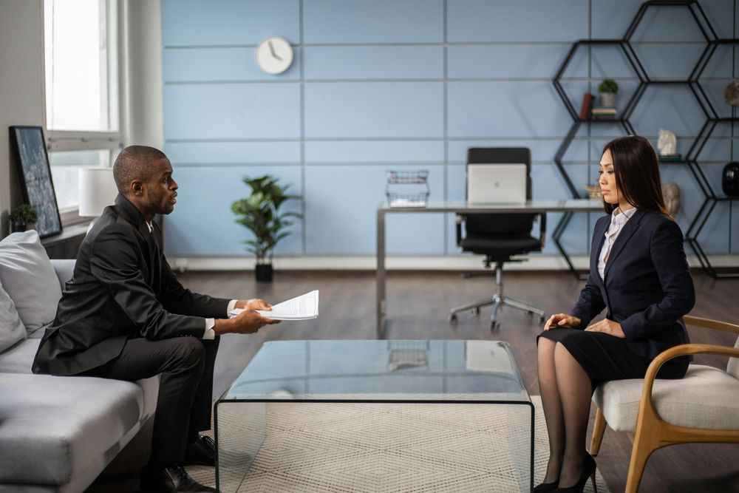

07
PHOTOGRAPHY
Real people, real work, real light.
Connection: genuine smiles, natural light
Warmth: people meeting as equals
Recruitment: calm, respectful talks
Compliance: detail handled carefully
Look for
Avoid
Diverse South African faces, ages and abilities
Real workplaces: offices, shop floors, factories, training rooms
Natural light and soft, true colour
Candid moments, with calm space for a headline
Stock clichés: thumbs-up, pointing at screens, jigsaws
Cold corporate scenes and heavy, moody filters
More than one handshake per page
Visible CVs, ID numbers, payslips or personal data

Slide 29


07
PHOTOGRAPHY
Text on images, and consent.
Put text on a calm area of the photo, or add a Deep Rise overlay that fades from 85% to 0% across the image. Text on photos is white, with bold headlines. Round photo corners to 18px on screens.
Consent comes first. Only photograph or publish real candidates, clients, learners or staff with their written permission, in line with POPIA. Record the consent with the image, and credit stock photos where the licence asks for it.

Slide 30
08
Voice & tone
Professional, clean and modern. Always human, warm and supportive.

Slide 31
08
VOICE & TONE
We sound like a capable friend.
1
2
3
4
Talk to people
Keep it clear
Be warm and honest
Lead to action
Write to one person with “you” and “we”. Say people, team and candidate, not “human capital” or “headcount”.
Short sentences, everyday words, one idea per paragraph. If a 15-year-old wouldn’t follow it, rewrite it.
Show empathy, especially with bad news. Never overpromise. Only publish facts and figures we can prove.
Say what happens next and what to do: “Submit your CV”, “Book a seat”, “Request talent”.
No corporate jargon. Short, clear sentences that lead to an action.

Slide 32
08
VOICE & TONE
Our voice stays the same. Our tone adapts.
Situation | Tone | Sounds like
Business owners & managers | Confident, practical, efficient | “Tell us what you need. We’ll send a shortlist of people who fit.”
Job seekers | Warm, encouraging, honest | “Send us your CV and a real consultant will read it.”
Training delegates | Motivating, hands-on | “Practical skills you can use at work on Monday.”
Discipline, investigations, CCMA | Calm, neutral, precise | “Here’s what happens next, and what your rights are at each step.”
Unsuccessful candidates | Kind, specific, forward-looking | “This role went to another candidate. We’d like to keep your CV for roles that fit.”
Social media | Friendly, upbeat, professional | “We’re hiring in Cape Town. Here’s what makes this role special.”

Slide 33
08
VOICE & TONE
Words we use.
We say | Instead of
people, team, staff | human capital, headcount, resources
candidate, job seeker | applicant pool, talent stock
match, fit, the right person | leverage synergies, best-in-class talent solutions
help, support, look after | facilitate, action, operationalise
start, use, about | commence, utilise, in respect of
a consultant reviews every CV | applications are processed
smart tools, AI-assisted | our AI picks your candidate
OUR NAME
HumanRise
One word, with a capital H and R.
Never “Human Rise”, “Humanrise” or “HUMANRISE” in running text.
Possessive: HumanRise’s.
Legal: HumanRise ZA (Pty) Ltd on contracts, invoices and letterheads.

Slide 34
08
VOICE & TONE
Before and after.
BEFORE
AFTER
Closing line of a job advert
Should you not receive a response within 14 days, please consider your application unsuccessful.
A HumanRise consultant reads every application. If this role isn’t the one, we’ll keep your CV (with your permission) and look out for roles that fit.
A business proposal
We leverage best-in-class talent acquisition solutions to optimise your human capital.
We find people who fit your team, and we handle the HR detail so you can focus on growth.
A disciplinary matter
Don’t worry, we’ll sort this out quickly!
We’ll guide you through each step and make sure the process is fair, lawful and properly recorded.
Talking about AI
Our AI finds your perfect candidate in seconds.
Smart tools speed up our search. A HumanRise consultant reviews every CV and every shortlist.

Slide 35
08
VOICE & TONE
Taglines and lines.
TAGLINE AND SIGN-OFF
Overcoming Limits.
With the logo, in footers and email signatures, and at the end of adverts and videos. Title case, with a full stop when it stands alone.
Supporting line | Role | Where
Raising People. Raising Potential. | Headline line | Campaigns, banners, website hero sections
Hire people who raise the room. | For businesses | Business pages, proposals, LinkedIn
Building your career, not just your CV. | For individuals | Career-enhancement content with the Career Cat
Let’s raise potential together. | Call to action | Closing sections, invitations
Use one line per piece. Don’t stack them.

Slide 36
08
VOICE & TONE
Boilerplate: about HumanRise.
SHORT · 25 WORDS
HumanRise is a people-first HR and recruitment partner based in Cape Town, helping businesses and individuals across South Africa overcome their limits.
MEDIUM · 55 WORDS
HumanRise is a people-first HR and recruitment partner. We connect great businesses with great people, matching on skills and on fit, and support teams with HR, POPIA-ready compliance and practical, accredited training. Based in Cape Town and working nationally, we are human-led and AI-assisted, and we help people and teams overcome their limits.
LONG · 110 WORDS
HumanRise ZA (Pty) Ltd is a people-first HR and recruitment partner based in Cape Town, serving clients across South Africa. We place permanent, temporary and contract candidates, matching on skills and culture fit, with psychometric testing where it helps. For businesses, we provide outsourced HR support, from contracts and policies to payroll and disciplinary guidance, with POPIA-compliant practice built in. Our training courses, some QCTO-accredited, build capable and motivated teams and prepare first-time job seekers for work. We are human-led and AI-assisted: modern tools help us work faster, and a real consultant makes every decision. Our promise is simple: Overcoming Limits.

Slide 37
08
VOICE & TONE
Writing style.
Spelling | South African English: colour, organisation, programme, centre, licence (noun), enrol, practise (verb).
Dates and times | 1 October 2026 · Mon–Fri, 08:00–17:00
Numbers and money | One to nine in words, 10 and up in numerals. R2 000 and R15 500 (space as thousands separator, no space after R).
Phone | 021 001 8094 locally · +27 21 001 8094 internationally
Acronyms | Spell out first: Protection of Personal Information Act (POPIA), Quality Council for Trades and Occupations (QCTO), Commission for Conciliation, Mediation and Arbitration (CCMA).
Ampersands | “&” in navigation and headings (HR & Compliance). “and” in sentences.
Inclusive language | Gender-neutral titles (chairperson, salesperson), “they” for an unknown person, no age-coded phrases like “young and dynamic”.
Exclamation marks | Rarely, at most one per post. Never in sensitive HR matters.

Slide 38
09
Applications
Ready-made layouts for the things we produce most.

Slide 39
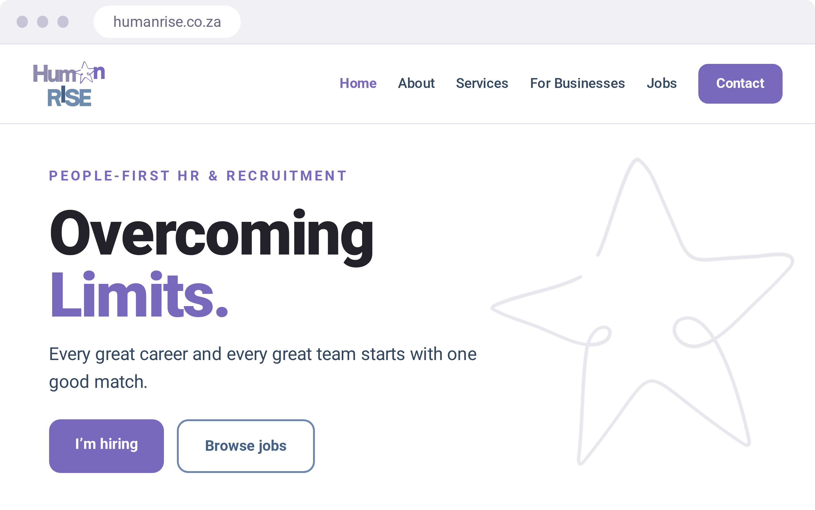
09
APPLICATIONS
Website.
White pages with Mist and Sky sections, and a sticky header with the logo top left.
One primary button per view.
On mobile: sticky bottom navigation and a floating “Book a consultation” button.
Developers: link brand/tokens.css for every colour, size, radius and shadow.
Show trust signals: POPIA, the registered name, and QCTO on accredited courses.

Slide 40
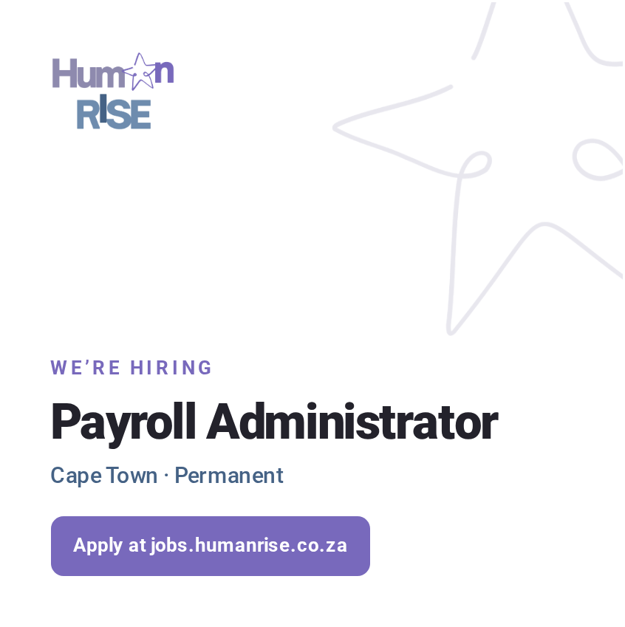
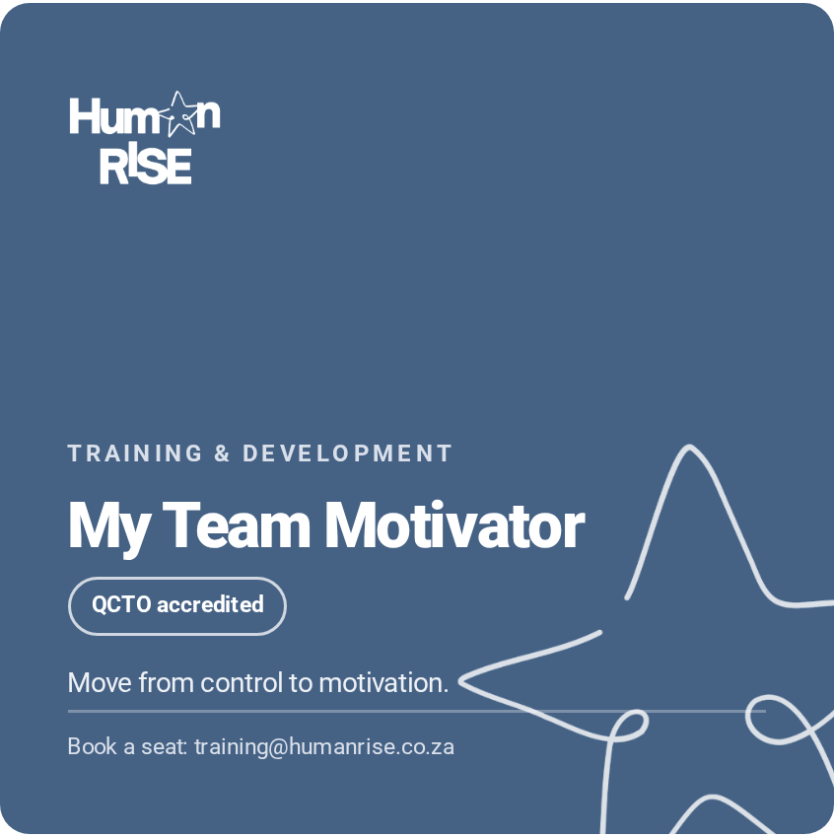
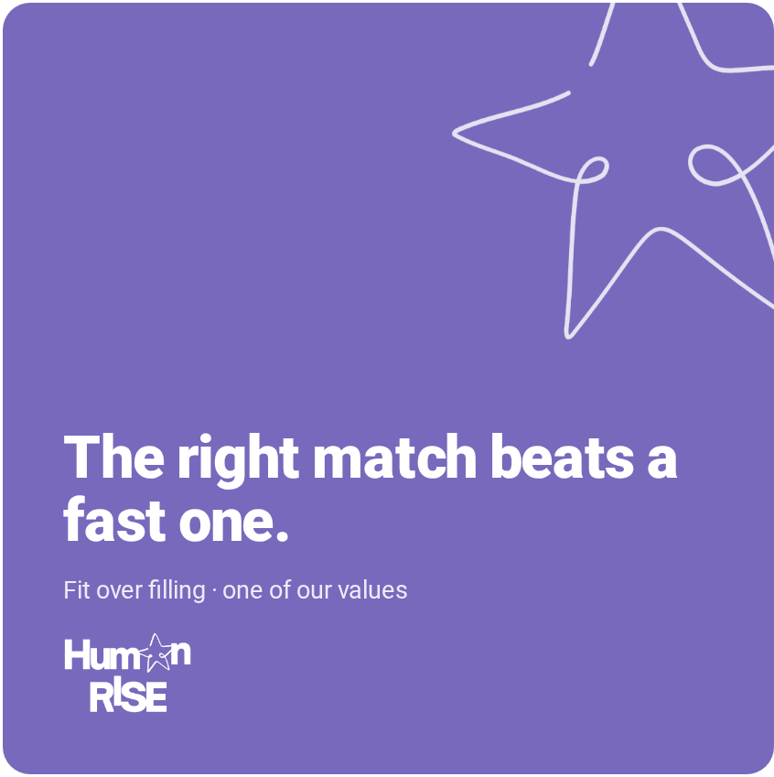

09
APPLICATIONS
Social media posts.
SPECS
1080 × 1080px, or 1200 × 1200px for LinkedIn. One message, one star, one action. Logo top left at about 22% of the width.
Vacancy: white, faint star, purple action. The role shown is an example.
Training: Deep Rise with a white logo and star.
Value or insight: Star Purple with a short statement.
Caption: a hook line, two or three short lines of detail, one call to action with a link, then #HumanRise #OvercomingLimits and up to three topic tags (#Hiring #CapeTownJobs #HRSouthAfrica). Tag partners and clients only with permission.

Slide 41
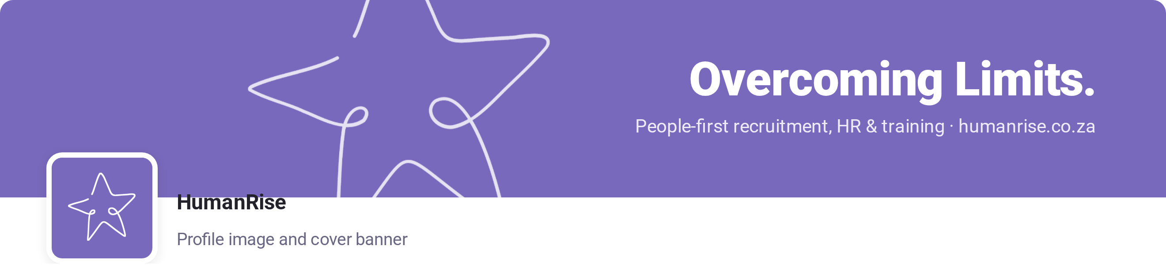
09
APPLICATIONS
Profiles and banners.
Profile image: the full logo on white where the platform shows it at 120px or larger. Otherwise use the star avatar (star/humanrise-avatar.png), which also suits WhatsApp, favicons and app icons.
LinkedIn cover: 1128 × 191px in Star Purple, with text on the right. The profile image covers the bottom-left corner.
Everywhere: the same name (HumanRise) and the medium boilerplate as the bio.

Slide 42
09
APPLICATIONS
Job adverts.
WE’RE HIRING
Use the same structure on our website, LinkedIn and job boards.
Point every application to jobs.humanrise.co.za, so candidates use the same secure, POPIA-compliant form.
Mark example or placeholder roles clearly. Never publish a role that doesn’t exist.
[Job title]
[Area, City] · [Permanent / Temporary / Contract] · [Salary, if disclosed]
About the role
Two or three warm, plain sentences on what the job is and why it matters.
What you’ll do
Four to six bullet points, each starting with a verb.
What you’ll bring
Four to six points, with must-haves separate from nice-to-haves.
Why you’ll like it
Team, growth and benefits, as the client confirms them.
How to apply
“Apply at jobs.humanrise.co.za. A HumanRise consultant reviews every application.” Add the closing date.
Compliance lines
The POPIA line, plus the client’s employment equity statement where it applies.

Slide 43
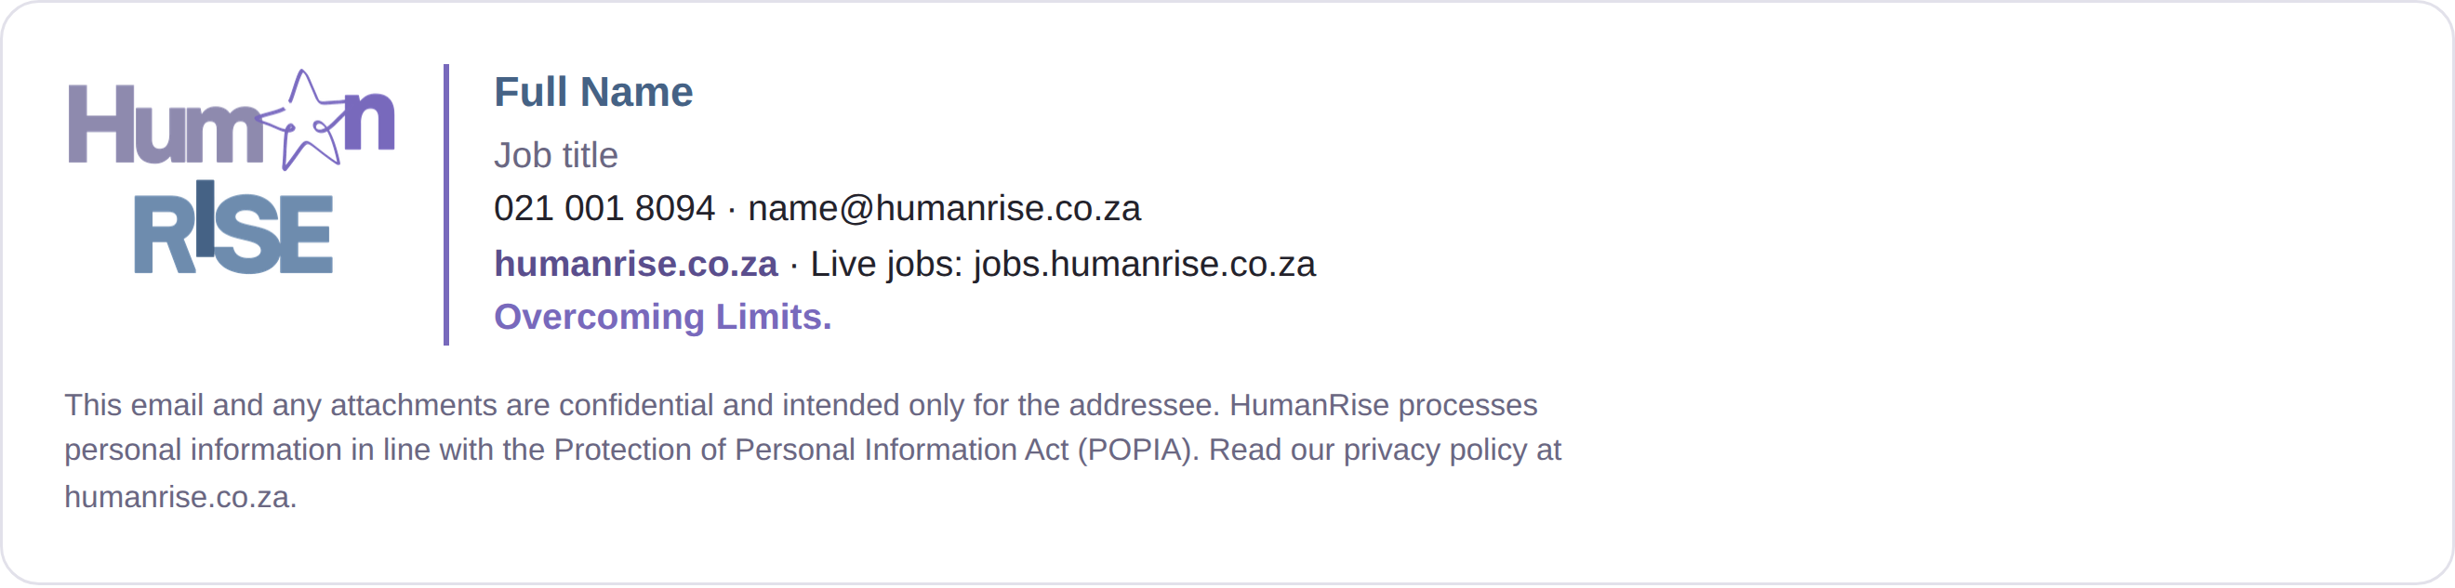

09
APPLICATIONS
Email signature.
Copy the ready-made HTML from the web version of this guide (brand/index.html, chapter 09) into your email settings.
Arial, a 120px logo (logo/humanrise-logo-email.png) and one Star Purple divider.
Name, job title, phone, email, website and live-jobs link, then “Overcoming Limits.”
The confidentiality and POPIA line underneath in 11px grey.
No extra images, quotes, banners or coloured backgrounds.

Slide 44

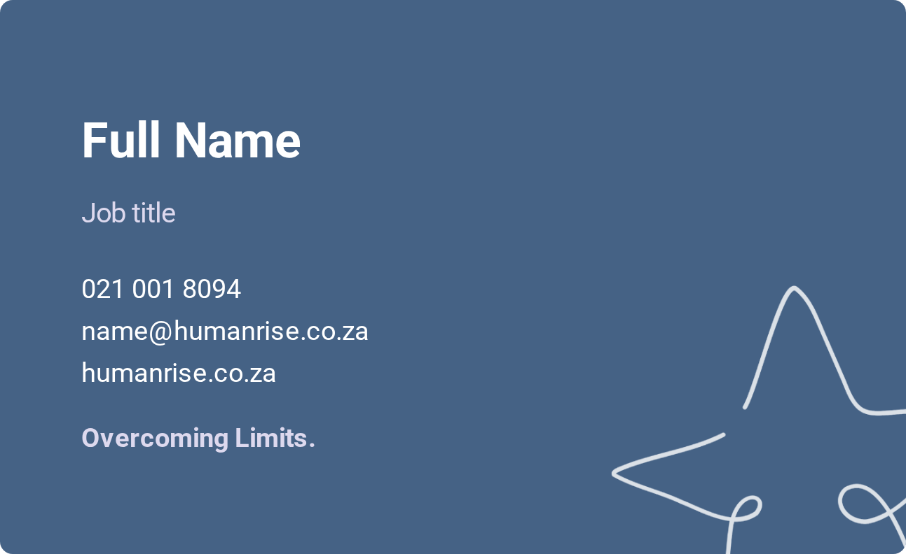
09
APPLICATIONS
Business cards.
Front: the logo centred on white.
Back: Deep Rise, with the white star bleeding off the corner.
90 × 55mm with 3mm bleed on 350gsm matt board. Name in Roboto Bold 9pt, details in Regular 7.5pt. Keep text 5mm inside the trim.

Slide 45
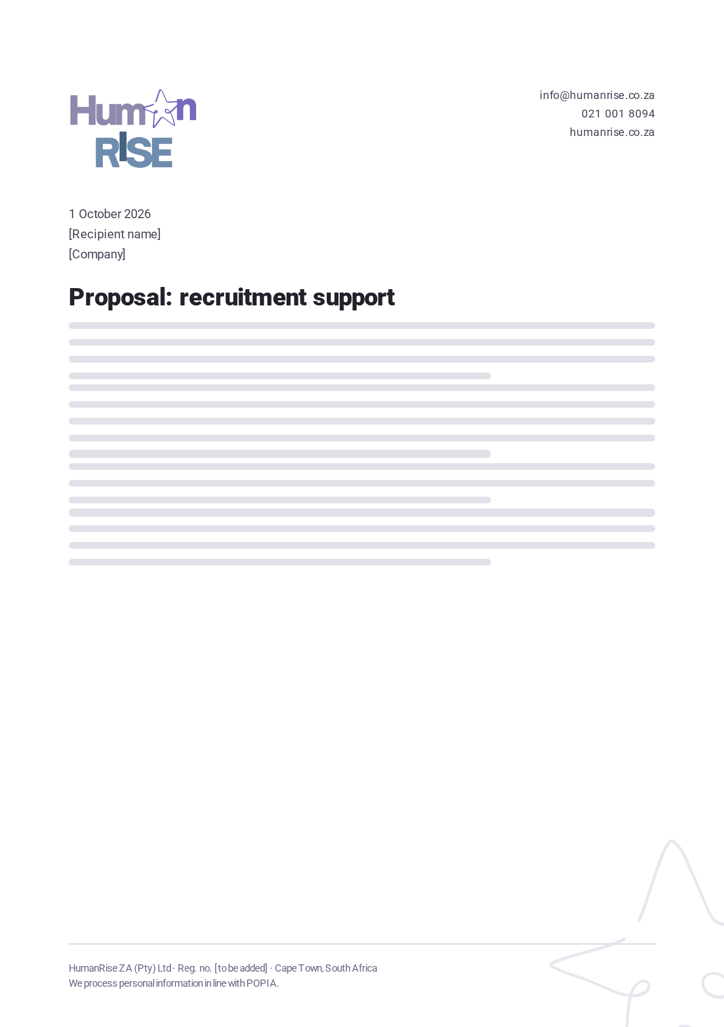
09
APPLICATIONS
Letterhead and documents.
A4 with 20mm margins. The logo goes top left at 40mm wide.
Contact details top right in Roboto Regular 8pt.
Body in Roboto 10.5pt (Arial in editable Word files), Ink on white, left-aligned.
Headings in Roboto Black. The faint star is cropped in the bottom-right corner.
The footer carries the legal name, registration number, city and the POPIA line.
Use it for proposals, quotes, contracts, policies, handbooks and certificates.

Slide 46
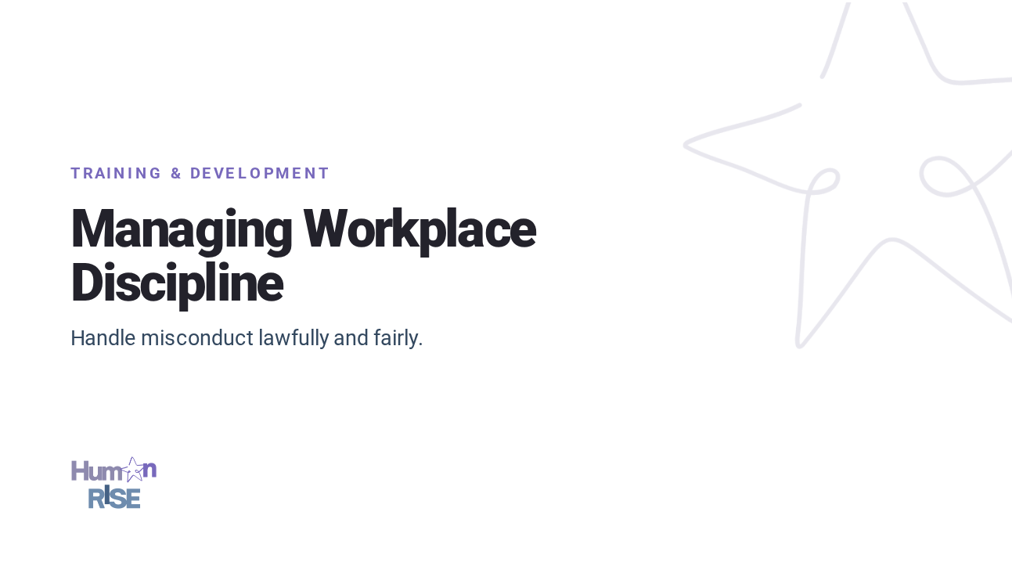
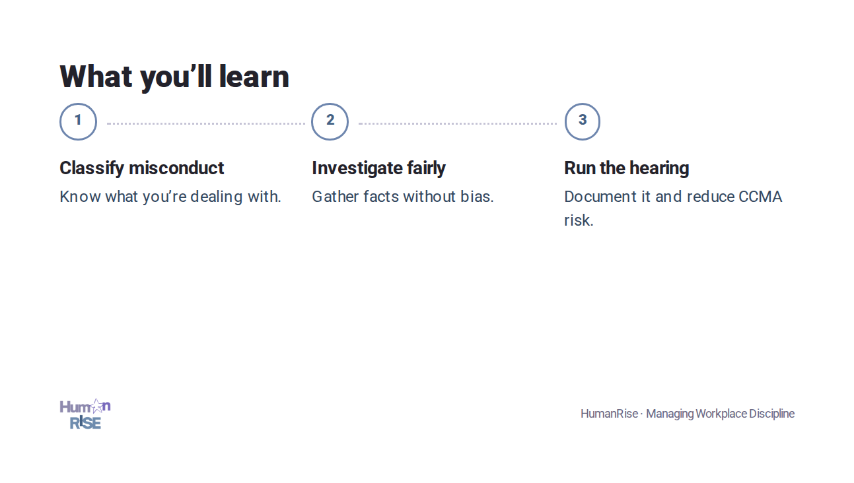
09
APPLICATIONS
Presentations and training material.
16:9, white backgrounds, one idea per slide. Section dividers use Deep Rise or Star Purple with the white logo and star.
Write course titles exactly. Show “QCTO accredited” only on accredited courses (currently My Team Motivator and Workplace Preparation).
Workbooks and certificates use the letterhead layout, with the course title in a bold headline.

Slide 47
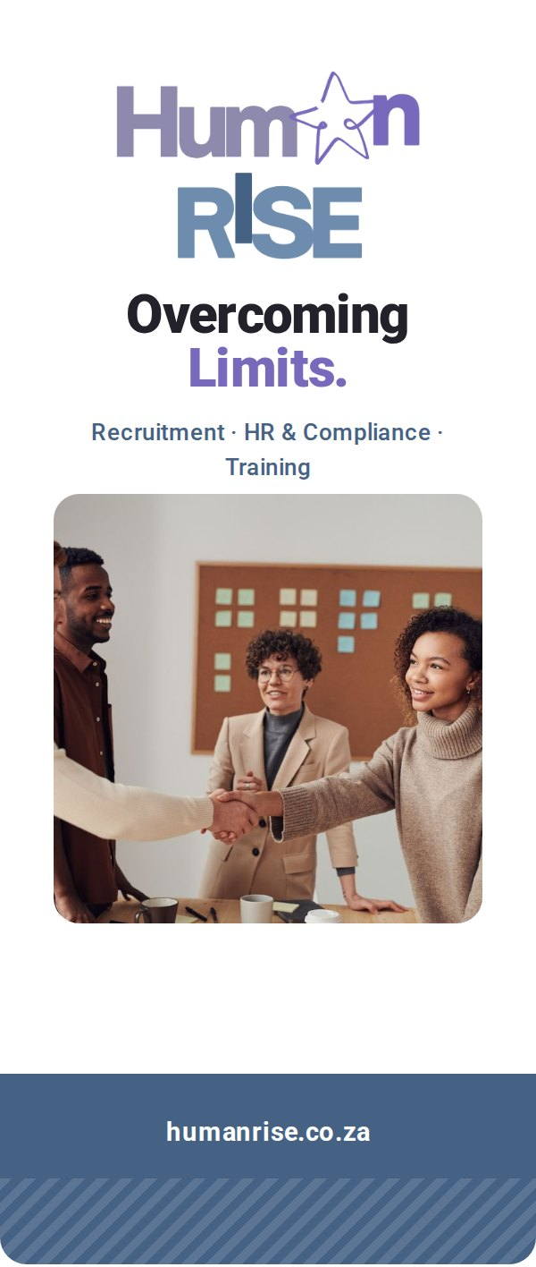
09
APPLICATIONS
Pull-up banner.
850 × 2000mm. Logo in the top quarter, at eye level.
One line, three services and one photo. Nothing else.
The website in white on a Deep Rise base band.
Keep text out of the bottom 200mm (shown striped). The stand and the crowd hide it.
Supply vector PDFs, with images at 150dpi at full size.

Slide 48
10
Partners & linking
For partners, clients, venues, job boards and media who mention, link to or co-brand with HumanRise.

Slide 49

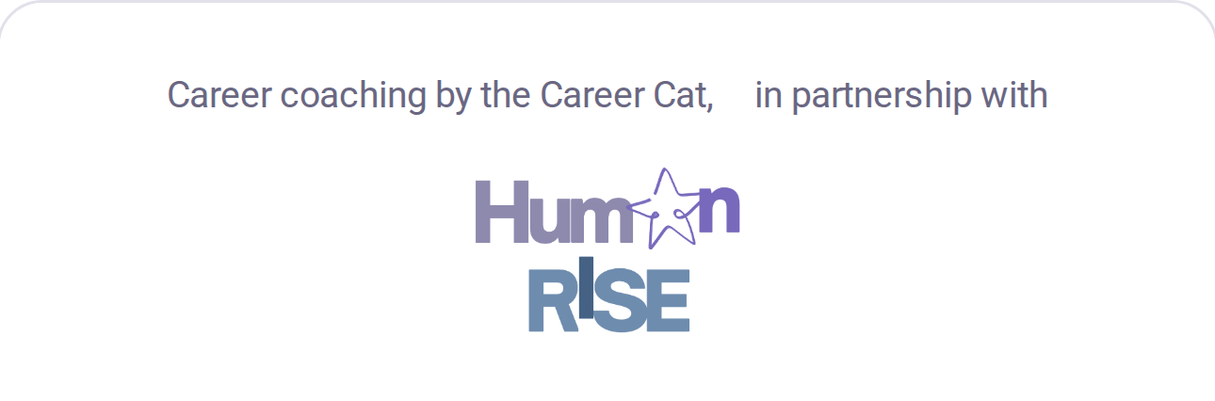
10
PARTNERS & LINKING
Mentioning us and co-branding.
Write HumanRise as one word with a capital H and R. Use HumanRise ZA (Pty) Ltd in contracts.
Describe us as a “people-first HR and recruitment partner”, or use a boilerplate.
Credit lines: “Recruitment partner: HumanRise”, “Training by HumanRise”, “In partnership with HumanRise”.
Don’t present HumanRise as endorsing a product or service without our written agreement.
Partnership lock-up: equal visual size, a Lavender 200 divider and 2X clear space around each logo.
Endorsement: on partner-led material, our logo follows “in partnership with”, at no less than the minimum size.

Slide 50
10
PARTNERS & LINKING
Co-branding rules and approval.
Do
Don’t
Use our master logo files, unaltered
Give each logo its own clear space
Full colour on white, white logo on dark colours
Send artwork for approval before it goes out
Merge logos or create a combined mark
Recolour either logo to match the other
Shrink ours below minimum size
Use the star on its own in co-branded work
GETTING APPROVAL
1
2
3
Draft with this guide
Send it to us
Approve and publish
Use the master files, colours and wording.
Email info@humanrise.co.za with the artwork, where it will appear, dates and quantities.
We reply with approval or changes. Allow time before print deadlines.

Slide 51
10
PARTNERS & LINKING
Linking online.
Link to | Address | Suggested link text
HumanRise home | https://humanrise.co.za | HumanRise · people-first HR & recruitment
Live vacancies | https://jobs.humanrise.co.za | Browse jobs at HumanRise
Submit a CV | https://humanrise.co.za/submit-cv.html | Submit your CV to HumanRise
Business services | https://humanrise.co.za/business.html | Recruitment and HR support for businesses
Training courses | https://humanrise.co.za/services.html | HumanRise training courses
Contact | https://humanrise.co.za/contact.html | Contact HumanRise
LinkedIn | linkedin.com/company/humanriseza | Follow HumanRise on LinkedIn
Career enhancement | https://careercat.co.za | CV writing and coaching with the Career Cat
Link our logo to https://humanrise.co.za. Use descriptive link text, never “click here”.
Link to jobs.humanrise.co.za instead of copying our adverts, so roles stay current and applications stay secure.
Tag HumanRise on LinkedIn and use #HumanRise and #OvercomingLimits.
Add tracking so we can thank you: humanrise.co.za/?utm_source=careercat&utm_medium=referral&utm_campaign=partner-page

Slide 52
10
PARTNERS & LINKING
Compliance and trust lines.
POPIA · FORMS AND ADVERTS
By submitting your information, you agree that HumanRise may process your personal information for recruitment purposes, in line with the Protection of Personal Information Act (POPIA). Read our privacy policy at humanrise.co.za.
AI USE · WHERE RELEVANT
HumanRise uses AI-assisted tools to help manage applications. A HumanRise consultant reviews every application, and no decision is made by automated processing alone.
ACCREDITATION
Show “QCTO accredited” only next to accredited courses (currently My Team Motivator and Workplace Preparation), never next to the HumanRise logo on its own.

Slide 53
10
PARTNERS & LINKING
The brand kit.
Everything in this guide lives in the brand/ folder of the HumanRise website repository, and at humanrise.co.za/brand/ once published. For vector or print-ready files, email info@humanrise.co.za.
Folder / file | Contents
HumanRise-CI-Guidelines.pptx | These guidelines as a presentation (this deck)
HumanRise-CI-Guidelines.pdf | Full guidelines as an A4 PDF, for print and sharing
HumanRise-CI-Guidelines-Slides.pdf | This deck as a PDF
index.html | Web version, with copy-ready email signature HTML
tokens.css | Colour, type, radius and shadow variables for developers
assets/logo/ | Full colour, white, Deep Rise, black and email logo files
assets/star/ | Five star colourways and the profile avatar
assets/photos/ | Approved example photographs (web size)
assets/partners/ | Partner logos for approved lock-ups

Slide 54
11
CHECKLIST
Before anything goes out.
The logo comes from the master files, unaltered, with 2X clear space and above minimum size.
No more than one star, used as an outline, unfilled and not redrawn.
Full colour on white or light tints, white on dark colours. No mid-tones, no cream.
Photos show real, diverse people in natural light, with consent recorded.
Colours come from the palette, with purple as the spark and plenty of white.
Copy is short, warm and jargon-free, and ends with one clear action.
Text passes contrast: Ink, Deep Rise or Star Purple on white, white on Deep Rise or Star Purple.
Facts and figures are true and provable. AI is described as assisting people, never deciding.
Type is Roboto (Arial in email and editable files), with headings and buttons in sentence case.
Legal lines are in place: POPIA, the registered name where needed, QCTO only on accredited courses.

Slide 55
12
NOTES & OPEN ITEMS
Open items for version 1.1.
1
Vector logo master
5
Registration number
Export SVG and PDF versions of the logo and star from the original design file.
Add it to the letterhead and legal footers.
2
Update the master artwork
6
Social channels
Remove the light-blue strip under the rising I, and retire the cream exports.
Confirm handles beyond LinkedIn and add them to the guide.
3
Print colour
7
Website alignment
Match the four core colours to Pantone references with your printer.
Buttons are sentence case (the June 2026 spec said uppercase). Switch small Rise Blue labels to Star Purple or Deep Rise for WCAG AA.
4
Profile avatar
8
AI commitments
Approve the slightly heavier star line, or replace it with an original small-size drawing.
Confirm the three commitments match how HumanRise uses AI today, and review them as tools change.

Slide 56
Overcoming Limits.
Questions about the brand, or need a file?
info@humanrise.co.za · 021 001 8094 · humanrise.co.za
HumanRise ZA (Pty) Ltd · Corporate Identity Guidelines v1.0 · October 2026

