Slide 1
Code Glosser
Developed by: Louis Jenkins
Advised by: Drue Coles

Slide 2
What is Code-Glosser
Academic Enrichment Tool
Allows professors to provide feedback for student assignments
Make as effortless as possible
Free
Open Source
BSD 3-Clause License
Minimal
Nearly non-existent learning curve
Stand-Alone Application

Slide 3
Why should you use Code-Glosser
Current Approach to Grading
The Code-Glosser Approach
Print out project
Waste of paper
Bulky to carry around
Very bad for multi-file projects
Leave feedback in pen
Your handwriting may not be intelligible to everyone
Mistakes cannot be erased
You are much less likely to leave feedback for small or less important things
Especially if a lot of people make the same mistakes
Feedback left most likely short
Need to fit on a single page, and also need to write them in bulk
Time Consuming
Too much time and effort to do for each and every student, every assignment for every class
Hand back to student
They may not even read it anyway
May have been wasted time
Open the project in Code-Glosser
Can open any file inside of the project
File markups are preserved when switching files
Markup project
Can markup while you’re reading it
No need to make multiple passes
Easy to make changes
Create, Modify, and Delete on demand
Easy to leave feedback on very common mistakes
Templates make it trivial
Leave feedback on any section of code
Can be a variable, a block of code, or even a function
Export Project
Exports into a compressed archive that the student may view
No printing needed
All electronic

Slide 4
Features
Portability
To Markup
Java Runtime Environment 8
To View
Web Browser (HTML + CSS support)
Effortless Markups
Markup portions of code in moments
Leave feedback for student with a message
Templates
Save more time by applying templated markups
Project-Scale Grading
Markup and exportation of entire projects
Projects are as simple as a directory containing code
Does not need to be a NetBeans or Eclipse project
Can even be individual files
Syntax Highlighting
Uses the highlight.js library for syntax highlighting
Supports 169 languages
Does not require an internet connection to markup or to view

Slide 5
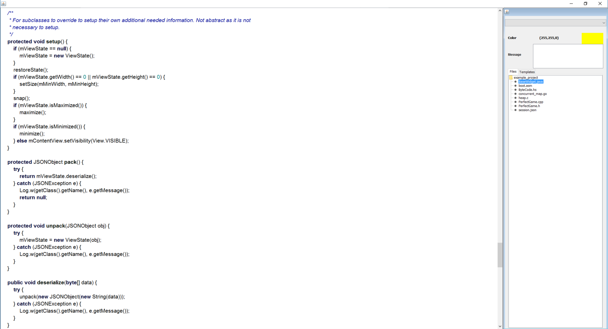
Java – S.A.K-Overlay Android App. (CS345)

Slide 6
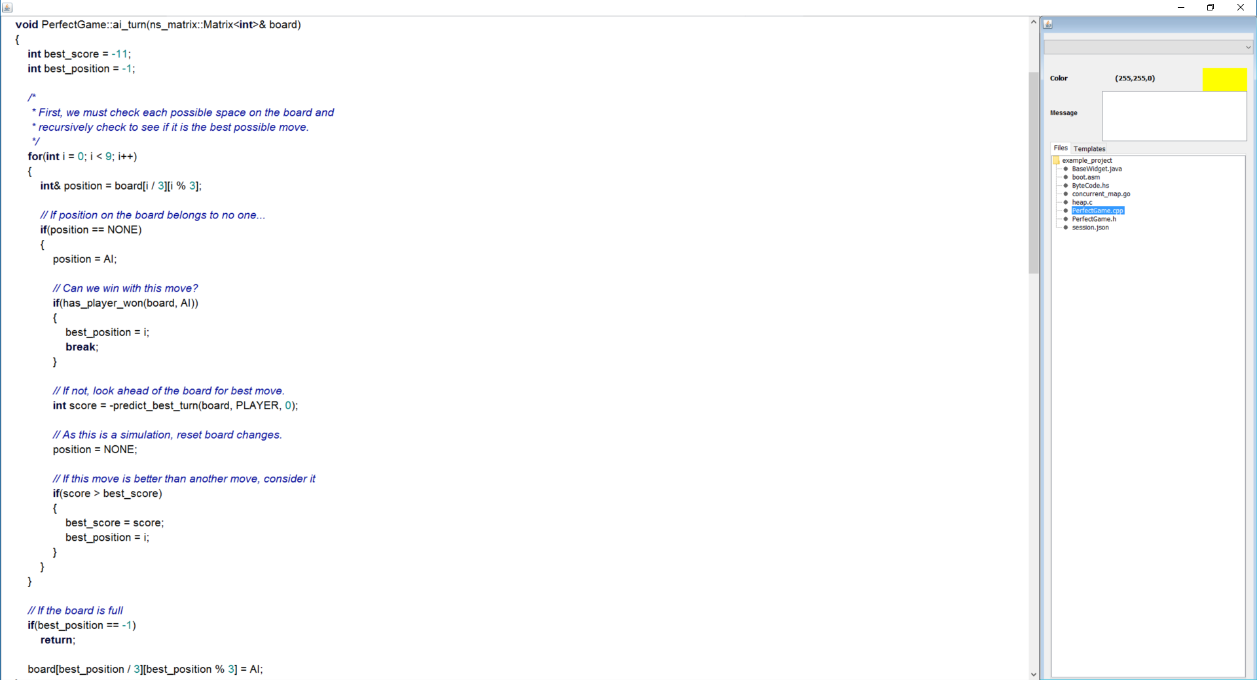
C++ - TicTacToe (CS255)

Slide 7
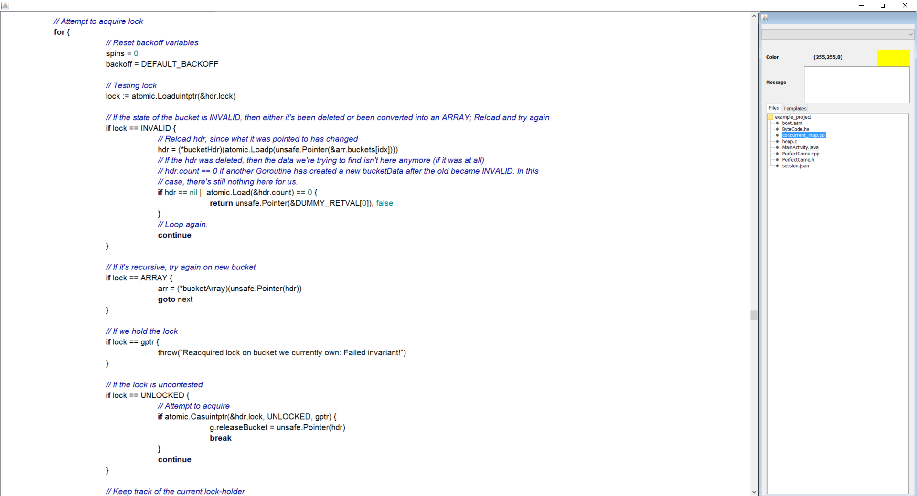
Go – Concurrent Map (Runtime Impl.)

Slide 8
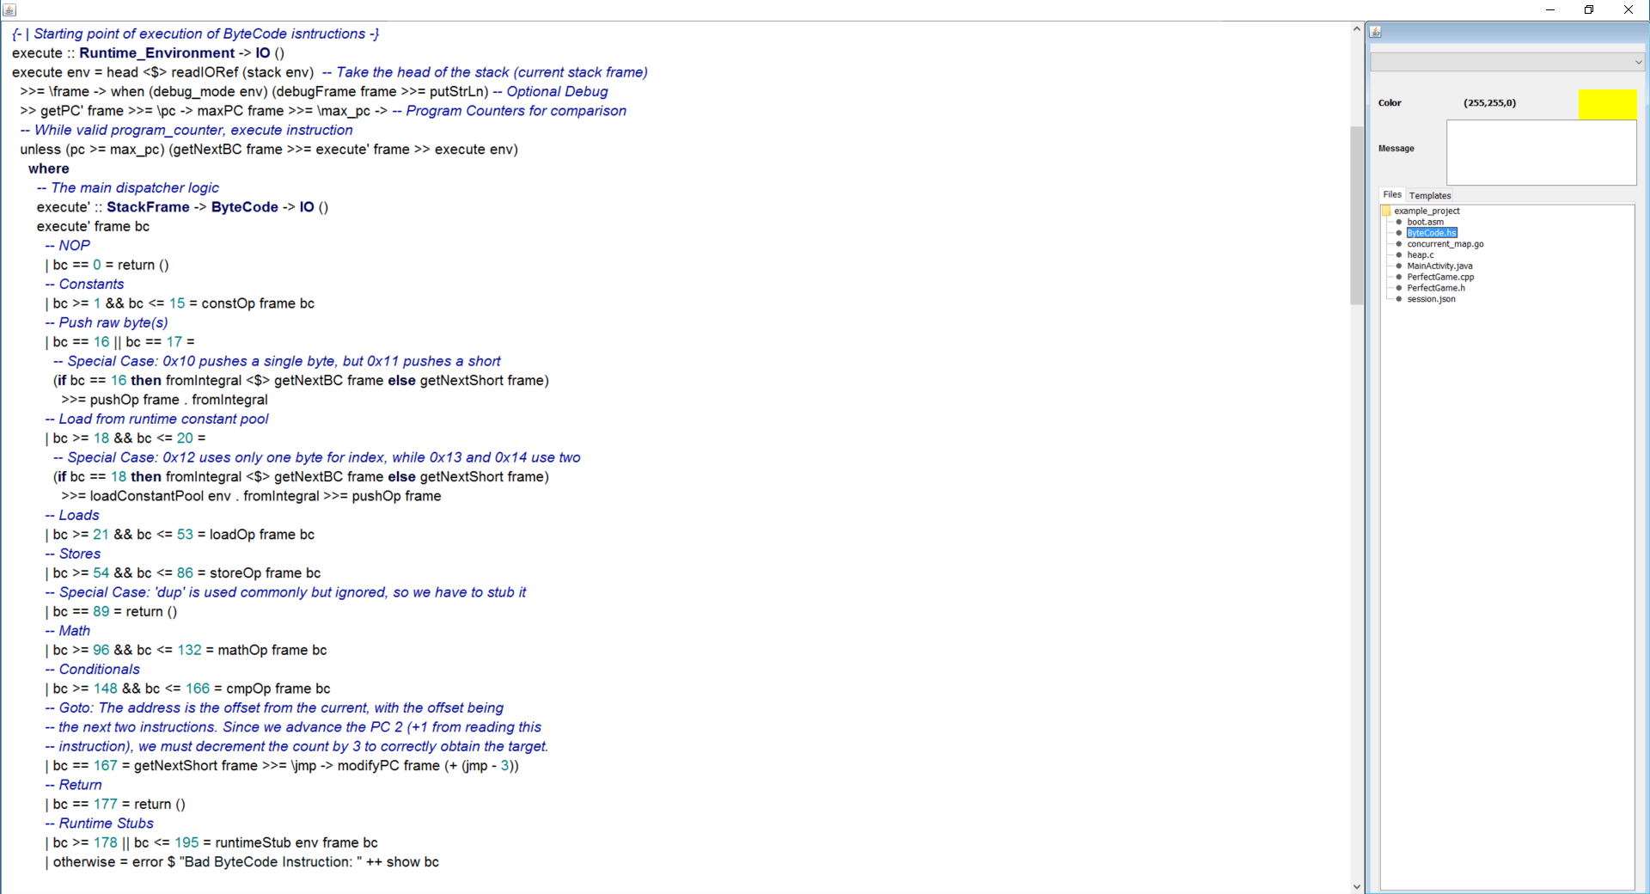
Haskell – JVM ByteCode Interpreter (CS350)

Slide 9
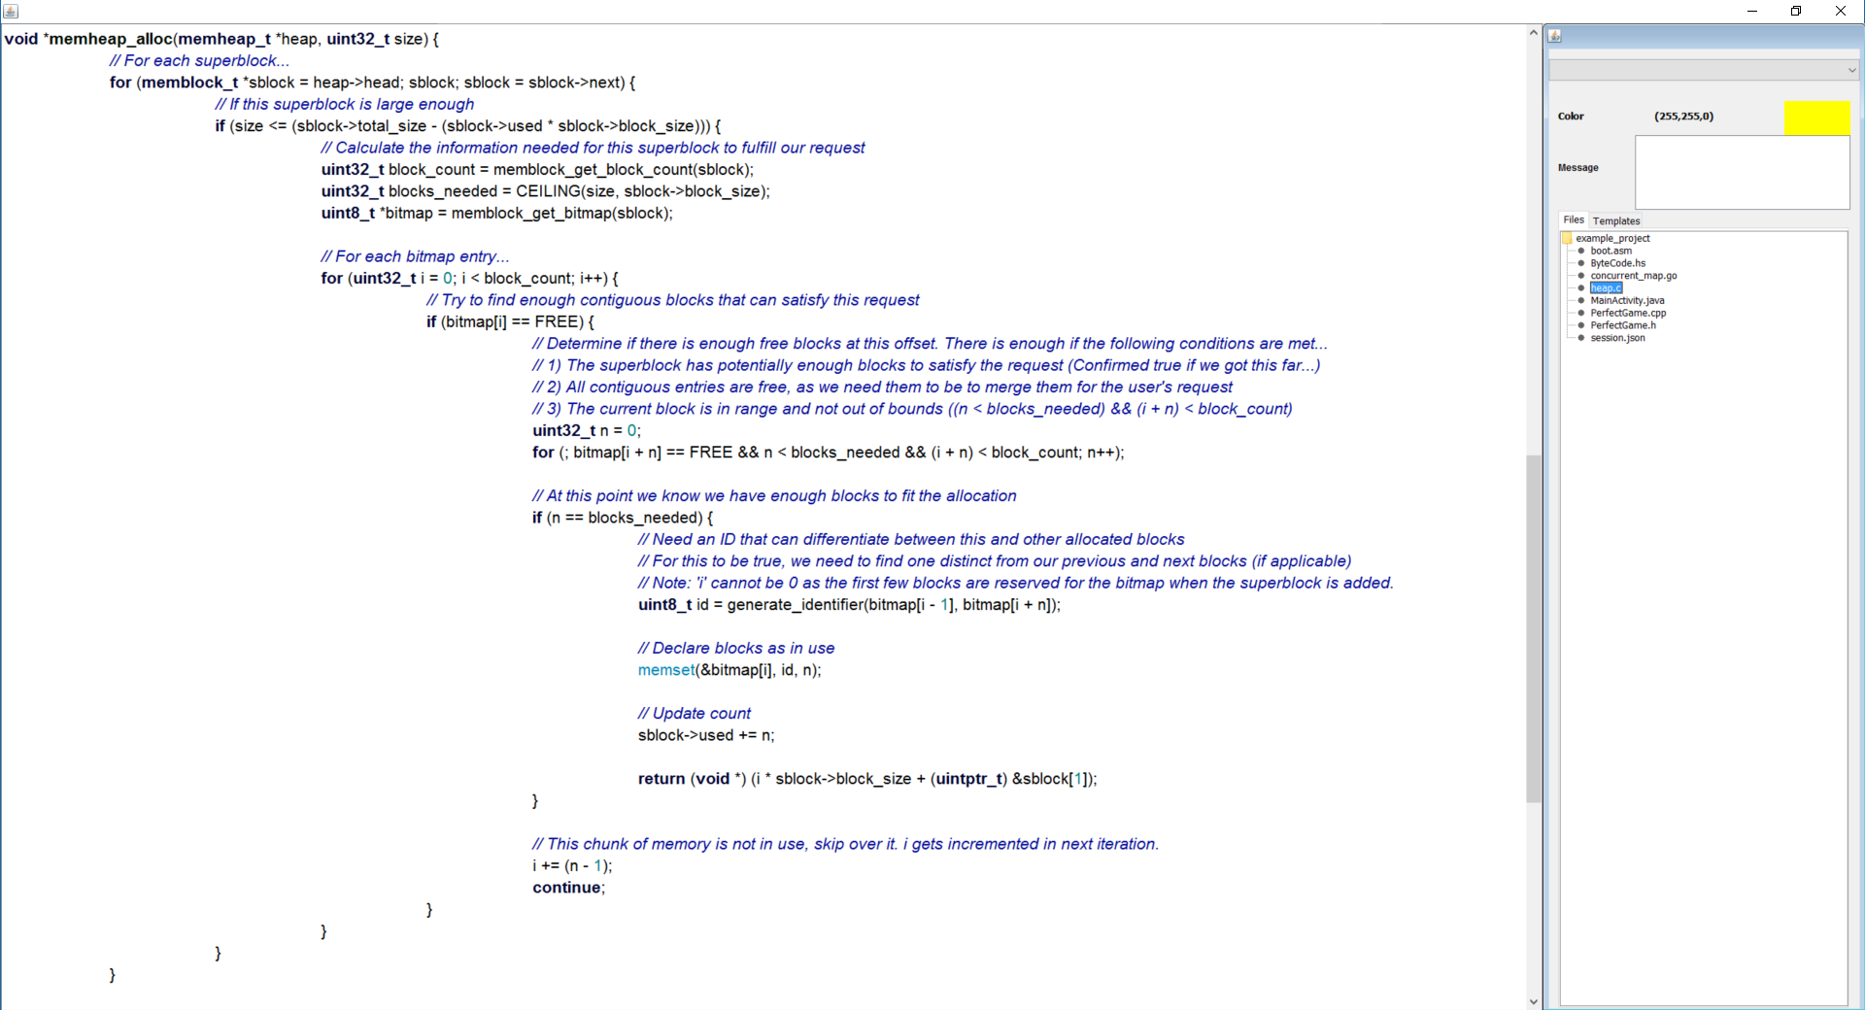
C – Bitmap Heap (MoltarOS)

Slide 10
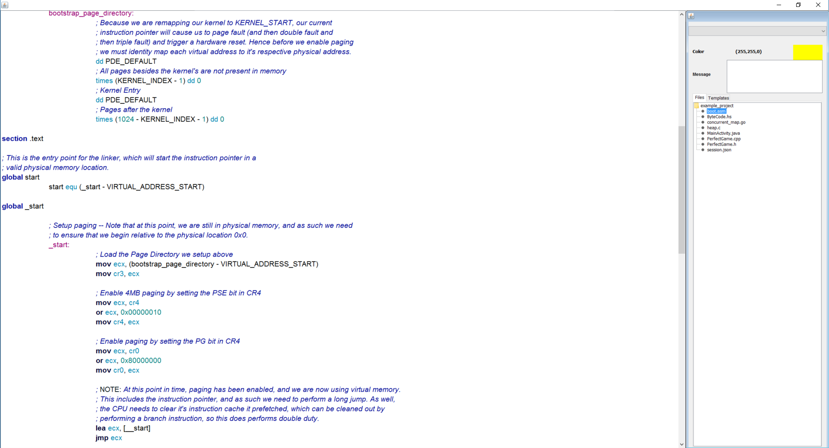
X86 Assembly – Bootstrap (MoltarOS)

Slide 11


Slide 12
Implementation of Code-Glosser
The “Interesting” Design and Implementation details

Slide 13
Handling UI Events – The Problem
UI Events can occur at anytime, even while processing another event
UI Events may need to notify multiple components
These components may need to react and notify other components based on certain conditions
Including the component that notified it
Events need to flow both ways
What about IO Events
IO Event – A network call or reading from hard drive
All IO Bound tasks should not be performed on the UI Thread
IO Bound – “Time needed is based on speed of the IO Device (I.E: Hard Drive), not CPU.”
CPU Bound – “Time needed is based on speed of CPU”
Need to perform these on a background thread…
How do we keep this extensible
How do we not tightly couple components together
How do we keep the control flow understandable
How do we model it
How can it be improved and extended upon with ease

Slide 14
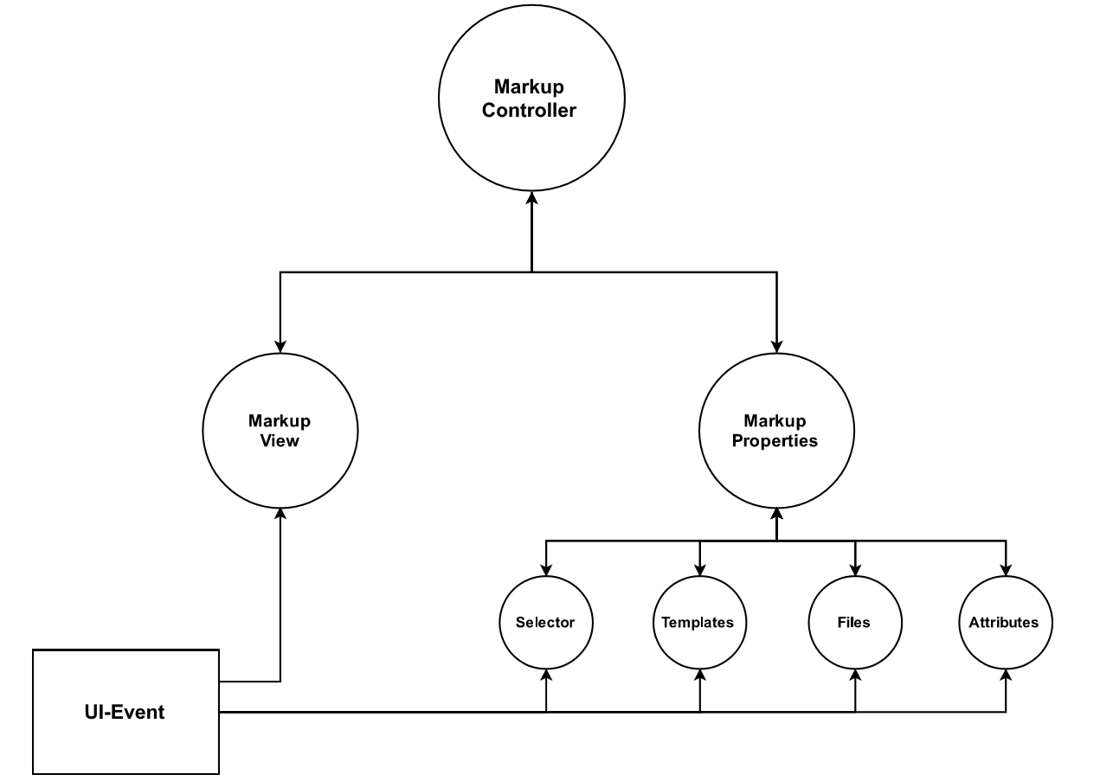
Handling UI Events – The Model

Slide 15
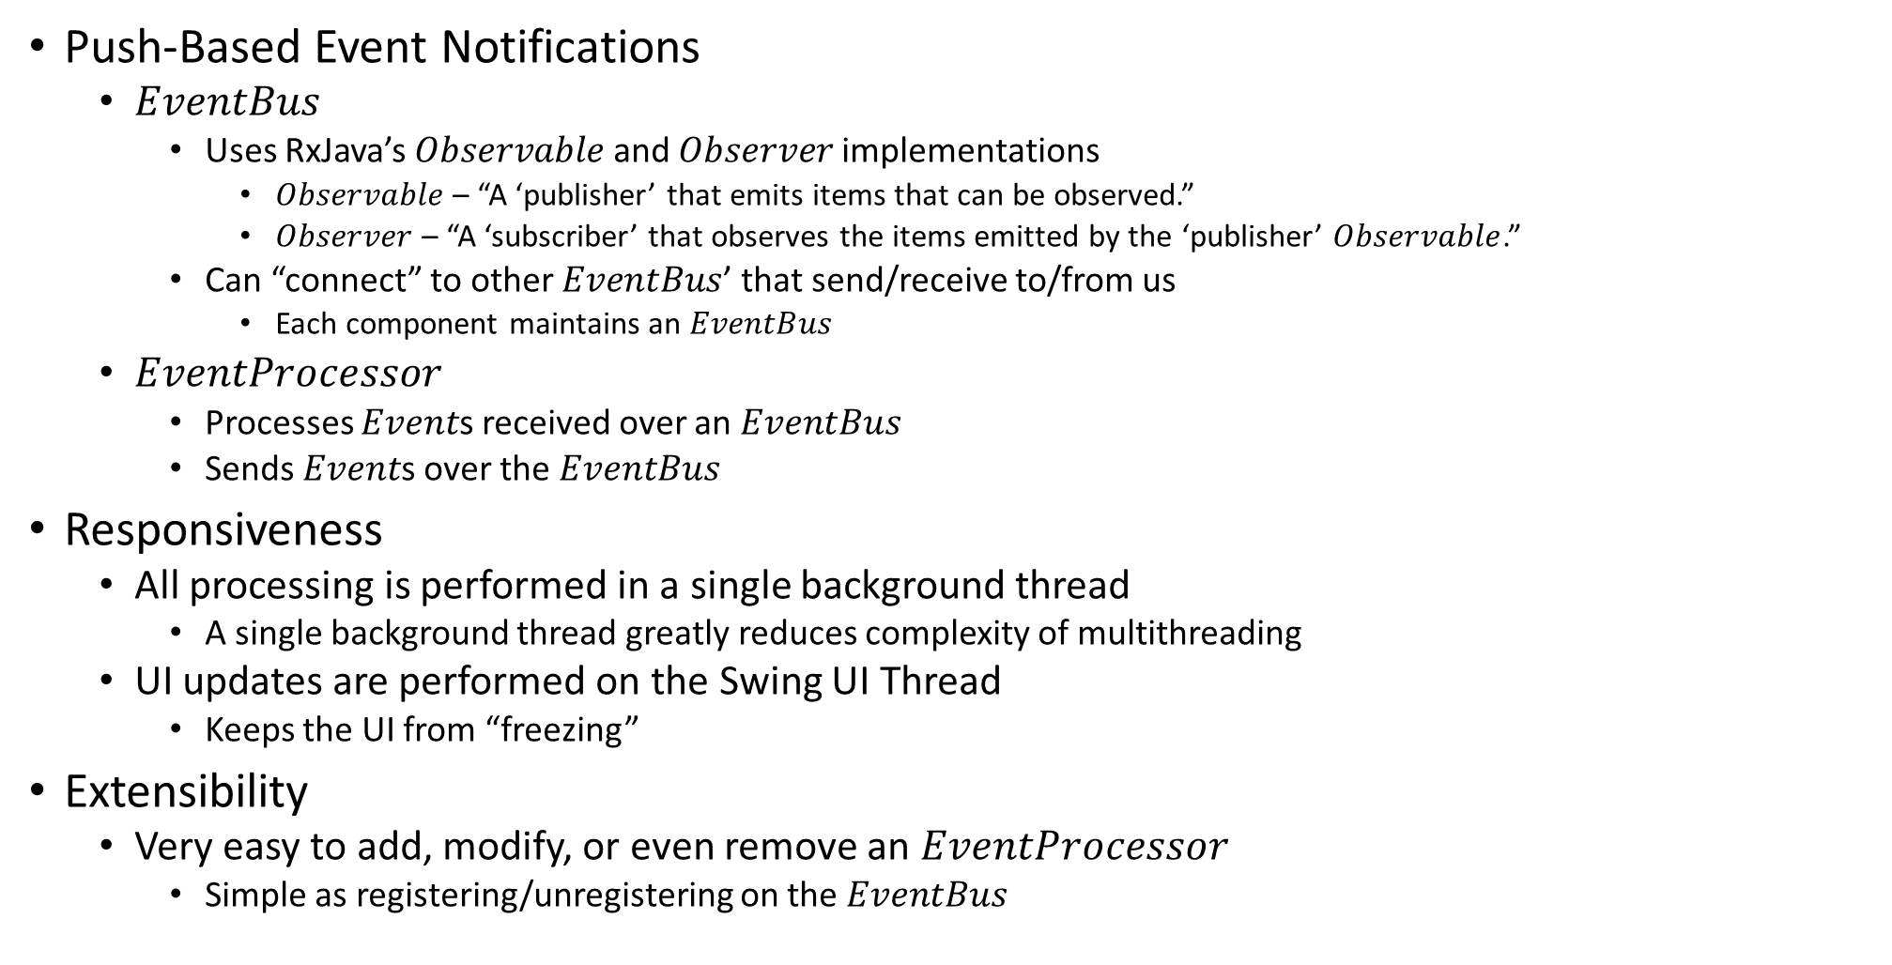
Handling UI Events – The Solution
Push-Based Event Notifications
$EventBus$
Uses RxJava’s $Observable$ and $Observer$ implementations
$Observable$ – “A ‘publisher’ that emits items that can be observed.”
$Observer$ – “A ‘subscriber’ that observes the items emitted by the ‘publisher’ $Observable$.”
Can “connect” to other $EventBus$’ that send/receive to/from us
Each component maintains an $EventBus$
$EventProcessor$
Processes $Event$s received over an $EventBus$
Sends $Event$s over the $EventBus$
Responsiveness
All processing is performed in a single background thread
A single background thread greatly reduces complexity of multithreading
UI updates are performed on the Swing UI Thread
Keeps the UI from “freezing”
Extensibility
Very easy to add, modify, or even remove an $EventProcessor$
Simple as registering/unregistering on the $EventBus$

Slide 16
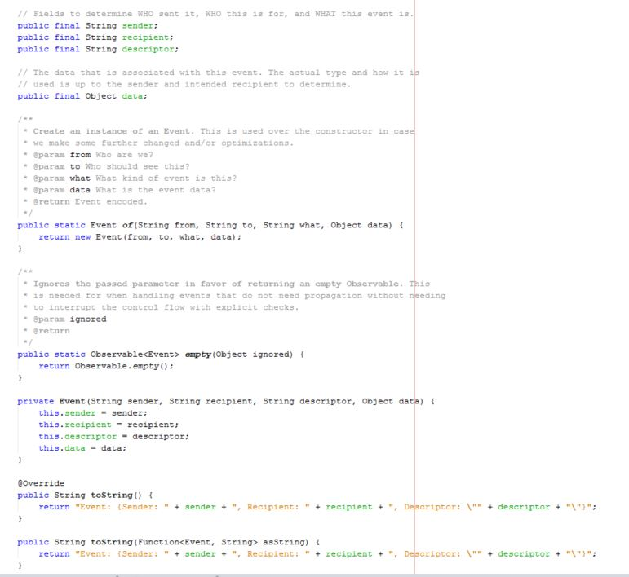
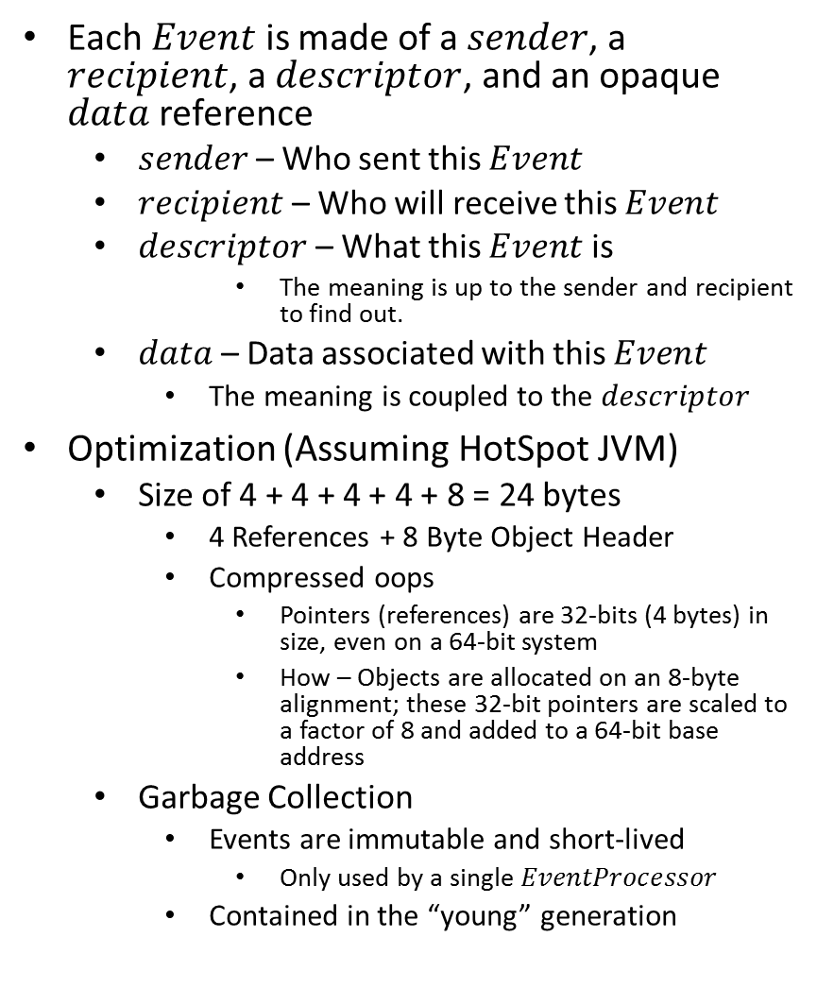

$$Event$$
Each $Event$ is made of a $sender$, a $recipient$, a $descriptor$, and an opaque $data$ reference
$sender$ – Who sent this $Event$
$recipient$ – Who will receive this $Event$
$descriptor$ – What this $Event$ is
The meaning is up to the sender and recipient to find out.
$data$ – Data associated with this $Event$
The meaning is coupled to the $descriptor$
Optimization (Assuming HotSpot JVM)
Size of 4 + 4 + 4 + 4 + 8 = 24 bytes
4 References + 8 Byte Object Header
Compressed oops
Pointers (references) are 32-bits (4 bytes) in size, even on a 64-bit system
How – Objects are allocated on an 8-byte alignment; these 32-bit pointers are scaled to a factor of 8 and added to a 64-bit base address
Garbage Collection
Events are immutable and short-lived
Only used by a single $EventProcessor$
Contained in the “young” generation

Slide 17
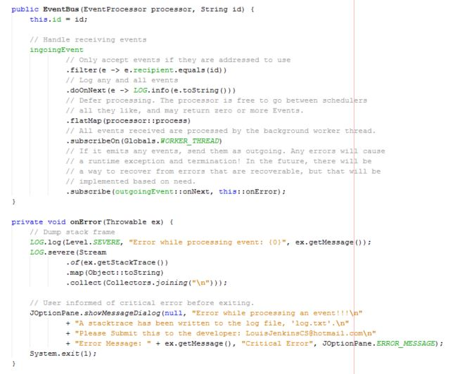
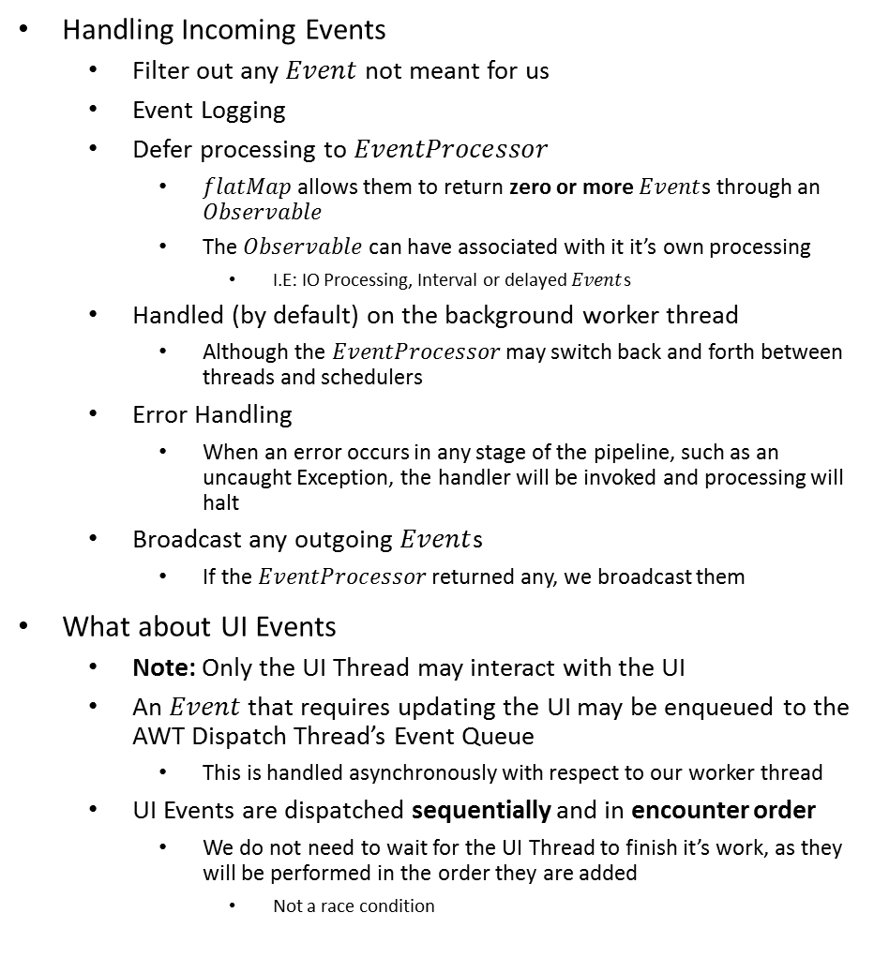

$$EventBus$$
Handling Incoming Events
Filter out any $Event$ not meant for us
Event Logging
Defer processing to $EventProcessor$
$flatMap$ allows them to return zero or more $Event$s through an $Observable$
The $Observable$ can have associated with it it’s own processing
I.E: IO Processing, Interval or delayed $Event$s
Handled (by default) on the background worker thread
Although the $EventProcessor$ may switch back and forth between threads and schedulers
Error Handling
When an error occurs in any stage of the pipeline, such as an uncaught Exception, the handler will be invoked and processing will halt
Broadcast any outgoing $Event$s
If the $EventProcessor$ returned any, we broadcast them
What about UI Events
Note: Only the UI Thread may interact with the UI
An $Event$ that requires updating the UI may be enqueued to the AWT Dispatch Thread’s Event Queue
This is handled asynchronously with respect to our worker thread
UI Events are dispatched sequentially and in encounter order
We do not need to wait for the UI Thread to finish it’s work, as they will be performed in the order they are added
Not a race condition

Slide 18
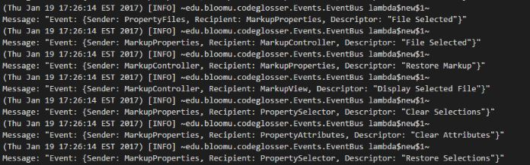
Event Sourcing
Logging
Log files contain the exact sequence of events that occur in the system
Describes WHEN the event occurs, WHO sent it, WHO is the intended receiver, and WHAT the event is.
Makes it easier to debug problems that potential clients may face
Easy for me to determine where and what caused the issue by examining the log file

Slide 19
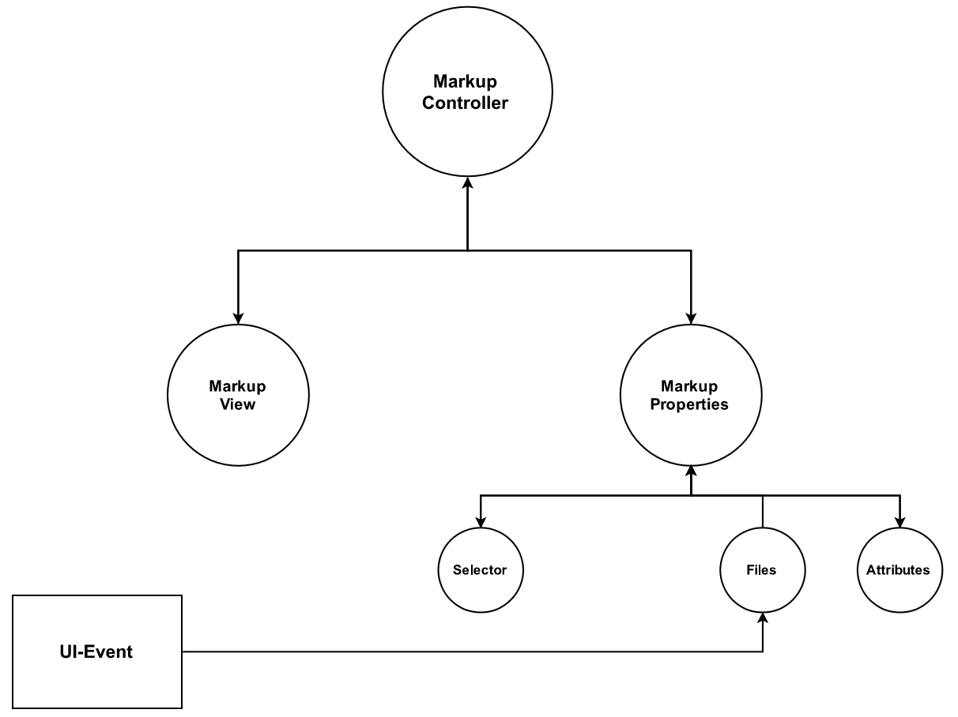
Example: Selecting a File
User Selects a new file in PropertyFiles
PropertyFiles notifies MarkupProperties of file name
MarkupProperties notifies PropertyAttributes to clear back to default state.
MarkupProperties notifies PropertySelector to clear it’s adapter of all entries (as they are no longer valid)
MarkupProperties notifies MarkupController of file name
MarkupController checks if a previous session for this File exists.
If yes, goto 7, else goto 9
MarkupController notifies MarkupProperties of a list of Markups to restore the state of
MarkupProperties notifies Selector to add all entries to it’s adapter (in lexicographical order)
MarkupController notifies MarkupView with file contents and markup highlight bounds if applicable
MarkupView passes a syntax highlighted version of the file contents to it’s view-model and adds highlighting for all sent highlight offsets.

Slide 20
Conclusion
Final Words and Thoughts

Slide 21
Software Engineering
A simple idea becomes that much more when production is on the line
Bugs, error handling, arch-specific issues, etc.
“That doesn’t happen when I run it on my machine”
Maintenance
The job isn’t over once it is released
New features need to be added
Bugs need fixing
It isn’t always “fun”
Even if there is nothing new to learn, the obligations still remain
Spent 250+ hours on this
Lost interest about 1/5 of the way
Still had to do it
Not something I want to do again
At least not unpaid…
Solidified my resolve to go to graduate school for my PhD
Prefer theory anyway

Slide 22
Final Thoughts
Code-Glosser took a long time to make, but if people use it, then it was worth it
A lot of thought was put into its design
A lot of time was put into its implementation
Distribution
https://github.com/LouisJenkinsCS/Code-Glosser/releases
Bug Reporting and Feature Requests
File an issue using GitHub’s bug tracker
https://github.com/LouisJenkinsCS/Code-Glosser/issues

