Slide 1
Language Design and Optimizations
By – Louis Jenkins

Slide 2
Presentation Summary
Create our own programming language
Demystify and Explore how they are created
Grammars, Lexers, Syntax Trees, etc.
Define semantics for our language
Interpret and run programs written in our language
High-Level overview of program execution
Control Flow Graphs

Slide 3
Defining Our Language
Domain Specific Language
Language created to solve a particular problem domain
Our domain is academic research
Opposite of a general-purpose language
C, C++, Java, Go, etc.
Grammars
Defines our actual language
Lexers tokenizes input defined in the grammar
Lexer is also known as scanner or tokenizer
Determines syntactic correctness
Parsers infer meaning from sequences of tokens
Also determine syntactic correctness
Lexer and Parser provide different granularities in providing syntactic correctness.

Slide 4
Building the Parser
YACC
Yet Another Compiler Compiler
A LALR Parser generator
Look Ahead Left To Right
Can look ahead K symbols to determine the right action to take.
Reads in BNF grammar
Backus-Naur Form is a context-free grammar capable of defining any language
Also known as meta syntax that can even define itself.
Shift-Reduce Parser
Shift pushes the symbol on the stack
Reduce combines the symbols on the top of the stack into a single symbol if it satisfies a grammar rule.
Is a push-down automaton

Slide 5
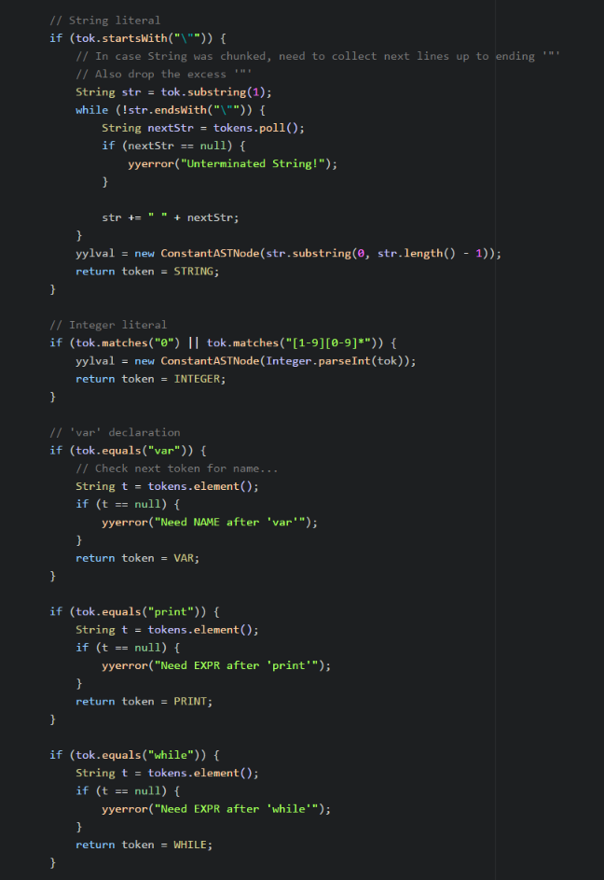
The Grammar Pt.1
Lexer
Also known as a scanner or tokenizer
Deals with parsing characters into streams of tokens
Tokens are the primitives that make up a language
Example: ‘var’, ‘this’, ‘if’, ‘else’, ‘while’, ‘for’
Tokens are also referred to as lexemes
Determines syntactic correctness
If input cannot be tokenized, it is syntactically invalid.

Slide 6
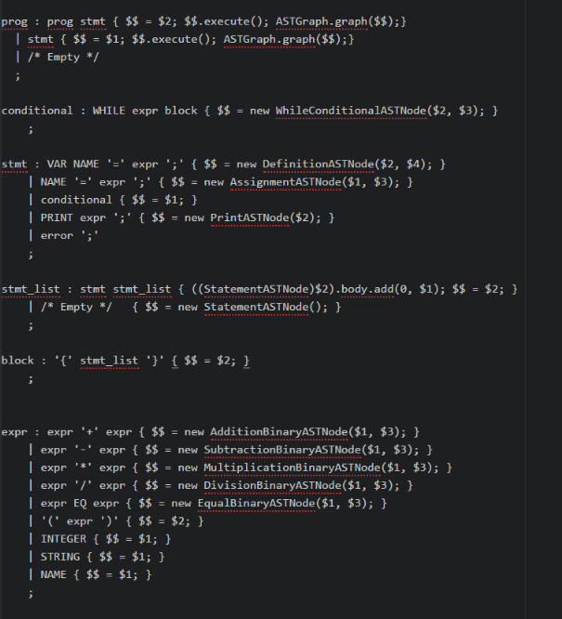
The Grammar Pt. 2
Semantics
Parser Expressions
Snippets of code called upon reduction
Define semantics
Create our Abstract Syntax Tree here
Each node has defined with it semantics
Has an Action
AdditionBinaryASTNode performs type checking and handles addition of both expression operators.

Slide 7
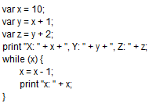
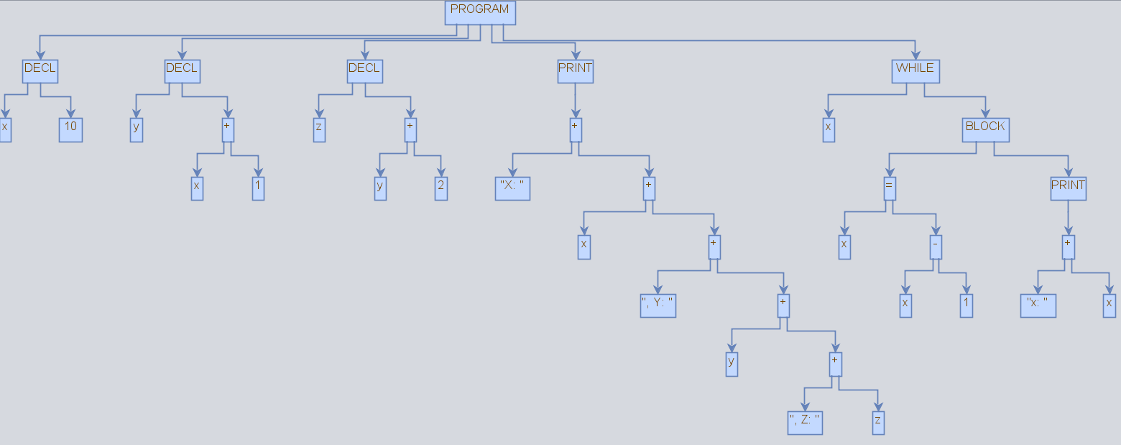
Abstract Syntax Tree
Tree representation of the syntactic structure of a program
Each node represents some constant in the source code
Why is it Abstract
Does not contain all details, only what is important
Difference between ‘+’ and ‘AdditionBinaryASTNode’
Applications and Uses
“Walking” the syntax tree
Also known as the ‘visitor’ pattern
Allows us to make interesting observations and compile-time checks
Type-Checking, Definitions, Etc.
Could even be interpreted

Slide 8
Interpreter – Executing our Language
Symbol Table
Mapping from a name to it’s symbol
In the interpreter, the symbol keeps track of it’s value
We do not support lexical scoping
Only one instance of a variable name can exist in the program at one time.
‘Visitor’ execution
Walking the tree allows us to obtain the structure of the program
This structure can be used to interpret the intent behind the original instructions and executed
Similar style can be used to construct the Control Flow Graph
Each root of a statement subtree can be used to reconstruct the intent of the original statement
Each statement is a node with an edge to the next statement node.
But what about loops and conditional statements?

Slide 9
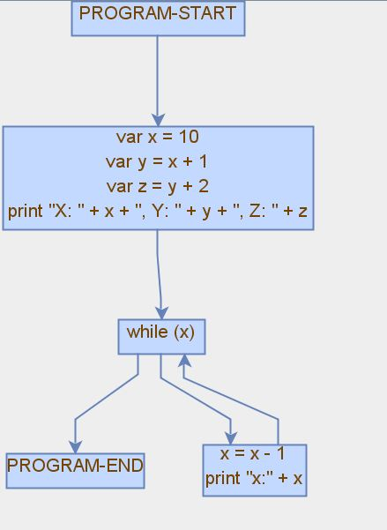
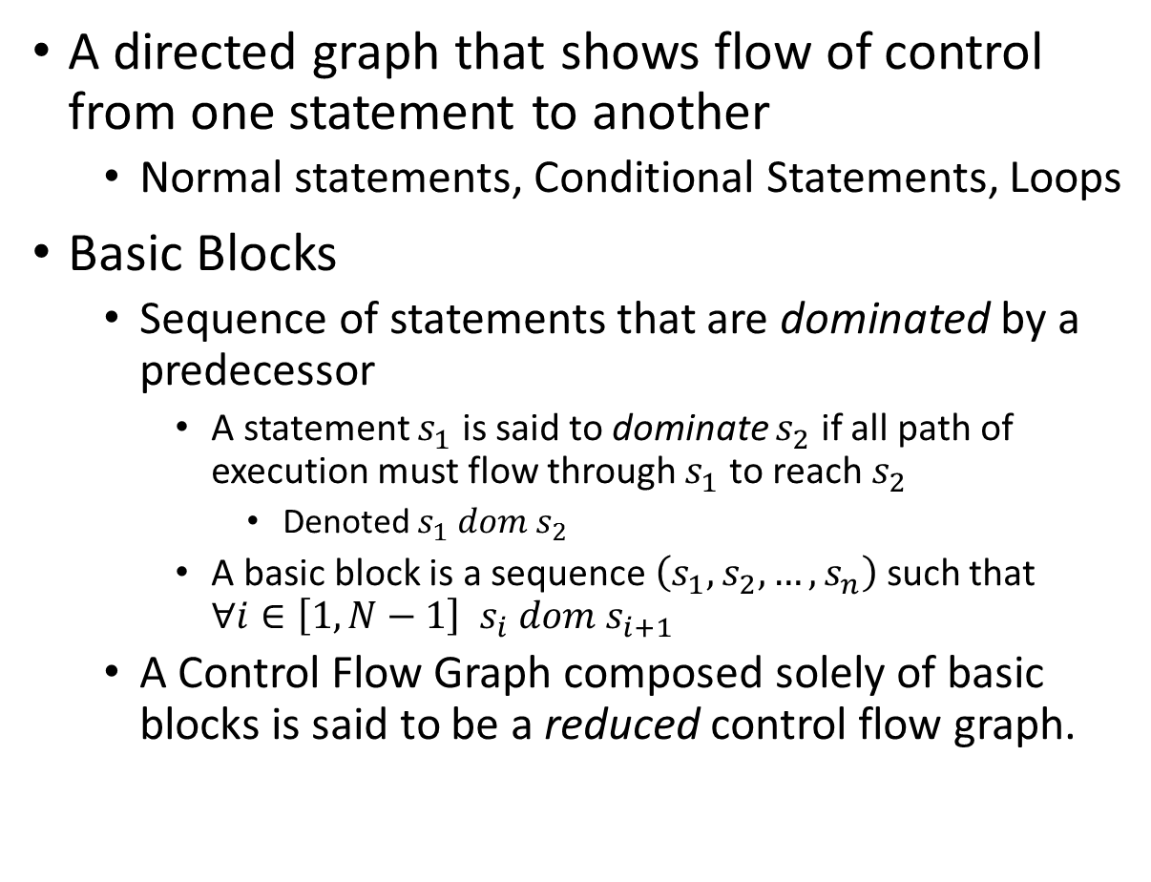
Control Flow Graph
A directed graph that shows flow of control from one statement to another
Normal statements, Conditional Statements, Loops
Basic Blocks
Sequence of statements that are dominated by a predecessor
A statement $s_{1}$ is said to dominate $s_{2}$ if all path of execution must flow through $s_{1}$ to reach $s_{2}$
Denoted $s_{1} dom s_{2}$
A basic block is a sequence $\left(s_{1}, s_{2}, …, s_{n}\right)$ such that $∀i∈\left[1,N−1\right]$ $s_{i} dom s_{i+1}$
A Control Flow Graph composed solely of basic blocks is said to be a reduced control flow graph.

Slide 10
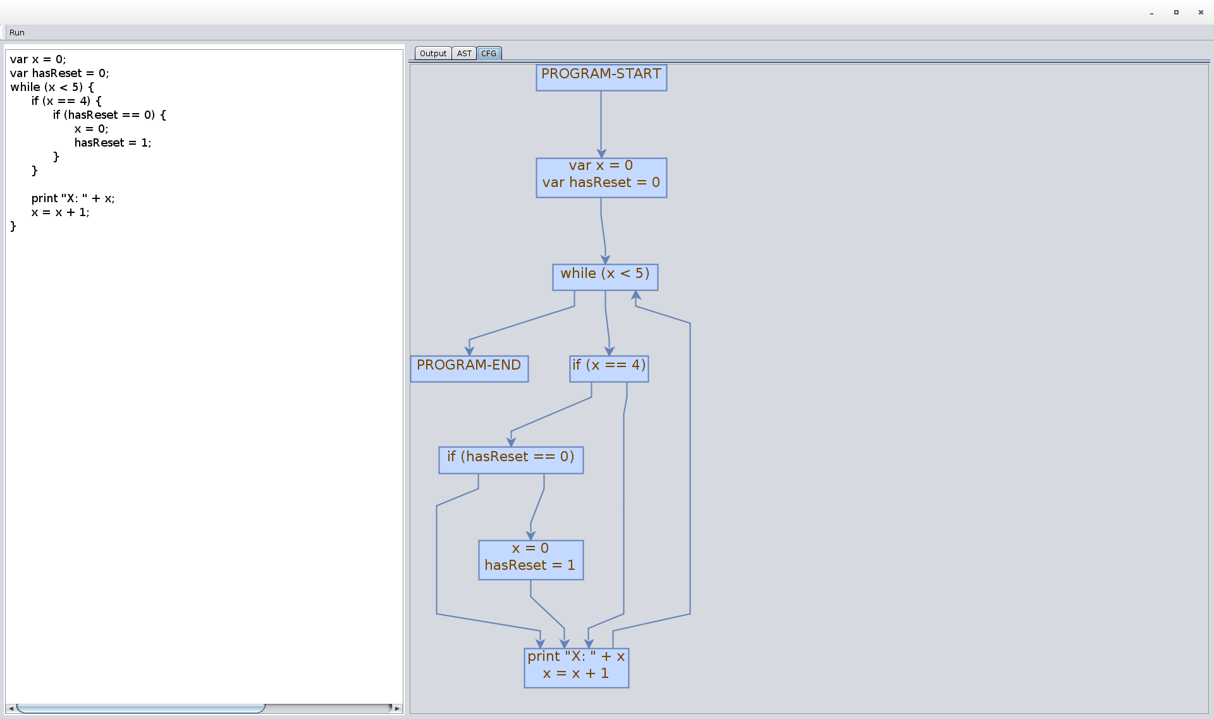
Live Demo – Screenshot

Slide 11
Language Test – Duff’s Device
Duff’s device is a loop unrolling optimization that reduces the number of conditional evaluations in a loop
By unrolling the loop, we do not need to explicitly check on each pass
I.E: 1000 checks vs 1000 / N checks
N is the amount of the loop duplicated/unrolled on each iteration
In most cases 8
Trade-Off
Larger program size
The Test
Implement loop unrolling in our language as the ultimate test
Tests everything needed to prove we are Turing Complete

Slide 12
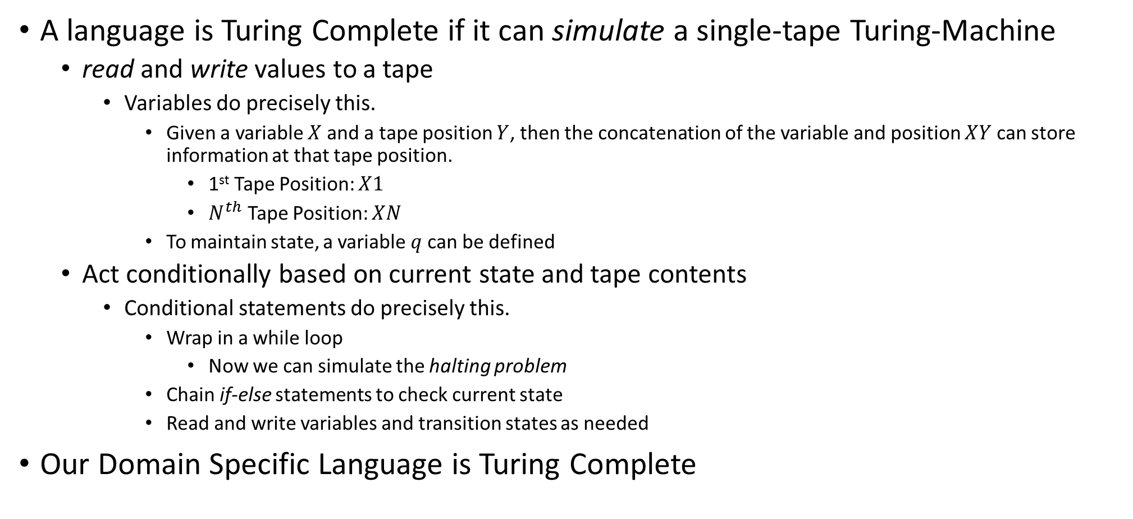
Turing Completeness
A language is Turing Complete if it can simulate a single-tape Turing-Machine
read and write values to a tape
Variables do precisely this.
Given a variable $X$ and a tape position $Y$, then the concatenation of the variable and position $XY$ can store information at that tape position.
1st Tape Position: $X1$
$N^{th}$ Tape Position: $XN$
To maintain state, a variable $q$ can be defined
Act conditionally based on current state and tape contents
Conditional statements do precisely this.
Wrap in a while loop
Now we can simulate the halting problem
Chain if-else statements to check current state
Read and write variables and transition states as needed
Our Domain Specific Language is Turing Complete

Slide 13
Conclusion
Recap
Created our own language by defining it’s grammar
Created the Abstract Syntax Tree from the grammar
Interpreted and ran ACTUAL code in our language by walking the syntax tree
Created the Control Flow Graph
Reduced it into basic blocks, handles loops and conditionals
Established Turing Completeness of our language
Was it fun?
Yep
Taught myself everything in a compiler design course

