Slide 1
JVM ByteCode Interpreter written in Haskell (In under 1000 Lines of Code)
By Louis Jenkins

Slide 2
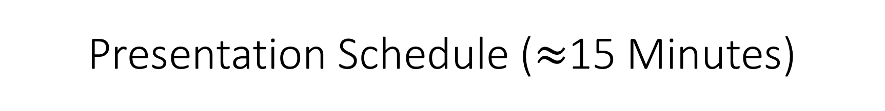
Presentation Schedule ($≈$15 Minutes)
Discuss and Run the Virtual Machine first
<5 Minutes
Syntax, Binding & Scope, Data Types, Control Flow, and Subprograms
<10 Minutes
+Code Snippets
Future goals and plans
1 minute

Slide 3
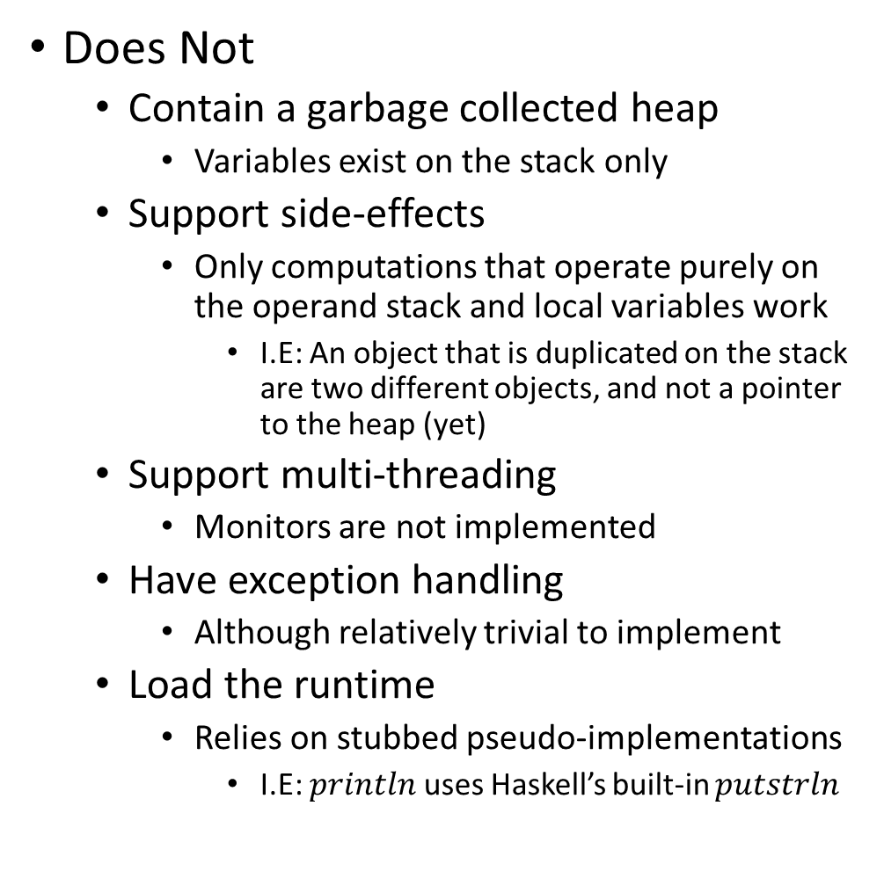
Virtual Machine
Does
Accept and parse .class files
Can be generated by any JVM Language
Examples shown are generated from Scala and Java
Interpret a subset of ByteCode instructions
Loads, Stores, Arithmetic
Basic I/O support, Support for conditional expressions
‘if…else if… else’, ‘for’, ‘while’
‘for’ only supported in Java
Scala generates more complex bytecode
Does Not
Contain a garbage collected heap
Variables exist on the stack only
Support side-effects
Only computations that operate purely on the operand stack and local variables work
I.E: An object that is duplicated on the stack are two different objects, and not a pointer to the heap (yet)
Support multi-threading
Monitors are not implemented
Have exception handling
Although relatively trivial to implement
Load the runtime
Relies on stubbed pseudo-implementations
I.E: $println$ uses Haskell’s built-in $putstrln$

Slide 4
Syntax
Currying, Function Declaration and Definition, Pattern Guards, and Function Calling

Slide 5

Currying
The translation of an ‘uncurried’ function taking a tuple of arguments, into a sequence of functions taking only a single argument
Example
$f\left(x,y\right)=z≡f:x→\left(y→z\right)$
The function $f$ takes $x$ as the input, and returns a function $f_{x}:y→z$.
Note that the arrows are right associative, so $x→\left(y→z\right)≡x→y→z$

Slide 6
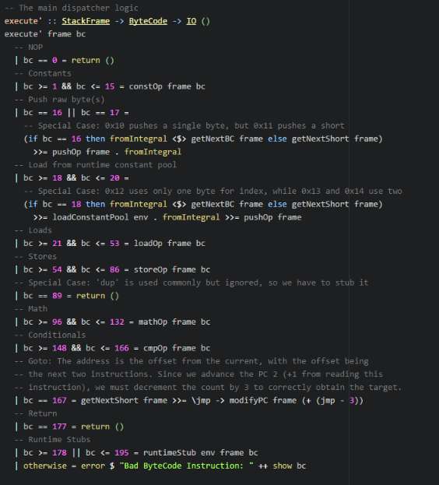

Function Syntax
Functions take arguments as arrows
Considered the ‘Curried’ form of function application
Declaration arrows represent the types, but the names are decided in the definition
Pattern Guards
Determine which function definition to call based on predicate
Represented with the ‘|’ character
Functions arguments are passed sequentially
To disambiguate the function arguments, they can be wrapped in $\left(…\right)$, or have the ‘$’ operator appended after the function.

Slide 7
Binding & Scope Rules
Unlimited Extent, Lambdas, Lazy Evaluation, Thunks, and more…

Slide 8
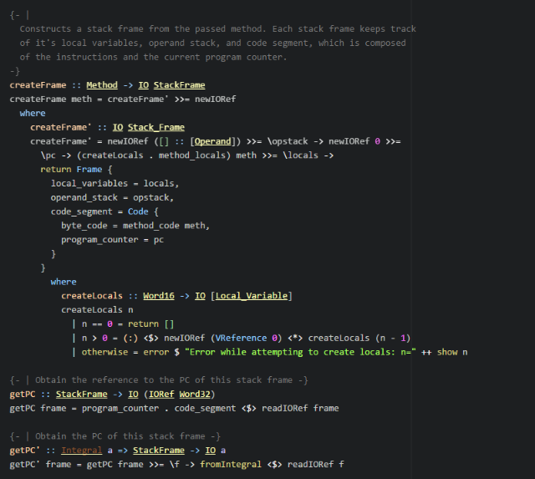
Binding & Scoping Rules
Referential Transparency
Variables defined are immutable
With some exceptions…
Since they are immutable, their outputs are always deterministic
Variables have Unlimited Extent
They exist for as long as they are referenced
Even variables of lambdas
Lazy-Evaluation
Computations are delayed inside of ‘thunks’
Thunks contain ‘lazy’ computations that are only evaluated when needed.
Immutability
All data is immutable, with some exception
The IO Monad needs side-effects to interact with the ‘RealWorld’
I.E: Printing to the console is a side-effect
‘IORef’, ‘STRef’, ‘MVar’, ‘Tvar’, etc., all can maintain references to immutable to data that can be changed to point something else
Special Case: Software Transactional Memory
Underlying data is still immutable
Notes:
Mention Referential Transparency (immutable values) and thunks (???)

Slide 9
Control Flow
Functors, Applicative Functors, ‘Lazy’ Recursion and Evaluation, and Monads

Slide 10
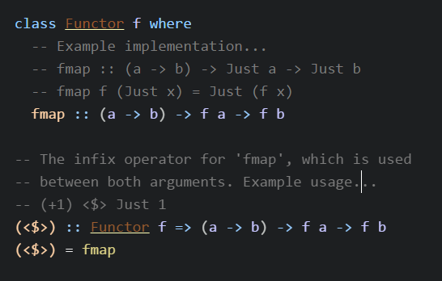
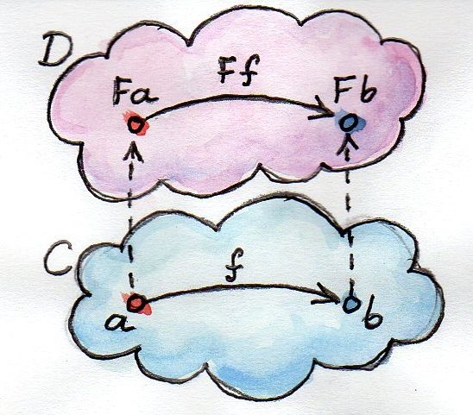
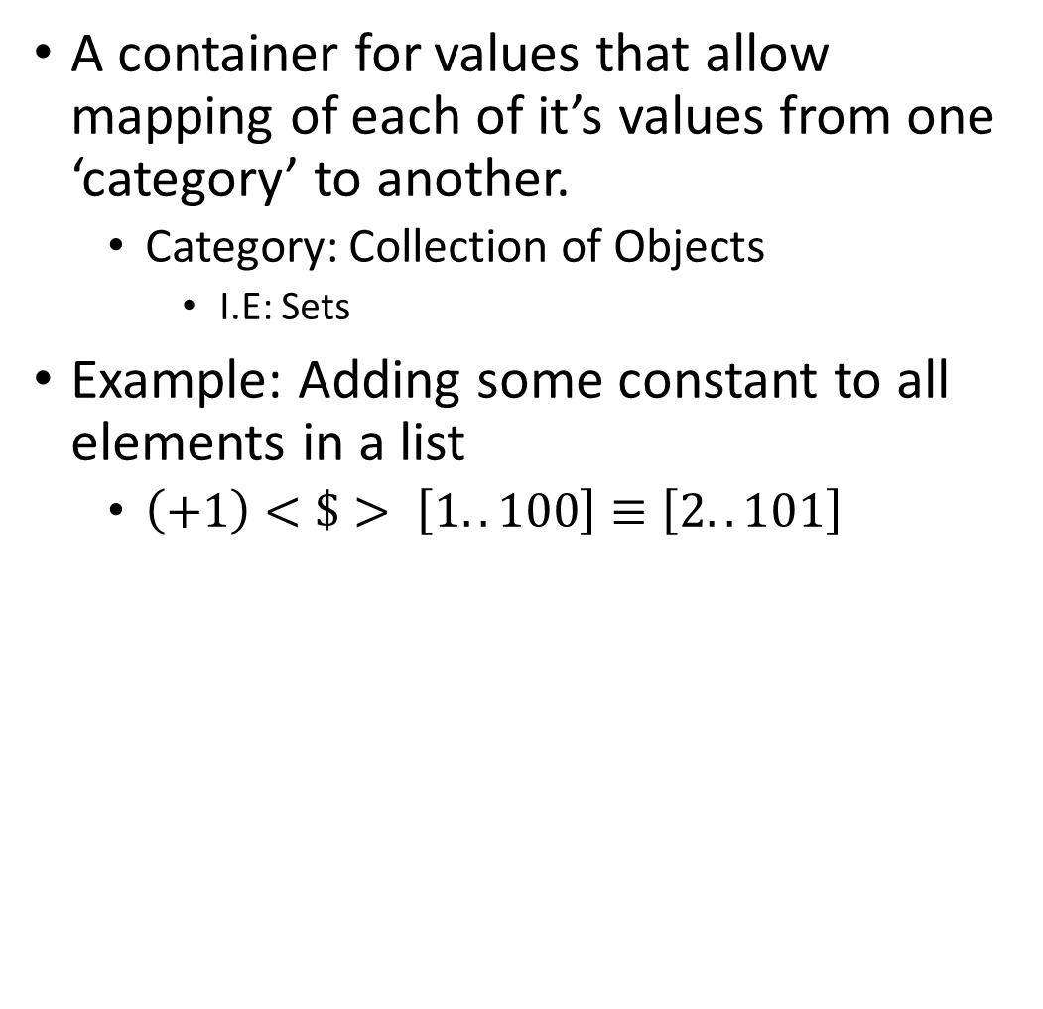
Functors - Simplified
A container for values that allow mapping of each of it’s values from one ‘category’ to another.
Category: Collection of Objects
I.E: Sets
Example: Adding some constant to all elements in a list
$\left(+1\right)<\$> \left[1..100\right]≡\left[2..101\right]$

Slide 11
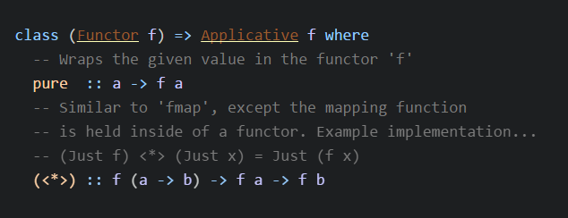
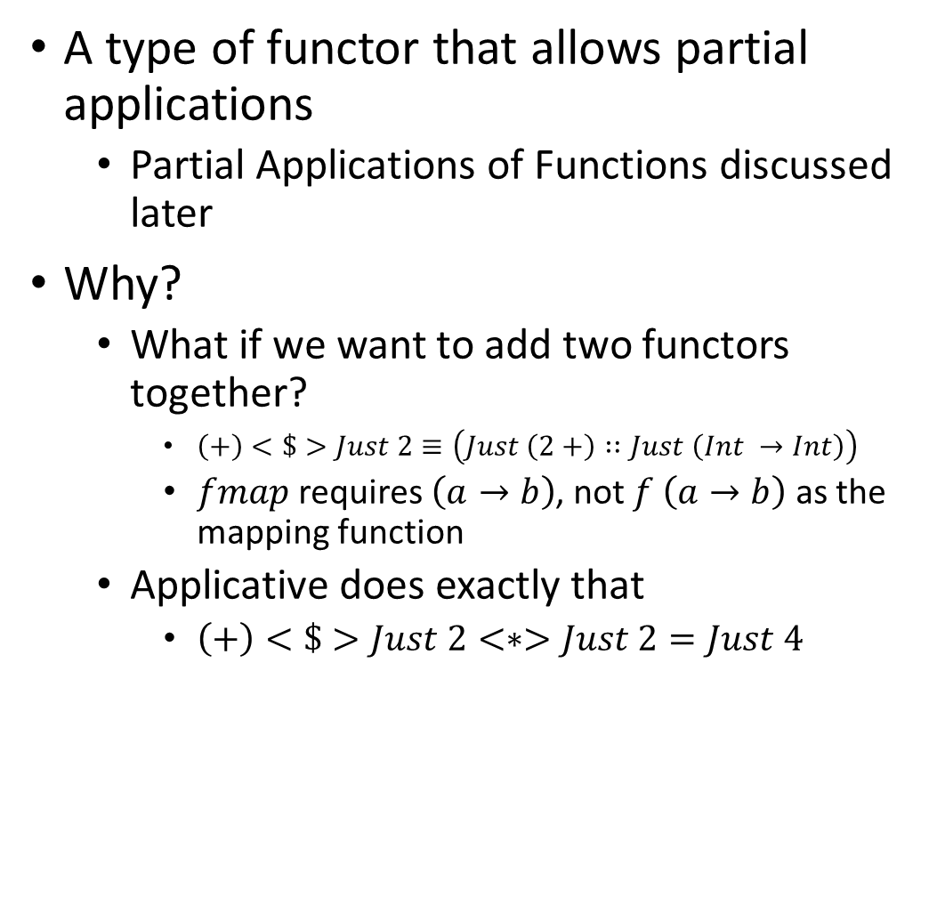
Applicative Functors - Simplified
A type of functor that allows partial applications
Partial Applications of Functions discussed later
Why?
What if we want to add two functors together?
$\left(+\right)<\$>Just 2≡\left(Just \left(2+\right)∷Just \left(Int →Int\right)\right)$
$fmap$ requires $\left(a→b\right)$, not $f \left(a→b\right)$ as the mapping function
Applicative does exactly that
$\left(+\right)<\$>Just 2<∗>Just 2=Just 4$

Slide 12
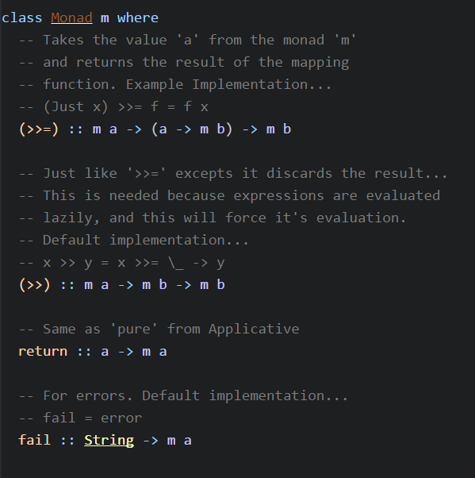
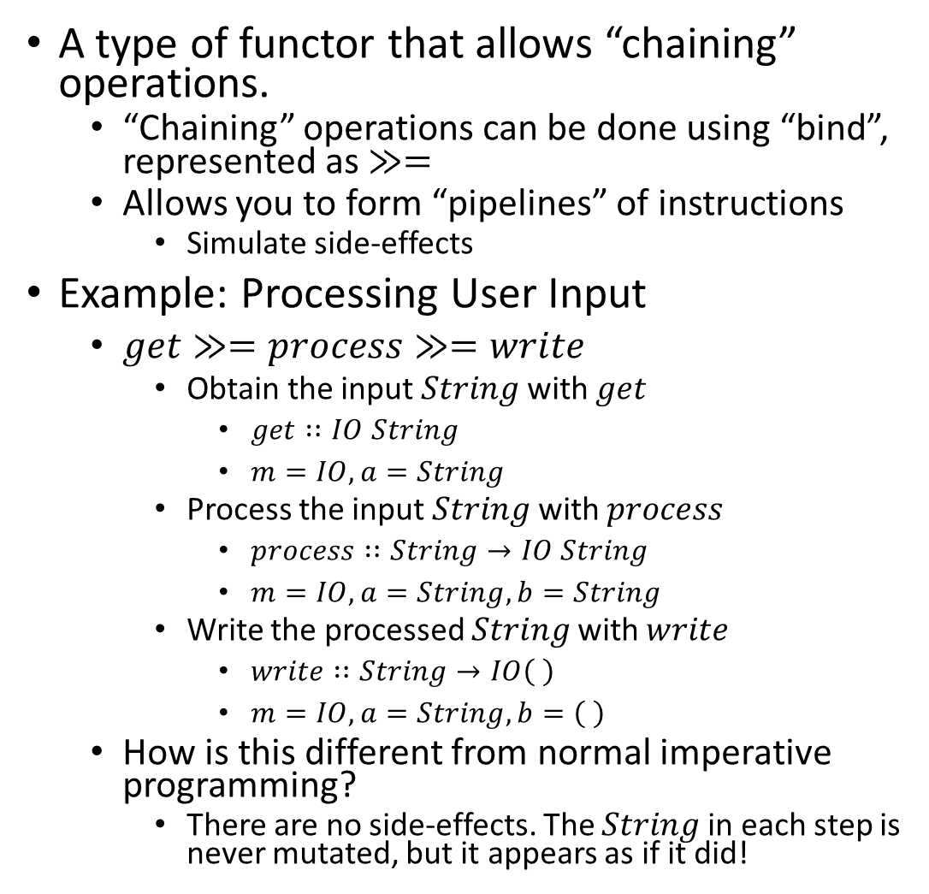
Monads
A type of functor that allows “chaining” operations.
“Chaining” operations can be done using “bind”, represented as $≫=$
Allows you to form “pipelines” of instructions
Simulate side-effects
Example: Processing User Input
$get≫=process≫=write$
Obtain the input $String$ with $get$
$get∷IO String$
$m=IO,a=String$
Process the input $String$ with $process$
$process∷String→IO String$
$m=IO, a=String,b=String$
Write the processed $String$ with $write$
$write∷String→IO\left( \right)$
$m=IO,a=String,b=\left( \right)$
How is this different from normal imperative programming?
There are no side-effects. The $String$ in each step is never mutated, but it appears as if it did!

Slide 13
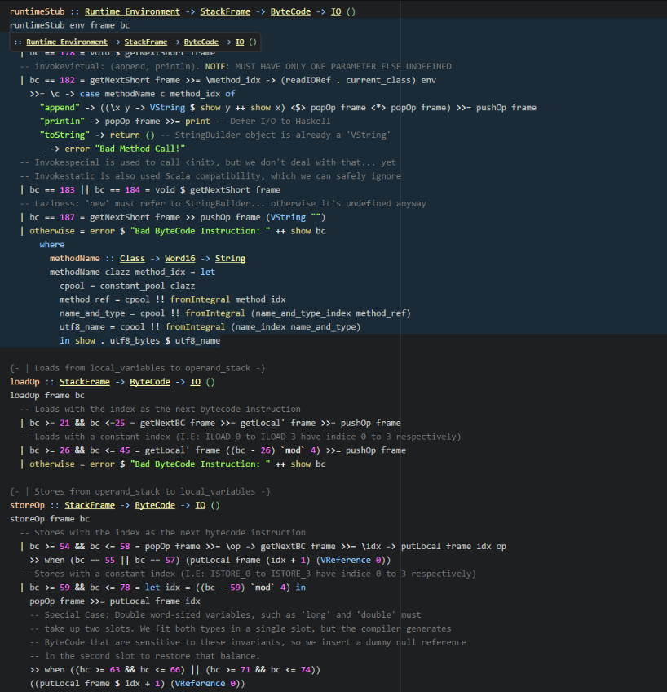

Control Flow (Recursion)
Recursion
Any and all ‘iteration’ is performed through recursion
Why?
Iteration requires mutation of some variable
All variables are immutable
Infinite recursion is actually ‘safe’
Used to produce infinite data streams
Recursive calls only called when needed
Example: Obtain first $n$ Fibonacci Numbers
$fibs=0 :1 :zipWith \left(+\right) fibs \left(tail fibs\right)$
$take n fibs$
Result of each call to $fibs$ is stored as evaluated inside of a thunk. The function used $\left(zipWith∷\left(a→b→c\right)→\left[a\right]→\left[b\right]→\left[c\right]\right)$ applies the function to the head of both lists (I.E: The last two values evaluated). $take$ will force it to evaluate only up to $n$ times and collect the result.

Slide 14
Data Types
Type-Classes and deriving/instantiating them

Slide 15
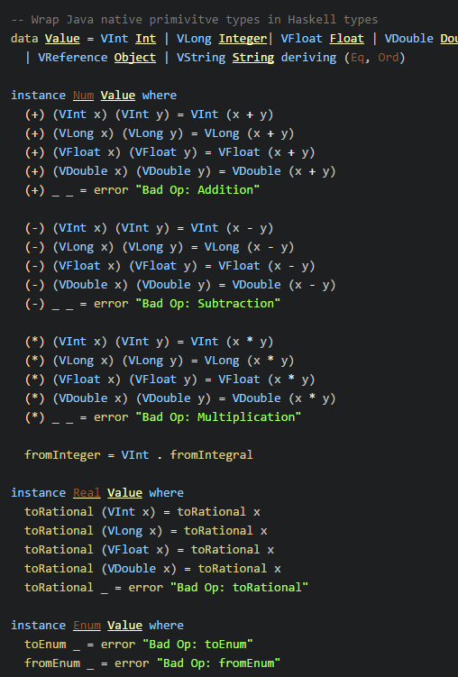

Data Types
Type Classes
Constructs that define methods
Even arithmetic operators are methods
Can sometimes be automatically derived
Only if the objects they are composed of all are instances of it
Can be used for type constraints of polymorphic functions
Specify that the generic type must implement the listed types
Have ‘data constructors’
Remember: Same as a normal function
Can have ‘field selectors’
Can have a ‘default’ values of undefined
Defined as $⊥$, or ‘bottom’
Also used for non-terminating functions and runtime errors
All types have this value in common
Can be instantiated by data types
Must implement required methods

Slide 16
Subprograms and Parameter Passing
Partial Applications of Functions (in theory and practice)

Slide 17
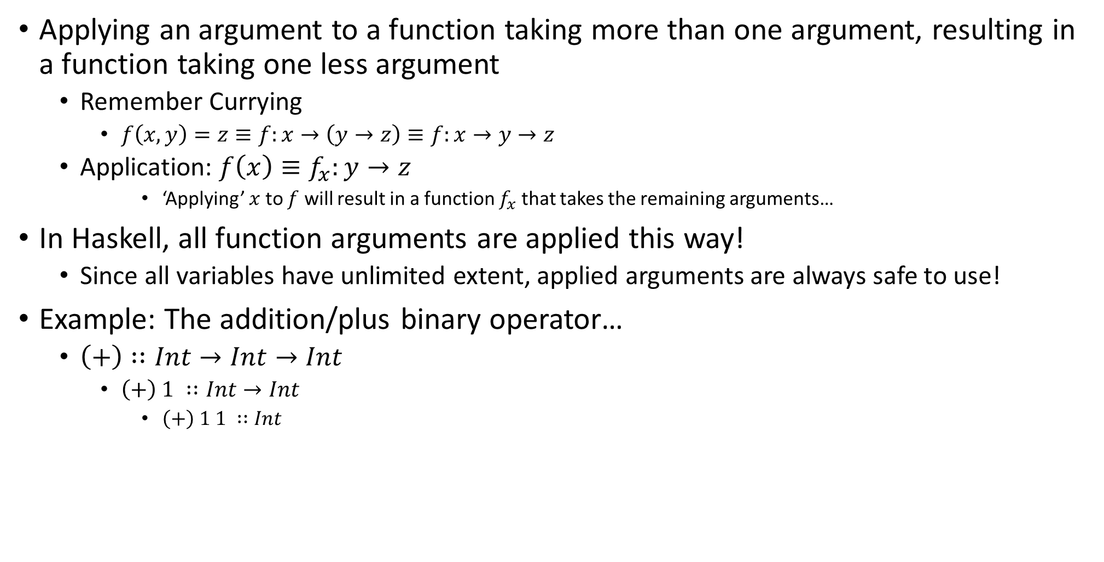
Partial Application of Functions (in Theory)
Applying an argument to a function taking more than one argument, resulting in a function taking one less argument
Remember Currying
$f\left(x,y\right)=z≡f:x→\left(y→z\right)≡f:x→y→z$
Application: $f\left(x\right)≡f_{x}:y→z$
‘Applying’ $x$ to $f$ will result in a function $f_{x}$ that takes the remaining arguments…
In Haskell, all function arguments are applied this way!
Since all variables have unlimited extent, applied arguments are always safe to use!
Example: The addition/plus binary operator…
$\left(+\right)∷Int→Int→Int$
$\left(+\right) 1 ∷Int→Int$
$\left(+\right) 1 1 ∷Int$

Slide 18
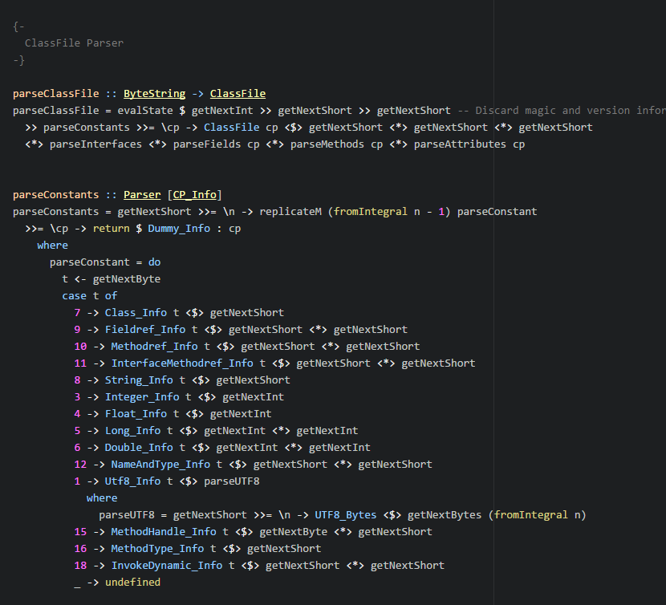

Subprograms and Parameter Passing
Partial Application of Functions (in Practice)
Data Constructors for a type are just functions, and like such can be partially applied
With a combination of the results from $getNext^{∗}$, which returns a $Parser Word^{∗}$, that result can be passed to the data constructor through application.
Why is this important?
Arguments can be passed from functors
Arguments can also be passed by value
Cuts out the amount of boilerplate
Functions Composition
The ‘.’ operator denotes function composition.
$\left(g.f\right)\left(x\right)≡\left(g∘f\right)\left(x\right)=g\left(f\left(x\right)\right)$
Pronounced $g$ “after” $f$ of $x$
$\left(.\right)∷\left(b→c\right)→\left(a→b\right)→\left(a→c\right)$

Slide 19
Virtual Machine – Plans and Goals
Implement a Heap that takes advantage of Haskell’s GC
Implement all ByteCode Instructions
Bootstrap Classloading
Monitors
Exception Handling
Refactor, Refactor, Refactor…
Needs vast improvements!

