Slide 1
JVM ByteCode Interpreter written in Haskell (In under 1000 Lines of Code)
By Louis Jenkins

Slide 2
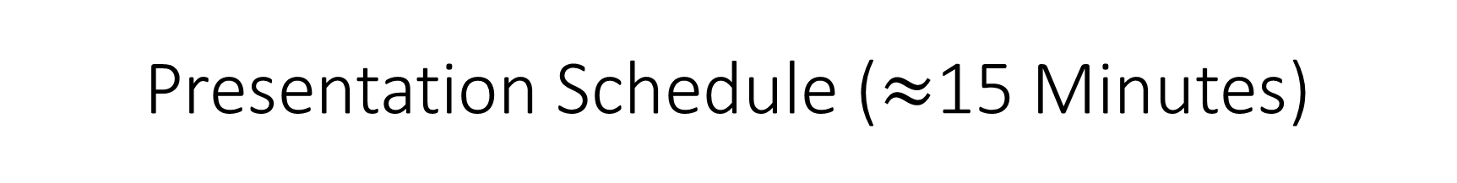
Presentation Schedule ($≈$15 Minutes)
Discuss and Run the Virtual Machine first
<5 Minutes
Required Prerequisite Knowledge on Category Theory
<5 Minutes
Syntax, Binding & Scope, Data Types, Control Flow, and Subprograms
<5 Minutes
+Code Snippets
Future goals and plans
1 minute

Slide 3
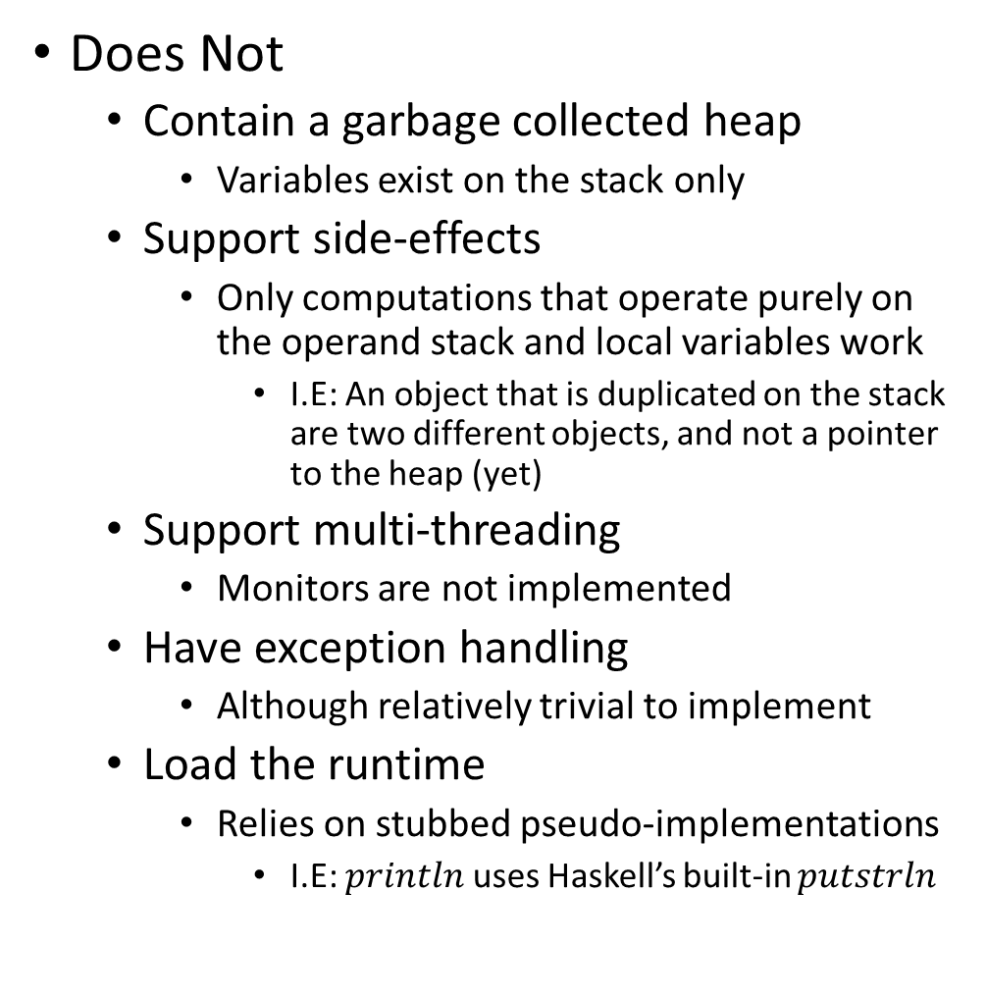
Virtual Machine
Does
Accept and parse .class files
Can be generated by any JVM Language
Examples shown are generated from Scala and Java
Interpret a subset of ByteCode instructions
Loads, Stores, Arithmetic
Basic I/O support, Support for conditional expressions
‘if…else if… else’, ‘for’, ‘while’
‘for’ only supported in Java
Scala generates more complex bytecode
Does Not
Contain a garbage collected heap
Variables exist on the stack only
Support side-effects
Only computations that operate purely on the operand stack and local variables work
I.E: An object that is duplicated on the stack are two different objects, and not a pointer to the heap (yet)
Support multi-threading
Monitors are not implemented
Have exception handling
Although relatively trivial to implement
Load the runtime
Relies on stubbed pseudo-implementations
I.E: $println$ uses Haskell’s built-in $putstrln$

Slide 4
Prerequisite Knowledge
Category Theory 101
Monoids
Functors
Applicative Functors
Monads
Why?
Haskell requires a fundamental understanding of these concepts
Topics of Presentation
Skipping to more “interesting” bits due to time constraints

Slide 5
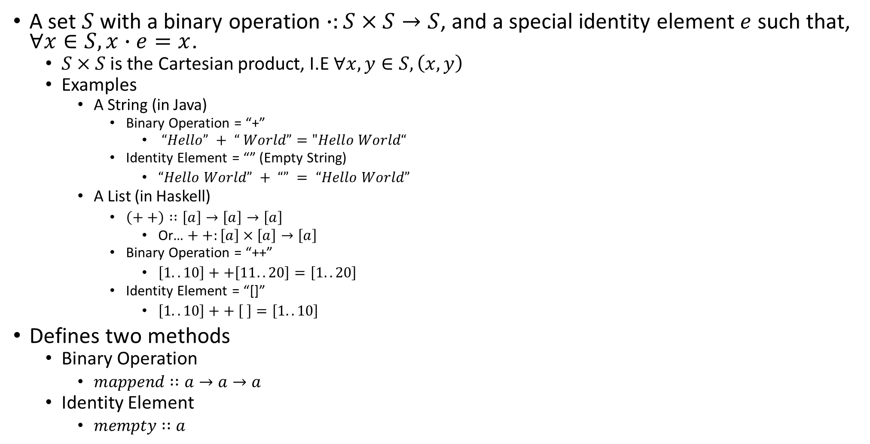
Monoids
A set $S$ with a binary operation $∙:S×S→S$, and a special identity element $e$ such that, $∀x∈S,x∙e=x$.
$S×S$ is the Cartesian product, I.E $∀x,y∈S,\left(x,y\right)$
Examples
A String (in Java)
Binary Operation = “+”
$“Hello” + “ World”="Hello World“$
Identity Element = “” (Empty String)
$“Hello World” + “” = “Hello World”$
A List (in Haskell)
$\left(++\right)∷\left[a\right]→\left[a\right]→\left[a\right]$
Or… $++:\left[a\right]×\left[a\right]→\left[a\right]$
Binary Operation = “++”
$\left[1..10\right]++\left[11..20\right]=\left[1..20\right]$
Identity Element = “[]”
$\left[1..10\right]++ \left[ \right]=\left[1..10\right]$
Defines two methods
Binary Operation
$mappend∷a→a→a$
Identity Element
$mempty∷a$

Slide 6
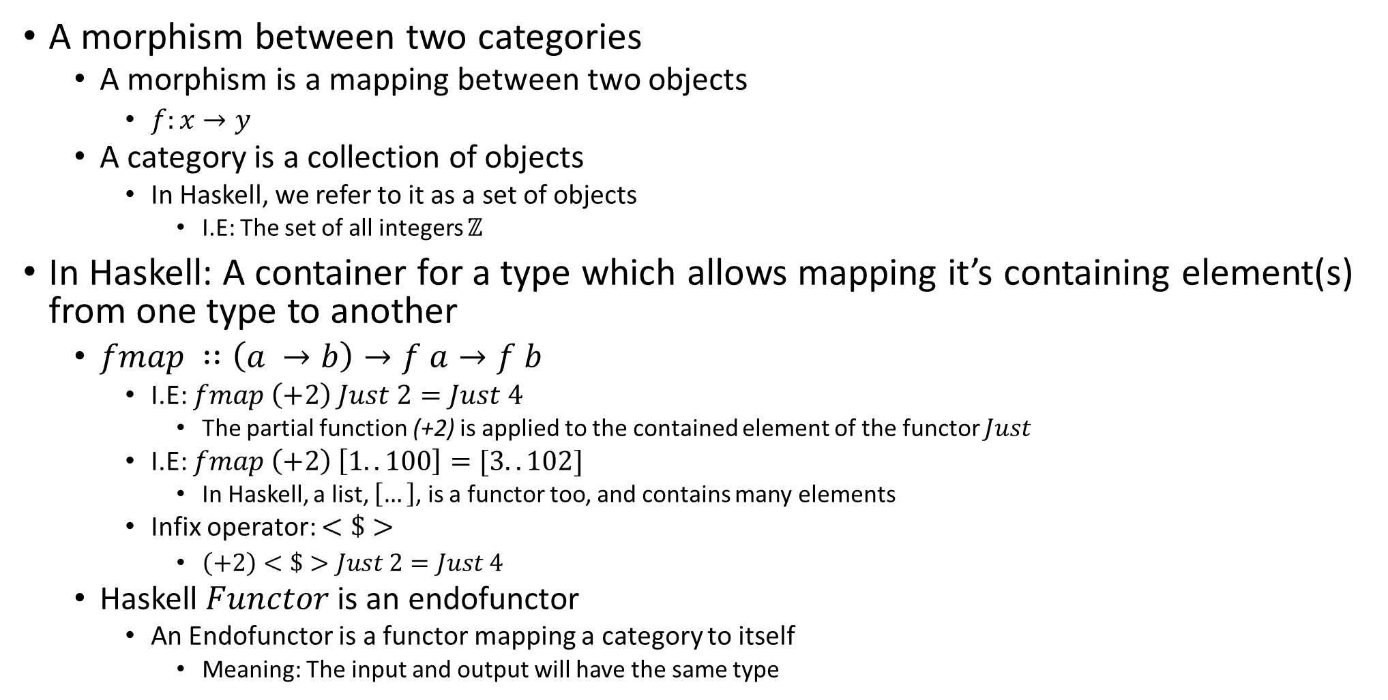
Functors
A morphism between two categories
A morphism is a mapping between two objects
$f:x→y$
A category is a collection of objects
In Haskell, we refer to it as a set of objects
I.E: The set of all integers $ℤ$
In Haskell: A container for a type which allows mapping it’s containing element(s) from one type to another
$fmap ∷\left(a →b\right)→f a→f b$
I.E: $fmap \left(+2\right) Just 2=Just 4$
The partial function (+2) is applied to the contained element of the functor $Just$
I.E: $fmap \left(+2\right) \left[1..100\right]=[3..102]$
In Haskell, a list, $\left[…\right]$, is a functor too, and contains many elements
Infix operator: $<\$>$
$\left(+2\right)<\$>Just 2=Just 4$
Haskell $Functor$ is an endofunctor
An Endofunctor is a functor mapping a category to itself
Meaning: The input and output will have the same type

Slide 7
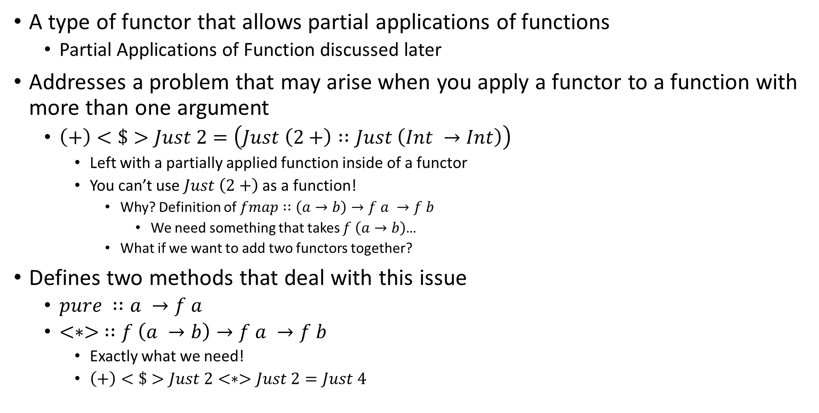
Applicative Functors
A type of functor that allows partial applications of functions
Partial Applications of Function discussed later
Addresses a problem that may arise when you apply a functor to a function with more than one argument
$\left(+\right)<\$>Just 2=\left(Just \left(2+\right)∷Just \left(Int →Int\right)\right)$
Left with a partially applied function inside of a functor
You can’t use $Just \left(2+\right)$ as a function!
Why? Definition of $fmap∷\left(a→b\right)→f a →f b$
We need something that takes $f \left(a→b\right)$…
What if we want to add two functors together?
Defines two methods that deal with this issue
$pure ∷a →f a$
$<∗> ∷f \left(a →b\right)→f a →f b$
Exactly what we need!
$\left(+\right)<\$>Just 2<∗>Just 2=Just 4$

Slide 8
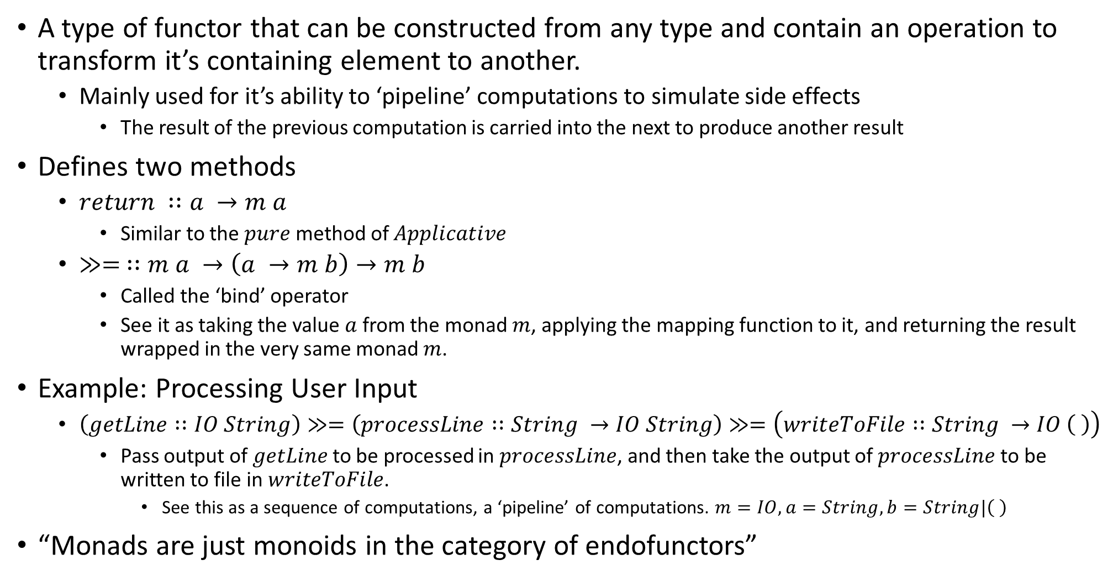
Monads
A type of functor that can be constructed from any type and contain an operation to transform it’s containing element to another.
Mainly used for it’s ability to ‘pipeline’ computations to simulate side effects
The result of the previous computation is carried into the next to produce another result
Defines two methods
$return ∷a →m a$
Similar to the $pure$ method of $Applicative$
$≫= ∷m a →\left(a →m b\right)→m b$
Called the ‘bind’ operator
See it as taking the value $a$ from the monad $m$, applying the mapping function to it, and returning the result wrapped in the very same monad $m$.
Example: Processing User Input
$\left(getLine∷IO String\right)≫=\left(processLine∷String →IO String\right)≫=\left(writeToFile∷String →IO \left( \right)\right)$
Pass output of $getLine$ to be processed in $processLine$, and then take the output of $processLine$ to be written to file in $writeToFile$.
See this as a sequence of computations, a ‘pipeline’ of computations. $m=IO,a=String,b=String|\left( \right)$
“Monads are just monoids in the category of endofunctors”

Slide 9
Syntax
Interesting Parts Only: Function Syntax, Pattern Matching, Etc.

Slide 10
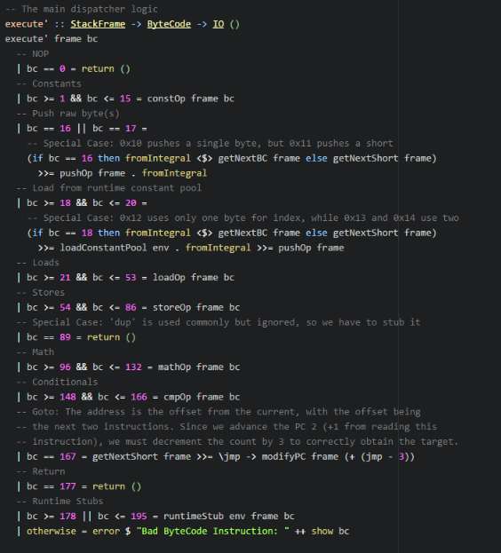

Function Syntax
Functions take arguments as arrows
Considered the ‘Curried’ form of function application
Explained later
Declaration arrows represent the types, but the names are decided in the definition
Pattern Guards
Determine which function definition to call based on predicate
Represented with the ‘|’ character
Functions arguments are passed sequentially
To disambiguate the function arguments, they can be wrapped in $\left(…\right)$, or have the ‘$’ operator appended after the function.
Functions Composition
The ‘.’ operator denotes function composition.
$\left(g.f\right)\left(x\right)≡\left(g∘f\right)\left(x\right)=g\left(f\left(x\right)\right)$
Pronounced $g$ “after” $f$ of $x$
$\left(.\right)∷\left(b→c\right)→\left(a→b\right)→\left(a→c\right)$

Slide 11
Binding & Scope Rules
Unlimited Extent, Lambdas, Lazy Evaluation, Thunks, and more…

Slide 12
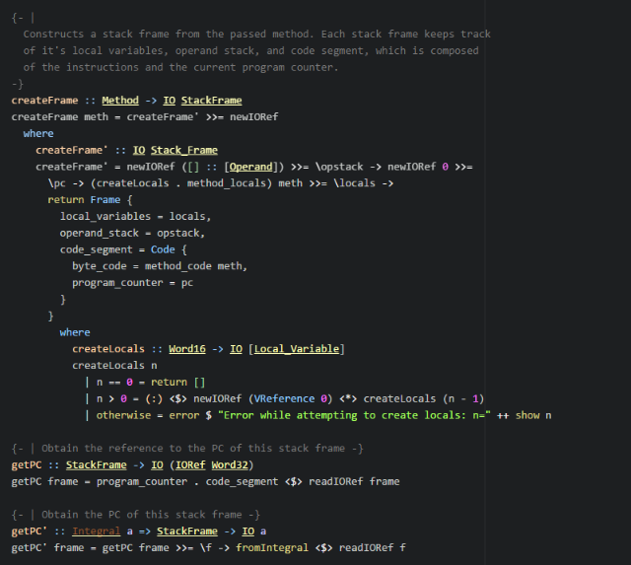
Binding & Scoping Rules
Referential Transparency
Variables defined are immutable
With some exceptions…
Since they are immutable, their outputs are always deterministic
Variables have Unlimited Extent
They exist for as long as they are referenced
Even variables of lambdas
Lazy-Evaluation
Computations are delayed inside of ‘thunks’
Thunks contain ‘lazy’ computations that are only evaluated when needed.
Immutability
All data is immutable, with some exception
The IO Monad needs side-effects to interact with the ‘RealWorld’
I.E: Printing to the console is a side-effect
‘IORef’, ‘STRef’, ‘MVar’, ‘Tvar’, etc., all can maintain references to immutable to data that can be changed to point something else
Special Case: Software Transactional Memory
Underlying data is still immutable
Notes:
Mention Referential Transparency (immutable values) and thunks (???)

Slide 13
Control Flow
The power of Haskell…

Slide 14
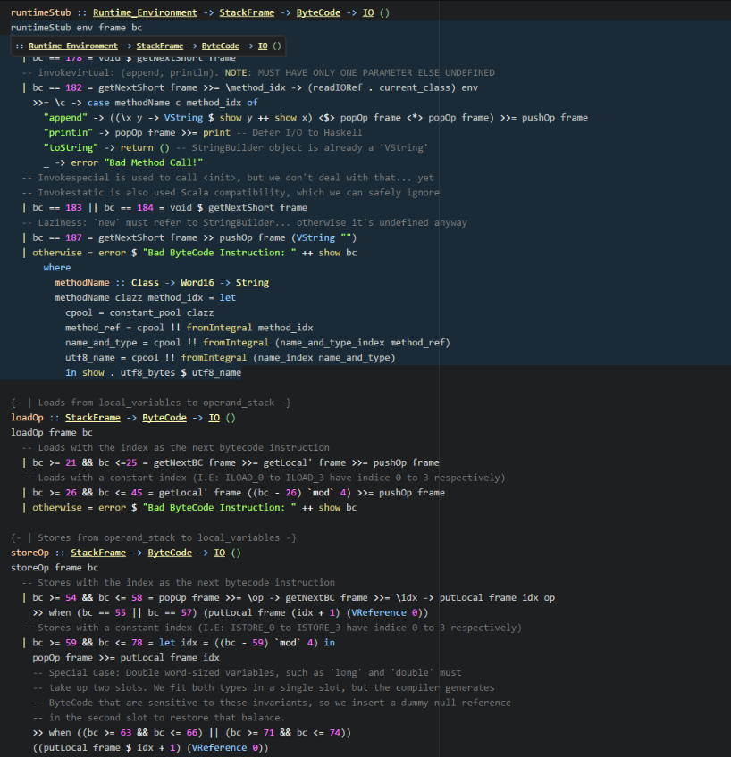

Control Flow
Recursion
Any and all ‘iteration’ is performed through recursion
Why?
Iteration requires mutation of some variable
All variables are immutable
Infinite recursion is actually ‘safe’
Used to produce infinite data streams
Recursive calls only called when needed
I.E Obtain first $n$ numbers in the Fibonacci Sequence
$fibs=0 :1 :zipWith \left(+\right) fibs \left(tail fibs\right)$
$take n fibs$
Result of each call to $fibs$ is stored as evaluated inside of a thunk. The function used $\left(zipWith∷\left(a→b→c\right)→\left[a\right]→\left[b\right]→\left[c\right]\right)$ applies the function to the head of both lists (I.E: The last two values evaluated). $take$ will force it to evaluate only up to $n$ times and collect the result.
Monad Pipelines
Discussed earlier
Feeds result of previous computation into next using the $≫=$ operator, the $≫$ evaluates and throws away that result.

Slide 15
Data Types
Type-Classes and deriving/instantiating them

Slide 16
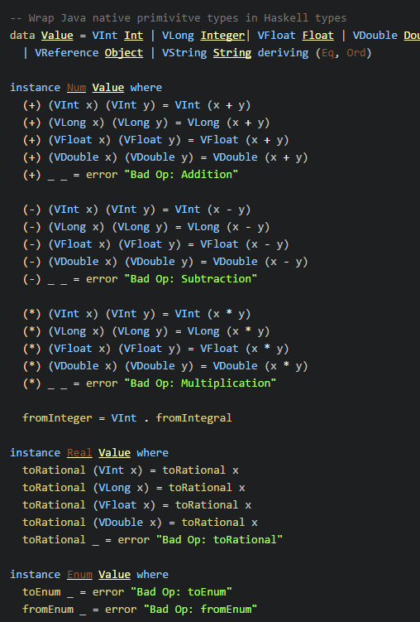

Data Types
Type Classes
Constructs that define methods
Even arithmetic operators are methods
Can sometimes be automatically derived
Only if the objects they are composed of all are instances of it
Can be used for type constraints of polymorphic functions
Specify that the generic type must implement the listed types
Have ‘data constructors’
Remember: Same as a normal function
Can have ‘field selectors’
Can have a ‘default’ values of undefined
Defined as $⊥$, or ‘bottom’
Also used for non-terminating functions and runtime errors
All types have this value in common
Can be instantiated by data types
Must implement required methods

Slide 17
Subprograms and Parameter Passing
Currying and Partial Applications of Functions

Slide 18
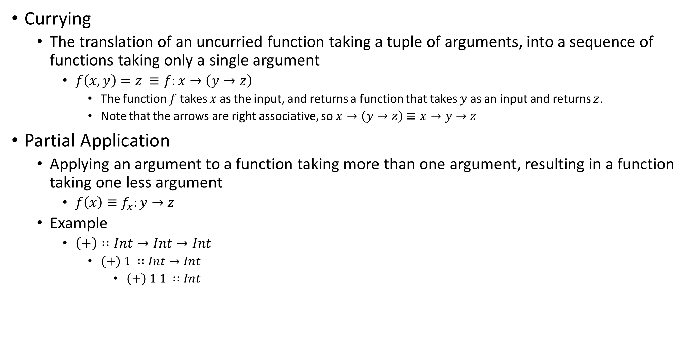
Currying and Partial Application of Functions
Currying
The translation of an uncurried function taking a tuple of arguments, into a sequence of functions taking only a single argument
$f\left(x,y\right)=z ≡f:x→\left(y→z\right)$
The function $f$ takes $x$ as the input, and returns a function that takes $y$ as an input and returns $z$.
Note that the arrows are right associative, so $x→\left(y→z\right)≡x→y→z$
Partial Application
Applying an argument to a function taking more than one argument, resulting in a function taking one less argument
$f\left(x\right)≡f_{x}:y→z$
Example
$\left(+\right)∷Int→Int→Int$
$\left(+\right) 1 ∷Int→Int$
$\left(+\right) 1 1 ∷Int$

Slide 19
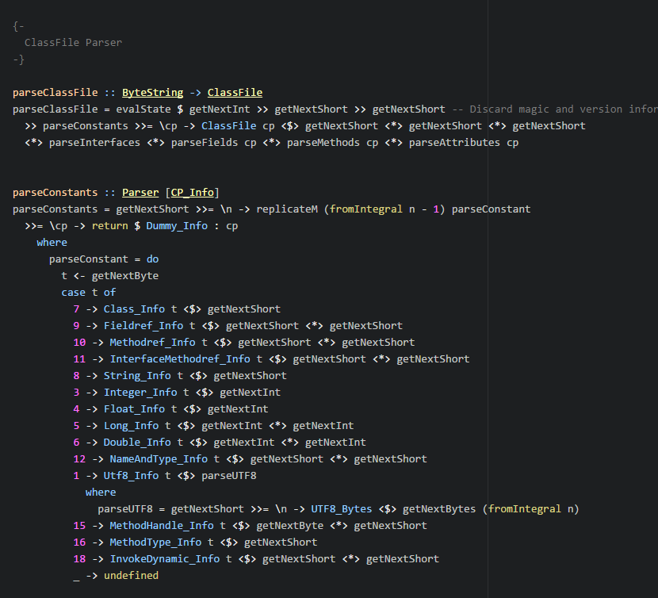

Subprograms and Parameter Passing
Partial Application
Data Constructors for a type are just functions, and like such can be partially applied
With a combination of the results from $getNext^{∗}$, which returns a $Parser Word^{∗}$, that result can be passed to the data constructor through application.
Why is this important?
Arguments can be passed from functors
Arguments can also be passed by value
Cuts out the amount of boilerplate

Slide 20
Virtual Machine – Plans and Goals
Implement a Heap that takes advantage of Haskell’s GC
Refactor, Refactor, Refactor…
Needs vast improvements!

