Slide 1
Introducing LLVM to the Java Virtual Machine
By: Louis Jenkins
Advisor: William Calhoun

Slide 2
Schedule
Java Virtual Machine
LLVM
Java Virtual Machine to LLVM
Live Demo

Slide 3
What is the Java Virtual Machine?
Runtime Environment for Classfiles
Classfile must follow specification
Any language can compile a program into a classfile, not just Java
Backend for many languages
Java, Scala, Frege, Jython, Clojure, Kotlin, Groovy, etc.
Why
Get a runtime environment ‘for-free’
Gain access to the main JVM libraries that exist
I.E: Any library written in Java
Easy to exchange between langauges
I.E: Can incrementally swap out .java files with .scala in a project
Portable

Slide 4
Java Virtual Machine – Computational Model
Stack-Based Computations
Operands and subexpressions are pushed onto a stack
Compilation Unit: Classfile
Instruction Set: Bytecode

Slide 5
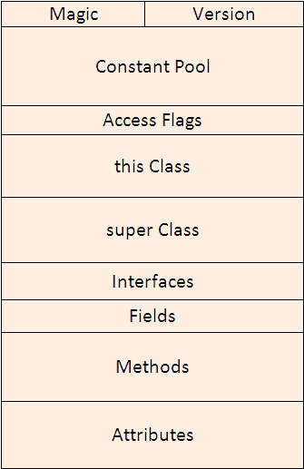
Classfile
Constant Pool
Constant Values
Method and Field names and types
Interfaces, Fields, and Methods
Keep track of names, types and attributes
Indexes into constant pool
Attributes
Metadata
Bytecode
Exception Table
Is this a constant value?

Slide 6
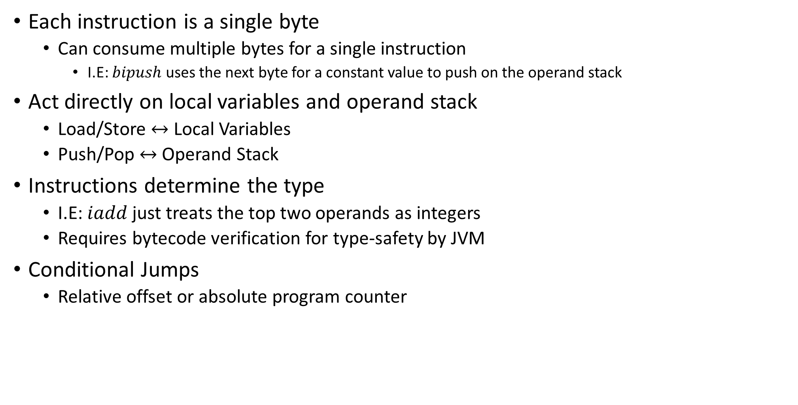
Bytecode
Each instruction is a single byte
Can consume multiple bytes for a single instruction
I.E: $bipush$ uses the next byte for a constant value to push on the operand stack
Act directly on local variables and operand stack
Load/Store $↔$ Local Variables
Push/Pop $↔$ Operand Stack
Instructions determine the type
I.E: $iadd$ just treats the top two operands as integers
Requires bytecode verification for type-safety by JVM
Conditional Jumps
Relative offset or absolute program counter

Slide 7
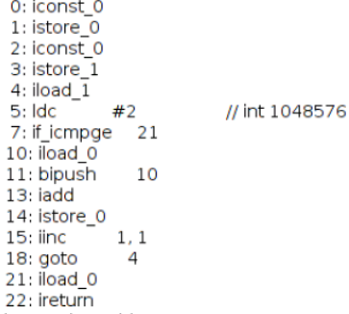
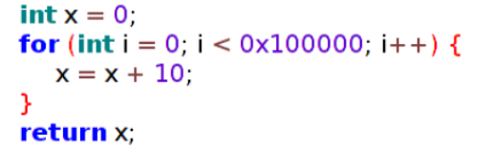
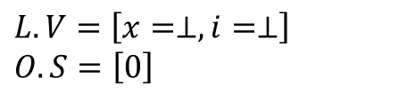
Computation
Local Variables
Slots of read/write registers
Operand Stack
Stack of values and sub-expressions
Java to Bytecode
$$L.V=\left[x=⊥,i=⊥\right]$$
$$O.S=\left[0\right]$$

Slide 8
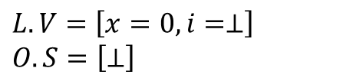
Computation
Local Variables
Slots of read/write registers
Operand Stack
Stack of values and sub-expressions
Java to Bytecode
$$L.V=\left[x=0,i=⊥\right]$$
$$O.S=\left[⊥\right]$$

Slide 9
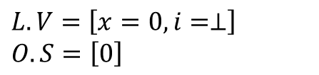
Computation
Local Variables
Slots of read/write registers
Operand Stack
Stack of values and sub-expressions
Java to Bytecode
$$L.V=\left[x=0,i=⊥\right]$$
$$O.S=\left[0\right]$$

Slide 10
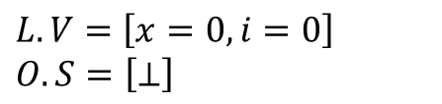
Computation
Local Variables
Slots of read/write registers
Operand Stack
Stack of values and sub-expressions
Java to Bytecode
$$L.V=\left[x=0,i=0\right]$$
$$O.S=\left[⊥\right]$$

Slide 11
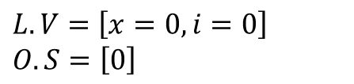
Computation
Local Variables
Slots of read/write registers
Operand Stack
Stack of values and sub-expressions
Java to Bytecode
$$L.V=\left[x=0,i=0\right]$$
$$O.S=\left[0\right]$$

Slide 12
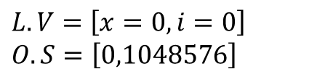
Computation
Local Variables
Slots of read/write registers
Operand Stack
Stack of values and sub-expressions
Java to Bytecode
$$L.V=\left[x=0,i=0\right]$$
$$O.S=\left[0,1048576\right]$$

Slide 13
Computation
Local Variables
Slots of read/write registers
Operand Stack
Stack of values and sub-expressions
Java to Bytecode
$$L.V=\left[x=0,i=0\right]$$
$$O.S=\left[0,1048576\right]$$
≥

Slide 14
Computation
Local Variables
Slots of read/write registers
Operand Stack
Stack of values and sub-expressions
Java to Bytecode
$$L.V=\left[x=0,i=0\right]$$
$$O.S=\left[0\right]$$

Slide 15
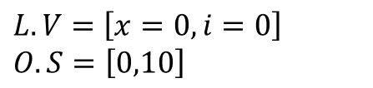
Computation
Local Variables
Slots of read/write registers
Operand Stack
Stack of values and sub-expressions
Java to Bytecode
$$L.V=\left[x=0,i=0\right]$$
$$O.S=\left[0,10\right]$$

Slide 16
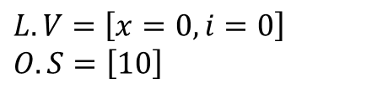
Computation
Local Variables
Slots of read/write registers
Operand Stack
Stack of values and sub-expressions
Java to Bytecode
$$L.V=\left[x=0,i=0\right]$$
$$O.S=\left[10\right]$$

Slide 17
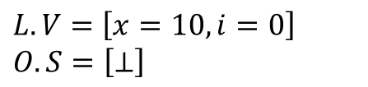
Computation
Local Variables
Slots of read/write registers
Operand Stack
Stack of values and sub-expressions
Java to Bytecode
$$L.V=\left[x=10,i=0\right]$$
$$O.S=\left[⊥\right]$$

Slide 18
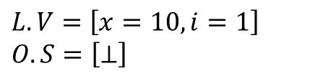
Computation
Local Variables
Slots of read/write registers
Operand Stack
Stack of values and sub-expressions
Java to Bytecode
$$L.V=\left[x=10,i=1\right]$$
$$O.S=\left[⊥\right]$$

Slide 19
Computation
Local Variables
Slots of read/write registers
Operand Stack
Stack of values and sub-expressions
Java to Bytecode
$$L.V=\left[x=10,i=1\right]$$
$$O.S=\left[⊥\right]$$

Slide 20
Computation
Local Variables
Slots of read/write registers
Operand Stack
Stack of values and sub-expressions
Java to Bytecode
$$L.V=\left[x=10,i=1\right]$$
$$O.S=\left[⊥\right]$$

Slide 21
1048576 Iterations Later…

Slide 22
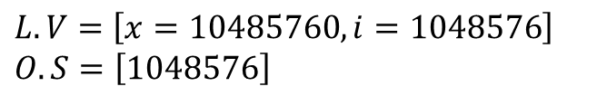
Computation
Local Variables
Slots of read/write registers
Operand Stack
Stack of values and sub-expressions
Java to Bytecode
$$L.V=\left[x=10485760,i=1048576\right]$$
$$O.S=\left[1048576\right]$$

Slide 23
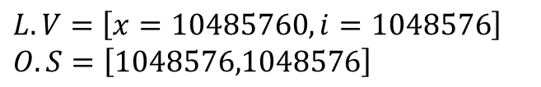
Computation
Local Variables
Slots of read/write registers
Operand Stack
Stack of values and sub-expressions
Java to Bytecode
$$L.V=\left[x=10485760,i=1048576\right]$$
$$O.S=\left[1048576,1048576\right]$$

Slide 24
Computation
Local Variables
Slots of read/write registers
Operand Stack
Stack of values and sub-expressions
Java to Bytecode
$$L.V=\left[x=10485760,i=1048576\right]$$
$$O.S=\left[1048576,1048576\right]$$
≥

Slide 25
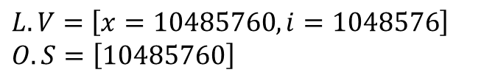
Computation
Local Variables
Slots of read/write registers
Operand Stack
Stack of values and sub-expressions
Java to Bytecode
$$L.V=\left[x=10485760,i=1048576\right]$$
$$O.S=\left[10485760\right]$$

Slide 26
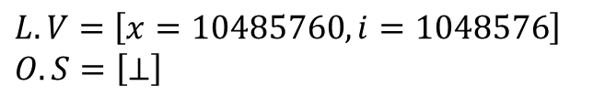
Computation
Local Variables
Slots of read/write registers
Operand Stack
Stack of values and sub-expressions
Java to Bytecode
$$L.V=\left[x=10485760,i=1048576\right]$$
$$O.S=\left[⊥\right]$$

Slide 27
Problems with Pure Interpretation
Problems with Interpretation
Naïve
No optimizations
Redundant Load/Store and Push/Pop operations
Solution
Just-In-Time compilation
Compile the code on-demand ahead of time
How do we build such a compiler
With LLVM…

Slide 28
What is LLVM
Compiler Infrastructure
Provide tools for data flow analysis and optimizations
Let you build your own compiler
Requires implementing a frontend
Tool to convert from one language to LLVM compatible format
Backend for many compilers
Clang (C/C++), GHC (Haskell), Chapel (Chapel), Falcon JIT (Java), etc.
Why
100+ Optimizations ‘for-free’
Relatively straight-forward to implement frontend

Slide 29
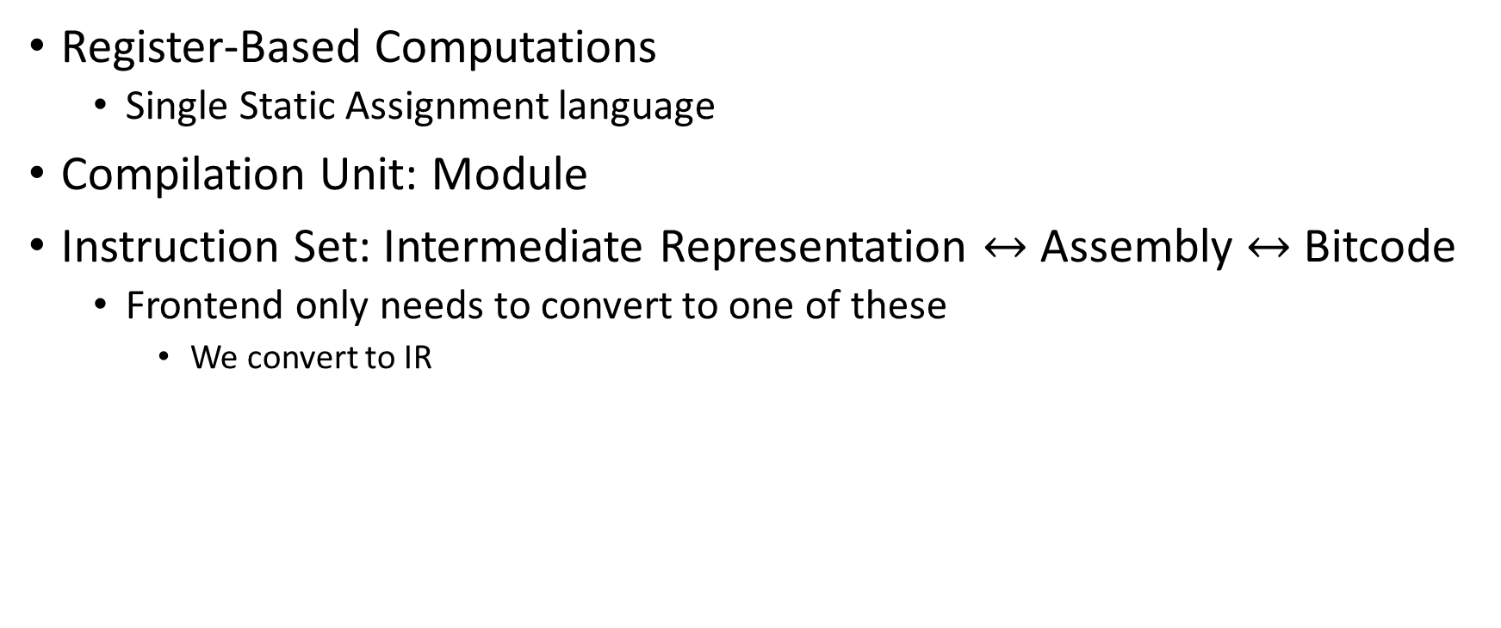
LLVM – Computational Model
Register-Based Computations
Single Static Assignment language
Compilation Unit: Module
Instruction Set: Intermediate Representation $↔$ Assembly $↔$ Bitcode
Frontend only needs to convert to one of these
We convert to IR

Slide 30
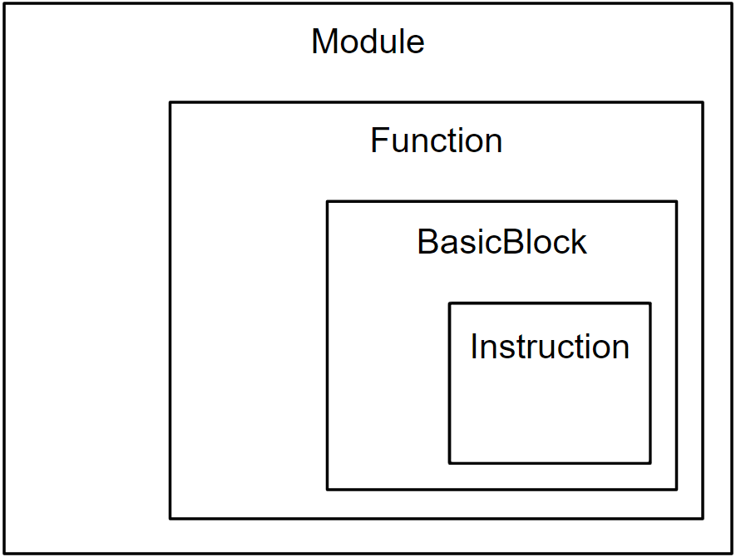
Modules
Global Definitions
Functions
Basically a Control Flow Graph
Global Variables

Slide 31
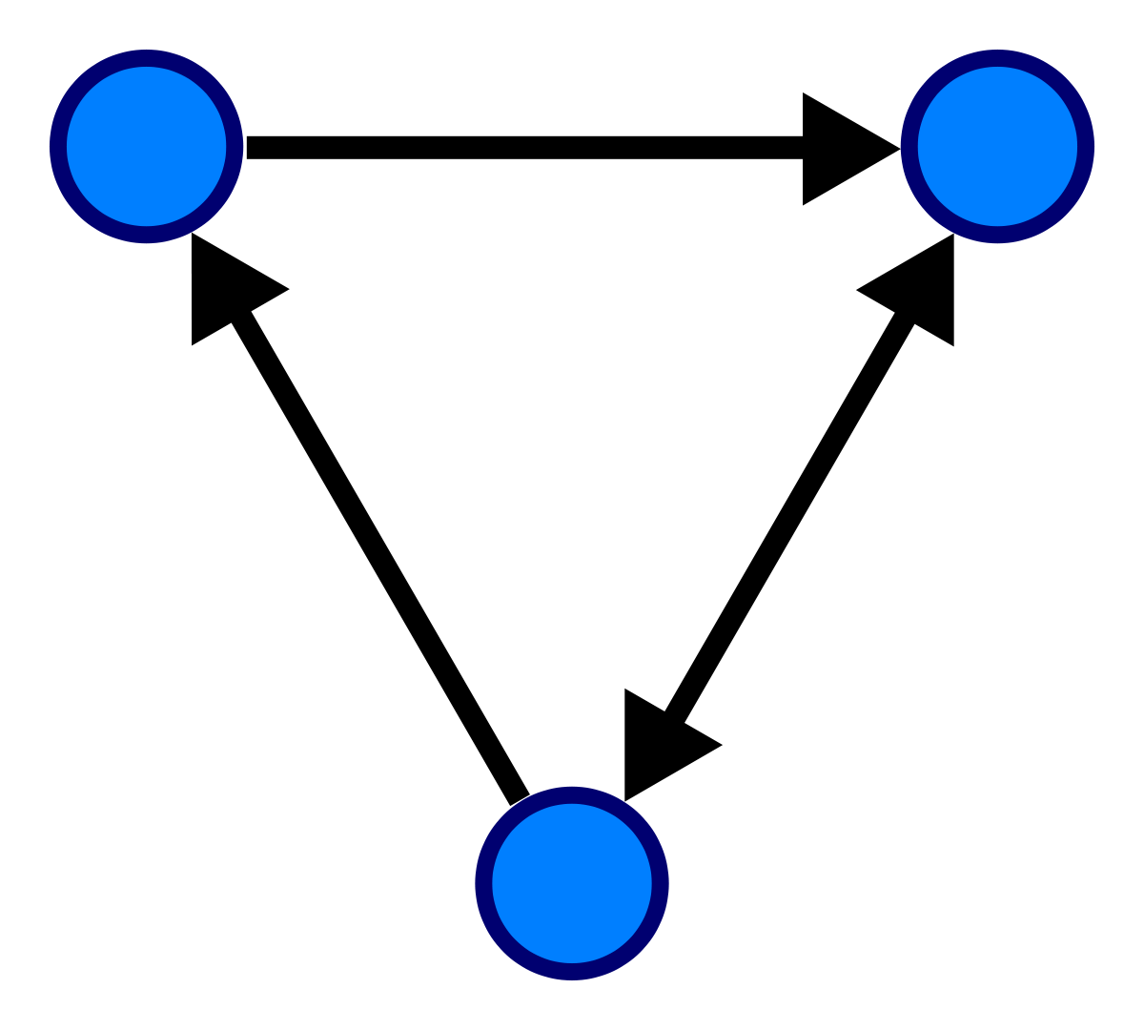
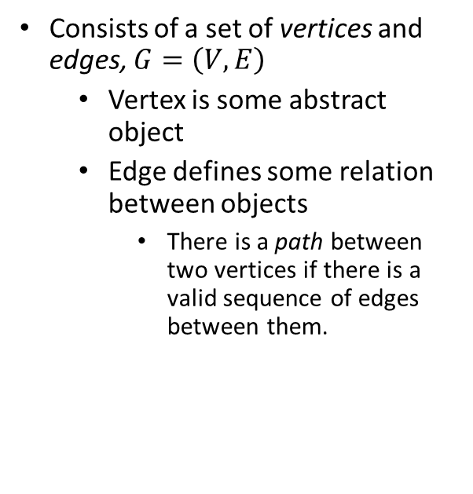
Directed Graph
Consists of a set of vertices and edges, $G=\left(V,E\right)$
Vertex is some abstract object
Edge defines some relation between objects
There is a path between two vertices if there is a valid sequence of edges between them.

Slide 32
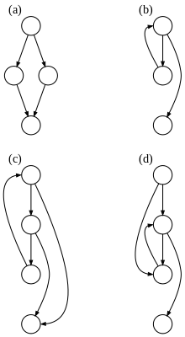
Control-Flow Graph
Represents the flow of control in a program
Edges represent potential flow of control
Vertices are basic blocks
Basic Block
A sequence of instructions having exactly one entry and exit point.

Slide 33
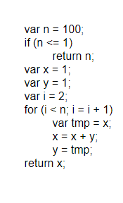
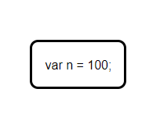
Constructing a Control Flow Graph
Pseudo-Code
Control Flow Graph
Create Block
Notes:
Skipping AST generation step…

Slide 34
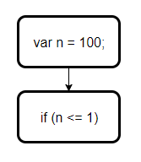
Constructing a Control Flow Graph
Pseudo-Code
Control Flow Graph
Create Block

Slide 35

Constructing a Control Flow Graph
Pseudo-Code
Control Flow Graph
Combine

Slide 36
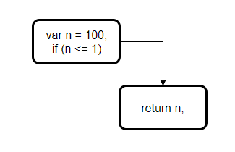
Constructing a Control Flow Graph
Pseudo-Code
Control Flow Graph
Create Block

Slide 37
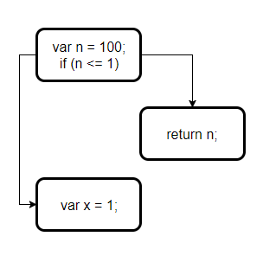
Constructing a Control Flow Graph
Pseudo-Code
Control Flow Graph
Create Block

Slide 38
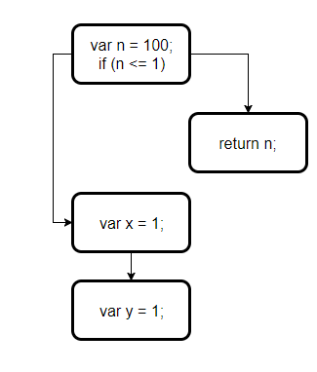
Constructing a Control Flow Graph
Pseudo-Code
Control Flow Graph
Create Block

Slide 39
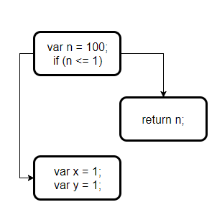
Constructing a Control Flow Graph
Pseudo-Code
Control Flow Graph
Combine

Slide 40
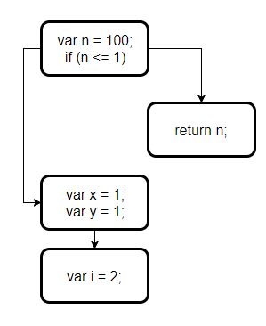
Constructing a Control Flow Graph
Pseudo-Code
Control Flow Graph
Create Block

Slide 41
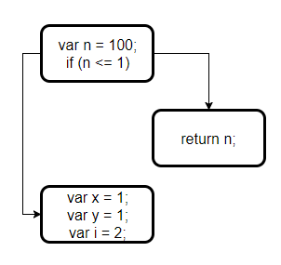
Constructing a Control Flow Graph
Pseudo-Code
Control Flow Graph
Combine

Slide 42
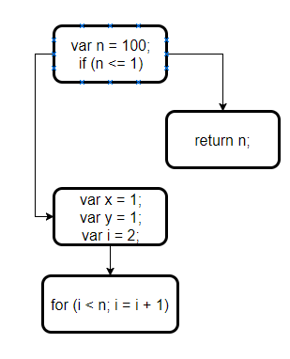
Constructing a Control Flow Graph
Pseudo-Code
Control Flow Graph
Create Block

Slide 43
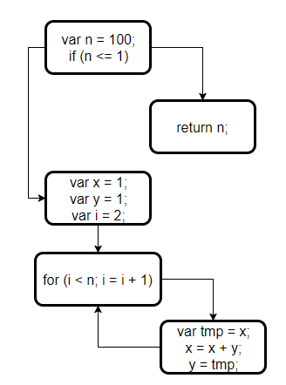
Constructing a Control Flow Graph
Pseudo-Code
Control Flow Graph
Create and Combine Blocks

Slide 44
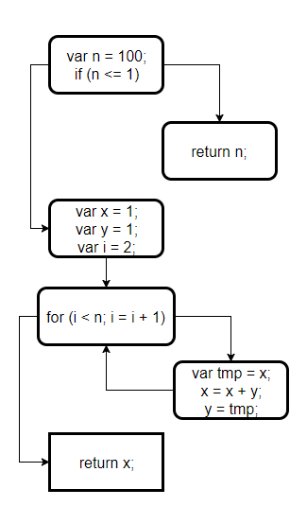
Constructing a Control Flow Graph
Pseudo-Code
Control Flow Graph
Create Block

Slide 45
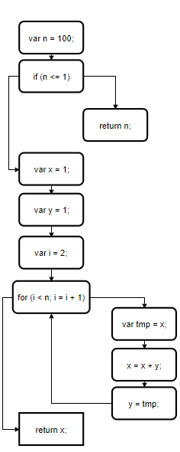
Basic Blocks
Without Basic Blocks
With Basic Blocks

Slide 46

Optimizations
Pass Manager
Manages the ordering of the sequence of passes
Types of Passes
Module
Function
Loop
Basic Block
Call Graph

Slide 47
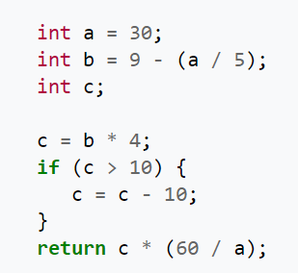
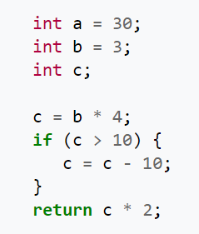
Constant Folding & Constant Propagation
Constant Folding
Evaluation of an expression that can be computed at compile time
Constant Propagation
Using a constant value in place of its variable definition
Constant Propagation
And
Constant Folding

Slide 48
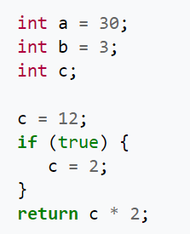
Constant Folding & Constant Propagation
Constant Folding
Evaluation of an expression that can be computed at compile time
Constant Propagation
Using a constant value in place of its variable definition
Constant Propagation
And
Constant Folding

Slide 49
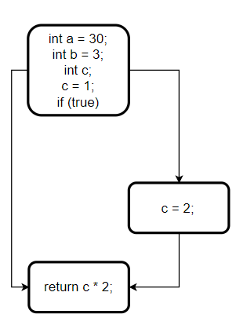
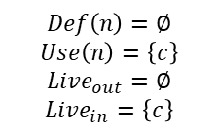

Liveness Analysis - Basics
$Use\left(n\right)=$ A set of variables used by $n$
$Def\left(n\right)=$ A set of variables defined by $n$
$$Live_{in}\left(n\right)=Use\left(n\right)∪\left(Live_{out}\left(n\right)−Def\left(n\right)\right)$$
$$Live_{in}\left(n_{0}\right)=∅$$
$$Live_{out}\left(n\right)=\bigcup_{s∈Succ\left(n\right)}{Live_{in}\left(s\right)}$$
Control Flow Graph
Liveness Analysis
$$Def\left(n\right)=∅$$
$$Use\left(n\right)=\left\{c\right\}$$
$$Live_{out}=∅$$
$$Live_{in}=\left\{c\right\}$$

Slide 50
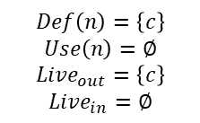
Liveness Analysis - Basics
$Use\left(n\right)=$ A set of variables used by $n$
$Def\left(n\right)=$ A set of variables defined by $n$
$$Live_{in}\left(n\right)=Use\left(n\right)∪\left(Live_{out}\left(n\right)−Def\left(n\right)\right)$$
$$Live_{in}\left(n_{0}\right)=∅$$
$$Live_{out}\left(n\right)=\bigcup_{s∈Succ\left(n\right)}{Live_{in}\left(s\right)}$$
Control Flow Graph
Liveness Analysis
$$Def\left(n\right)=\left\{c\right\}$$
$$Use\left(n\right)=∅$$
$$Live_{out}=\left\{c\right\}$$
$$Live_{in}=∅$$
$$Def\left(n\right)=∅$$
$$Use\left(n\right)=\left\{c\right\}$$
$$Live_{out}=∅$$
$$Live_{in}=\left\{c\right\}$$

Slide 51
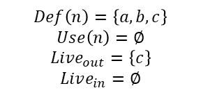
Liveness Analysis - Basics
$Use\left(n\right)=$ A set of variables used by $n$
$Def\left(n\right)=$ A set of variables defined by $n$
$$Live_{in}\left(n\right)=Use\left(n\right)∪\left(Live_{out}\left(n\right)−Def\left(n\right)\right)$$
$$Live_{in}\left(n_{0}\right)=∅$$
$$Live_{out}\left(n\right)=\bigcup_{s∈Succ\left(n\right)}{Live_{in}\left(s\right)}$$
$$Def\left(n\right)=\left\{a,b,c\right\}$$
$$Use\left(n\right)=∅$$
$$Live_{out}=\left\{c\right\}$$
$$Live_{in}=∅$$
Control Flow Graph
Liveness Analysis
$$Def\left(n\right)=\left\{c\right\}$$
$$Use\left(n\right)=∅$$
$$Live_{out}=\left\{c\right\}$$
$$Live_{in}=∅$$
$$Def\left(n\right)=∅$$
$$Use\left(n\right)=\left\{c\right\}$$
$$Live_{out}=∅$$
$$Live_{in}=\left\{c\right\}$$

Slide 52
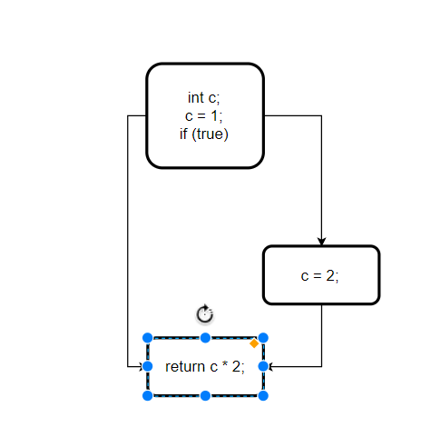
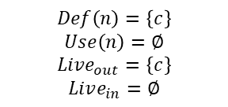
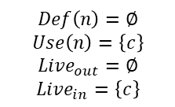
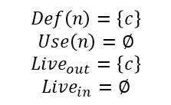
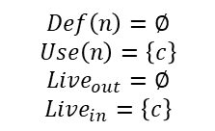
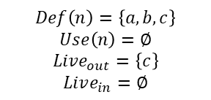
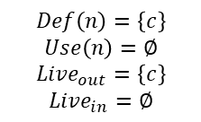
Dead Code Elimination - Liveness Analysis
$Use\left(n\right)=$ A set of variables used by $n$
$Def\left(n\right)=$ A set of variables defined by $n$
$$Live_{in}\left(n\right)=Use\left(n\right)∪\left(Live_{out}\left(n\right)−Def\left(n\right)\right)$$
$$Live_{in}\left(n_{0}\right)=∅$$
$$Live_{out}\left(n\right)=\bigcup_{s∈Succ\left(n\right)}{Live_{in}\left(s\right)}$$
$$Def\left(n\right)=\left\{c\right\}$$
$$Use\left(n\right)=∅$$
$$Live_{out}=\left\{c\right\}$$
$$Live_{in}=∅$$
$$Def\left(n\right)=\left\{a,b,c\right\}$$
$$Use\left(n\right)=∅$$
$$Live_{out}=\left\{c\right\}$$
$$Live_{in}=∅$$
Eliminate ‘Dead’ Variables
$$Def\left(n\right)=\left\{c\right\}$$
$$Use\left(n\right)=∅$$
$$Live_{out}=\left\{c\right\}$$
$$Live_{in}=∅$$
$$Def\left(n\right)=\left\{c\right\}$$
$$Use\left(n\right)=∅$$
$$Live_{out}=\left\{c\right\}$$
$$Live_{in}=∅$$
$$Def\left(n\right)=∅$$
$$Use\left(n\right)=\left\{c\right\}$$
$$Live_{out}=∅$$
$$Live_{in}=\left\{c\right\}$$
$$Def\left(n\right)=∅$$
$$Use\left(n\right)=\left\{c\right\}$$
$$Live_{out}=∅$$
$$Live_{in}=\left\{c\right\}$$

Slide 53


Dead Code Elimination – Unreachable Code
Unreachable Code
Code in which is on a path that can never be computed (determined statically)
Can be removed or simplified
Eliminate Unreachable Code
Simplify
Unreachable

Slide 54
Intermediate Representation
Operations act directly on registers
Infinite ‘virtual’ registers
Register allocation (handled for us)
Values may only be written once (SSA)
Registers determine the type
Type-checking is simple
Conditional Jumps
Represented simply by edges in control flow graph

Slide 55



Single Static Assignment
SSA Form
All variables are defined before they’re use
All variables are defined exactly once
Definition used interchangeably with assignment
Multiple assignments to the same variable can be given a subscript
I.E $x←x+1⇒x_{2}←x_{1}+1$
Phi Functions
Needed when there are multiple definitions of a variable along two or more paths
Place $φ$ functions where path converges
Each definition $v_{1},…,v_{n}$ along a converging path are the arguments
$φ\left(v_{1},…,v_{n}\right)$
Minimal SSA Form
Minimum number of phi functions inserted
Placed at dominance frontiers
Pruned SSA Form
Only places phi functions where we have a $Live_{in}$

Slide 56




JVM $→$ LLVM – Local Variables
Problem
The JVM requires local variables
LLVM only allows computations in Single Static Assignment form
Solution
Allocate pointers on the stack on first use
Pointers are constant and do not change
Now the values they point to on the other hand, can change
Bytecode
IR
Java

Slide 57

JVM $→$ LLVM – Stack $→$ Register
Problem
The JVM operates solely using the stack
Solution
Simulate the stack computational model
Maintain a compile-time ‘operand stack’
Save the result of each to a register treated as an operand
Bytecode
IR
Java

Slide 58

JVM $→$ LLVM – Stack $→$ Register
Problem
Operating on stack pointers is magnitudes slower than registers
Solution
Mem2Reg
LLVM optimization pass that converts stack allocations to registers based on dominance frontiers…
Bytecode
IR
Java

Slide 59



JVM $→$ LLVM – Stack $→$ Register
Problem
What about control flow?
Solution
Create basic blocks at relative offset and absolute program counter locations where jumps occur
Just keep track of which program counter each basic block belongs to
Bytecode
IR
Java

Slide 60
Live Demo

Slide 61
How do we convert a program to SSA?

Slide 62


Dominance
“A node $a$ dominates a node $b$ if every path from the $root$ to $b$ must go through $a$. A node $a$ strictly dominates a node $b$ if $a$ dominates $b$ and $a≠b$.”

Slide 63

Dominance Frontier
What
“A node $y$ is in the dominance frontier of $x$ if $x$ does not strictly dominate $y$ but does dominate an immediate predecessor of $y$.”
Why
The dominance frontier indicates a join point of control flow where two or more potential definitions can come together.
Use – Pruned SSA Form
For a variable $v$, we place phi-functions, $φ\left(v_{1},…,v_{n}\right)$, at the dominating frontiers and where $v$ is in the $Live_{in}$.

Slide 64












Computing SSA
$w∈DF\left(v\right)⇒v$ dominates $w$’s predecessor but does dominate $w$.
$$DF\left(ℒ_{v}\right)=\bigcup_{x_{v}∈ℒ_{v}}{DF\left(x_{v}\right)}, L_{v}=Nodes containing assignment to v$$
$DF^{+}=Iterated Dominance Frontier$
$$DF^{+}=DF\left(ℒ_{v}∪DF\left(ℒ_{v}\right)\right)$$
$$𝒶$$
$$𝒶$$
$$𝒷$$
$$𝒷$$
$$𝒸$$
Liveness Analysis
$$𝒸$$
$$𝒹$$
$$𝒹$$

Slide 65












Computing SSA
$w∈DF\left(v\right)⇒v$ dominates $w$’s predecessor but doesn’t dominate $w$.
$$DF\left(ℒ_{v}\right)=\bigcup_{x_{v}∈ℒ_{v}}{DF\left(x_{v}\right)}, L_{v}=Nodes containing assignment to v$$
$DF^{+}=Iterated Dominance Frontier$
$$DF^{+}=DF\left(ℒ_{v}∪DF\left(ℒ_{v}\right)\right)$$
$$𝓛_{x}=\left\{a,c\right\}$$
$$𝒶$$
$$𝒶$$
$$𝒷$$
$$𝒷$$
$$𝒸$$
Place $φ$
$$𝒸$$
$$𝒹$$
$$𝒹$$

Slide 66


Computing SSA
$w∈DF\left(v\right)⇒v$ dominates $w$’s predecessor but does dominate $w$.
$$DF\left(ℒ_{v}\right)=\bigcup_{x_{v}∈ℒ_{v}}{DF\left(x_{v}\right)}, L_{v}=Nodes containing assignment to v$$
$DF^{+}=Iterated Dominance Frontier$
$$DF^{+}=DF\left(ℒ_{v}∪DF\left(ℒ_{v}\right)\right)$$
$$ℒ_{x}=\left\{a,c\right\}$$
$$DF_{x}\left(a\right)=\left\{c, d\right\}$$
$$𝒶$$
$$𝒶$$
$$𝒷$$
$$𝒷$$
$$𝒸$$
Place $φ$
$$𝒸$$
$$𝒹$$
$$𝒹$$

Slide 67

Computing SSA
$w∈DF\left(v\right)⇒v$ dominates $w$’s predecessor but does dominate $w$.
$$DF\left(ℒ_{v}\right)=\bigcup_{x_{v}∈ℒ_{v}}{DF\left(x_{v}\right)}, L_{v}=Nodes containing assignment to v$$
$DF^{+}=Iterated Dominance Frontier$
$$DF^{+}=DF\left(ℒ_{v}∪DF\left(ℒ_{v}\right)\right)$$
$$ℒ_{x}=\left\{a,c\right\}$$
$$DF_{x}\left(a\right)=\left\{c, d\right\},DF_{x}\left(c\right)=\left\{b\right\}$$
$$𝒶$$
$$𝒶$$
$$𝒷$$
$$𝒷$$
$$𝒸$$
Place $φ$
$$𝒸$$
$$𝒹$$
$$𝒹$$

Slide 68


Computing SSA
$w∈DF\left(v\right)⇒v$ dominates $w$’s predecessor but does dominate $w$.
$$DF\left(ℒ_{v}\right)=\bigcup_{x_{v}∈ℒ_{v}}{DF\left(x_{v}\right)}, L_{v}=Nodes containing assignment to v$$
$DF^{+}=Iterated Dominance Frontier$
$$DF^{+}=DF\left(𝓛_{v}∪DF\left(𝓛_{v}\right)\right)$$
$$ℒ_{x}=\left\{a,c\right\}$$
$$DF_{x}\left(a\right)=\left\{c, d\right\},DF_{x}\left(c\right)=\left\{b\right\}$$
$$DF_{x}\left(𝓛_{x}\right)=DF_{x}\left(a\right)∪DF_{x}\left(c\right)=\left\{b,c,d\right\}$$
$$𝒶$$
$$𝒶$$
$$𝒷$$
$$𝒷$$
$$𝒸$$
Place $φ$
$$𝒸$$
$$𝒹$$
$$𝒹$$

Slide 69





Computing SSA
$w∈DF\left(v\right)⇒v$ dominates $w$’s predecessor but does dominate $w$.
$$DF\left(ℒ_{v}\right)=\bigcup_{x_{v}∈ℒ_{v}}{DF\left(x_{v}\right)}, L_{v}=Nodes containing assignment to v$$
$DF^{+}=Iterated Dominance Frontier$
$$DF^{+}=DF\left(ℒ_{v}∪DF\left(ℒ_{v}\right)\right)$$
$$ℒ_{x}=\left\{a,b,c\right\}$$
$$DF_{x}\left(a\right)=\left\{c, d\right\},DF_{x}\left(b\right)=∅,DF_{x}\left(c\right)=\left\{b\right\}$$
$$DF_{x}\left(ℒ_{x}\right)=DF_{x}\left(a\right)∪DF_{x}\left(b\right)∪DF_{x}\left(c\right)=\left\{b,c,d\right\}$$
$$𝒶$$
$$𝒶$$
$$𝒷$$
$$𝒷$$
$$𝒸$$
NOP
$$𝒸$$
$$𝒹$$
$$𝒹$$

Slide 70





Computing SSA
$w∈DF\left(v\right)⇒v$ dominates $w$’s predecessor but does dominate $w$.
$$DF\left(ℒ_{v}\right)=\bigcup_{x_{v}∈ℒ_{v}}{DF\left(x_{v}\right)}, L_{v}=Nodes containing assignment to v$$
$DF^{+}=Iterated Dominance Frontier$
$$DF^{+}=DF\left(ℒ_{v}∪DF\left(ℒ_{v}\right)\right)$$
$$𝒶$$
$$𝒶$$
$$𝒷$$
$$𝒷$$
Propagate Dominator
Definition
$$𝒸$$
$$𝒸$$
$$𝒹$$
$$𝒹$$

Slide 71
Computing SSA
$w∈DF\left(v\right)⇒v$ dominates $w$’s predecessor but does dominate $w$.
$$DF\left(ℒ_{v}\right)=\bigcup_{x_{v}∈ℒ_{v}}{DF\left(x_{v}\right)}, L_{v}=Nodes containing assignment to v$$
$DF^{+}=Iterated Dominance Frontier$
$$DF^{+}=DF\left(ℒ_{v}∪DF\left(ℒ_{v}\right)\right)$$
$$𝒶$$
$$𝒶$$
$$𝒷$$
$$𝒷$$
Propagate Dominator
Definition
$$𝒸$$
$$𝒸$$
$$𝒹$$
$$𝒹$$

Slide 72
Computing SSA
$w∈DF\left(v\right)⇒v$ dominates $w$’s predecessor but does dominate $w$.
$$DF\left(ℒ_{v}\right)=\bigcup_{x_{v}∈ℒ_{v}}{DF\left(x_{v}\right)}, L_{v}=Nodes containing assignment to v$$
$DF^{+}=Iterated Dominance Frontier$
$$DF^{+}=DF\left(ℒ_{v}∪DF\left(ℒ_{v}\right)\right)$$
$$𝒶$$
$$𝒶$$
$$𝒷$$
$$𝒷$$
Propagate Dominator
Definition
$$𝒸$$
$$𝒸$$
$$𝒹$$
$$𝒹$$

Slide 73









Computing SSA
$w∈DF\left(v\right)⇒v$ dominates $w$’s predecessor but does dominate $w$.
$$DF\left(ℒ_{v}\right)=\bigcup_{x_{v}∈ℒ_{v}}{DF\left(x_{v}\right)}, L_{v}=Nodes containing assignment to v$$
$DF^{+}=Iterated Dominance Frontier$
$$DF^{+}=DF\left(ℒ_{v}∪DF\left(ℒ_{v}\right)\right)$$
$$𝒶$$
$$𝒶$$
$$𝒷$$
$$𝒷$$
Repeat for ${DF}_{y}^{+}$ and $DF_{i}^{+}$
$$𝒸$$
$$𝒸$$
$$𝒹$$
$$𝒹$$

Slide 74








Computing SSA
$w∈DF\left(v\right)⇒v$ dominates $w$’s predecessor but does dominate $w$.
$$DF\left(ℒ_{v}\right)=\bigcup_{x_{v}∈ℒ_{v}}{DF\left(x_{v}\right)}, L_{v}=Nodes containing assignment to v$$
$DF^{+}=Iterated Dominance Frontier$
$$DF^{+}=DF\left(ℒ_{v}∪DF\left(ℒ_{v}\right)\right)$$
$$𝒶$$
Variable Renaming
+
Simplify
$$𝒷$$
$$𝒷$$
$$𝒸$$
$$𝒸$$
$$𝒹$$
$$𝒹$$

Slide 75
Questions?

