Slide 1
Assignment 3: NLP Analysis of Federal Reserve FOMC Minutes
Louis Keller
Student ID: 1384004

Slide 2
The 2022–2025 Rate Shock: Fed Language as Economic Policy
In November 2022, an FOMC meeting got published and one sentence got the attention of the market: "ongoing increases will be appropriate" which means that the committee is going to continue to increase the rates.
Couple hours after, S&P 500 drop to 2.4% in session. Only one sentence made this. This shows how analysis of Fed language is so powerful and important.
For businessmen or traders, predict what feds are going to say represent a unique advantage. Indeed, if an NLP model detect that the vocabulary tend to terms like 'disinflation', it becomes possible for them to have an early position on the interest rate markets.
To conclude, the post Covid period (2022-2025) is really rich in data because it covers 3 distinct monetary systems where we go from rates nearly equal to 0 right after the covid crisis to a bank crisis in 2023 to a pivot with the first decreases in September 2024, all in a context of the return of trade uncertainty in 2025 with tariffs.
This is why VADER and LDA are going to be very useful to analyze all of this.

Slide 3
The Post-COVID Monetary Landscape: Your Dataset
The dataset is composed of 32 meetings between January 2022 and December 2025. The average words is 6750 words which shows that every text are long and dense. The vocabulary size is 5590 before filtering and 2430 after.
The policy rate timeline is:
- A 0.25% rate in January 2022 right after Covid coming from the post Covid politics.
- In June 2022, it brutally accelerate with +75bp while inflation reaches 9.1%.
- In July 2023, the rate pic to 5.5% stay like this for a year (with bank crisis in March 23)
- In December 2025 the rate finish at 4.25% after a series of progressive reductions

Slide 4
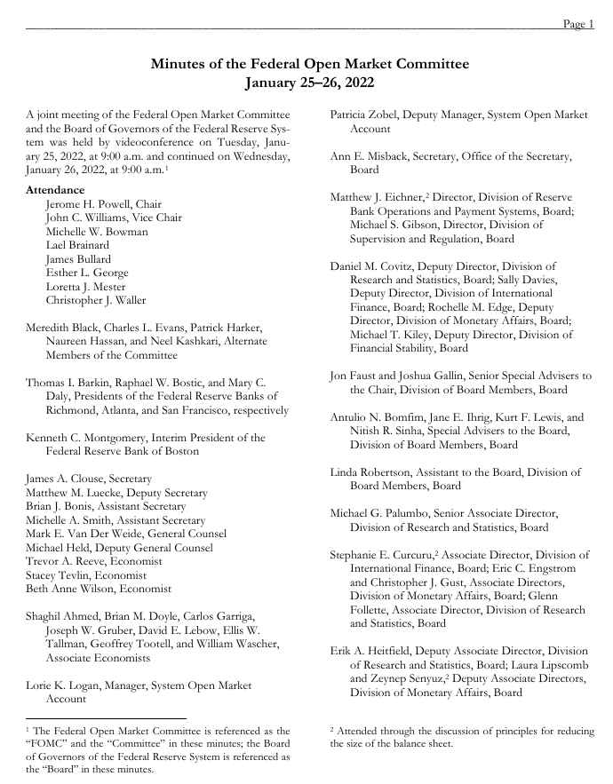
The Post-COVID Monetary Landscape: Your Dataset 2
First page pf Pdf Version of Jan 2022:
We can see that there is a lot of names, unimportant words like Page, or even some weird spaces... that we needed to remove.
And the cleaned text of January 2022 meeting looks like this: [operations, turned, first, discussion, period...]
This section is rich in NLP because there was a lot of changes in the market in just 3 years creating naturally changes for the vocabulary used.
Words like disinflation, restrictive, … became more frequent and never seen before making our models detecting and dating them precisely.
Also, in 2025, Trump era introduces new vocabulary such as tariffs, trade or uncertainty that the LDA model isolate it like a cluster compared with everything before.

Slide 5
Data Architecture: From FOMC.gov to Analysis-Ready CSV
Scrapping Architecture:
Cleaning Part: First, we normalized the date because Fed uses a variety of formats for their dates like Jan 25-26, 2022 or January 14-15, 2022. So we converted everything with datetime64 (like this pandas can manipulate it) to be in the format Month, Year. After, we removed the boilerplate. Indeed, each document starts headers like: "Board of Governors of the..." And also as page numbers or multispaces or unwanted line breaks. There was problems with the text itself like stopwords, URL's special characters...
To remove and clean all of this, we used regex for URL's, weird spaces... And nltk for stopwords but we still added some extra stopwords related to the text such as: committee, federal, reserve...
FOMC calendar
URL
Cleaning
CSV
PDF extraction

Slide 6
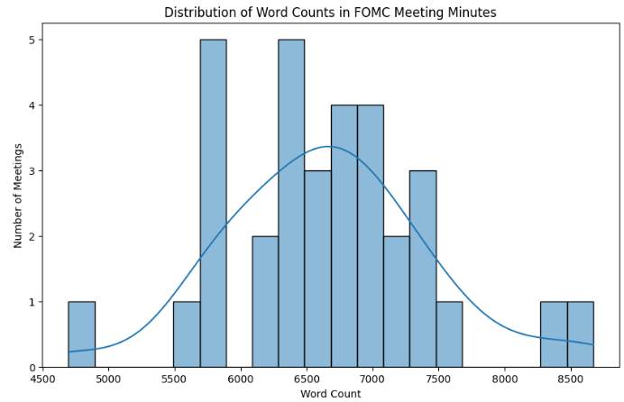
Data Architecture: From FOMC.gov to Analysis-Ready CSV 2
Then we visualized how the cleaning looked like in a table and draw histogram of word count to see if there is any outliers:
We can see that here there is none.

Slide 7
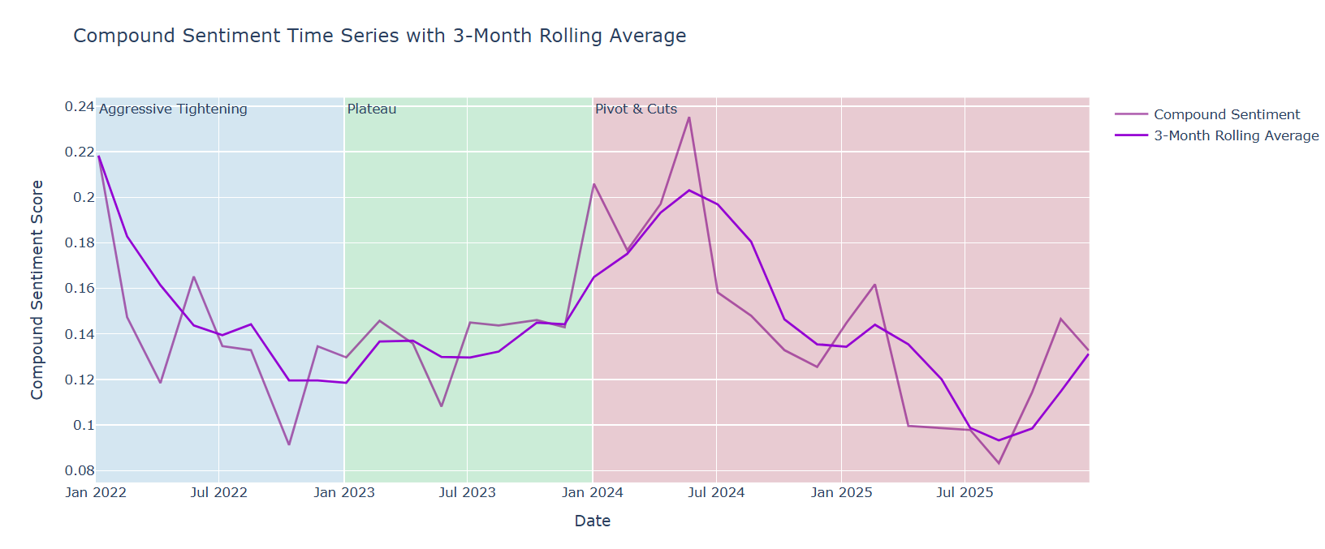
VADER Sentiment: Measuring Fed Tone Across the Hiking Cycle

Slide 8
VADER Sentiment: Measuring Fed Tone Across the Hiking Cycle
On the previous graph, we can observe that in general the compound sentiment of the meetings is between 0.1 and 0.2 and it's normal.
Indeed, the FOMC minutes are written in a deliberately technical and impersonal style to not alarm anyone and the market. That's why the score is 85% neutral because it doesn't contain any emotional words which is the linguistic signature of those meetings.
VADER always read Fed text as 'neutral-positive' because first of all VADER got built and trained with general text like social media, product reviews... which is not the vocabulary used in the Fed meetings. Also, in the statements used by the Fed, even the hikes are formulated with neutral words, containing no negative words present in the VADER lexicon.
A compound score between 0.10 and 0.20 doesn't mean that the Fed are optimistic, it just means that the language used is technically neutral with a little positive tint. Again, FOMC uses bureaucratic style for the meetings. Each word taken individually doesn't have strong emotional valence.

Slide 9
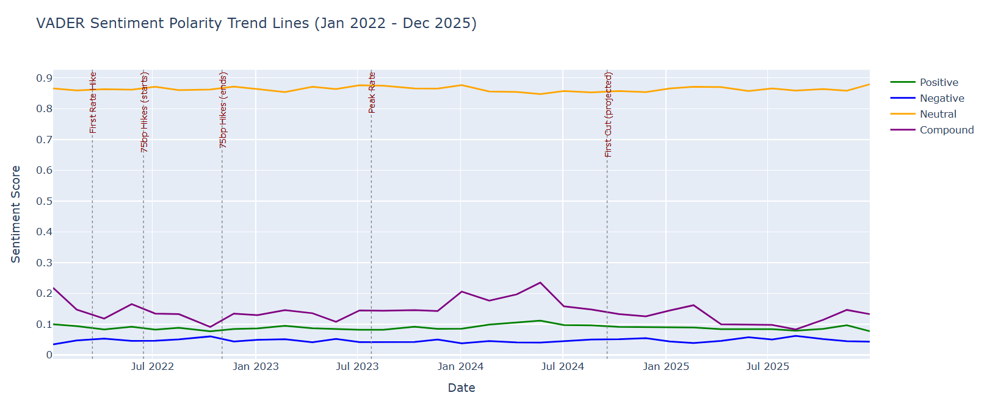
VADER Sentiment: Measuring Fed Tone Across the Hiking Cycle

Slide 10
Polarity Deep Dive: Neutral Dominates, But When Does Negativity Spike?
On the graph before, the negative sentiment stay between 0.03 and 0.06, but if we look a little closer several moments stand out.
The first pick that we can see is early 2022. Between January and February, the meetings introduce for the first time vocabulary based on inflation making the trend increase a little. The Fed recognize for the first time publicly that there is a problem.
The second pick corresponds to the 75bp phase between June and November 2022. The Negative curve reaches a plateau slightly higher than at the beginning of the year. The minutes from this period use more urgent wording for the first time. The June 2022 CPI figures at 9.1% are the direct trigger for this change in tone.
The third signal concerns March 2023 and the bank failures. That's when we are supposed to see the highest peak, and yet the Negative curve barely rises. This is exactly the limitation of VADER on this corpus. Phrases like "stress in the banking sector" or "heightened uncertainty" are not recognized as negative by VADER because these words are not part of a training corpus built from tweets. VADER detects terrible or awful but not contagion or systemic risk.

Slide 11
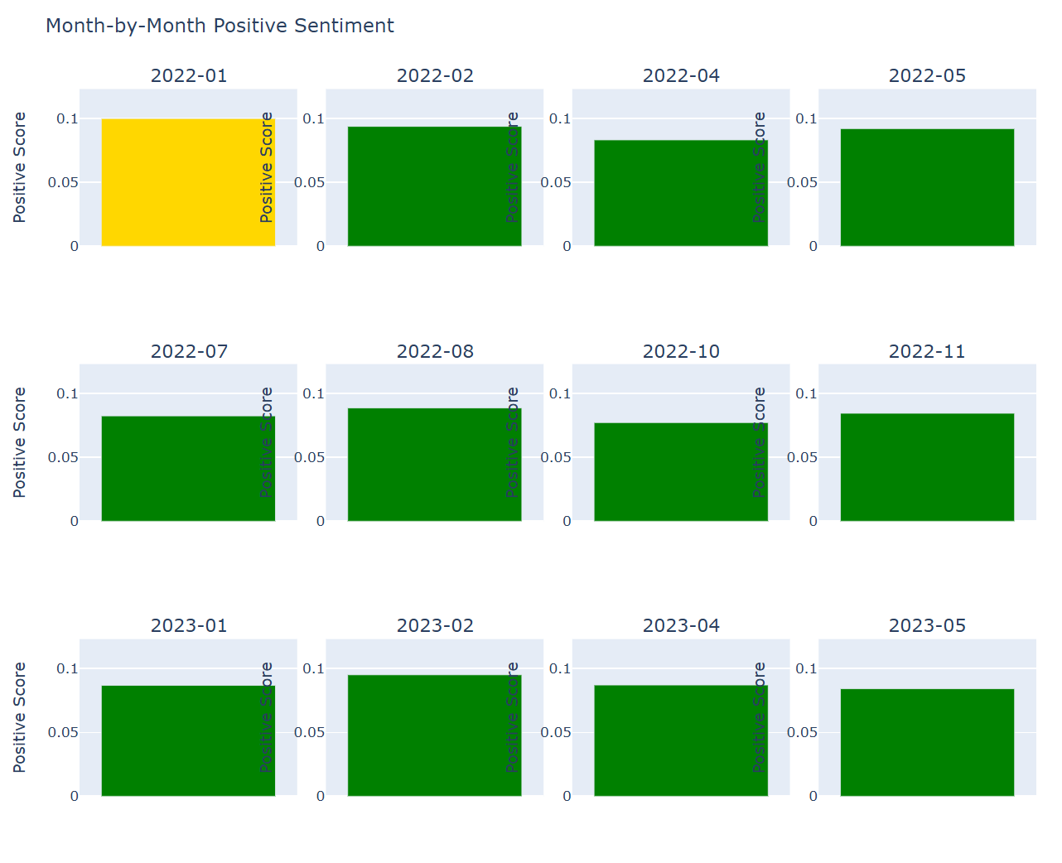
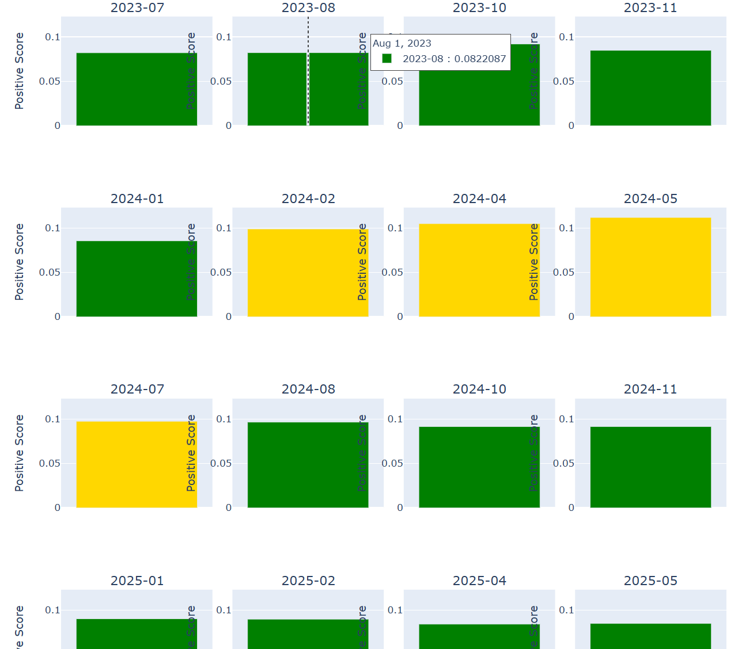
Month-by-Month Positive Sentiment: When Did the Fed Sound Optimistic?

Slide 12
Month-by-Month Positive Sentiment: When Did the Fed Sound Optimistic?
We can see on the multi-panel graphs before that in 2022 only one graph is yellow (which means that the positive VADER score is above average). The Fed is still talking about post-COVID economic recovery, an improving labor market, and strong demand. From February 2022, the color turns green and stays that way all year. During the entire phase of aggressive 75bp hikes between June and November 2022, the green bars remain low and stable around 0.08. The vocabulary of this period leaves no room for positivity.
In 2023, it stays green the whole year. But, in 2024, we can observe a cluster of yellow graphs. Indeed, between February and July, every graphs are yellow. It's because inflation is approaching 3% and declining, unemployment remains around 3.7% despite two years of rates at 5.50%, and the minutes include phrases like "labor market remains strong" or "risks are coming into better balance." These phrases contain words that VADER recognizes as positive (strong, better, eased, balance), which explains why the color turns yellow.
The 2025 panels are all back in the green. This is consistent with what we saw on the compound curve in the second half of 2024 and 2025, showing a deterioration in sentiment despite the ongoing rate cuts. The 2025 minutes reintroduce a vocabulary of uncertainty related to trade risks with the tariff increases implemented by Trump (which, by the way, did a lot of damage to our businesses like wine... in France...) that offsets the positive impact of the rate cuts.

Slide 13
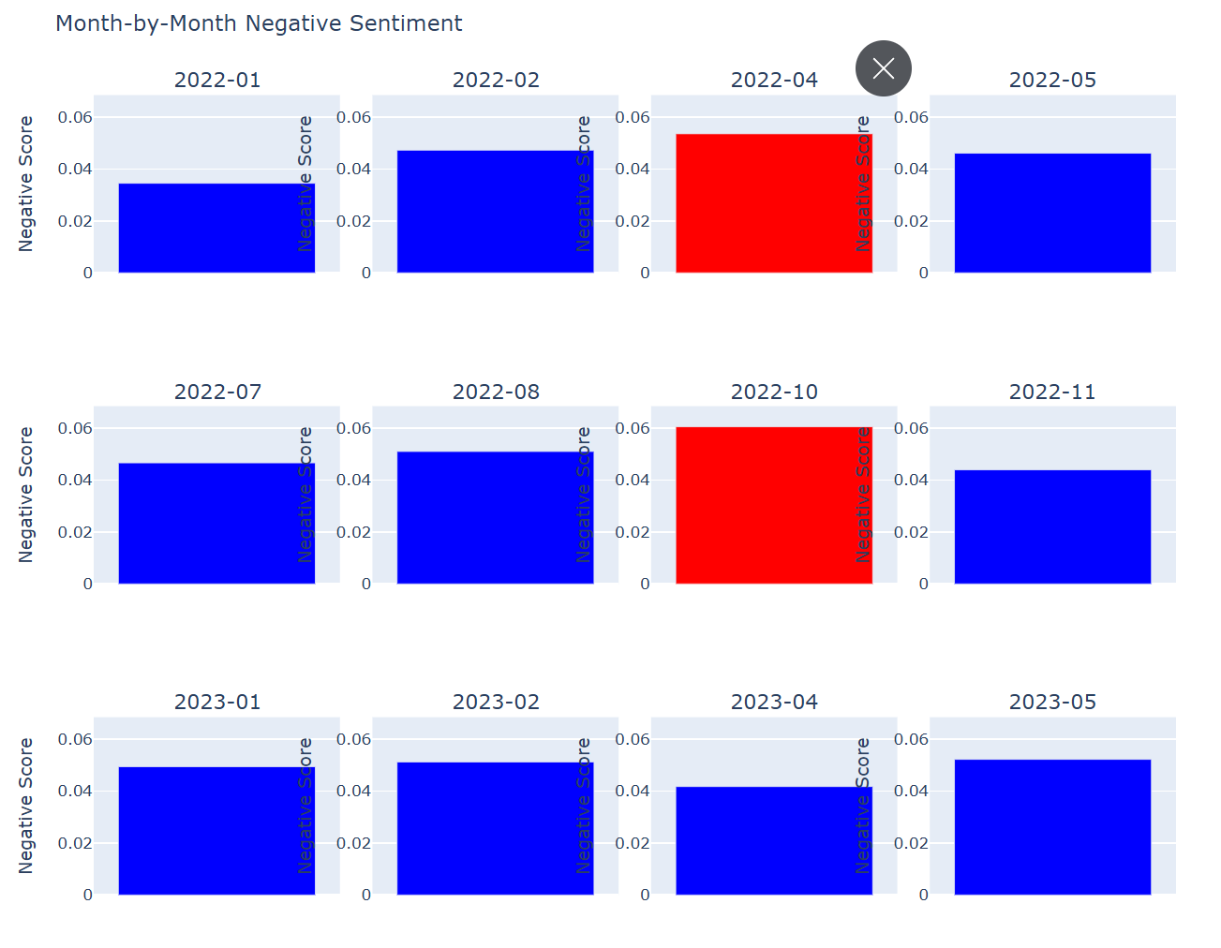
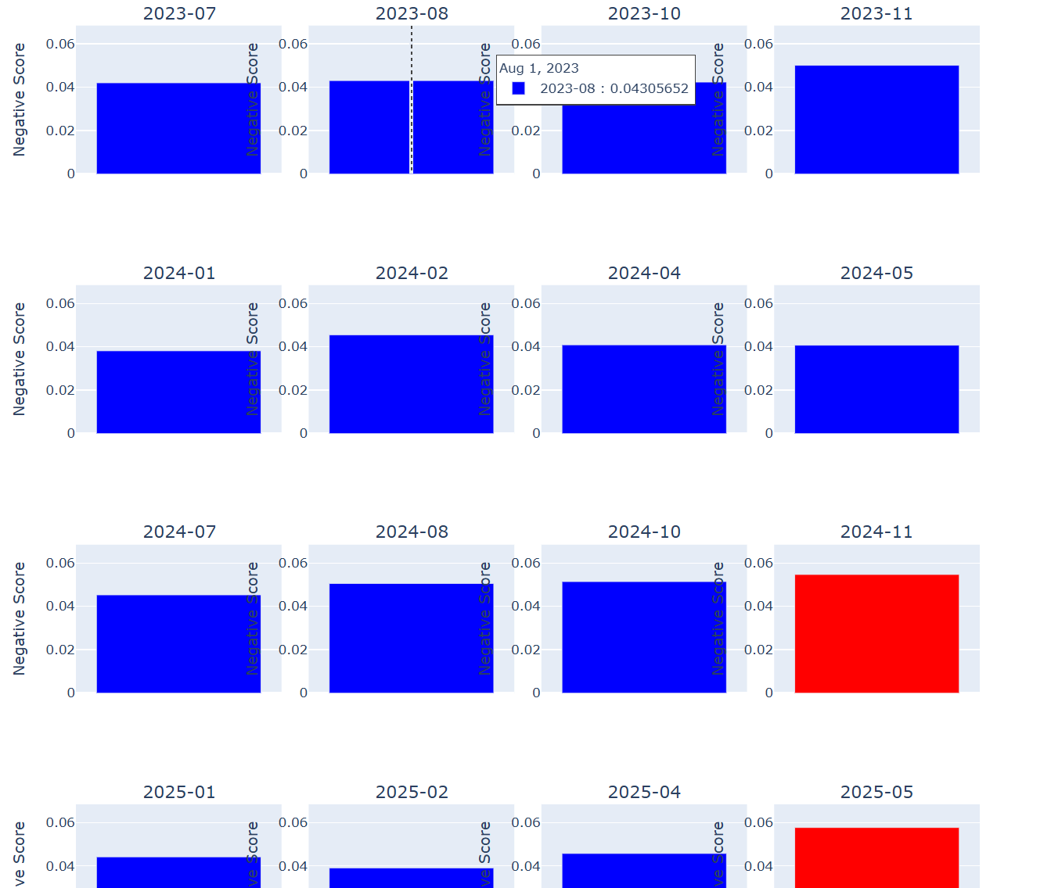
Month-by-Month Negative Sentiment: Stress Signals in Fed Language

Slide 14
Month-by-Month Negative Sentiment: Stress Signals in Fed Language
On the graphs before, we can observe that there is few month where the negative VADER sentiment is above average (just 4).
The first one appears in April 2022, way before the major 75bp hikes. It's interesting because April 2022 corresponds to the minutes in which the Fed acknowledges for the first time that inflation is not transitory.
The second red panel, and the biggest of 2022, is October, with a bar reaching almost 0.06. It is the month of the fourth consecutive 75bp increase. It is also the period when global risks were accumulating, and US CPI figures were still resisting the rise but started to increase.
In 2023, everything is blue and again show the limitations of VADER that does not understand the bank crisis of 2023 still because of the vocabulary used by the FOMC meetings.
In 2024 and 2025 there is also some surprising time were the graphs are red.
To conclude on what we saw there, the Negative score is a current, non-predictive indicator; it reflects the tone of the meeting but, by itself, does not allow one to anticipate the next decision. So, it doesn't predict a pause or acceleration.

Slide 15
VADER's Blind Spot: What Lexicon-Based Sentiment Misses in Fed Text
VADER as a lot of limitations. Indeed, being trained on texts for the general public, such as social media or Amazon reviews, the dictionary of VADER is limited.
The fundamental problem with the FOMC minutes is that the economic vocabulary is not in this dictionary with the correct valences. A word like 'elevated' scores slightly positive in VADER because in everyday language it suggests something high and distinguished.
So, the sentence: 'inflation remains elevated above our 2% target' should be scored negatively. But VADER decompose the sentence word by word and put elevated and target positive when the global meaning of the sentence made by the Fed is to say that it's a serious problem.
A model specifically trained on central bank texts such as FinBERT, or a BERT fine-tuned on Fed communications, would learn that 'elevated inflation' is negative in this context.
But VADER is still useful because it's fast and doesn't require any GPU and even if the score is sometimes wrong and biased it's pretty informative and accurate on the sentiment of the documents.

Slide 16
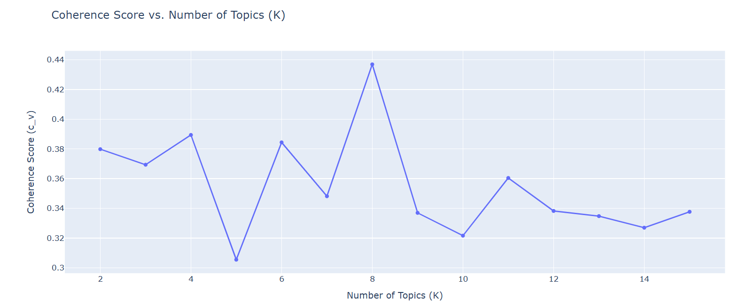
LDA Coherence Search: Finding the Optimal Number of Fed Topics

Slide 17
LDA Coherence Search: Finding the Optimal Number of Fed Topics
Our chosen K here is K = 8.
Indeed, we can see on the previous graph that the peak at K=8 is undeniable. It clearly dominates all other points, with a gap of about 0.05 points above the second highest score, which is K=4 at 0.39.
Topic names:
Topic 1: Post-Covid Normalization
Topic 2: No names (because I got a little problem for this one...)
Topic 3: Disinflation Progress
Topic 4: Cumulative Tightening And Banking Sector Stress
Topic 5: Trade Policy And Financial Vulnerabilities (Trump 2025)
Topic 6: Supply Chain Disruptions
Topic 7: Pandemic Shocks
Topic 8: Resilient Economy

Slide 18
LDA Coherence Search: Finding the Optimal Number of Fed Topics
It's coherent because the 8 topics cover exactly the major themes between 2022 and 2025: the post-Covid exit, external supply shocks with the war, the policy response to geopolitical shocks, banking stress, the narrative pivot and disinflation, Trump's trade policy and the 2025 tariffs.
So, it produced that many topics because it's number of major economic events that the Fed had to deal simultaneously between 2022 and 2025, and the model discovered them independently.

Slide 19
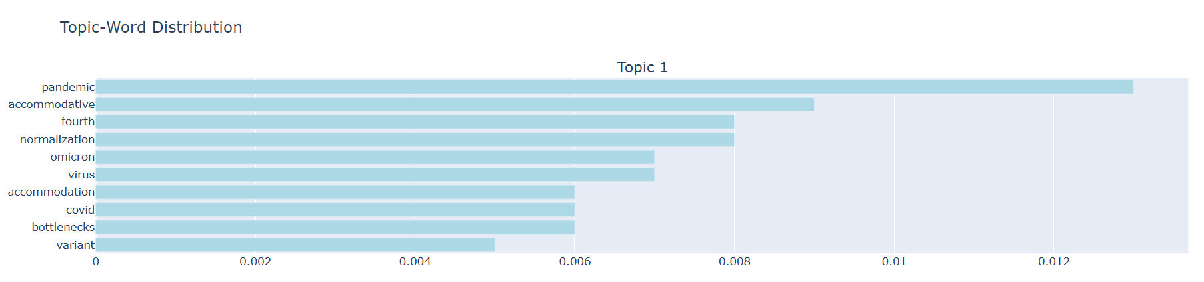
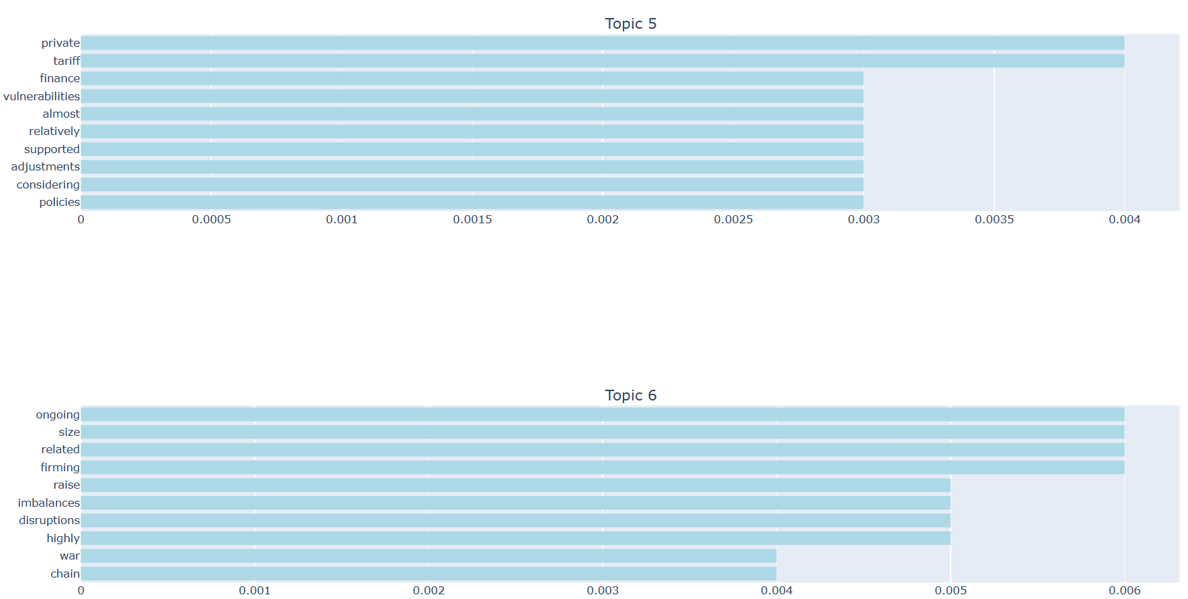
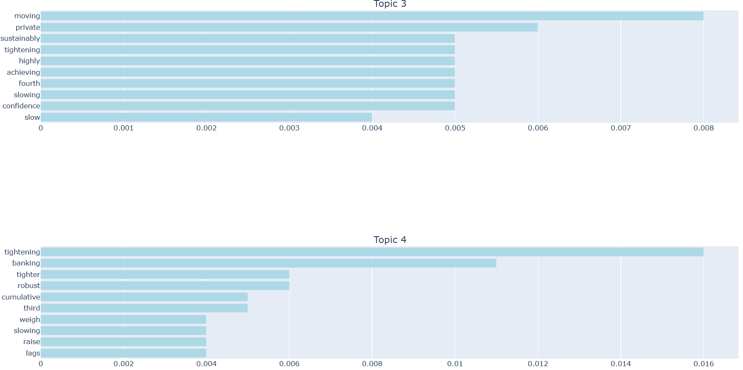
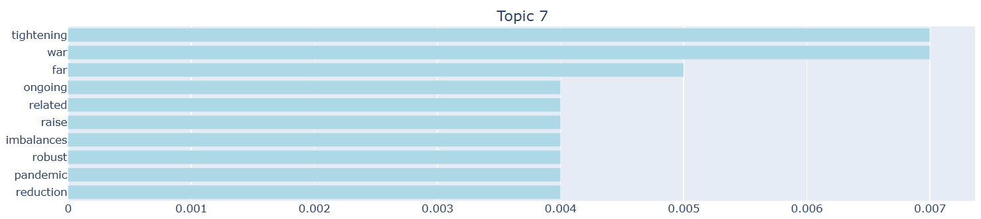
Topic-Word Distribution: What Each LDA Topic Represents

Slide 20
Topic-Word Distribution: What Each LDA Topic Represents
On the precedent graphs, we can identify clearly what each topics talk about.
Topic 1: The dominant word is pandemic. Next come accommodative, normalization, Omicron, virus, Covid, bottlenecks, variant. This topic is very specific, corresponding to the early 2022 meetings where the Fed begins to exit two years of ultra-accommodative policy.
Topic 3: Sustainably and achieving are the two key words here and appear consistently in the 2023/2024 minutes when the Fed begins to formulate the necessary condition for lowering rates. Inflation must sustainably return to around 2%.
Topic 4:
Topic 5: ‘Tariff’ is the signal word for 2025 and does not appear in any minutes before Trump, and its presence here confirms that LDA has correctly isolated the new 2025 policy. Vulnerabilities and finance together suggest that this topic also captures discussions on financial stability in a context of tariffs and trade uncertainty. This is the most recent Topic.
Topic 6, 7 and 8 are really close: Ongoing, firming, rising, imbalances, disruptions, war, chain, size form the topic of supply shocks. Disruptions and chain together clearly pinpoint post-Covid logistical problems. War and imbalances add the geopolitical dimension. This topics take place in 2022.

Slide 21
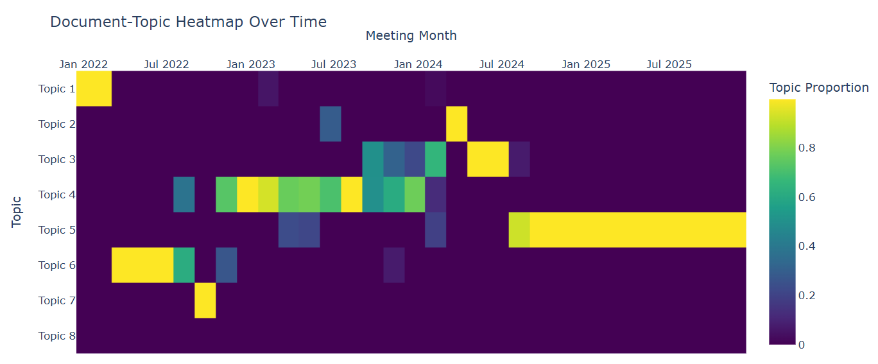
Document-Topic Heatmap: Which Meetings Focused on Which Themes?

Slide 22
Document-Topic Heatmap: Which Meetings Focused on Which Themes?
The graph before perfectly illustrates what we saw for each topics.
Indeed, Topic 1 is only one yellow cell in 2022, showing that it's the post Covid normalization dominating completely the first meetings of 2022.
Topic 4 is the richest in the chart. It shows a green-yellow block that begins around the end of 2022, becomes completely yellow in 2023, and remains present until early 2024. It is the longest phase of the corpus and corresponds to the 2023 period when the Fed kept rates at 5.50%. The presence of intense yellow cells over several consecutive meetings in 2023 indicates that this topic is not occasional but a sustained concern over a long period.
We can see that Topic 5 is almost completely black from 2022 to the end of 2024 (it does not exist), and then from early 2025 it turns bright yellow and remains so in all subsequent meetings. This yellow band represents the emergence of the vocabulary related to tariffs and Trump's trade policy. LDA detected some new vocabulary that was not present in the minutes before 2025. This is evidence that the Fed's discursive regime fundamentally changed with the Trump era.
Topics 6 and 7 show an intense yellow-green block from around March to July 2022. This geopolitical response topic dominates the period just after the outbreak of the war in Ukraine, when post-Covid supply chains were still causing major disruptions.

Slide 23
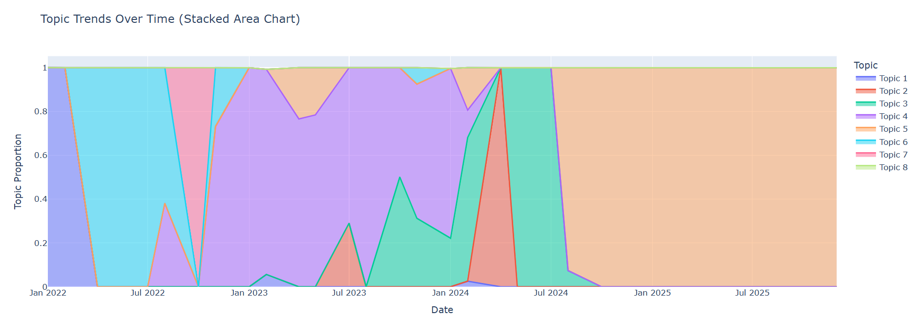
Topic Trends Over Time: The Stacked Area Story of Fed Concerns

Slide 24
Topic Trends Over Time: The Stacked Area Story of Fed Concerns
This chart shows four distinct phases. We can see that the first phase in blue illustrates the Covid output and supply shocks. The second phase in purple highlights the obsession with cumulative tightening over more than a year. The third phase in green depicts the emergence of the pivot. Finally, the fourth phase in orange shows the complete shift to a new uncertainty that the Fed had not anticipated.
These four phases correspond exactly to the four economic regimes we defined at the beginning, and LDA recovered them in a completely unsupervised manner from the raw text of the minutes.

Slide 25
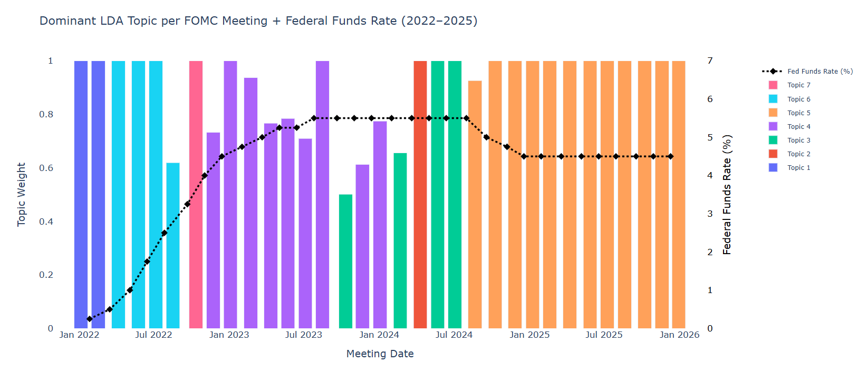
Top Topic Per Month: The Fed's Single Biggest Concern Each Meeting

Slide 26
Top Topic Per Month: The Fed's Single Biggest Concern Each Meeting
This graph represents the dominant topic for each month. The height indicates the weight and the color indicates the dominating topic. The black dashed line with diamonds shows the feds funds rate every month.
We can see on the graph that when the fed funds rates increase in 2022, it's topic 6 and 7 that dominate and it's because supply shocks and war are the causes. It's the inflation.
Between early 2023 and July 2024, the dotted line is perfectly horizontal at 5.50%. During this period, Topic 4 dominates. This is the clearest relationship on the chart; the rate no longer moves, and the dominant topic hardly changes either. The Fed is stuck, wondering at each meeting whether to keep or lower the rate.
We can observe that between Jan 2024 and Jul 2024, Topic 3 appear but the rate is still at 5%.LDA detects this shift in rhetorical tone before the curve begins to fall. This shows that NLP analysis of the minutes can serve as a leading indicator and that, with a few meetings in advance, one can understand how rates are moving.
After the rate stay the same with topic 5 during Trump era.

Slide 27
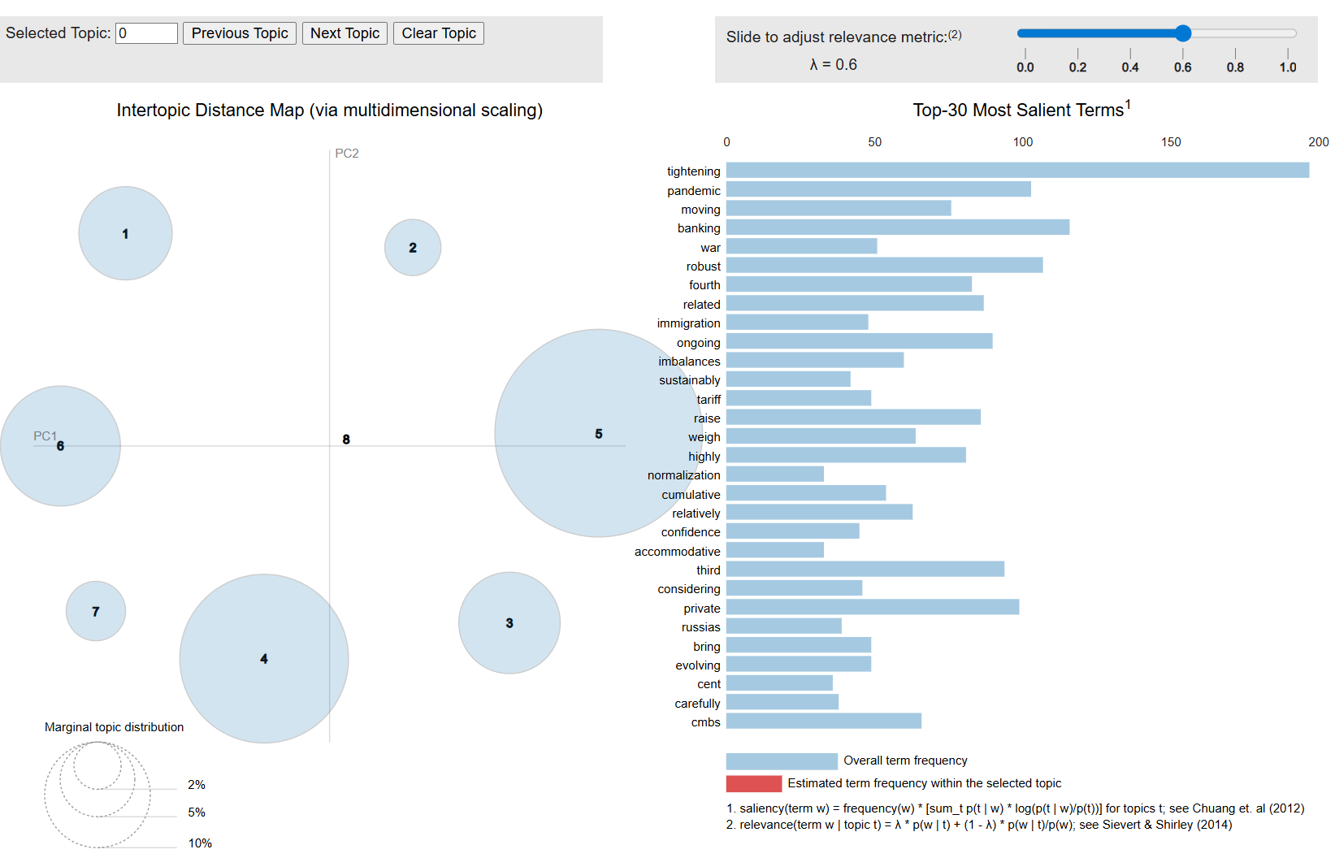
pyLDAvis: Exploring Topic Separation and Vocabulary

Slide 28
pyLDAvis: Exploring Topic Separation and Vocabulary
We can see that Topic 1 is isolated in the top left and serves as evidence that the Covid vocabulary is unique in this corpus, as no other topic uses pandemic.
The central cluster of Topics 3, 4, 5, and 8 truly reflects that several phases of the tightening cycle share a common vocabulary.
The dominant size of Topic 5 confirms the main finding of our entire analysis. Indeed, the Trump 2025 era created a thematic break that occupies more space in the corpus than other event of the period, including the 2022 inflation peak.

Slide 29
Economic Takeaways: What NLP Tells Us About the 2022–2025 Policy Cycle
The biggest finding from the NLP analysis is that LDA detected the narrative pivot 2 to 3 meetings before the first drop in September 2024, with Topic 3 becoming dominant as of January 2024. Another one is that VADER confirms that the Fed's language remains structurally neutral even in a crisis, with only 4 red panels out of 32 meetings.
Some limitations can be that VADER doesn't detect specific topic and words like economic ones and as problem to classify the sentiment. Also, in LDA, word order doesn't exist. The sentence 'inflation risks have decreased' and the sentence 'risks of decreased inflation' produce exactly the same tokens for LDA. In FOMC minutes, where the syntactic structure carries a large part of the economic meaning, this loss of information is significant.
To conclude and help those limitations, we can integrate FRED API to automatically calculate correlations between LDA topics and the CPI and rate. But LDA (an unsupervised model) identified the four acts of the 2022/2025 cycle that economists later identified.

