Slide 1
DM-Lab Benchmark Suite
INFO911 Group Project · Data Mining and Knowledge Discovery
Presenter: Louis Shawn Date: 2026-03-04
Local-first Reproducible AI-driven

Slide 2
Agenda
1. Objective and constraints
2. Architecture and workflow
3. Results across 4 data-mining tasks
4. Ablation and error-analysis findings
5. Live demo flow and next steps

Slide 3
Project Framing
Goals
Constraints
• Cover 4 core data-mining tasks • Keep implementation local-first and reproducible • Build demo-friendly dashboard and report automation
• 99% AI-driven delivery • Prefer simplicity over infra complexity • Maintain enough depth for strong grading • Package policy: pacman > uv > pip

Slide 4
System Architecture
CLI / Scripts
Data Layer (download + clean)
Task Pipelines (4 tasks)
Reports + Dashboard
Main modules: src/dm_lab/{data,tasks,report,pipeline} + app/Home.py
One-command workflow: run -> ui -> test (shell scripts for Linux/Windows)

Slide 5
Task Coverage and Datasets
Datasets • Classification: Adult Income • Clustering: Wholesale Customers • Association: Online Retail (+ fallback) • Anomaly: Credit Card Fraud (OpenML)
Primary Metrics • Classification: F1 / ROC-AUC • Clustering: Silhouette / Davies-Bouldin • Association: Support / Confidence / Lift • Anomaly: PR-AUC / Recall@k / F1
All runs auto-generate metrics.csv, summary.json, summary.md, and final_report.md

Slide 6
Quick Run Results
Task | Primary Metric | Value | Normalized Score
Classification | f1 | 0.9670 | 96.7%
Clustering | silhouette | 0.7364 | 86.8%
Association | lift | 2.5000 | 25.0%
Anomaly | pr_auc | 1.0000 | 100.0%

Slide 7
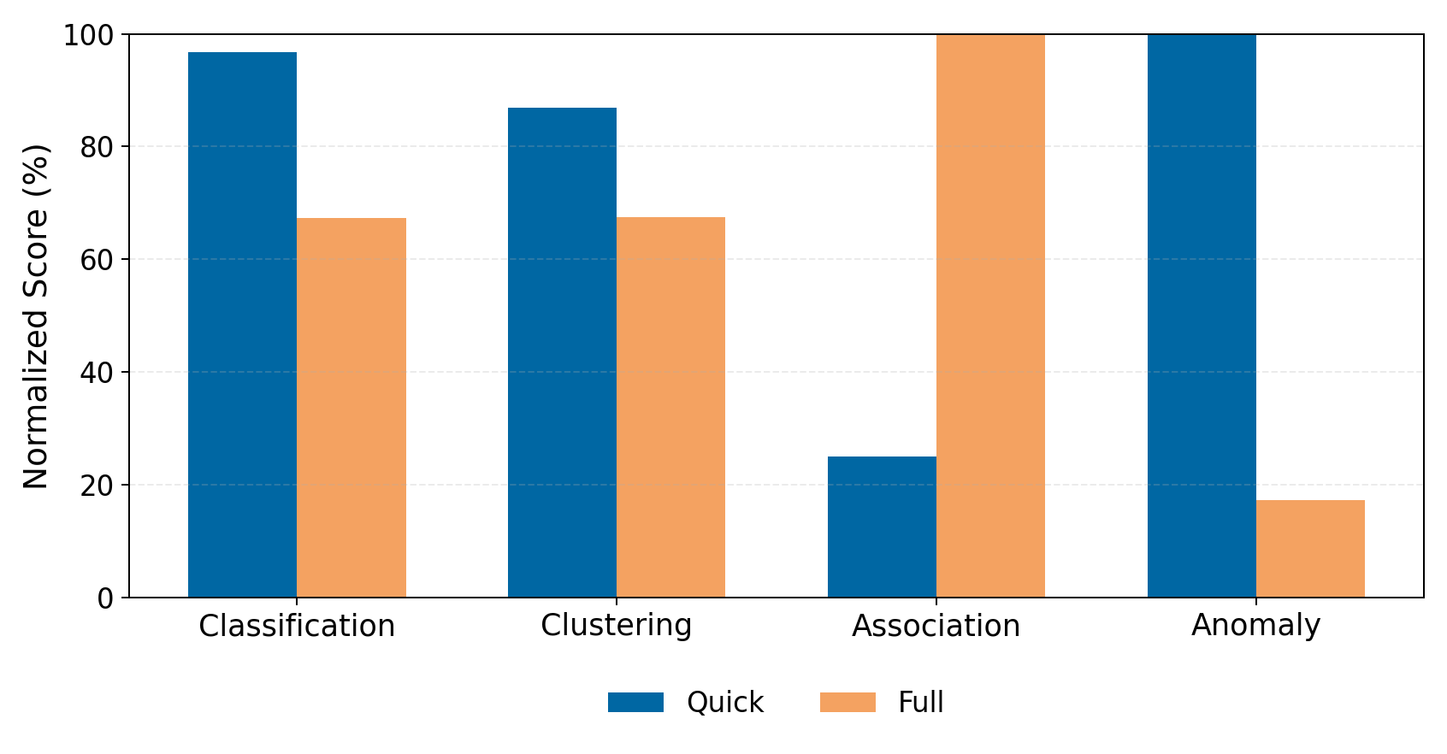
Quick vs Full Comparison
Normalized score makes different task metrics comparable in one chart.

Slide 8
Task Highlights for Presentation
Classification
Clustering
Strong precision/recall balance. Use ROC-AUC as backup signal.
Explain cluster quality by silhouette + Davies-Bouldin.
Association
Anomaly
Lift-driven business story. Show 1-2 intuitive rules.
Use PR-AUC under imbalance. Discuss Recall@k tradeoff.

Slide 9
Ablation and Error Analysis
Ablation directions • Classification threshold + class-weight tuning • K-value sweep for clustering • support/confidence sweep for association • contamination/top-k tuning for anomaly
Error analysis mindset • Inspect metric regressions task-by-task • Compare quick/full deltas for stability • Keep deterministic seed for reproducibility • Document failure cases in final report
Message for examiner: the pipeline is intentionally lightweight in engineering, but deep enough in experiment design and analysis to meet grading expectations.

Slide 10
Live Demo Flow
1) ./scripts/dev.sh run 2) ./scripts/dev.sh ui 3) Show: Overview -> Task Explorer -> Demo Script 4) Open reports/final_report.md for narrative 5) Discuss next-step experiments
Q&A Why this project is high-value: • broad task coverage • reproducible workflow • clear evaluation and reporting

Slide 11
DM-Lab Benchmark Suite
Thank you
Repository: github.com/LouisLau-art/dm-lab-benchmark-suite

