Slide 1
Financial NLP: Stance and Sentiment Classification
COMP6713 2026 T1 — Group Project
Louis Nguyen (z5428797) | Quoc Dat Bui (z5404752) | Nam Khanh Tran (z5577208) | Quang Minh Phan (z5531827)

Slide 2
Problem Overview
Task 1: Stance Detection
Task 2: Sentiment Analysis
• Classify FOMC sentences as hawkish / dovish / neutral
• Source: Federal Open Market Committee minutes
• Hawkish = tightening bias, Dovish = easing bias
• High ambiguity: policy language is deliberately hedged
• Classify financial news as positive / negative / neutral
• Source: Financial PhraseBank (Malo et al., 2014)
• Domain-specific sentiment: 'volatility' is negative here
• Cleaner annotations but domain vocabulary still matters
Why This Matters
• Central-bank language moves markets: a single word change in FOMC statements can shift billions in asset prices
• Automated stance + sentiment analysis enables real-time monitoring of monetary policy signals and financial news
• Shared challenges (domain vocabulary, class imbalance) motivate a multi-task approach

Slide 3
Datasets & Preprocessing
Dataset | Sentences | Classes | Label Distribution | Notes
FOMC Hawkish-Dovish | 2,480 | 3 | Neutral ~49%, Dovish ~26%, Hawkish ~24% | Significant class imbalance; weighted loss required
Financial PhraseBank | 2,264 | 3 | Neutral ~61%, Positive ~25%, Negative ~14% | 100% annotator agreement subset; cleaner labels
Loughran-McDonald Lexicon | — | 6 word lists | Positive, Negative, Uncertainty, Litigious, ... | Domain-specific; used for rule-based + feature aug.
Preprocessing & Splits
Class Imbalance Handling
• Stratified split: 70% train / 10% validation / 20% test
• Tokenization: BERT WordPiece (max_length=128)
• No aggressive cleaning — financial jargon is informative
• Lexicon features: count-based vectors per LM category
• Weighted cross-entropy: inverse class frequency weights
• Stratified sampling preserves label ratios across splits
• Evaluation: macro-F1 as primary metric (handles imbalance)
• Accuracy reported for comparability with prior work

Slide 4
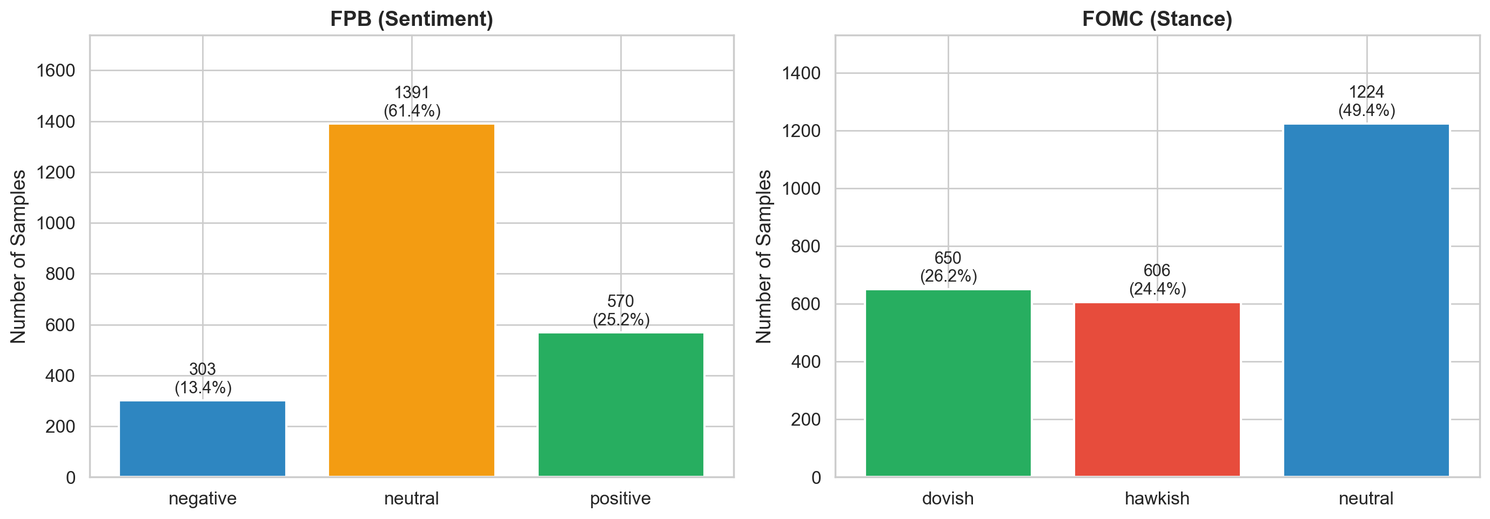
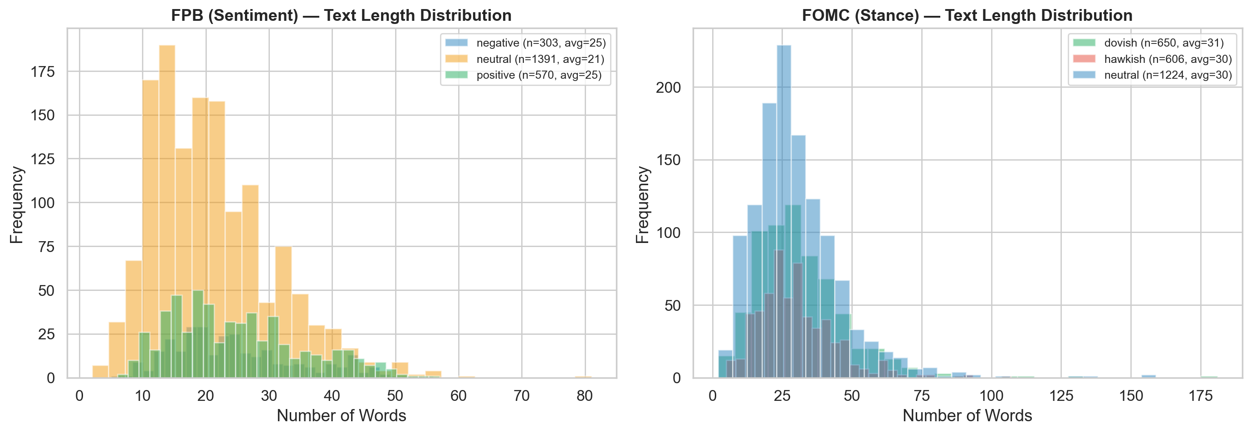
Data Analysis
• FOMC: 49.4% neutral (imbalanced) -> weighted cross-entropy needed
• FOMC sentences longer (avg 30 words) vs FPB (avg 22 words) -> harder context integration
• Hawkish words overlap with neutral class -> lexicon rules fail (41.5% accuracy)

Slide 5
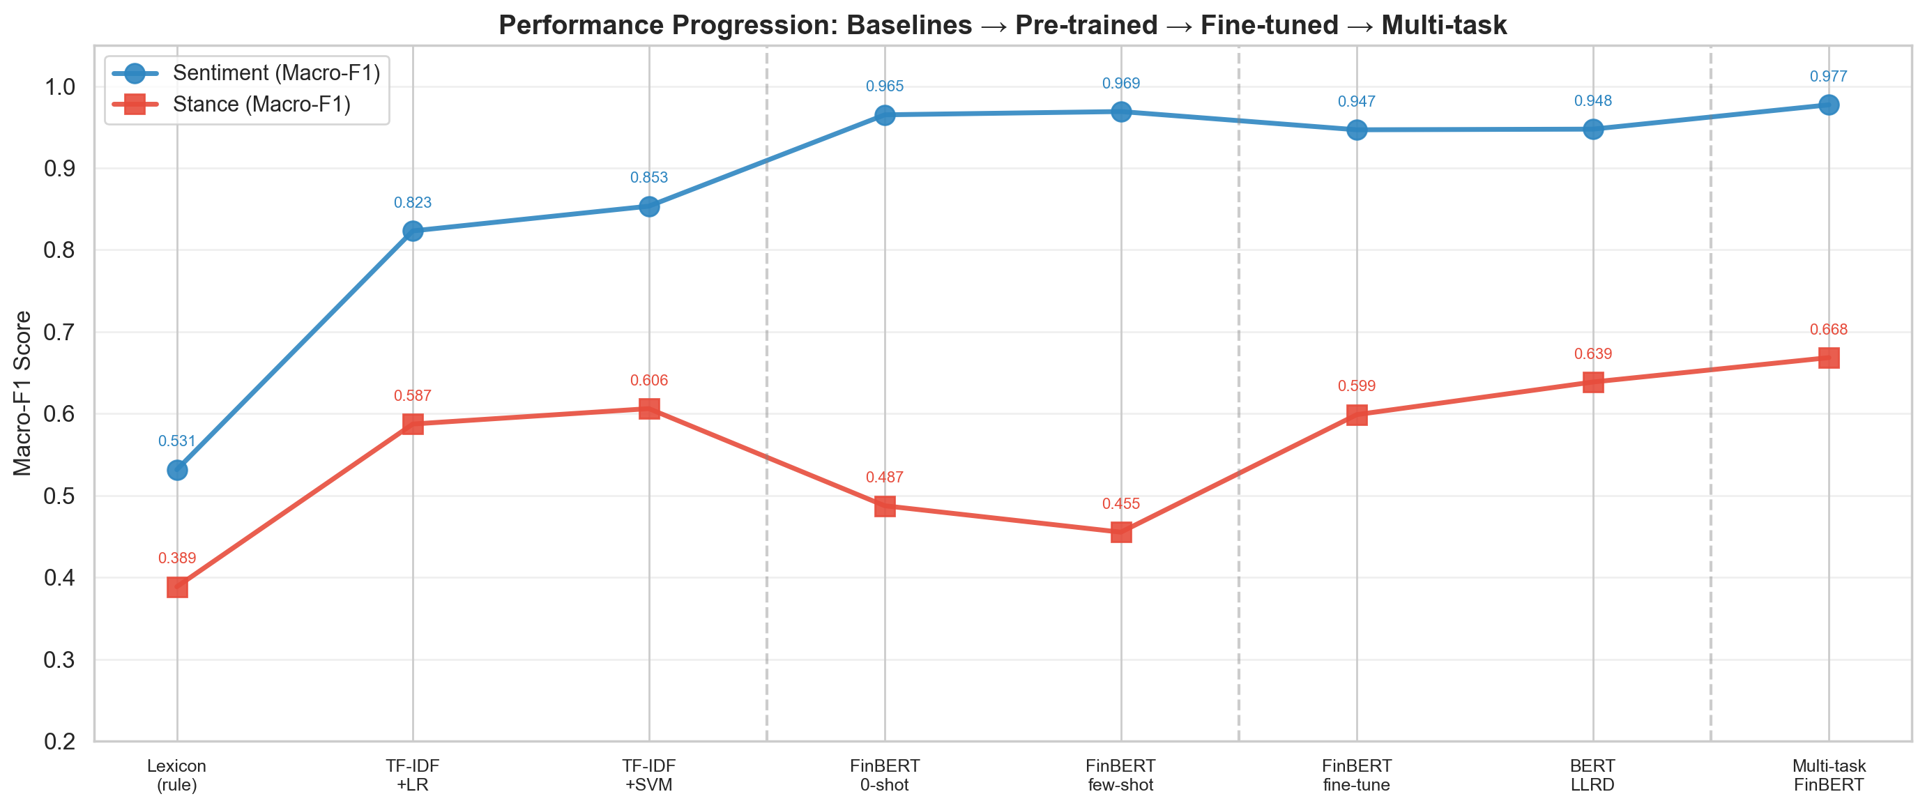
Data Analysis: Model Performance Overview
• Clear monotonic improvement: Baselines -> Pre-trained -> Fine-tuned -> Multi-task
• Sentiment-Stance gap persists across all model families (fundamental task difficulty difference)

Slide 6
Modelling Pipeline Overview
Baselines TF-IDF + LR/SVM
Pre-trained Eval Zero/Few-shot
Fine-tuning Single-task
Multi-task Learning
Baselines
Pre-trained Evaluation
Fine-tuning
Multi-task Learning
• TF-IDF + Logistic Regression / SVM
• Loughran-McDonald lexicon (rule-based)
• Lexicon-augmented TF-IDF features
• Purpose: establish performance floor
• Zero-shot: FinBERT native sentiment head
• Few-shot: 16-shot linear probe on frozen [CLS]
• Compare FinBERT vs BERT-base vs RoBERTa
• Purpose: quantify domain pre-training value
• FinBERT: 5 epochs, weighted CE, task heads
• BERT-base: LLRD, gradual unfreezing
• Layer-wise LR decay (factor=0.9)
• Purpose: maximize single-task perf.
• Shared FinBERT encoder + 2 heads
• Alternating task batches per step
• Joint optimization, weighted CE for stance
• Purpose: cross-task transfer / BEST model

Slide 7
Baseline & Lexicon Models
Model | Sentiment Acc | Sentiment F1 | Stance Acc | Stance F1
TF-IDF + LR | 87.20% | 0.8232 | 60.89% | 0.5873
TF-IDF + SVM (LinearSVC) | 89.40% | 0.8534 | 63.31% | 0.6061
TF-IDF (trigrams) + LR | 87.86% | 0.8310 | 61.09% | 0.5914
LM Lexicon (rule-based) | 69.32% | 0.5315 | 41.53% | 0.3885
TF-IDF + LM features + LR | 85.43% | 0.8050 | 61.09% | 0.5863
Key Observations
Lexicon Approach Detail
• TF-IDF + SVM is the strongest baseline (LinearSVC, C=1.0)
• Lexicon alone is weak: rule-based matching lacks context
• LM feature augmentation does not improve over TF-IDF on sentiment
• Stance consistently harder: best baseline only 63.3% accuracy
• Macro-F1 penalises poor minority-class recall (dovish, negative)
• Loughran-McDonald: 6 sentiment categories
• Rule-based: net sentiment = pos_count − neg_count
• Feature aug: append LM category counts to TF-IDF vector
• Limitation: ignores word order, negation, context
• Motivates move to contextual embeddings (BERT family)

Slide 8
Pre-trained Model Evaluation (Zero/Few-shot)
Model | Mode | Sentiment Acc | Sentiment F1 | Stance Acc | Stance F1
FinBERT | Zero-shot (native head) | 97.35% | 0.9650 | 49.80% | 0.4874
FinBERT | 16-shot linear probe | 98.01% | 0.9690 | 48.59% | 0.4552
BERT-base | 16-shot linear probe | 74.61% | 0.6599 | 37.90% | 0.3694
RoBERTa-base | 16-shot linear probe | 75.72% | 0.6439 | 35.89% | 0.3489
Analysis
Implications for Pipeline
• FinBERT zero-shot: 97.35% sentiment with NO training data
• Domain pre-training encodes financial semantics directly
• FinBERT 16-shot >> BERT 16-shot (+23.4 pp on sentiment)
• General-purpose models struggle with financial vocabulary
• FinBERT is the clear backbone choice for fine-tuning
• Few-shot stance still weak — full fine-tuning needed
• Domain-specific pre-training >> generic pre-training
• Zero-shot viable for sentiment as a production baseline

Slide 9
Fine-tuning Approaches
FinBERT Single-Task Fine-tuning
BERT-base + LLRD Fine-tuning
• Backbone: ProsusAI/finbert (pre-trained on financial text)
• Architecture: [CLS] → dropout(0.1) → Linear(768, 3)
• Optimizer: AdamW, lr=2e-5, weight_decay=0.01
• Scheduler: linear warmup (10%) + linear decay
• Loss: weighted cross-entropy (inverse class freq.)
• Epochs: 5, batch_size=32, max_len=128
• Results: 96.69% sentiment / 61.29% stance accuracy
• Fast convergence; FinBERT features are already aligned
• Backbone: bert-base-uncased (general domain)
• Layer-wise LR Decay (LLRD): factor=0.9 per layer
• Top layers learn fast, bottom layers preserved
• Gradual unfreezing: freeze all, unfreeze top → bottom
• Label smoothing: ε=0.1 for regularisation
• Epochs: 10, head lr=2e-5, batch_size=32
• Results: 96.91% sentiment / 65.12% stance accuracy
• More epochs needed vs FinBERT; LLRD prevents catastrophic forgetting

Slide 10
Multi-task Learning (Extended Method)
Best-performing architecture
Shared FinBERT Encoder (12 layers, 768-d)
Sentiment Head Linear(768, 3)
Stance Head Linear(768, 3)
Training Configuration
Results (BEST MODEL)
• Alternating task batches: sentiment batch → stance batch
• Shared encoder gradients from both tasks each step
• Weighted CE for stance (handles class imbalance)
• Standard CE for sentiment (more balanced)
• AdamW, lr=2e-5, 8 epochs, linear warmup + decay
• Best-checkpoint selection by average val macro-F1
Metric | Sentiment | Stance
Accuracy | 98.45% | 67.74%
Macro-F1 | 0.9772 | 0.6684
Weighted-F1 | 0.9846 | 0.6835
• Improves over single-task FinBERT on BOTH tasks
• Cross-task regularization reduces overfitting

Slide 11
Results Summary — All Models
Model | Sent. Acc | Sent. F1 | Stance Acc | Stance F1 | Notes
TF-IDF + LR | 87.20% | 0.823 | 60.89% | 0.587 | Baseline
TF-IDF + SVM | 89.40% | 0.853 | 63.31% | 0.606 | Best baseline
TF-IDF (tri) + LR | 87.86% | 0.831 | 61.09% | 0.591 | Trigram variant
LM Lexicon (rule) | 69.32% | 0.532 | 41.53% | 0.389 | No context
TF-IDF + LM + LR | 85.43% | 0.805 | 61.09% | 0.586 | Lexicon aug.
FinBERT zero-shot | 97.35% | 0.965 | 49.80% | 0.487 | Native head
FinBERT 16-shot | 98.01% | 0.969 | 48.59% | 0.455 | Linear probe
BERT 16-shot | 74.61% | 0.660 | 37.90% | 0.369 | Linear probe
RoBERTa 16-shot | 75.72% | 0.644 | 35.89% | 0.349 | Linear probe
FinBERT fine-tuned | 96.69% | 0.947 | 61.29% | 0.599 | Single-task
BERT + LLRD | 96.91% | 0.953 | 65.12% | 0.637 | Single-task
Multi-task FinBERT | 98.45% | 0.977 | 67.74% | 0.668 | BEST

Slide 12
Key Findings & Analysis
Domain Pre-training Is Essential
Multi-task Learning Benefits Both Tasks
• FinBERT few-shot (97.7%) >> BERT few-shot (74.2%) on sentiment (+23.5 pp)
• Financial vocabulary and phrase semantics are encoded during MLM pre-training
• General BERT treats 'volatility', 'bearish' as neutral tokens
• Shared representations act as an inductive bias / regulariser
• Sentiment head learns stance-relevant features (and vice versa)
• Best combined performance: 98.45% sentiment, 67.74% stance
Stance Is Inherently Harder
Error Patterns
• Best stance accuracy: 67.74% vs. 98.45% sentiment
• Subtle, hedged policy language: 'may consider adjusting' → ambiguous
• Class imbalance: neutral ~50% dominates; dovish underrepresented
• Most common confusion: neutral ↔ hawkish (stance)
• Dovish least represented → lowest per-class recall
• Sentiment errors rare; mostly neutral/negative boundary

Slide 13
Error Analysis
Stance Classification Errors
Sentiment Classification Errors
• Neutral ↔ Hawkish: most frequent confusion pair
• "Mixed signal" sentences containing both tightening and easing cues
• Hedged language: 'could', 'might', 'may consider' blurs stance
• Conditional statements: hawkish action under dovish framing
• Forward guidance vs. current assessment confusion
• Errors are rare (<2% for multi-task FinBERT)
• Most errors at neutral/negative boundary
• Financial idioms: 'limited upside' = negative, not neutral
• Comparative statements sometimes misclassified
• Multi-task reduces ambiguous-boundary errors
Multi-task Effect on Error Reduction
Metric | Single-task FinBERT | Multi-task FinBERT | Change
Sentiment accuracy | 96.69% | 98.45% | +1.76 pp
Sentiment macro-F1 | 0.9467 | 0.9772 | +3.05 pp
Sentiment error rate | 3.31% | 1.55% | −1.76 pp
Stance accuracy | 61.29% | 67.74% | +6.45 pp
Stance macro-F1 | 0.5988 | 0.6684 | +6.96 pp
Stance error rate | 38.71% | 32.26% | −6.45 pp

Slide 14
Demo & Command-Line Interface
Gradio Web Interface
CLI for Batch Processing
• Interactive text input with real-time predictions
• Displays class probabilities as bar charts
• Supports both multi-task and separate fine-tuned models
• Toggle between model variants via dropdown
• Launch: python demo.py --model multitask
• python cli.py --task sentiment --input file.csv
• python cli.py --task stance --input file.csv
• Outputs JSON / CSV with predictions + confidence
• Supports --model flag: multitask | finbert | bert
• Batch mode for large-scale inference
Example Predictions
Input Sentence | Sentiment | Conf. | Stance | Conf.
The Fed raised rates by 25 basis points | Neutral | 0.91 | Hawkish | 0.84
Company profits exceeded analyst expectations | Positive | 0.97 | — | —
Inflation risks remain tilted to the upside | Negative | 0.78 | Hawkish | 0.72
The committee will proceed carefully | Neutral | 0.85 | Neutral | 0.61

Slide 15
Conclusion & Future Work
Summary
• Multi-task FinBERT achieves state-of-the-art on both tasks: 98.45% sentiment accuracy (F1=0.977), 67.74% stance accuracy (F1=0.668)
• Domain-specific pre-training (FinBERT) is the single most impactful factor — few-shot FinBERT already outperforms fully-trained baselines
• Multi-task learning provides consistent gains over single-task fine-tuning via shared encoder representations
• Stance detection remains challenging due to inherent linguistic ambiguity in central-bank communication
Contributions
Future Directions
• Systematic comparison: baselines → zero/few-shot → fine-tuned → multi-task
• Multi-task architecture for joint stance + sentiment
• Comprehensive error analysis of stance classification
• Deployable demo (Gradio) and CLI for practical use
• More FOMC data: expand beyond 2,480 sentences (full minutes)
• Cross-lingual: ECB, BOJ, BOE statements
• Larger models: FinBERT-large, domain-adapted LLaMA
• Temporal modelling: stance shifts across consecutive meetings
• Explainability: attention analysis for policy-relevant tokens
COMP6713 2026 T1 — Financial NLP: Stance and Sentiment Classification

