Slide 1
Capstone Find the best neighborhood in Toronto to open a GROCERY Store
Applied Data Science Capstone
IBM Data Science Professional Certificate

Slide 2
Introduction
A small Grocery Store called Blenco has been doing well for some years now and want to expand and create other outlets across the state and are trying to determine which neighborhood in Toronto they should to start with.

Slide 3
Problem Description
Problem Statement
Which neighborhood should Blenco open their new Grocery store in Toronto?
Conditions
1.) The store needs to be located in a strategic area in Toronto region that is close to residential Estates and Schools
2.) Confirm any assumption by means of modeling and testing the data.
3.) To ensure that people have easy access to the store and it's in a safe neighborhood
a.) Is it a highly populated neighborhood?
b.) The average salary has to be equal to or greater than the Canadian National Average to show the purchasing power of people in the neighborhood
4.) Locating a new store according to the above conditions will ensure the following:
i. Easy access for customers as it is within residential Estates
ii. Increase in sales and number of customers
iii. Increase in weekend customers due to close proximity with residential areas.

Slide 4
DATA REQUIREMENTS
1.) This is a list from Wikipedia of Toronto neighborhoods broken down according to the postal code https://en.wikipedia.org/wiki/List_of_postal_codes_of_Canada:_M
2.) List of the average population in Toronto neighborhoods by postal code https://www12.statcan.gc.ca/census-recensement/2016/dp-pd/hlt-fst/pd-pl/Tables/File.cfm?T=1201&SR=1&RPP=9999&PR=0&CMA=0&CSD=0&S=22&O=A&Lang=Eng&OFT=CSV
3.) List of average income after Tax deductions in Toronto neighborhoods according to postal code. https://www12.statcan.gc.ca/census-recensement/2016/dp-pd/prof/search-recherche/change-geo.cfm?Lang=E&Geo1=FSA
4.) This is the National Average Income after Tax in Canada by Postal code https://www150.statcan.gc.ca/n1/daily-quotidien/180313/dq180313a-eng.htm
5.) Here we can get the list of all Grocery Stores from all neighborhoods in Toronto by Postal code using the foursqaure API https://api.foursquare.com
6.) Put all of these information into a workable Data Set for clustering and for Geo-Spatial mapping of the results showing the best neighborhood to open a Grocery Store
Combining all of these data sets will result the following:
a. The neighborhoods in Toronto have clusters of stores
b. The population of every neighborhood
c. The average income after tax per person in these neighborhoods
d. What neighborhood should be targeted by Blenco in order to open a new store.

Slide 5
METHODOLOGY
Algorithm
K-Means Clustering https://towardsdatascience.com/clustering-algorithms-for-customer-segmentation-af637c6830ac
Choosing the correct number of clusters
use Silhouette analysis to determine the optimum number of clusters to use. https://www.jeremyjordan.me/grouping-data-points-with-k-means-clustering/
Run K means and segment data into clusters and generate labels
Merge the Toronto data with geo coordinates data and make sure it's the right shape
Reshape the Toronto data in order for it to match the clustered data
Add the KMeans Labels
Determine the largest cluster in this case it was cluster number 2 with a shape of (76, 15)
Cluster 2 Contains the highest cluster density. We need to find the geographic centroid for this cluster. This is the optimum location for a new Grocery Store.
Here we take the average latitude and longitude to be the centroid.
Install opencage to reverse lookup the coordinates

Slide 6
Methodology cont’d:
Choosing the correct number of clusters.
https://www.jeremyjordan.me/grouping-data-points-with-k-means-clustering/ Use Silhouette analysis to determine the optimum number of clusters to use.
A backgrounder on Silhouette analysis.
“We can use Silhouette analysis to evaluate each model. A Silhouette coefficient is calculated for observation, which is then averaged to determine the Silhouette score. The coefficient combines the average within-cluster distance with average nearest-cluster distance to assign a value between -1 and 1. A value below zero denotes that the observation is probably in the wrong cluster and a value closer to 1 denotes that the observation is a great fit for the cluster and clearly separated from other clusters. This coefficient essentially measures how close an observation is to neighboring clusters, where it is desirable to be the maximum distance possible from neighboring clusters. We can automatically determine the best number of clusters, k, by selecting the model which yields the highest Silhouette score.”

Slide 7
Methodology cont’d
Cluster 2 Contains the highest cluster density. We need to find the geographic centroid for this cluster. This is the optimum location for a new Store.
Here we take the average latitude and longitude to be the centroid.
Install opencage to reverse lookup the coordinates
Opencage allows me to reverse lookup the geo coordinates.

Slide 8
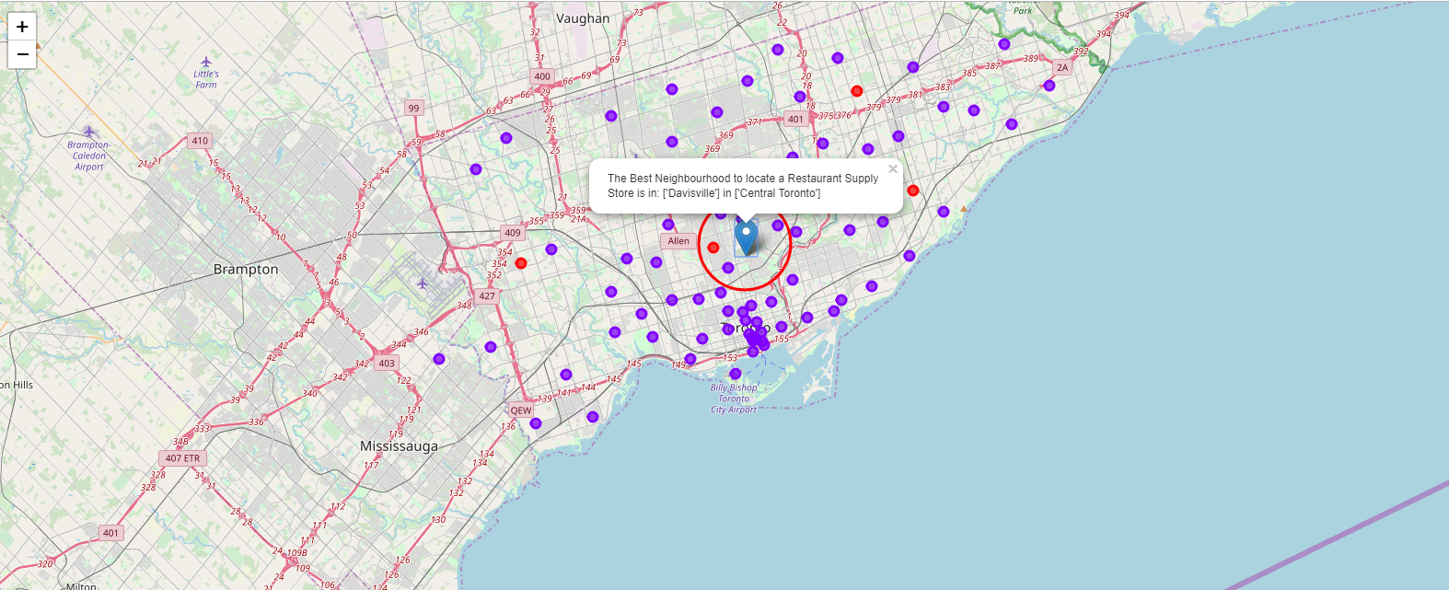
RESULTS
Plot the clusters on a Map of the Toronto and Super Impose the best location of a Store

Slide 9
OBSERVATIONS
By comparing our list of neighborhoods with Grocery store locations, it was discovered that most neighborhoods were similar and the greatest concentration of stores are in Central Toronto and downtown Toronto regions respectively. This might seem obvious but it would also appear that these are some of the most respected and safe neighborhoods in Toronto so it is correlation with the objective. By opening a store in the general premises of the exact location Blenco would be geographically centered in this cluster and assured to cater to a large amount of customers with optimum efficiency.
Building our our K-Means dataset using Silhouette analysis, tells us there is a lot of similarity between neighborhoods and the most common stores contained with in. Really there is only 2 types of clusters or neighborhoods in greater Toronto. The vast majority of them are in 1 cluster. So Toronto Grocery stores might be many but they are very similarly located near the center of Toronto.
Out of the 103 Toronto Neighborhoods gathered only 55.3% or 57 Neighborhoods are above the median income after tax. 37.8% or 39 Neighborhoods are below this median 6.7% or 7 neighborhoods did not register as it seems their populations are quite low. It shows that the greatest concentration of wealthy people are in central Toronto. Blenco can keep all neighborhoods in the dataset regardless of income of population as the majority were close enough.

Slide 10
CONCLUSION
With a high degree of confidence from the observations above as it is backed up by data, while one can ever be 100% certain Blenco will definitely be better informed on how to go about opening their new store

