Slide 1
HackAI
Explainable AI for HR retention
Talk flow
A decision-support prototype to identify attrition risk, explain key drivers, and suggest preventive actions.
Problem & HR pain point
Approach & explainable scoring logic
Live demo of the website
Trusted AI safeguards, limits, roadmap
Oral defense
Positioning: AI assists HR; it does not replace HR decisions.
Hackathon with Capgemini
ESILV A4
Team members : MEGHAGHI, DEVARAJ, PIROT, KOCH and HASSON
Notes:
[Sources] - Repository README: https://github.com/LouisPir/HackAI (overview, objective, approach, limitations) [/Sources]

Slide 2
1. Problem, target user, and value proposition
Problem
Target user
Our answer
Turnover is costly and disruptive for teams.
HR often reacts too late to weak signals.
Raw HR tables do not clearly show who needs attention first.
HR manager or HRBP.
Needs fast prioritization, not a black-box model.
Needs actionable explanations for each employee.
A local web app that scores attrition risk.
Per-employee explanations + recommendations.
Portfolio and analytics views for proactive retention.
Notes:
[Sources] - Repository README: https://github.com/LouisPir/HackAI (problem context, target use, objective) [/Sources]

Slide 3
2. Reasoning and solution approach
HR dataset
→
Feature preparation
→
Rule-based score
→
Explanation + recommendation
Why this approach?
Main inputs used
What the HR sees
Simple enough for HR users to understand.
Fast to demo and iterate in a hackathon.
Aligned with explainability by design.
Examples: salary, absences, satisfaction, performance, engagement.
Signals are converted into an interpretable risk score.
A percentage of departure risk.
Key drivers behind the score.
Suggested preventive actions.
Notes:
[Sources] - Repository README: https://github.com/LouisPir/HackAI (technical structure, scoring logic in frontend, examples of variables) [/Sources]

Slide 4
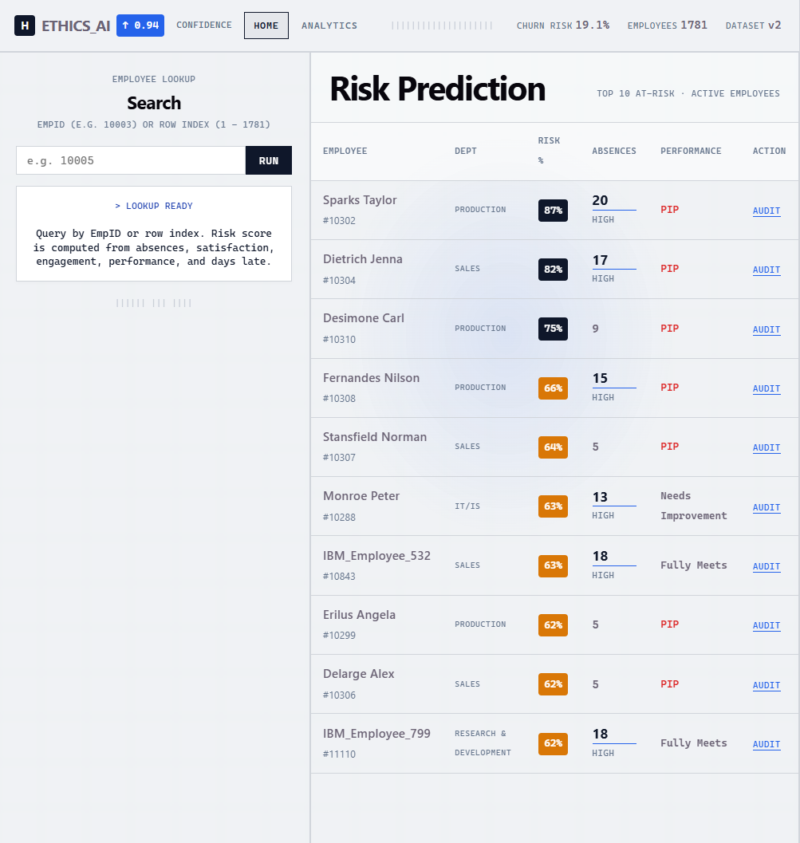
3. Product demo guide
Notes:
[Sources] - Repository README: https://github.com/LouisPir/HackAI (employee search, risk score, explanations, recommendations, analytics page) [/Sources]

Slide 5
4. Trusted AI: strengths, limits, safeguards
Strengths
Limits
Safeguards
Explainable by construction.
Useful for prioritization and discussion.
Human validation remains central.
The prediction model may return results that are slightly different from reality because the dataset is quite small.
Not suitable for automated HR decisions.
Use as decision support only.
Audit data quality, bias, and subgroup effects.
Control access and document governance.
Notes:
[Sources] - Repository README: https://github.com/LouisPir/HackAI (limitations, responsible AI and next steps) [/Sources]

Slide 6
5. Conclusion and roadmap
Key message
Next improvements
Backend + secure authentication
Model validation and calibration
Fairness audit across employee groups
SHAP/LIME-style explanations if moving to ML
Governance: logging, review workflow, access control
HackAI shows how an explainable prototype can help HR teams move from reactive retention to earlier, more structured action.
Not a final HR decision engine - a transparent and useful starting point.
Notes:
[Sources] - Repository README: https://github.com/LouisPir/HackAI (next steps) [/Sources]

