Slide 1
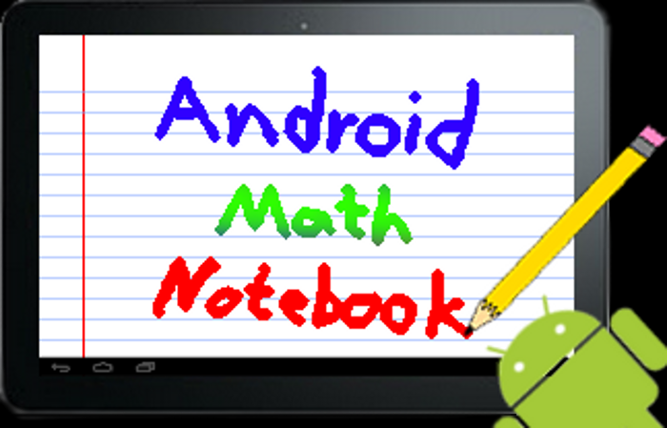
Alex Hunt and Jon Kriss

Slide 2
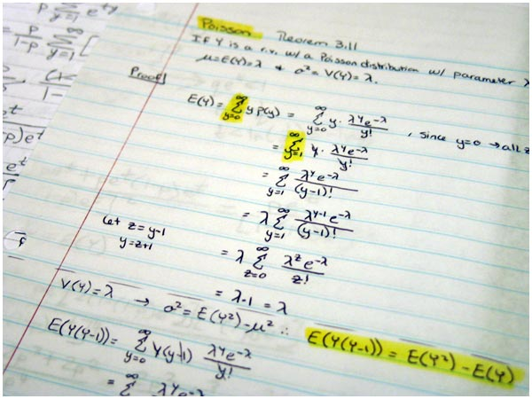
What is Android Math Notebook
Android Tablet App
Electronic Notes
Handwriting
Recognition
Math Mode

Slide 3
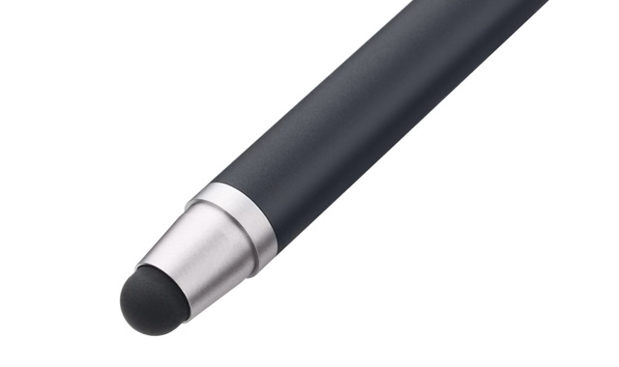
Handwriting Recognition
Libraries Exist
We’re using LipiTK
Supports All Symbols
Trainable
Need to compile for NDK

Slide 4
Math Mode
Create Math Blocks
Edit Math Blocks
Manipulate Blocks
Solve expressions
24y + 38 = 7x
-38 -38
-------------------
24y = 7x - 38
Notes:
Verbose vs Concise Math representation

Slide 5
Other Features
Export Math Blocks as MathML or LaTeX
Search
Export document to other formats
Undo/Redo
Easy Error-Correction
0
o
a

Slide 6
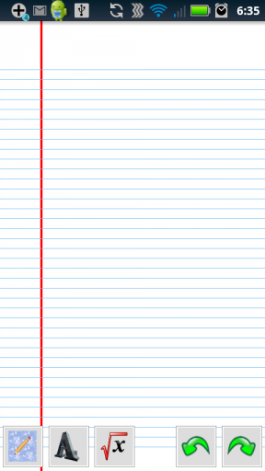
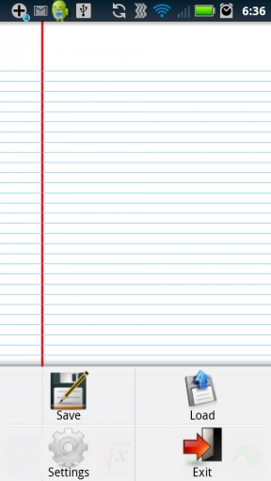
So Far…

Slide 7

Convalot
File Converter Tool
Still Working On
Very Close to Release
Simple Context Menu
Advanced Options
Stability
Ease of Installation

Slide 8
Thanks!
Thanks to…
Moorthy
Sean O’Sullivan
RCOS members
Questions?

