Slide 1
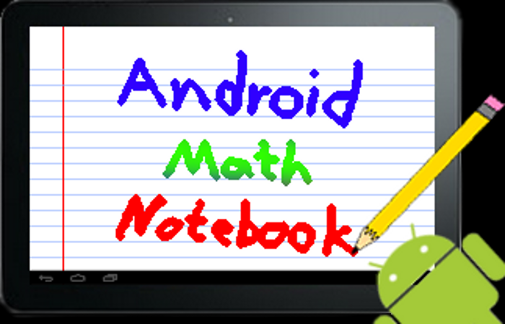
Alex Hunt and Jon Kriss

Slide 2
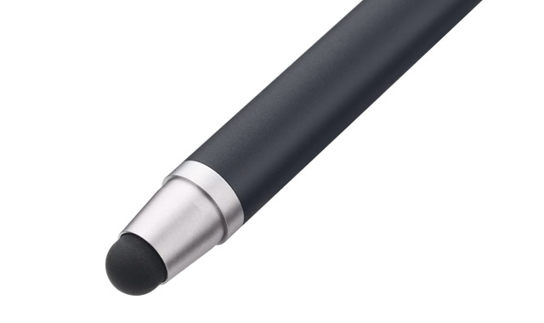
What is Android Math Notebook
Android Tablet App
Electronic Notes
Handwriting Recognition
Special Math Mode

Slide 3
Handwriting Recognition
Libraries Exist
We’re using LipiTK
Supports All Symbols
Trainable
Need to compile for NDK

Slide 4
Math Mode
Create Math Blocks
Edit Math Blocks
Manipulate Blocks
Solve expressions
24y + 38 = 7x
-38 -38
-------------------
24y = 7x - 38

Slide 5
Other Features
Export Math Blocks as MathML or LaTeX
Search
Export to other formats
Undo/Redo

Slide 6
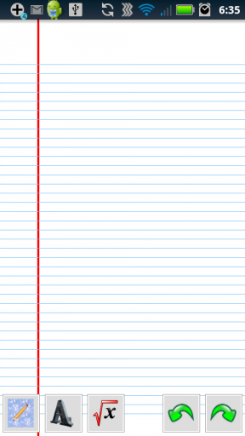
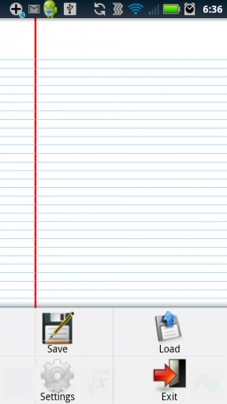
So Far…

Slide 7
Thanks!
Thanks to…
Moorthy
Sean O’Sullivan
RCOS members
Questions?

