Slide 1
Reproduce the “T0: Multitask Prompted Training Enables Zero-Shot Task Generalization” 2022 ICLR
Fengye Tao
fxt200001
Notes:
Hello everyone, good afternoon. my project is a reproduction of the paper “T0: Multitask Prompted Training Enables Zero-Shot Task Generalization.” Before diving into my work, I’d like to give a quick recap of what this paper is about.

Slide 2
The Research Question
Can zero-shot generalization instead be directly induced by explicit multitask learning instead of Implicit multitask learning ?
To achieve this, A pretrained encoder-decoder model, T5(Text-to-Text Transfer Transformer), is then fine-tuned on this multitask mixture.
Notes:
First the research question.
The research question the authors want to explore is: “Can zero-shot generalization be directly induced by explicit multitask learning instead of implicit multitask learning?”
As you know, the success of large language models has been largely attributed to implicit multitask learning, right? So here, the authors want to find out whether explicit multitask learning can achieve the same kind of generalization.
To test this, they fine-tuned a T5 model on a mixture of tasks and then evaluated its zero-shot performance on tasks it hadn’t seen during training.

Slide 3
Multitasks, Prompts with diverse wording
T5+LM(11B)
T0,T0p,T0pp(11B)
T0_3B
Notes:
This is the conceptual diagram from the paper.
Left side is the model authors use. They started with a LM adapted T5 model, and fine-tuned it using a multitask mixture combined with multiple prompts—to encourage diverse understanding.
On the right, you can see the resulting models:
T0, T0+, and T0++ are all 11-billion parameter models.
T0_3B is a smaller distilled version with 3 billion parameters.

Slide 4
Prompting Strategy
A large set of supervised datasets are converted such that each sample is with multiple prompts with diverse wording. These prompted datasets allow for benchmarking the ability of a model to perform completely held-out tasks.
Prompt Templates, promptsource:
Utilized multiple prompt formats per dataset to enhance robustness.
Developed a templating system for converting datasets into natural language prompts.
Public Pool of Prompts (P3):
Collected 2,073 prompts across 177 datasets.
Encouraged community contributions to diversify prompt styles.
Notes:
A large set of supervised datasets are converted such that each sample is with multiple prompts with diverse wording. These prompted datasets allow for benchmarking the ability of a model to perform completely held-out tasks.
To standardize inputs, they developed a system of prompt templates and also encouraged community contributions to diversify prompt styles.

Slide 5
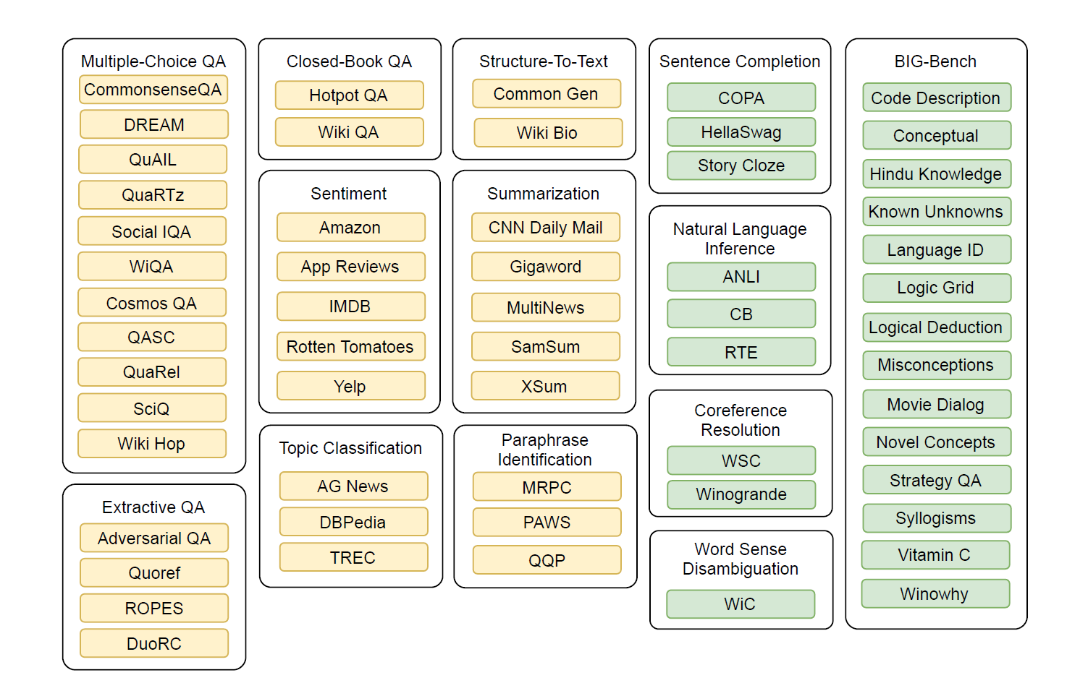
Datasets & Evaluation Strategy
Notes:
Training Data:
They used 12 NLP tasks encompassing 62 datasets.
Excludes non-English and specialized domain datasets.
Evaluation Strategy:
Held out entire tasks like NLI, coreference resolution, sentence completion, and word sense disambiguation to test zero-shot generalization.

Slide 6
My work
Part 1: Reproduce Inference and Evaluation
Run locally on NVIDIA RTX 4050
Use T0_3B, the distilled model from the original paper
Part 2: Reproduce Fine-Tuning on 3 Datasets
Use T5-small (60 million)
Fine-tune on super_glue (copa, wsc.fixed),winogrande(winogrande_xl)
Compare performance of finetuned T5-small vs. T0_3B
Notes:
One of the main challenges I ran into was the environment setup. The original paper was developed in Python 3.7, but if you're using Python 3.11 — which is what Colab uses now — you’ll run into compatibility issues. On top of that, Python 3.7 isn’t fully compatible with the latest versions of PyTorch and CUDA. So for my local setup, I went with Python 3.9 to balance compatibility.
What’s even more confusing is that some Colab runtimes, like those with L4 GPUs, can install the promptsource package successfully... but sometimes they just don’t. It’s pretty inconsistent.
So for the first part of my project, I decided to reproduce the inference and evaluation portion of the paper on my local computer. My GPU is an RTX 4050, so I used the T0_3B model, which is a distilled version created by the authors. The full T0 model is too large — it can’t even run on my machine.
[Run the inference part in virtual environment] [Show the result of evaluation]
Even with the smaller model, the evaluation took around 3 hours in total,
For the second part — finetune with promt templates— it’s not really feasible to train a model as large as T0, which has 11 billion parameters. So I switched to T5-small, which only has about 60 million parameters. It’s much more manageable.
Even then, training it on Google Colab with an L4 GPU took nearly 4 hours to complete.

Slide 7
Reference
Multitask Prompted Training Enables Zero-Shot Task Generalization T0, by Numerous Organizations 2022 ICLR, Over 500 Citations
Review — T5: Text-to-Text Transfer Transformer | by Sik-Ho Tsang | Medium
Brief Review — T0: Multitask Prompted Training Enables Zero-Shot Task Generalization | by Sik-Ho Tsang | Medium

