Slide 1

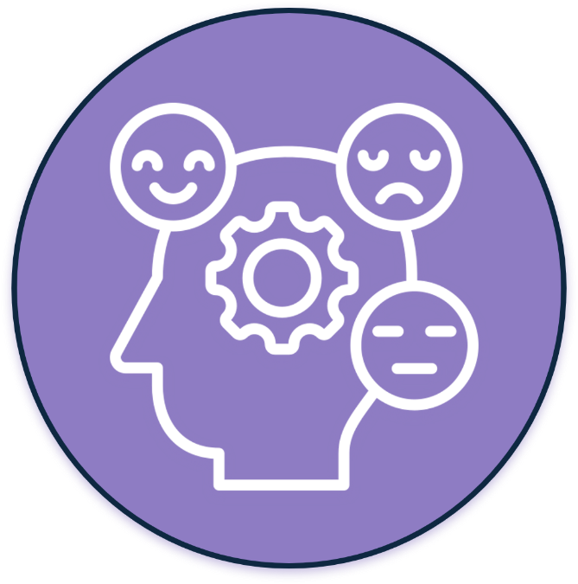
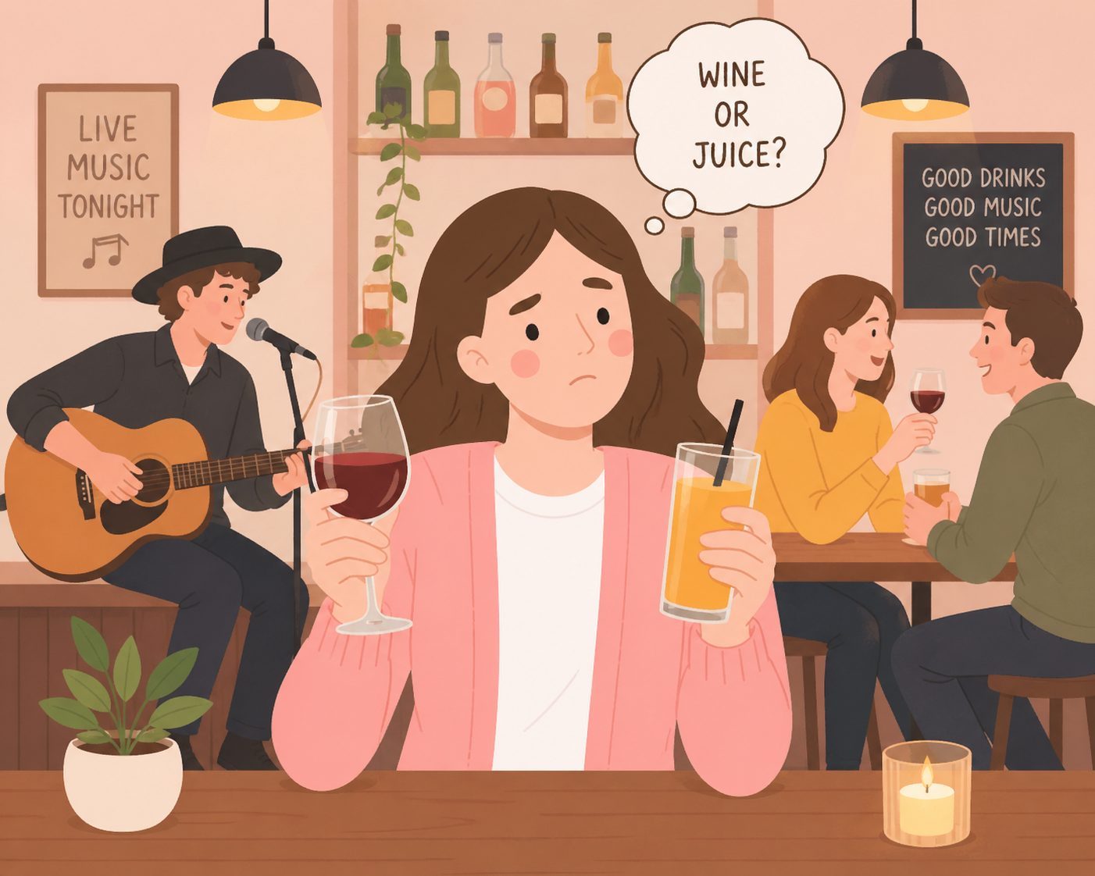
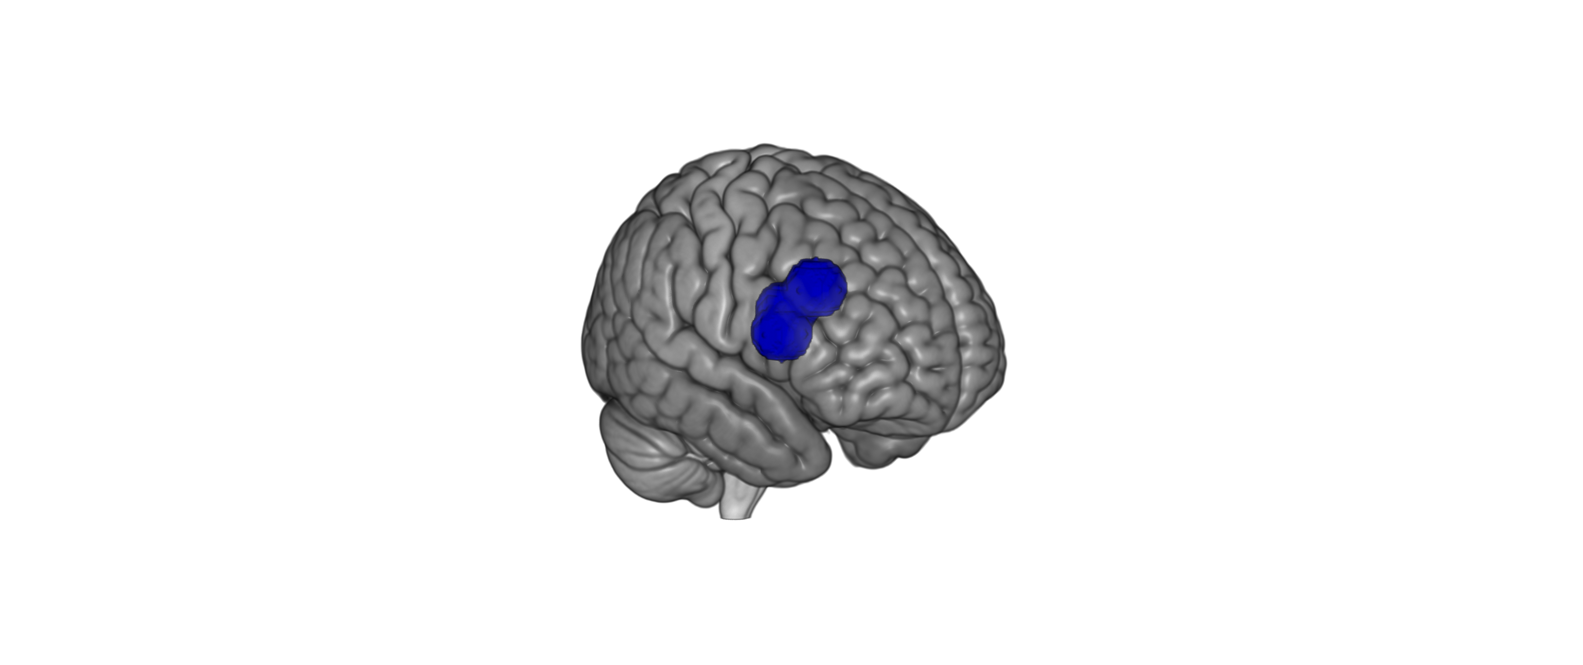
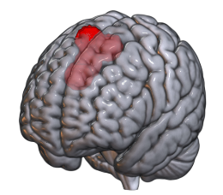
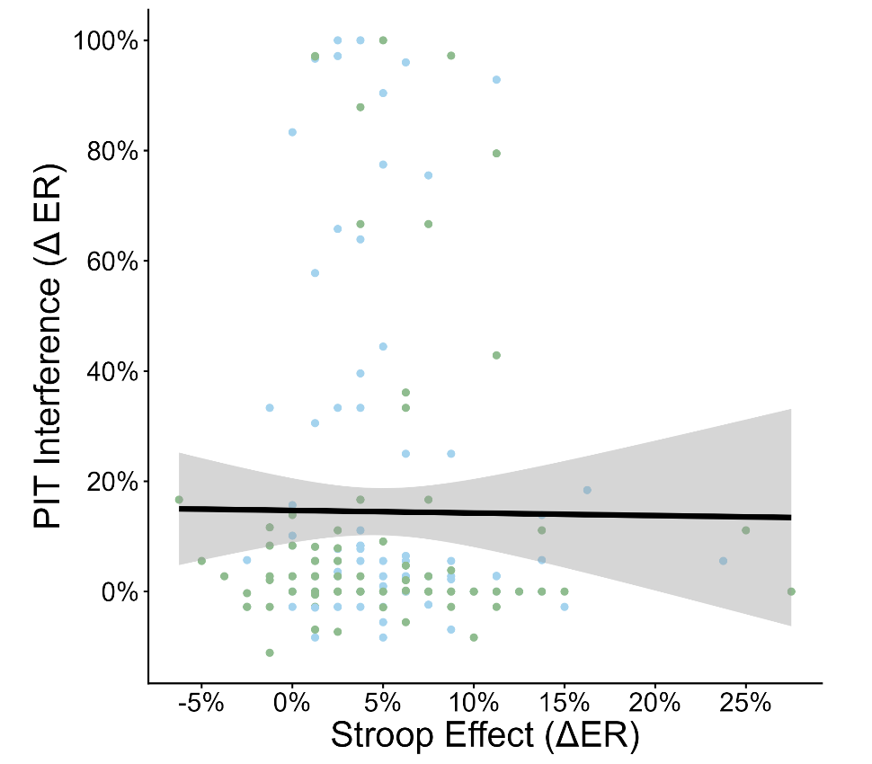
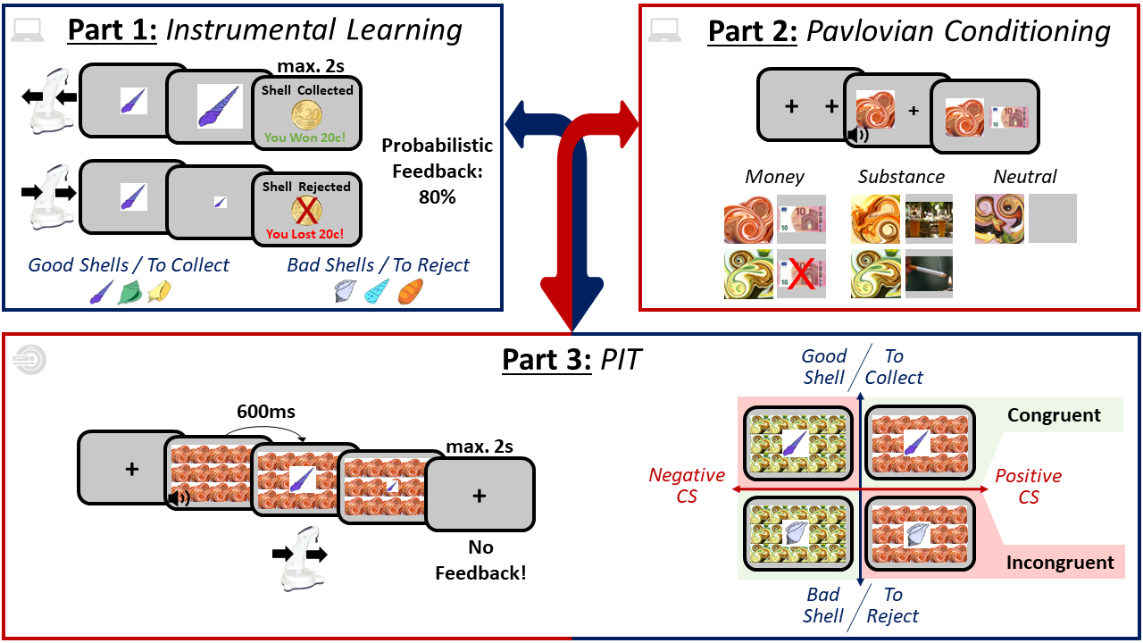
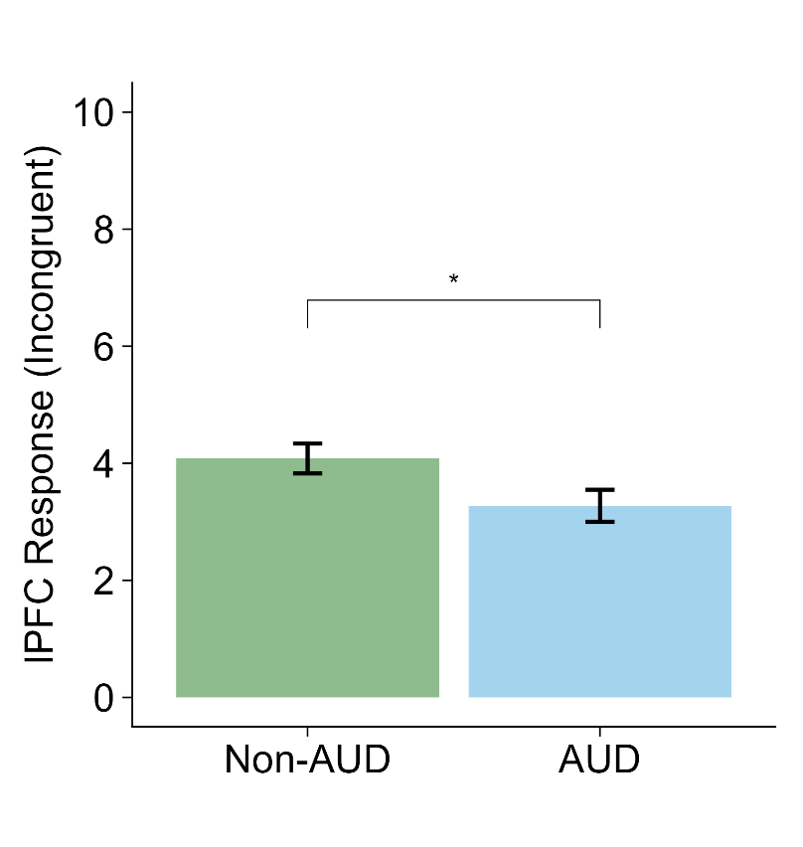
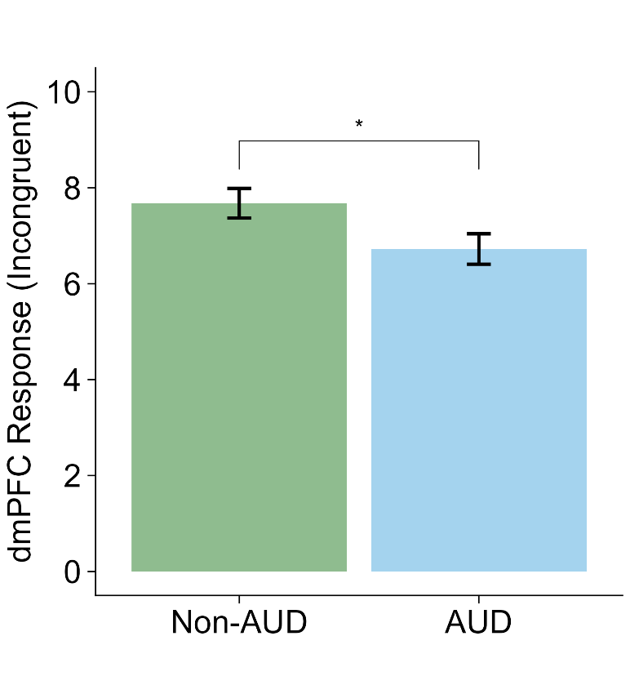
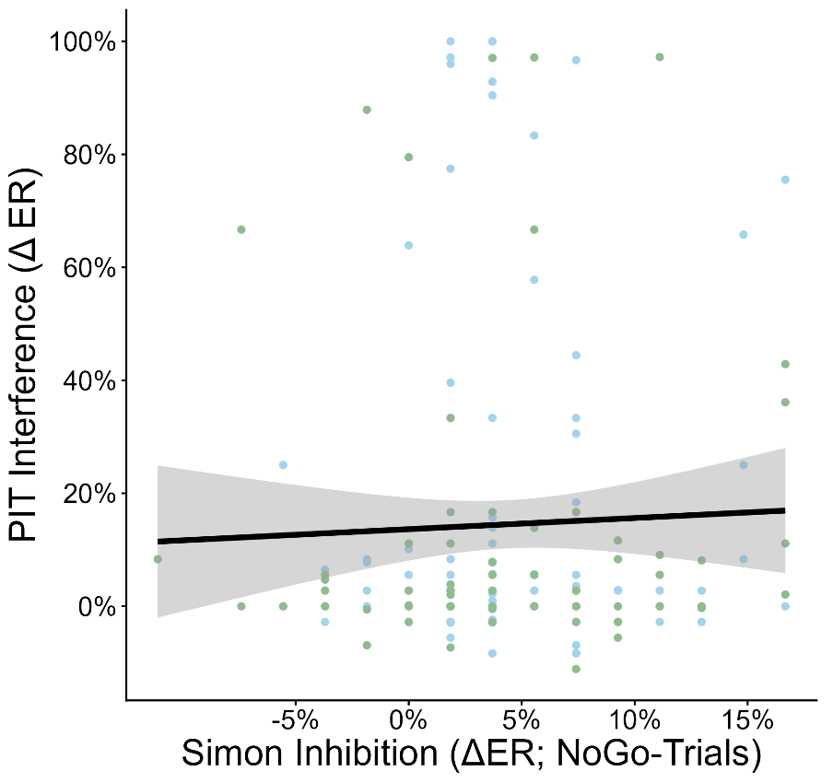
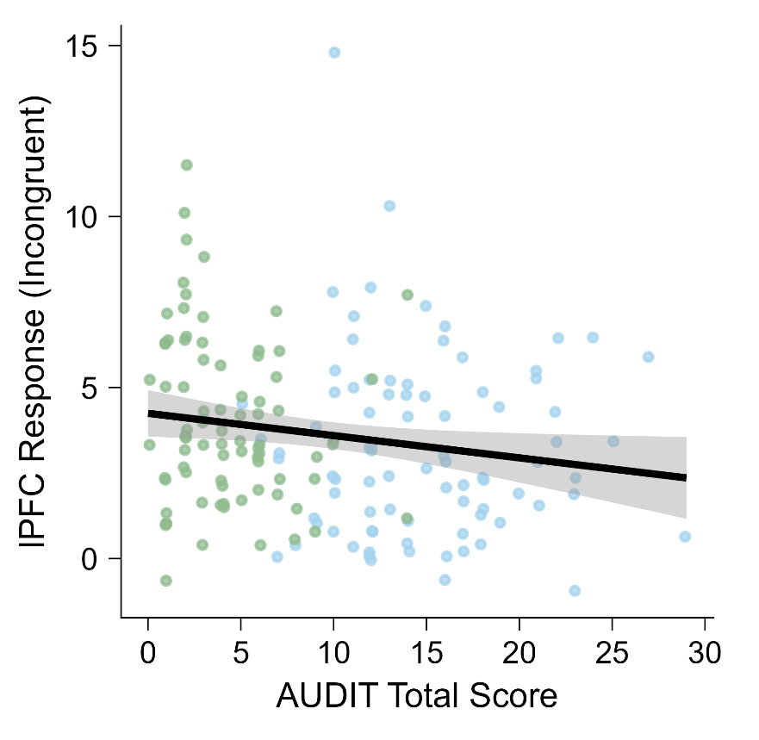
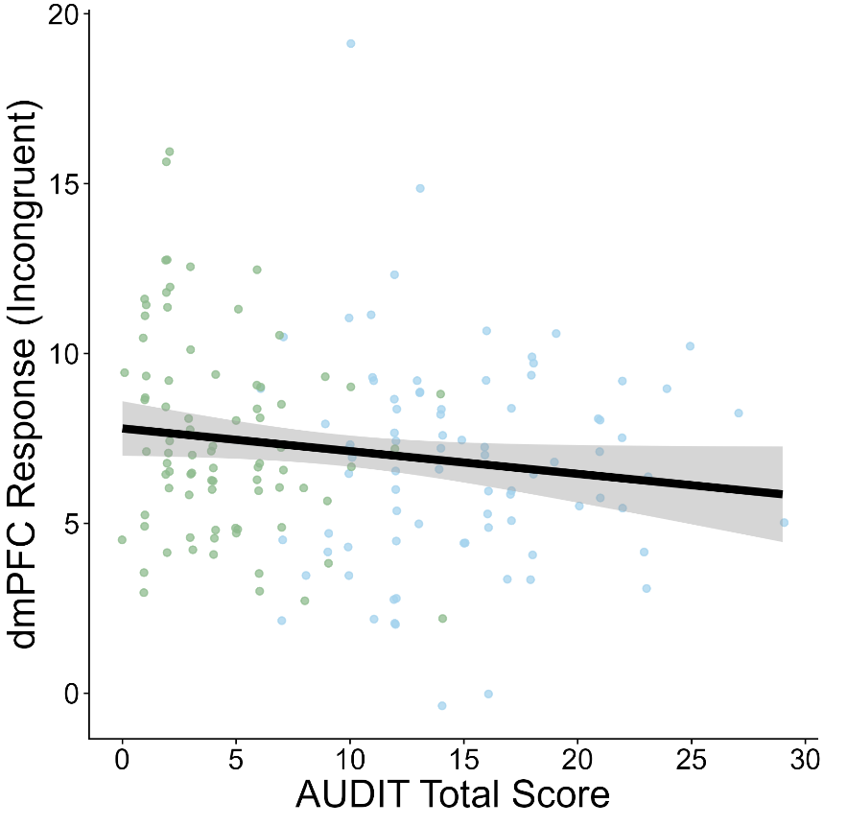
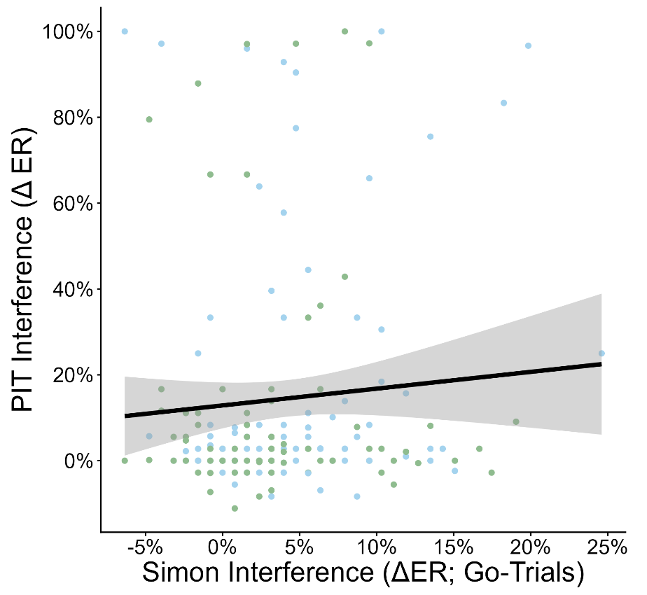




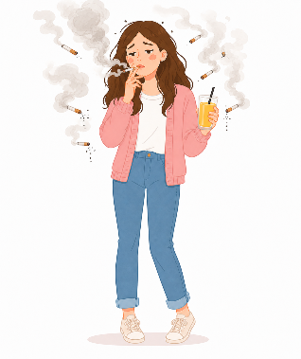
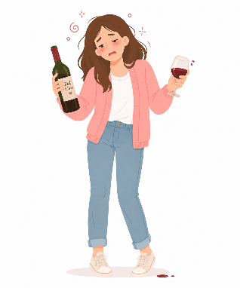


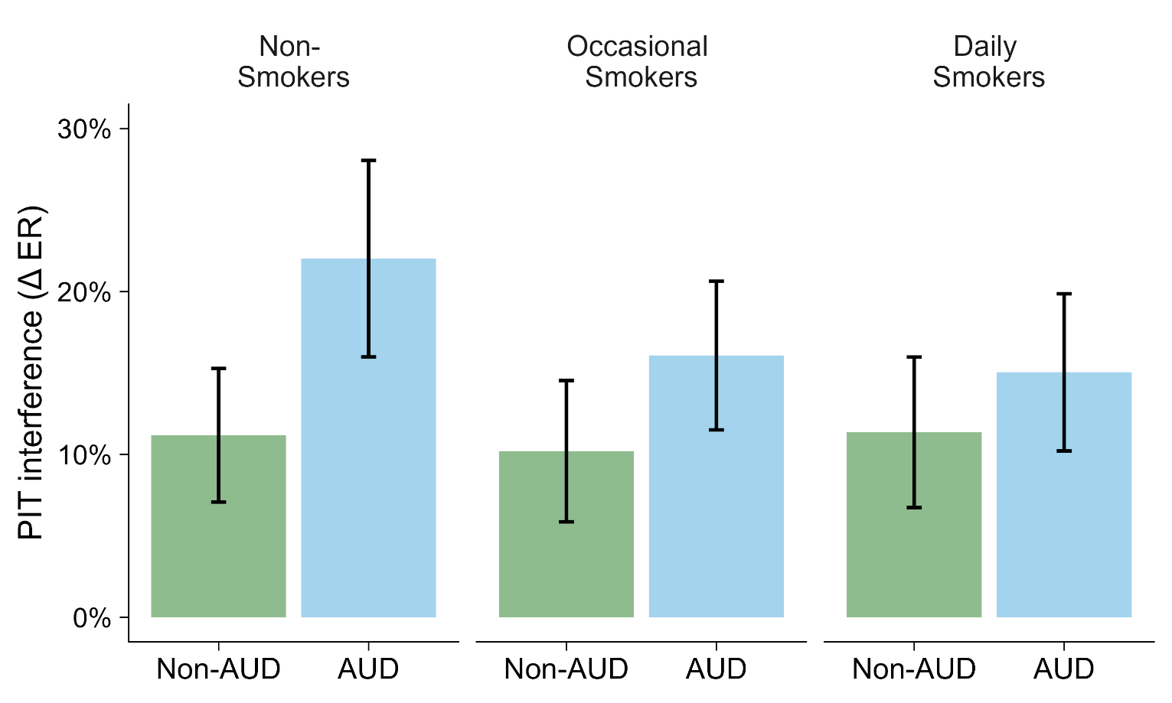

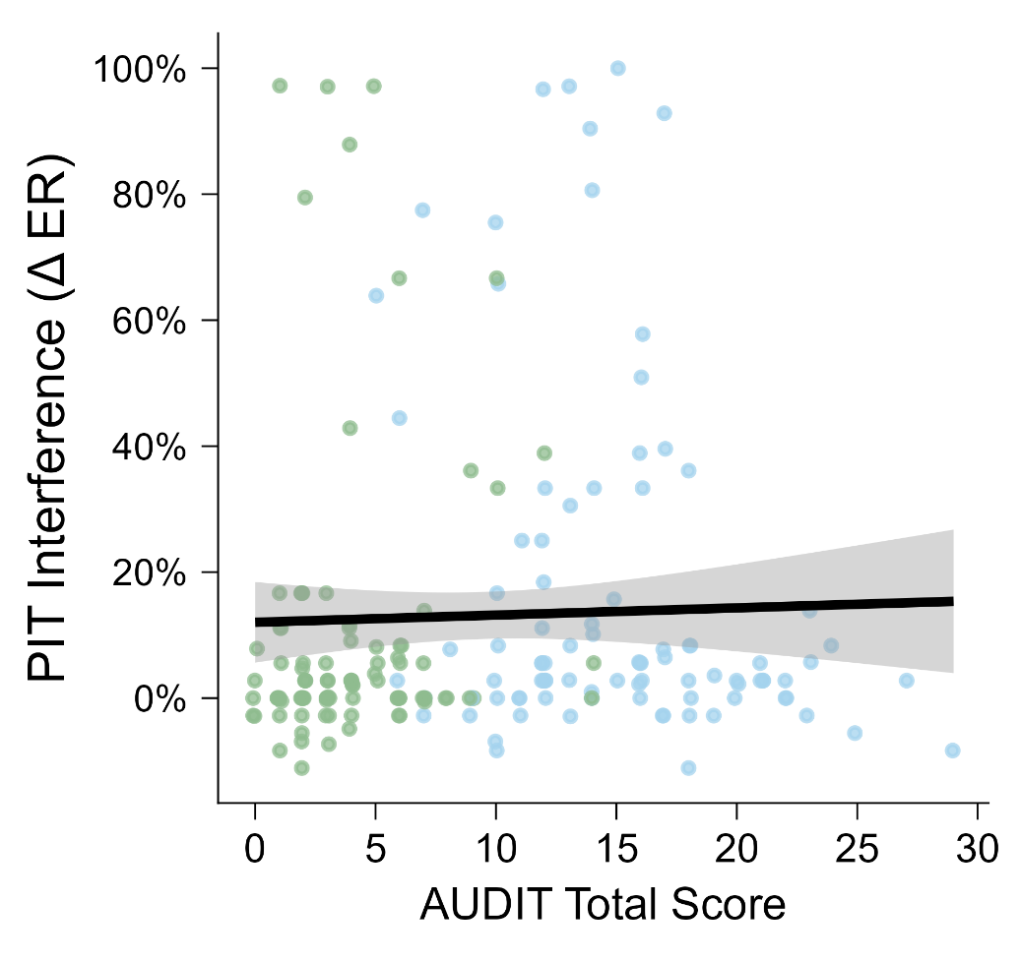


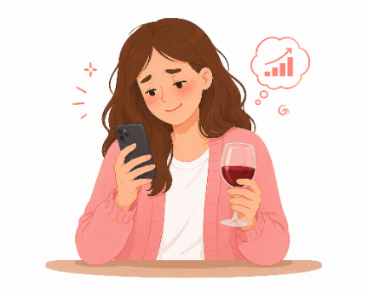


31
A Transdiagnostic Investigation of Pavlovian-to-Instrumental Transfer and Its Neurocognitive Underpinnings
Louis Thill¹
Michael N. Smolka¹, Robert Leech², Thomas Goschke¹
¹Dresden University of Technology, Germany; ²King’s College London, United Kingdom
https://tu-dresden.de
Background
Pavlovian-to-Instrumental Transfer (PIT)
Pavlovian conditioned stimuli (CS) can influence the accuracy & intensity of instrumental behavior¹
pos. CS → activation + approach
neg. CS → inhibition + avoidance
Increased in preclinical^{2,3} & clinical^{4,5} AUD samples
Associated with increases in alcohol consumption³ & relapses⁵
Neural correlates in NAcc², amygdala⁶, lPFC² & dmPFC²
Heterogeneous (🚬⁷) or no evidence for other substances
Aim 1:
Test the transdiagnostic
nature of PIT
Aim 2:
Investigate the
neurocognitive underpinnings of PIT
Methods
Results: PIT & Cognitive Control
Pre- Screening
Basic
Assessment
On-Site
Session 1
On-Site
Session 2
FU
Incongruent Trials
Control Capacities
BA
every
4 months
3x
lPFC
dmPFC
slPIT
ftPIT
τ = .003
p = .52
d = .32; p = .02
d = .32; p = .02
τ = .03
p = .59
Sample Stratification at BA
N = 200
n = 100
AUD
n = 100
τ = .04
p = .78
x
n = 37
n = 34
n = 29
Smoking
Status
n = 33
n = 38
n = 29
r = -.17; p = .03
r = -.15; p = .05
Results: AUD x Smoking Status
Conclusion & Anne‘s case
cognitive control
CS effectsll
Increased PIT interference across AUD spectrum
No evidence for similar effects in smoking or interaction
Potential link with reduced recruitment of control resources
occasional,
controlled drinking
frequent, dependent drinking
AUD: η_{p}² = 0.02; p = .03
Smoking: η_{p}² = 0.001; p = .83
AUD x Smoking: η_{p}² = 0.01; p = .37
τ = .10; p = .03
risk assessment & monitoring
just-in-time intervention
Publications
Thill, L., Chen, H., Baeuchl, C., Krasniqi, S., Born, M., Heinz, A., & Smolka, M.N. (in Prep.). Reduced Control Over Pavlovian-to-Instrumental Transfer Conflicts in Alcohol Use Disorder But Not Smoking.
Baeuchl, C., Chen, H., Thill, L., Heinz, A., & Smolka, M.N. (2025). Erhöhter alkohol-spezifischer Pawlowsch-instrumenteller Transfer bei Alkoholkonsumstörung. Deutscher Suchtkongress, 2(1), 2292. https://doi.org/10.18416/DSK.2025.2292
Rapp, M., Wiedenhöft, J.L., …, Thill, L., …, Heinz, A., & Banaschewski, T. (under review). Impulsivity, loneliness, and stress in individuals with alcohol use disorder across the lifespan. Submitted to Journal of Studies on Alcohol and Drugs.

