Slide 1
FIRST SUPERVISOR MEETING
Learned indexes: from positions to compressed layouts
A historical walkthrough with inspectable evidence and runnable experiments
UNDERSTAND
RUN
DECIDE
What changed at each stage of the literature?
Small offline experiments linked by lesson ID.
Agree on the next common-data reproduction milestone.
Existing work first. A new contribution comes after the baseline.
SCALE-LI research workspace • 8 September 2026
01
Notes:
Open with the purpose, not the implementation. Say: I organized the existing approaches and their evidence so we can agree on a baseline before choosing a new contribution. The custom compressed map is one experimental control, not a replacement for the state of the art. Spend about 30 seconds here.

Slide 2
HOW TO READ THIS DECK
Three evidence labels — three different claims
A rerun of arithmetic is not a reproduction of a published system.
Label
What it supports
Example
PUBLISHED
What the paper reports in its setup
NFL Tables 1–2; CSV promoted keys
TEACHING DEMO
Inspect a mechanism and its objective
Two-stage fitting; virtual points
LOCAL MEASUREMENT
What tested code does on this fixture
RadixSpline-derived; custom map
No full ALEX / PGM / NFL / CSV upstream reproduction is claimed.
Coverage: docs/APPROACHES.md • Raw evidence: results/saved/
02
Notes:
Explain the three labels once. Published means a number is taken from a paper in its own experimental setup. Teaching means independently written code that explains a mechanism, not an implementation of that paper. Local measurement means compiled code was actually executed on the bundled synthetic fixture. RadixSpline is source-derived but not an exact commit-pinned checkout. There is no complete upstream ALEX, PGM, NFL or CSV reproduction in this release.

Slide 3
2018 → 2026
The history is branching, not a single leaderboard
The papers improve different parts of the same access path.
Period
Main idea
Representative approaches
2018–20
Predict positions; bound error; build cheaply
RMI → FITing-Tree → PGM / RadixSpline
2020–23
Maintain learned structure under updates
ALEX → LIPP → SALI
2021–24
Compress while retaining direct access
LA-vector → LeCo
2022–25
Change the distribution / positions
NFL → CSV
2025–26
Evaluate robustness and maintenance tails
SEA comparison / RoBin / LINE
Primary-source registry: sources/registry.json
03
Notes:
Present the history as parallel design choices. Early work learns rank; later work adds explicit error bounds and cheaper construction. Dynamic indexes change placement and maintenance. Another branch compresses representations. NFL and CSV change what the models see. Recent work strengthens robustness evaluation. Publication order is not a universal performance ranking.

Slide 4
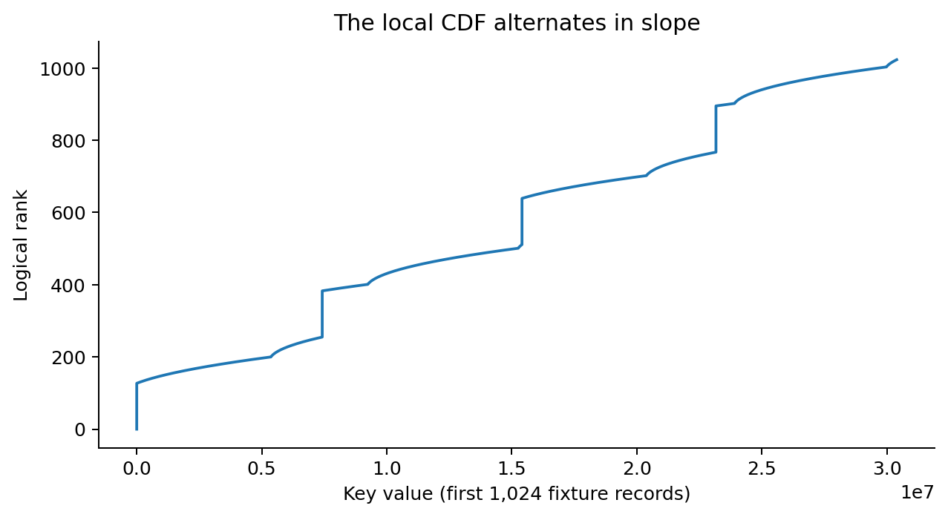
L01 • SYNTHETIC DATASET
Start with the task: exact ordered lookup
Use case: look up integer-keyed records and scan their successors.
INPUT
16,384 distinct sorted uint64 keys. Alternating dense and sparse intervals.
OUTPUT
lower_bound(k): the first stored key that is at least k.
BASELINE
Binary search gives an exact answer without a fitted predictor.
L01 python3 walkthrough.py demo 01
Fixture: evidence/dense_sparse_fixture_uint64 • SHA-256 in its manifest
04
Notes:
The use case is an ordered map over integer keys: find a record or scan its successors. The live fixture contains 16,384 synthetic, distinct uint64 keys. The plot shows only the first 1,024 records to expose local density changes. These are not Facebook or OpenStreetMap data. Lesson 01 loads this exact checksummed file. Rank is the position in sorted order.

Slide 5
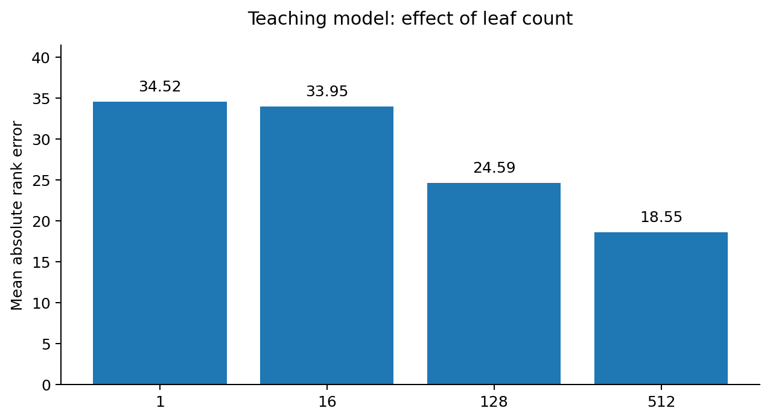
PUBLISHED IDEA + INDEPENDENT TEACHING MODEL
2018 · predict rank, then specialize
RMI introduces model-guided navigation and exact correction.
MECHANISM
A root prediction selects a local model. That model predicts a position.
WHAT WE CHECK
20,482 exact query checks after corrective search.
TRADE-OFF
More models can help fitting, but consume space and add routing work.
L01 python3 walkthrough.py demo 01
Kraska et al., SIGMOD 2018 • L01 is NOT the authors’ RMI implementation
05
Notes:
Show lesson 01. A root prediction selects a leaf model, then the leaf predicts a rank and an exact expanding-window search resolves the answer. The capacity sweep changes the leaf count while keeping the keys fixed. The root is additional. It measures mean absolute fitting error, not throughput or total model memory. This is our teaching model, not the original RMI implementation. Every stored key and a selection of missing keys are checked against bisect.

Slide 6
LITERATURE • NOT LOCALLY REPRODUCED
2019 · make prediction error an explicit parameter
FITing-Tree: piecewise-linear approximation with a chosen error bound.
BEFORE
CHANGE
COST
A good average fit can still leave difficult local regions.
Partition into linear segments that meet a specified error tolerance.
Tighter tolerance may require more segments and metadata.
Prediction + bounded correction, not “the model must be exact.”
Galakatos et al., SIGMOD 2019 • https://arxiv.org/abs/1801.10207
06
Notes:
FITing-Tree makes the error tolerance an explicit control. A tighter tolerance can require more segments but reduce final correction work. The paper also supplies a cost model for choosing the parameter. Do not imply that our two-stage model implements FITing-Tree. There is no local FITing-Tree executable in this pack. The next native demonstration uses RadixSpline to illustrate bounded final search.

Slide 7
LITERATURE • UPSTREAM ADAPTER NOT VALIDATED
2020 · build a hierarchy of bounded models
PGM indexes the segments recursively and supplies static and dynamic variants.
MODELS OF MODELS
BOUND + SPACE
DISTINCTION
Each level narrows the next search; the final interval is corrected exactly.
Error tolerance determines the fit/space/search trade-off.
Compressing model parameters is not automatically compressing the keys.
Ferragina & Vinciguerra, PVLDB 2020, §§2–4 • doi:10.14778/3389133.3389135
07
Notes:
PGM recursively indexes the keys identifying its linear segments. The paper includes static, dynamic and compressed-model variants. The important distinction for this project is that compressing model parameters is not the same as compressing stored keys. The inherited Dynamic PGM adapter has not been compiled and tested against its upstream implementation here; it is an integration starting point only.

Slide 8
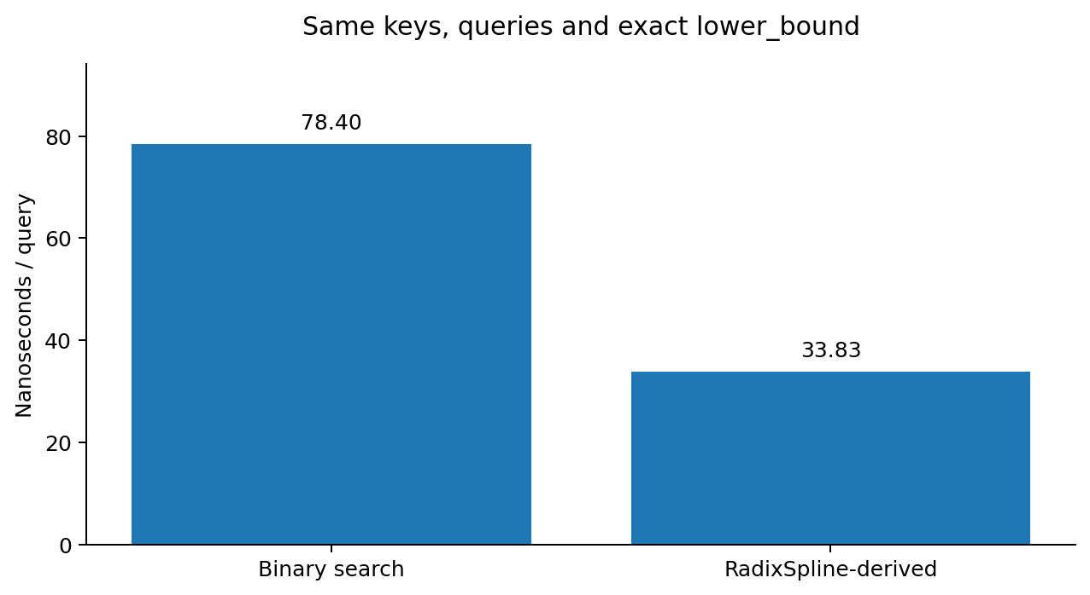
SOURCE-DERIVED NATIVE EXPERIMENT
2020 · RadixSpline makes the path concrete
One-pass spline construction + radix directory + exact bounded search.
FINAL WINDOW
At most 66 keys in this run, with ε = 32.
EXACTNESS
Every query in the measured trace checked against std::lower_bound.
SPACE SCOPE
131,072 key bytes + 5,908 auxiliary bytes; no payloads.
L02 python3 walkthrough.py demo 02
Kipf et al., aiDM 2020 • third_party/radix_spline/PROVENANCE.md • results/saved/02/
08
Notes:
Run: python3 walkthrough.py demo 02. The code is transcribed from three small MIT-licensed RadixSpline headers, with provenance disclosed. It is not a byte-identical, commit-pinned source checkout or a reproduction of the full SOSD experiment. There are 16,384 keys and 100,000 queries; epsilon is 32 and radix bits is 10. The largest returned search interval contains 66 keys in this implementation. All query results are checked against std::lower_bound. Five warmed repeats use the same process and trace, so they are not five independent performance trials. Memory here excludes payloads because the contract is keys-only lower_bound.

Slide 9
LITERATURE • NOT LOCALLY REPRODUCED
2020–21 · updates require a storage strategy
ALEX and LIPP address insertion and conflicts differently.
ALEX
LIPP
Use gaps and adaptive expansion/splitting to accommodate writes.
Use predicted placement; represent collisions through additional nodes.
The baseline must include inserts, scans, memory and maintenance — not reads alone.
Ding et al., ALEX, SIGMOD 2020 • Wu et al., LIPP, PVLDB 2021
09
Notes:
ALEX uses gapped data nodes and structural adaptation to accommodate writes. LIPP focuses on predicted placement and additional nodes for collisions. Explain the contrasting mechanisms, not a winner. Neither system is executed in this release. Our experimental sorted overlay and regional rebuild are not a reproduction of either. Ask how insertion order, initial sampling and domain growth should be included in later evaluation.

Slide 10
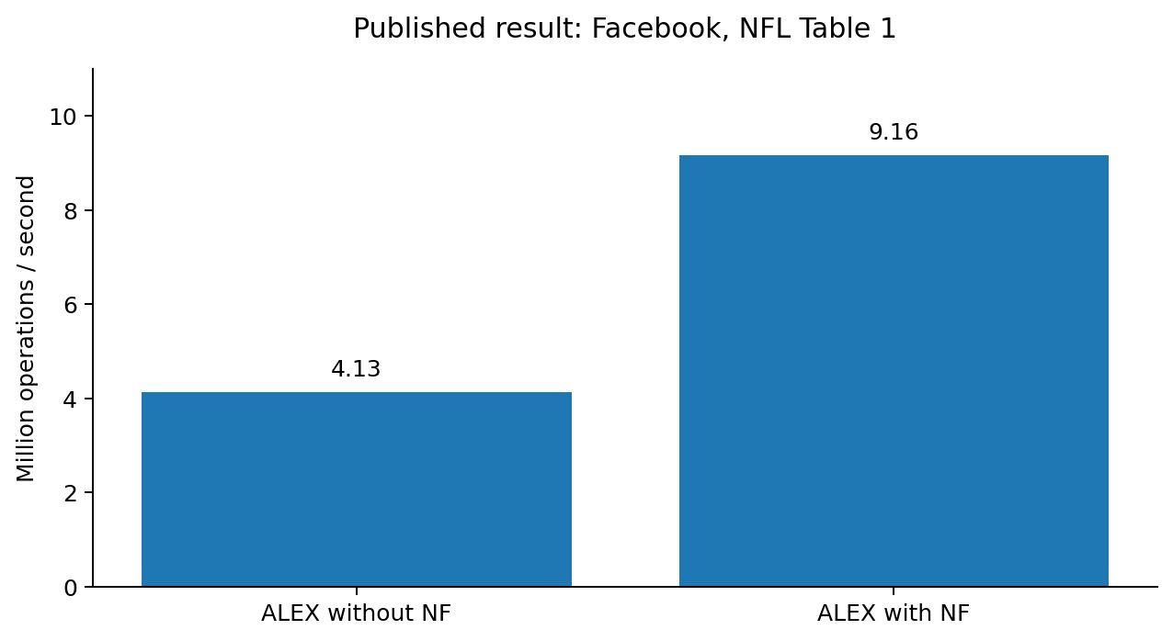
PUBLISHED RESULT • TABLE ARITHMETIC
2022 · NFL changes the input distribution
Transform numerical keys before building an After-Flow Learned Index.
KEY CHANGE
Original key → numerical flow → transformed key → learned index.
REPORTED EXAMPLE
Facebook: max tree height 11 → 3. Throughput 4.13 → 9.16 Mops/s.
NEXT QUESTION
Does the lower search cost repay the online transformation?
L03 python3 walkthrough.py demo 03
Uploaded NFL paper • Table 1 p.3; framework pp.4–6 • results/saved/03/
10
Notes:
Show lesson 03 and NFL Table 1 on page 3 of the supplied paper. ALEX on Facebook is reported at 4.13 Mops/s without NF and 9.16 with NF; maximum tree height is 11 versus 3. This is not the paper's overall NFL-versus-all-baselines comparison. Table 1 does not state its exact operation mix or batch size, so do not silently borrow settings from later experiments. The lesson recomputes source-table arithmetic; it does not train or execute a flow.

Slide 11
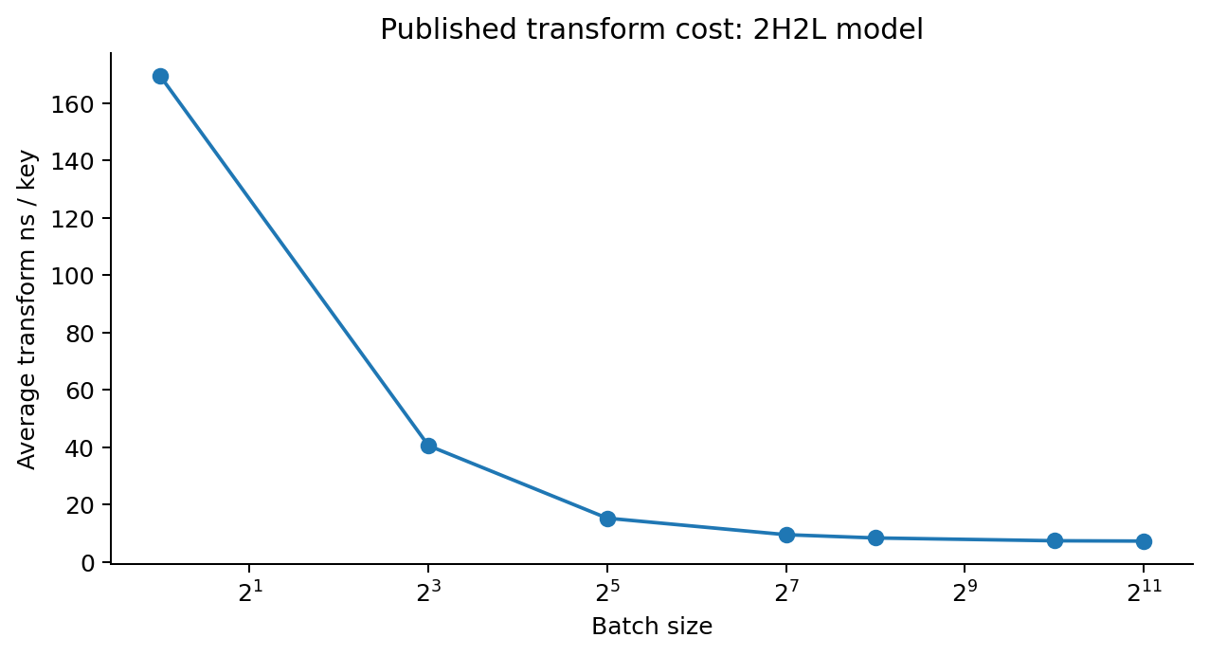
PUBLISHED RESULT • NOT A LOCAL MEASUREMENT
The cost of a transformation is part of the result
Batching changes the per-key economics; latency definitions also matter.
SINGLE KEY
169.53 ns/key average transformation cost, reported for 2H2L.
BATCH OF 256
8.38 ns/key average, in that same table.
DO NOT CONFLATE
Batch-normalized P99 is not the P99 of individual request latency.
L03 python3 walkthrough.py demo 03
NFL Table 2 p.6; §4.3 p.10; §4.2 discussion p.10
11
Notes:
NFL Table 2 reports transformation-only average costs for its 2H2L model: 169.53 ns/key at batch size 1, and 8.38 at batch size 256. These are not complete query times. Separately, the paper defines its reported P99 as a batch-latency percentile divided by batch size. That is not the P99 of individual request latencies. The paper also reports cases where transformation overhead offsets improved indexing. This motivates measuring total cost.

Slide 12
LITERATURE • NOT LOCALLY REPRODUCED
2021–24 · compress without losing efficient access
A parallel line of work: LA-vector and LeCo.
LA-VECTOR
LECO
PUBLISHED SYSTEM RESULT
A learned compressed representation with exact rank/select operations.
Model position → value, then store exact residuals and partition metadata.
LeCo reports up to 16% higher Seek throughput in its RocksDB setup.
That experiment uses 900M generated records and 64 threads — not our workload.
Boffa et al., ALENEX 2021 • Liu et al., LeCo, SIGMOD 2024, §5.2
12
Notes:
Return to the parallel compression branch. LA-vector combines a learned compressed representation with exact rank/select. LeCo models serial relationships and stores lossless residuals with random access. Its reported up-to-16% Seek throughput gain comes from the RocksDB experiment against the second-best tested configuration: 900 million generated records, 20-byte keys, 400-byte values and 64 threads. It is not a predicted benefit for our small in-memory map. Neither LA-vector nor LeCo is reproduced here.

Slide 13
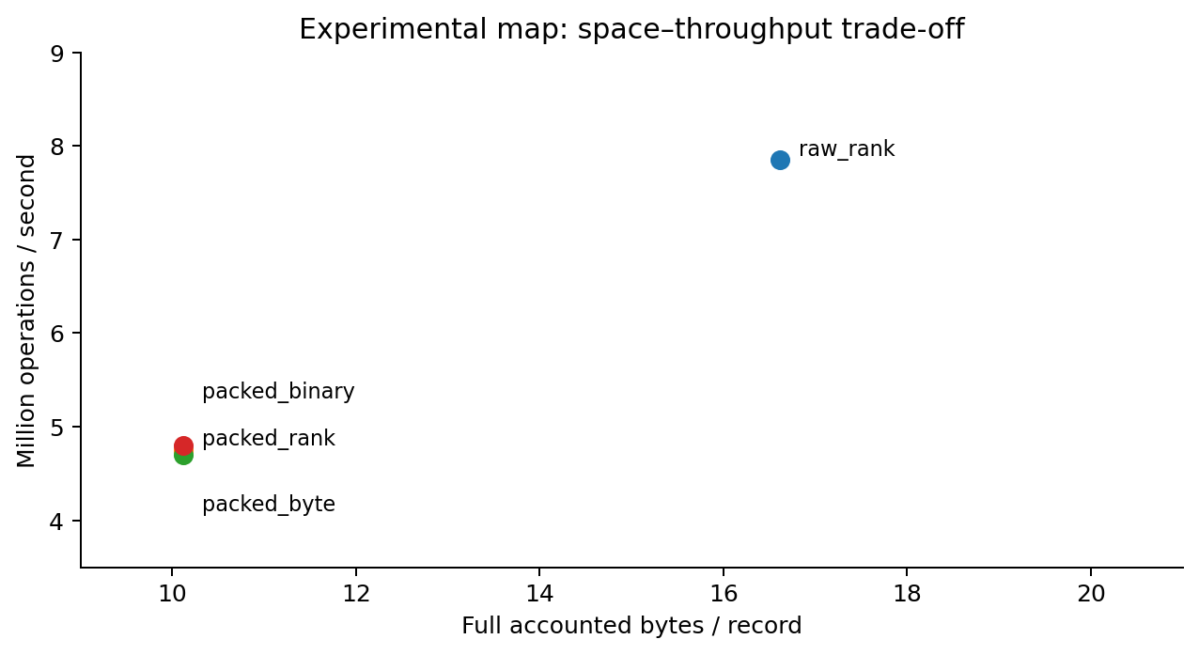
LOCAL EXPERIMENTAL MAP • NOT LECO
Run a control: compression can save space yet slow reads
Hold keys, block boundaries, query traces and exact map semantics fixed.
REPRESENTATIONS
Raw, FOR, restarted delta and integer-linear residual blocks.
MATCHED COMPARISONS
Raw/rank → packed/rank → packed/byte. Packed/binary is another control.
OBSERVATION
The packed footprint is smaller. This run does not show a throughput win.
L04 python3 walkthrough.py demo 04
results/saved/04/ • 16,384 synthetic records; 10K ops/seed; three seeds; full initial load
13
Notes:
Show lesson 04. The custom map is useful as an attribution experiment: compare raw/rank with packed/rank, then packed/rank with packed/byte, and use packed/binary as a control. Keys, partitions and operation traces are matched. The new dataset is the bundled binary fixture, not the old C++-generated archive. Three seeds each run 10,000 read-only operations after a full load. Memory includes values and metadata. The compact layout is slower here; do not hide that. This is not a SOTA comparison.

Slide 14
PUBLISHED RESULT • ATTACHED 2024/25 VERSION
CSV · change positions with virtual points
Refit models and reconstruct selected subtrees when the cost condition permits.
MECHANISM
REPORTED BENEFIT
COST TO REPORT
Insert virtual positions, refit, then potentially reduce traversal depth.
Up to 34% less query time for the selected promoted keys.
At α = 0.1, ALEX preprocessing ranges from 889 to 2,902 seconds.
Conditional query gain ≠ whole-workload speedup. Preprocessing is not free.
Uploaded CSV paper • Figure 2 p.2; §6.1 p.9; Figure 7 p.10; Table 4 p.11
14
Notes:
CSV inserts virtual positions and refits models, then applies a cost condition to selected subtree reconstructions. Explain the single-model and hierarchical steps separately. Its reported up-to-34% query-time reduction concerns promoted keys; each queried key is repeated 100 times and averaged. ALEX preprocessing at alpha 0.1 ranges from 889 to 2,902 seconds across the four datasets. The maximum query improvement and these fixed-alpha costs are not claimed to be one matched setting. The attached paper's date labels are inconsistent; retain its supplied version.

Slide 15
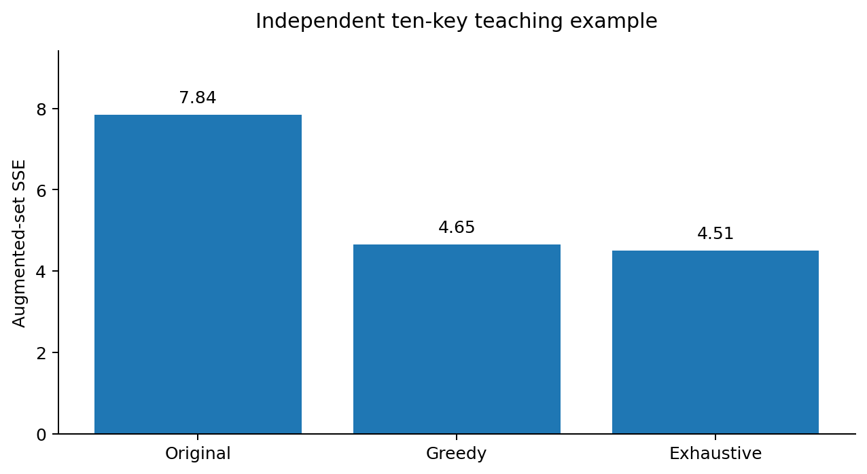
INDEPENDENT TEACHING DEMO • NOT CSV
Make virtual-point smoothing inspectable
A ten-key teaching example exposes exactly what the objective changes.
INPUT
10 explicit keys; budget = 3 virtual points. No hidden dataset.
VERIFY
Exhaustive search provides a ceiling over this finite candidate set.
LIMIT
These are fitting errors, not query-time savings. The full CSV hierarchy is absent.
L05 python3 walkthrough.py demo 05
experiments/lessons.py::lesson05 • inherited virtual_points_lab.py • results/saved/05/
15
Notes:
Run: python3 walkthrough.py demo 05. First say that these are our ten keys and a budget of three, not the paper's Figure 2 or Table 2. Greedy selection and exhaustive enumeration optimize augmented-set OLS SSE; original-key SSE is retained separately. Exhaustive enumeration checks 1,351 subsets. The greedy result is close to, but not equal to, the best result in that finite space. These are fitting errors, not query-time improvements. This is not the optimized CSV Algorithm 1 or hierarchical Algorithm 2.

Slide 16
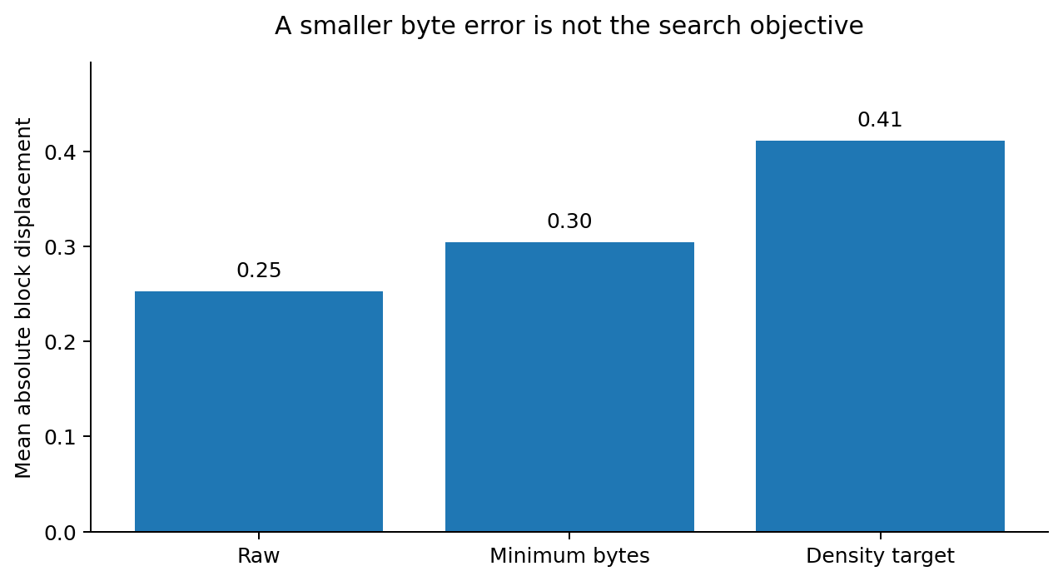
LOCAL EXPERIMENTAL GEOMETRY
The project hypothesis must distinguish rank from bytes
Lossless compression changes representation, not the order of the same keys.
INVARIANT
Logical rank model unchanged across raw, packed and density-target layouts.
WHAT WE MEASURE
Encoded bytes, normalized fitting error, initial block displacement.
OBSERVATION
Lower byte-fitting error did not imply lower block-search error here.
L06 python3 walkthrough.py demo 06
results/saved/06/layout_*.csv • same fixture and block boundaries; full initial load
16
Notes:
Show lesson 06's geometry table. Verify that rank-normalized error is identical across layouts for the same keys and partitions. The normalized byte error decreases, but initial block displacement gets worse on this fixture. The plot shows block displacement only, not a mixture of units. These numbers differ from the earlier archive because the binary fixture is different. The lesson is to optimize actual search cost rather than assume a smoother byte curve is sufficient.

Slide 17
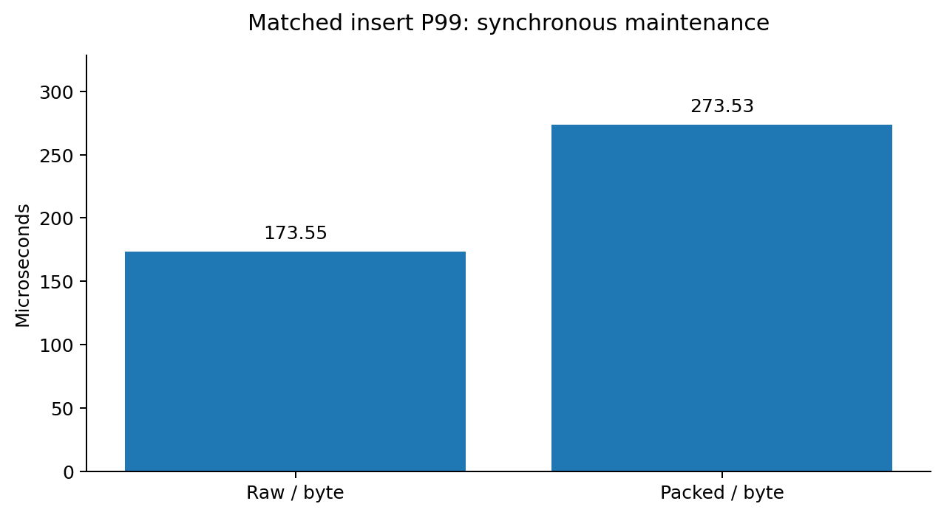
MATCHED LOCAL UPDATE CONTROLS
Updates expose another cost: rebuilding a region
A compression benefit must survive maintenance, not just the initial build.
UPDATE PATH
Recent changes enter a sorted overlay. A full overlay triggers local rebuilding.
FAIR CONTROL
Raw and compressed variants both perform maintenance on the same trace.
QUESTION
Which cost comes from decoding, copying, allocation, fitting or rewriting?
L06 python3 walkthrough.py demo 06
results/saved/06/updates_*.json • same trace; 75% initial load; read-heavy mix
17
Notes:
Show the separate update-control table in lesson 06. Both variants have the same trace, byte router, 75% initial load and 10,000 read-heavy operations. They each record 25 compactions here. Insert P99 is about 173.6 microseconds for raw and 273.5 for packed on the recorded Linux run. Your Mac timings will differ. Synchronous rebuilding is included in the triggering operation. Remaining maintenance is drained and reported separately. Profiling is still needed to allocate time among decoding, allocation, copying, fitting and rewriting.

Slide 18
LITERATURE • NOT LOCALLY REPRODUCED
2025–26 · robustness is part of the baseline
Recent work reinforces the need to vary workloads and control maintenance tails.
STRONG CONTROLS
ROBUSTNESS GRID
MAINTENANCE
Compare against optimized traditional and compressed representations.
Vary initial sampling, initial size, insertion order and domain growth.
LINE decomposes lengthy structural changes into group-wise migrations.
Do not infer a universal ranking from a favorable read-only dataset.
SEA 2025 comparison • RoBin, PACMMOD 2025 / SIGMOD context • LINE, SIGMOD 2026
18
Notes:
Recent evaluations argue for stronger baselines and workload variation. The SEA 2025 comparison includes optimized traditional and compressed methods. RoBin varies initial sampling, initial size and insertion order; its article is dated September 2025 even though the linked filename refers to SIGMOD 2026. LINE is a June 2026 paper: group-enhanced leaves, a cache-optimized inner tree and group-wise migrations address local hardness and maintenance tails. These are literature coverage, not new local reproductions or a universal ranking.

Slide 19
IMPLEMENTATION STATUS
What is ready — and what still needs reproduction
A transparent baseline plan is stronger than overstating coverage.
Ready now
Not yet established
Chronological deck + traceable paper evidence
Full benchmark reproduction for each paper
7 executable lessons + saved offline outputs
Authors’ RMI/FITing/ALEX/PGM/NFL/CSV runs
Native source-derived RadixSpline comparison
A commit-pinned upstream parity claim
Exact custom-map compression/update controls
Improvement over SOTA or real-data robustness
docs/APPROACHES.md • evidence/VALIDATION.md
19
Notes:
Use this status slide explicitly. The chronological meeting package, paper evidence and runnable lessons are ready. The full common-data, commit-pinned upstream SOTA comparison is not. The native RadixSpline-derived code and custom map have passed checks, but that does not stand in for reproducing all other systems. No real-data performance results have been produced in this release.

Slide 20
SUPERVISOR DISCUSSION
Agree on the next baseline milestone
Use the history to choose experiments, not to preselect a new method.
1 · COMMON CONTRACT
2 · REPRODUCTIONS
3 · SUCCESS METRICS
Static lower_bound first? Or point lookup, scans and updates with fixed payloads?
Agree on pinned upstream implementations and the first real corpus.
Memory budget, exactness, lookup/scan cost, write tails and rebuild debt.
Next milestone: one reproducible common-data comparison, then iterate.
Proposed next work • not completed experiments
20
Notes:
Close by asking for concrete scope decisions: the common API contract, the mandatory implementations, and the first real datasets. Propose one commit-pinned static comparison with a strong conventional baseline before moving to mutable point/scan/update workloads. Agree on memory accounting, exactness, tail latency and maintenance debt. This is a proposed milestone, not a claim that the work has already been completed.

Slide 21
RUN MAP
Appendix · one command for each evidence trail
Every lesson ends in a result JSON and an offline report section.
ID
Run / inspect
Classification
01
Rank fitting + corrected search
Teaching model
02
RadixSpline / binary exact lower_bound
Source-derived native
03
NFL table ratios + batching
Published evidence
04
Matched compression and routing
Experimental native map
05
Greedy / exhaustive virtual points
Teaching model
06
Geometry + matched mutation tails
Experimental native map
07
Archive / Mac evidence checks
Audit; no fresh timing
Entrypoint: walkthrough.py • Optional notebook: Walkthrough.ipynb
21
Notes:
This is the navigation appendix. The command for any stage is python3 walkthrough.py demo followed by its two-digit lesson ID. The report gives the figure, raw result, environment and a repeat command. Lesson 03 recomputes paper arithmetic. Lesson 07 audits archived data; neither is a new performance reproduction. Use the saved report instead of running everything during the meeting.

Slide 22
REHEARSAL
Appendix · rehearse once; keep a fallback open
Do not debug installations or download datasets during the meeting.
BEFORE THE MEETING
IF A RUN FAILS
python3 walkthrough.py prepare
python3 walkthrough.py demo all
Open results/saved/report.html. Explain that these are recorded runs with their environment.
LIVE: ONLY THREE COMMANDS
demo 02
demo 05
demo 06
WHICH TAB?
Use this deck and the numbered result page. The older code guide is only a reference.
docs/REHEARSAL.md • All timings are machine-dependent
22
Notes:
Use the new scaleli_sota folder, not the older Downloads/scaleli folder. Before the meeting run prepare, then demo all, and open the local report. Prepare builds and runs three CTest entries plus twelve Python test methods. During the meeting limit live work to lessons 02, 05 and optionally 06. The deck charts reflect results/saved and do not automatically change after a Mac rerun. If setup fails, use the saved report and PDF. Do not debug a new dependency installation in front of the supervisor.

Slide 23
PRIMARY SOURCES
Appendix · source map, foundations
The user-provided NFL and CSV versions are preserved in sources/.
Source
Read for
Kraska et al. • SIGMOD 2018 • arXiv:1712.01208
RMI / learned key-to-position viewpoint
Galakatos et al. • SIGMOD 2019 • arXiv:1801.10207
FITing-Tree / bounded approximation
Ferragina & Vinciguerra • PVLDB 2020
PGM / recursive models and variants
Kipf et al. • aiDM 2020 • arXiv:2004.14541
RadixSpline / single-pass construction
Ding et al. • SIGMOD 2020 • microsoft/ALEX
ALEX / adaptive dynamic structure
Wu et al. • PVLDB 2021 • p1276-wu.pdf
LIPP / precise placement
Full references and URLs: sources/registry.json
23
Notes:
Foundation references. All URLs and bibliographic context are in sources/registry.json. The local runtime covers only the subset listed in the status matrix. Mentioning a source does not imply its implementation was run. The two uploaded papers are also preserved as PDFs for offline inspection.

Slide 24
PRIMARY SOURCES
Appendix · source map, transformation and compression
Keep each result attached to its own experimental contract.
Source
Read for
NFL • uploaded 2205.11807v1.pdf
Tables 1–2; batching and latency definitions
CSV • uploaded 2408.06134v3.pdf
Algorithms 1–2; promoted-key measurements
Boffa et al. • ALENEX 2021
LA-vector / learned compressed rank/select
LeCo • SIGMOD 2024 • arXiv:2306.15374
Serial correlations / random access
SEA 2025 • doi:10.4230/LIPIcs.SEA.2025.5
Strong static comparisons
RoBin • doi:10.1145/3749188; LINE • 3802080
Robustness / maintenance frontier
Full references and URLs: sources/registry.json
24
Notes:
Transformation, compression and robustness references. The original supplied NFL and CSV versions define the cited numeric results. Published timings must stay attached to their datasets, workload and machine. The new native numbers have their own raw results and validation logs. Do not combine them into a cross-paper leaderboard.

