Slide 1
Project II
COMP 4989
TEAM 5: James Pike, Yi (Louis) Lu, John Gilpin, Jaskamal Singh
Notes:
Good afternoon everyone! We are team 5. On our team is James Pike, Louis Lu, John Gilpin and Jaskamal Singh.

Slide 2

Overview
Problem
Goals
Process
Results
Insights
Notes:
We would like to discuss in this presentation the problem we saw, the goals we decided on to solve it, the process of solving it, the results and the insights gained from the experience.

Slide 3



Problem Description
COVID-19
COVID Policies
Travelling
COVID-19 has affected everyone worldwide, and each country is handling it in their own way.
Each country has different policies when it comes to controlling the spread of COVID-19.
Internal and international travel may promote the spread of the virus.
Notes:
To start with, our problem as with everyone else’s, was related to Covid-19, the pandemic currently affecting the planet. As a part of the problem we were looking at how every country is responding to and handling the pandemic in their own ways. This has resulted in different levels of success depending where you look. We then thought that the policies the countries were implementing would have an effect on the number of new cases and deaths that are emerging each day. With governments restricting access and movement we believed that it should be represented in a decrease in number of cases or a bending of the new cases curve as has been talked about in recent months by health officials. Lastly, we came to the conclusion, having investigated some policies, that international and domestic travel was likely having as large or larger of an impact on the case numbers. Our thought here was that even with restrictions in place, if people could still enter the country and then move around in it the virus would find it easier to spread.

Slide 4

GOALS
Create a model to predict the projection figures of new Covid cases.
Estimate the Covid-19 cases should the factors continue in the pattern they are following.
Notes:
Having developed an understanding of our problem area, we decided on a couple goals to attempt to envision and solve. First, we wanted to develop a machine learning model which could help to predict figures for both numbers of new cases and numbers of deaths. We decided to limit this to numbers of new cases rather than creating two models or trying to fit one model to both labels. Secondly, we wanted to try and predict the number of new Covid-19 cases if factors continued in the pattern they were following.

Slide 5

Datasets
Features:
Government Policies
Countries Internal Movement
COVID19 Cases and Death Count
Population / Population Density
Open Source Datasets:
Oxford Covid-19 Government Response Tracker
Global Mobility Report (Google)
WHO COVID19 Death and Cases Count
Population by Country 2020
Notes:
To make our attempt at achieving these goals, we found four datasets which we wanted to use. The first dataset we decided on was one about government policies related to Covid-19. This was the dataset put together by the Blavatnik School of Government at Oxford University. The second dataset is in regards to the movement of people within a country. This is provided by data from Google and other devices which use Google Maps. The third dataset we used is a record of covid case numbers and deaths that is kept by the World Health Organization. Finally, we also added a dataset which contains the populations of countries for 2020. We used the population and population density data to replace the country names in the datasets, as they more accurately portray the demographics of each nation, more than the nations name.

Slide 6


Government Response Index
Dataset contains 18 indicators divided into 4 categories:
C - containment and closure policies
E - economic policies
H - health system policies
M - miscellaneous policies
And aggregate data:
Government Response Index
All indicators
Containment and Health Index
All C and H indicators
Stringency Index
All C and H1 (public information campaigns)
Economic Support Index
All E indicators
Notes:
Johnny
The Government Policies dataset uses something called the Government Response Index, which describes levels of government response along certain dimensions.
...
To help make sense of the data, we have produced four indices that aggregate the data into a single number. Each of these indices report a number between 0 to 100.

Slide 7


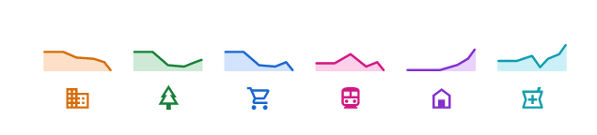
Community Mobility Reports
The reports chart movement trends over time by geography, across different categories of places such as retail and recreation, groceries and pharmacies, parks, transit stations, workplaces, and residential.
Internal country movement (not international)
Data representation = percentage to baseline
Notes:
The community mobility reports dataset was our other major dataset for this project. In the dataset it keeps track of the percent change in movement within countries for the time period of February 15th until November 1st. In detail, the movement data that is kept track of in it is the percent change of people moving to or spending time in retail and recreation locations, grocery stores and pharmacies, parks, transit stations, workplaces such as offices or other locations of in-person work, and residential areas.
Google developed these reports with the intention of being helpful but also maintaining their privacy protocols. The reports developed do not include any information which could help to identify a person such as their location, contacts or movement. The data was also only gathered from users of Google devices and maps who had turned on their location history, which is turned off by default. This decreases the accuracy slightly of the data, however it should still be a good statistical representation of the countries internal movement. The mobility data reports Google created will only be available until public health officials no longer find them useful, according to Google’s webpage for the datasets.
Some further explanation is needed still to understand the data in the community mobility reports. First, the baseline number which is what every datapoint is based off of is a median value based on a period of five weeks between January 3rd and February 6th. It is meant to represent a normal value for each day of the week. This value is not a perfect representation though as such a short period of the year can not represent the normal value for every region of the planet. This baseline day also never changes to help track week-to-week changes, however it does not account for changes in season which can change certain values like movement to parks.

Slide 8




Data Preprocessing & Visualization
Notes:
We would now like to talk about the data preprocessing we accomplished and data visualization which informed the rest of our project.

Slide 9
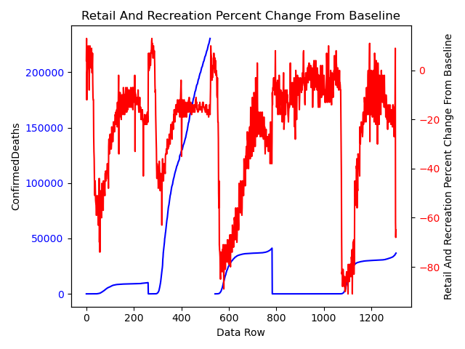
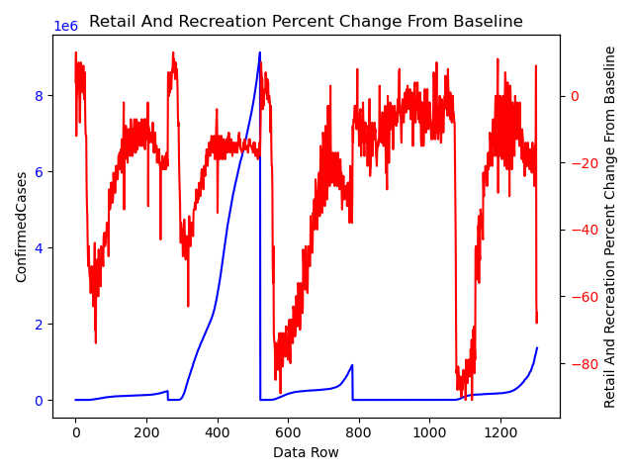
Canada, United States, United Kingdom, Taiwan, France
Notes:
As an example of the data visualization that was done for the Community mobility reports, these are a couple of the graphs. On the left is a comparison of the total confirmed deaths for a country in comparison to the change from the baseline for retail and recreation centres. On the right is the same but for confirmed number of cases in millions. For every approximately 260 data rows, the country changes. In these graphs, the countries being represented are Canada, the United States, the United Kingdom, Taiwan and France in that order. As can be seen, the numbers of confirmed cases and confirmed deaths does increase roughly the same as with increases in movement to and time spent in retail and recreation areas.

Slide 10
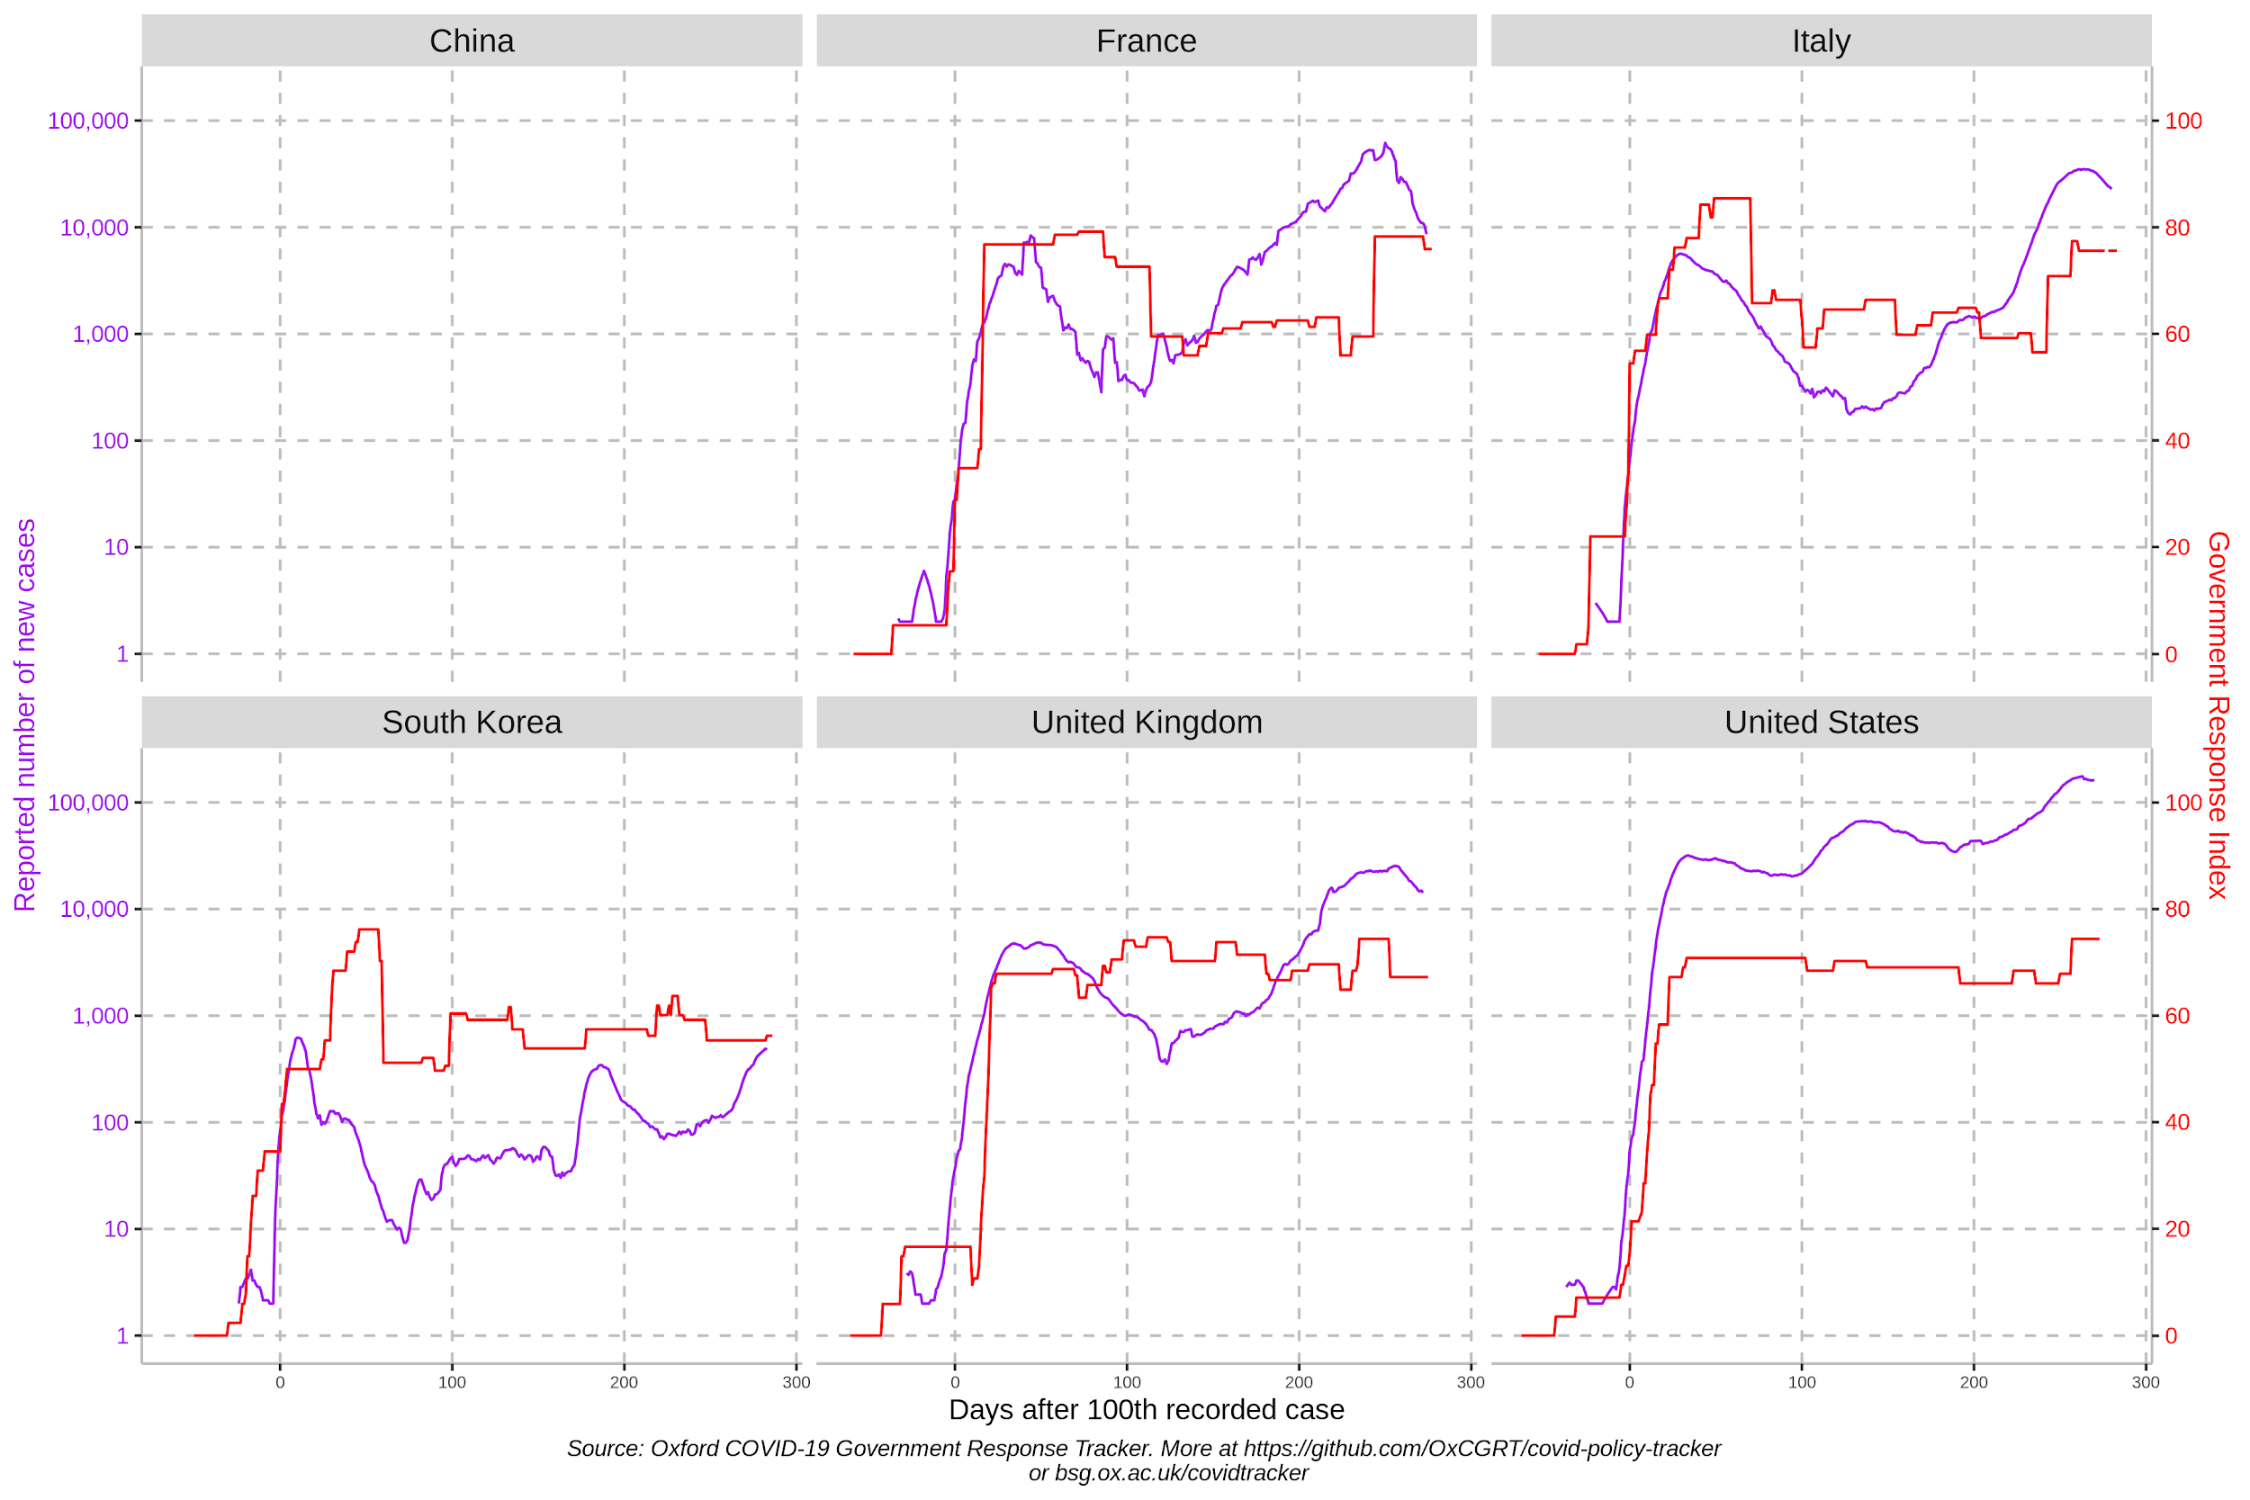
Government Response Index and Reported Number of New Cases (OxCGRT dataset)
Notes:
Johnny
These graphs were pulled from the Oxford Government Response Tracker Dataset.
It shows the Government Response Index and the Reported Number of New Cases in 2020 for a few countries.
The general trend we can take from this is that when there is a spike in the Government Response Index, there follows a dip in the Number of New Cases, and Vice Versa.
United States does not really follow this trend, most likely due to a large percentage of their population not following the government policies.

Slide 11
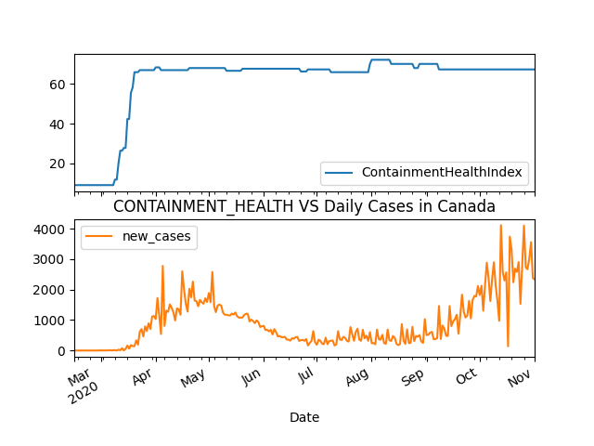
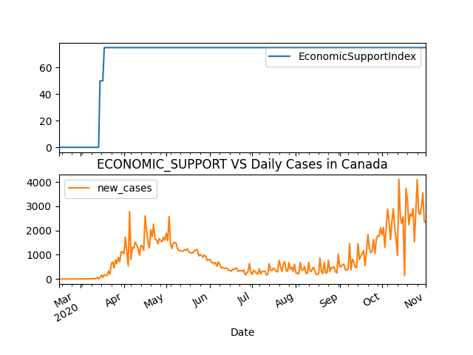
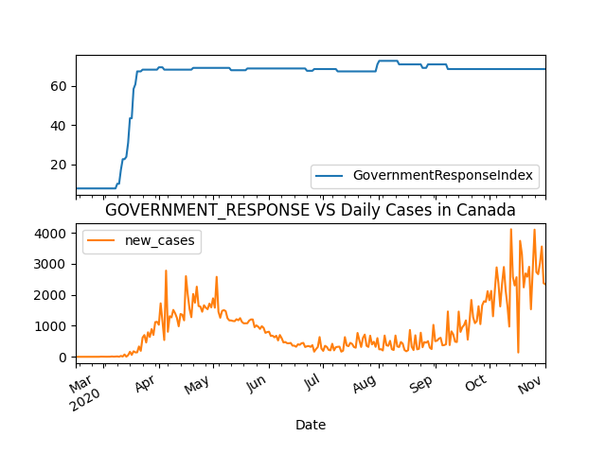
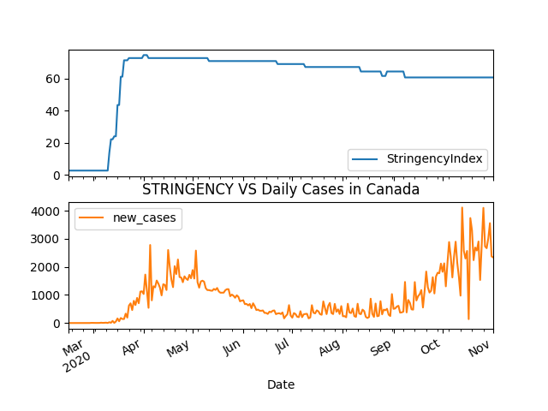
The 4 Aggregate Indices VS New Daily Cases in Canada
Notes:
Johnny
These 4 graphs were created through Matplotlib using the same government response tracker dataset.
It compares the 4 indices that aggregate the policy indicators, and the number of new daily cases in Canada.
However, these graphs only show the same trend discussed earlier, for 3 Indices: CH, GR, and Str.
So the Economic Support Index does not correlate well with the number of new daily cases.

Slide 12




Building Dataset
First Attempt
Second Attempt
Manually select 5 countries
Use certain time range ( 2020-02-15 to 2020-11-01)
Use countries which exist in all 3 datasets
Remove inconsistent countries:
Missing date within Feb - Nov
Missing values for government response (null)
Add countries population and density information (static)
Notes:
Louis

Slide 13



Building Dataset (contd.)
Complete.csv
Extract all relevant information from 3 open source datasets.
Features summary:
Country Name, Date, Government Response Indicators, Mobility Features, Population, Population Density, etc.
Label decision:
Cumulative confirmed cases
Daily new cases
Cumulative confirmed deaths
Notes:
Louis

Slide 14

Machine Learning Solution

Slide 15


Model Selection
Random Forest Regressor
XGBoost Regressor
Extra Tree Regressor
Stacking Regressor
Notes:
Louis - 1 & 2
James - 3 & 4
The extra tree regressor is a regressor class under the sklearn ensemble module that uses a meta estimator, an estimator which uses another estimator as a parameter, to fit a number of randomized decision trees. This is why it is called the extra-trees regressor. These decision trees are then used on various sub-samples of the dataset being looked at after which the class uses averaging to improve its prediction accuracy and to control over-fitting of data.
The stacking regressor on the other hand is another class in the ensemble module which takes a stack of estimators such as the random forest regressor and extra forest regressor, or any other regressor in the sklearn library, and uses the estimates gained from those regressor classes to inform it’s final regressor. In the stacking regressor, a stacked generalization consisting of the stacked outputs of the estimators is created which is then used as an input for the final estimator which is also chosen by the user. For this project, the estimators chosen for the stack were the random forest regressor, the gradient boosting regressor, the linear SVR class and the extra trees regressor, while the final regressor was also the extra trees regressor.

Slide 16
Parameter Tuning
5-Fold Cross Validation
Parameters
ExtraTreeRegressor and RandomForestRegressor
n_estimator = [50, 100, 150, 200, 250, 300]
XGBoostRegressor
learning_rate = [0.0001, 0.001, 0.01, 0.1, 0.2, 0.3]
n_estimator = [50, 100, 150, 200, 250, 300]
Notes:
Louis

Slide 17
Final Model
Mean Absolute Error = 310.3041
Mean Absolute Error with CountryName encoding = 296.5456
XGBoostRegressor

Slide 18
Insights
Notes:
From this project we learned a lot about working with real world datasets. There were a few specific insights though, that stood out to us.

Slide 19


What we have learned
Filtering to specific countries generates bias
Combining well, and cleaning datasets are very important
Cross Validation on model selection and parameter tuning is taking really long time; should be done early
Government are reactive
COVID-19 symptom appear 2 weeks later, so the “new cases” label may relate more to features from 2 weeks before
Notes:
One of the main points we learned about was that for the goal we were pursuing, filtering to a limited number of specific countries would not work, as it creates too much bias in the data since each country is so different. As well, we learnt how important it is to properly combine datasets and clean up the unusable data rows. Our first couple times running our models we had accidentally missed some rows which were missing data and this was affecting our results. After removing these rows our predictions got much better. Additionally, performing cross validation on model selection and parameter tuning is important but can take a long time and should be made sure to be finished early in a project of this sort.
A couple other insights we gained from this project that are less related to machine learning is that for one, governments seem to be more reactive when it comes to dealing with the pandemic as opposed to being proactive. Secondly, because of the nature of the incubation time of Covid-19, symptoms could appear around 2 weeks after infection and the new cases label could possibly be more related to the same day from two weeks in the past as opposed to the day they are reported which makes predicting these cases hard.

Slide 20
Team Member Contributions
James Pike | Data Visualization ExtraTreeRegressor Model StackingRegressor Model | Research Report and Poster
Louis Lu | Data Visualization RandomForestRegressor Model XGBoost Model | Combined Datasets Research Report and Poster
John Gilpin | Data Visualization & Graph Generation Add population features | Research Report and Poster
Jaskamal Singh | Data Visualization Research | Report and Poster
Notes:
This is the team member contributions for our project. Thank you.

Slide 21

Q&A
Notes:
Are there any questions?

Slide 22
Citations
Thomas Hale, Sam Webster, Anna Petherick, Toby Phillips, and Beatriz Kira. (2020). Oxford COVID-19 Government Response Tracker. Blavatnik School of Government. https://github.com/OxCGRT/covid-policy-tracker.
Google. (2020, December 1). COVID-19 Community Mobility Reports. https://www.google.com/covid19/mobility/.
Hasell, J., Mathieu, E., Beltekian, D. et al. (2020). A cross-country database of COVID-19 testing. Sci Data 7, 345. https://doi.org/10.1038/s41597-020-00688-8.
Prabhu, Tanu N. (2020, September). Population by Country - 2020. Worldometer. www.kaggle.com/tanuprabhu/population-by-country-2020.
Sklearn Library Cross Validation for Parameter Tuning. https://machinelearningmastery.com/tune-number-size-decision-trees-xgboost-python/.

