Slide 1

§5 Minimum Spanning Tree
【Definition】 A spanning tree of a graph G is a tree which consists of V( G ) and a subset of E( G )包含所有顶点
〖Example〗 A complete graph and three of its spanning trees
Note: 有生成树 == 连通图
The minimum spanning tree is a tree since it is acyclic -- the number of edges is |V| – 1.
It is minimum for the total cost of edges is minimized.
It is spanning because it covers every vertex.
A minimum spanning tree exists iff G is connected.
Adding a non-tree edge to a spanning tree, we obtain a cycle.
1/4

Slide 2

§5 Minimum Spanning Tree
Greedy Method
Make the best decision for each stage, under the following constrains :
(1) we must use only edges within the graph; 用图中的边
(2) we must use exactly |V| −1 edges;满足边的数量
(3) we may not use edges that would produce a cycle.不产生环
1. Prim’s Algorithm – grow a tree
/* very similar to Dijkstra’s algorithm */
v₁
2
v₂
4
1
3
10
v₃
2
v₄
7
v₅
8
4
5
6
v₆
1
v₇
2/4

Slide 3
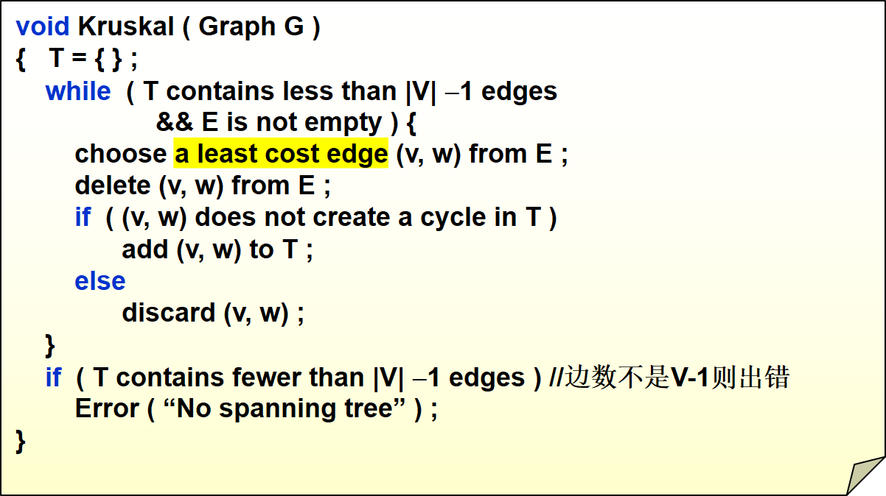

§5 Minimum Spanning Tree
2. Kruskal’s Algorithm – maintain a forest
/* DeleteMin */
/* Union / Find */ 把所有符合的最小边都连起来
图由散点图变成逐渐连接的过程
A more detailed pseudocode is given by Figure 9.58 on p.321
3/4

Slide 4


Laboratory Project 3
Image Segmentation
Due: Monday, December 4th, 2017 at 10:00pm
Detailed requirements can be downloaded from http://www.cs.zju.edu.cn/ds/
Don’t forget to sign
you names
and duties at the end of
your report.

