Slide 1
CHAPTER 6
SORTING
Comparison-based sorting 基于比较的排序
§1 Preliminaries
void X_Sort ( ElementType A[ ], int N )
/* N must be a legal integer */
/* Assume integer array for the sake of simplicity */
/* ‘>’ and ‘<’ operators exist and are the only operations allowed on the input data */
/* Consider internal sorting only */
The entire sort can be done in main memory
1/4

Slide 2
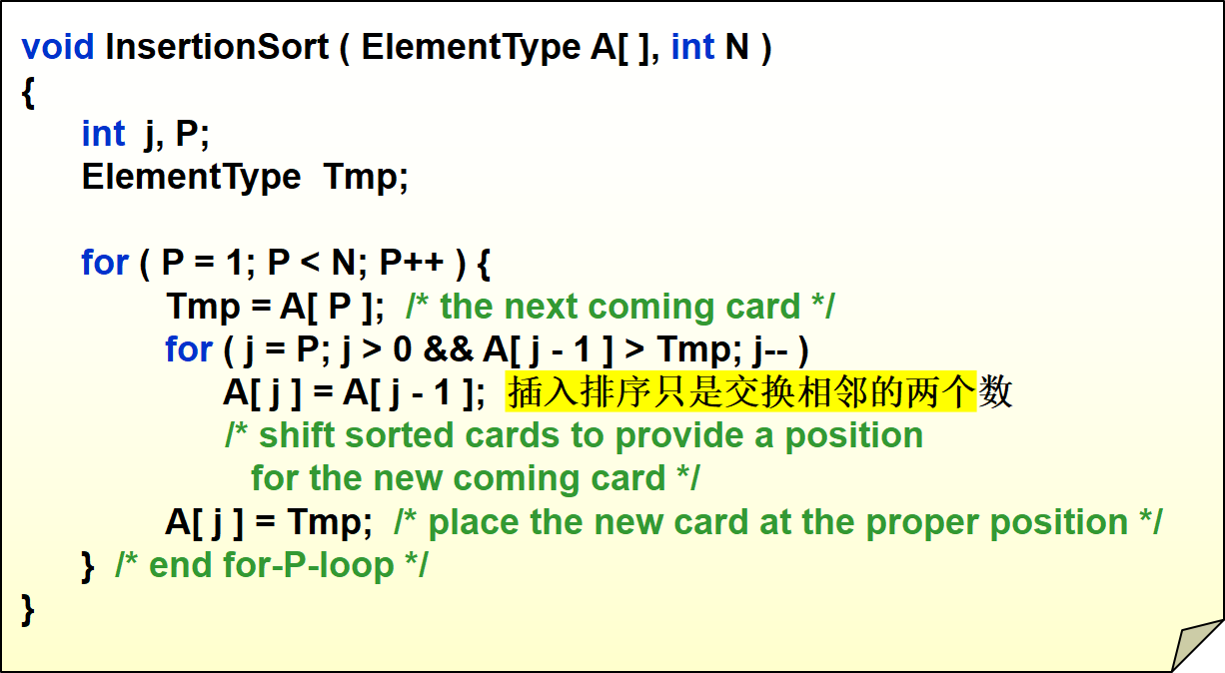
§2 Insertion Sort
The worst case:
Input A[ ] is in reverse order. T( N ) = O( N² )
The best case:
Input A[ ] is in sorted order. T( N ) = O( N )
2/4

Slide 3
§3 A Lower Bound for Simple Sorting Algorithms
【Definition】An inversion逆序对 in an array of numbers is any ordered pair ( i, j ) having the property that i < j but A[i] > A[j]. 插入排序只能一次改变一个逆序对
〖Example〗 Input list 34, 8, 64, 51, 32, 21 has inversions.
9
(34, 8) (34, 32) (34, 21) (64, 51) (64, 32) (64, 21) (51, 32) (51, 21) (32, 21)
There are swaps needed to sort this list by insertion sort.
9
Swapping two adjacent elements that are out of place removes exactly one inversion.
T ( N, I ) = O( ) where I is the number of inversions in the original array.
N是外层循环遍历所有点，I是逆序对的个数
I + N
Fast if the list is almost sorted.
3/4

Slide 4






§3 A Lower Bound
【Theorem】The average number of inversions in an array of N distinct numbers is N ( N − 1 ) / 4. 有C_{n}²个逆序对
【Theorem】Any algorithm that sorts by exchanging adjacent elements requires Ω ( N² ) time on average.
For a class of algorithms that performs
only adjacent exchanges, we’ll have to take
O( N² ) time to sort them.
Uhhh… hashing?
Is that all?
How can you speed it up?
Hey! We are talking about
comparison-based sorting.
You must do comparisons, and?
Smart guy! To run faster, we just
have to eliminate more than just
one inversion per exchange.
What does this theorem tell you?
… and swaps elements
that are far apart?
4/4

