Slide 1

§4 Shellsort ---- by Donald Shell 希尔排序
〖Example〗Sort:
81
94
11
96
12
35
17
95
28
58
41
75
15
5-sort
35
17
11
28
12
41
75
15
96
58
81
94
95
3-sort
28
12
11
35
15
41
58
17
94
75
81
96
95
1-sort
11
12
15
17
28
35
41
58
75
81
94
95
96
 Define an increment sequence h₁ < … < h_{t} ( h₁ = 1 )最后是1-sort
 Define an h_{k}-sort at each phase for k = t, t − 1, …, 1
Note: An h_{k}-sorted file that is then h_{k−1}-sorted remains h_{k}-sorted.
1/10

Slide 2
§4 Shellsort
☞ Shell’s increment sequence:
h_{t} = ⎣ N / 2 ⎦ , h_{k} = ⎣ h_{k+1} / 2 ⎦
void Shellsort( ElementType A[ ], int N )
{
int i, j, Increment;
ElementType Tmp;
for ( Increment = N / 2; Increment > 0; Increment /= 2 )
/*h sequence */
for ( i = Increment; i < N; i++ ) { /* insertion sort */
Tmp = A[ i ];
for ( j = i; j >= Increment; j - = Increment )
if( Tmp < A[ j - Increment ] )
A[ j ] = A[ j - Increment ];
else
break;
A[ j ] = Tmp;
} /* end for-I and for-Increment loops */
}
2/10

Slide 3
§4 Shellsort
☞ Worst-Case Analysis:
【Theorem】The worst-case running time of Shellsort, using Shell’s increments, is Θ ( N² ).
〖Example〗A bad case:
1
9
2
10
3
11
4
12
5
13
6
14
7
15
8
16
8-sort
1
9
2
10
3
11
4
12
5
13
6
14
7
15
8
16
4-sort
1
9
2
10
3
11
4
12
5
13
6
14
7
15
8
16
2-sort
1
9
2
10
3
11
4
12
5
13
6
14
7
15
8
16
1-sort
1
2
3
4
5
6
7
8
9
10
11
12
13
14
15
16
Pairs of increments are not necessarily relatively prime. Thus the smaller increment can have little effect.
3/10

Slide 4
§4 Shellsort
☞ Hibbard’s Increment Sequence:
h_{k} = 2^{k} − 1 ---- consecutive increments have no common factors.
【Theorem】The worst-case running time of Shellsort, using Hibbard’s increments, is Θ ( N^{3/2} ).
Shellsort is a very simple algorithm, yet with an extremely complex analysis. It is good for sorting up to moderately large input (tens of thousands).
Conjectures:
 T_{avg – Hibbard} ( N ) = O ( N^{5/4} )
 Sedgewick’s best sequence is {1, 5, 19, 41, 109, … } in which the terms are either of the form 9×4^{i} – 9×2^{i} + 1 or
4^{i} – 3×2^{i} + 1. T_{avg} ( N ) = O ( N^{7/6} ) and T_{worst} ( N ) = O ( N^{4/3} ).
☞ 排序算法的性质：· in-place 不需要同样大小的新数组来储存
☞ 排序算法的性质：· stable 不会改变原来相同数据的顺序
(插入排序可以设置stable 但是希尔排序不是stable)
4/10

Slide 5
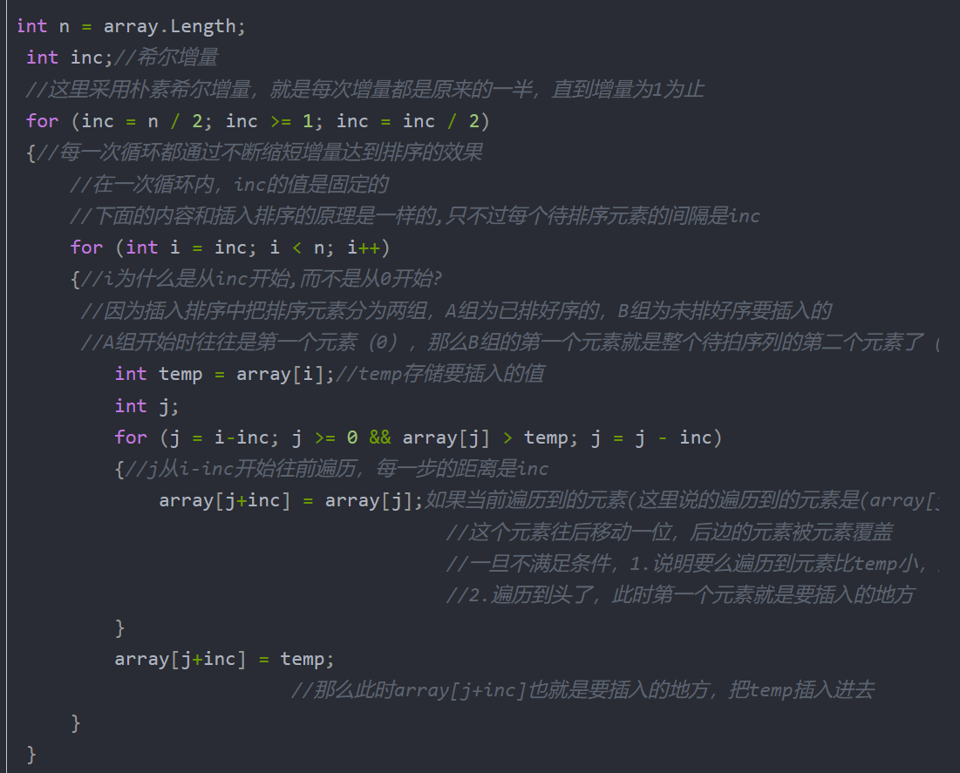
§5 Heapsort
Algorithm 1:
{
BuildHeap( H );
for ( i=0; i<N; i++ )
TmpH[ i ] = DeleteMin( H );
for ( i=0; i<N; i++ )
H[ i ] = TmpH[ i ];
}
/* PercolateDown的算法建堆O( N ) * /
/* O( log N ) */
/* O( 1 ) */
T ( N ) = O ( N log N )
 The space requirement is doubled.
5/10

Slide 6
§5 Heapsort
Algorithm 2:
void Heapsort( ElementType A[ ], int N )
{ int i;
for ( i = N / 2; i >= 0; i - - ) /* BuildHeap */
PercDown( A, i, N );
for ( i = N - 1; i > 0; i - - ) {
Swap( &A[ 0 ], &A[ i ] ); /* DeleteMax */
PercDown( A, 0, i );
}
}
b
d
b
c
a
b
A [0]
a
[1]
d
c
b
a
b
a
c
[2]
c
b
[3]
d
Heapsort data start from position 0.
【Theorem】The average number of comparisons used to heapsort a random permutation of N distinct items is
2N log N − O( N log log N ) .
Note: Although Heapsort gives the best average time, in practice it is slower than a version of Shellsort that uses Sedgewick’s increment sequence.
6/10

Slide 7
§6 Mergesort 归并排序 outplace & sable
1. Merge two sorted lists
Aptr
Aptr
Bptr
Bptr
1
13
24
26
2
15
27
38
1
2
Cptr
Cptr
Cptr
T ( N ) = O ( ) where N is the total number of elements.
N
7/10

Slide 8
2. Mergesort 分治思想
§6 Mergesort
void MSort( ElementType A[ ], ElementType TmpArray[ ],
int Left, int Right )
{ int Center;
if ( Left < Right ) { /* if there are elements to be sorted */
Center = ( Left + Right ) / 2;
MSort( A, TmpArray, Left, Center ); /* T( N / 2 ) */
MSort( A, TmpArray, Center + 1, Right ); /* T( N / 2 ) */
Merge( A, TmpArray, Left, Center + 1, Right ); /* O( N ) */
}
}
void Mergesort( ElementType A[ ], int N )
{ ElementType *TmpArray; /* need O(N) extra space */
TmpArray = malloc( N * sizeof( ElementType ) );
if ( TmpArray != NULL ) {
MSort( A, TmpArray, 0, N - 1 );
free( TmpArray );
}
else FatalError( "No space for tmp array!!!" );
}
If a TmpArray is declared locally for each call of Merge, then S(N) = O( )
N log N
8/10

Slide 9
§6 Mergesort
/* Lpos = start of left half, Rpos = start of right half */
void Merge( ElementType A[ ], ElementType TmpArray[ ],
int Lpos, int Rpos, int RightEnd )
{ int i, LeftEnd, NumElements, TmpPos;
LeftEnd = Rpos - 1;
TmpPos = Lpos;
NumElements = RightEnd - Lpos + 1;
while( Lpos <= LeftEnd && Rpos <= RightEnd ) /* main loop */
if ( A[ Lpos ] <= A[ Rpos ] )
TmpArray[ TmpPos++ ] = A[ Lpos++ ];
else
TmpArray[ TmpPos++ ] = A[ Rpos++ ];
while( Lpos <= LeftEnd ) /* Copy rest of first half */
TmpArray[ TmpPos++ ] = A[ Lpos++ ];
while( Rpos <= RightEnd ) /* Copy rest of second half */
TmpArray[ TmpPos++ ] = A[ Rpos++ ];
for( i = 0; i < NumElements; i++, RightEnd - - )
/* Copy TmpArray back */
A[ RightEnd ] = TmpArray[ RightEnd ];
}
9/10

Slide 10
3. Analysis
§6 Mergesort
T ( 1 ) = 1
Note: Mergesort requires linear extra memory, and copying an array is slow. It is hardly ever used for internal sorting, but is quite useful for external sorting.
T ( N ) = 2T ( N / 2 ) + O( N )
= 2^{k} T ( N / 2^{k} ) + k * O( N )
= N * T ( 1 ) + log N * O( N )
= O( N + N log N )
Iterative version :
A
0
1
2
3
…… ……
n−4
n−3
n−2
n−1
…… ……
…… ……
…… …… …… ……
10/10

