Slide 1
Dynamic Programming

Slide 2
Dynamic Programming
Solve sub-problems just once and save answers in a table
Use a table instead of recursion
1. Fibonacci Numbers: F(N) = F(N – 1) + F(N – 2)
int Fib( int N )
{
if ( N <= 1 )
return 1;
else
return Fib( N - 1 ) + Fib( N - 2 );
}
T(N) ≥ T(N – 1) + T(N – 2)
T(N) ≥ F(N)

Slide 3
F6
Dynamic Programming
F5
F4
F4
F3
F3
F2
F3
F2
F2
F1
F2
F1
F1
F0
F2
F1
F1
F0
F1
F0
F1
F0
F1
F0
Trouble-maker: The growth of redundant calculations is explosive.
Solution: Record the two most recently computed values to avoid recursive calls.
int Fibonacci ( int N )
{ int i, Last, NextToLast, Answer;
if ( N <= 1 ) return 1;
Last = NextToLast = 1; /* F(0) = F(1) = 1 */
for ( i = 2; i <= N; i++ ) {
Answer = Last + NextToLast; /* F(i) = F(i-1) + F(i-2) */
NextToLast = Last; Last = Answer; /* update F(i-1) and F(i-2) */
} /* end-for */
return Answer;
}
T(N) = O(N)

Slide 4
Dynamic Programming
2. Ordering Matrix Multiplications
〖Example〗 Suppose we are to multiply 4 matrices
M_{1 [ 10×20 ]} ∗ M_{2 [ 20×50 ]} ∗ M_{3 [ 50×1 ]} ∗ M_{4 [ 1×100 ]} .
If we multiply in the order
M_{1 [ 10×20 ]} ∗ ( M_{2 [ 20×50 ]} ∗ ( M_{3 [ 50×1 ]} ∗ M_{4 [ 1×100 ]} ) )
Then the computing time is
50 × 1 × 100 + 20 × 50 × 100 + 10 × 20 × 100 = 125,000
If we multiply in the order
( M_{1 [ 10×20 ]} ∗ ( M_{2 [ 20×50 ]} ∗ M_{3 [ 50×1 ]} ) ) ∗ M_{4 [ 1×100 ]}
Then the computing time is
20 × 50 × 1 + 10 × 20 × 1 + 10 × 1 × 100 = 2,200
Problem: In which order can we compute the product of n matrices with minimal computing time?

Slide 5
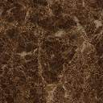
Dynamic Programming
Let b_{n} = number of different ways to compute M₁⋅ M₂⋅ ⋅ ⋅ ⋅ M_{n}. Then we have b₂ = 1, b₃ = 2, b₄ = 5, ⋅ ⋅ ⋅
Let M_{ij} = M_{i}⋅ ⋅ ⋅ ⋅ M_{j} . Then M_{1n} = M₁⋅ ⋅ ⋅ ⋅ M_{n} = M_{1i} ⋅ M_{i+1 n}
There are only O( N² ) values of M_{ij} .
If j – i = k , then the only values M_{xy} required to compute M_{ij} satisfy
y – x < k .
b_{n}
b_{i}
b_{n−i}
b
=
O
(
4
n
)
/* Catalan number */
n
n
n
Suppose we are to multiply n matrices M₁ ∗ ⋅⋅⋅ ⋅⋅⋅ ∗ M_{n} where M_{i} is an r_{i−1}× r_{i} matrix. Let m_{ij} be the cost of the optimal way to compute M_{i} ∗ ⋅⋅⋅ ⋅⋅⋅ ∗ M_{j} . Then we have the recurrence equations:

Slide 6
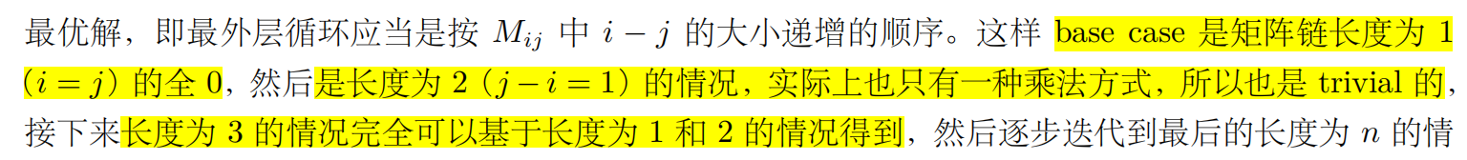
Dynamic Programming
/* r contains number of columns for each of the N matrices */
/* r[ 0 ] is the number of rows in matrix 1 */
/* Minimum number of multiplications is left in M[ 1 ][ N ] */
void OptMatrix( const long r[ ], int N, TwoDimArray M )
{ int i, j, k, L;
long ThisM;
for( i = 1; i <= N; i++ ) M[ i ][ i ] = 0;
for( k = 1; k < N; k++ ) /* k = j - i */
for( i = 1; i <= N - k; i++ ) { /* For each position */
j = i + k; M[ i ][ j ] = Infinity;
for( L = i; L < j; L++ ) {
ThisM = M[ i ][ L ] + M[ L + 1 ][ j ]
+ r[ i - 1 ] * r[ L ] * r[ j ];
if ( ThisM < M[ i ][ j ] ) /* Update min */
M[ i ][ j ] = ThisM;
} /* end for-L */
} /* end for-Left */
}
T(N) = O(N³ )
上面的矩阵最底下是base0，倒数第二行是base1...
To record the ordering please refer to Figure 10.46 on p.388

Slide 7

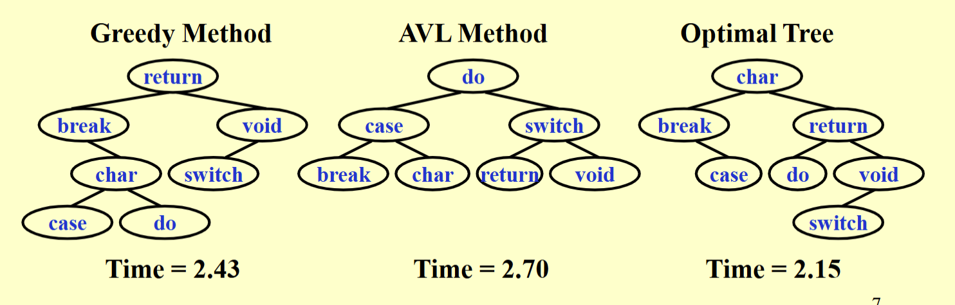
Dynamic Programming
3. Optimal Binary Search Tree
—— The best for static searching (without insertion and deletion)
Given N words w₁ < w₂ < …… < w_{N}, and the probability of searching for each w_{i} is p_{i} . Arrange these words in a binary search tree in a way that minimize the expected
total access time.
〖Example〗Given the following table of probabilities:
word
break
case
char
do
return
switch
void
probability
0.22
0.18
0.20
0.05
0.25
0.02
0.08
Discussion 10:
Please draw the trees obtained by greedy methods and by AVL rotations. What are their expected total access times?

Slide 8
Dynamic Programming
T_{i j} ::= OBST for w_{i} , ……, w_{j} ( i < j )
c_{i j} ::= cost of T_{i j} ( c_{i i} = 0 )
r_{i j} ::= root of T_{i j}
这里加上了weightL和R是因为分了两部分后L和R的深度加了一所以加上一次频率p_{k}
w_{i j} ::= weight of T_{i j} = ( w_{i i} = p_{i} )
T_{1N} with root r_{1N},
weight w_{1N}, and
cost c_{1N} .
T_{i j}
w_{k}
L
w_{i}…w_{k−1}
R
w_{k+1}…w_{j}
c_{i j} = ?
p_{k} + cost( L ) + cost( R )
+ weight( L ) + weight( R )
= p_{k} + c_{i, k−1} + c_{k+1, j} + w_{i, k−1} + w_{k +1, j} = w_{i j} + c_{i, k−1} + c_{k +1, j}
T_{i j} is optimal ⇒ r_{i j} = k is such that
这里有个问题l<j不能取等号

Slide 9
C33
Dynamic Programming
word
break
case
char
do
return
switch
void
probability
0.22
0.18
0.20
0.05
0.25
0.02
0.08
break.. break
case..case
char.. char
do..do
return..return
switch..switch
void.. void
0.22
break
0.18
case
0.20
char
0.05
do
0.25
return
0.02
switch
0.08
void
break.. case
case.. char
char..do
do.. return
return..switch
switch.. void
0.58
break
0.56
char
0.30
char
0.35
return
0.29
return
0.12
void
break.. char
case..do
char.. return
do.. switch
return.. void
按照字母序排好了，也是一颗搜索树
1.02
case
0.66
char
0.80
return
0.39
return
0.47
return
break..do
case.. return
char.. switch
do.. void
C35
1.17
case
1.21
char
0.84
return
0.57
return
char
break.. return
case.. switch
char.. void
break
return
1.83
char
1.27
char
1.02
return
break.. switch
case.. void
case
do
void
1.89
char
1.53
char
T(N) = O(N³ )
switch
break.. void
Please read 10.33 on p.419 for an O( N² ) algorithm.
2.15
char
右下角是考虑了局部最优的根结点，第一层就一个，第二层考虑两个节点，依次合并第一层的两个。例如计算C13需要找l=2(3个possibility相加+c11+c33)

Slide 10

Dynamic Programming
4. All-Pairs Shortest Path
For all pairs of v_{i} and v_{j} ( i ≠ j ), find the shortest path between.
Method 1 Use single-source algorithm for |V| times.
T = O( |V|³ ) – works fast on sparse graph.
Method 2 Define
D^{k}[ i ] [ j ] = min{ length of path i → { l ≤ k } → j }
and D⁻¹[ i ] [ j ] = Cost [ i ] [ j ]. Then the length of the shortest path from i to j is
D^{N−1}[ i ] [ j ].
这里的k表示经过的边个数
Algorithm
Start from D⁻¹ and successively generate D⁰, D¹, ..., D^{N−1}. If D^{k−1} is done, then either
① k ∉ the shortest path i → { l ≤ k } → j ⇒ D^{k} = D^{k−1} ; or
② k ∈ the shortest path i → { l ≤ k } → j
= { the S.P. from i to k } ∪ {the S.P. from k to j }
⇒ D^{k} [ i ] [ j ] = D^{k−1}[ i ] [ k ] + D^{k−1}[ k ] [ j ]

Slide 11
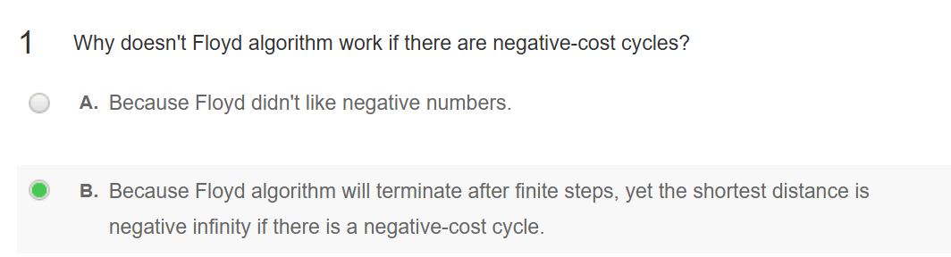
Dynamic Programming
/* A[ ] contains the adjacency matrix with A[ i ][ i ] = 0 */
/* D[ ] contains the values of the shortest path */
/* N is the number of vertices */
/* A negative cycle exists iff D[ i ][ i ] < 0 */
void AllPairs( TwoDimArray A, TwoDimArray D, int N )
{ int i, j, k;
for ( i = 0; i < N; i++ ) /* Initialize D */
for( j = 0; j < N; j++ )
D[ i ][ j ] = A[ i ][ j ];
for( k = 0; k < N; k++ ) /* add one vertex k into the path */
for( i = 0; i < N; i++ )
for( j = 0; j < N; j++ )
if( D[ i ][ k ] + D[ k ][ j ] < D[ i ][ j ] )
/* Update shortest path */
D[ i ][ j ] = D[ i ][ k ] + D[ k ][ j ];
}
T(N) = O(N³ ), but faster in a dense graph.
Works if there are negative edge costs, but no negative-cost cycles.
To record the paths please refer to Figure 10.53 on p.393

Slide 12
Dynamic Programming
How to design a DP method?
☞ Characterize an optimal solution
☞ Recursively define the optimal values 使用分治法
☞ Compute the values in some order
☞ Reconstruct the solving strategy

Slide 13
Dynamic Programming
5. Product Assembly
Two assembly lines for the same car
Different technology (time) for each stage
One can change lines between stages
Minimize the total assembly time
……
t_{0,0}
t_{0,1}
t_{0,2}
t_{0->1,0}
……
Parts
t_{1->0,0}
Car
……
t_{1,0}
t_{1,1}
t_{1,2}
Exhaustive search gives O( 2^{N} ) time + O( N ) space
这里2^{N}因为每次考虑是否跳到另一条路

Slide 14
Dynamic Programming
☞ Characterize an optimal solution
stage
Parts
Car
Slower path to stage
Optimal solution
 An optimal solution contains an optimal solution of a sub-problem!

Slide 15
Dynamic Programming
☞ Recursively define the optimal values
An optimal path to stage is based on an optimal path to stage–1
+
min
stage
☞ Compute the values in some order
+
O( N ) time + O( N ) space
f[0][0]=0; f[1][0]=0;
for (stage=1; stage<=n; stage++){
for (line=0; line<=1; line++){
f[line][stage] = min(
f[ line][stage-1] + t_process[ line][stage-1],
f[1-line][stage-1] + t_transit[1-line][stage-1]);
}
}
Solution = min(f[0][n],f[1][n]);

Slide 16
Dynamic Programming
☞ Reconstruct the solving strategy
f[0][0]=0; L[0][0]=0;
f[1][0]=0; L[1][0]=0;
for(stage=1; stage<=n; stage++){
for(line=0; line<=1; line++){
f_stay = f[ line][stage-1] + t_process[ line][stage-1];
f_move = f[1-line][stage-1] + t_transit[1-line][stage-1];
if (f_stay<f_move){
f[line][stage] = f_stay;
L[line][stage] = line;
}
else {
f[line][stage] = f_move;
L[line][stage] = 1-line;
}
}
}
line = f[0][n]<f[1][n]?0:1;
for(stage=n; stage>0; stage--){
plan[stage] = line;
line = L[line][stage];
}
如果想要找到借的情况，需要额外增加一个结构L[line][stage]记录每一个stage选择的是哪一条line，最后倒序找到plan

Slide 17
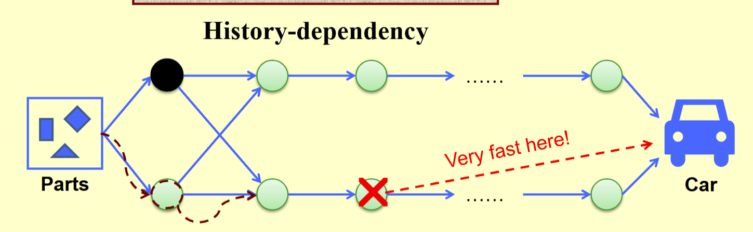
Dynamic Programming
Elements of DP:
☞ Optimal substructure
☞ Overlapping sub-problems
Discussion 11:
When can’t we apply dynamic programming?

Slide 18
Research Project 3
Beautiful Subsequence (26)
Given an integer m, we consider a sequence (with at least 2 elements) as beautiful if it contains 2 neighbors with difference no larger than m. Given an integer sequence with n elements, your job is to calculate the number of beautiful subsequences in it.
Detailed requirements can be downloaded from
https://pintia.cn/

Slide 19
Reference:
Introduction to Algorithms, 3rd Edition: Ch.15, p. 359-413； Thomas H. Cormen, Charles E. Leiserson, Ronald L. Rivest and Clifford Stein. The MIT Press. 2009

