Slide 1
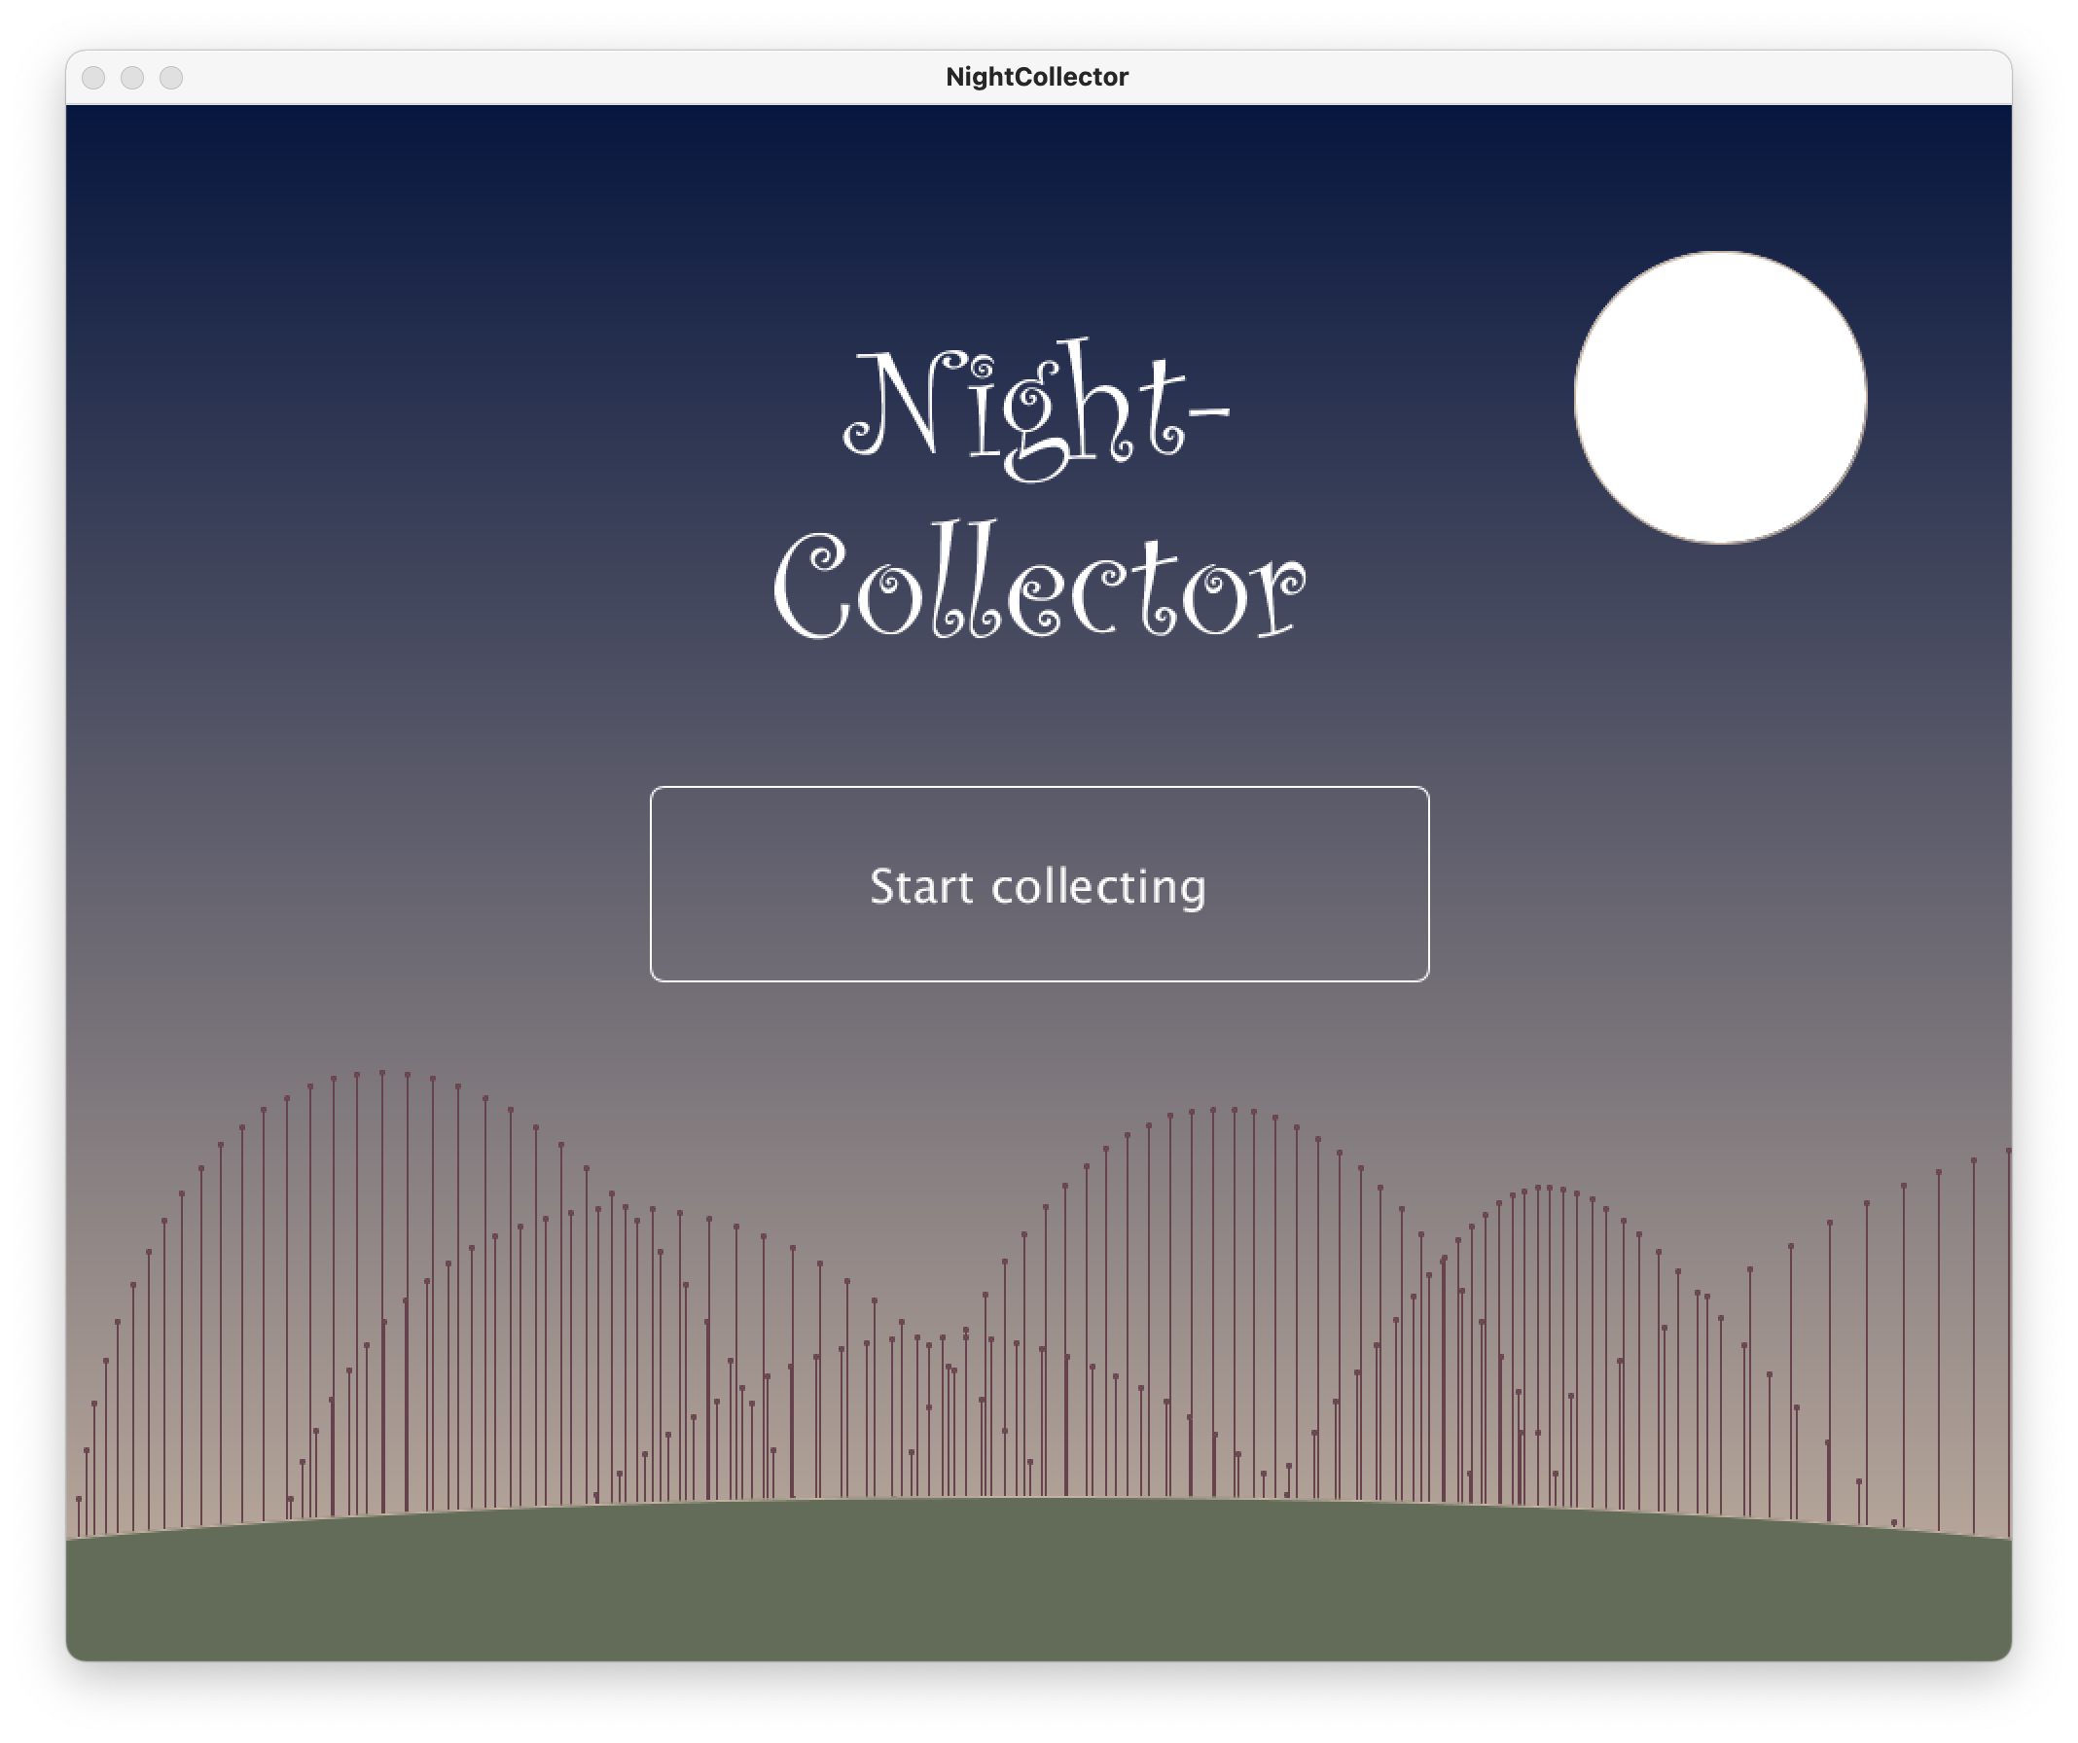
Notes:
What? (Andi)
Game to collect falling elements

Slide 2
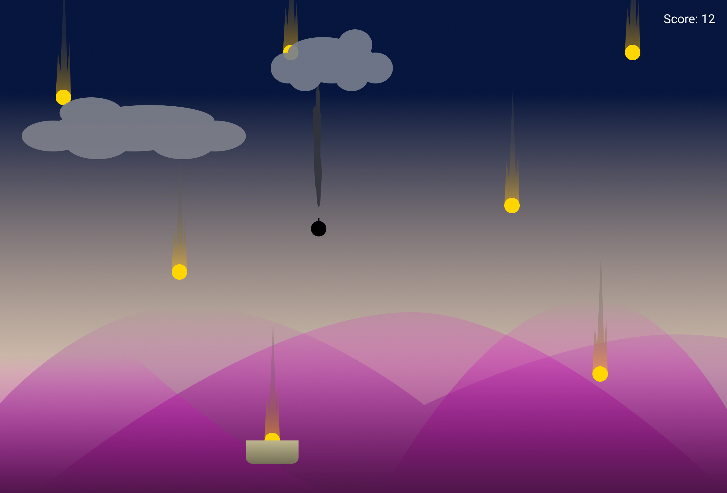
Notes:
Why? (Lou)

Slide 3

Notes:
how? (Lou)

Slide 4
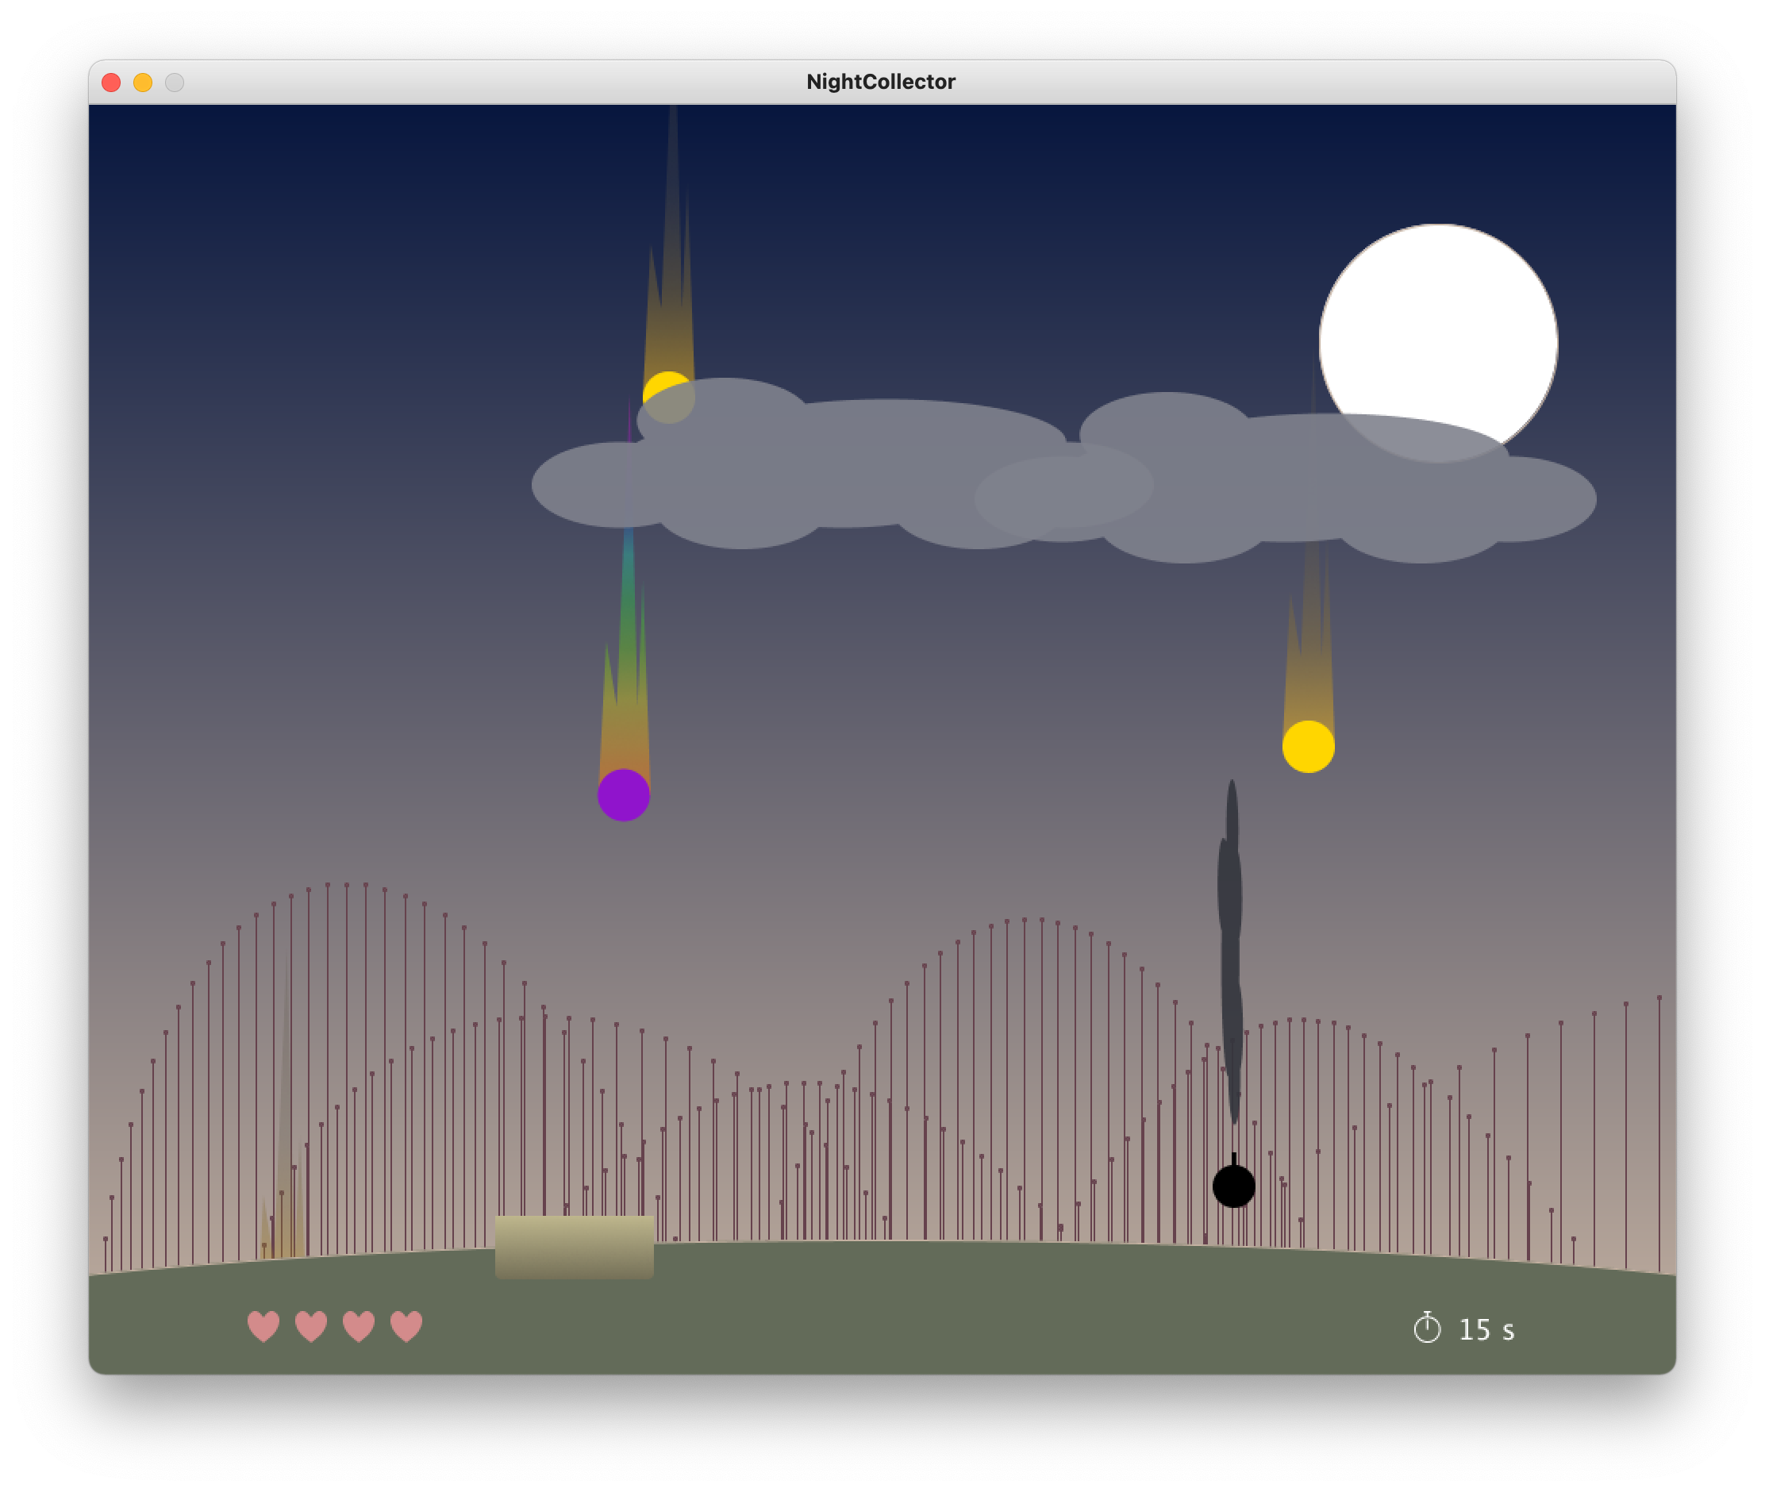
Notes:
STILL LOU: Talk about moutains and stuff
THEN ANDI: Results? Demo!

Slide 5
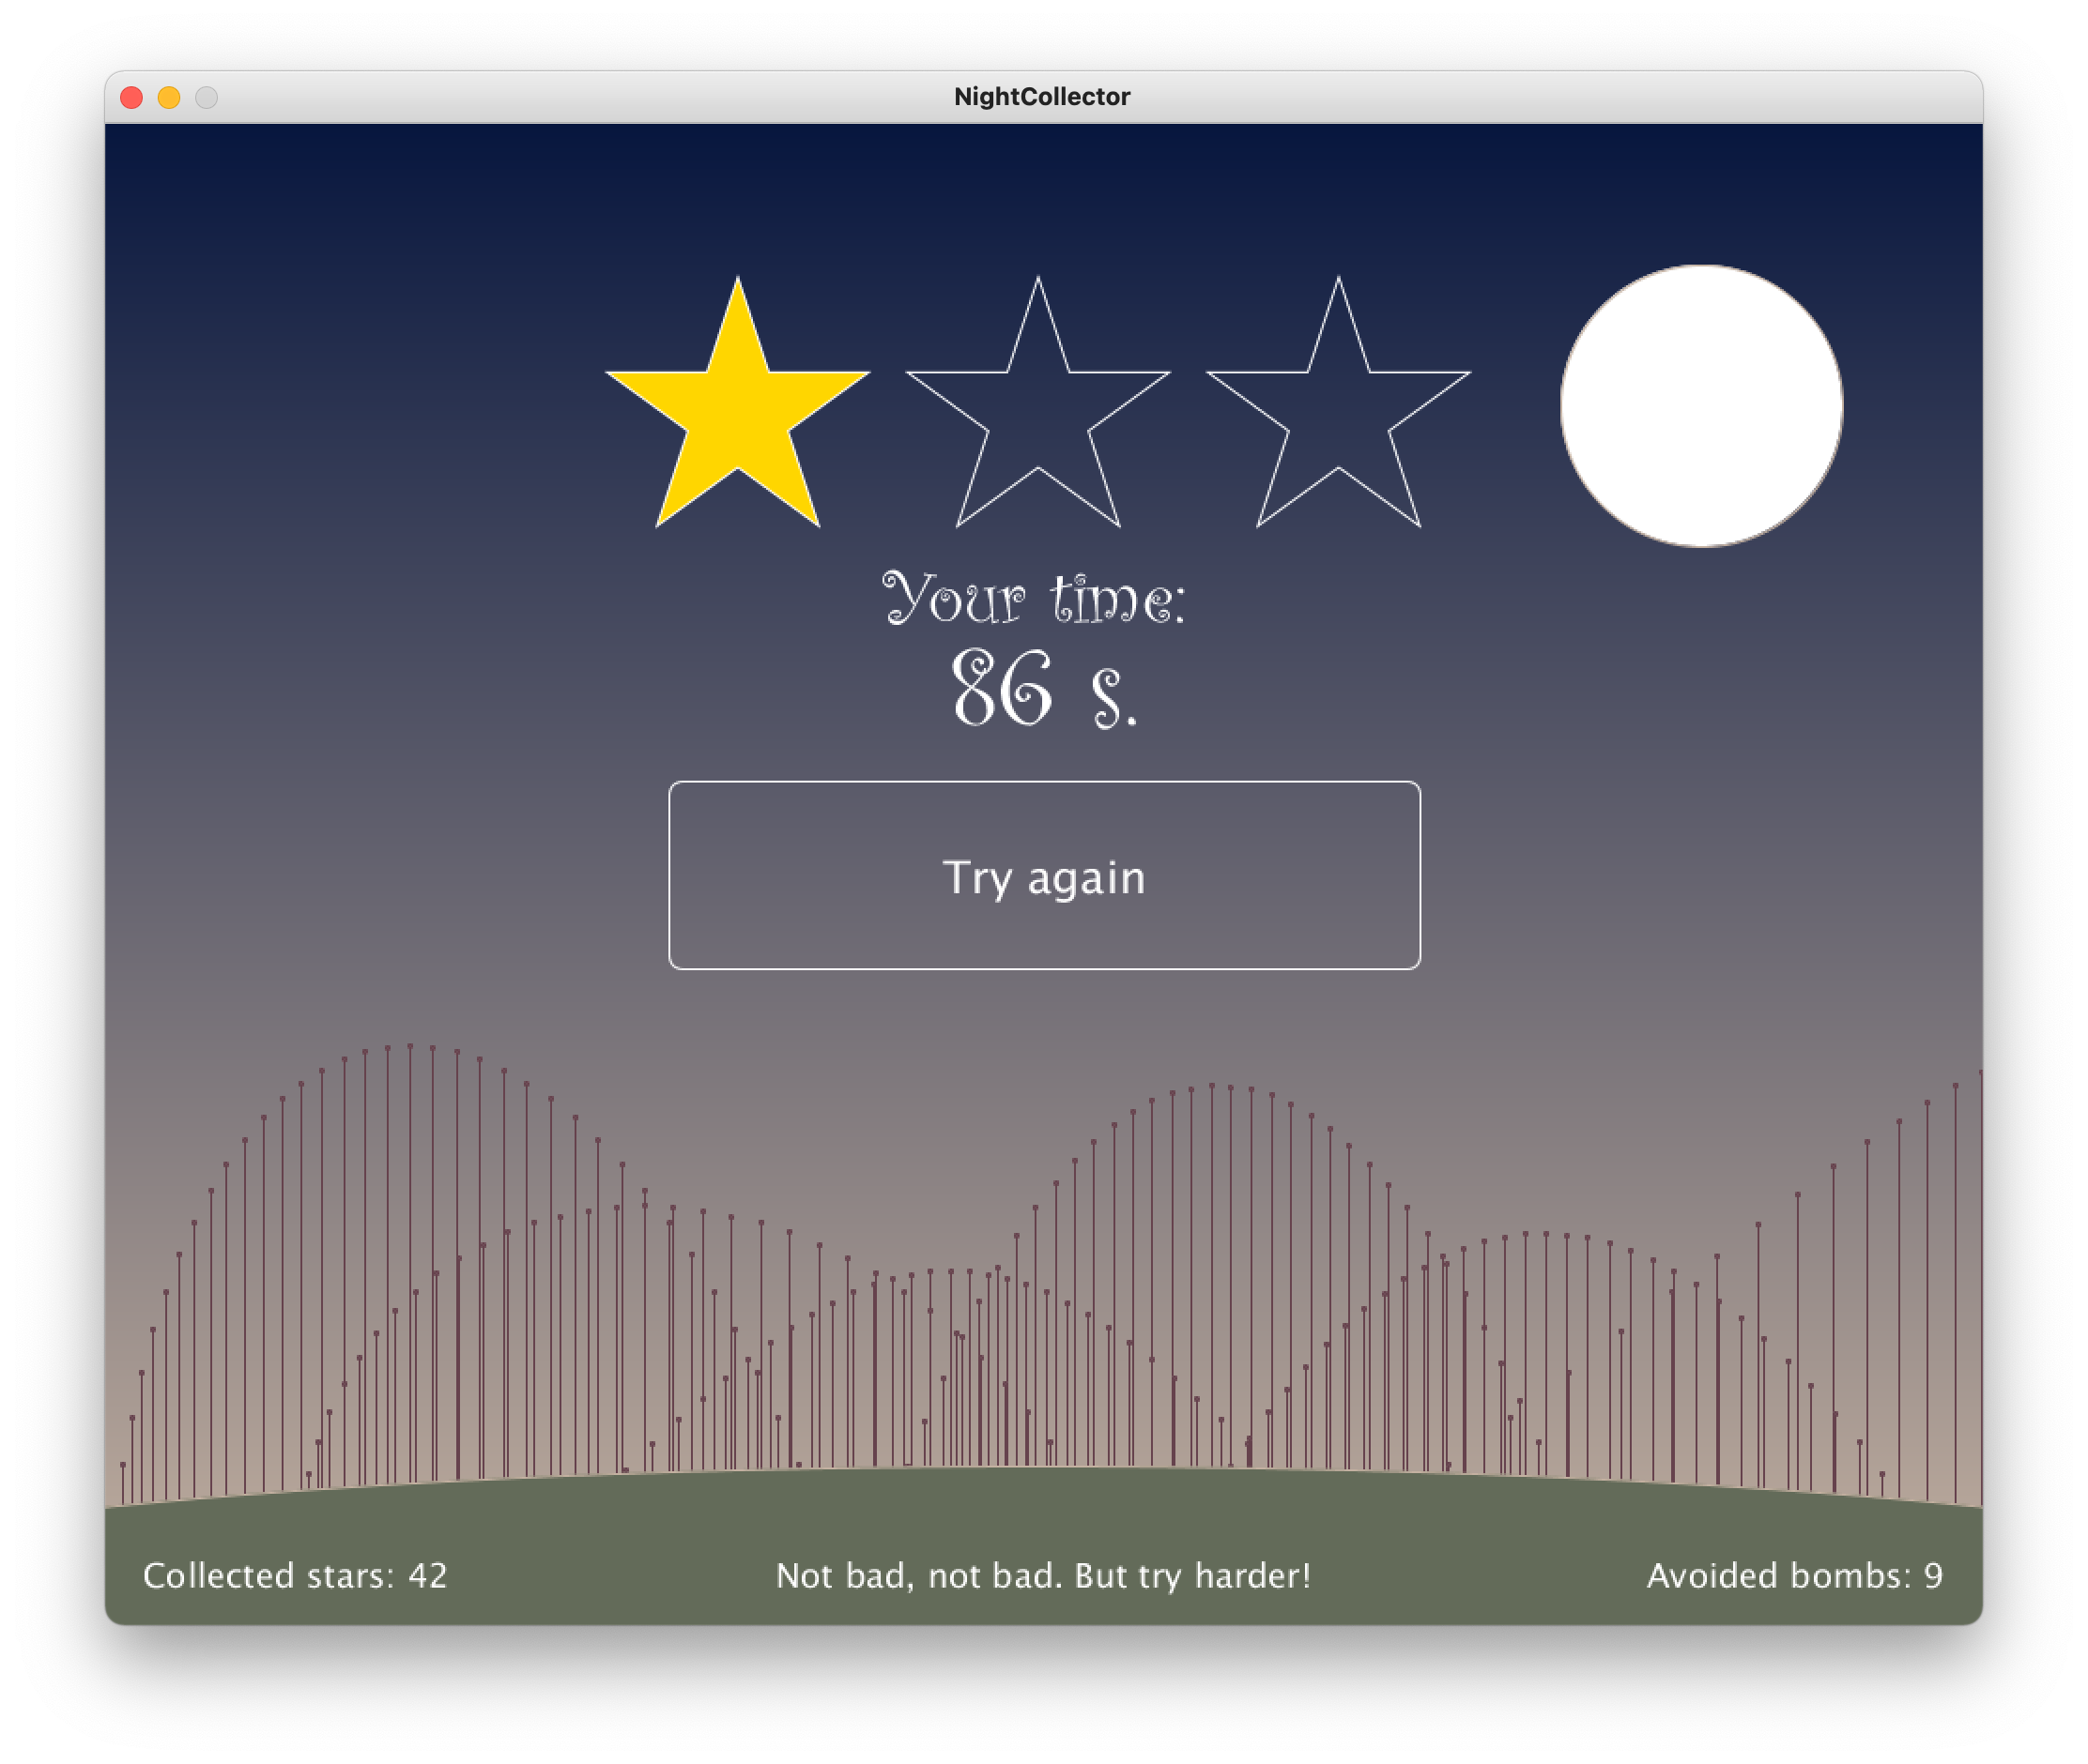
Notes:
Discussion

