Slide 1
Quantum Algorithm Grand Challenge 2024: A Special Ansatz Approach
Team: Tina Oberoi, Nicole and Louis Chen
Date: 1 Jul 2024

Slide 2
Introduction to Quantum Algorithm Grand Challenge
Quantum chemistry one of the most promising candidate for NISQ applications.
But still far from achieving the quantum advantage.
Besides high fidelity we need useful NISQ algorithms, defined evaluation criteria for performance comparisons.
QAGC Focus:
Practical Applications based NISQ algorithm
Evaluation criteria for performance benchmarking

Slide 3
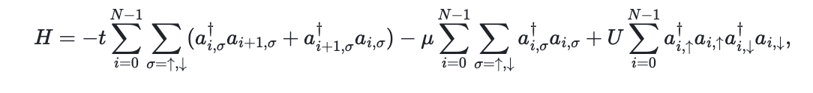
Problem Description
In quantum chemistry ground state an important quantity for understanding a system.
Goal of QAGC 2024: Find ground state energy of the Fermi Hubbard Model
Fermi Hubbard Model describes properties of strongly correlated electron systems.
Used to explain phenomena such as magnetism, Mott insulators, and high-temperature superconductors.

Slide 4
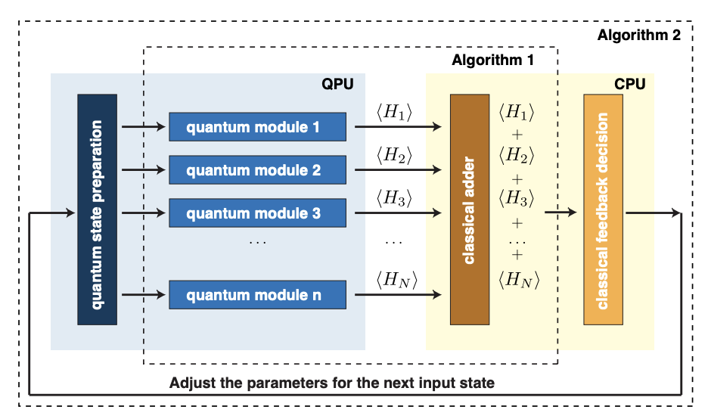
VQE
Hybrid Classical Algorithm based on variational principle.
Provides a way for approximating ground state energy.
VQE uses optimization algorithms to find optimal parameters.
https://arxiv.org/pdf/1304.3061

Slide 5
Setup in VQE algorithm
Encode qubit Hamiltonian
Choose parameterized ansatz for state preparation
Measure in the basis of qubit Hamiltonian to get expectation values
Send result to classical optimizer for updated parameters.

Slide 6
Crucial for success of VQE algorithm
1. Initialization of state
2. Choosing ansatz
3. Optimizers

Slide 7
State Initialization: Hartree-Fock (HF)
HF method provides a mean-field approximation of the electronic wavefunction.
It can serve as a good initial guess for the more accurate but computationally expensive VQE.
This is because the HF wavefunction is typically close to the true ground state wavefunction for many systems.

Slide 8
Choosing an ansatz
General Ansatz : Parameterized circuits made of one/two qubit gates. Usually of the form
Need for Ansatz: An ansatz that could optimize with fewer iterations.
Idea: FAMILY of PARAMETERISED UNITARIES

Slide 9


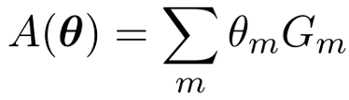
Choosing an ansatz
General Ansatz : Parameterized circuits made of one/two qubit gates. Usually of the form
Need for Ansatz: An ansatz that could optimize with fewer iterations.
Idea: FAMILY of PARAMETERISED UNITARIES

Slide 10
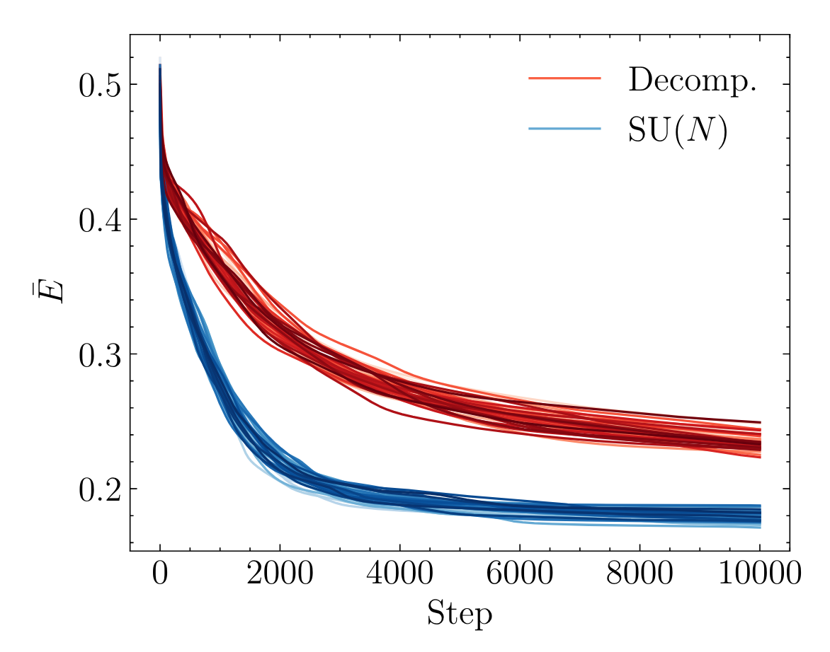
SU Performance
http://arxiv.org/abs/2303.11355

Slide 11
Results
Qubits | Value | Error (%) | Time Taken
4 | -3.99 | 0.25 | 21 sec
12 | -12.69 | 5.5 | 7 hrs
20 | -20.5 | 6.8 | 25 hrs
**Depth 2 steps 200** **SLSQP Optimizer**

Slide 12
Conclusion
We have constructed our solution using
HF Initialisation
SU Ansatz
SLSQP Optimizer

