Slide 1






Fermion Operator pool
6. Result
Measure Gradients
yes
1. Initialize
2. Select operators
From pool
Converged ?
Prepare states
….
5. Iteration
no
n = n + 1
Select operator
with largest gradient
Fermi-Hubbard Model
4. VQE: Re-optimize All Parameters
3. Anstaz Update
Grimsley, Harper R., et al. "An adaptive variational algorithm for exact molecular simulations on a quantum computer." Nature communications 10.1 (2019): 3007.
Process Flow of Adapt-VQE
For Fermi-Hubbard Model
Team: QuanInt
Quantum Algorithm Grand Challenege 23'

Slide 2
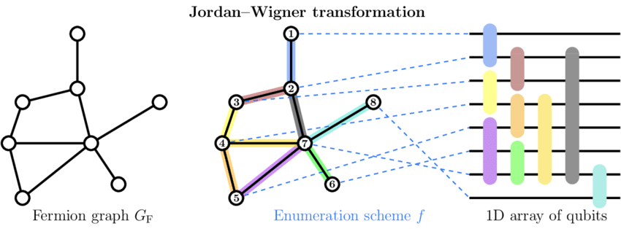
Step 1: Initialization:
The algorithm starts by initializing the Hamiltonian and the number of qubits.
The fermion pool is initialized based on the number of orbitals (which is half the number of qubits). The fermion pool consists of single and double excitation operators.
The fermion operators are then transformed into qubit operators using the Jordan-Wigner transformation. This forms the qubit pool.
The initial state is set to a computational basis state, and the initial ansatz circuit is constructed from the Hartree-Fock state.
Chiew, Mitchell, and Sergii Strelchuk. "Optimal fermion-qubit mappings." arXiv preprint arXiv:2110.12792 (2021).

Slide 3
Step 2: Operator Selection:
For each operator in the qubit pool, the algorithm calculates the gradient of the operator with respect to the current state.
The operator with the largest absolute gradient is selected and added to the ansatz.
Step 3: Ansatz Update:
The ansatz circuit is updated by appending the selected operator.
The new parameter associated with the selected operator is initialized to zero.

Slide 4
Step 4: Parameter Optimization:
The parameters of the ansatz circuit are optimized using the Adam optimizer.
The cost function is the expectation value of the Hamiltonian, and the gradient is calculated using the parameter-shift rule.
The optimization process updates the parameters to minimize the cost function.
Step 5: Iteration:
Steps 2-4 are repeated until a stopping condition is met. In this case, the stopping condition is when the total quantum circuit time exceeds a certain limit.

Slide 5
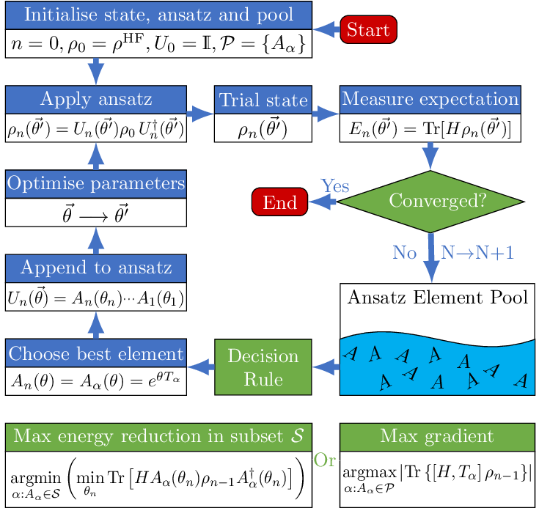
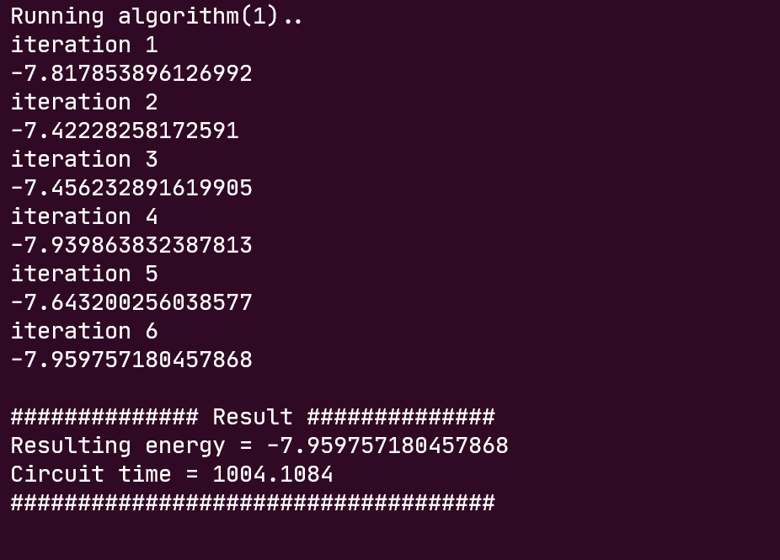
Result:
The final result is the minimum expectation value of the Hamiltonian, which represents the estimated ground state energy of the system.
END
Yes
Dalton, Kieran, et al. "Variational quantum chemistry requires gate-error probabilities below the fault-tolerance threshold." arXiv preprint arXiv:2211.04505 (2022).

