Slide 1

ReadUp
2201810943 - Muhamad Daffa Mennawi
2201760945 - Kevin Orlando Sutanto
2201752994 - Louis Choules

Slide 2
ReadUp
ReadUp is a free website to read various Japanese comics and manga
The website is entirely free without ads and is delivered in high definition
Disclaimer: Website still uses dummy data

Slide 3
Homepage

Slide 4
Explanation
The homepage shows some of the most currently popular manga and some of the most recent releases. The algorithm used for determining which manga is popular is still not final so it can still be adjusted.

Slide 5
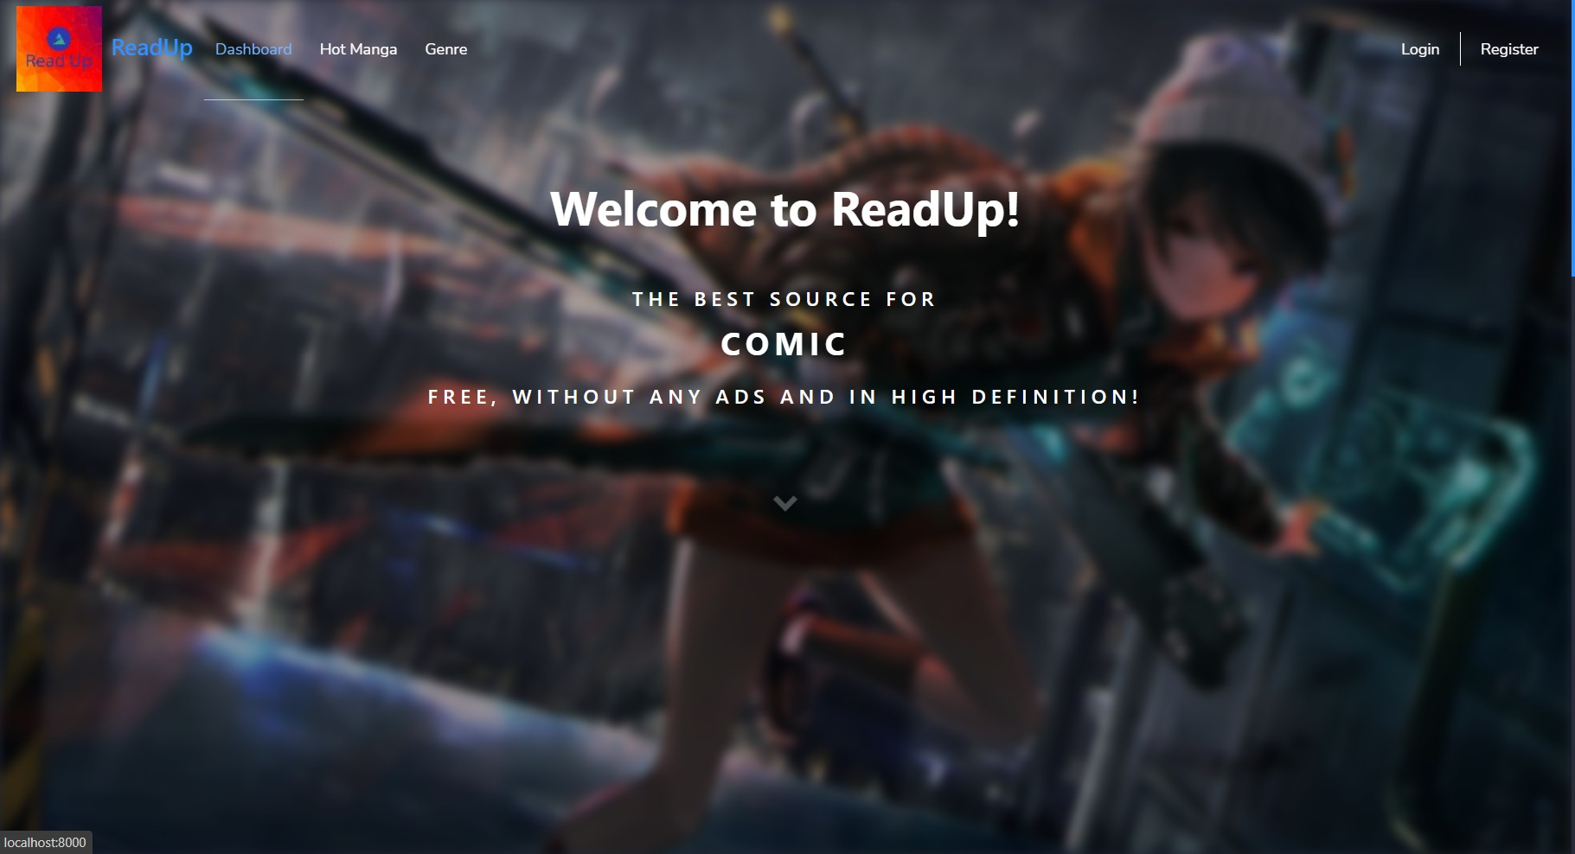

Slide 6
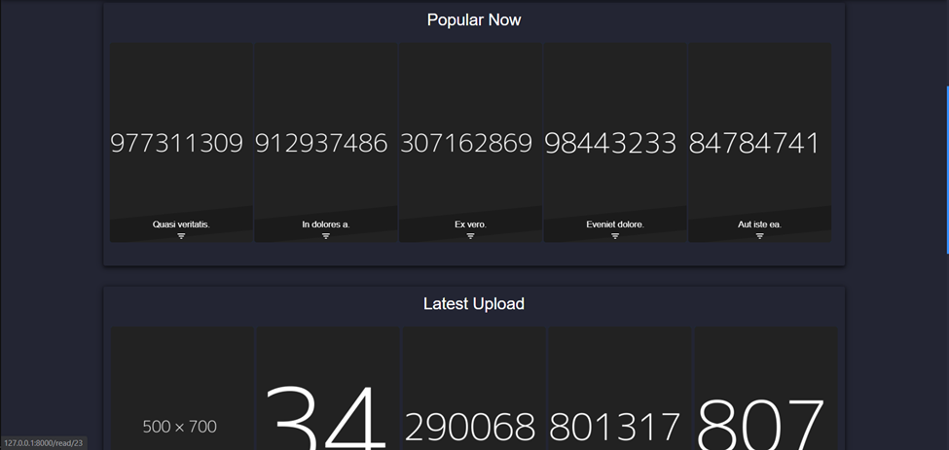

Slide 7
Hot Manga

Slide 8
Explanation
This page shows more of the currently trending Manga according to user’s rating and view.

Slide 9
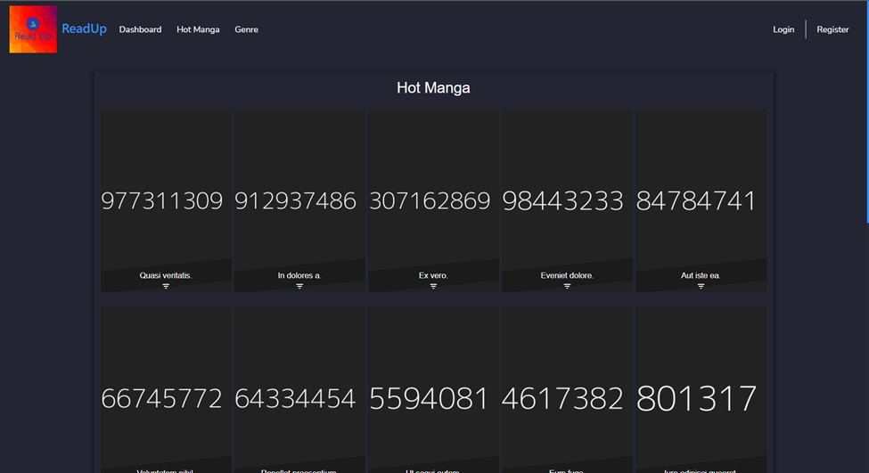

Slide 10
Genre

Slide 11
Explanation
This page shows all of the available genre so that the user can search for manga based on its genre. The genres can be displayed in two ways, sorted according to alphabetical order or by popularity.

Slide 12
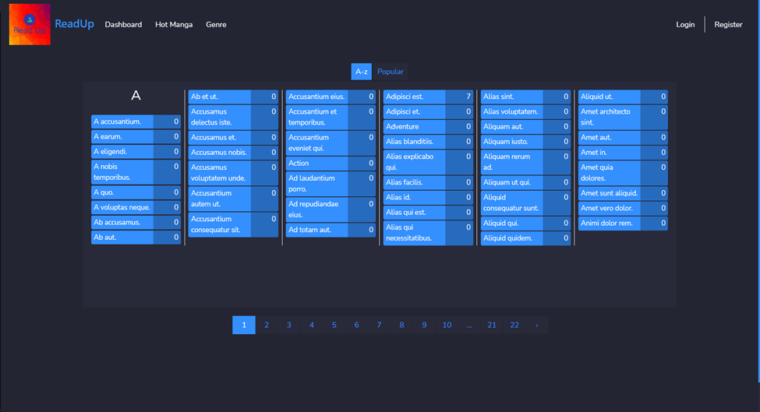

Slide 13
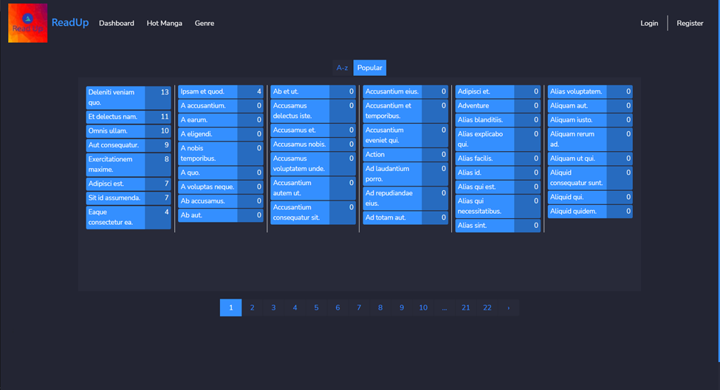

Slide 14
Display Manga by Genre

Slide 15
Explanation
This page shows all manga which fit certain genre chosen by the user

Slide 16
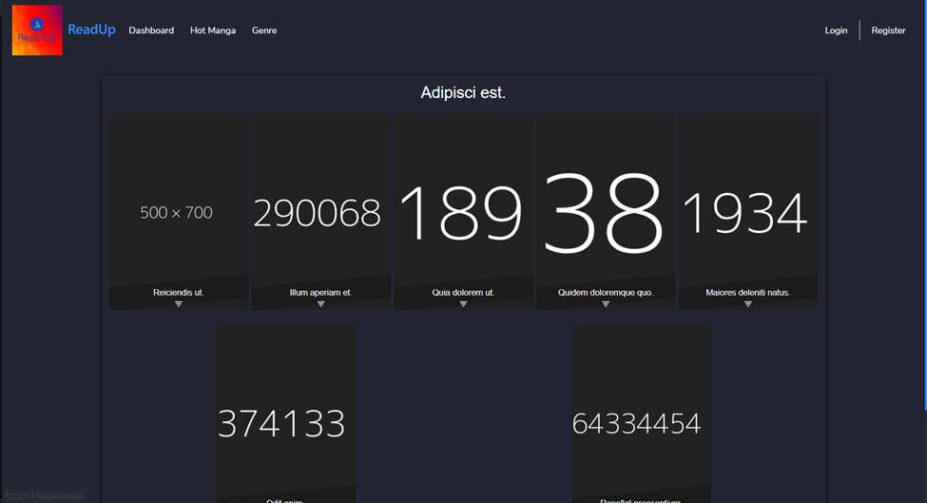

Slide 17
Manga Detail

Slide 18
Explanation
This page shows a selected manga’s details, including its ratings, list of available chapters, description and many more.

Slide 19
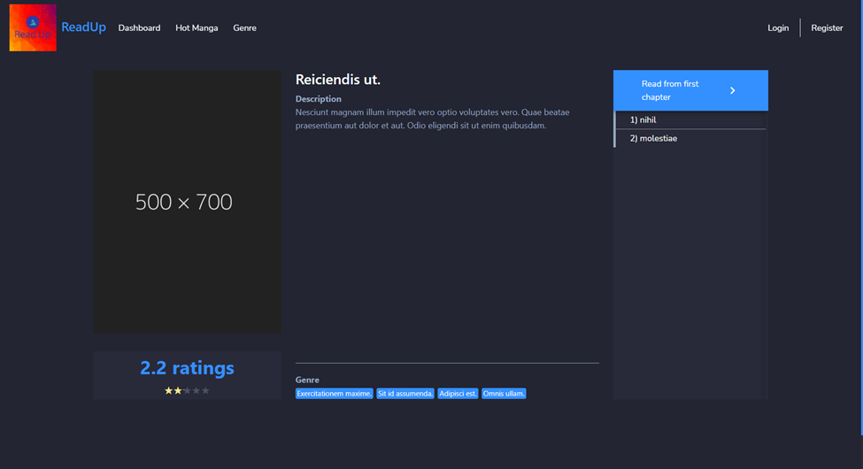

Slide 20
Read Manga

Slide 21
Explanation
This is the page where the users read the manga page by page, delivered in high quality.

Slide 22
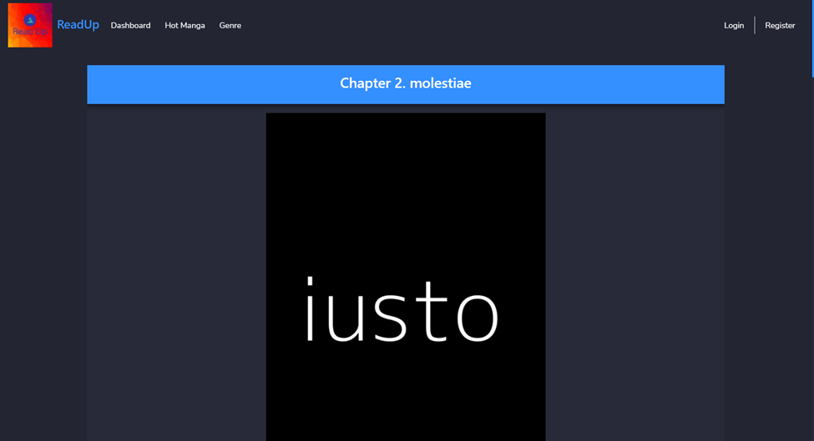

Slide 23
Authentication

Slide 24
Explanation
ReadUp also provides user with login and register page so that we can keep track of many things a user has already done, such as leaving a rating on a manga or many other activities.

Slide 25
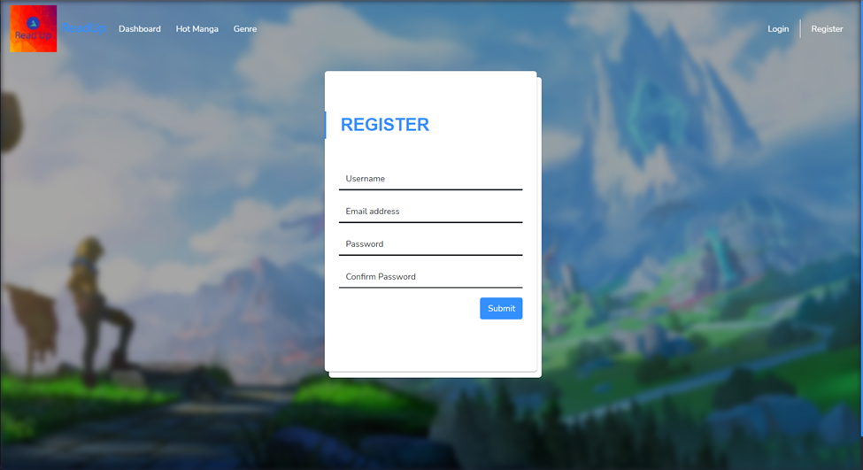

Slide 26
