Slide 1
Sequential Labeling for Building Sensors
Zheng Luo

Slide 2
Introduction
Smart buildings are a trend, and have a large demand on sensors for different functionalities; they must be properly recognized and managed.
Human recognizing and labeling is too expensive or impossible.
Want to give a solution to automatically label the sensor names.
Want to use as few human efforts as possible.

Slide 3
Dataset
Our dataset is a set of strings with a fixed length 14. Each character in each string is manually labeled for experiments.
We use BIO (beginning-inside-outside) tagging format.
For example,
SODA4337A_RVAV
B-site, I-site, I-site, B-ahu, I-ahu, B-room, I-room, I-room, I-room, O, B-RVAV, I-RVAV, I-RVAV, I-RVAV

Slide 4
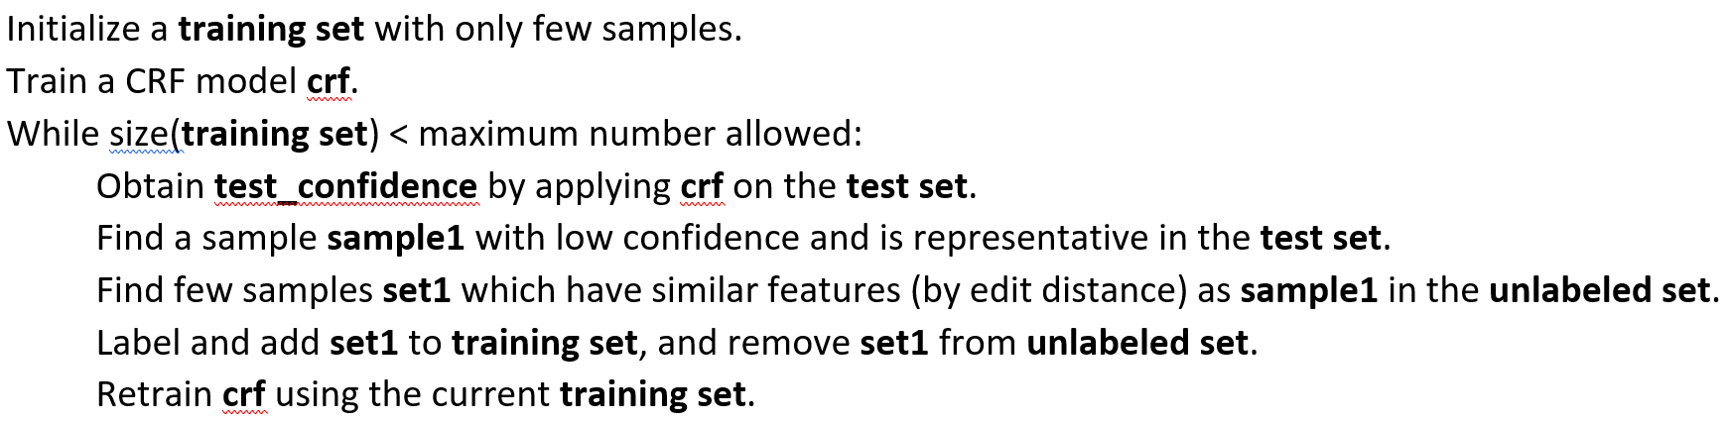
Proposed Method (Baseline)
Conditional random field with active learning.

Slide 5
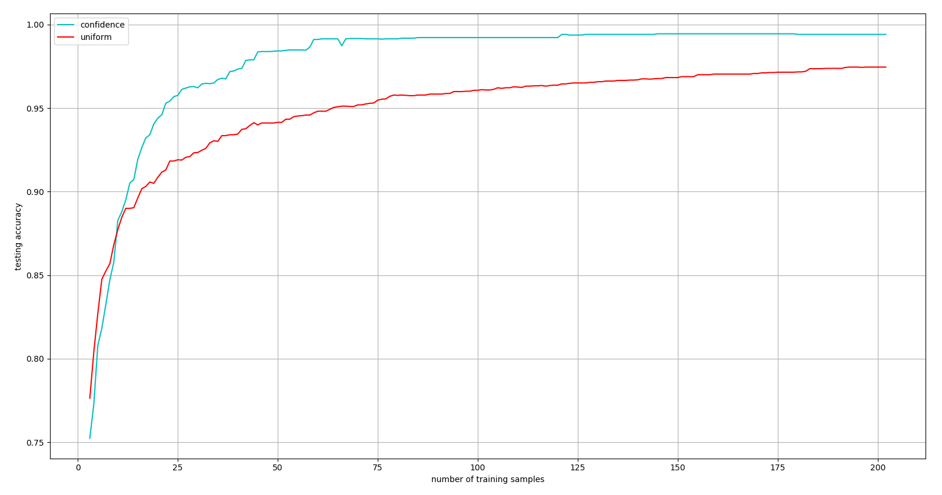
Proposed Method (Baseline)

Slide 6
Proposed Method (Improving)
Query on patterns instead of whole strings.
Phrase-level errors are most likely made due to unseen patterns by a CRF.
Querying on whole strings may keep the CRF model away from some important features because the queried information is averaged.
Further reduce human efforts.
Pseudo labeling.
For a queried sample string, only label the needed patterns (by humans), pseudo-label the other patterns (by the currently trained CRF).
Want to keep a balanced impact between human and pseudo labeling. May need to add some simple constraints/rules when doing pseudo labeling.

