Slide 1
MTA16431

Slide 2
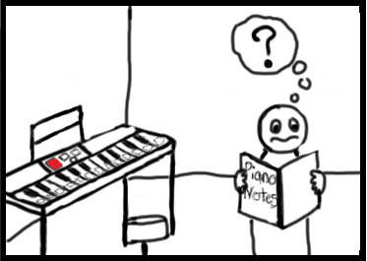
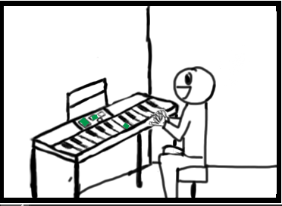
Storyboard

Slide 3
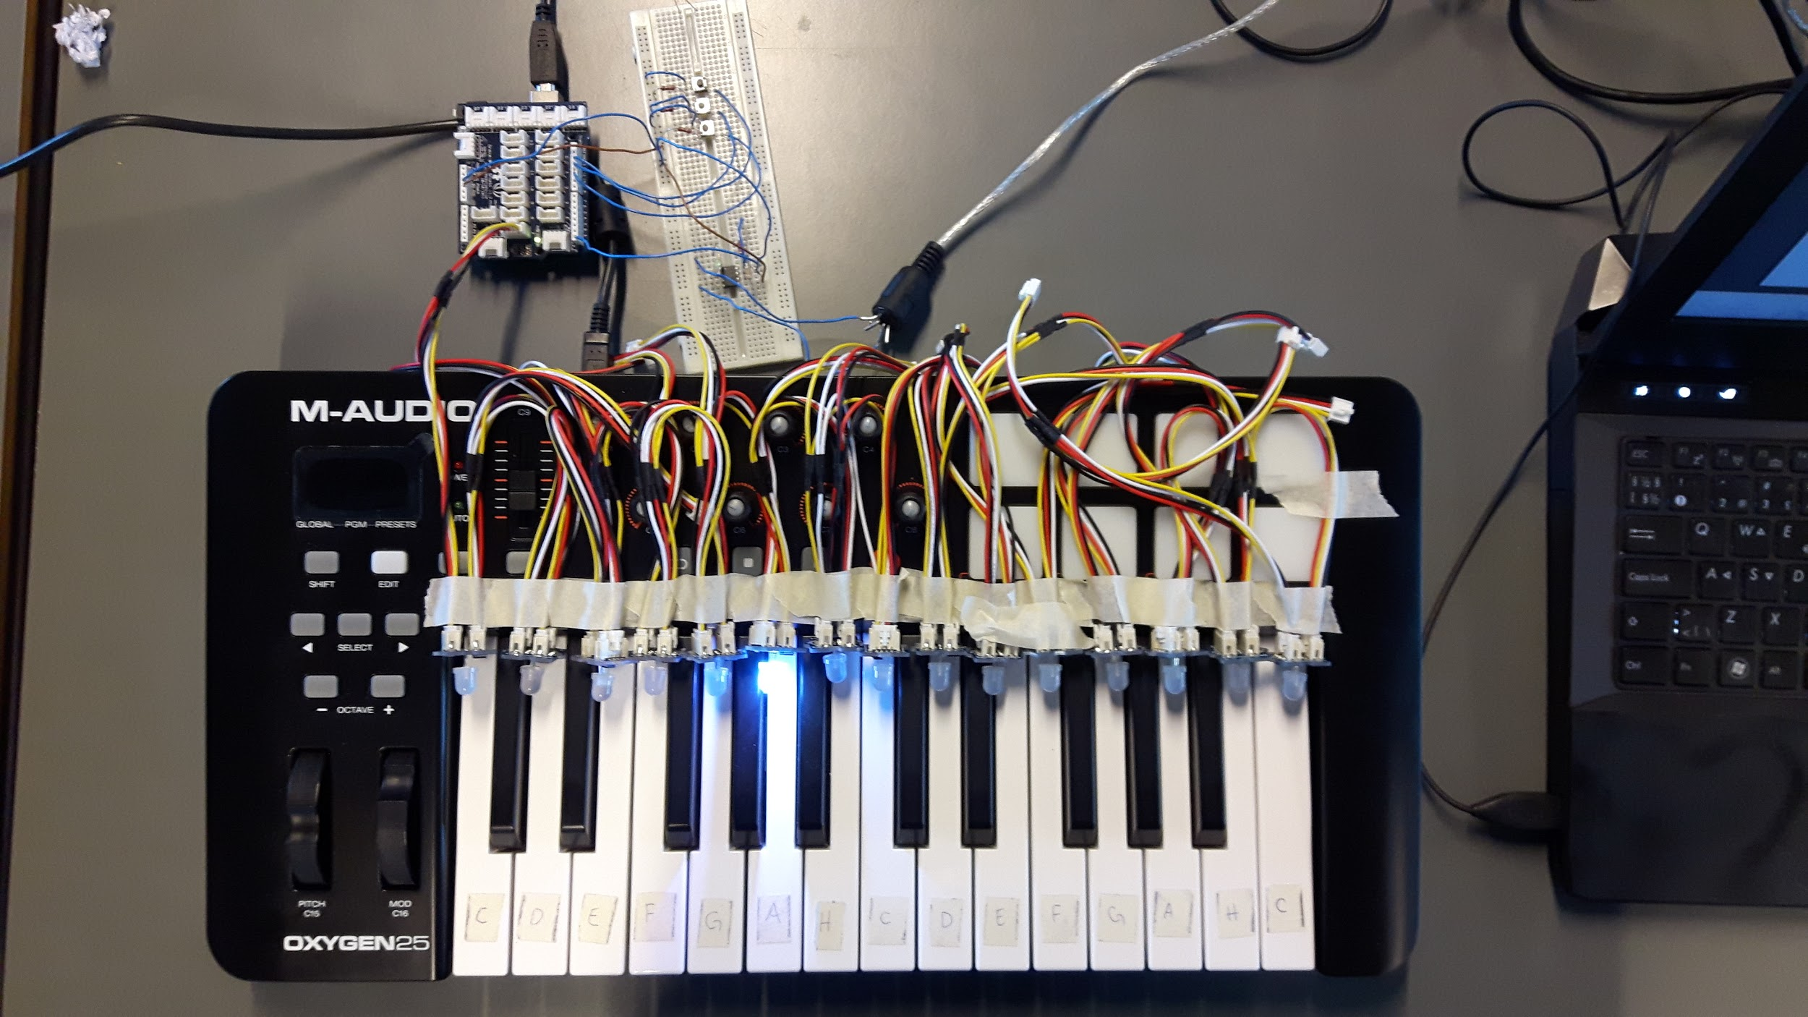

Slide 4

Prototype Demonstration

Slide 5
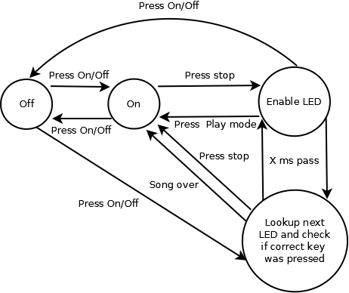

Slide 6
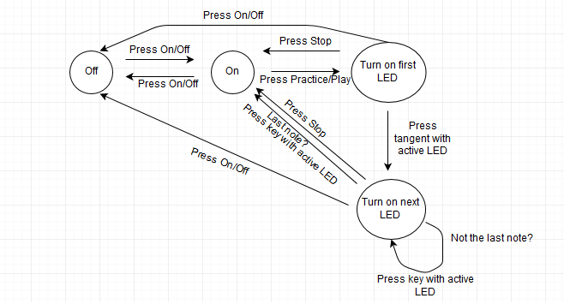

Slide 7
 | Feedforward | Perceived Affordance | Feedback
On/Off-Switch | On/Off Symbol, LED is on/off | Pressing the button will turn the device on/off | LED indicates that it is turned on or off
Learn Song-button | Learn Song Text, LED is on/off | Pressing the button will enter the Learn Song mode if in Standby mode | LED tells you that this mode is active
Play Song-button | Play Song Text, LED is on/off | Pressing the button will enter the Play Song mode if in Standby mode | LED tells you that this mode is active
Stop Button | Red Color | Pressing the button will enter Standby mode | All LEDs turn off, except the on/off-diode
Tempo Dial | Turtle and Hare, incremental lines | Turning the dial clockwise or counterclockwise will change the speed of the song correspondingly | LEDs on the keyboard blink faster or slower
Keyboard Keys | LED is on/off on each key | Pressing the piano key will play a sound. Pressing the piano key with the active LED will play the correct sound and advance the song | A sound plays. If the correct key is pressed, the active LED turns off and the next note-to-be-played’s LED turns on

Slide 8
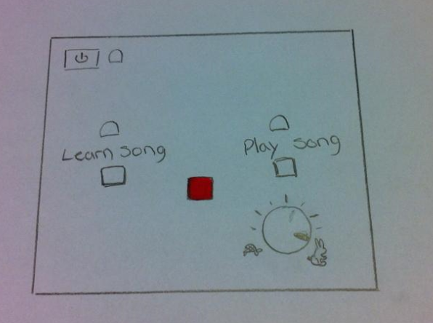
Mental Model Elicitation Setup
Notes:
The goal for our mental model elicitation is to find out if our conceptual model fits with their mental model. This box we used in our mental model elicitation have all the buttons we used in our affordance scheme.

Slide 9
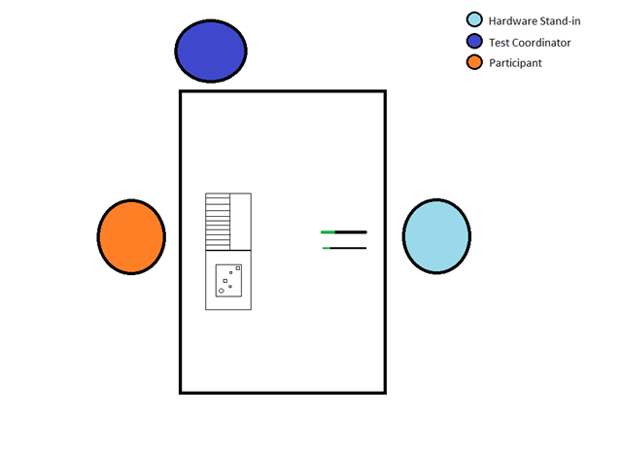
Mental Model Elicitation Setup
Test Coordinator
Hardware Stand-in
Participant
Notes:
There were three people at each test. A Test Coordinator and a Hardware stand-in, both 2 members of the group, and a participant to test. The setup is in the picture on the right.

Slide 10
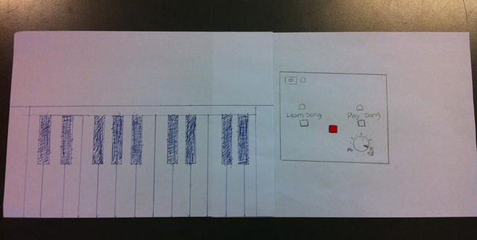
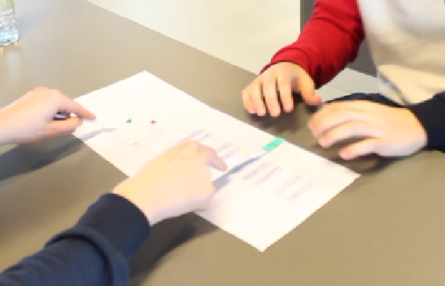
Mental Model Elicitation Setup
Notes:
During the test we made the participant use every button, to see if the participant acted with the perceived affordance we thought based on the feedforward that was given to them..

Slide 11
Analysis of results
“Stop”-button’s function was ambiguous
Feedforward - The red color assumption
Perceived affordance - Unclear function
Changing modes
Perceived affordance - Learn/Play-mode
Tempo-dial symbol confusion
Feedforward - Symbols were misleading
Suggestions to the prototype
“Stop” is unnecessary
Incremental tempo regulation with musical timings
Tempo-dial symbols with greater relevance

Slide 12
 | Feedforward | Perceived Affordance | Feedback
On/Off-Switch | On/Off Symbol, LED is on/off | Pressing the button will turn the device on/off | LED indicates that it is turned on or off
Learn Song-button | Learn Song Text, LED is on/off | Pressing the button will enter the Learn Song mode if in Standby mode | LED tells you that this mode is active
Play Song-button | Play Song Text, LED is on/off | Pressing the button will enter the Play Song mode if in Standby mode | LED tells you that this mode is active
Stop Button | Red Color | Pressing the button will enter Standby mode | All LEDs turn off, except the on/off-diode
Tempo Dial | Turtle and Hare, incremental lines | Turning the dial clockwise or counterclockwise will change the speed of the song correspondingly | LEDs on the keyboard blink faster or slower
Keyboard Keys | LED is on/off on each key | Pressing the piano key will play a sound. Pressing the piano key with the active LED will play the correct sound and advance the song | A sound plays. If the correct key is pressed, the active LED turns off and the next note-to-be-played’s LED turns on

