Slide 1
Classification of Street View House Numbers Using PyTorch
DC027534 Ruoxuan Li no.6

Slide 2
Table of contents
01
02
03
Approach
&
Implementation
Findings
&
Analysis
Conclusion

Slide 3
01
Approach
&
Implementation

Slide 4
Data
SVN DataLoader
Data Loading
Data Augmentation
Load dataset : torch.utils.data.DataLoader
Train & Test : transform_data
Rotation : .Rotate
Random cropping : .RandomResizedCrop
Color jitter : .ColorJitter
Normalition : .Normalize

Slide 5
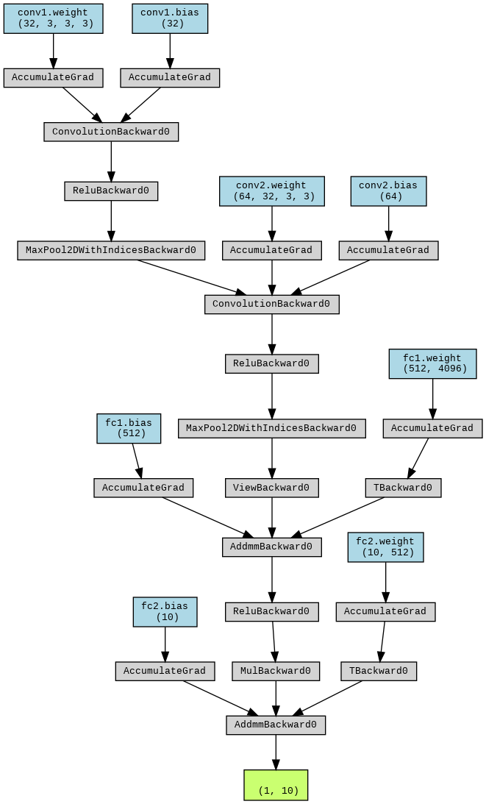
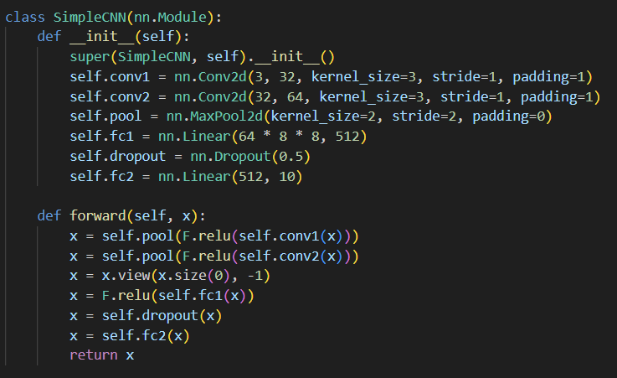
Neural Network
SimpleCNN

Slide 6
02
Findings & Analysis

Slide 7
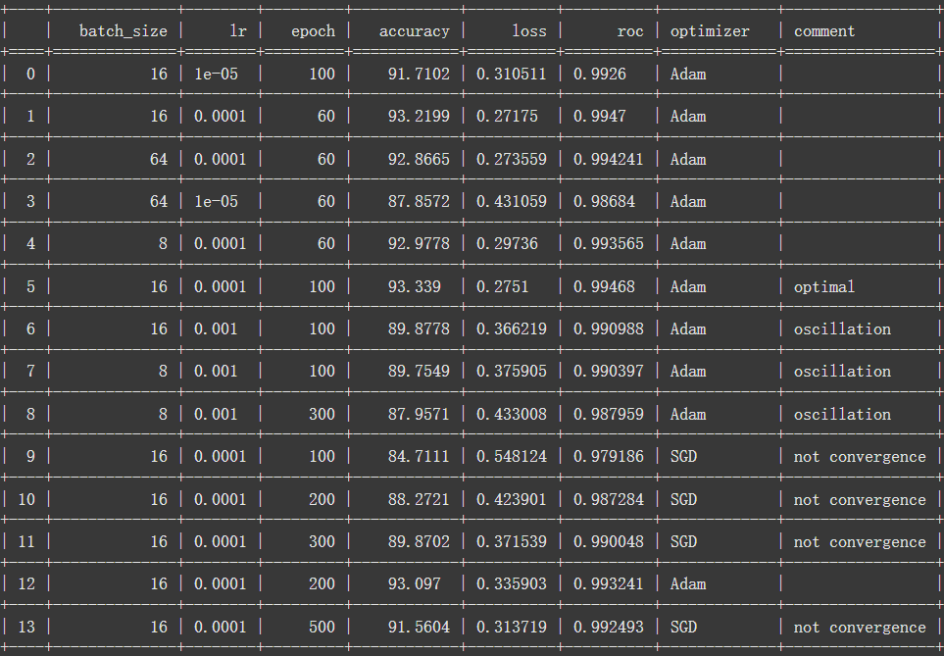
Original Data

Slide 8
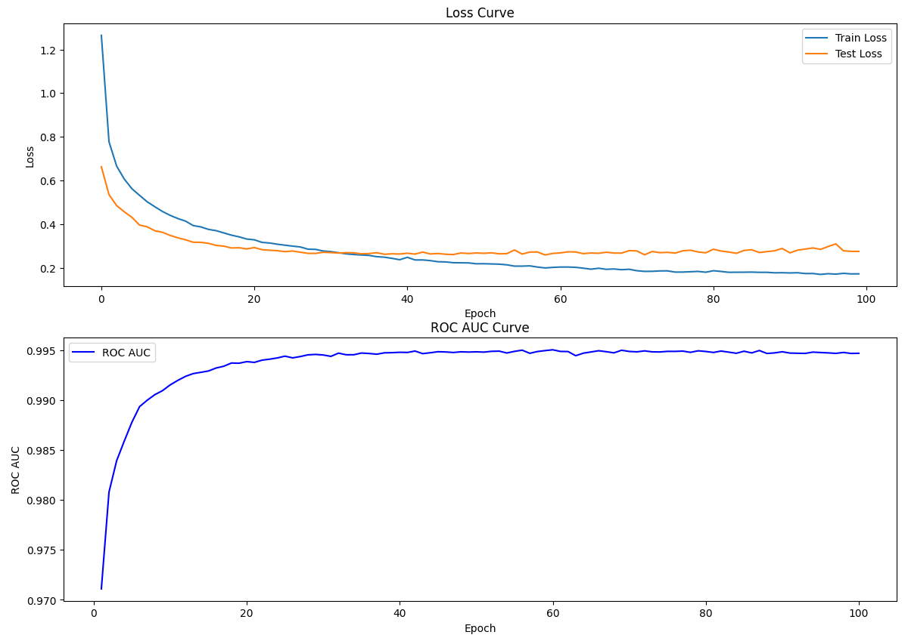
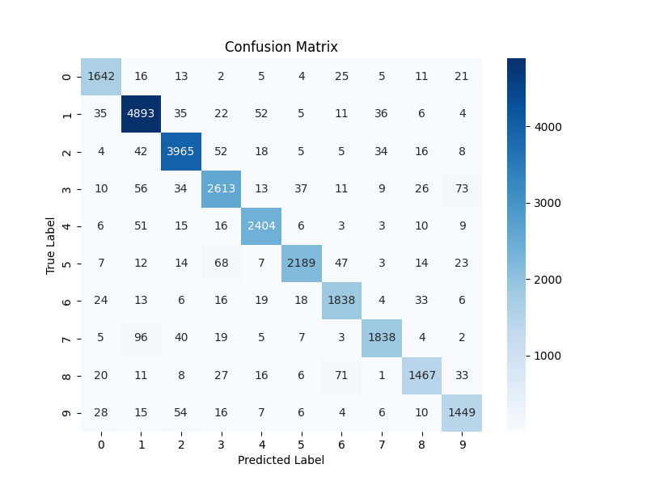
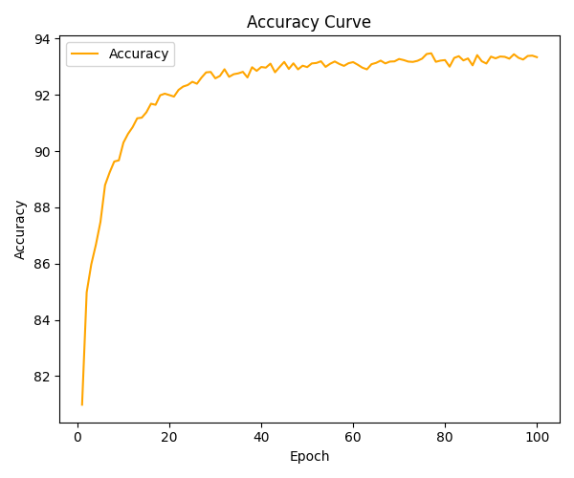
Optimal model
Accuracy 93.3%
Rapid Initial Increase: The accuracy increases sharply during the initial epochs.This indicates that the model is quickly learning the patterns in the data.
plateaus
Loss 0.2751 & ROC 0.994
Confusion Matrix
Good Convergence: Both training and test losses are low, and the high ROC score indicates strong classification performance.
Slight Overfitting: gap between the training and test loss curves.
Early Stopping & Regularization via dropout
High Overall Accuracy: The matrix shows that most predictions are along the diagonal, indicating high accuracy across most classes.
Potential for Improvement: the classification of digits "8" and "9"
Improvement: Model Fine-Tuning “3 & 8”
Data Augmentation

Slide 9
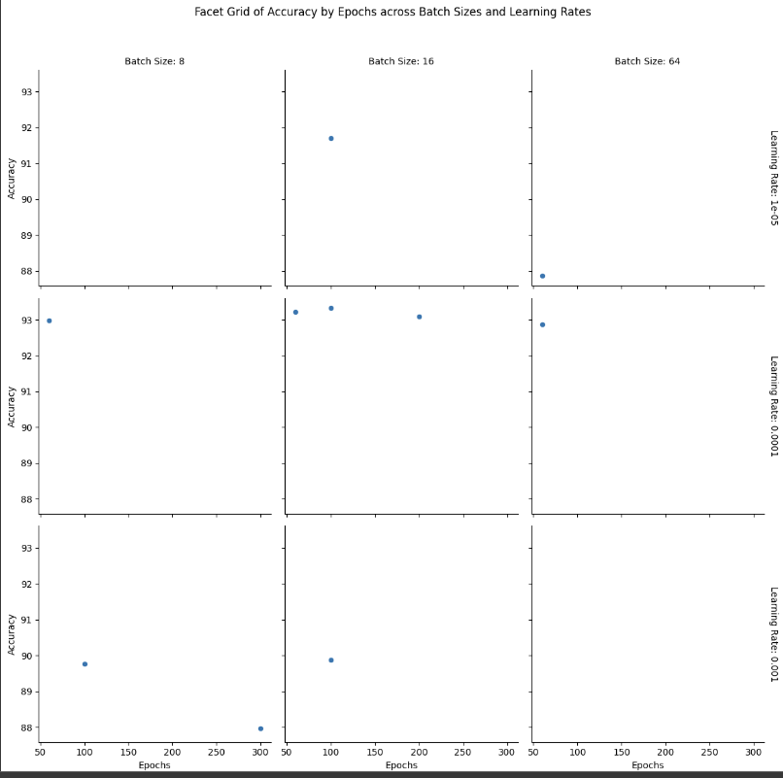
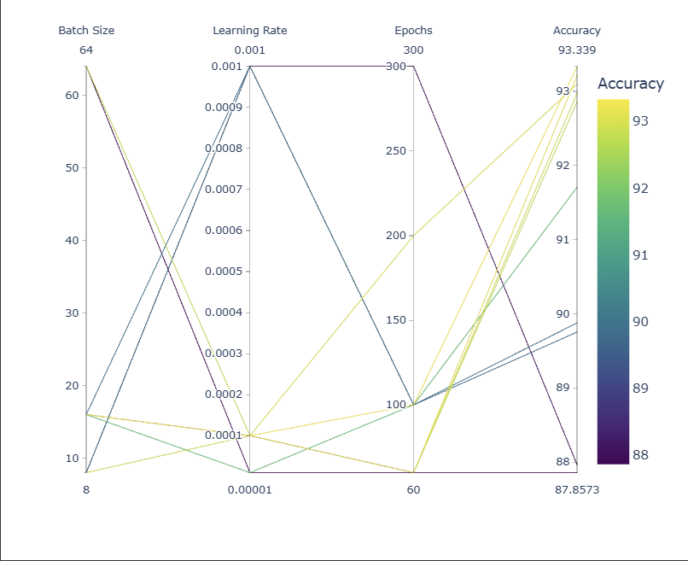
Comparison
Facet grid
parallel coordinate plot

Slide 10
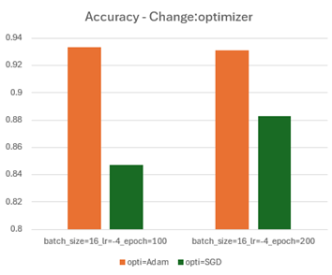
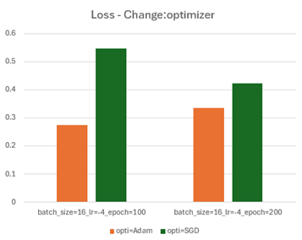
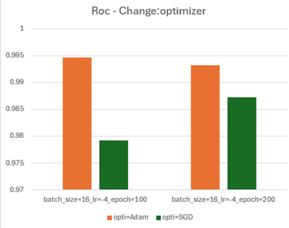
Notes:
Optimizer Comparison:
Findings: The Adam optimizer significantly outperformed SGD in terms of convergence speed and final accuracy. For example, with batch_size = 16, lr = 0.0001, and 100 epochs, Adam achieved 93.34% accuracy, whereas SGD only managed 84.71% accuracy, even after extensive training.
Explanation: Adam's adaptive learning rate mechanism allows it to handle noisy and sparse gradients more effectively, making it better suited for deep learning tasks, particularly when the dataset or gradients are complex. SGD often requires more fine-tuning of hyperparameters and more epochs to reach comparable performance.

Slide 11
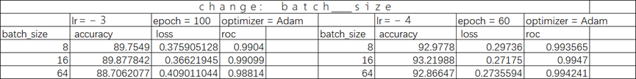
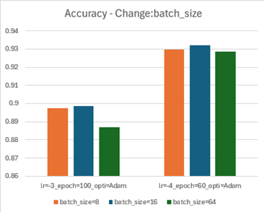
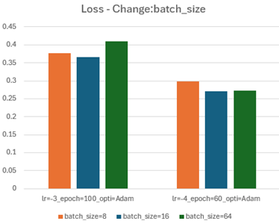
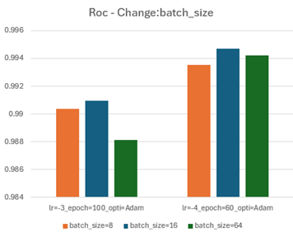
Notes:
Batch Size Effects:
Findings: Smaller batch sizes (8 and 16) generally resulted in higher accuracy and better ROC scores compared to larger batch sizes (64). For instance, with lr = 0.0001 and 60 epochs, a batch size of 16 achieved 93.22% accuracy, while a batch size of 64 achieved slightly lower accuracy of 92.87%.
Explanation: Smaller batch sizes can lead to more frequent updates to model weights, often resulting in smoother convergence and better generalization. However, they may also introduce noise in the gradient estimates, which sometimes helps escape local minima. Larger batch sizes, while more stable, may require more epochs to converge.

Slide 12
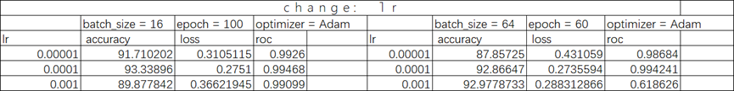
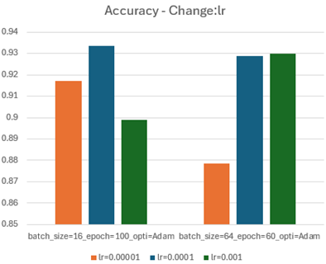
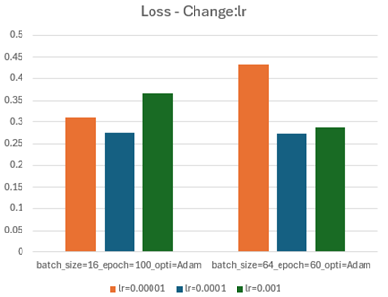
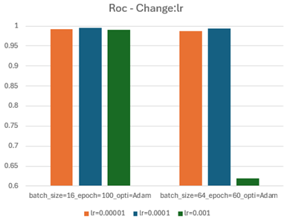
Notes:
Learning Rate Impact:
Findings: A learning rate of 0.0001 consistently provided the best balance between convergence speed and model performance, achieving the highest accuracy and lowest loss. Extremely small learning rates (0.00001) led to slow convergence, while larger learning rates (0.001) sometimes resulted in higher loss and worse ROC scores due to unstable updates.
Explanation: A learning rate that is too high can cause the model to diverge or oscillate around the optimal point, while a learning rate that is too low slows down convergence, requiring more epochs and time. 0.0001 provided a sweet spot for convergence in this case.

Slide 13
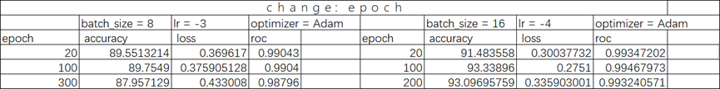
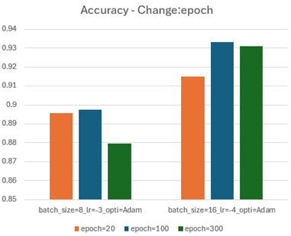
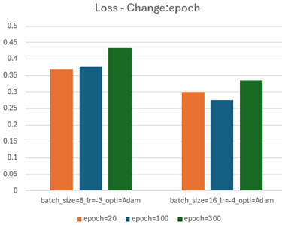
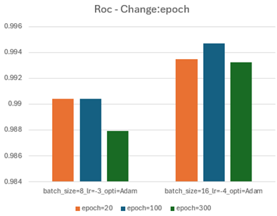
Notes:
Epoch Count Influence:
Findings: Increasing the number of epochs generally improved the model's accuracy until a certain point, after which performance gains diminished. For example, with batch_size = 16 and lr = 0.0001, accuracy improved from 91.48% at 20 epochs to 93.34% at 100 epochs but only slightly increased or even stagnated at 200 epochs.
Explanation: More training epochs allow the model to learn better but also increase the risk of overfitting. Early stopping mechanisms can be helpful to identify the point where additional training no longer benefits performance.

Slide 14
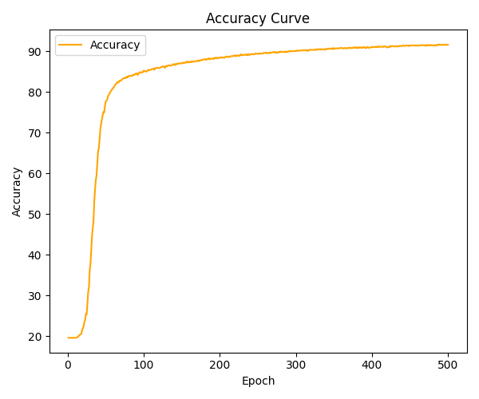
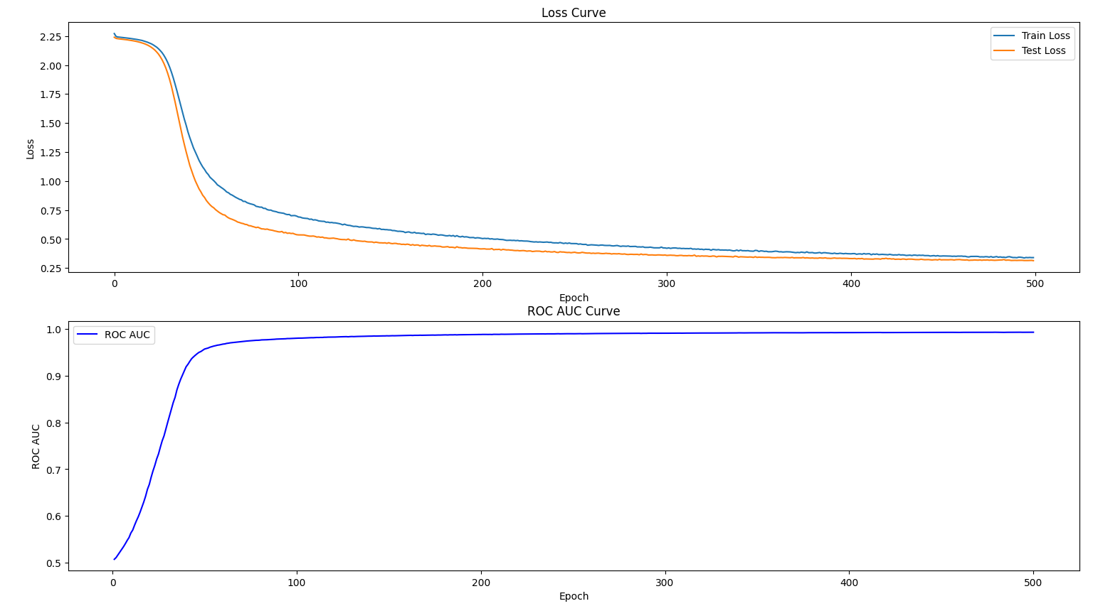
Adam optimizes better than SGD
converges faster and achieves higher accuracy
Adaptive Learning Rate | Individual Learning Rate for Each Parameter & Accumulated Squared Gradients
Momentum Mechanism | First-order & Second-order Momentum Estimate
Bias Correction | Bias Correction Technique
Convergence Speed and Precision | Rapid Convergence & Improved Accuracy
Robustness | Lower Sensitivity to Hyperparameters

Slide 15
03
Conclusion

Slide 16
Learning rate
B_s
High Sensitivity
Direct Control Over Gradient Magnitude
Optimizer
optimizer
Adaptive Properties
Convergence Efficiency
Lr
Batch_size
Training noise levels and computational efficiency

Slide 17

Thanks!

