Slide 1
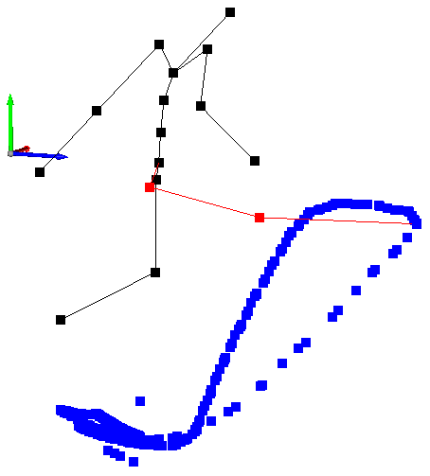
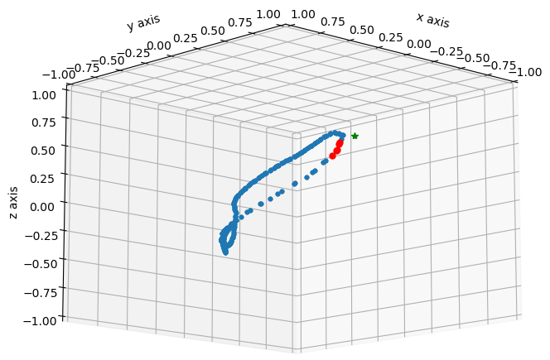
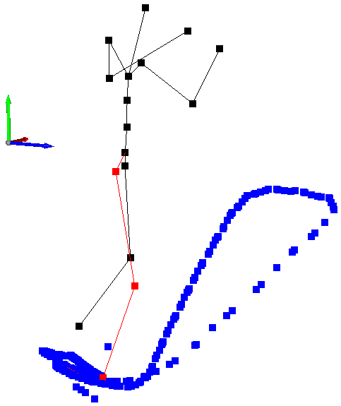
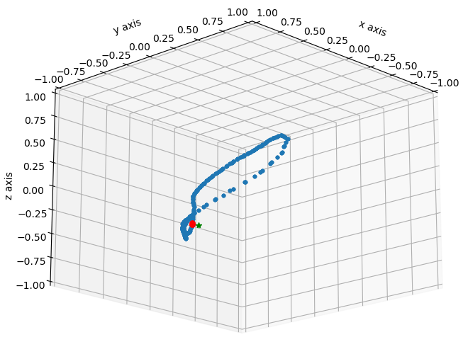
Kick
Stand

Slide 2
 | Trajectory of the foot in the example animation | Trajectory and corresponding avatar’s pose
Stand
Kick

