Slide 1
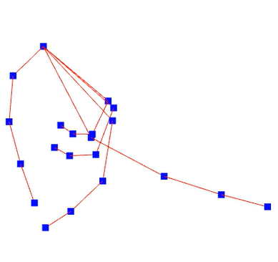
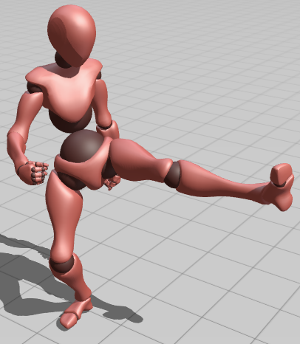
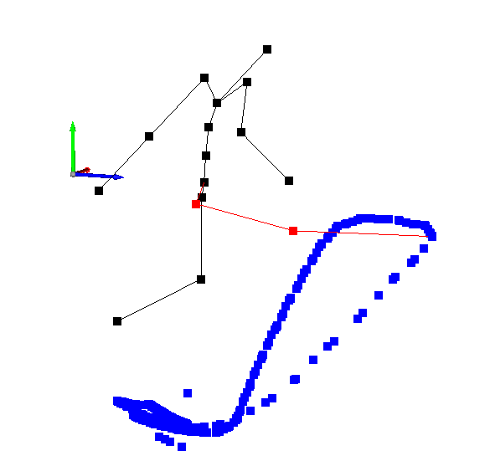
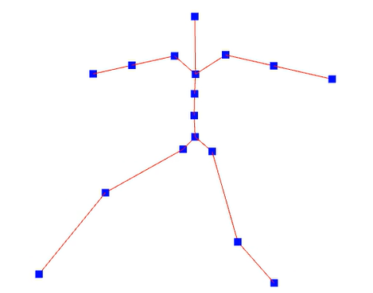
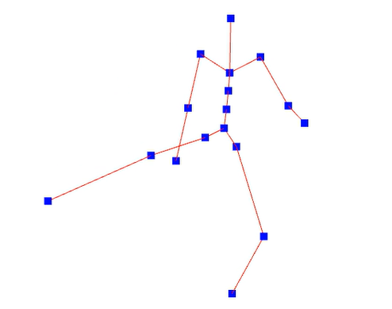


Hand rotation reference sequence
…
$$Φ$$
…
Rotation mapping function
Finger performance video
Hand landmark
Body rotation reference sequence
FV1
…
…
FV2
…
FV3
…
FV4
…
FV5
Example animation
Trajectory
Feature vectors (FVs)
Training stage
Testing stage
…
FV1
FV2
…
Pose blending
Finger performance
$$Φ$$
…
FV3
Rotation mapping
Match Similar FVs
…
Feature vector
Hand landmark
Lower body motion
Full body Pose

